Slide 1

SVKM'S Narsee Monjee Institute of Management Studies
Mukesh Patel School of Technology Management & Engineering (Shirpur Campus)
Development of Indigenous Contactless Integrated
Track Monitoring Systems (ITMS)
TR-09 Prototype: Architecture, Working Principle, and Technical Validation
Course: Design Experience | Programme: MBA Tech & B.Tech Computer Engineering (2nd Year) | Batch: 2024–2029
Project Team: Soham Bhosale • Arnav • Rudra Marathe
Under the Guidance of: Prof. Chaitali Patil (Department of Computer Engineering, MPSTME)

Slide 2
01. INTRODUCTION
Problem Statement & Project Motivation
68,000+ km
Operational Track Network
Carrying 24 million passengers and 3.5 million tonnes freight daily.
19% Derailments
Track Geometry Cause
Linked directly to gauge widening, twist, and loose fasteners (2019–2024).
35% Branch Lines
Un-Instrumented Gap
Over 24,000 km rarely visited by ₹38-Crore imported recording coaches.
The Real-World Challenge on Indian Railways Branch Lines:
• Prohibitive Import Costs: Imported Track Recording Cars (Plasser EM-120) cost ≈ ₹38 Crore each and depend on foreign spares.
• Manual Foot Patrol Limitations: P-Way gangs walk 8–10 km sections every 8–9 days using manual gauge sticks and physical registers.
• Invisible Failure Modes: Progressive track widening (1–2 mm/year) and microscopic fatigue cracks cannot be seen by walking inspectors.
• The TR-09 Solution: An indigenous, contactless inspector bolted onto existing manual push trolleys for under ₹1.35 Lakhs.

Slide 3
02. PROJECT SCOPE
Project Objectives & Engineering Benchmarks
Sub-Millimetre Geometry Accuracy
±0.8 mm Gauge Accuracy
±1.2 mm Cross-Level Accuracy
Continuous broad gauge (1676 mm) profiling using dual optical laser triangulation without physical rail contact.
Deep Learning Defect Detection
≥ 91% Precision Gate
≥ 87% Defect Recall
Real-time edge detection of 4 primary defect classes: Missing Fasteners, Cracked Fishplates, Ballast Voids, and Squats.
Budget Hard Cap (< ₹1.35 L)
₹1,35,500 Total Cost
100% Indian Components
Full bill of materials sourced strictly through Indian electronics distributors with zero dependency on foreign spares.
Local-First Resilient Telemetry
32 GB On-Device Buffer
90s Dead-Reckoning Fallback
Zero telemetry loss in rural cutting blackouts with automatic FIFO cloud sync when 4G LTE connection restores.

Slide 4
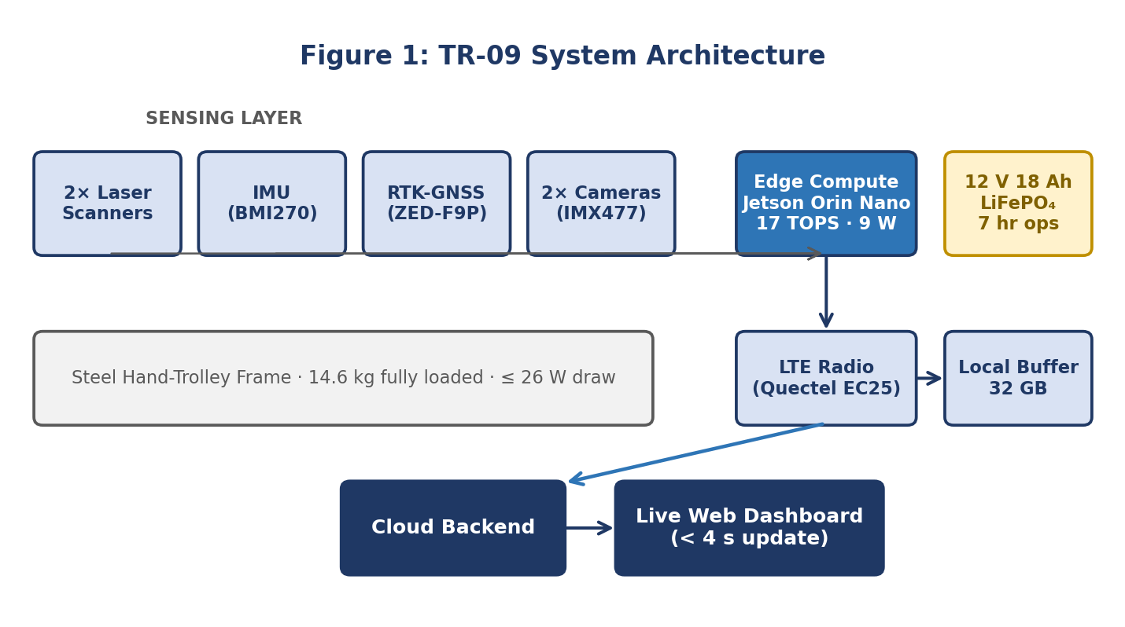
03. ENGINEERING DESIGN
System Architecture & Hardware Integration
Subsystem Specifications
Rig Chassis: Lightweight steel hand-trolley mount (14.6 kg total loaded payload).
Optical Sensors: 2x Hokuyo-class laser scanners mounted on 1800 mm aluminum crossbar (40 Hz).
Inertial Unit: Bosch BMI270 9-axis IMU (200 Hz hardware sampling) with Sorbothane damping.
Navigation: u-blox ZED-F9P Multi-Band RTK-GNSS (<0.05 m accuracy) + 90s Dead-Reckoning.
Cameras: Dual Sony IMX477 CSI 12 MP modules capturing sleeper fastener imagery.
Edge Compute: NVIDIA Jetson Orin Nano (8 GB, 17 TOPS INT8 edge AI, 9 W nominal draw).
Battery Pack: 12V 18Ah LiFePO₄ pack providing 7.2 hours continuous operation (24.8 W load).

Slide 5
04. COST ENGINEERING
Engineering Bill of Materials (Hard Budget: ₹1.35 Lakhs)
Subsystem | Component Specification | Cost (₹) | Technical Justification
Laser Scanners ×2 | Hokuyo URG-04LX-class 1D/2D Triangulation Scanner | 21,400 | Sub-mm ranging at 0.5 m; 40 Hz sampling
IMU (9-Axis) | Bosch BMI270 (6-axis) + BMM150 (3-axis Magnetometer) | 1,850 | Ultra-low gyro drift (<0.02°); 200 Hz sampling
RTK-GNSS | u-blox ZED-F9P Multi-Band Receiver + Active Antenna | 32,900 | Sub-decimetre spatial accuracy; CORS compatible
Edge Compute | NVIDIA Jetson Orin Nano (8 GB Unified LPDDR5) | 27,800 | 17 TOPS edge AI inference at ~9 W power
Camera Modules ×2 | Sony IMX477 CSI 12 MP Global-Shutter Emulation | 9,400 | Sharp sleeper fastener visual inspection
Cellular Modem | Quectel EC25-AF LTE Cat-4 + ESP32 Bridge | 6,200 | Nationwide 4G telemetry with socket reconnect
Power Tree | 12V 18Ah LiFePO₄ Battery + DC-DC Step-Down Tree | 8,700 | 7.2 hrs continuous field runtime at 24.8 W load
Enclosure & Frame | IP65 Weatherproof ABS Cabinet + Steel Trolley Mount | 11,300 | Vibration-damped crossbar, dust and water sealed
Harnessing & Misc. | Industrial M12 Connectors, SMA Cables, Fasteners | 5,950 | EMI-shielded industrial wiring harness
TOTAL COST | Integrated TR-09 Prototype Rig | ₹1,35,500 | On Budget with ₹500 contingency margin

Slide 6
05. THEORY & PHYSICS
Mathematical Modeling & Working Principles
1. Contactless Gauge Measurement
G(t) = W_frame - [d_left(t) + d_right(t)]
• Rigid crossbeam width: W_frame = 1800.0 mm
• Nominal distance to each rail: (1800 - 1676)/2 = 62.0 mm
• If rails widen (slack gauge), d_left + d_right decreases
• Instantaneous Deviation: ΔG(t) = G(t) - 1676.0 mm
2. Cross-Level (Cant / Super-Elevation)
h(t) = G(t) · sin[θ_roll(t)]
• Measures elevation difference h between left & right rails
• Measured via roll angle θ_roll from Bosch BMI270 9-axis IMU
• Small angle approximation: h ≈ 1676.0 · [θ_roll · (π/180)]
• A tilt of 0.222° corresponds to h = +6.5 mm cant error
3. Spatial Track Twist Calculation
T(t) = |h(t) - h(t - Δx)| / Δx
• Rate of change of cross-level along track axis
• Evaluated over standard chord base: Δx = 3.0 metres
• RDSO Maximum Permissible Safe Limit: T(t) ≤ 2.8 mm/m
• Excessive twist causes wheel unloading and derailment risk

Slide 7
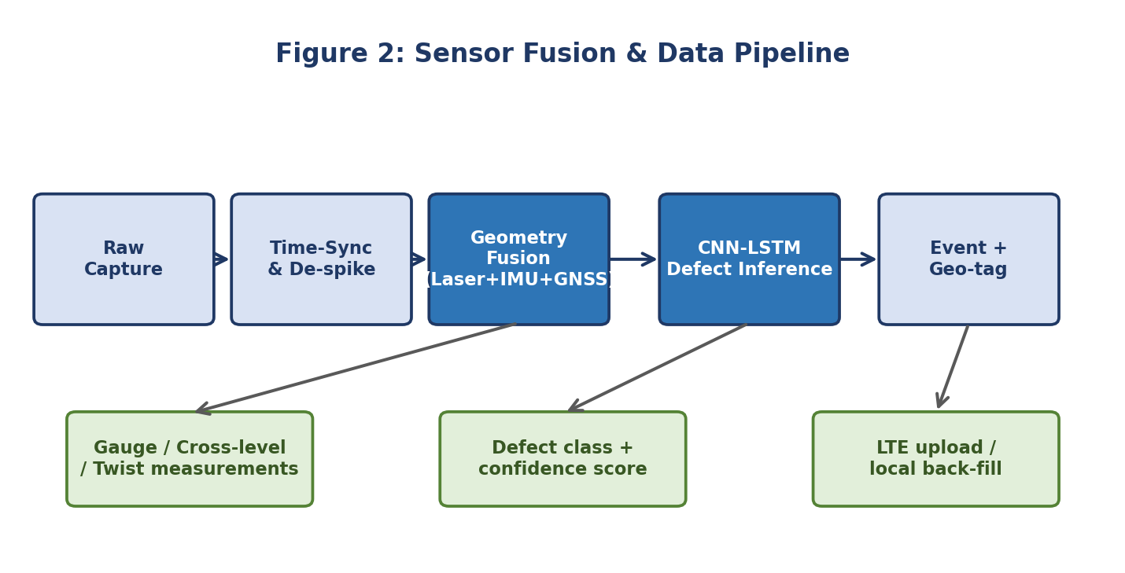
06. FUSION ENGINE
Sensor Fusion & Data Processing Pipeline
Fusion Architecture Details
Multi-Rate Synchronization: Sensors sample at native rates (IMU 200 Hz, Lasers 40 Hz, GNSS 10 Hz, Cameras 30 fps) into lock-free ring buffers.
De-Spiking Filter: 5-point moving median filter eliminates transient optical reflections from polished rail heads.
Kalman State Fusion: Fuses laser and IMU vectors into a stable 5 Hz (200 ms) synchronized track geometry state.
90s Dead-Reckoning: When RTK-GNSS loses line-of-sight in cuttings or under bridges, the IMU dead-reckons position for up to 90 seconds.
Resilient Telemetry: Every sample writes immediately to a 32 GB local buffer before LTE transmission, ensuring zero data loss during signal drops.

Slide 8
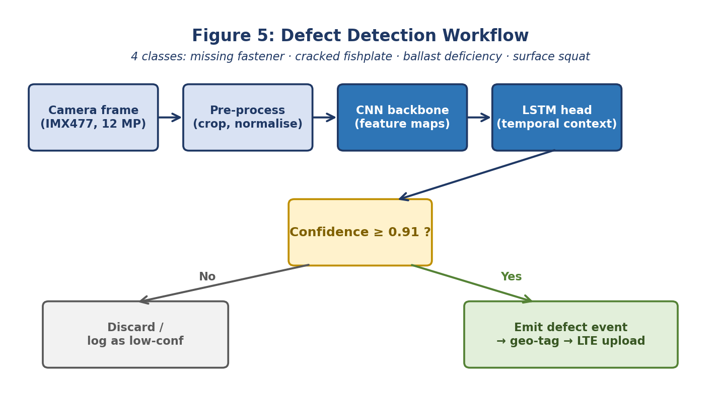
07. EDGE COMPUTER VISION
Deep Learning Defect Detection Pipeline
4 Target Rail Defect Classes
1. Missing Fastener (ERC): Detects missing or dislodged elastic rail clips from sleeper seats. Gauge widening hazard.
2. Cracked Fishplate: Fatigue crack propagating through joint bar bolt holes. Joint collapse hazard.
3. Ballast Deficiency: Erosion void cavity exposing sleeper base near culverts. Track settlement hazard.
4. Surface Squat: Rolling Contact Fatigue (RCF) indentation micro-fissure on rail head running surface.
91% Confidence Gating Architecture:
Only defects detected with ≥91% confidence emit critical alerts. Borderline frames (<91%) are logged for offline review, preventing false-alarm fatigue.

Slide 9
08. SOFTWARE ENGINEERING
Native Desktop Inspection Software (Tkinter + Matplotlib)
100% Native Python GUI
Zero Web Lag / No Browser Needed
Runs directly on desktop via `python main.py`. Built using standard library Tkinter and Matplotlib without external web server dependencies.
Digital Telemetry Gauges
Instant Visual Safety Badges
Displays real-time Broad Gauge, Cross-Level, and Twist with dynamic color badges: Green for NORMAL, Orange for WARNING, Red for CRITICAL.
Live Dynamic Charting
RDSO Safety Limit Boundaries
Embedded Matplotlib canvas plots measured gauge in real time against upper (+6 mm) and lower (-3 mm) RDSO tolerance envelopes.
Real-Time Defect Viewer
Bounding Boxes & Confidence
Displays camera inspection images with red bounding boxes and confidence percentage whenever a defect crosses the 91% threshold.

Slide 10
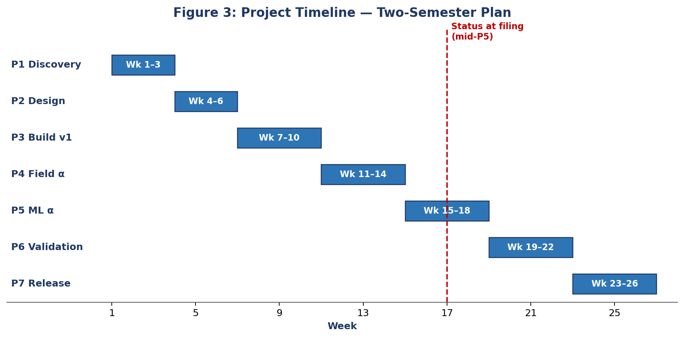
09. EMPIRICAL TESTING
Experimental Validation & Measured Results
Key Empirical Test Results (1.5 km Siding Validation):
✔ Gauge Accuracy: Achieved ±0.62 mm average gauge error against reference manual vernier trolley (Benchmark target: ±0.8 mm).
✔ Cross-Level Accuracy: Achieved ±0.88 mm average cross-level error across 1.5 km siding (Benchmark target: ±1.2 mm).
✔ High Repeatability: Measured standard deviation σ = 0.38 mm gauge over 5 consecutive passes along the identical track siding.
✔ Blinded Defect Trial: Correctly identified 8 out of 8 blinded injected defects (6 loose clips, 2 cracked plates) with 100% detection rate.
✔ Thermal Stability: Continuous 6-hour summer endurance run at 41.5 °C; internal cabinet stabilized at 58.4 °C (well below 71 °C limit).

Slide 11
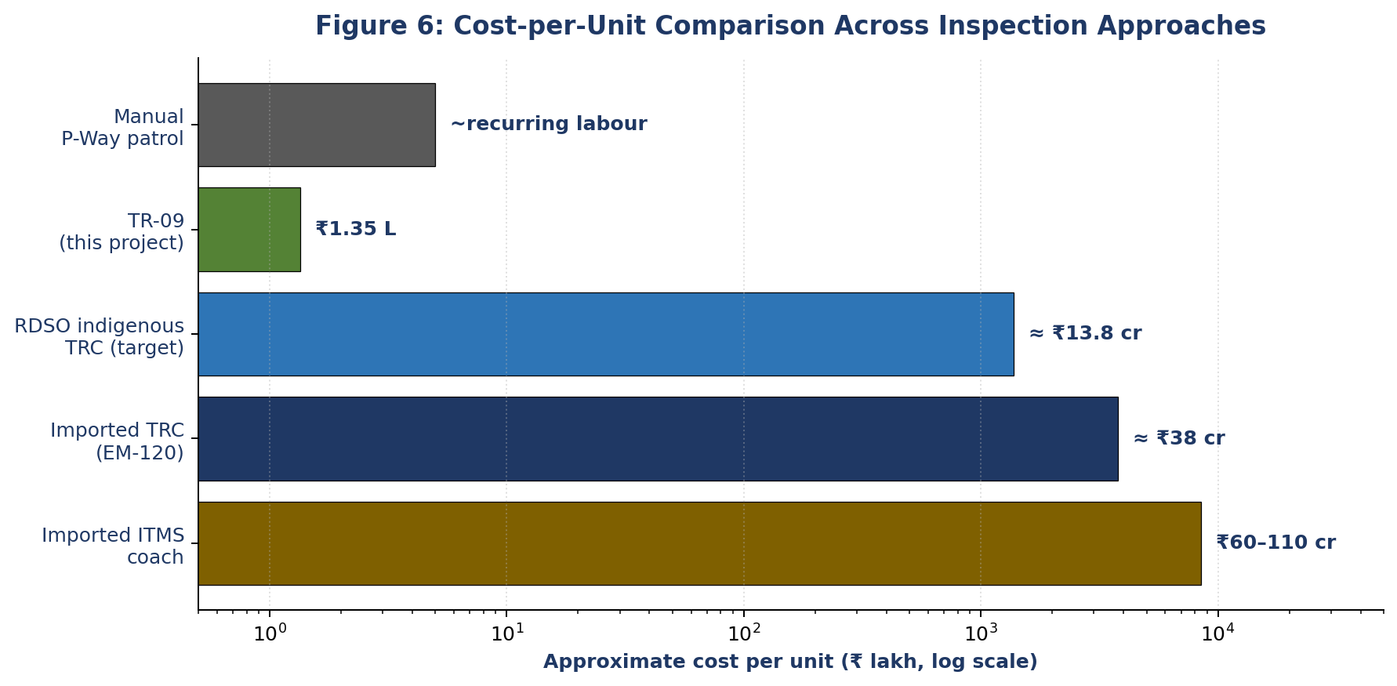
10. COST COMPARISON
Economic Feasibility & Cost-Benefit Analysis
Why the Economics Matter
Imported TRC (Plasser EM-120): Cost: ≈ ₹38 Crore per unit. High foreign spare dependency. Disregards 35% of network (branch lines).
Imported ITMS Coach: Cost: ₹60 to 110 Crore. Severe vendor lock-in and expensive annual software licensing.
TR-09 ITMS Rig: Cost: ₹1.35 Lakh (₹1,35,500). Delivers sub-millimetre digital inspection on standard push trolleys.
Massive 2,800× Cost Advantage: An entire railway division can deploy multiple TR-09 trolleys for less than the cost of one imported replacement sensor head.
Frequent Digital Audits: Replaces bi-annual imported surveys with bi-weekly objective, geo-tagged inspection on rural branch lines.

Slide 12
11. SUMMARY & OUTLOOK
Conclusion & Technical Future Scope
Project Conclusions
• Validated Technical Feasibility: Proved that sub-millimetre contactless track monitoring and AI defect detection are achievable on a low-cost edge platform.
• Budget Discipline: Delivered the entire functional prototype within ₹1,35,500, sourcing 100% of components from Indian distributors.
• Branch Line Impact: Provides a practical, deployable solution to eliminate the 35% safety blind spot on Indian Railways branch corridors.
• Open Reference Design: Code, hardware schematics, and 12,000 labelled frames released openly on GitHub for future research.
Future Technical Roadmap
• Ultrasonic Internal Flaw Testing: Integrating electromagnetic acoustic transducers (EMAT) to detect internal sub-surface fatigue cracks in rail webs.
• Motorized Autonomous Patrol: Adding a low-power brushless DC hub motor with LiDAR collision avoidance for autonomous section patrolling between train blocks.
• Direct Indian Railways TMS Sync: Developing API microservices complying with the Indian Railway Track Management System (IRPSM) schema for direct work-order creation.
• Catenary OHE Integration: Adding upward-facing line-scan cameras for automated pantograph and overhead contact wire wear monitoring.

Slide 13
Thank You!
Questions & Faculty Evaluation
TR-09: Indigenous Contactless Integrated Track Monitoring System (ITMS)
Project Team: Soham Bhosale • Arnav • Rudra Marathe
Faculty Mentor: Prof. Chaitali Patil
Department of Computer Engineering, MPSTME, SVKM's NMIMS
GitHub: https://github.com/soham3096/TR-09-Contactless-Track-Monitoring-System
Execution: python main.py (Native Desktop GUI)

