Slide 1

Battle of Neighbourhoods
Introduction
A restaurant is to be opened in a borough of New York. For this problem Brooklyn, NY is selected. The neighbourhood in which the restaurant should be opened is to be decided.The deciding factor in selection is the proximity to other popular restaurants. Since it is very competitive to establish a restaurant in a neighbourhood with plenty of popular restaurants, a neighbourhood with least dining options is a good choice.
This type of analysis will be useful for stakeholders planning on investing in restaurants and fast food joints.

Slide 2
Datasets
New York has a total of 5 boroughs and 306 neighborhoods. In order to segment the neighborhoods and explore them, we will essentially need a dataset that contains the 5 boroughs and the neighborhoods that exist in each borough as well as the the latitude and longitude coordinates of each neighborhood.New York data can be downloaded from:
https://cf-courses-data.s3.us.cloud-object-storage.appdomain.cloud/IBMDeveloperSkillsNetwork-DS0701EN-SkillsNetwork/labs/newyork_data.json
The above link redirects to a json file which can be downloaded.
From the above dataset features of each borough and neighbourhood can be extracted Into dataframe. Since we will be focusing in Brooklyn, data for only Brooklyn will be sliced from the dataframe to create a new dataframe.

Slide 3
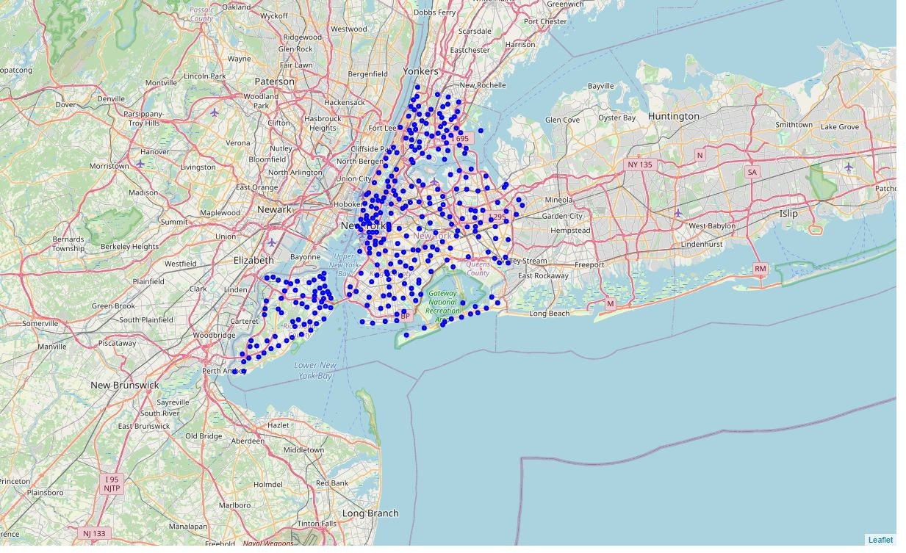
Methodology
The datasets for all the neighbourhoods of a borough are organized. Foursquare location data is used to identify the top 100 venues in each neighbourhood.
Further analysis is performed on the data to determine the frequency of each category in each neighbourhood. With this we can determine the concentration of restaurants at any neighbourhood and avoid that location.
New York City

Slide 4
After cleaning and processing the datasets, machine learning algorithms are used to determine clusters in the borough. All clusters are then superimposed on the map of brooklyn using folium for visualization. Then the top venues in each neighborhood is determined from foursquare data.
value_counts is used to get the total number of unique venue category.
Number of clusters in K mean clustering= 5

Slide 5
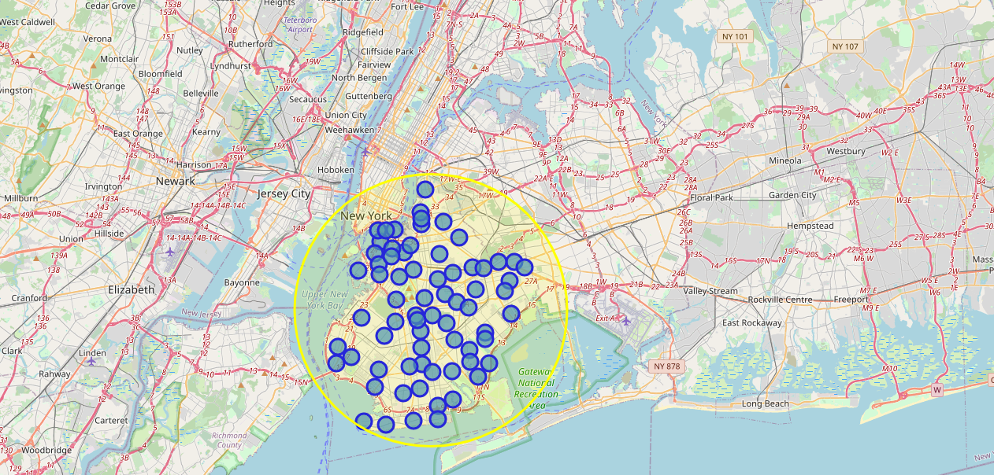
Results
Below is the folium generated map of Brooklyn with its neighborhoods indicated by the blue circles.
The yellow circle is an approximation of brooklyn.
Brooklyn Neighborhoods

Slide 6
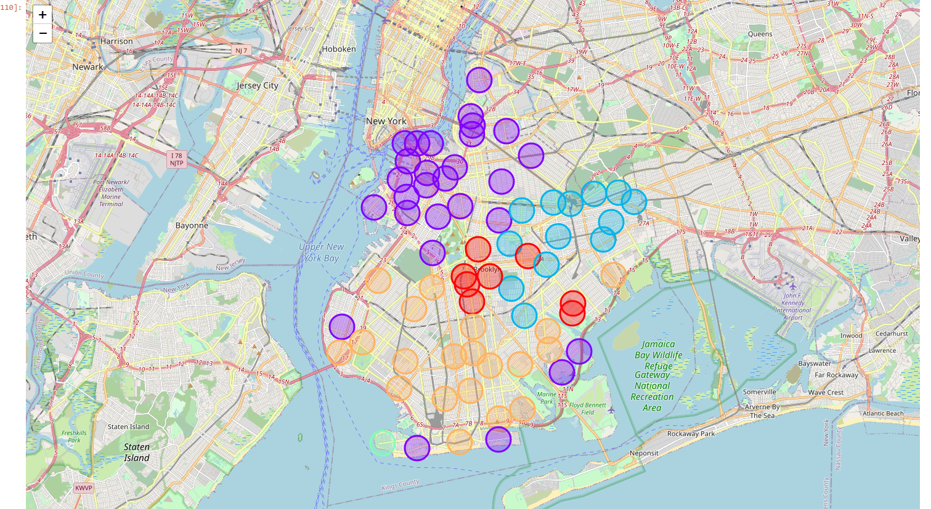
After using K Means clustering, all 70 neighborhoods were grouped into 5 different clusters. Based on these clusters, location determination was made.
Below is the visualization of the clusters

Slide 7
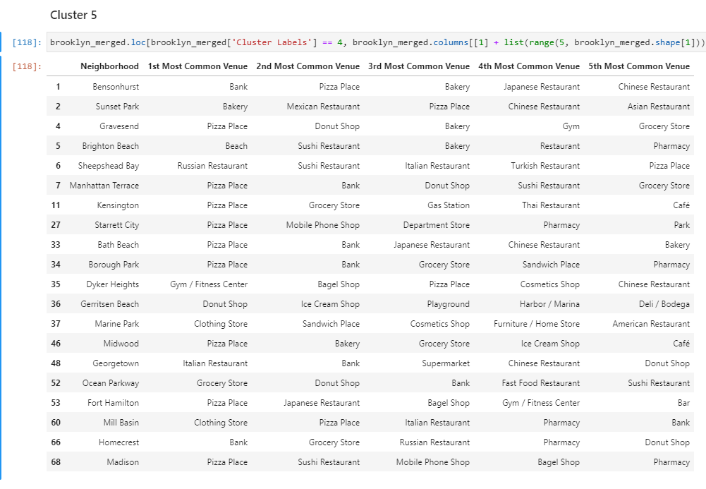
For example below is the screenshot of top 5 venues of cluster 5.

Slide 8
DIscussions
Pizza plaza is the most popular venue in all of Brooklyn followed by Coffee shops while bath houses, print shops are least popular.
The accuracy of the above code depends on the location data provided by Foursquare api, accuracy of geopy.
Also the above model assumed each neighborhood as a circle with a radius of 1 km.

Slide 9
Conclusion
So from examining the above clusters we can predict the neighbourhood where food places should be opened. For example opening a restaurant at cluster 4 in the neighbourhood of Sea Gate would be appropriate since there are no popular restaurants nearby.
The above procedure can be applied to all boroughs of New York to determine location for any type of commercial establishment.

