Slide 1
State Wise Profit Analyzer: NY | CA | FL
Profit Insights from R&D, Administration & Marketing Spend

Slide 2
Project Roadmap
Phase 1: Data Collection & Cleaning (SQL + Excel)
Phase 2: Exploratory Data Analysis (Power BI)
Phase 3: Regression Analysis (Excel)
Phase 4: Insights & Presentation

Slide 3
Descriptive Statistics
 | R&D Spend | Administration | Marketing Spend
Average | 78.24 | 121.95 | 228.39
Std Dev | 43.22 | 26.52 | 110.12
Min | 1.00 | 51.28 | 1.90
Max | 165.35 | 182.65 | 471.78
Mid | 74.66 | 122.70 | 239.45
Correlation | 0.98 | 0.14 | 0.73

Slide 4
Regression Summary Output
Variable | Coefficient | Std Error | t Stat | P-value | Lower 95% | Upper 95%
Intercept | 59.21 | 5.96 | 9.93 | 1.38E-12 | 47.18 | 71.25
R&D Spend | 0.78 | 0.04 | 20.32 | 2.40E-23 | 0.70 | 0.85
Administration | -0.06 | 0.04 | -1.37 | 0.179 | -0.15 | 0.03
Marketing Spend | 0.02 | 0.01 | 1.30 | 0.199 | -0.01 | 0.05

Slide 5
State – wise profit
State | Profit | R&D Spend | Administration | Marketing Spend | Total Spend
New York | 1.78 | 120.84 | 186.10 | 349.09 | 833.56
California | 1.71 | 109.92 | 180.03 | 305.80 | 766.66
Florida | 1.90 | 129.16 | 194.83 | 395.72 | 909.74

Slide 6
Regresion summary & prediction error
Metric | Value
Multiple R | 0.98
R Square | 0.96
Adjusted R Square | 0.96
Standard Error | 7.37
Observations | 46
Predicted Profit | 2.72
Actual Profit | 5.38
Absolute Error | 2.66

Slide 7
ANOVA Summary
Source | df | SS | MS | F | Significance F
Regression | 3 | 5591.08 | 1863.69 | 343.35 | 1.47E-29
Residual | 42 | 227.97 | 5.43
Total | 45 | 5819.05

Slide 8
Coefficient Table
Variable | Coefficient | Std Error | t Stat | P-value | Lower 95% | Upper 95% | Lower 95.0% | Upper 95.0%
Intercept | 59.214 | 5.963 | 9.93 | 1.38e-12 | 47.179 | 71.248 | 47.179 | 71.248
R&D Spend | 0.777 | 0.038 | 20.31 | 2.4e-23 | 0.6999 | 0.8543 | 0.6999 | 0.8543
Administration | -0.06 | 0.044 | -1.36 | 0.179 | -0.1494 | 0.0288 | -0.1494 | 0.0288
Marketing Spend | 0.019 | 0.014 | 1.3 | 0.199 | -0.0106 | 0.0491 | -0.0106 | 0.0491

Slide 9
Predicted vs Actual Profit
Actual - 5.38 Million
Predicated Profit – 2.72 Million
Absolute Error – 2.66 Million

Slide 10
Scatter Plot Insights
Profit vs R&D Spend: Strong upward trend
Profit vs Administration: Weak trend
Profit vs Marketing Spend: Moderate correlation

Slide 11
Dashboard Summary
Florida leads in R&D and profit
Highest ROI: California
Total Profit: 5.38M

Slide 12
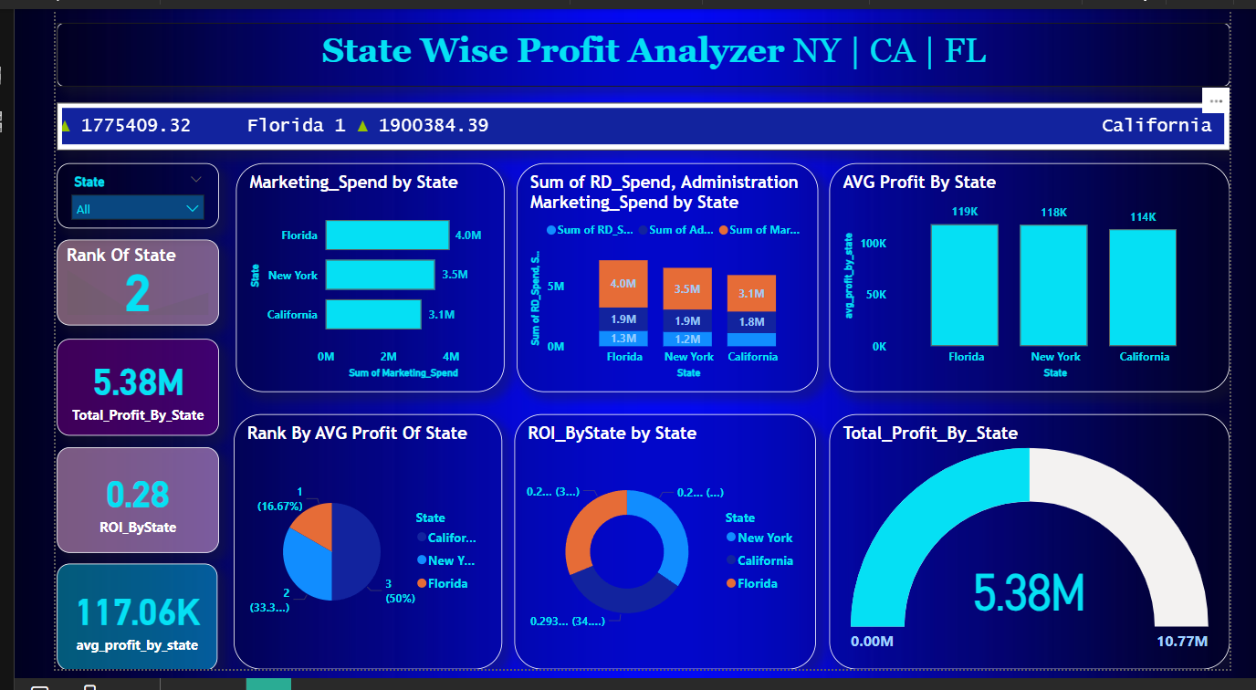
Interactive Power BI Dashboard

Slide 13
Final Recommendations
Increase R&D spending
Control Admin costs
Optimize marketing
Focus on Florida

Slide 14
- Florida leads in all key performance areas.
- California spends more on marketing but returns are less.
- New York is balanced but slightly behind Florida.
Insights:

Slide 15
Thank You
Questions & Answers

