Slide 1

B.M.S. College of Engineering | Department of Computer Science and Engineering
ReliCast
NACK-Suppressed Reliable Multicast for LAN Content Distribution
with SNTP-Synchronised Measurement
NAME 1 (USN 1) | NAME 2 (USN 2) | NAME 3 (USN 3) | NAME 4 (USN 4)
Network Programming (23CS7PCNWP) - Guide: Dr. Anitha H M, Associate Professor
AAT Presentation (2026-2027) | Alternate Assessment Tool, 2026-2027
Notes:
Introduce the team and the topic: reliable file distribution to many LAN receivers using multicast with NACK suppression.

Slide 2
Problem and use case
• Use case: push slides or an update package to every laptop in a lab
• TCP to each receiver: sender transmits N copies, so time and bytes grow linearly with N
• Raw UDP multicast: one copy, but no retransmission - data is silently lost
• Need: one multicast copy + reliable repair that does not cause a NACK implosion
• Our answer: ReliCast = multicast DATA + receiver-driven NACKs with randomised suppression + SNTP-synchronised measurement
Measured at N = 16
TCP overhead 18.30x
ReliCast overhead 1.72x
Raw UDP at 20% loss
Delivers only 79.3% of the data
ReliCast | BMSCE CSE | Network Programming 2026-2027
2
Notes:
A teacher or admin pushes a file to many laptops on one LAN.

Slide 3
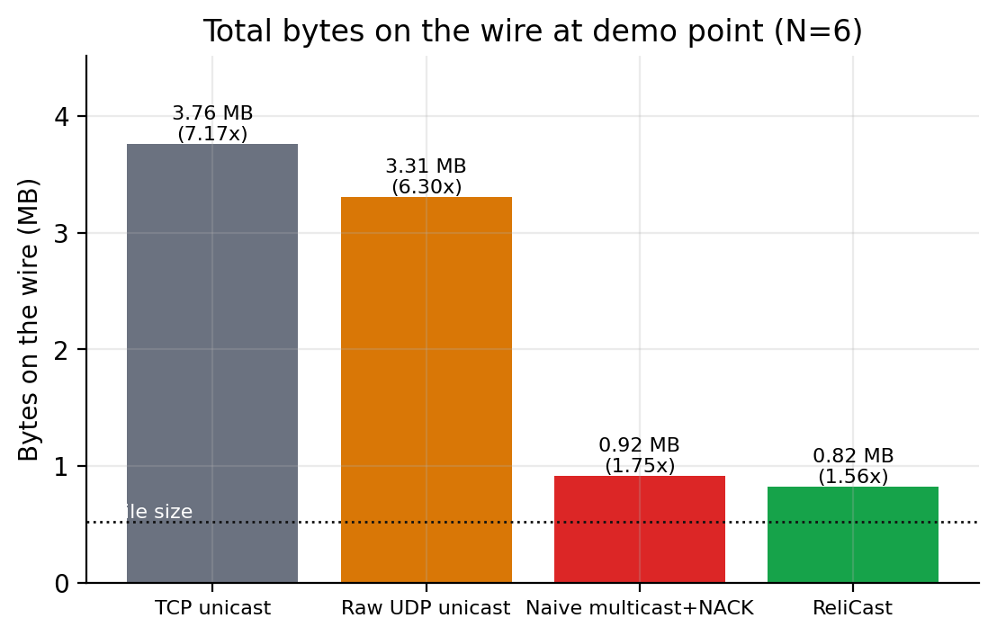
Why multicast?
• Unicast: N copies leave the sender; overhead ratio ~ N
• Broadcast: reaches everyone, interested or not, one subnet only
• Multicast (RFC 1112): one datagram to a group address; receivers join via IGMP; TTL limits scope
• Price: UDP semantics - the application must supply reliability and pacing
Bytes on the wire at the demo point (N = 6)
Demo point: TCP sent 3.76 MB, naive multicast 0.92 MB, ReliCast 0.82 MB (file = 0.52 MB)
ReliCast | BMSCE CSE | Network Programming 2026-2027
3
Notes:
One copy on the wire regardless of N; the network replicates it.

Slide 4
Research papers reviewed
SRM - Floyd et al., IEEE/ACM ToN 1997
NORM - Adamson et al., RFC 5740, 2009
Problem: ACK implosion; sender cannot track all receivers
Mechanism: random request timer in [C1*d, (C1+C2)*d]; suppress if another request is heard; exponential back-off; any member can repair; adaptive timers
Results: ns-2 chain / star / tree topologies, wb whiteboard
Limits: session-message overhead, multicast repairs, simulation only
Used here: random timers, suppression, back-off
Problem: scalable NACK-based reliability over multicast
Mechanism: GRTT-scaled random back-off, NACK suppression, sender repair aggregation, flush/heartbeat, optional FEC and congestion control
Results: standards-track specification (no measurement campaign)
Limits: GRTT state, no one-way-delay method, complex
Used here: repair hold-off + union, heartbeat
Supporting specs: RFC 4330 (SNTPv4), RFC 1112 (host multicast)
ReliCast | BMSCE CSE | Network Programming 2026-2027
4
Notes:
Only the two foundational protocols, in depth.

Slide 5
Research gap
• SRM / NORM windows come from distance or GRTT estimates - not tuned from measured one-way delay and jitter
• SRM results are ns-2 simulations; RFC 5740 has no measurements - little data from real sockets
• One-way delay needs synchronised clocks, so papers report RTT or simulated time
• Comparisons with TCP-unicast and raw UDP baselines are mostly qualitative
Chosen gap
A real-socket study of NACK-suppressed multicast with an SNTP-synchronised, delay-adaptive window, benchmarked against TCP, raw UDP and un-suppressed multicast in one harness.
ReliCast | BMSCE CSE | Network Programming 2026-2027
5
Notes:
Narrowed from several gaps to one.

Slide 6
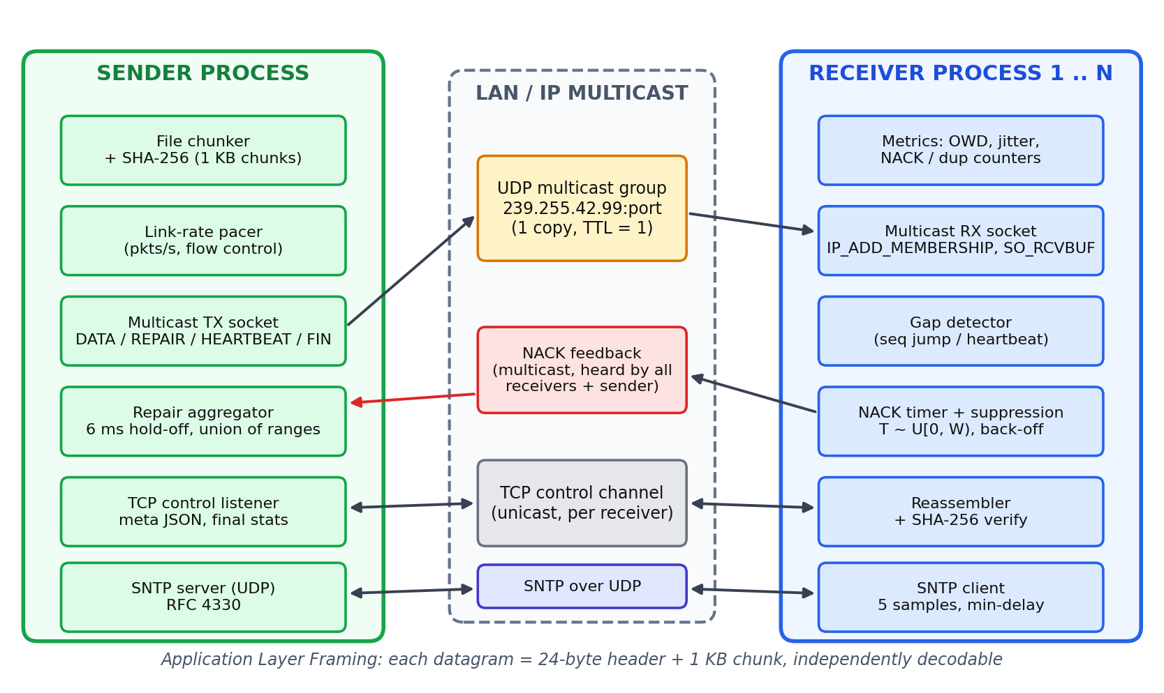
System architecture
ReliCast | BMSCE CSE | Network Programming 2026-2027
6
Notes:
One sender process, N receiver processes.

Slide 7
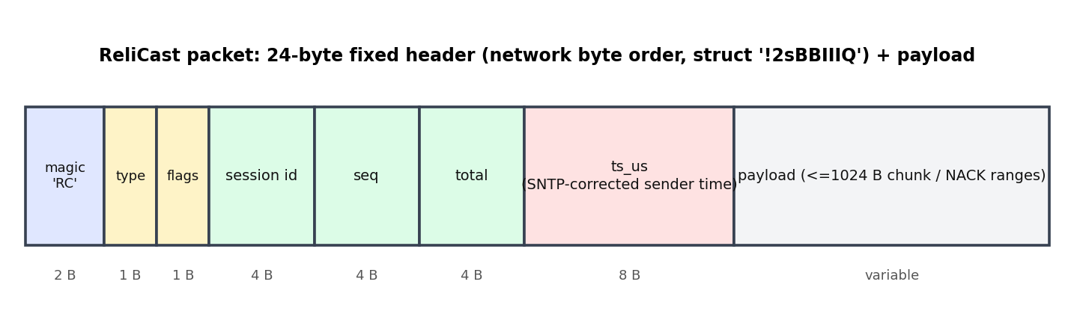
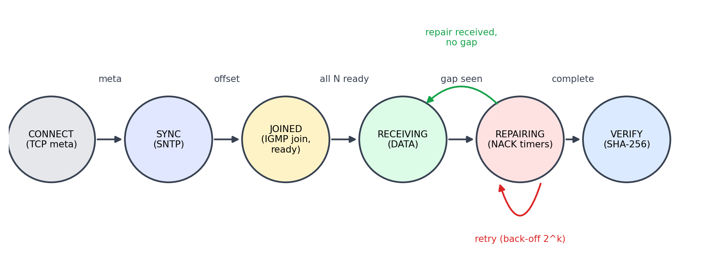
Protocol and packet format
• DATA / REPAIR: 1 KB chunk, seq, total, SNTP-corrected sender timestamp
• HEARTBEAT: carries highest seq sent - exposes tail losses
• NACK: receiver id + inclusive seq ranges
• FIN / PROBE: end of session / interface test
• TCP control: JSON meta (size, chunks, SHA-256, group, SNTP port) and final stats
Receiver state machine
ReliCast | BMSCE CSE | Network Programming 2026-2027
7
Notes:
24-byte header in network byte order; ALF - each packet self-describing.

Slide 8
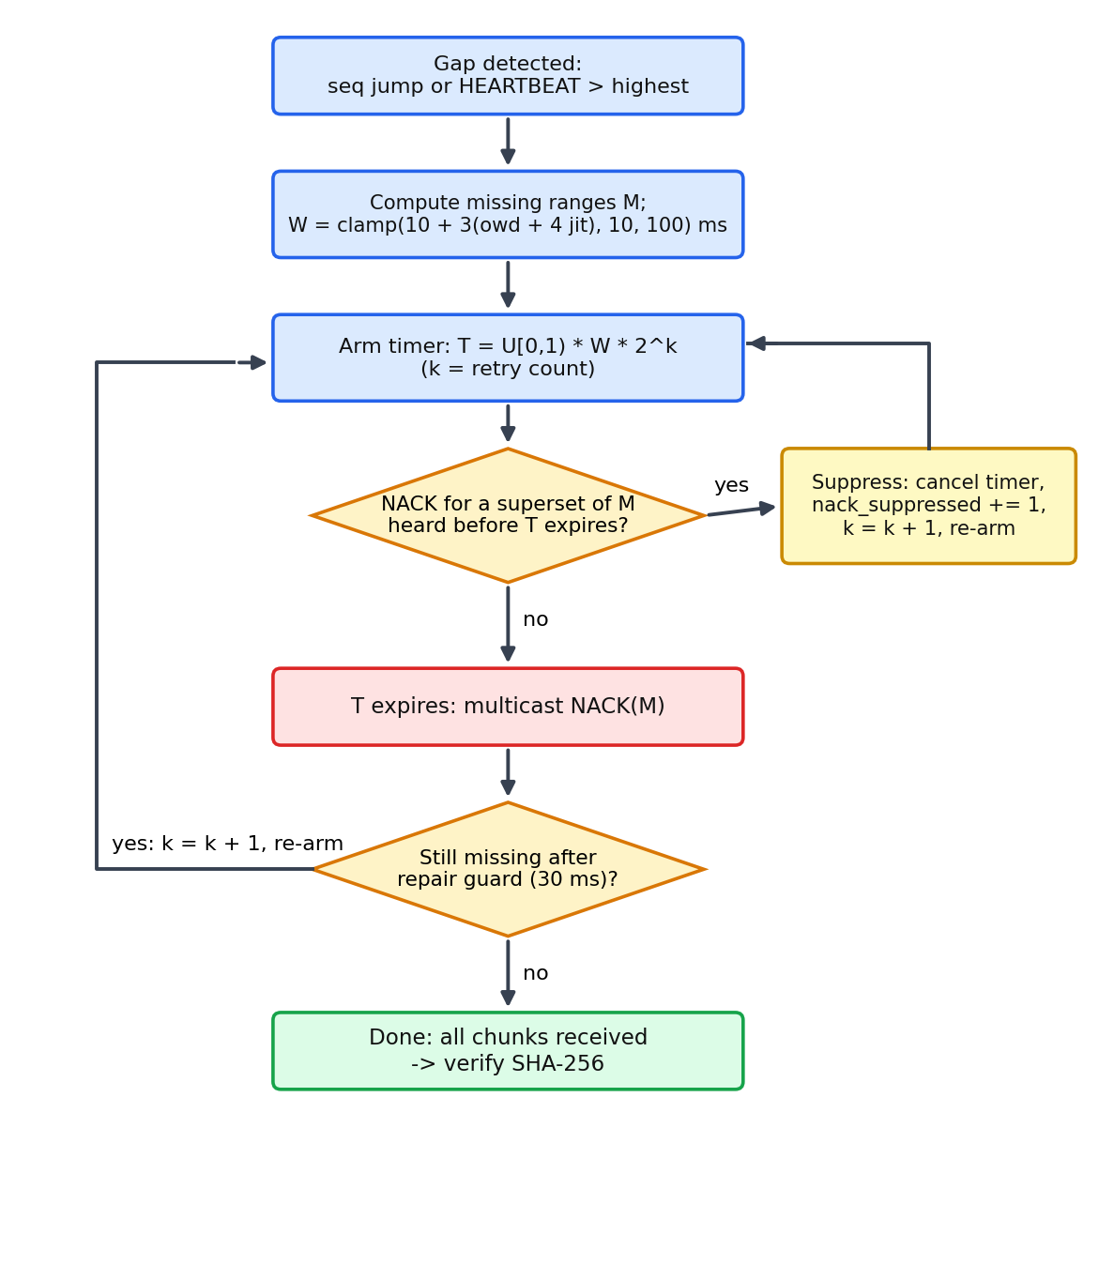
Algorithm: NACK suppression
• Timer: T = U[0,1) x W x 2^k, W = clamp(10 + 3(owd + 4 jitter), 10, 100) ms
• Suppression: an overheard NACK covering my gap cancels my timer
• Expected NACKs per lost chunk: ~ 1 + M*d/W (M receivers missing it, d = delay) vs M without suppression
• Sender: 6 ms hold-off, repair the union of ranges once, 30 ms repair guard
• Result at demo point: 130 NACKs vs 322 naive (60% fewer); 134 suppressed
ReliCast | BMSCE CSE | Network Programming 2026-2027
8
Notes:
Randomised timer, suppression on overheard NACK, back-off, sender hold-off and aggregation.

Slide 9
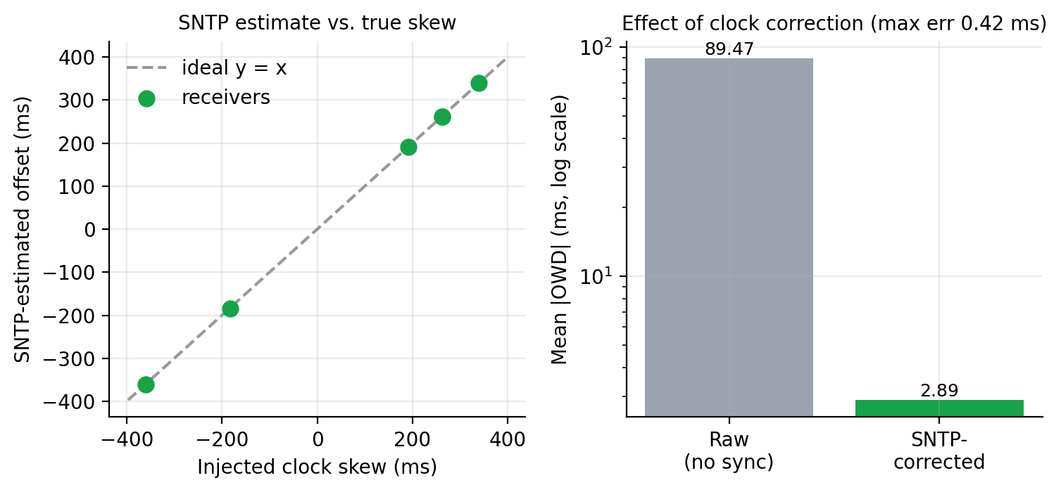
SNTP: measuring one-way delay
• Offset: theta = ((t2 - t1) + (t3 - t4)) / 2
• Delay: delta = (t4 - t1) - (t3 - t2)
• Best of 5 samples (min delay) per receiver
• OWD = (t_rx - theta) - ts_sender
Skews up to 360 ms recovered to within 0.42 ms; mean OWD 89.5 ms raw -> 2.89 ms corrected
ReliCast | BMSCE CSE | Network Programming 2026-2027
9
Notes:
Receivers have injected clock skew of +/-100..500 ms; SNTP corrects it.

Slide 10
Socket programming and syllabus mapping
Unit | Feature | Calls / options
1 | Sockets, byte order, buffers | socket(), struct '!2sBBIIIQ', SO_RCVBUF
2 | TCP control channel, socket options | bind / listen / accept / connect / sendall / recv; SO_REUSEADDR, SO_REUSEPORT, IP_MULTICAST_TTL / IF / LOOP
3 | UDP data path, no flow control | sendto / recvfrom, pacing, select(), timeouts
4 | Unicast vs broadcast vs multicast | IP_ADD_MEMBERSHIP (ip_mreq), 239.255.42.99, TTL scope
5 | SNTP clock sync | 48-byte NTP packet over UDP, client + server (RFC 4330)
ReliCast | BMSCE CSE | Network Programming 2026-2027
10
Notes:
Every call used is a syllabus topic.

Slide 11
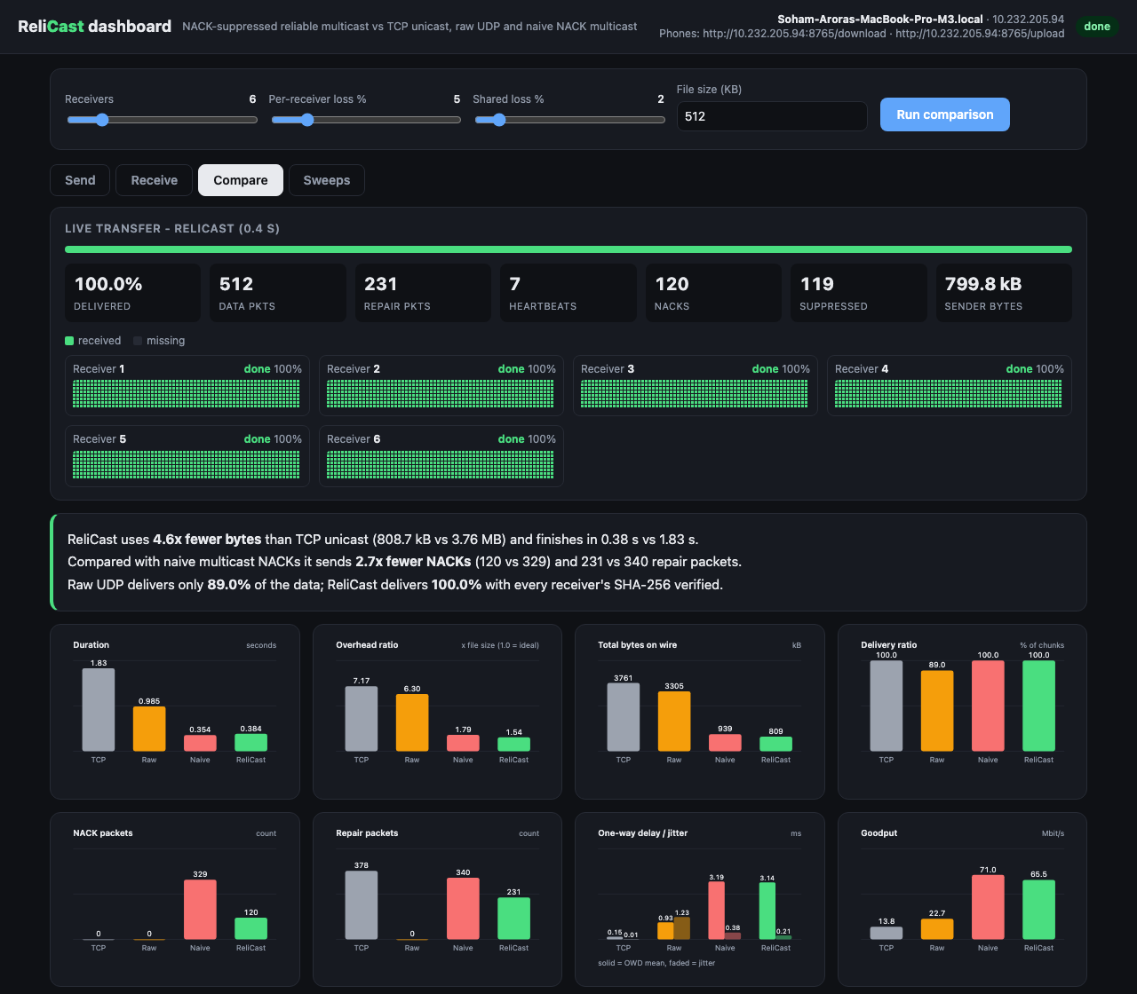
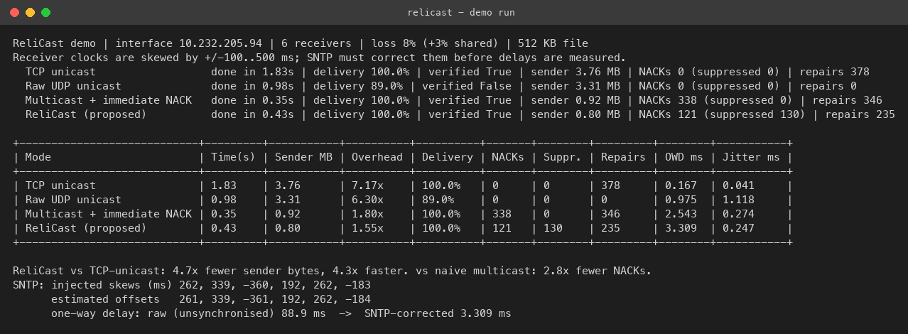
Demo and dashboard
Dashboard: Compare tab
• Live chunk map, 8 charts, SNTP card
• Sweeps tab from experiments.json
Console demo run
Demo: 6 receivers, 8% loss, 3% shared loss, 512 KB file - ReliCast 130 NACKs (134 suppressed), verified: True
ReliCast | BMSCE CSE | Network Programming 2026-2027
11
Notes:
Run python run.py dashboard; compare the four modes live.

Slide 12
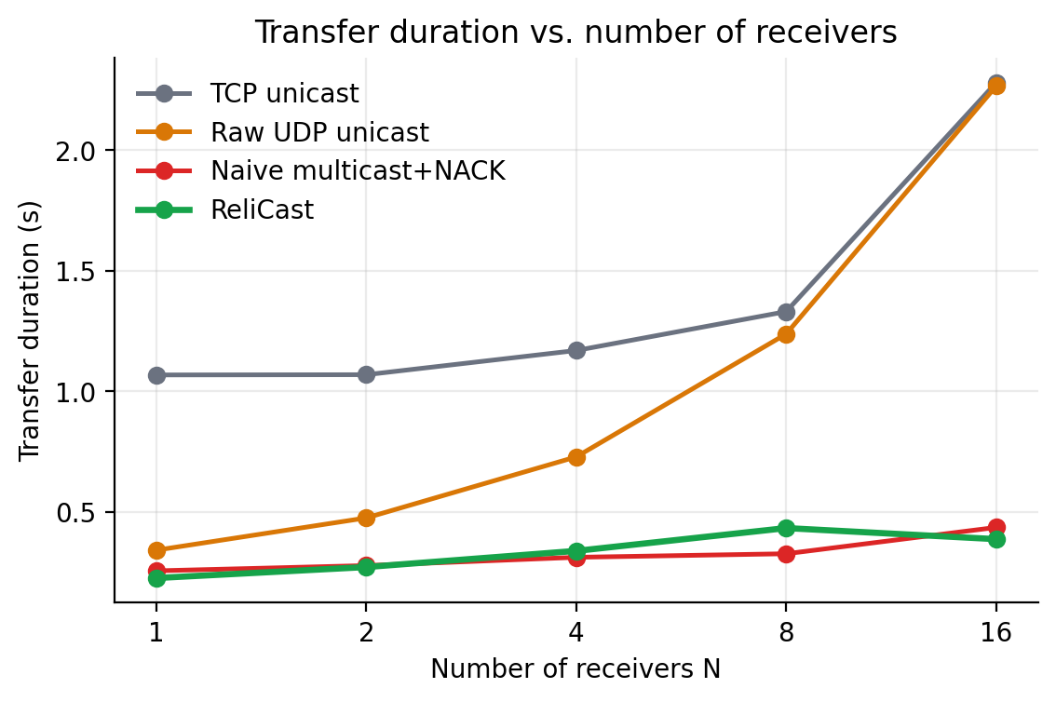
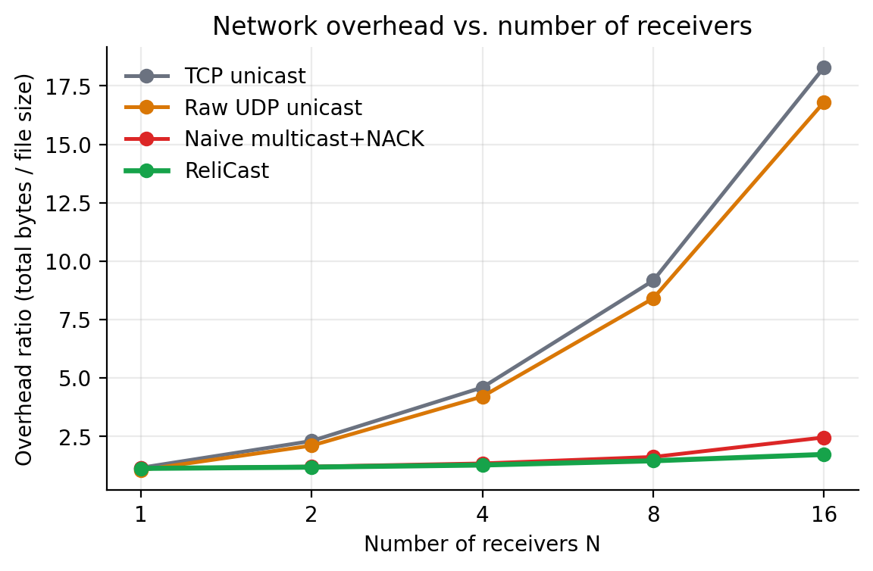
Results 1: scaling with receivers
Controlled comparison: byte-identical payload (same SHA-256) in all 4 modes, same N / loss / 4000 pkt/s link (TCP paced too), 3 reps averaged; only bytes on the wire may differ.
N = 16: overhead TCP 18.30x vs ReliCast 1.72x; duration TCP 2.28s, naive 0.43s, ReliCast 0.39s
ReliCast | BMSCE CSE | Network Programming 2026-2027
12
Notes:
Duration and overhead versus N.

Slide 13
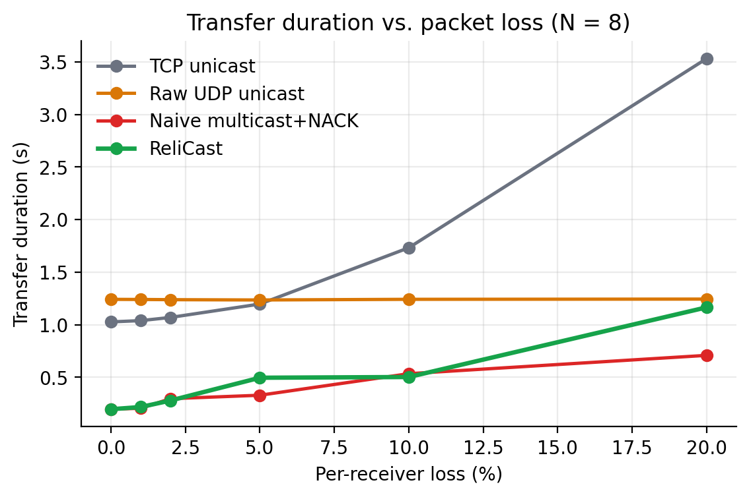
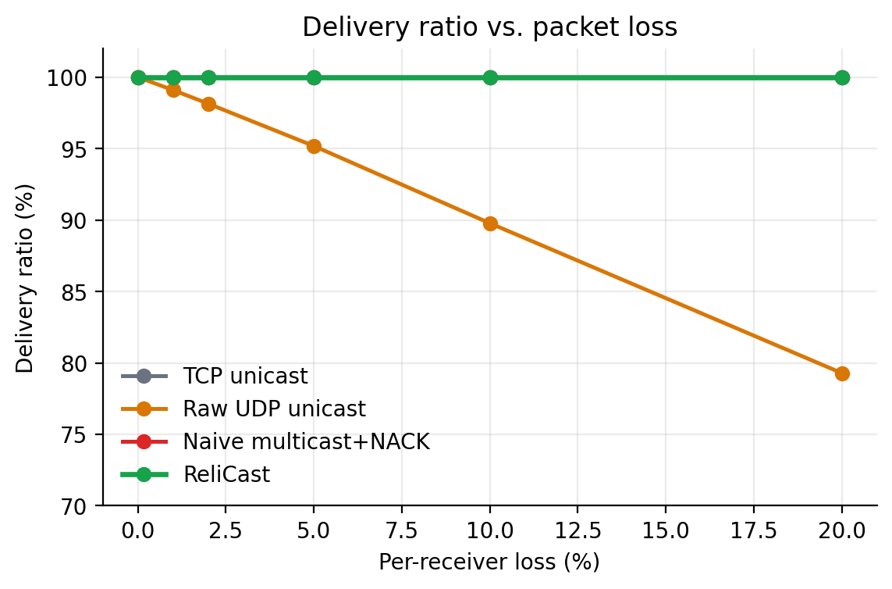
Results 2: effect of packet loss
At 20% loss: UDP delivers 79.3%; ReliCast and naive deliver 100%; ReliCast pays latency (1.16s vs 0.71s naive)
ReliCast | BMSCE CSE | Network Programming 2026-2027
13
Notes:
Duration and delivery ratio versus loss at N = 8.

Slide 14
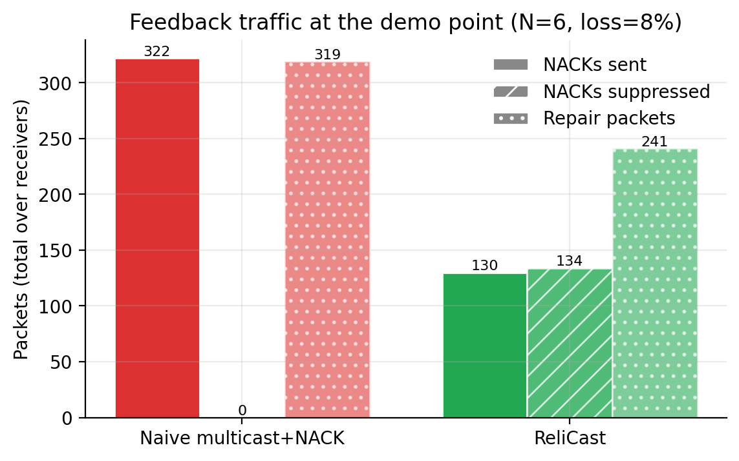
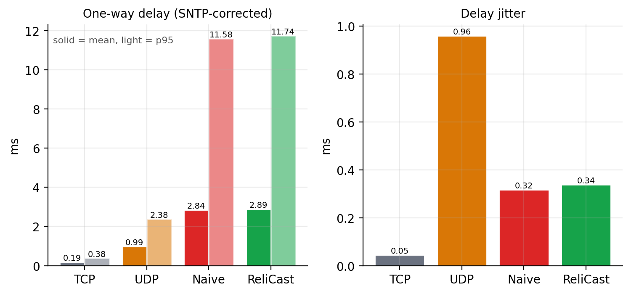
Results 3: feedback traffic, delay and jitter
60% fewer NACKs and 24% fewer repairs than naive multicast; OWD 2.89 ms, jitter 0.34 ms (ReliCast)
ReliCast | BMSCE CSE | Network Programming 2026-2027
14
Notes:
NACK/repair counts and SNTP-corrected OWD at the demo point.

Slide 15
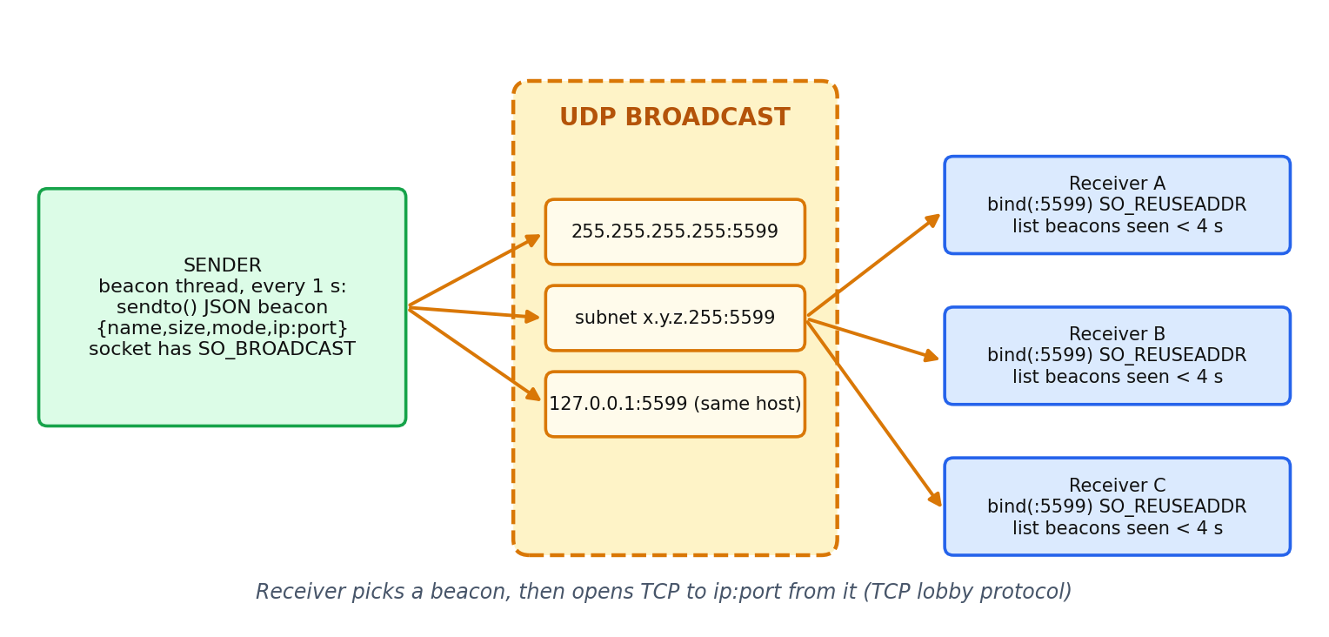
Real-world mode: discovery and lobby
• Send: python run.py send <file> --mode relicast|naive|tcp|udp
• Receive: python run.py receive (or dashboard tabs)
• Discovery: UDP broadcast beacon on port 5599 every second (Unit 4)
• Lobby: TCP JSON lines - meta, ready, probe, start{transport}, progress, done
• Saved to ~/ReliCast/received after SHA-256 check
• Phones: /download and /upload pages with --lan
Cross-platform: no SO_REUSEPORT on Windows, wildcard multicast bind, perf_counter-anchored clock, ANSI enable
ReliCast | BMSCE CSE | Network Programming 2026-2027
15
Notes:
python run.py send <file> / receive; dashboard Send and Receive tabs.

Slide 16
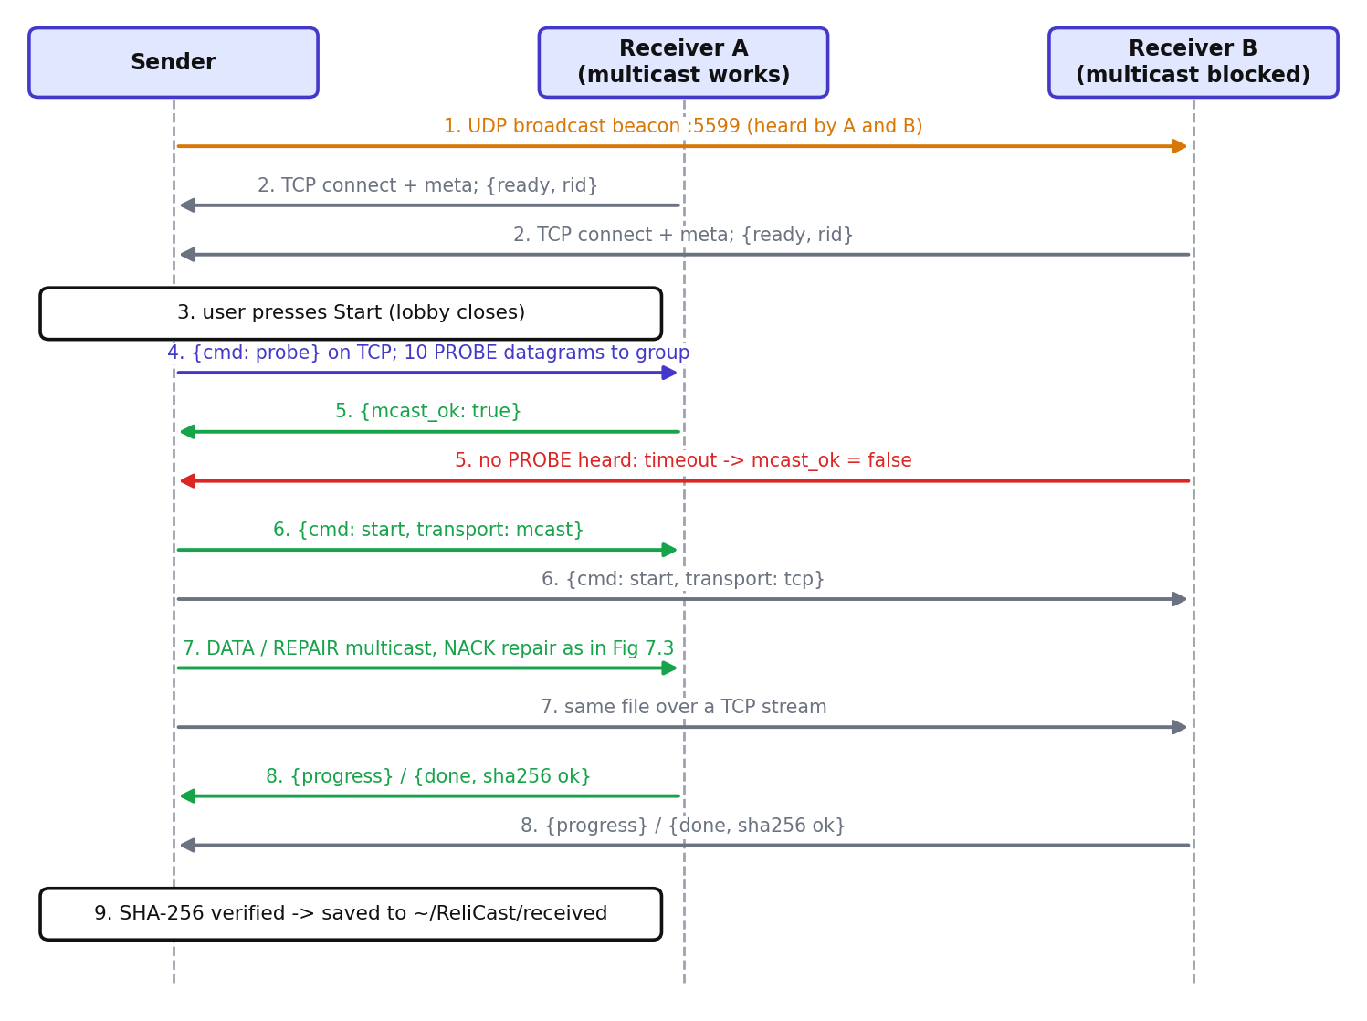
Multicast probe and TCP fallback
• Sender multicasts 10 PROBE packets; each receiver replies mcast_ok over TCP
• Receivers that hear nothing are served over TCP
• Others keep multicast + NACK repair
• One blocked device never stalls the session
ReliCast | BMSCE CSE | Network Programming 2026-2027
16
Notes:
Hotspots and APs often block multicast; hybrid delivery keeps the session alive.

Slide 17
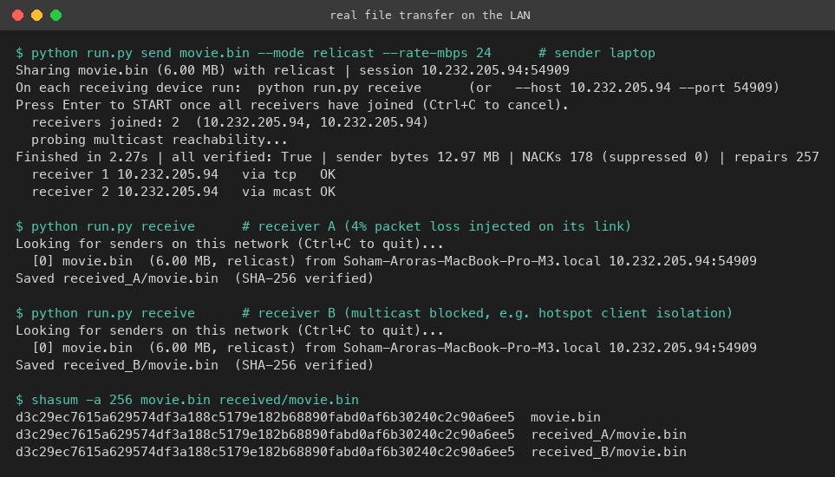
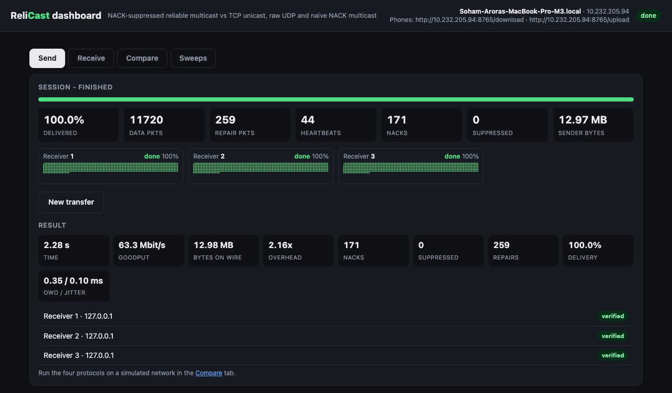
Real transfer evidence
Dashboard Send tab: all verified
• Identical SHA-256 on all copies
• One machine, own interface: loopback-class delivery, emulated loss
Send / receive terminals
Honest scope: real multi-device hotspot testing is future work
ReliCast | BMSCE CSE | Network Programming 2026-2027
17
Notes:
6 MB file, one receiver with 4% injected loss, one with multicast blocked.

Slide 18
Conclusion
• Bytes: ReliCast overhead stays 1.13-1.72x for N up to 16; unicast grows ~ N
• Reliability: 100% delivery with SHA-256 verification (every ReliCast transfer was verified); raw UDP only 79.3% at 20% loss
• Feedback: randomised suppression + aggregation cut NACKs by 60% and repairs by 24% at the demo point
• Measurement: SNTP recovers skews within 0.42 ms, making real-socket OWD and jitter measurable
• Limitation: emulated loss, one host; at high loss ReliCast trades latency for fewer packets
ReliCast | BMSCE CSE | Network Programming 2026-2027
18
Notes:
Summarise findings, contribution and honest limits.

Slide 19
Future work
• Multi-host LAN and Wi-Fi measurement campaign (IGMP snooping, multicast rates)
• FEC-coded repairs (NORM-style parity)
• Congestion control instead of a fixed pacing rate
• SRM-style local recovery and receiver-side repair
• Authenticated sessions; larger groups; wider comparison of adaptive vs fixed windows
ReliCast | BMSCE CSE | Network Programming 2026-2027
19

Slide 20
Questions?
References: Floyd et al., IEEE/ACM ToN 1997 (SRM) | RFC 5740 (NORM) | RFC 4330 (SNTP) | RFC 1112

