Slide 1



INTRODUCTION TO RabbitMQ
- Maulik Parmar (.NET DEv)

Slide 2
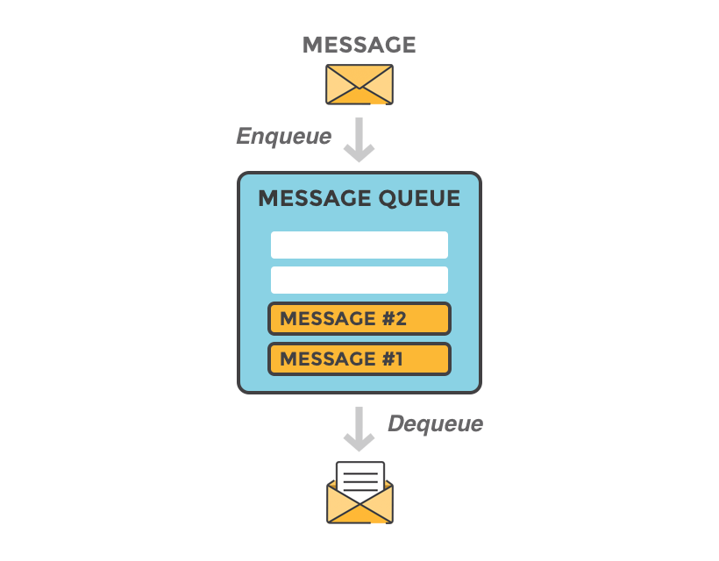


What is RabbitMQ ?
RabbitMQ is a message-queueing software also known as a message broker or queue manager. Simply said : it is software where queues are defined, to which applications connect in order to transfer a message or messages.
Do You have
Any idea About
RabbitMQ ?
A message can include any kind of information. It could, for example, have information about a process or task that should start on another application (which could even be on another server), or it could be just a simple text message.
The queue-manager software stores the messages until a receiving application connects and takes a message off the queue. The receiving application then processes the message.

Slide 3

Now you might think, “where on earth would a message queue fit in my architecture”? The simple and quick answer is when:
you have “timeout errors” due to too many requests at the same time.
you need a decoupled way to communicate between or within your application.
you are polling a data store too often and you want this data store to be available to answer qualified queries instead
you need to scale up and down during peak hours
In other words, any time a task is not part of a basic user transaction, and/or the results doesn’t impact a user response, that’s a perfect job for a message queue..
We will now explain cases where a message queue can be beneficial. Simply put, two obvious cases can be used as examples of when message queues really shine:
For long-running processes and background jobs
As the middleman in between microservices
When & why should you use RabbitMQ?

Slide 4
Long-running processes and background jobs
Images Scaling
Sending large/many emails
Search engine indexing
File scanning
Video encoding
Delivering notifications
PDF processing
Calculations
The middleman in between microservices
Order handling (Order placed, update order status, send an order, payment, etc.)
Food delivery service (Place an order, prepare an order, deliver food)
Any web service that needs to handle multiple requests
When & why should you use RabbitMQ?

Slide 5
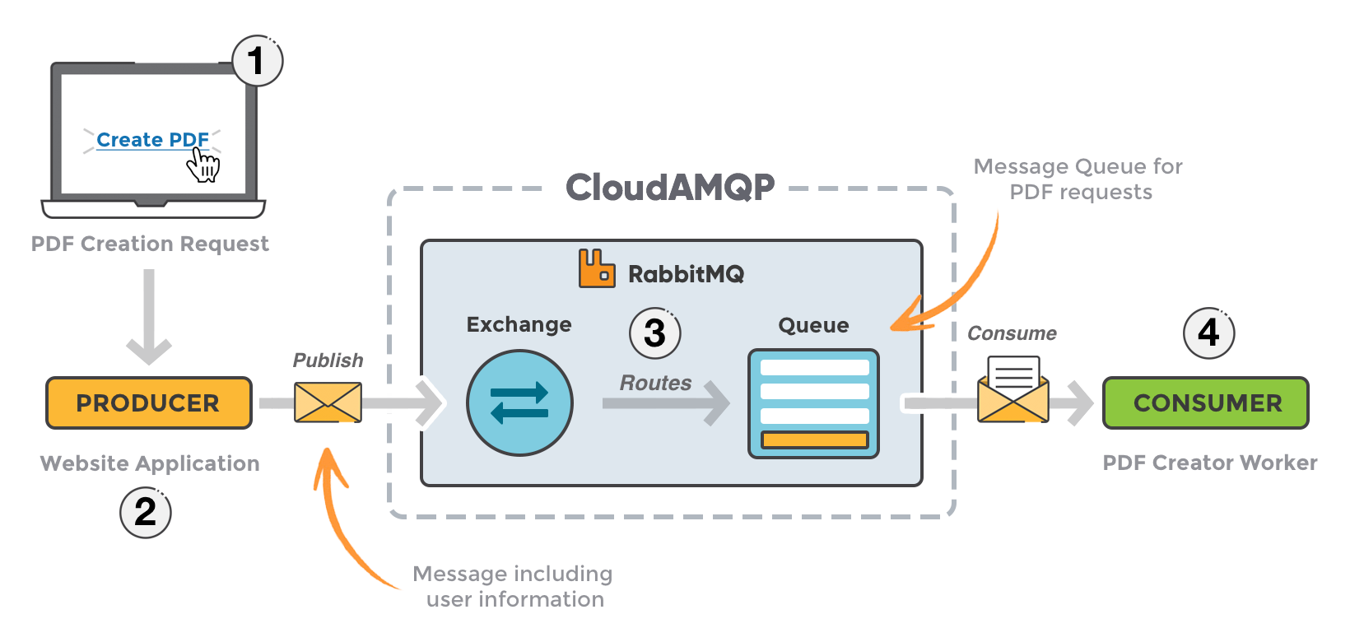
Message queueing allows web servers to respond to requests quickly instead of being forced to perform resource-heavy procedures on the spot that may delay response time.
Message queueing is also good when you want to distribute a message to multiple consumers or to balance loads between workers.
When & why should you use RabbitMQ?

Slide 6
Pros
Most widely deployed open source message broker.
Asynchronous Messaging.
Developer easier experience with languages such as: DotNet, Java, PHP, Python
Use Puppet, BOSH, Chef and Docker for deployment.
Management UI.
Minimum data traffic.
Security, supports two authentication (2FA) ,SSL and several authorization backends.
It embraces Advanced Message Queueing Protocol (AMQP, HTTP, STOMP, MQTT).
It can scale one million messages in one second.
Pros & Cons of RabbitMQ

Slide 7
Cons
Needs Erlang.
Lack of documentation.
Issues with processing big amounts of data
More to deploy & maintain (brokers/RabbitMQ need installing on machines, it's not just built into the modules)
Pros & Cons of RabbitMQ

Slide 8
RabbitMQ is multi-tenant system: connections, exchanges, queues, bindings, user permissions, policies and some other things belong to virtual hosts, logical groups of entities.
If you are familiar with virtual hosts in Apache or server blocks in Nginx, the idea is similar.
There is, however, one important difference: virtual hosts in Apache are defined in the configuration file; that's not the case with RabbitMQ: virtual hosts are created and deleted using rabbitmqctl or HTTP API instead.
For more information : https://www.rabbitmq.com/vhosts.html
VIRTUAL HOST

Slide 9
A queue is a sequential data structure with two primary operations: an item can be enqueued (added) at the tail and dequeued (consumed) from the head. Queues play a prominent role in the messaging technology space: many messaging protocols and tools assume that publishers and consumers communicate using a queue-like storage mechanism.
Queues in RabbitMQ are FIFO ("first in, first out"). Some queue features, namely priorities and requeueing by consumers, can affect the ordering as observed by consumers.
For more information : https://www.rabbitmq.com/queues.html
QUEUES

Slide 10
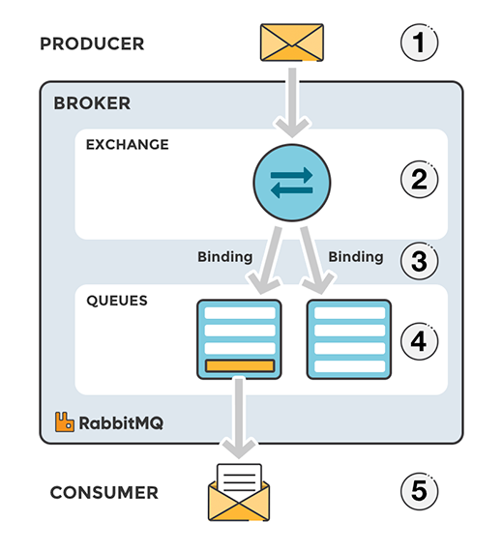
Message flow in RabbitMQ
The producer publishes a message to an exchange. When creating an exchange, the type must be specified. This topic will be covered later on.
The exchange receives the message and is now responsible for routing the message. The exchange takes different message attributes into account, such as the routing key, depending on the exchange type.
Bindings must be created from the exchange to queues. In this case, there are two bindings to two different queues from the exchange. The exchange routes the message into the queues depending on message attributes.
The messages stay in the queue until they are handled by a consumer
The consumer handles the message
Request Flow

Slide 11
RabbitMQ provides several security features to ensure the confidentiality, integrity, and availability of your messaging infrastructure.
Authentication: RabbitMQ allows you to authenticate users connecting to the broker. You can configure different authentication backends such as LDAP, OAuth2, or custom plugins.
Access Control: RabbitMQ provides fine-grained access control to define which users or applications can access which resources. You can control access to exchanges, queues, vhosts, and management interfaces.
Encryption: RabbitMQ supports SSL/TLS encryption to protect data in transit. You can configure client and server-side SSL/TLS to ensure secure communication between the client and the broker.
Auditing and Logging: RabbitMQ provides logging and auditing capabilities to track activities, errors, and security events. You can configure different logging backends, including syslog, file, and console.
Authorization: RabbitMQ supports different authorization mechanisms, including OAuth2, LDAP, and custom plugins. You can configure authorization rules to restrict users' actions based on their roles and permissions.
Virtual Hosts: RabbitMQ supports virtual hosts, which allow you to segregate resources such as exchanges, queues, and users into logical groups. This can help you achieve better security by isolating different applications or user groups.
Overall, RabbitMQ provides a robust set of security features to protect your messaging infrastructure from unauthorized access, data breaches, and other security threats.
Security

Slide 12
Durability is a feature in RabbitMQ that ensures that messages published to queues are not lost in the event of a broker failure.
When a message is published to a queue, RabbitMQ stores the message on disk before acknowledging the message to the publisher.
This ensures that the message is not lost even if the broker crashes or restarts.
To ensure durability, RabbitMQ uses two concepts: durable exchanges and durable queues. When an exchange or queue is declared as durable, RabbitMQ stores the metadata (such as the exchange or queue name, type, and bindings) on disk, which means that the metadata survives a broker restart.
In addition, messages published to durable queues are stored on disk, so they survive a broker restart as well.
To make an exchange or queue durable, you need to set the "durable" flag to true when you declare them.
For example, when declaring a durable queue using the RabbitMQ Java client, you can use the following code:
channel.queueDeclare("my_durable_queue", true, false, false, null);
In this example, the second parameter is set to "true" to indicate that the queue is durable.
Durability

Slide 13
Message acknowledgment, also known as message ack, is a mechanism used in message queuing systems like RabbitMQ to ensure that messages are processed successfully and not lost.
When a message is delivered to a consumer, the consumer must acknowledge the message to indicate that it has been received and processed successfully. If the message is not acknowledged within a certain time period, RabbitMQ assumes that the message has been lost and redelivers it to another consumer.
There are two types of message acknowledgment in RabbitMQ: automatic and manual.
Automatic acknowledgment, also known as "auto-ack," is the default mode in RabbitMQ. In this mode, when a message is delivered to a consumer, RabbitMQ automatically sends an acknowledgement to the broker without waiting for the consumer to acknowledge the message explicitly. This mode is suitable for scenarios where message loss is not critical or where message processing is idempotent, meaning that processing the same message multiple times has the same effect as processing it once.
Manual acknowledgment, also known as "manual-ack," requires the consumer to explicitly acknowledge each message after it has been processed.
This mode is suitable for scenarios where message loss is critical or where message processing is not idempotent, such as when performing financial transactions or updating a database. To acknowledge a message manually, the consumer must call the basicAck method on the channel object and pass the delivery tag of the message as an argument, like this:
channel.BasicAck(deliveryTag: ea.DeliveryTag, multiple: false);
In this example, ea is an instance of the BasicDeliverEventArgs class that contains information about the delivered message, and multiple is a Boolean flag that indicates whether to acknowledge all messages up to and including the specified delivery tag.
By using manual acknowledgment, the consumer can ensure that messages are processed reliably and not lost, even in the event of consumer or broker failures. However, it also adds complexity to the consumer code and may affect performance due to the overhead of sending acknowledgments.
Message acknowledgment

Slide 14
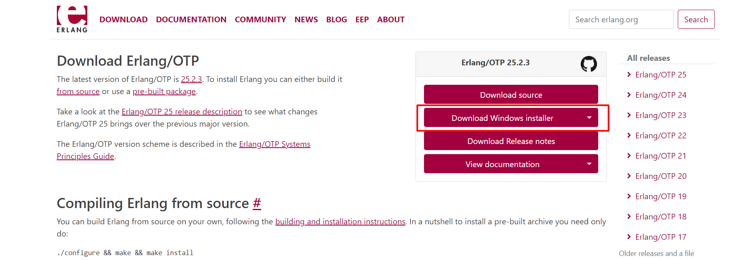
Go this link : https://www.erlang.org/downloads
Install Erlang/OTP
RabbitMQ Install

Slide 15
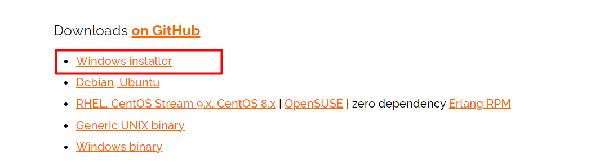
Go to this Link : https://www.rabbitmq.com/download.html
Download the RabbitMQ windows Installer and install the software.
RabbitMQ Install

Slide 16
Got to this Path
C:\Program Files\RabbitMQ Server\rabbitmq_server-3.11.10\sbin
Open the Command prompt and type below command
rabbitmq-plugins enable rabbitmq_management
RabbitMQ Install

Slide 17
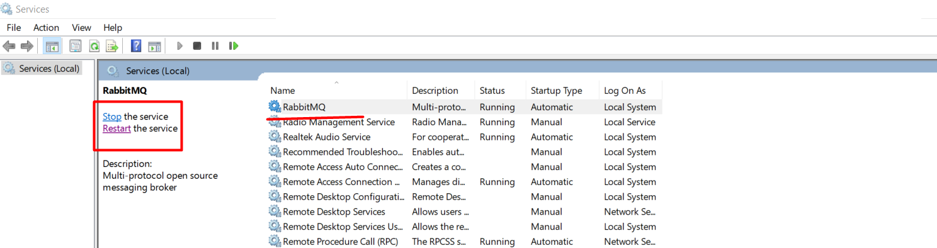
Find RabbitMQ service and check its on running mode .
RabbitMQ Install
Open Browser and Enter the URL :- http://localhost:15672/

Slide 18
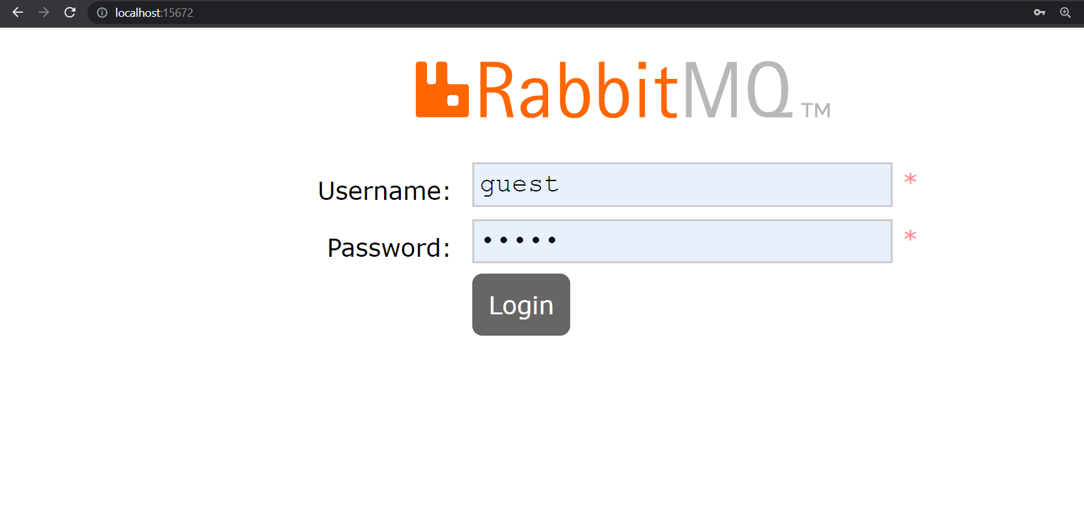
RabbitMQ Install
RabbitMQ Login page will appear. Enter Username and Password
Username : guest
Password : guest

Slide 19
Required
NuGet Package for
RabbitMQ
(C#)
<PackageReference Include="RabbitMQ.Client" Version="6.4.0" />

Slide 20
using System;
using System.Text;
using RabbitMQ.Client;
var factory = new ConnectionFactory() { HostName = "localhost", UserName = "guest", Password = "guest" };
using var connection = factory.CreateConnection();
using var channel = connection.CreateModel();
channel.QueueDeclare(
queue: "letterbox",
durable: false,
exclusive: false,
autoDelete: false,
arguments: null);
var message = "This is my first Message";
var body = Encoding.UTF8.GetBytes(message);
channel.BasicPublish("", "letterbox", null, body);
Console.WriteLine($"Send message: {message}");
Console.ReadKey();
Example of Publisher Code in C#

Slide 21
using System;
using System.Text;
using RabbitMQ.Client;
using RabbitMQ.Client.Events;
var factory = new ConnectionFactory() { HostName = "localhost", UserName = "guest", Password = "guest" };
using var connection = factory.CreateConnection();
using var channel = connection.CreateModel();
channel.QueueDeclare(
queue: "letterbox",
durable: false,
exclusive: false,
autoDelete: false,
arguments: null);
var consumer = new EventingBasicConsumer(channel);
consumer.Received += (model, ea) =>
{
var body = ea.Body.ToArray();
var message = Encoding.UTF8.GetString(body);
Console.WriteLine($"Recieved new message: {message}");
};
channel.BasicConsume(queue: "letterbox", autoAck: true, consumer: consumer);
Console.WriteLine("Consuming");
Console.ReadKey();
Example of Consumer Code in C#

Slide 22
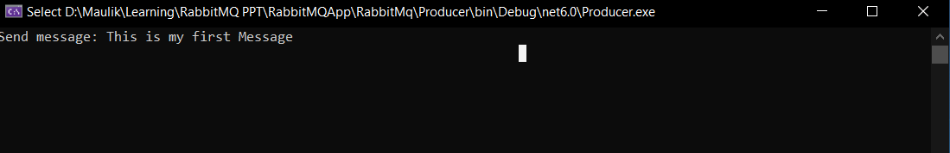
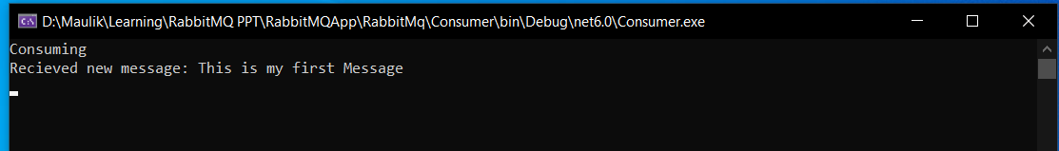
Producer.cs
Output
Consumer.cs

Slide 23
Q & A

Slide 24
Thank You

