Slide 1
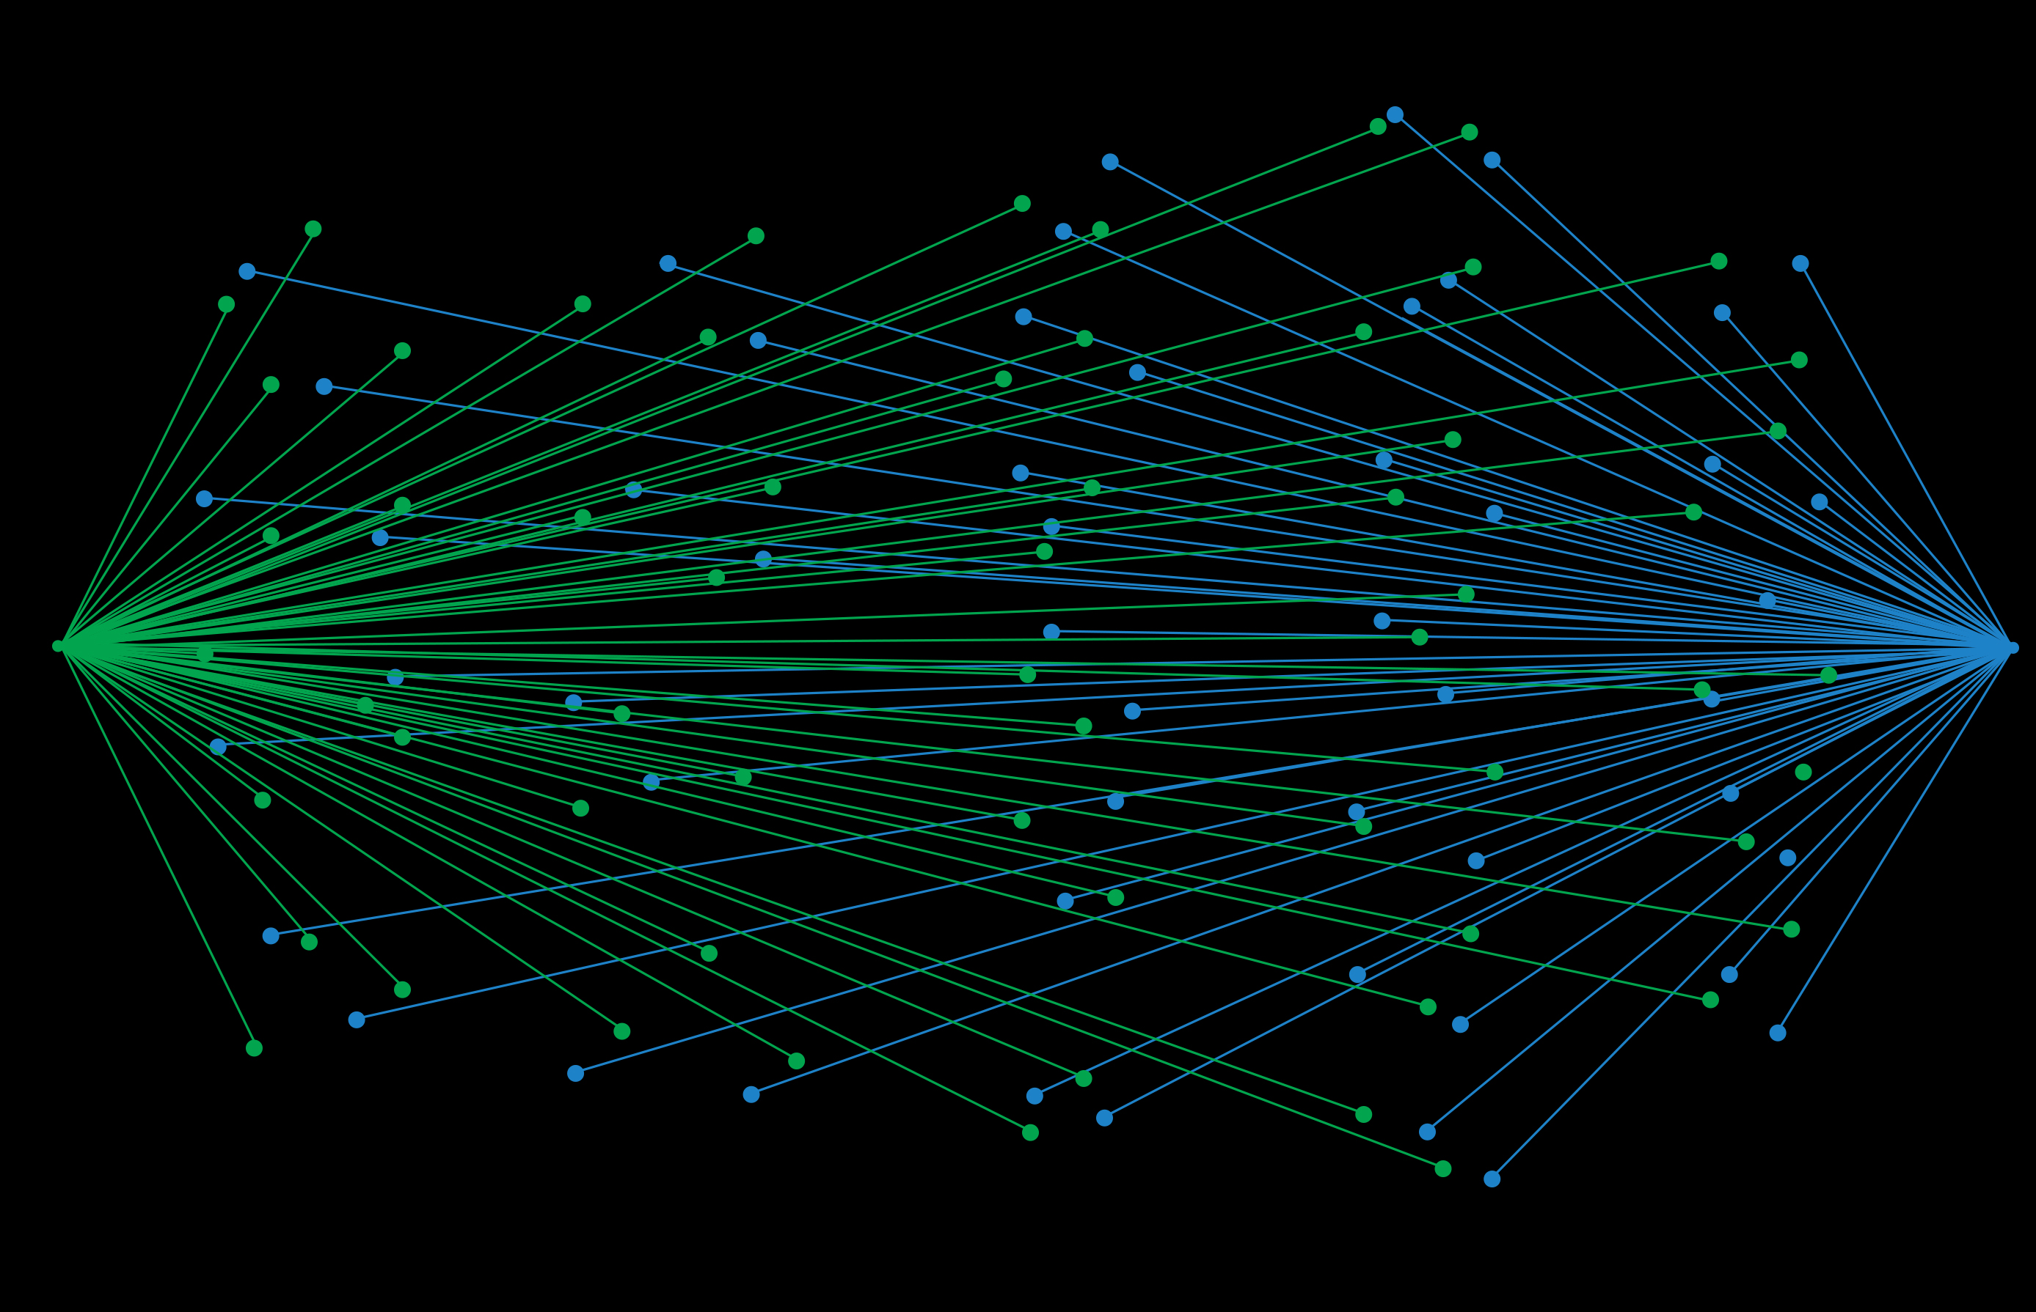
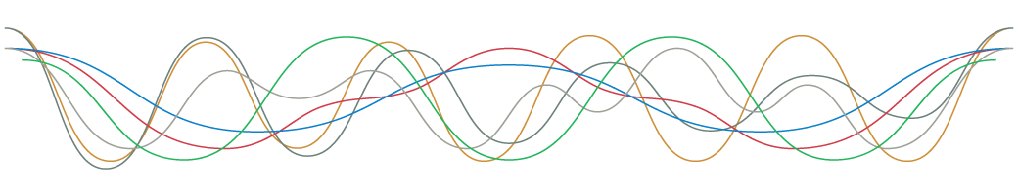
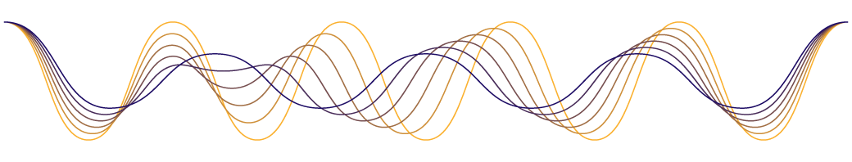

N-hidden-layer Artificial Neural Network for Nonclassical Adaptive Filtering
f
Fig. Representation of a discrete-time system, i.e., a transformation that maps an input sequence x [n] into a unique output sequence y[n].*
*From Discrete-Time Signal Processing, 2e
by Oppenheim, Schafer, and Buck
©1999-2000 Prentice Hall, Inc.
Notes:
Representation of a
discrete-time system, i.e., a
transformation that maps an input
sequence x [n] into a unique output
sequence y[n].
From Discrete-Time Signal Processing, 2e
by Oppenheim, Schafer, and Buck
©1999-2000 Prentice Hall, Inc.

Slide 2
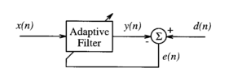

Slide 3
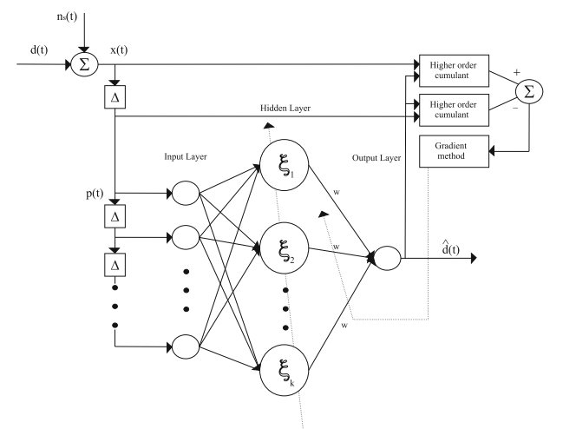

Slide 4


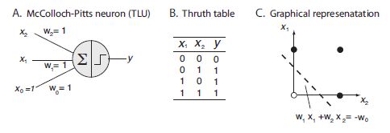

Slide 5
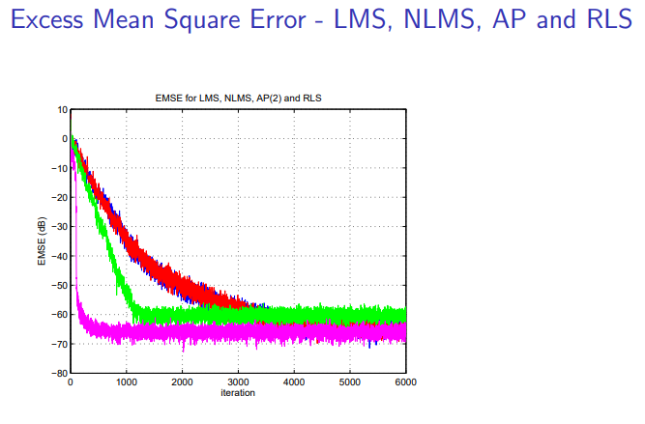
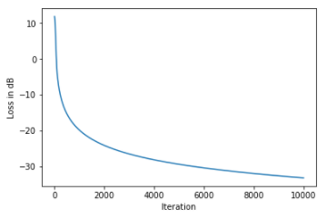
and ANN

Slide 6
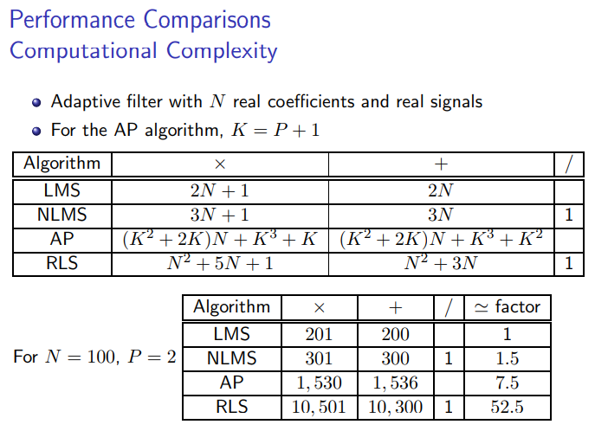

Slide 7
1.Ability to learn the model of almost any continuous (and preferable differentiable) nonlinear physical process given sufficient input-output data pairs generated from that process.
2. Ability to accept weak statistical assumptions about the process.
3. Ability to generalise its learning to new data after initial training.
4. VLSI implementation in a massively parallel structure that is fault tolerant to hardware failure of some of the circuits because of the inherent redundancy.

Slide 8
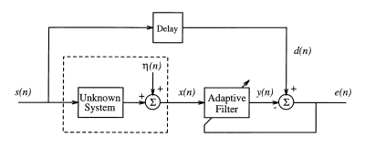
Application Example:

Slide 9
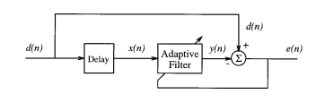
Limitations:

Slide 10

References:
[1] The Theory of Linear Prediction, P. P. Vaidyanathan, California Institute of Technology
[2]

