Slide 1
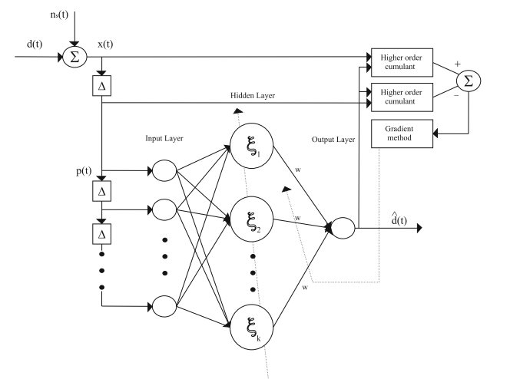
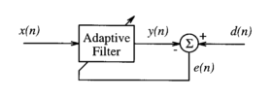
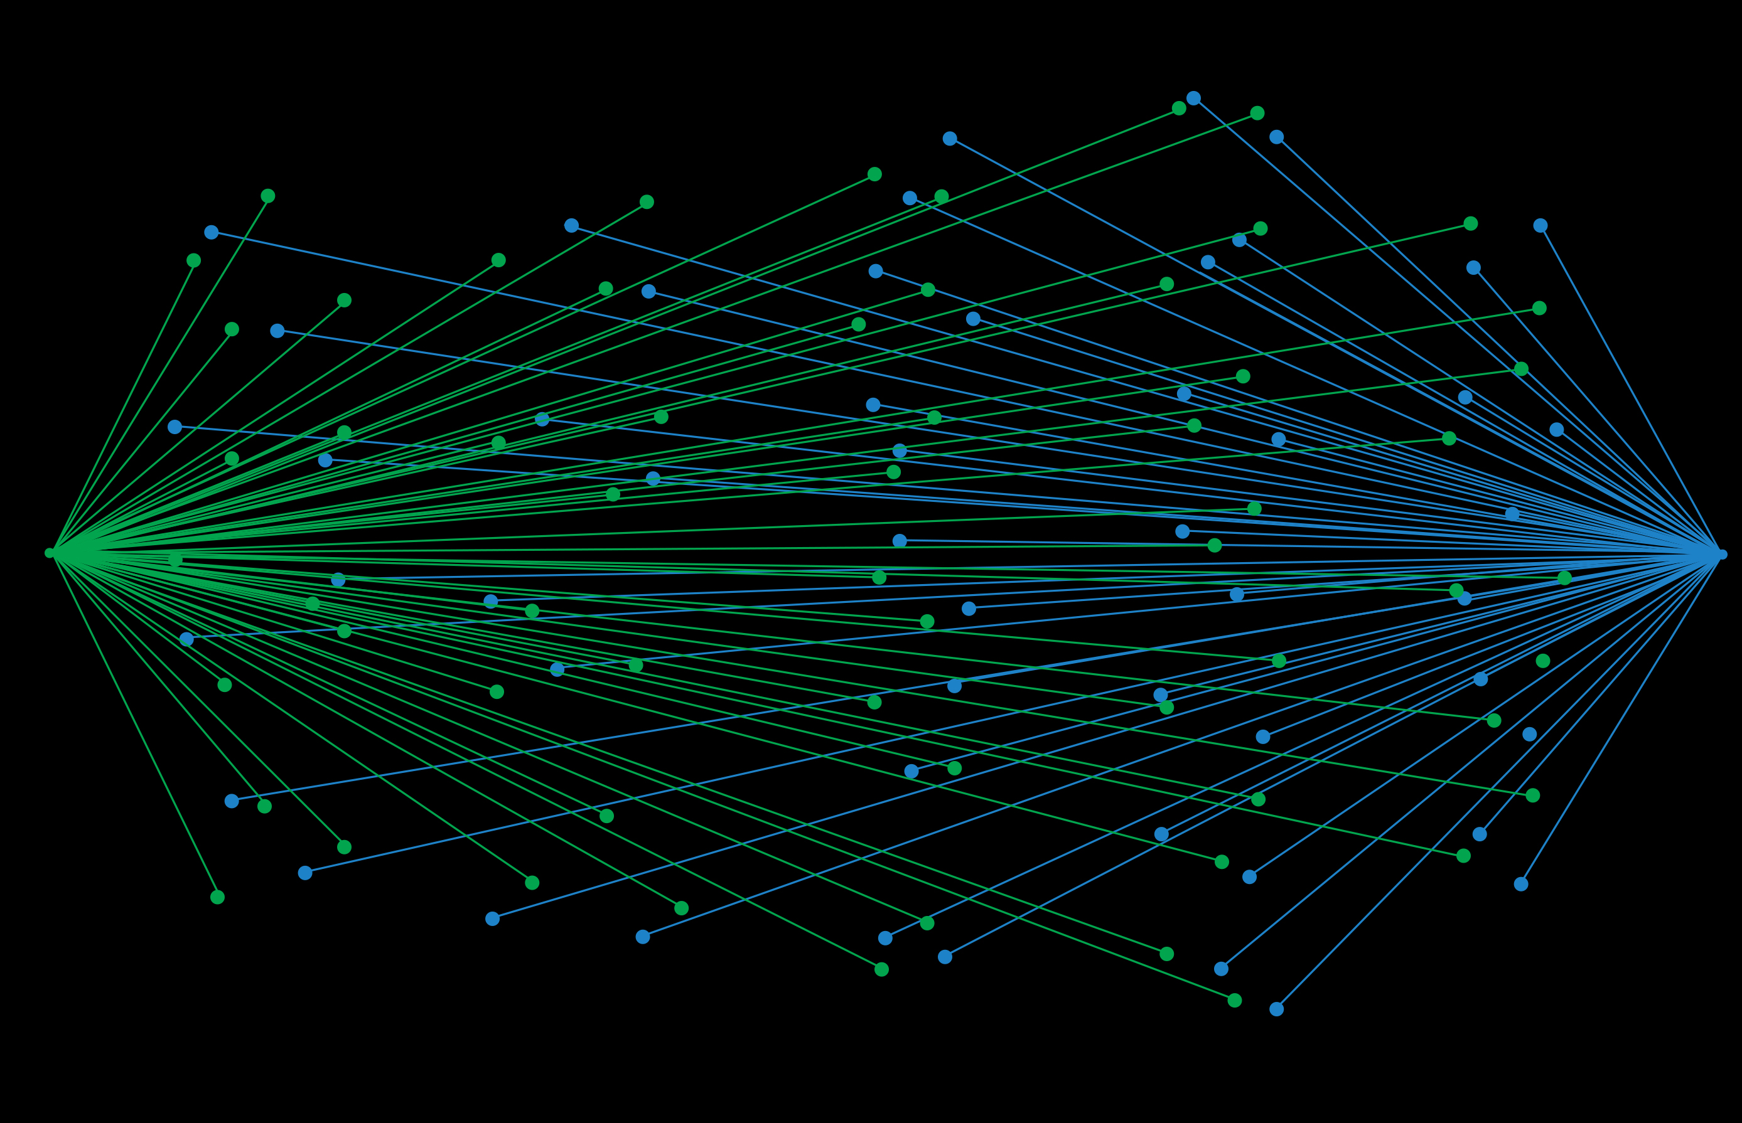
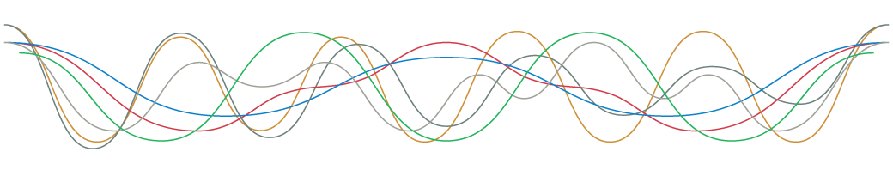
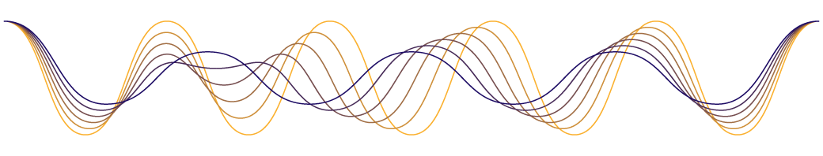
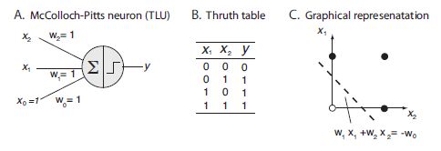
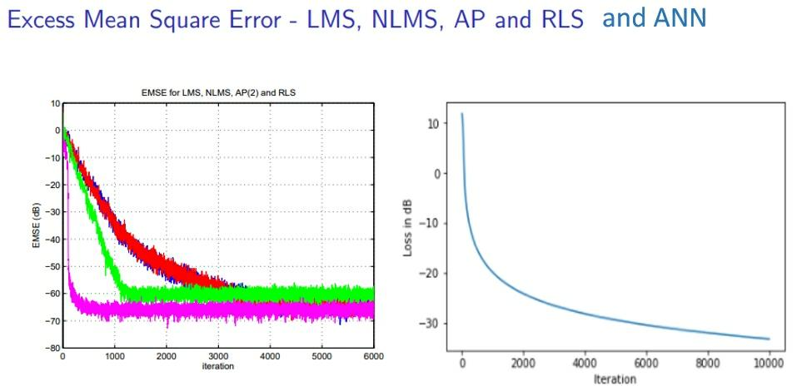



N-hidden-layer Artificial Neural Network for Nonclassical Adaptive Filtering
f
Fig. Representation of a discrete-time system, i.e., a transformation that maps an input sequence x [n] into a unique output sequence y[n].*
*From Discrete-Time Signal Processing, 2e
by Oppenheim, Schafer, and Buck
©1999-2000 Prentice Hall, Inc.
Notes:
Representation of a
discrete-time system, i.e., a
transformation that maps an input
sequence x [n] into a unique output
sequence y[n].
From Discrete-Time Signal Processing, 2e
by Oppenheim, Schafer, and Buck
©1999-2000 Prentice Hall, Inc.

