Slide 1
Department of Computer Science and Design
New Horizon Institute of Technology and Management
University of Mumbai
“NEWS AGGREGATOR SYSTEM”
By
Sr. No. | Name of the Student | IEN No.
1 2 3 4 | Disha Birari Bhakti Patil Soham Bhere Shafe ahemad | 12327014 12217011 12217012 12327003
Guided by:
Dr./Prof.
Mrs.Swati Patil

Slide 2
Outline
1. Introduction
2. Problem Statement and Objectives
2.1 Problem Definition
2.2 Objectives:
2.3 Problem Identification
2.4 Problem Solution
3. Workflow
4. Hardware & Software Requirements
6. Results
7. Conclusion
8. Future Scope
9. References

Slide 3
1. Introduction
The News Aggregator System is a web-based application that collects and displays the latest news from various sources using the GNews API. Built with Django (Python) for the backend and HTML, CSS, and JavaScript for the frontend, it allows users to view, filter, and search for news articles across multiple categories.
A News Aggregator System is a digital platform that collects, organizes, and presents news from multiple sources in one place. It provides users with real-time updates, categorized news, and personalized content based on their preferences. By leveraging automation and AI-driven recommendations, the system enhances the news consumption experience by delivering relevant, credible, and diverse perspectives.

Slide 4
2. Problem Statement and Objectives
2.1 Problem Definition :
In today’s fast-paced world, users struggle to stay updated with the latest news from various sources. Visiting multiple news websites can be time-consuming and inefficient. There is a need for a centralized platform that aggregates news from diverse categories and delivers it in real-time.
2.2 Objectives:
Centralized News Access: Aggregate news from multiple sources using the GNews API..
Real-Time Updates: Provide the latest news dynamically
User-Friendly Interface: Ensure easy navigation with HTML, CSS, and JavaScript.

Slide 5
Problem Identificaion and Solution
2.3 Problem Identification :
In today’s digital age, staying informed requires accessing news from multiple sources, which can be time-consuming and inefficient. Users often face challenges due to the absence of a centralized platform that aggregates real-time news across various categories.
2.4 Problem Solution:
The News Aggregator System addresses these challenges by providing a centralized platform to collect and display real-time news from multiple sources using the GNews API. This system automatically fetches the latest articles across various categories, ensuring users have access to up-to-date information in one place

Slide 6

Hardware Requirements
Windows Requirements
  RAM: 4 GB
  CPU: Intel Pentium
  Web Browser: chrome, firefox, etc.
  OS: Windows 8
Android Requirements
  RAM: 4 GB
  processor: Snapdragon 425
  Network: Internet Connection 4g/5g.
  OS: Android 10
(“NEWS AGGREGATOR SYSTEM”)

Slide 7
Software Requirements
1.Integrated Development Environment (IDE): Visual Studio Code (VS Code) Version: 1.83.1.
2.Backend: i) Python 3.13.2 ii) Django framework 5.1.7
3.API Integration: GNews API (for fetching real-time news data)
4.Markup Language: Hypertext Markup Language (HTML5) Version: 4.01.
5.Styling: Cascading Style Sheets (CSS) Version W3.CSS.
6.Scripting language: JavaScript (JS) Version: ES2024.
(“NEWS AGGREGATOR SYSTEM”)

Slide 8
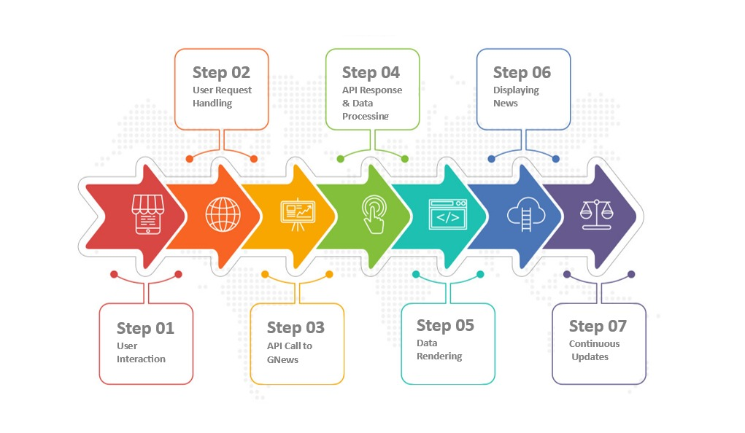
Workflow

Slide 9
Implementation Plan
1: Project Setup (Week 1)
Environment Setup
  Install Python (latest version).
  Set up a virtual environment.
  Install Django framework.
Project Initialization
Create a Django project (news_aggregator).
  Create a Django app (news).
  Configure settings.py (templates, static files, installed apps).
2: API Integration (Week 2)
GNews API Setup
  Register for the GNews API and get the API key.
  Configure environment variables to store the API key securely.
Fetch and Display News
  Use Python’s requests module to fetch news from the GNews API.
  Create a function in views.py to call the API and parse the response.
  Display news articles dynamically on the homepage

Slide 10
Implementation Plan
3: Core Features Development (Week 3–4)
News Categorization
  Add filters to display news by categories (e.g., Sports, Technology, Business).
  Update API calls to fetch category-specific news.
Search Functionality
  Implement a search bar to find articles by keywords.
  Modify the API query to include user search input.
Pagination
  Implement pagination to handle large datasets and improve performance.
4: User Interface (Week 5)
Frontend Design
  Create a responsive layout using HTML, CSS, and Bootstrap.
  Ensure smooth navigation between categories and search results.
Enhance User Experience
  Implement JavaScript for dynamic updates without page reloads.
  Use loading spinners while fetching news.

Slide 11
Implementation Plan
5: System Optimization (Week 6)
Caching
  Implement caching using Django’s cache framework to store API responses.
Error Handling
Handle API errors (e.g., failed requests, rate limits).
  Display meaningful error messages to users
6: Testing and Deployment (Week 7–8)
Testing
  Perform unit testing (Django test framework) for API calls and views.
  Test the search, category filters, and pagination.
Deployment
  Prepare for deployment using Gunicorn and NGINX.
  Deploy on Heroku, AWS, or PythonAnywhere.

Slide 12
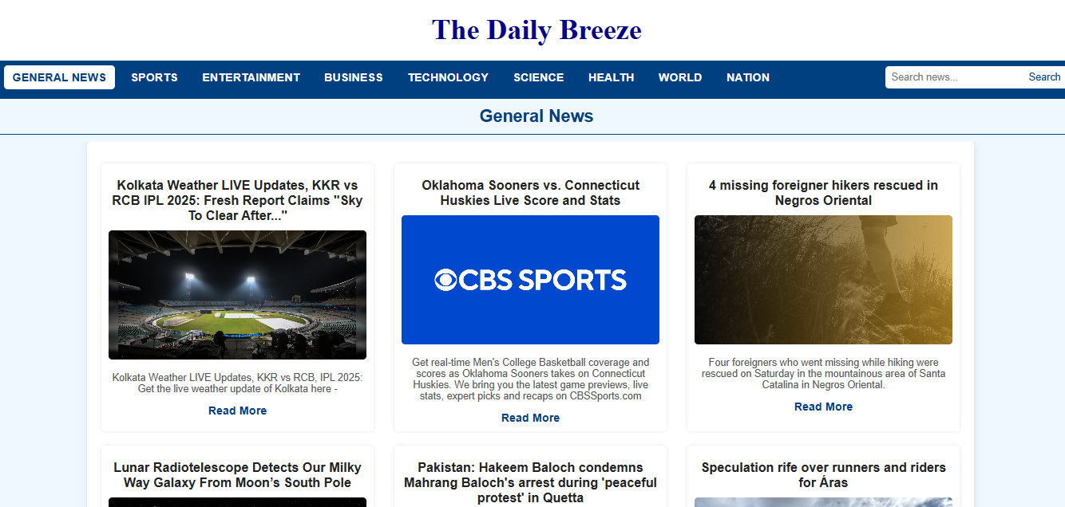
Result / Output
(“NEWS AGGREGATOR SYSTEM”)

Slide 13
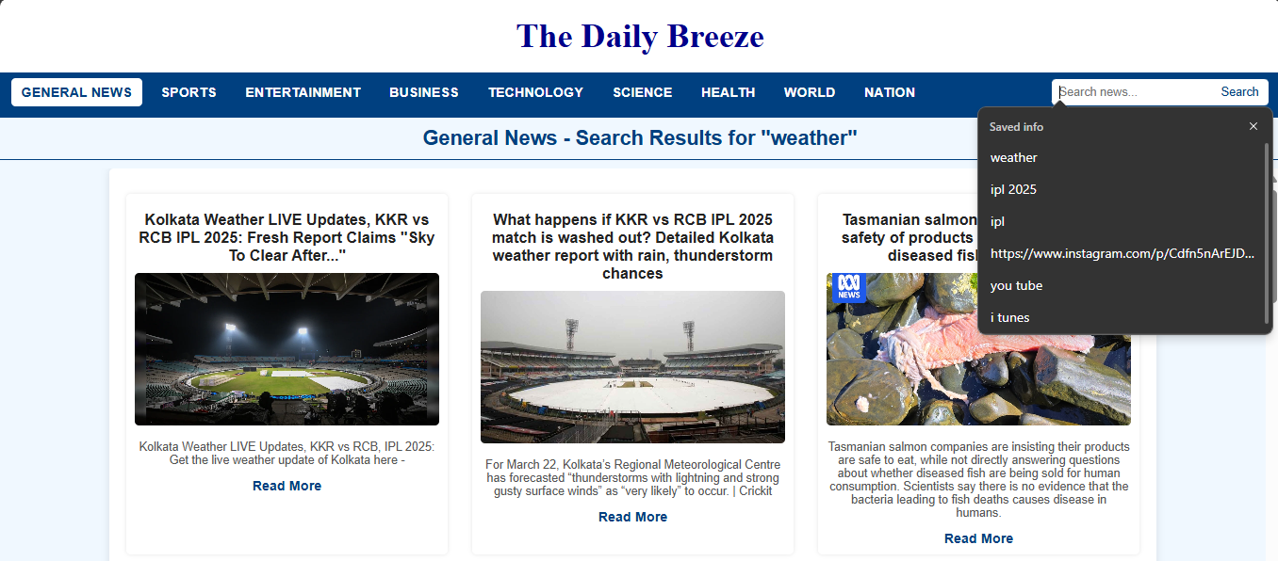
Result / Output
(“NEWS AGGREGATOR SYSTEM”)

Slide 14
Future Scope
User Authentication & Personalization:
News Recommendations:
Multi-Language Support:
Voice Search and Text-to-Speech:
Live News Updates & Streaming:
Offline Access:
Collaborations with Journalists & Publications:
Advanced Search & Filters:
Mobile App Integration:
Monetization Opportunities:.

Slide 15
Conclusion
The News Aggregator System is an efficient and user-friendly platform that centralizes news from multiple sources using the GNews API, providing real-time updates across various categories. Built with Django (Python) for the backend and HTML, CSS, and JavaScript for the frontend, the system delivers a seamless and responsive user experience.
This project addresses the challenges of fragmented news consumption by offering features like category filtering, keyword search, and dynamic content delivery. Users can easily access and navigate the latest information in one place, saving time and enhancing their browsing experience.

Slide 16
References
"News Aggregator Web Application Using Django -July 2025. chrome-extension://kdpelmjpfafjppnhbloffcjpeomlnpah/https://ijcrt.org/papers/IJCRT2107231.pdf
"Build a News Aggregator Like Google News" by Pratik Dhakal. Inspiring Lab, December 2, 2024. https://inspiringlab.com.np/build-a-news-aggregator-like-google-news/?utm_source=chatgpt.com
"How I Designed a News Aggregator Web Application Using Django" by Jonathan Okah. Finxter, May 15, 2023 https://blog.finxter.com/how-i-designed-a-news-aggregator-web-application-using-django/
"Building News Aggregator Web App with Django Using Python Web Scraping" by Rajan Kumar. HackersFriend, January 12, 2020 https://inspiringlab.com.np/build-a-news-aggregator-like-google-news/?utm_source=chatgpt.com
"Build a News App Using Django" by Max. DEV Community, August 15, 2020. https://dev.to/max236/news-app-in-django-2dcd

Slide 17
THANK YOU!

