Slide 1
Department of Computer Science and Design
New Horizon Institute of Technology and Management
University of Mumbai
(“Virtual Paint”)
By
Sr. No. | Name of the Student | IEN No.
1 2 3 4 | Rohan P Patil Bhakti A Patil Soham S Bhere Vaishali B Darwande | 12217042 12217011 12217012 12317051
Guided by:
Dr./Prof.
Mrs.Priyadarshini B.

Slide 2
Outline
1. Introduction
2. Problem Statement and Objectives
2.1 Problem Definition
2.2 Objectives:
2.3 Problem Identification
2.4 Problem Solution
3. Workflow
4. Hardware & Software Requirements
6. Results
7. Conclusion
8. Future Scope
9. References

Slide 3
1. Introduction
Creating a virtual paint application in Python is an exciting project that uses computer vision, specifically the OpenCV library, to allow users to draw on a virtual canvas . The core idea of this project is to create a system where a webcam captures video feed, tracks a specific object or marker (such as a colored object or hand), and uses the tracked movement to simulate drawing on a virtual canvas
1. Key Libraries Needed
i.OpenCV
ii.NumPy
iii.Hand Tracking Module
2. Features
i. Webcam Capture
ii. Hand Gesture Control
iii. Eraser Tool

Slide 4
2. Problem Statement and Objectives
2.1 Problem Definition :
Virtual Paint refers to the use of digital tools and software to create to artworks on a computer or mobile devices it allows user to simulate the experience of traditional painting by providing a wide range of digital brushes to draw the various shapes.
2.2 Objectives:
To create a virtual canvas for purpose of sketching.
To do the Morphological operations.
To create an interface between user and the system.

Slide 5
Problem Statement and Objectives
2.3 Problem Identification :
In normal paint application everyone is not comfortable to draw anything with the help of mouse. This application is Very friendly with Not only Kids but also all age peoples.
2.4 Problem Solution:
This system can use smartphone camera or images from library and overlay the chosen images by the user needs.

Slide 6

Hardware Requirements
Windows Requirements
  RAM: 4 GB
  CPU: Intel Pentium
  Web Browser: chrome, firefox, etc.
  OS: Windows 8
Android Requirements
  RAM: 4 GB
  processor: Snapdragon 425
  Network: Internet Connection 4g/5g.
  OS: Android 10
23 October 2024
(“Virtual Paint”)

Slide 7
Software Requirements
1.Integrated Development Environment (IDE): Visual Studio Code (VS Code) Version: 1.83.1.
2.Markup Language: Hypertext Markup Language (HTML5) Version: 4.01.
3.Scripting language: JavaScript (JS) Version: ES2024.
4.Styling: Cascading Style Sheets (CSS) Version W3.CSS.
5. Logic : Python 3.11.4
23 October 2024
(“Virtual Paint”)

Slide 8
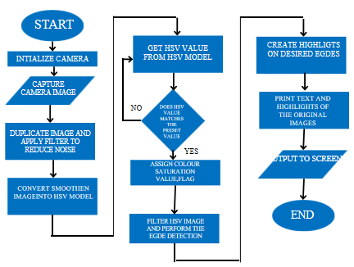
Workflow

Slide 9
Implementation
Software Required :
Code Editor -Visual Studio Code
TechStack Used:-
[a] HTML
[b]CSS
[c]python for logic
23 October 2024
(“Virtual Paint”)

Slide 10
Implementation
Importing required libraries (Numpy, Opencv)
Creating a window, that provides various options.(This will create a window that displays the different color options to draw and also it creates the buttons using cv2.putText.)
Capturing a video using a webcam and grabbing frames. (cam=cv2.VideoCapture(0) is used to capture video using webcam we will run a loop to grab the frames from the webcam and to display the dynamic results)
4. Using different morphing techniques
5. Displaying output.
23 October 2024
(“Virtual Paint”)

Slide 11
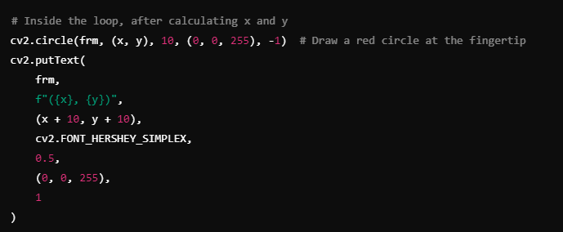
Implementation
Co-orinates
For changing color of fount –
1.(0, 255, 0) # Green in BGR
2. (255, 0, 0) # Blue in BGR
3. (255, 255, 255) # White in BGR
23 October 2024
(“Virtual Paint”)

Slide 12
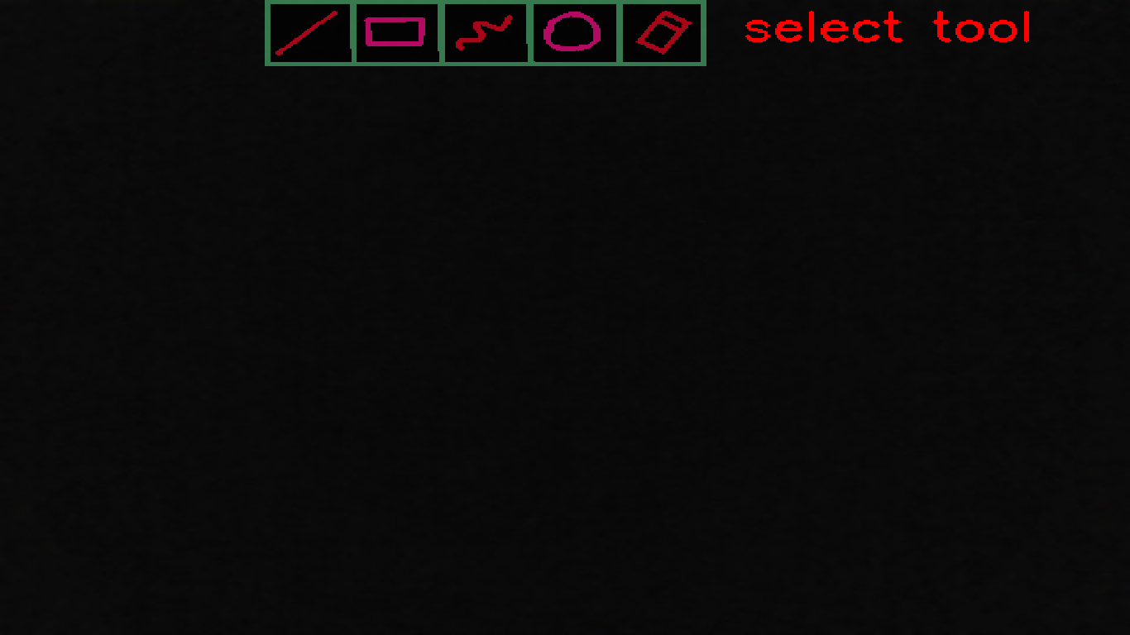
Result / Output
23 October 2024
(“Virtual Paint”)

Slide 13
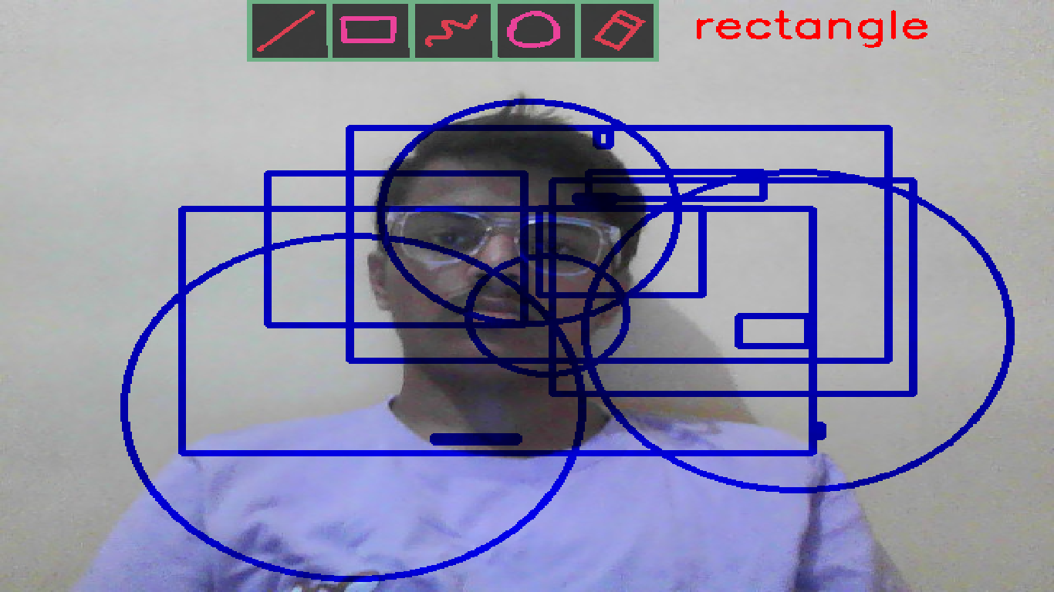
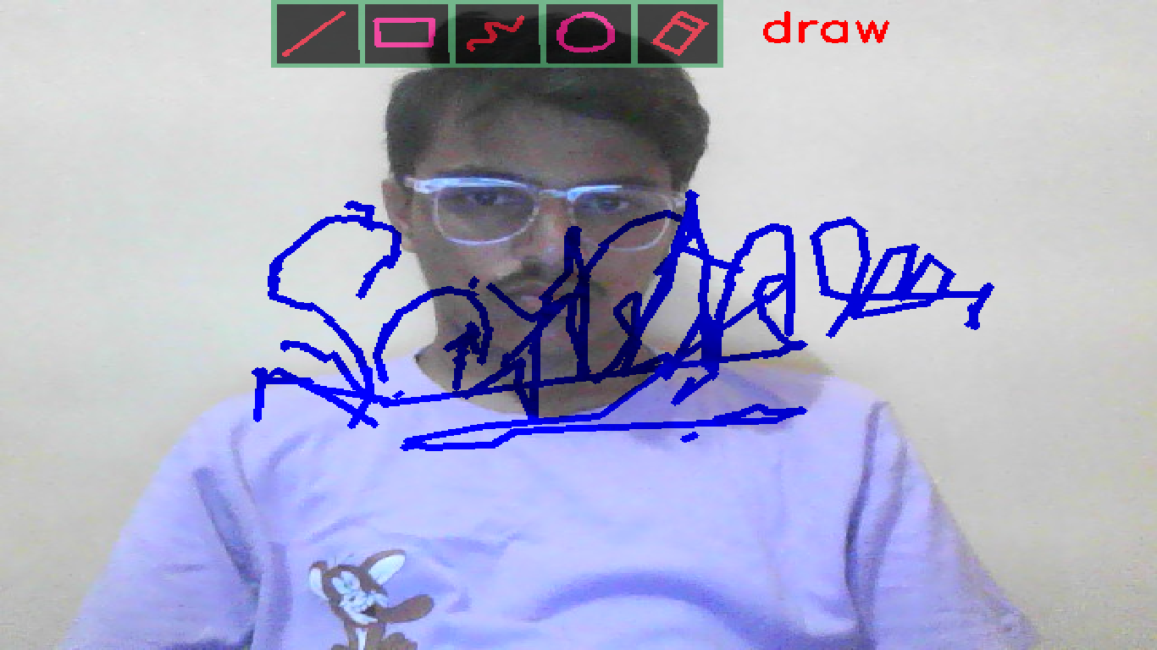
Result / Output
23 October 2024
(“Virtual Paint”)

Slide 14
Future Scope
In Future It Will Help For Time-Saving For Your Workforce
Educational Uses
Animation Capabilities
Advanced Drawing Tools
Integration with AI and Computer Vision
Gamification

Slide 15
Conclusion
The Virtual Paint project, developed using Python, serves as an engaging platform for digital drawing and creativity. Its simplicity makes it accessible to users of all skill levels, while its potential for future enhancements—such as advanced drawing tools, AI integration, and collaboration features—ensures its relevance in both educational and professional contexts. By incorporating technologies like OpenCV for gesture recognition and network programming for real-time collaboration, the project could evolve into a versatile tool for artists, educators, and hobbyists. Overall, this project lays a solid foundation for creative exploration with extensive possibilities for growth and innovation.

Slide 16
References
[1]. David lee,Juon hub Lee,” virtualization of pen head for digital drawing”, Published: 07 October 2022
[2]. Nanditha G. Bharadwaj; Nanditha Pa, “Smartolight-pen and User Interface Screen enabled with URL detection” 2022 IEEE North Karnataka subsection flagship international conference (NK Con)
[3].Hanbit Park Minsoon Hahn , “Digital painting tool with shaking interaction”, INSPEC Date Added to IEEE Xplore: 03 August 2021.
[4]. Bruce Wands,,” Art of The Digital Age”, Thames and Hudson University of Brighton Publication status Published - 2021
[5]. D. Sobczyk, V. Boyer and J-J. Bourdin, “The Virtual Painting Paintbox”,Université Paris 8,2020

Slide 17
THANK YOU!

