Slide 1
Super Store Sales Analysis
Power BI Dashboard Presentation

Slide 2
Problem Statement & Objective
Problem:
• Lack of clarity on sales, orders, and profitability across segments and states.
• No unified dashboard for tracking product, region, and ship mode performance.
Objective:
• Build an interactive Power BI dashboard that provides KPIs, trends, and insights.
• Enable management to take data-driven decisions.

Slide 3
Data Overview
Data Sources:
• Super Store Excel dataset
Dataset Structure:
• Rows: ~10,000
• Columns: ~20
• Time Period: 2019–2021
Key Fields:
• Sales, Profit, Orders, Ship Mode, Segment, Category, State

Slide 4
Data Preparation (Power Query ETL)
ETL Steps:
• Removed duplicates and corrected data types
• Cleaned text fields (State, Category, Segment)
• Created calculated columns: Profit %, Ship Delay Category
• Merged lookup tables

Slide 5
Data Model
Fact Table:
• Orders (Sales, Profit, Quantity)
Dimension Tables:
• Customer
• Product
• Category/Sub-Category
• State/Region
• Date
Relationships support slicing by segment, region, category.

Slide 6
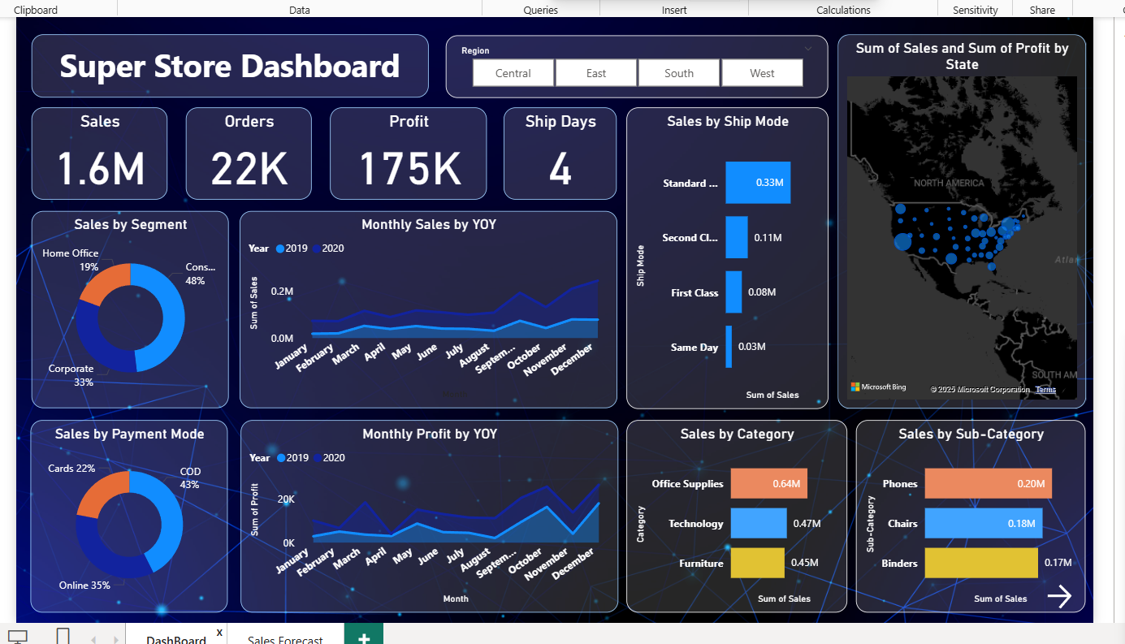
Super Store Dashboard

Slide 7
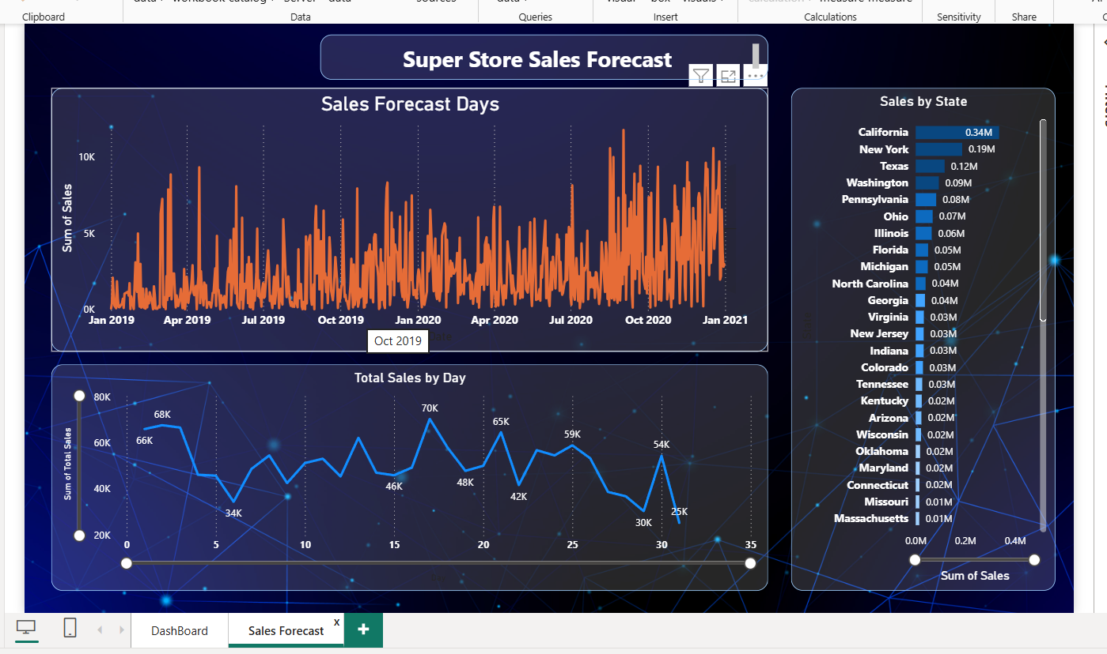
Super Store Sales Forecast

Slide 8
Key Insights
• Total Sales: 1.6M; Orders: 22K; Profit: 175K
• Consumer segment is the highest revenue contributor
• Office Supplies is the top-performing category (0.64M)
• Standard Shipping generates the largest sales volume
• California, New York, and Texas lead in sales
• Profitability fluctuates seasonally with spikes in Nov–Dec

Slide 9
Business Recommendations
• Increase focus on high-profit segments like Technology
• Offer faster delivery options in high-order states
• Improve profitability for low-margin categories
• Regional discounting strategies for weaker-performing states
• Use sales forecasting to plan inventory and staffing

Slide 10
Future Enhancements
• Integrate real-time data feeds
• Add predictive models for profit optimization
• Apply customer segmentation using RFM analysis
• Add mobile-friendly dashboard view

