Slide 1


SMART INDIA HACKATHON 2024
TITLE PAGE
Problem Statement ID – 1762
Problem Statement Title- Building a National Web Community for Indian Philatelists
Theme- Transportation & Logistics
PS Category- Software
Team ID- 35497
Team Name- Codingerz

Slide 2


IndiPostCollect
Codingerz
Proposed Solution:
User Profile
Create and link accounts on the PDA platform.
Track collections and transactions via linked accounts.
Use strong passwords and enable two-factor authentication.
Philatelic Content and Event Calendar
Monitor upcoming events like exhibitions and webinars.
Stay updated with the latest philatelic articles and guides.
Choose delivery method:
email or SMS.
Auction
Participate in auctions for rare and valuable stamps.
Compete in bidding to secure unique items.
Verify items with expert certification for authenticity.
Community Forums
Engage in discussions on community forums.
Share ideas and experiences
with fellow philatelists.
Connect with collectors across the country.
Marketplace
Engage in trading with fellow collectors.
Browse listings to buy and
sell stamps.
Use search tools to find specific items and deals.
Explore marketplace features for enhanced transactions.
Guidance for New Collectors
Get started with basic philatelic knowledge and tips.
Learn about essential collecting practices and terminology.
Access resources for building and maintaining a collection.

Slide 3











TECHNICAL APPROACH
Codingerz
Technologies :

Slide 4
FEASIBILITY AND VIABILITY
Codingerz
Operational Feasibility
Financial Feasibility
Possible Risks and Challenges
How to Overcome These Challenges
User-Friendly Interface: Seamless navigation for orders and account management.
Collaboration: Coordination with postal circles for timely material updates.
Investment: Requires funding for development; revenue from sales, memberships, and services.
Cost Efficiency: Leveraging postal infrastructure and digital payments minimizes costs.
Data Sync: Real-time updates from postal circles may be difficult.
User Adoption: Convincing less tech- savvy users to switch online.
Security: Ensuring safe transactions and data protection.
Integration: Use APIs for real-time data sync.
Education: Provide tutorials and incentives for user adoption.
Security: Implement encryption, secure payments, and regular audits.

Slide 5

IMPACT AND BENEFITS
Codingerz
Impacts on Culture and Heritage –
Digital Archive Creation: Every scanned kolam becomes part of a permanent digital collection, preserving patterns that might otherwise be lost.
Bridges the gap between elderly practitioners and younger generations through technology they understand
Captures and categorizes regional variations (Tamil Nadu, Karnataka, Andhra Pradesh styles) before they disappear
Accuracy Validation: Ensures traditional patterns are preserved correctly without modern misinterpretations
Benefits of digitizing a traditional artform -
Cultural Pride: Young people develop appreciation for their heritage through modern interfaces
Global Reach: Makes kolam art accessible to Tamil diaspora worldwide, maintaining cultural connections
Provides researchers with large-scale pattern analysis data for cultural studies
Platform allows culture to evolve while maintaining authenticity
Traditionally female-dominated art form gets formally recognized and preserved

Slide 6
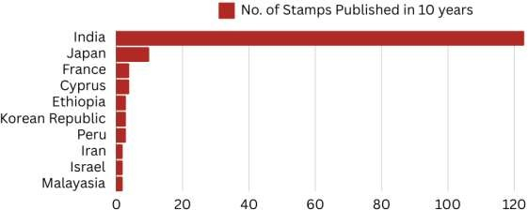
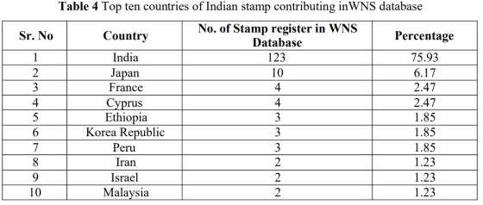
RESEARCH AND REFERENCES
Codingerz
RESEARCH
Our research on philately, analyzing the WNS database (2002-2016), shows that 2007 had the highest stamp registrations at 16.8%, followed by 2003 (14.5%) and 2005 (11.0%).
India led globally with 123 stamps, with Japan (10), France, and Cyprus (4 each) also contributing. The data Highlights philately's international reach and the need for a centralized, web-based platform to connect collectors, provide resources, and facilitate trading and a comprehensive, user-friendly solution for philatelists.
REFERENCES
India Post, "Stamps," India Post. [Online]. Available: https://www.indiapost.gov.in/Philately/Pages/Content/Stamps.aspx
Kolkata GPO

