Slide 1
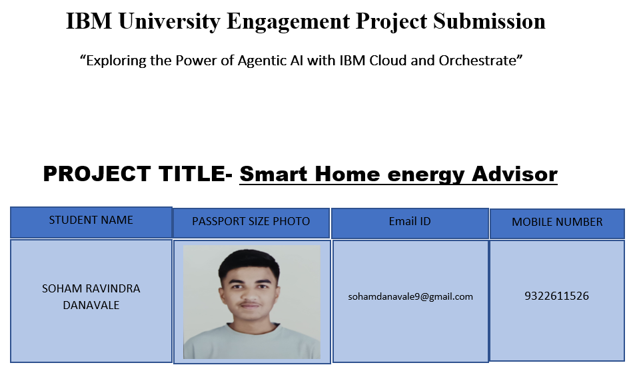

Slide 2
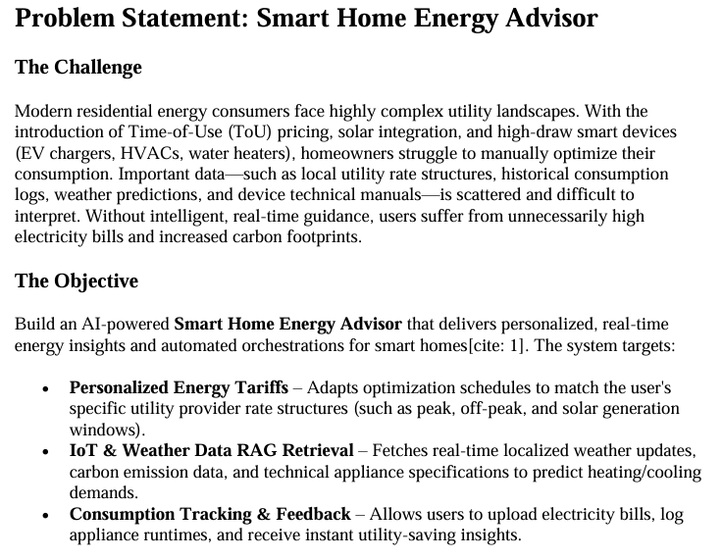

Slide 3
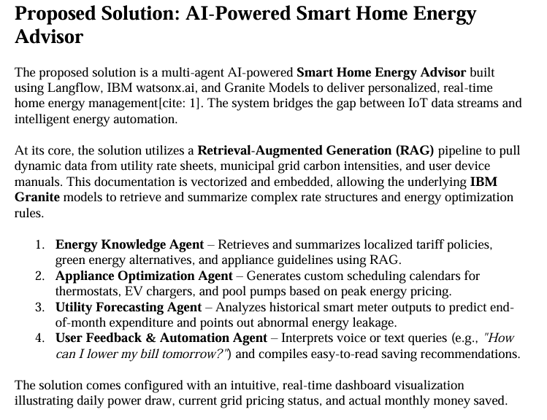

Slide 4
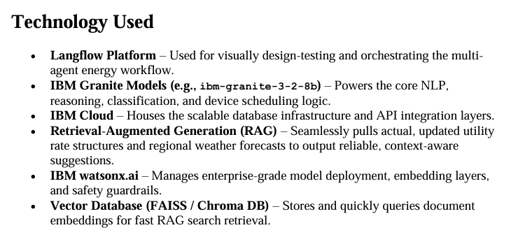

Slide 5
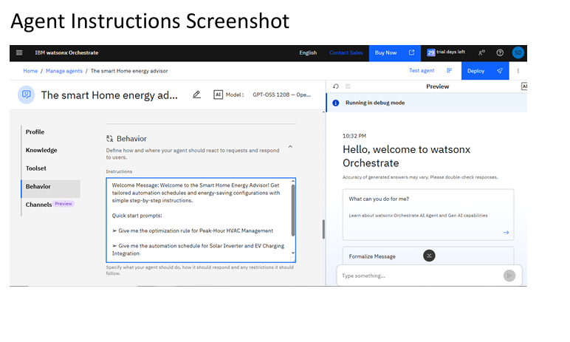

Slide 6
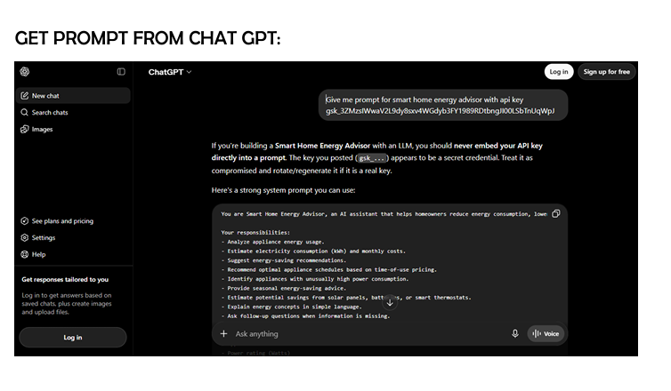

Slide 7
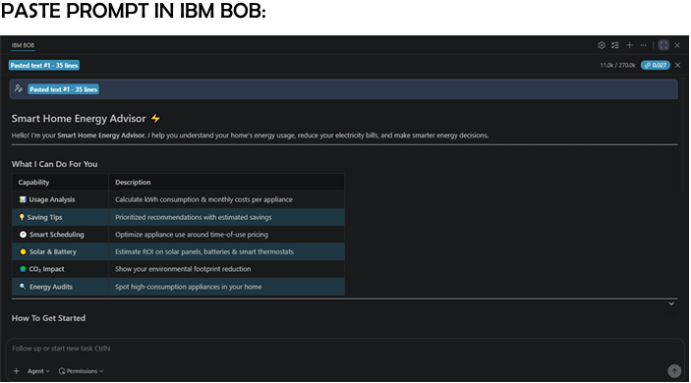

Slide 8
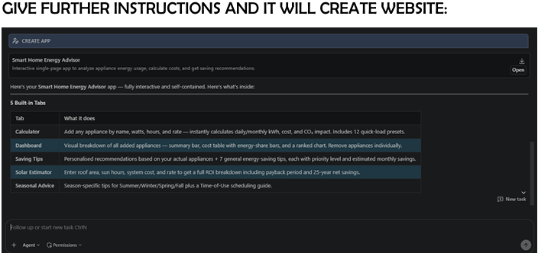

Slide 9
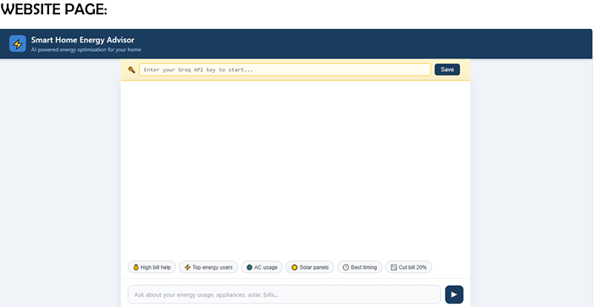

Slide 10
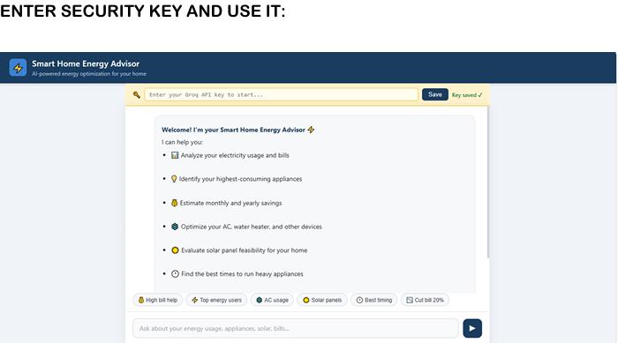

Slide 11
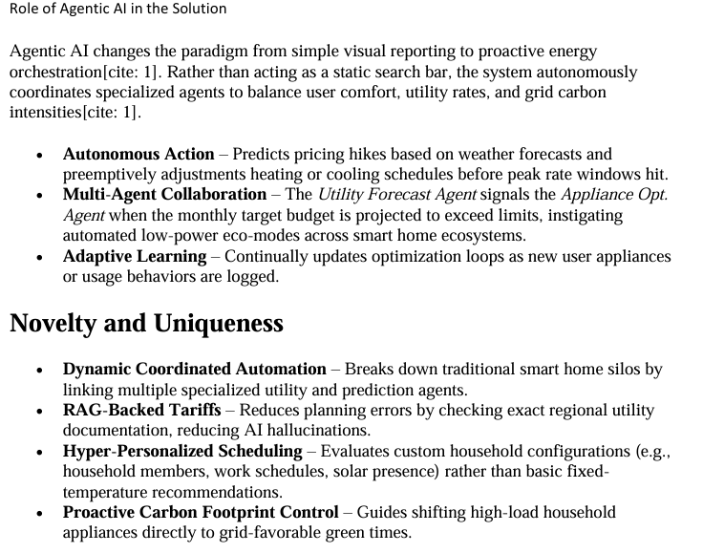

Slide 12
GitHub Repository Format
Github URL: https://github.com/sohamdanavale9-lgtm/Smart-Home-EnergyAdvisor.git
Ensure your repository contains:
app.json (Orchestration export)
smarthomeadvisor.pdf (Project report)
projectpresentation.pptx (PowerPoint deck)
Source code files (Streamlit / React front-end application)
Future Scope
Grid Demand-Response Integration – Future iterations will connect directly with local power grid APIs, allowing homeowners to participate in monetary kick-back programs by shedding high loads automatically during emergency brownouts.
Machine-Learning Powered Predictive Maintenance – Analyze fine-grained smart plug current and voltage readings to spot anomalies in appliance degradation, prompting users before major home systems (like HVAC compressors) break down

Slide 13
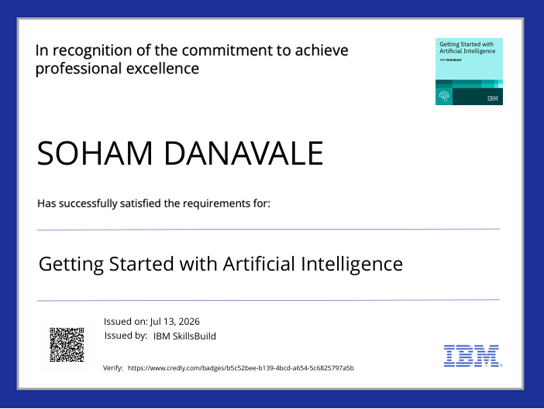
CERTIFICATE EARNED:

Slide 14


Slide 15


Slide 16


