Slide 1
DevOps-Driven Dynamic Tourism Website with Real-Time Weather Integration
Div: |  | D
Sl. No. | Name |  | SRN.
1. | Soham Mali |  | 02FE22BCI025
2. | Pradeep Awubaigol |  | 02FE22BCI030
3. | Aditya Koli |  | 02FE22BCI004
4. | Afifa Shaikh |  | 02FE22BCI005
24ECSE310
DevOps Course Project: Final Demo
Academic Year: 2025

Slide 2
Agenda
Problem Statement
Literature Survey
Objectives
Methodology
Model Flow
Snapshots
UI Snapshots
Acknowledgement

Slide 3
Problem Statement
In the tourism sector, users require real-time weather updates for better planning. However, few websites fail to offer dynamically updated information causing delays in updates.
Problem Statement: This project solves this problem by building a dynamic tourism website that integrates live weather updates and uses DevOps tools for automated deployment and scaling.

Slide 4
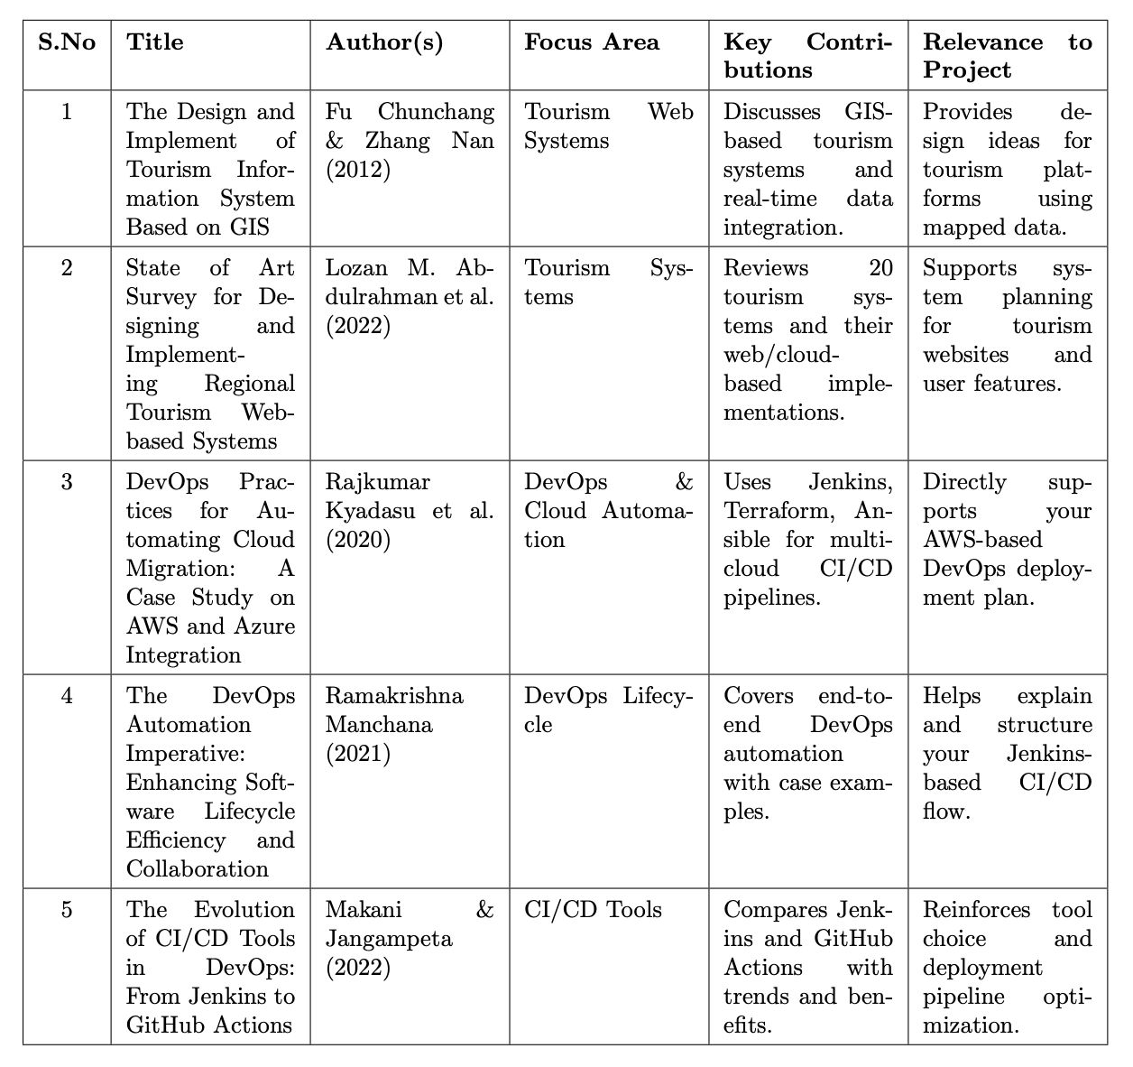
Literature Survey

Slide 5
Objectives
To develop a dynamic tourism website with real time Weather integration.
To automate deployment using AWS EC2 and S3.
To implement CI/CD Pipeline using Jenkins and GitHub.
To promote collaborative development via Git Branching strategies.

Slide 6
Methodology Flow
Developed a dynamic, responsive tourism website using React.js.
Integrated OpenWeatherMap API to fetch real-time weather data for user-selected locations.
Used GitHub for collaborative development and version control with branching strategies.
Set up Jenkins on AWS EC2, configured to automatically trigger CI/CD pipeline on every GitHub push.
Jenkins pulls the latest code, builds the React app, and deploys it to an AWS S3 bucket.

Slide 7
Model Flow
Website Development
Weather API Integration
Start
Static File hosting on AWS S3
CI/CD setup with Jenkins
Version Control with GitHub
Deployment on AWS EC2
Testing and Monitoring
Stop

Slide 8
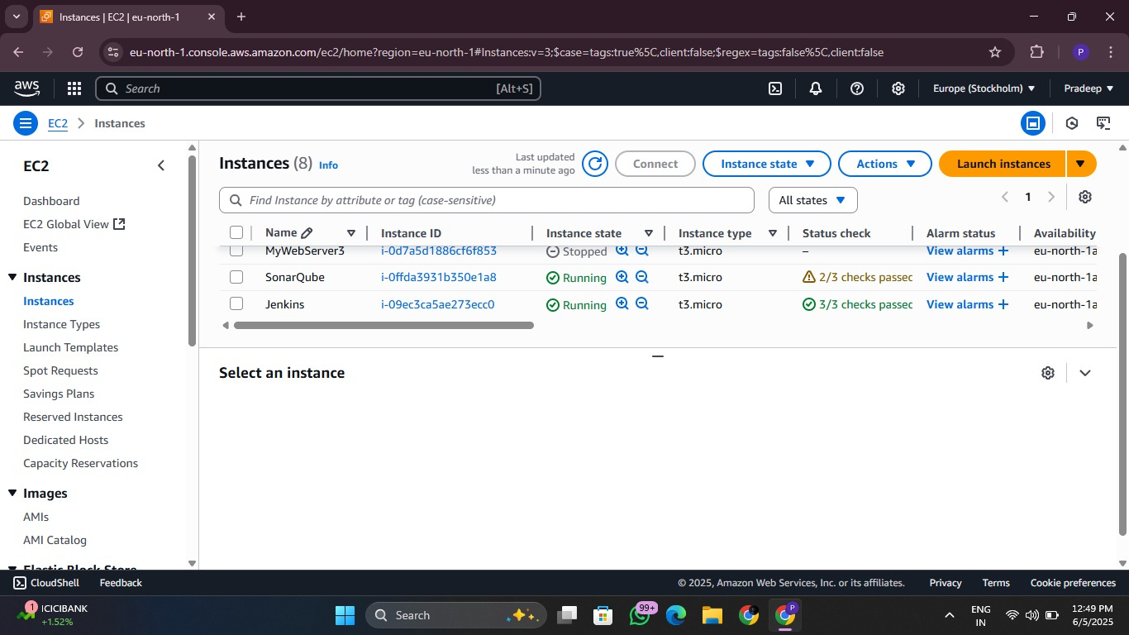
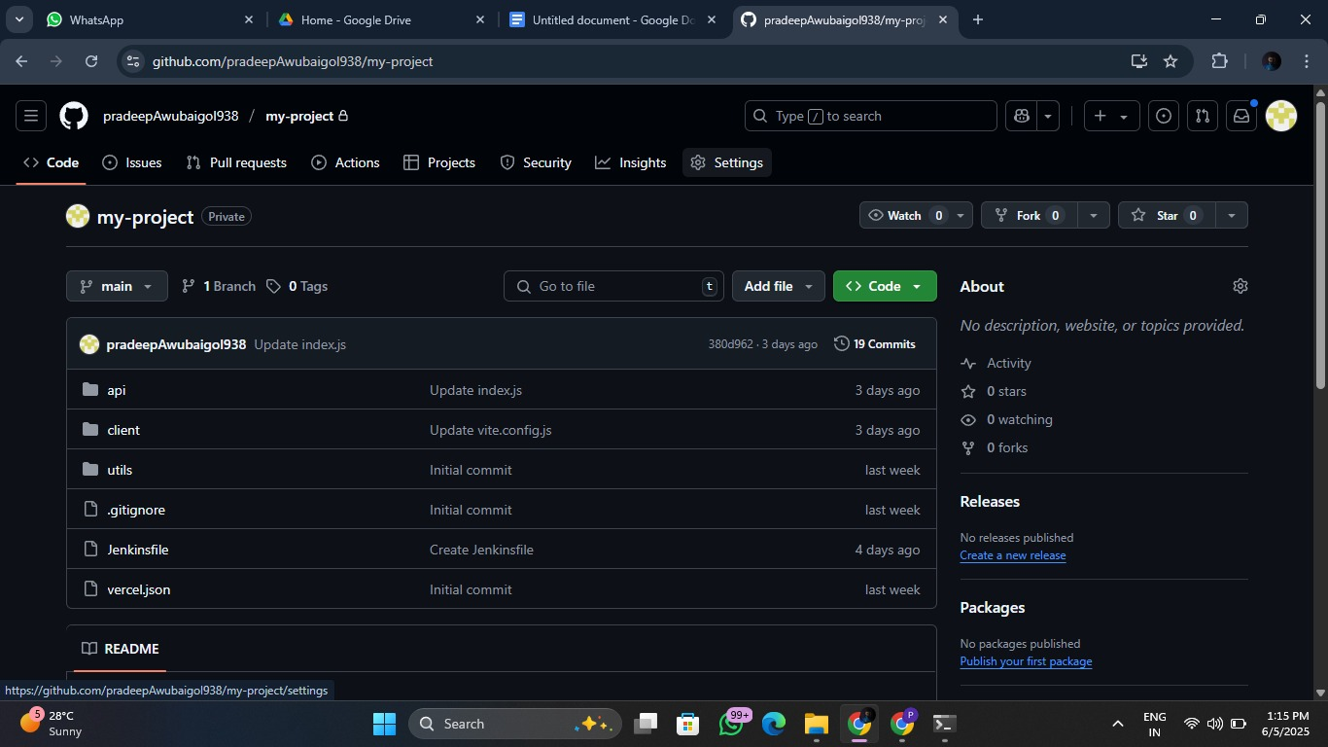
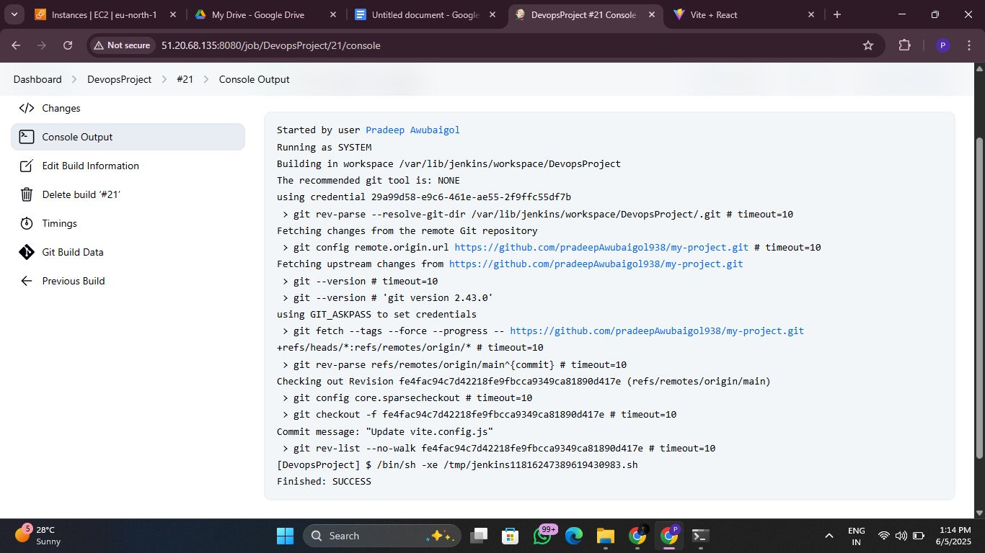
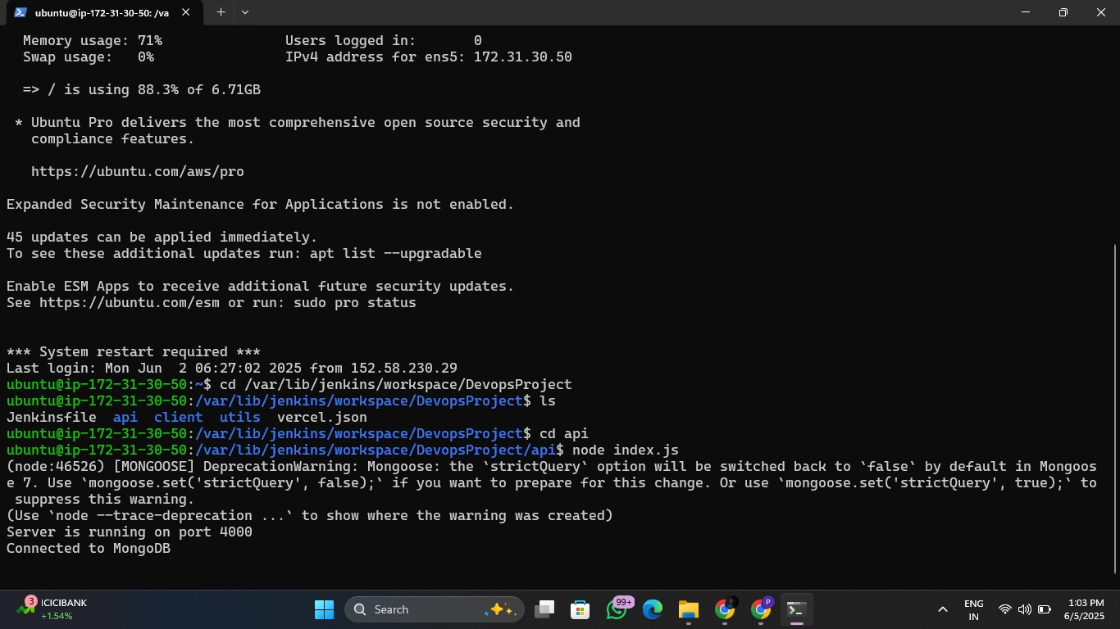
Snapshots

Slide 9
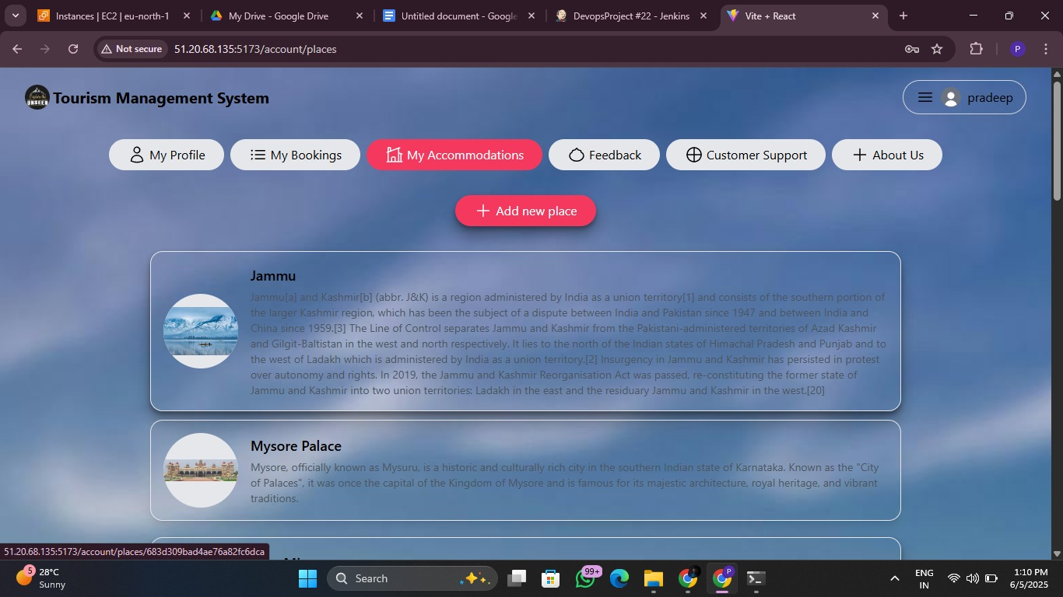
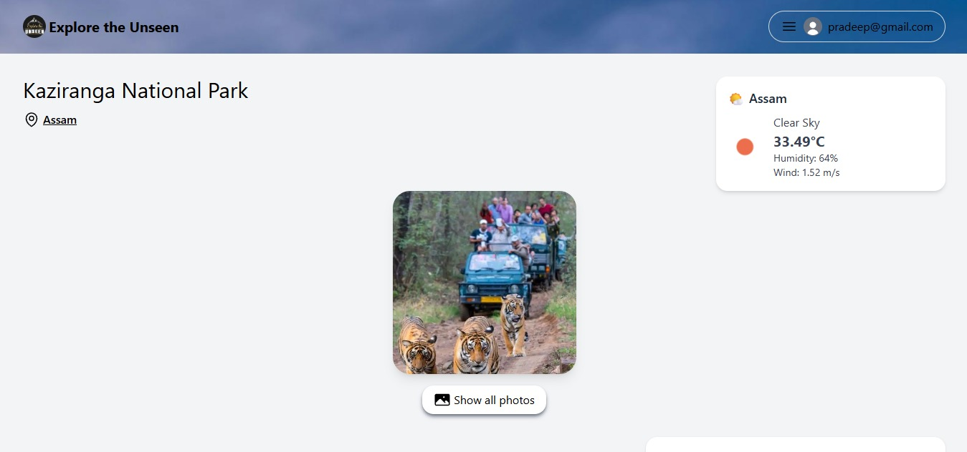
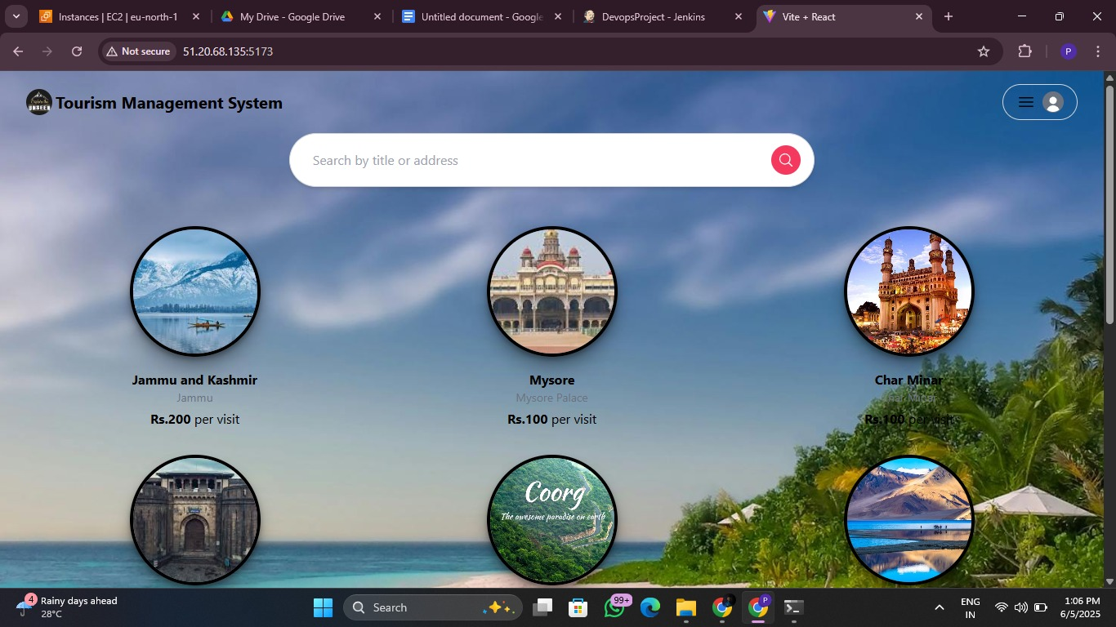
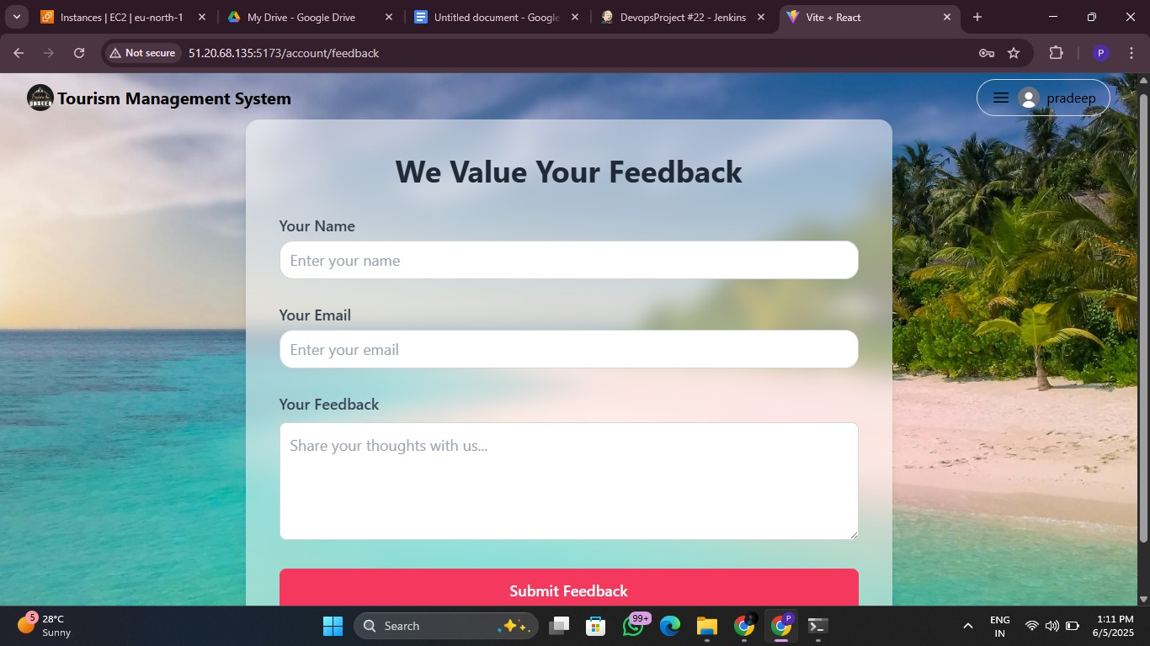
UI Snapshots

Slide 10
Acknowledgements
We would like to thank our guide Dr. Neha Nimbalkar for their invaluable guidance, continuous support, and feedback throughout the development of this project.
THANK YOU!

