Slide 1
Question Paper Scrutiny using NLP and LLMs
Div: |  | D
Sl. No. | Name |  | SRN.
1. | Soham Mali |  | 02FE22BCI025
2. | Pradeep Awubaigol |  | 02FE22BCI030
3. | Aditya Koli |  | 02FE22BCI004
4. | Afifa Shaikh |  | 02FE22BCI005
24ECAC307
NLP & Gen AI Course Project: Final Demo
Academic Year: 2025

Slide 2
Agenda
Problem Statement
Literature Survey
Objectives
Methodology
Model Flow
Snapshots
Evaluation Metrics
Paper Submission
Bibliography
Acknowledgement

Slide 3
Problem Statement
Manual scrutiny of question papers is labor-intensive, subjective, and prone to errors.
Problem Statement: There's a need for an automated system that assigns Bloom’s taxonomy levels, structural integrity, and course outcome coverage in question papers.

Slide 4
Literature Survey
TITLE | OBJECTIVE | YEAR | METHODS | RESULTS | RELEVANCE
Bloom’s Learning Outcomes’ Automatic Classification Using LSTM and Pretrained Word Embeddings | To automate the classification of Course Learning Outcomes (CLOs) and assessment items into Bloom’s taxonomy levels using deep learning techniques. | 2021 | LSTM for text classification | Achieved >80% accuracy on Bloom’s level classification | Core technique for classifying cognitive level of questions
NLP-Based Grammar Checking System for Academic Writing (S. Ch et al.) | To correct grammar errors in academic content | 2022 | Rule-based + transformer grammar correction models (T5/BART) | High success in detecting subject-verb agreement | Useful for grammar validation of extracted questions
Automatic Analysis of Educational Assessment Items Using NLP | To analyze the cognitive levels and linguistic features of exam items. | 2020 | Utilized NLP and machine learning techniques to assess linguistic complexity and cognitive challenge | Successfully identified indicators of question difficulty based on syntactic and semantic patterns. | Informs strategies for evaluating the complexity and difficulty of questions, aiding in Bloom’s taxonomy classification.
Course Outcome-Based Assessment Generator | To generate assessments aligned with specific course outcomes. | 2021 | Employed keyword mapping and semantic similarity measures to align questions with course outcomes. | Enabled semi-automated mapping of questions to course outcomes, enhancing assessment relevance. | Provides a framework for automating the alignment of exam questions with course outcomes, a critical aspect of your project.

Slide 5
Objectives
To extract Questions from PDF Files.
To Classify Questions by their Bloom’s Levels.
To Map Questions with their Course Outcomes (COs) and ensure Structural Integrity.

Slide 6
Methodology
Methodology consists of 6 steps:
Upload Question Paper in PDF format.
Extracting the Text and Segmenting into their Question Structure.
Apply NLP Models:
Fine Tuned DistilBERT for classifying Questions into Bloom’s Levels. This model is Pre-trained on Go-Emotions Dataset.

Slide 7
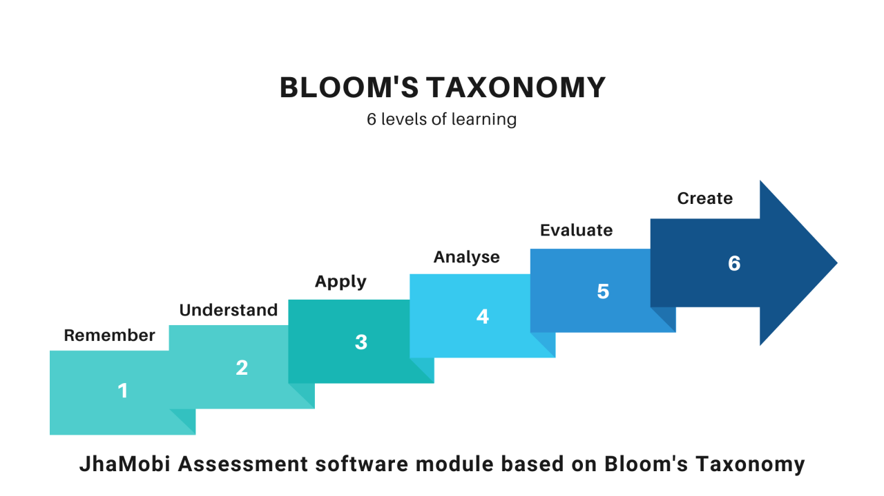
Methodology
Mapping questions to Course Outcomes (COs) using keyword Matching.
Verify Pattern Structure and Generating PDF of Scrutiny Report.

Slide 8
Model Flow
Start
Upload QP
Extract Questions
Map to Course Outcomes
Classify Bloom’s Levels
Generate PDF Report
End

Slide 9
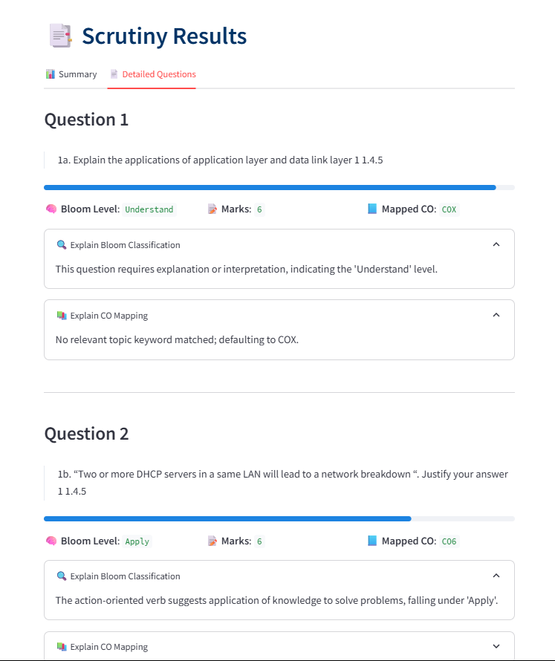
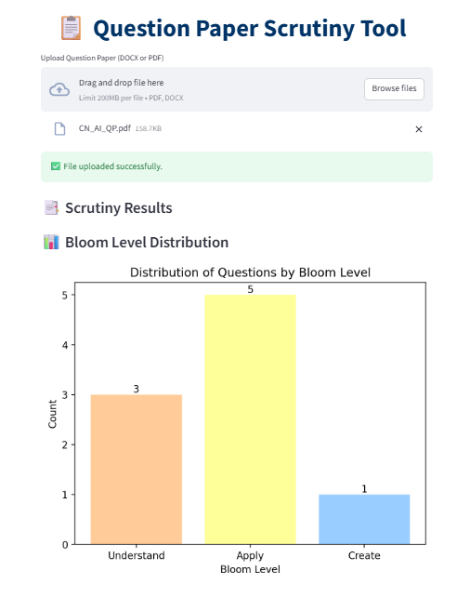
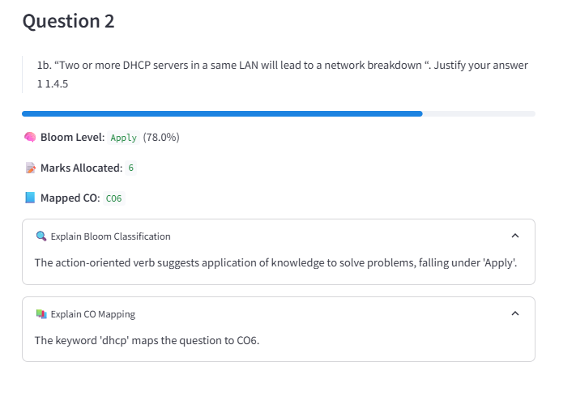
Snapshots

Slide 10
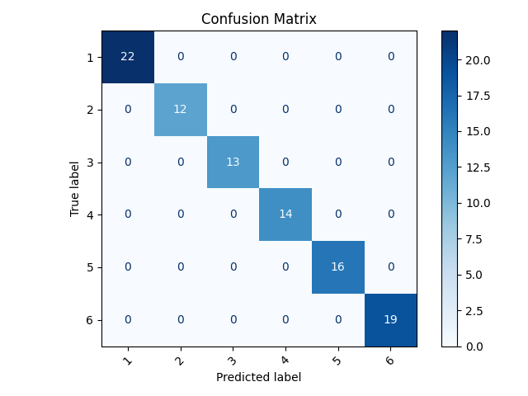
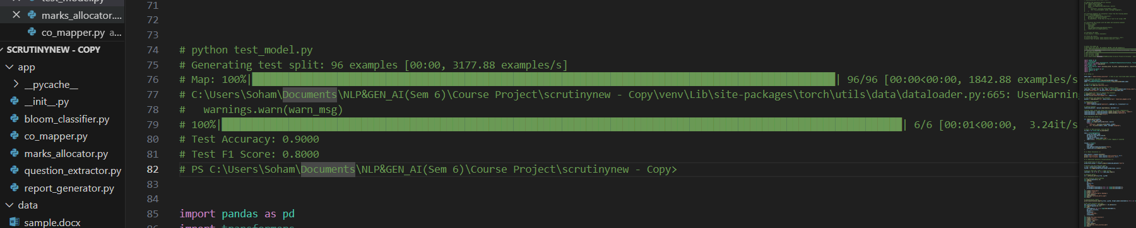
Evaluation Metrics

Slide 11
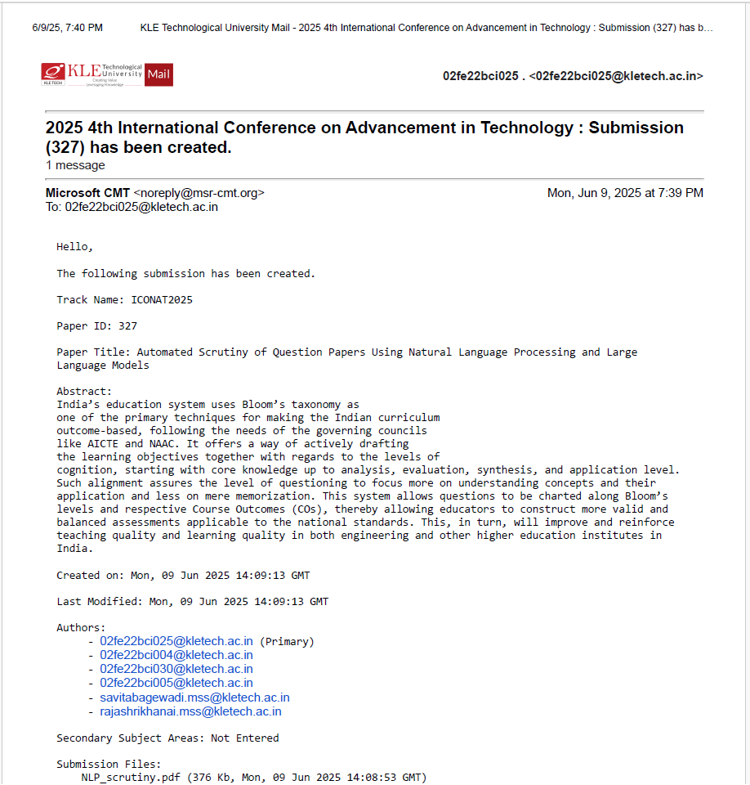
Paper Submission
This Study Paper is submitted to
“4th International Conference on Advancement in Technology”
Pid:327
Acceptance: TBA
Scopus Indexed: Yes

Slide 12

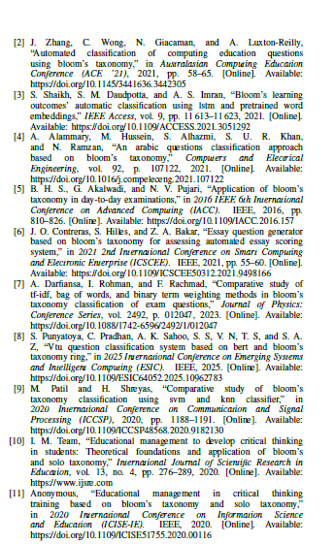
Bibliography

Slide 13
Acknowledgements
Thank You!

