Slide 1
NETWORK DESIGN PROPOSAL FOR A UNIVERSITY CDAC, Mohali Under the Guidance of Mr. Vijay Kumar
SOHAM GHOSH
101403178, COE 8

Slide 2


CDAC – A brief introduction
The Centre for Development of Advanced Computing is the premier R&D organization of the Ministry of Electronics and Information Technology for carrying out R&D in IT, Electronics, and other associated areas.
C-DAC was setup in 1988 to build supercomputers due to the denial of import of supercomputers by the USA.
The primary focus of C-DAC has changed since then – it now focuses on – Cloud Computing, Cultural Computing, Embedded Systems, Open Source Tech (FOSS), Cyber Security, and Training.

Slide 3
Scope and Utility
Scope
The project is primarily intended for small organizations, which include startups & other organizations, and small to medium-sized universities.
The project has been made keeping in mind both cost and efficiency.
Lastly, the project can be used both as a blank slate, and for upgrading a pre-existing network.
Utility
I firmly believe that the template provided by this design is applicable for any network – provided it is not large enough.

Slide 4
INTERNET SERVICE PROVIDER
NETWORK ADMINISTRATOR
RECEPTION
ACADEMIC BUILDING
STAFF BUILDING
HOSTEL
GUEST HOUSE
BOYS HOSTEL
GIRLS HOSTEL
HOSTEL – A
HOSTEL – B
HOSTEL - C
HOSTEL – D
HOSTEL - E
STAFF BUILDING – A
STAFF BUILDING - B
LIBRARY
DIRECTOR’S RESIDENCE
RECEPTION AREA
DIRECTOR’S OFFICE
CSED DEPT.
MECHANICAL DEPT.
CIVIL DEPT.
CHEMICAL DEPT.
DEPT. HEAD
PROFESSORS
LAB
CSLAB – 1
CSLAB - 2
DEPT. HEAD
PROFESSORS
ELECTRICAL DEPT.
DEPT.HEAD
PROFESSORS
DEPT. HEAD
PROFESSORS
DEPT. HEAD
PROFESSORS
Network Topology Diagram

Slide 5
Tools used, and key highlights
Tools
The main tool used is Cisco Packet Tracer, provided free of charge for educational or academic use, by Cisco Inc.
Highlights
ISP
Network Administration
Interconnection of various departments
VLANs
Network access for Library/Guesthouse
Open Wi-Fi for guests

Slide 6
Professional & technical learning
Professional
Broadened my horizons - learnt that there is more to life than studies.
Managed to set deadlines, and abide by them – so that there is no undue pressure near the end.
Technical
Learned the OSI and the TCP/IP model in great detail.
Learned about various protocols, and why they are (or not) in use.
Learned to build complex networks using Packet Tracer.
Learned in great detail about various components of a network – switches, routers, servers, connecting wires, etc.

Slide 7
Screenshots

Slide 8
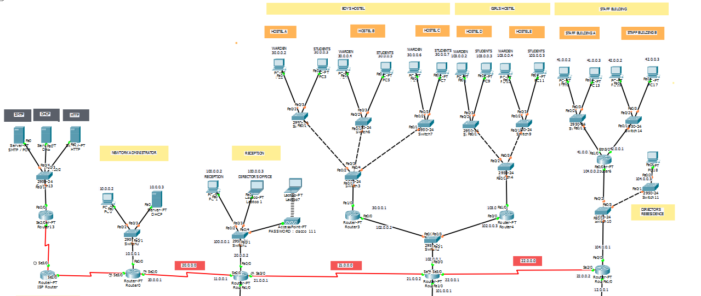
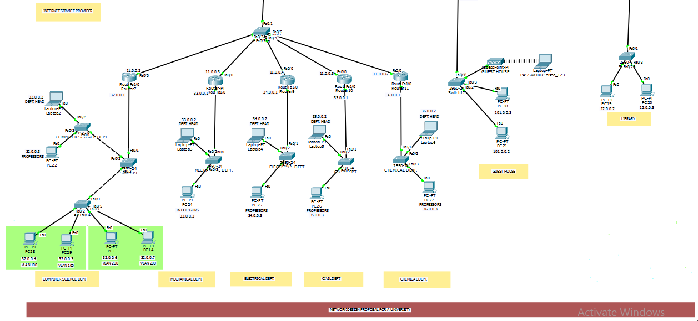

Slide 9
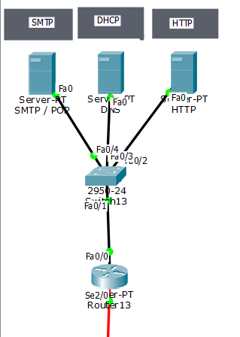
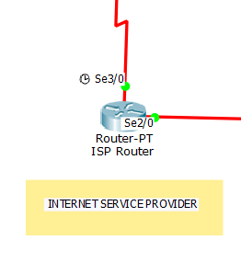

Slide 10
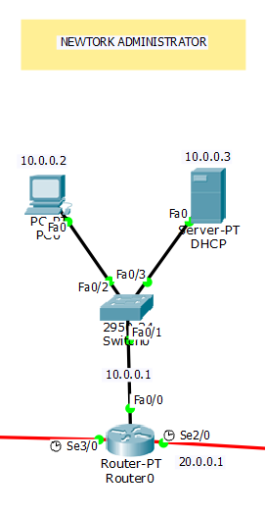

Slide 11
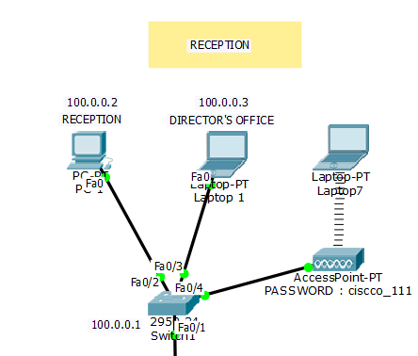

Slide 12
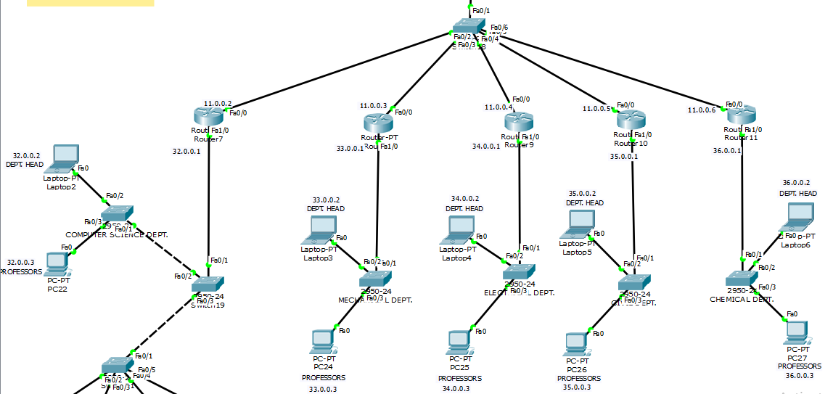
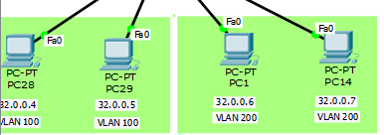

Slide 13
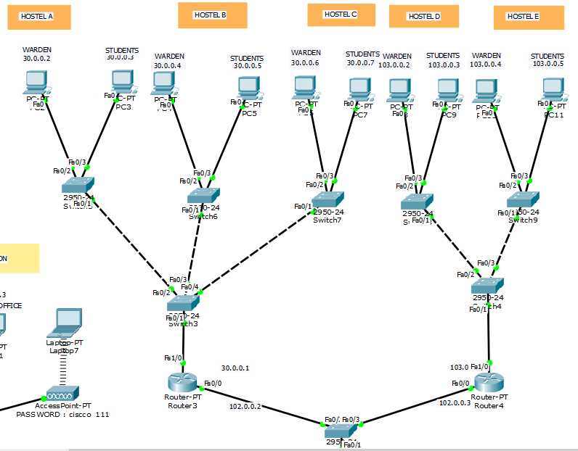

Slide 14
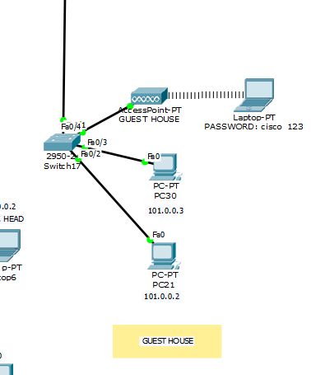

Slide 15
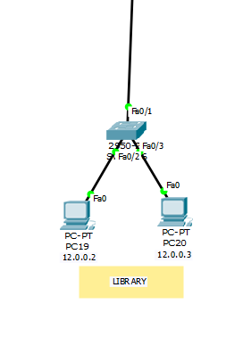

Slide 16
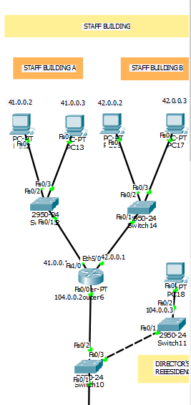

Slide 17
THANK YOU

