Slide 1



Fake News & Misinformation Detection on Social Media using AI & ML
Group ID - 25
Team Members :-
16010422246 – Aaryan Jayaprakash
16010422245 – Atharva Yewale
16010422248 – Soham Jadhav
16010422249 – Prem Nanda
Guide - Dr. Ravindra Divekar

Slide 2
Why This Topic Matters
Overview of the Challenge
Information Overload: Social media platforms generate vast amounts of content every second. The sheer volume makes it extremely challenging to manually monitor, verify, and filter out misinformation.
Speed of Misinformation Spread: Fake news can go viral quickly, reaching millions within minutes. This rapid dissemination exacerbates the challenge as even small delays in detection can lead to widespread impact.
Core Issues to Address
High Data Velocity and Volume: The system must handle real-time data streams from multiple platforms (e.g., Twitter, Facebook) and process them efficiently.
Complexity of Content: Misinformation is not always blatant; it often involves subtle distortions, manipulated images, or misleading context. This requires advanced natural language processing (NLP) and image analysis techniques.
Adaptive Adversaries: Misinformation creators constantly evolve their tactics to bypass detection systems. This calls for a dynamic solution that learns from new patterns and adapts over time.

Slide 3
Why This Topic Matters
Overview of the Challenge
Information Overload: Social media platforms generate vast amounts of content every second. The sheer volume makes it extremely challenging to manually monitor, verify, and filter out misinformation.
Speed of Misinformation Spread: Fake news can go viral quickly, reaching millions within minutes. This rapid dissemination exacerbates the challenge as even small delays in detection can lead to widespread impact.
Core Issues to Address
High Data Velocity and Volume: The system must handle real-time data streams from multiple platforms (e.g., Twitter, Facebook) and process them efficiently.
Complexity of Content: Misinformation is not always blatant; it often involves subtle distortions, manipulated images, or misleading context. This requires advanced natural language processing (NLP) and image analysis techniques.
Adaptive Adversaries: Misinformation creators constantly evolve their tactics to bypass detection systems. This calls for a dynamic solution that learns from new patterns and adapts over time.

Slide 4
Objectives
Detection and Filtering: Develop an automated system that can analyze social media posts and flag those that contain fake or misleading content.
Multimodal Analysis: Utilize both text-based (linguistic cues, sentiment analysis, and context) and multimedia methods (image verification, source credibility) for a more comprehensive detection mechanism.
Real-Time Response: Aim for a near real-time detection system that can alert users or moderators as soon as suspicious content is identified.
User Empowerment: Create an interface that not only displays detection outcomes but also provides explanations and confidence scores, allowing users to make informed judgments about the news they consume.

Slide 5
Literature Survey
Technology / Technique | Research Basis | Our Implementation
NLP-based Content Analysis | Shu et al. (2017) – “Fake News Detection on Social Media: A Data Mining Perspective” [ACM SIGKDD Explorations] | Leverages linguistic and semantic features (n-grams, sentiment, readability scores) to identify misleading language. Implements text preprocessing (tokenization, stop-word removal) and uses ML/DL classifiers (SVM, LSTM) for classification.
Social Context & Network Analysis | Conroy et al. (2015) – “Automatic Deception Detection: Methods for Finding Fake News” [ASIST Proceedings] | Incorporates user metadata (posting frequency, social ties) and network patterns (retweet/reshare graphs) to detect bot-driven misinformation campaigns. Flags suspicious activity based on propagation speed and engagement anomalies.
Hybrid Deep Learning Approaches | Wang (2017) – “Liar Dataset: A Benchmark for Fake News Detection” [ACL Anthology] | Utilizes a hybrid architecture (CNN + RNN) trained on the LIAR dataset to capture both contextual and sequential text features. Integrates attention mechanisms for better interpretability, highlighting key phrases that indicate misinformation.

Slide 6
Outcomes of Literature Survey
The literature review explored key technological advancements in automated question paper generation, metadata tagging, and randomization techniques in education.
A study published in IRJET (2020) highlighted the necessity of dynamically balancing question distribution across modules, difficulty levels, and marks. Our system addresses this by leveraging random sampling to ensure a fair and varied selection of questions.
Semantic Scholar (2019) emphasized the importance of efficient tagging and metadata structuring. We incorporated this by organizing questions using attributes such as module number, difficulty level, and mark allocation for seamless retrieval and categorization.
Insights from IJARIIE (2018) on advanced randomization techniques helped guide our algorithm design. These principles were applied to reduce question repetition while maintaining fair syllabus coverage and topic variation.
Together, these studies underline the importance of a metadata-driven and randomized approach—laying the groundwork for our system's intelligent and scalable architecture.

Slide 7
Scope
Functional Requirements: – Data Collection: Crawl and aggregate data from social media platforms (Twitter, Facebook, etc.). – Preprocessing: Clean text data and remove noise. – Feature Extraction: Use NLP techniques to extract semantic, syntactic, and sentiment features. – Classification: Implement machine learning models (e.g., SVM, Random Forest, Deep Learning) to classify news as fake or genuine. – Visualization & Reporting: Dashboard to display detection results and trends. • Non-Functional Requirements: – Performance: Real-time or near real-time detection capability. – Scalability: System should handle large volumes of social media data. – Usability: User-friendly interfaces for both analysts and end users.

Slide 8
Overview of Implementation
System Architecture: – Data Acquisition Module: APIs and web crawlers to collect social media posts. – Preprocessing Module: Text cleaning, tokenization, and normalization. – Feature Extraction Module: • Linguistic features (n-grams, POS tags) • Semantic features (word embeddings, sentiment scores) – Classification Module: • Machine Learning models (e.g., Neural Networks, SVM) trained on labeled datasets. – Post-Processing Module: Aggregation of results and flagging suspicious content. – User Interface: Dashboard for visualization, feedback, and reporting.

Slide 9
Technologies Used
Component | Technology Used | Purpose
Backend Framework | Django (Python) | Handles business logic, user roles, and rapid backend development
Frontend | HTML, CSS, JavaScript | Builds a clean and interactive user interface
Database | SQLite | Stores subjects, questions, users, and exam configurations
Logic Algorithm | Random Sampling | Smart selection of questions based on difficulty and marks
PDF Generation | xhtml2pdf or similar tools | Converts dynamically generated HTML into downloadable PDF question papers

Slide 10
Data Set Description
• Source Datasets: – LIAR dataset: A collection of short statements labeled for truthfulness. – FakeNewsNet: Aggregated dataset including news content, social context, and user engagement. • Data Attributes: – News content, publication date, author, social engagement metrics (likes, shares, comments) – Metadata (source credibility, geographical tags) • Data Challenges: – Imbalanced classes (more genuine than fake) – Noisy and unstructured data requiring thorough preprocessing

Slide 11
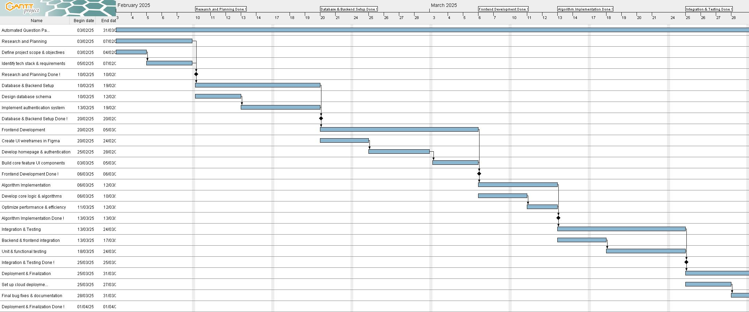
Timeline

Slide 12
Expected Outcomes
Deliverables: – A comprehensive platform for automated fake news detection. – A dashboard for real-time monitoring of misinformation trends. – Detailed documentation on the methodology, experiments, and results. • Impacts: – Efficiency: Rapid detection and flagging of misleading content. – Transparency: Clear metrics and visualizations for content credibility. – Future Work: Integration with fact-checking APIs and user feedback systems.

Slide 13
Conclusion
Summary: – The project addresses the urgent need to combat misinformation on social media using advanced data mining and NLP techniques. – A robust system combining data collection, preprocessing, feature extraction, and machine learning will help identify fake news effectively. • Future Directions: – Incorporation of deep learning models and network analysis. – Expansion to multi-language support and cross-platform integration. – Continuous model updates to adapt to evolving misinformation tactics.

Slide 14
References

