Slide 1
Soham Indian MIDI Piano
Created by
Soham Korade
JNV Belagavi

Slide 2
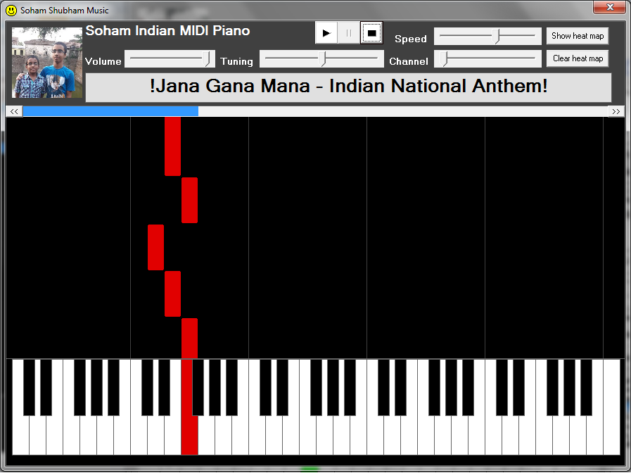
Introduction
This is a Virtual MIDI Piano capable of playing music through MIDI.
To connect external MIDI device, plug it in and select it from the Devices list in Output window.
There you can also select the tone in which the song will be played.

Slide 3
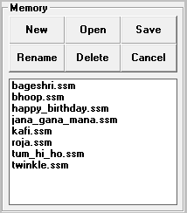
Memory window
You can save the song into memory, rename it or delete it in the Memory window. You can also create a new song or open an old one already saved in the memory.

Slide 4
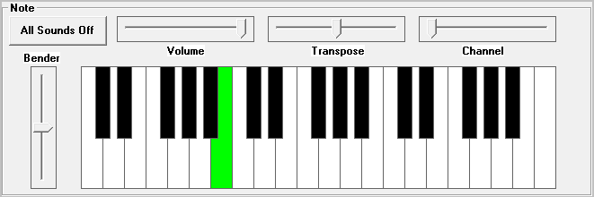
Note window
In the Note window, you can adjust the volume, transpose the note and alter its MIDI channel.
You can play the piano using the mouse.
Notes:
To use the Bender (Pitch Bend), first click on it and then use the mouse-wheel while playing the piano.
To play using the keyboard, first click on the Bender and use the keyboard.

Slide 5
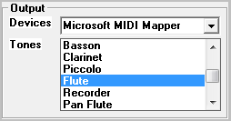
Output window
You can select the MIDI device to connect and also set the tone to play the notes in.

Slide 6
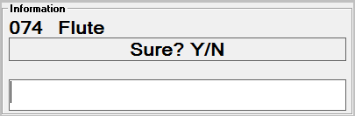
Information window
The selected tone name will be displayed here.
While playing the song, it also displays a seek bar.
There is a text area for renaming and confirming actions. Press <ENTER> to accept the input or click 'Cancel' in the Memory window to cancel.

Slide 7
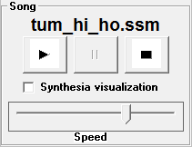
Song window
You can enter notes in Indian Swarlipi Notation (see below for more information) in the editor which can be played through the options in the Song window.
There you can adjust the speed and control the song. You can also visualize the song in Synthesia-style by checking the specific option.

Slide 8
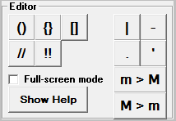
Editor window
This window has buttons to easily insert the notation symbols.
There is also a full-screen mode for the editor.
For any help, you can click 'Show Help'.

Slide 9
Indian Swarlipi notation
The seven swars (Sa, Re, Ga, Ma, Pa, Dha, Ni) are expressed using their initials.
e.g. s is Sa, r is Re, g is Ga, m is Ma, p is Pa, d is Dha, n is Ni
Shuddha swars are expressed using lower-case alphabets.
e.g. srgmpdn
Both Komal and Teevra swars are expressed using upper-case alphabets.
e.g. RGDN and M; S and P are also okay
Notes:
The seven swars (Sa, Re, Ga, Ma, Pa, Dha, Ni) are expressed using their initials.
e.g. s is Sa, r is Re, g is Ga, m is Ma, p is Pa, d is Dha, n is Ni
Shuddha swars are expressed using lower-case alphabets.
e.g. srgmpdn
Both Komal and Teevra swars are expressed using upper-case alphabets.
e.g. RGDN and M; S and P are also okay

Slide 10
Indian Swarlipi notation
( and ): the notes enclosed in these will play double the speed, 2x.
{ and }: the notes enclosed in these will play triple the speed, 3x.
[ and ]: the notes enclosed in these will play quadruple the speed, 4x.
/: use this enclose the notes not to be played or other text (lyrics, headings, etc.); the characters enclosed will be ignored.
!: same as /, but we recommend you to use this explicitly to enclose the title of the song.
Notes:
( and ): the notes enclosed in these will play double the speed, 2x.
e.g. (srgm) will be played in 2 beats (matras)
{ and }: the notes enclosed in these will play triple the speed, 3x.
e.g. {srgmpd} will be played in 2 beats (matras)
[ and ]: the notes enclosed in these will play quadruple the speed, 4x.
e.g. [srgm] will be played in 1 beat (matra)
/: use this enclose the notes not to be played or other text (lyrics, headings, etc.); the characters
enclosed will be ignored.
e.g. /srgm/, /antara/, /sa re ga ma/ will be ignored
!: same as /, but we recommend you to use this explicitly to enclose the title of the song.
e.g. /Bandish in Desh raga/ will be ignored

Slide 11
Indian Swarlipi notation
- (hyphen): used to extend the previous note by one beat (matra).
. (dot or period): the note immediately after the dot (period) will be played one octave (saptak) lower.
' (apostrophe): the note immediately after the dot (period) will be played one octave (saptak) higher.
| (bar sign): (optional) used to indicate parts of the rhythm.
(space): (optional) same as |, but we recommend you to use this for grouping notes.
<other alphabets, symbols or numerals>: they will simply be ignored.
Notes:
- (hyphen): used to extend the previous note by one beat (matra).
e.g. s-r-g- will take double the time of srg
. (dot or period): the note immediately after the dot (period) will be played one octave (saptak) lower.
e.g. srg will be played one octave higher than .s.r.g
' (apostrophe): the note immediately after the dot (period) will be played one octave (saptak) higher.
e.g. srg will be played one octave lower than 's'r'g
| (bar sign): (optional) used to indicate parts of the rhythm.
e.g. srgm|pdn's| is same as srgmpdn's
(space): (optional) same as |, but we recommend you to use this for grouping notes.
e.g. srgm pdn's is same as srgmpdn's
<other alphabets, symbols or numerals>: they will simply be ignored.
e.g. s1r2g3m4 p@d#n$'s% is same as srgmpdn's

Slide 12
Some of the Screenshots

Slide 13
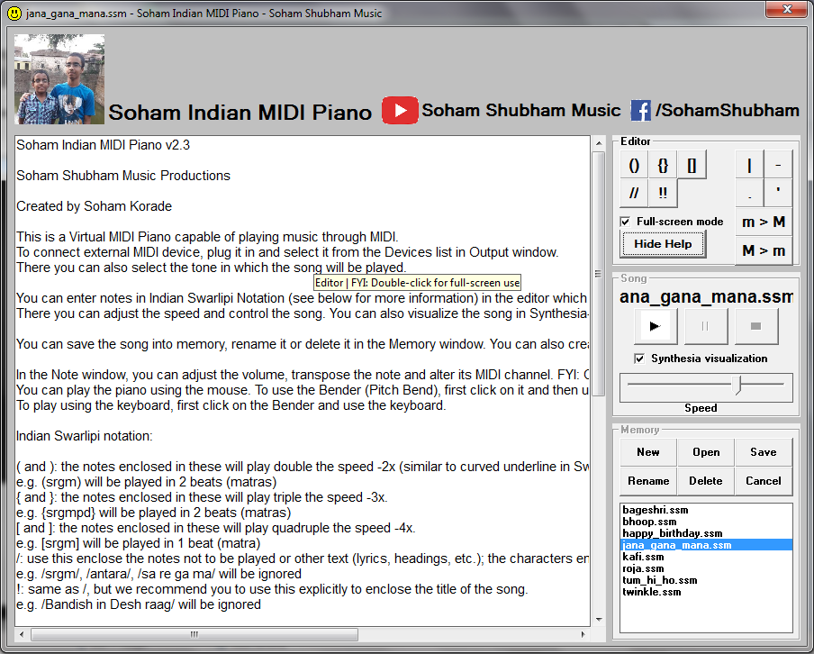
Showing Help

Slide 14
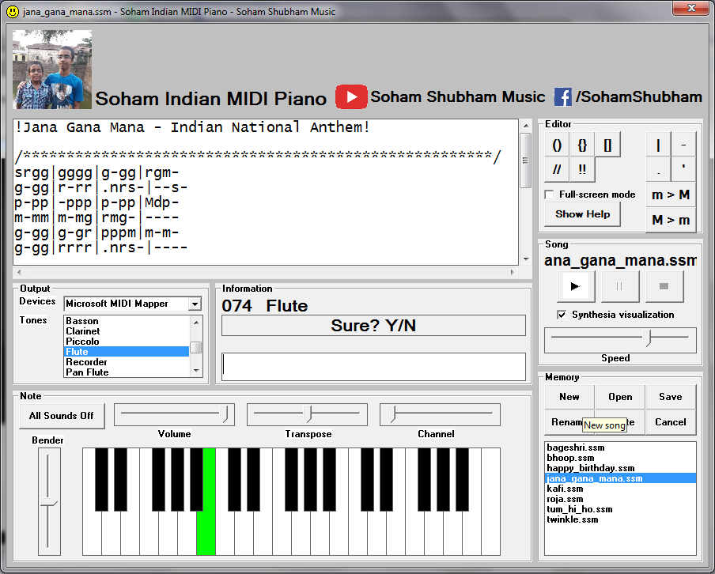
Asking confirmation

Slide 15
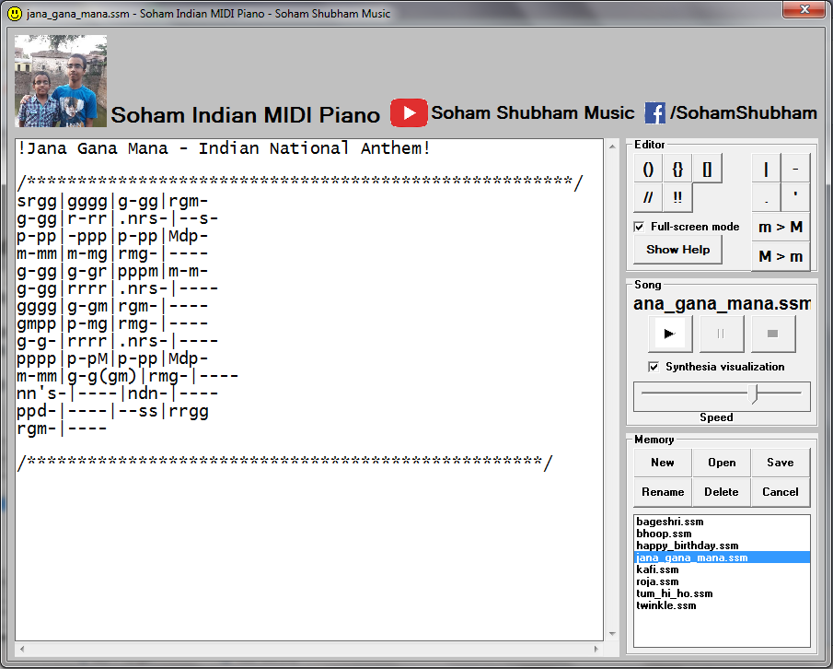
Full-screen editor

Slide 16
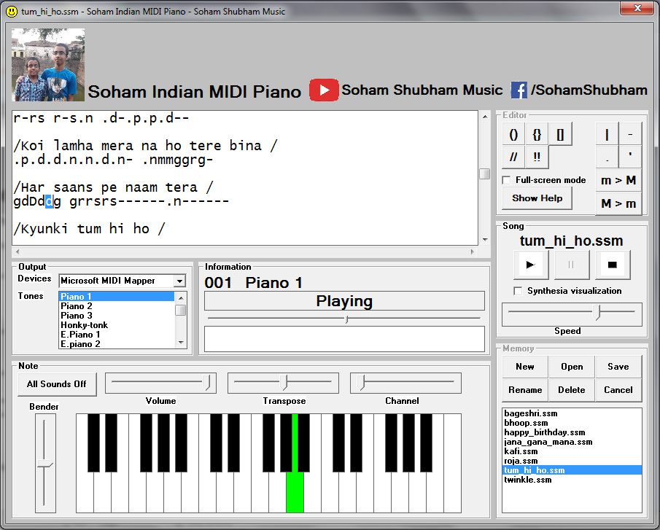
Playing the notes

Slide 17
Playing the notes with Visualization

Slide 18
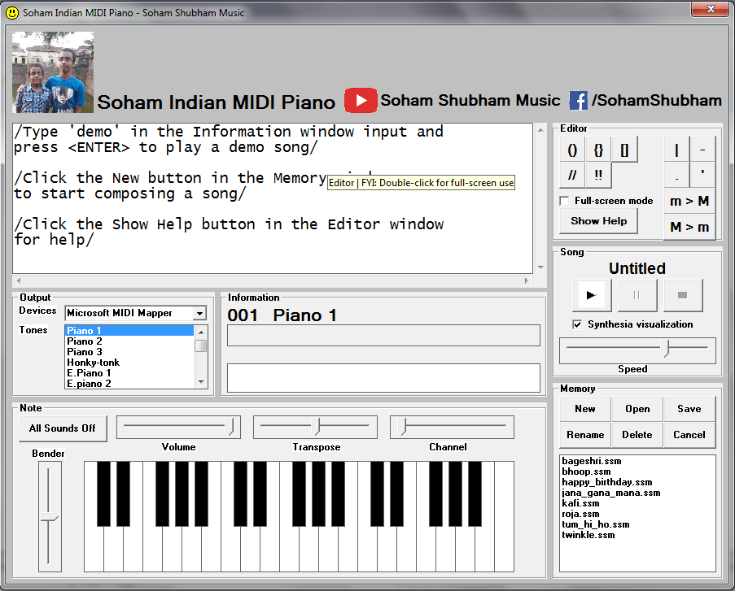
Tips for beginners at splash screen

Slide 19
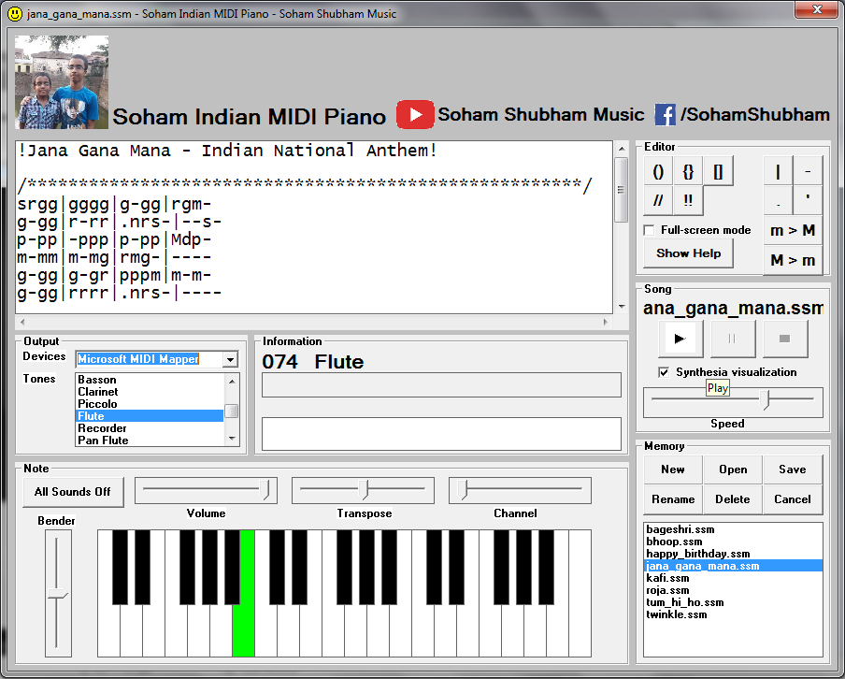
Changing the tone of the note

Slide 20
Thank you!
Also, do check out the sample songs.
Hope you will enjoy playing this Piano.
If you have any suggestions please e-mail me at:
sohamkorade.jnvkk(at)gmail.com

