Slide 1
ExportIntel AI
Predictive Export Intelligence & Logistics Optimization Platform
Title & Team Overview
Team Number: __________ Team Name: _______________________________
Project Leader: _______________________________________________________
Team Members (names on this slide as required):
1) ________________________ 2) ________________________
3) ________________________ 4) ________________________
Product pitch: Demand → Price → Logistics → Containers → Export Decision
ExportIntel AI · Startup Pitch Review 1 / 17

Slide 2
Problem Statement
Core problem we are solving
• Indian commodity exporters must decide what to export, which country to target, and which route is profitable — under fast-changing markets.
• Demand signals, mandi prices, freight costs, and container limits are scattered across tools and spreadsheets.
• Manual planning is slow and often misses live news that shifts opportunity overnight.
• Without a unified system, teams risk wrong country–commodity choices and loss-making logistics lanes.
ExportIntel AI · Startup Pitch Review 2 / 17

Slide 3
Proposed Solution
High-level overview of our unique product
• ExportIntel AI is a multi-agent export decision platform (React + Flask).
• One click runs: Live News → Demand → Price → Logistics → Container Prioritization.
• Live news from GDELT + Google News RSS feeds demand and India price intelligence.
• ML models score opportunities and forecast next-month prices in INR/quintal.
• Logistics engine ranks India→destination corridors by net profit (INR @ ₹96.3/USD).
• Container Agent allocates limited capacity by demand + profit + cost + transit priority.
• Groq LLM explanations + RAG Trade Assistant make decisions explainable and auditable.
ExportIntel AI · Startup Pitch Review 3 / 17

Slide 4
Target Users & Use Cases
Who uses it and where it creates value
Export Analysts
Operations Teams
Decision Makers
• Rank demand opportunities
• Review next-month buy prices
• Compare profitable corridors
• Allocate limited containers
• Prioritize export-first lanes
• Track cost, transit, profit
• Use supervisor recommendation
• Validate INR profit impact
• Ask Trade Assistant (RAG)
ExportIntel AI · Startup Pitch Review 4 / 17

Slide 5
Tech Stack
Technical architecture & technologies used
• Frontend: React + Vite dashboard (Demand, Price, Logistics, Containers, Agents, RAG)
• Backend: Flask REST APIs (pipeline, live news, RAG ask/rebuild, auth)
• ML: XGBoost/Joblib demand & price models with Pandas feature pipelines
• LLM: Groq Llama 3.3 70B for demand/price explanations and RAG answers
• Vector DB: Chroma (sklearn TF-IDF fallback) for retrieval-augmented Q&A
• Live News: GDELT Doc API + Google News RSS (+ optional NewsAPI)
• Persistence: SQLite for pipeline runs and logistics cost/profit history
• Scale path (optional): Kafka topics + Databricks/PySpark bronze→gold
ExportIntel AI · Startup Pitch Review 5 / 17

Slide 6
Data Source Breakdown
Original data vs synthetic data vs live data
Original / Trusted
Live External
Synthetic / Support
• Demand_prediction CSVs
• Commodities price datasets
• Logistics & cost CSVs
• Trade price tables
• Trained model bundles
• GDELT trade/commodity news
• Google News RSS (IN)
• Optional NewsAPI key
• Filtered to our commodities
• Demand countries only (demand box)
• Synthetic news feature rows
• Used for training coverage
• Not used as final demo truth
• Helps edge-case robustness
• Controlled, not live market
ExportIntel AI · Startup Pitch Review 6 / 17

Slide 7
Technical Workflow
End-to-end multi-agent pipeline
• 1) News Agent fetches Demand news + India price news in parallel
• 2) Demand Agent predicts top country–commodity demand scores (0–1)
• 3) Price Agent forecasts next-month INR/quintal with news adjustment
• 4) Logistics Agent optimizes India port → destination port corridors
• 5) Container Agent allocates limited 20FT/40FT capacity by priority
• 6) Explain Agent (Groq) + RAG Assistant produce reasoning and Q&A
• Persisted in SQLite → Dashboard cards + supervisor recommendation
ExportIntel AI · Startup Pitch Review 7 / 17

Slide 8
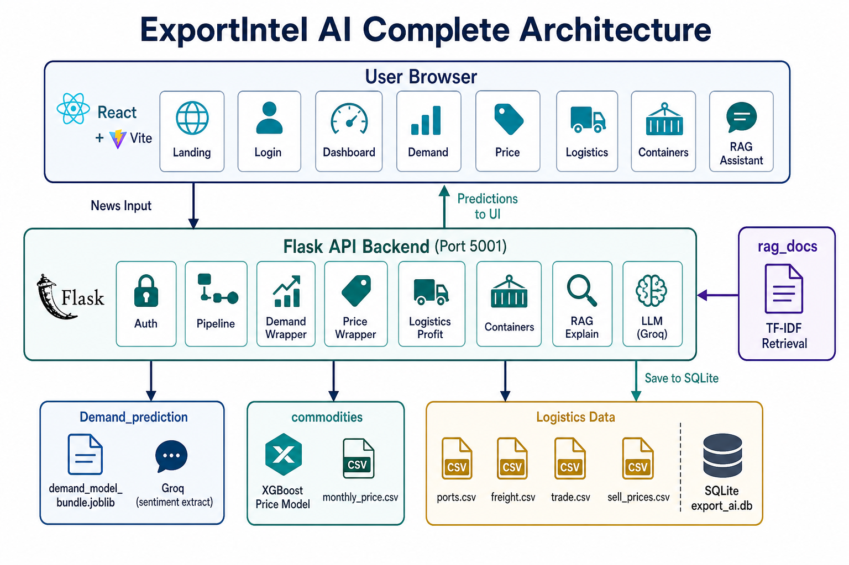
System Architecture & Data Flow
Agents, APIs, models, and knowledge layer
ExportIntel AI · Startup Pitch Review 8 / 17

Slide 9
Existing System vs Our System
Impact analysis & competitive edge
Existing / Typical Approach
ExportIntel AI
• Spreadsheets + fragmented tools
• Manual news copy-paste
• Demand/price/logistics siloed
• Route profitability checked late
• Container plan is ad-hoc
• Hard to explain decisions
• One-click multi-agent pipeline
• Auto live news (GDELT + RSS)
• Linked demand → price → profit
• Corridors ranked by INR net profit
• Priority-based container allocation
• LLM explanations + RAG Q&A
ExportIntel AI · Startup Pitch Review 9 / 17

Slide 10
Container Prioritization
How scarce capacity is allocated across export lanes
• Problem: exporters have limited containers (e.g., 6 × 20FT) but multiple profitable opportunities.
• Container Agent ranks lanes using a blended priority score: demand + net profit + logistics cost + transit time.
• Example split: High priority lane gets more containers (e.g., 3), next gets 2, lower priority gets 1.
• Quantity is applied here: profit/container = profit/ton × payload tons; combined profit uses allocated containers.
• Output: export-first recommendation, allocation table, remaining capacity, and expected combined INR profit.
• UI module: Container Priority page shows ranked cards + full allocation plan after Run Analysis.
ExportIntel AI · Startup Pitch Review 10 / 17

Slide 11
System Performance
Key metrics & product benchmarks
• End-to-end analysis: Demand + Price + Logistics + Container Prioritization in one Run Analysis.
• Live news fetch: parallel GDELT + Google RSS with relevance filters (max 10 headlines each).
• Price response to news: bullish vs bearish India news changes next-month prediction (not hard-coded).
• Profit engine: buy price always included; quantity applied via container payload × allocation.
• Persistence: SQLite stores full pipeline JSON + logistics cost/profit rows for audit.
• Local deploy: Frontend :5173 · Backend Flask :5001 (review-demo ready).
ExportIntel AI · Startup Pitch Review 11 / 17

Slide 12
Live Demo Screens
Working product samples from the deployed local app
Dashboard
Demand Prediction
Logistics Optimisation
Container Priority
ExportIntel AI · Startup Pitch Review 12 / 17

Slide 13
Alternative Approach
What we considered and why we chose this path
• Alternative A — Pure LLM decisions without ML models: rejected (less stable, harder to audit).
• Alternative B — Manual pasted news only: rejected (not product-like for daily export ops).
• Alternative C — Kafka + Databricks first for every demo: deferred (excellent for scale, heavy for review demo).
• Selected approach — Hybrid ML + live news APIs + Flask/React UX, with Kafka/Databricks as roadmap.
• Why it wins — Reliable demos, explainable scores, INR profit clarity, clear production scale path.
ExportIntel AI · Startup Pitch Review 13 / 17

Slide 14
Future Scope & Enhancements
Roadmap for scalability and upgrades
• Always-on Kafka news producers into Databricks bronze → silver → gold tables.
• Dynamic FX feeds and confidence intervals on demand/price predictions.
• What-if simulator for containers, port constraints, and tariff shocks.
• Multi-user roles, saved playbooks, and board-ready PDF/PPT exports.
• Backtesting harness on historical news weeks vs realized route outcomes.
ExportIntel AI · Startup Pitch Review 14 / 17

Slide 15
Practical Impact
Why this product matters in 14 minutes
• Faster export decisions: one pipeline replaces fragmented analysis.
• Profit-first logistics: buy price + freight + route compared in INR.
• Capacity realism: scarce containers allocated by opportunity priority.
• Trust layer: Groq explanations + RAG grounded in project datasets.
• Demo outcome: live news → ranked opportunity → container plan → action.
ExportIntel AI · Startup Pitch Review 15 / 17

Slide 16
Team Participation Plan (~14 min)
Equal speaking distribution for review
• Member A (~3.5 min): Title/Team, Problem, Proposed Solution, Users
• Member B (~3.5 min): Tech Stack, Data Sources, Workflow, Architecture
• Member C (~3.5 min): Existing vs Ours, Container Prioritization, Live Demo
• Member D (~3.5 min): Alternative Approach, Future Scope, Conclusion + Q&A
• Demo tip: Run Analysis → Demand → Logistics → Container Priority → Recommendation.
ExportIntel AI · Startup Pitch Review 16 / 17

Slide 17
Conclusion & Q&A
ExportIntel AI turns live market news into ranked demand, price forecasts, profitable routes, and prioritized container plans — with explainable AI support.
Thank you · We are ready for questions
ExportIntel AI · Startup Pitch Review 17 / 17

