Slide 1
ExportIntel AI
Predictive Export Intelligence & Logistics Optimization Platform
AI-powered decision support for Indian commodity exports
Demand + Price + Logistics + Container prioritization
Live news integration with explainable recommendations
Presented by: <Your Name>

Slide 2
Problem Statement
Exporters struggle to combine demand trends, price forecasts, and logistics costs quickly.
Manual analysis is slow, inconsistent, and risky when market news changes daily.
Need one system to recommend what to export, where to export, and how much to allocate.

Slide 3
Project Objectives
Predict top country-commodity demand opportunities
Forecast next-month India commodity prices (INR/quintal)
Optimize India port to destination route with net profit
Allocate limited containers based on opportunity score
Explain decisions with LLM and answer Q&A using RAG

Slide 4
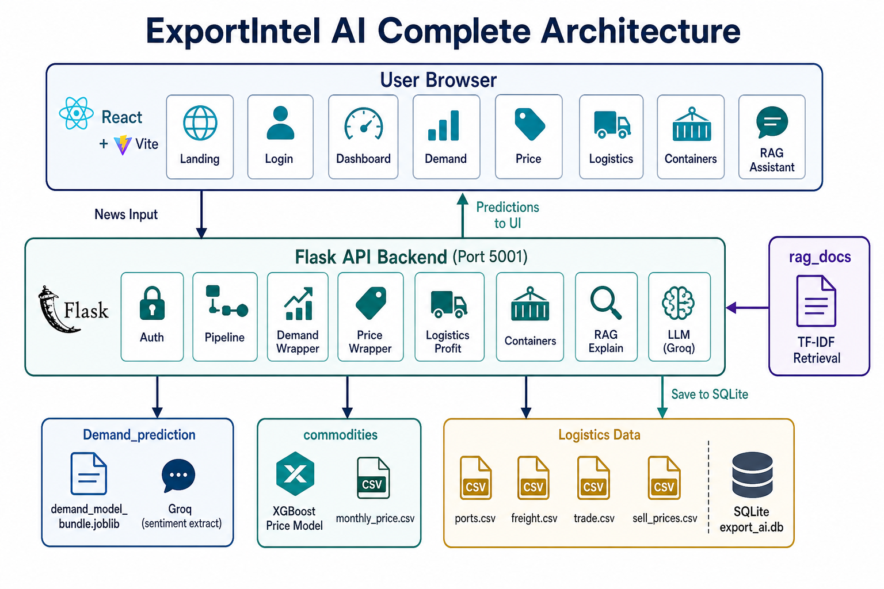
System Architecture
Multi-agent flow and data integration

Slide 5
End-to-End Pipeline
1) News Agent: fetches live demand and India price news
2) Demand Agent: predicts top opportunities with demand score
3) Price Agent: predicts next-month commodity prices
4) Logistics Agent: computes route cost, transit, and profitability
5) Container Agent: allocates limited containers by priority
6) Explain/RAG Agent: generates explanations and Q&A responses

Slide 6
Technology Stack
Core Application
AI + Knowledge
Frontend: React + Vite
Backend API: Flask (Python)
ML: XGBoost/Joblib + feature engineering
Data: Pandas + CSV datasets
LLM: Groq (Llama 3.3 70B)
RAG: Chroma Vector DB (with sklearn fallback)
Live News: GDELT + Google News RSS (+ optional NewsAPI)
Storage: SQLite (pipeline runs, logistics records)

Slide 7
Demand and Price Intelligence
Demand score uses country+commodity signals from news features and trained model.
Price prediction combines historical market features with news sentiment adjustment.
Predictions can change across runs when relevant news tone changes.
Prices are shown in INR/quintal; logistics/profit displayed in INR at fixed FX rate.

Slide 8
Logistics and Profit Optimization
Net profit/ton = sell price - buy price - logistics cost.
Quantity is considered for container and allocation-level profit.
Route optimization compares ports, transit days, and cost/ton.
Container prioritization balances demand, profitability, and speed.

Slide 9
Live Demo Screens
Dashboard, Demand, Logistics, Container Priority

Slide 10
Business Value
Reduces manual export planning effort and decision delay.
Improves profitability visibility before shipment commitment.
Provides explainable recommendations for management decisions.
Scales from local demo to Kafka + Databricks streaming architecture.

Slide 11
Challenges and Future Enhancements
News quality and source consistency require strong filtering logic.
Need broader commodity-country data and more real-time signals.
Future: automated streaming pipeline with Kafka and Databricks.
Future: dynamic FX, confidence intervals, and what-if simulation.

Slide 12
Thank You
Questions?
ExportIntel AI | End-to-End Intelligent Export Decision System

