Slide 1
ExportIntel AI
Predictive Export Intelligence & Logistics Optimization Platform
AI-powered decision support for Indian commodity exporters
Demand + Price + Logistics + Container Prioritization in one platform
Live news aware, explainable, and presentation-ready analytics
Presented by: <Your Name>
ExportIntel AI

Slide 2
Agenda
1. Problem and objectives
2. Architecture and workflow
3. ML, RAG, and live news integration
4. Logistics and container optimization
5. Demo outcomes, impact, and future scope
ExportIntel AI

Slide 3
Problem Statement
Export planning needs fast decisions across demand, pricing, and logistics.
Manual market analysis is slow and often misses daily news shifts.
Route and container choices directly impact profit and delivery reliability.
Need one intelligent system for end-to-end export recommendations.
ExportIntel AI

Slide 4
Project Objectives
Predict top country-commodity demand opportunities
Forecast next-month India commodity prices
Optimize India port to destination corridor profitability
Prioritize limited container allocation
Provide explainable insights and document-grounded Q&A
ExportIntel AI

Slide 5
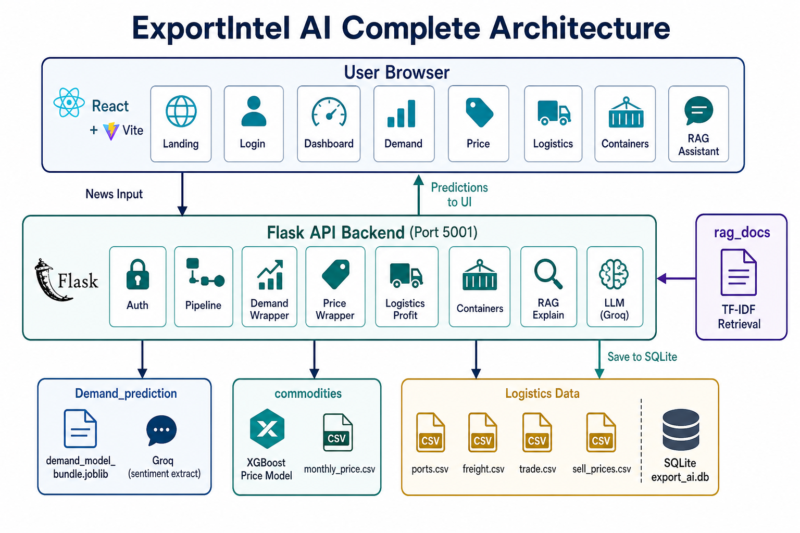
System Architecture
End-to-end multi-agent design and data flow
ExportIntel AI

Slide 6
Pipeline Overview
News Agent: fetches live demand and India commodity market news
Demand Agent: scores opportunities from model + extracted features
Price Agent: predicts next-month prices with news adjustment
Logistics Agent: evaluates route cost, days, and net profit
Container Agent: allocates containers by opportunity score
Explain Agent + RAG: generates reasoning and answers questions
ExportIntel AI

Slide 7
Technology Stack
Application Layer
AI and Intelligence Layer
Frontend: React + Vite
Backend: Flask REST APIs
Data processing: Pandas
Persistence: SQLite
ML: XGBoost/Joblib
LLM: Groq (Llama 3.3 70B)
RAG: Chroma Vector DB
News APIs: GDELT + Google RSS
ExportIntel AI

Slide 8
Demand Prediction Logic
News headlines are parsed for country, commodity, and sentiment indicators.
Model computes demand score (0 to 1) for each country-commodity pair.
Shortage, production drop, and export opportunity increase demand score.
Top opportunities are ranked and passed to the next stages.
ExportIntel AI

Slide 9
Price Forecasting Logic
Current price baseline comes from commodity mandi dataset (INR/quintal).
XGBoost predicts base next-month price per commodity.
News sentiment adds controlled positive or negative adjustment.
Prediction can change across runs when relevant news tone changes.
ExportIntel AI

Slide 10
Logistics and Net Profit Calculation
Net profit/ton = sell price - buy price - logistics cost/ton.
Buying amount is considered from predicted India commodity price.
Quantity is considered at container/allocation profit level.
Displayed values use INR conversion at fixed FX: 1 USD = Rs.96.3.
ExportIntel AI

Slide 11
RAG, Vector DB, and LLM
Trusted CSV datasets are indexed into Chroma Vector DB as chunks.
User question retrieves top relevant chunks using vector similarity.
Groq LLM answers using retrieved context for grounded responses.
Fallback retrieval uses sklearn TF-IDF if Chroma is unavailable.
ExportIntel AI

Slide 12
Live News Integration
Fetch Live News API calls GDELT + Google News RSS in parallel.
Demand news requires target countries + selected commodities.
Price news requires selected commodities + India market context.
Headlines are deduped, cleaned, and capped to top 10 per section.
ExportIntel AI

Slide 13
Live Demo Screens
Dashboard | Demand | Logistics | Container Priority
ExportIntel AI

Slide 14
Results and Observations
Platform produces consistent top demand, price, and route decisions.
Container plan reflects practical limited-capacity export prioritization.
Dashboard gives quick management view for export-first action.
System behavior is explainable through Agent Reasoning + RAG.
ExportIntel AI

Slide 15
Business Value
Faster export decision cycle with lower manual effort
Higher visibility into profitability before shipment commitment
Data-backed route and container decisions for operations teams
Clear communication for leadership through interactive dashboards
ExportIntel AI

Slide 16
Future Enhancements
Kafka-based streaming ingestion for continuous market updates
Databricks pipeline for large-scale batch/stream processing
Dynamic FX updates and risk-aware confidence intervals
Scenario simulation: what-if planning by container and route constraints
ExportIntel AI

Slide 17
Thank You
Questions and discussion
ExportIntel AI

