Slide 1
ExportIntel AI
Predictive Export Intelligence & Logistics Optimization Platform
Title & Team Overview
Team Name: ____________________________ Team Number: ______
Project Leader: ________________________
Team Members:
1) ____________________ 2) ____________________
3) ____________________ 4) ____________________
Pitch focus: Demand → Price → Logistics → Containers → Actionable Export Decision
ExportIntel AI · Product Pitch 1/18

Slide 2
Problem Statement
Why exporters lose speed, clarity, and margin
• Indian exporters must decide what to export, where to sell, and which route is profitable — under daily market shifts.
• Demand signals, mandi prices, freight costs, and container limits sit in separate tools and spreadsheets.
• Manual planning is slow, inconsistent, and often ignores live news that changes opportunity overnight.
• Without a unified decision system, teams risk wrong country–commodity choices and loss-making lanes.
ExportIntel AI · Product Pitch 2/18

Slide 3
Proposed Solution
One multi-agent platform for export decisions
• ExportIntel AI is a React + Flask product that runs a full decision pipeline in one click.
• News Agent pulls live demand & India price headlines (GDELT + Google News RSS).
• ML agents predict next-month demand opportunities and commodity prices (INR/quintal).
• Logistics + container agents optimize India→destination corridors and allocate scarce capacity.
• Groq LLM + RAG explain decisions and answer trade questions from trusted project data.
ExportIntel AI · Product Pitch 3/18

Slide 4
Target Users & Use Cases
Export Analysts
Operations Teams
Decision Makers
• Compare demand scores
• Check next-month buy price
• Pick profitable lanes
• Allocate limited containers
• Prioritize export-first lanes
• Track transit & cost/ton
• Review supervisor summary
• Validate profit in INR
• Ask Trade Assistant (RAG)
ExportIntel AI · Product Pitch 4/18

Slide 5
Tech Stack
Production-style local stack with cloud scale path
• Frontend: React, Vite
• Backend: Flask REST APIs
• ML: XGBoost / Joblib, Pandas
• LLM: Groq (Llama 3.3 70B)
• RAG: Chroma Vector DB (+ sklearn fallback)
• News: GDELT, Google News RSS, optional NewsAPI
• Store: SQLite (pipeline + logistics runs)
• Optional scale path:
• Kafka (streaming news topics)
• Databricks + PySpark notebooks
• Delta bronze → silver → gold
• Docker for local services
• FX display rate: ₹96.3 / USD
• Auth-protected pipeline APIs
ExportIntel AI · Product Pitch 5/18

Slide 6
Data Source Breakdown
Original project data + live sources + controlled synthetic support
• Original / trusted datasets: Demand_prediction CSVs, commodities monthly price & training data, Logistics + Logistics_Costs CSVs (ports, freight, charges, trade prices).
• Live external data: GDELT + Google News RSS for demand-country and India mandi headlines (filtered to project commodities/countries).
• Model artifacts: demand_model_bundle.joblib and price model tools (trained on project datasets).
• Synthetic / generated support: synthetic news/feature rows used for training coverage and stress cases — not for final demo truth.
• Runtime persistence: SQLite stores pipeline JSON + logistics cost/profit rows after each analysis.
ExportIntel AI · Product Pitch 6/18

Slide 7
Technical Workflow
Multi-agent pipeline from news to export action
• 1) News Agent → live demand news + India price news
• 2) Demand Agent → top country–commodity demand scores
• 3) Price Agent → next-month INR/quintal forecasts (news-adjusted)
• 4) Logistics Agent → India port → destination route + net profit
• 5) Container Agent → allocate limited 20FT/40FT containers by priority
• 6) Explain Agent (Groq) + RAG Assistant → reasoning & Q&A
• Output: supervisor recommendation + dashboard cards + SQLite history
ExportIntel AI · Product Pitch 7/18

Slide 8
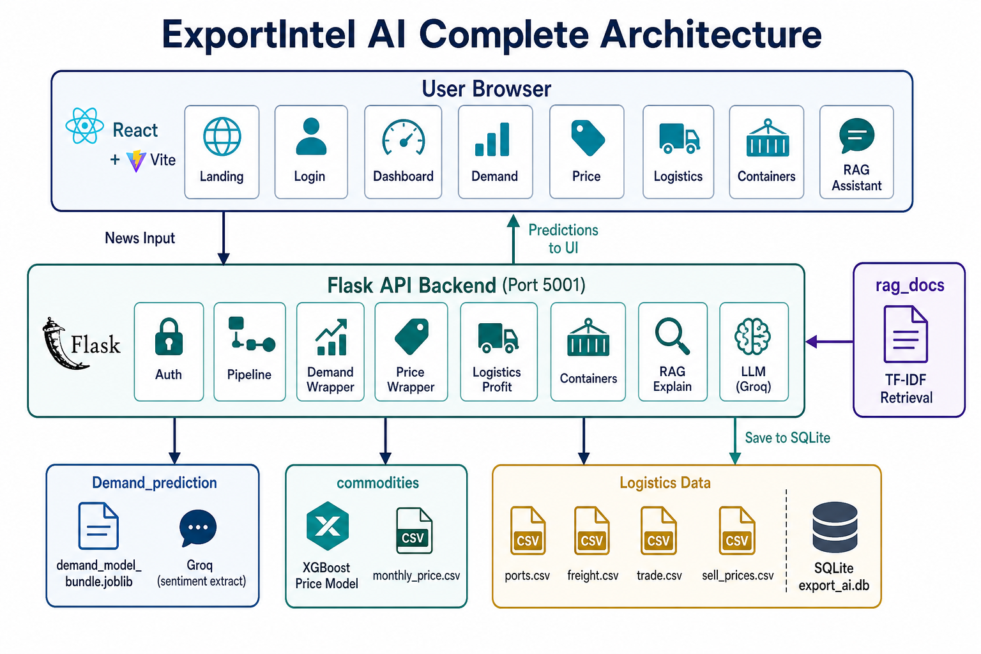
System Architecture
Agents, APIs, models, and knowledge layer
ExportIntel AI · Product Pitch 8/18

Slide 9
Existing System vs ExportIntel AI
Impact analysis & competitive edge
Typical / Existing Approach
Our System
• Spreadsheet + separate tools
• Static news copy-paste
• Price/demand viewed in isolation
• Route cost checked later
• Container plan is manual
• Hard to explain decisions
• One click end-to-end pipeline
• Auto live news (GDELT/RSS)
• Linked demand → price → profit
• Port corridors ranked by INR profit
• Priority-based container allocation
• LLM explanations + RAG Q&A
ExportIntel AI · Product Pitch 9/18
Notes:
Priratization

Slide 10
Core Intelligence: Demand & Price
How scores and forecasts are produced
• Demand score (0–1): news features (shortage, sentiment, opportunity) + trained demand model → ranked opportunities.
• Price forecast: dataset current mandi baseline + XGBoost next-month prediction + explicit news sentiment adjustment.
• Same news → stable prediction; clearly bullish/bearish news → price moves (verified in product behavior).
• All money values for logistics/profit shown in INR (FX ₹96.3/USD); prices stay INR/quintal.
ExportIntel AI · Product Pitch 10/18

Slide 11
Logistics & Profit Engine
Buying cost + quantity-aware allocation
• Net profit / ton = Sell (trade price) − Buy (predicted India price) − Logistics cost / ton.
• Buying amount is always considered via predicted INR/quintal converted to per-ton cost.
• Quantity enters at container & allocation level: payload tons × containers allocated.
• Logistics page compares routes on per-ton profit; Container page shows combined expected profit.
ExportIntel AI · Product Pitch 11/18

Slide 12
System Performance & Live Demo
Local deployment ready for review
• Frontend: http://localhost:5173 | Backend Flask API: http://127.0.0.1:5001
• Live demo path: Login → Fetch Live News / Run Analysis → Demand → Price → Logistics → Containers → Agents/RAG.
• SQLite retains pipeline runs and logistics cost rows for auditability.
• RAG answers use retrieved chunks from demand/price/logistics datasets (Chroma).
• Pitch demo highlight: one analysis produces ranked demand, INR profit routes, and container plan.
ExportIntel AI · Product Pitch 12/18

Slide 13
Live Product Screens
Dashboard · Demand · Logistics · Containers
Dashboard
Demand
Logistics
Containers
ExportIntel AI · Product Pitch 13/18

Slide 14
Alternative Approach Considered
Why we selected the primary design
• Alternative A: Pure LLM decisioning without ML models — rejected (less stable, harder to audit).
• Alternative B: Manual pasted news only — rejected (slow, not product-like for daily decisions).
• Alternative C: Databricks + Kafka-first for every demo — deferred (great for scale; overkill for local review).
• Selected approach: Hybrid ML + live news APIs + Flask/React product UX, with Kafka/Databricks as scale roadmap.
• Result: reliable demos, explainable scores, and a clear path to streaming production.
ExportIntel AI · Product Pitch 14/18

Slide 15
Future Scope & Enhancements
Roadmap beyond the review demo
• Always-on Kafka news producers → Databricks bronze/silver/gold tables.
• Dynamic FX feeds and confidence intervals on price/demand predictions.
• What-if simulator for container count, port constraints, and tariff shocks.
• Role-based multi-user workspaces and exportable board packs (PDF/PPT).
• Stronger evaluation harness: backtests on historical news weeks + route outcomes.
ExportIntel AI · Product Pitch 15/18

Slide 16
Product Impact Snapshot
What the pitch delivers in 14 minutes
• Faster export decisions: one pipeline replaces fragmented analysis.
• Profit-first logistics: buy price, freight, and route compared in INR.
• Capacity realism: limited containers allocated by opportunity priority.
• Trust layer: LLM explanations + RAG grounded in project datasets.
• Demo-ready: live news → ranked opportunities → actionable recommendation.
ExportIntel AI · Product Pitch 16/18

Slide 17
Conclusion
ExportIntel AI turns live market news into ranked demand, price forecasts, profitable routes, and container plans — with explainable AI support.
Q&A Ready · Thank you
ExportIntel AI 17/18

Slide 18
Suggested Speaking Split (~14 min)
Equal participation plan for team members
• Member A (3 min): Title, problem, proposed solution, users
• Member B (3 min): Tech stack, data sources, architecture/workflow
• Member C (4 min): Demand/price logic, logistics profit, existing vs ours
• Member D (3 min): Live demo screens, alternatives, future scope, close/Q&A
• Tip: Keep demo to 1 Run Analysis path — Demand card → Route → Containers.
ExportIntel AI · Product Pitch 18/18

