Slide 1
Searching Personnel Relationship from Myanmar Census Data using Graph Database and Deductive Reasoning Prolog Rules
2016 International Conference on Computer Communication and Informatics (ICCCl -2016)
SOHAM MEHTA
111496015

Slide 2
Aim
The aim of the paper is to explore graph database structure from a census data that can support effective storage structure for peoples' connected information and to study efficient searching algorithm that can find the relationship from separated person nodes

Slide 3
Where is it required?
Social networks like Facebook and LinkedIn to search relationship between social network members
Finding short paths in students' social network using local information about their immediate contacts
To find related information between persons to trace and discover the criminal cases
Searching personnel relationship between A and B for the case like missing MH370 flight
Explore the properties of certain person for corruption case to exchange information among people

Slide 4
Drawback of Previous Works
Most of the relationship searching researches have been developed based on the predefined relationship among every node using existing graph traversal algorithms.
Therefore, the proposed system is aimed to develop searching relationship based on the personnel information of separated nodes stored in graph database.

Slide 5
Highlight of the Paper
Person nodes are separately created with no predefined relationships among them where relationships may be direct links, links with one or more intermediate persons and disconnected persons.

Slide 6
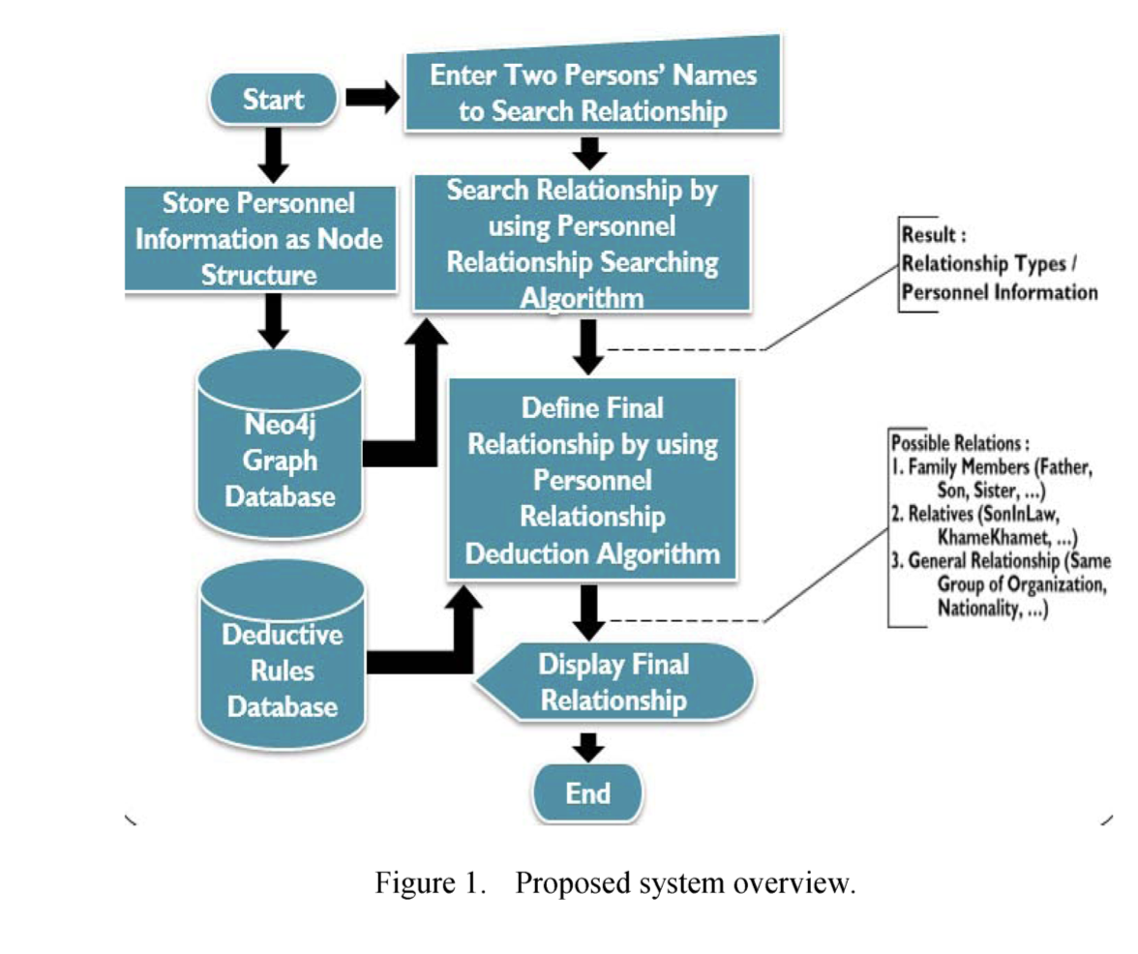
Project Proposed System

Slide 7
The proposed framework include three parts
1)For storage structure, the personnel information is stored as graph structure with persons as nodes by using Ne04j graph database.
2)For graph searching, the user needs to provide two persons' names to search their relation using Personnel Relationship Searching Algorithm. The results are relationship types
3)For reasoning, Personnel Relationship Deduction Algorithm is used to define the final relation for given two persons using the deductive reasoning rules.

Slide 8
Neo4j Graphs
It is a graph database which is used for the storage of graph-oriented data structures with nodes, edges, and properties to represent and store data.
Both nodes and relationships can hold any desired properties called key-value pairs. It has no rigid schema, node-labels and relationship-types can be defined arbitrary by users
Storage is optimized for the traversal of the graph, without using an index. It has fast deep traversal instead of slow SQL queries that span many tables joins.
Graph databases are used in many application domains like Social Networking and Recommendations, Calculating Routes, Network and Cloud Management, Master Data Management, Geospatial, Bioinformatics, Content Management, Security and Access Control

Slide 9
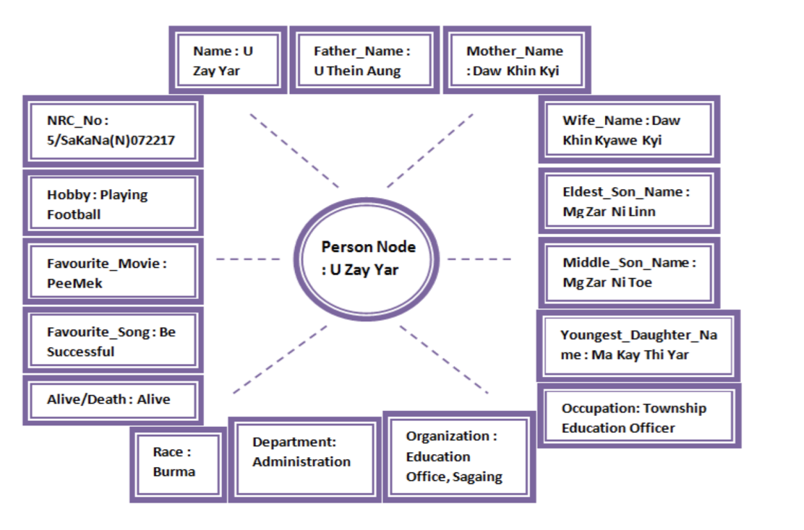
Node Reprsentation

Slide 10
Graph Search Algorithm
This searching focuses on matching every domain (or) attributes of each node for given two persons' names. For e.g. the searching algorithm starts matching one of the given values with every property (attributes such as name, occupation, address, father name, mother name, sibling name, etc.) of each node
One of the following 4 cases occur during the search:
Case 1: Searches Direct relationship
Case 2 : Searches Indirect relationship
Case 3: Searches relationship between two persons who are not connected but have same properties such as on same properties such as same occupation, same organization, and same hobby
Case 4: Defines for general relationship between given two persons such as nationality, race, maritial status etc.

Slide 11
Personnel Relationship Deduction Algorithm
After searching the common node or intermediate nodes that are related to given two persons, the final relationship is defined by using the deductive reasoning algorithm.
For example:
1) if the matched domain is relative or consanguine, types of relatives will be defined.
2) If matched domain is on specific attributes like work or organization, the co-worker or friend relation will be defined.
3) If the matched domain is on general attributes like religion or nationality, the same group of religion or nationality will be defined.

Slide 12
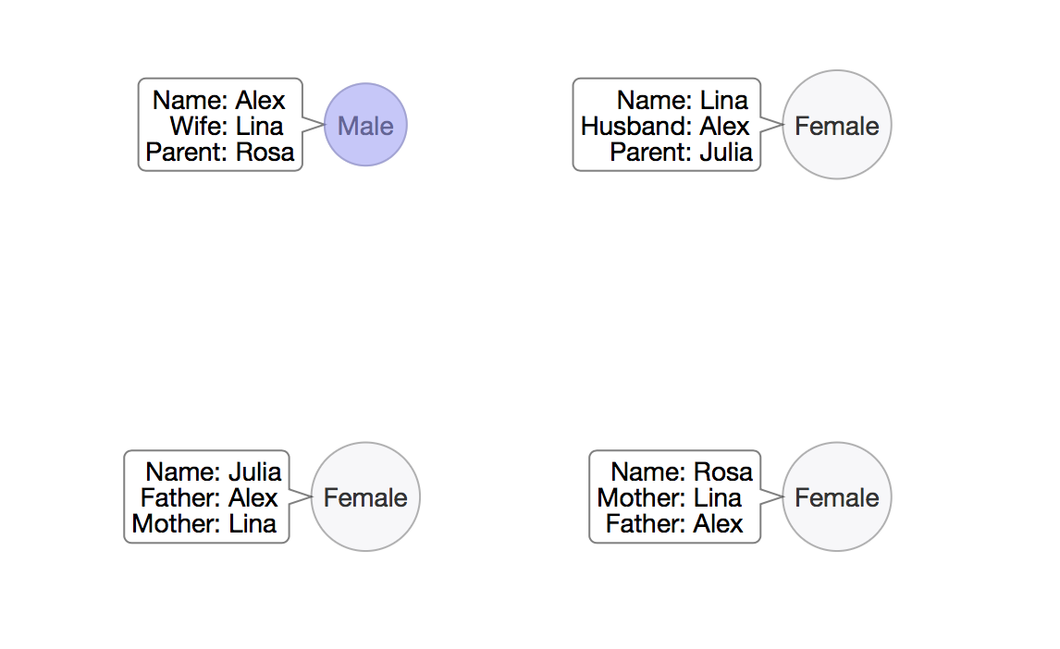
Implementation to Verify their approach
Since the paper repeatedly stresses on creating person nodes that are separately created with no predefined relationships, I tried to duplicate the same concept with the Example we learned in the class.

Slide 13
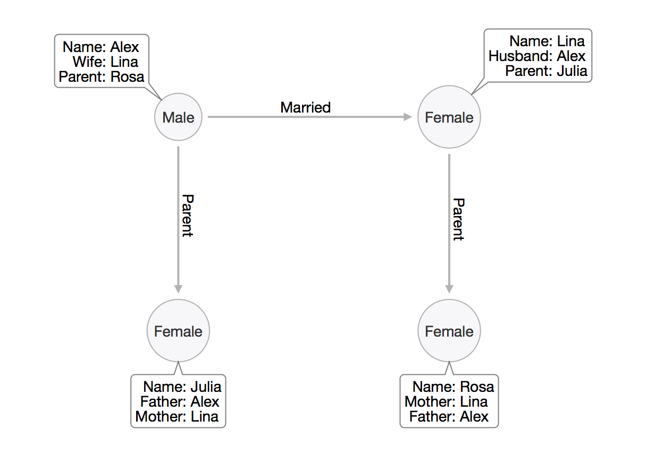
Including the relationships using the properties of the data nodes

Slide 14
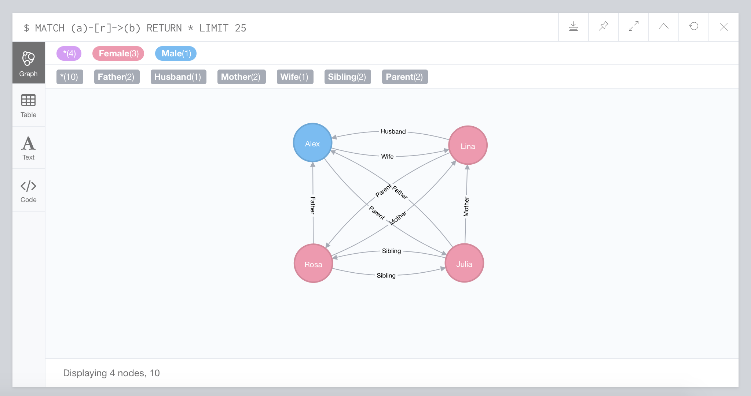
Running on Neo4j Sandbox

Slide 15
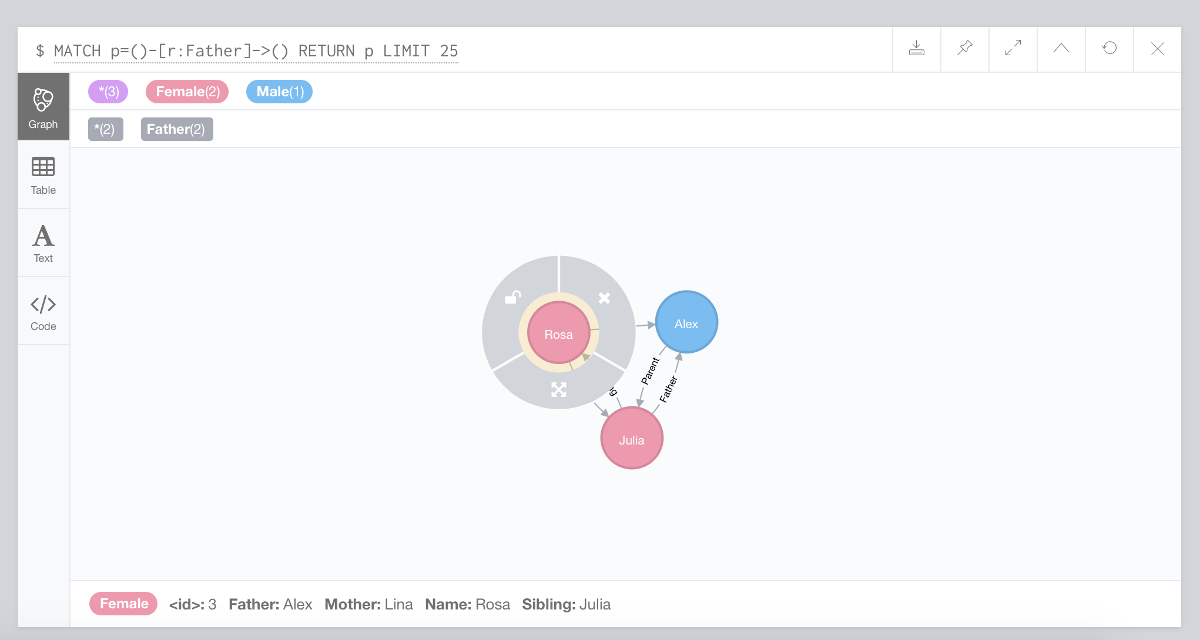
Selecting Rules with Neo4j
Here, we can simply select the nodes or the relations to find the respective tuples.
The following graph is for all nodes that have “Father” relation.

Slide 16
Extending the Paper
The authors have tried to implement to model the relation ships in the form of graphs so that the traversal Is fast. It justifies the reason of using graphs by stating that it is faster than SQL queries that require joins. It indeed can store complex and dynamic relationships of highly connected data like personnel information.
However, the relations between each nodes have to built separately. The effort of building relations for each entity in a large dataset is not practically possible

Slide 17
Using Prolog for Deduction
Prolog is a general purpose logic programming language in which the program logic is expressed in terms of relations, represented as facts and rules. This language has been used for theorem proving, expert systems, as well as natural language processing. It is well- suited for specific tasks that benefit from rule-based logical queries such as databases searching, voice control systems, and template filling.

Slide 18
Extending the paper using Prolog
Reasoning is the process of forming conclusions and judgments from facts or premises. It is the ability to coherently think from perceived premise to a logical conclusion
The main advantage for using Prolog is that we do not need to create relations for each and every node.
Instead, we just need to create a set of rules which will help make the system to make deductions based on rules and fact
It includes procedures for defining deductive rules which can infer information called intensional database and the facts loaded in the extensional database.

Slide 19
Thank You
Soham Mehta
111496015

