Slide 1

OCUFY
A MOBILE EYE TESTING INTERFACE
SOHAM MEHTA
RONAK SHUKLA
DR. XIAOJUN BI
DEPARTMENT OF COMPUTER SCIENCE,
STONY BROOK UNIVERSITY

Slide 2
What is the Problem?
Eye-testing is one of the most important health check-up which is required by all individuals.
However, it turns out that eye-checking is the most neglected health check-up of all time.
It is recommended to check-up eyes every six months.

Slide 3
Who is Affected?
Old Age People : 81% of all vision impaired people are aged 50 years and above
Children : An estimated 19 million children are vision impaired
Rural People : Developing & Underdeveloped countries have most affected people.
Women : 2/3rd of blind people are women
80% OF ALL VISION IMPAIRMENT CAN BE PREVENTED OR CURED.
Source : https://www.light-for-the-world.org/two-thirds-blind-people-are-women

Slide 4

What pain do we relieve ?
With advances in technology, the human eye is getting more and more hitched to the digital screen making it prone to blurred vision.
A study published in the journal Ophthalmology found that on current trends 50 percent of people on the planet would need glasses or contact lenses with 10 per cent suffering from severe myopia
Our application relieves the pain of the user who has no access to an eye clinic
Also it is for the user who does not anticipate the need for checking their eye until their vision is affected

Slide 5
Reasons for the Problem?
There aren’t many eye clinics available in the rural areas.
People do not anticipate the need for checking their eye until their vision is affected
It is too time consuming to go to book an appointment and visit the doctor

Slide 6
Are there any Existing Systems?
Being one of the most affecting problem on earth, there are lot of software solutions available.
They are available for both professional or personal use
But these solutions are faced 2 Major Problems

Slide 7
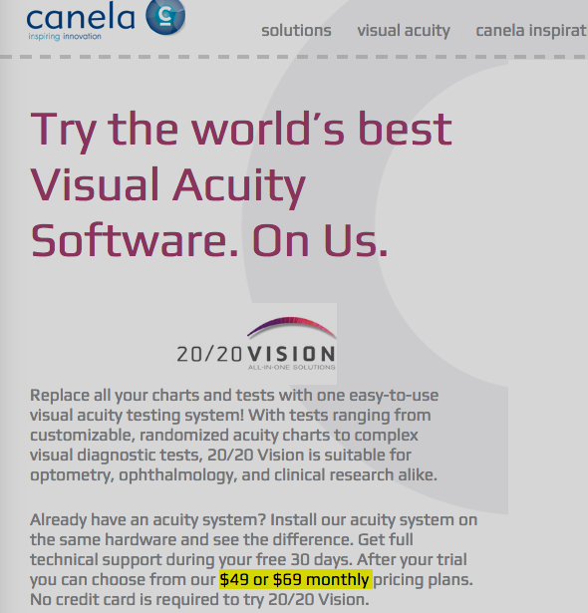
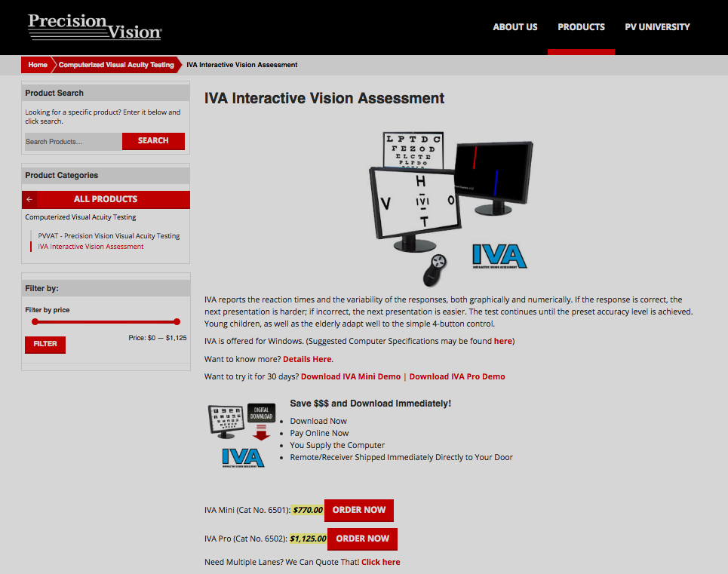
Problem 1 : Too Expensive
There are few start of the art software solutions available by professional companies.
• 20/20 Vision (Canela Software) • PVVATTM (Precision Vision)

Slide 8
Problem 2 : Incorrect Results
Due to rise in number of mobile phones, number of free applications are available in the Playstore.
Apps like “Eye Test- Eye Exam”,”iCare Eye Test-Eye Care” offer basic eye test by showing characters on screen and taking users response.
However, these apps easily provide incorrect results if the user is holding the phone at wrong distance
Since these existing apps have no metric to maintain this distance invariant, they show test of incorrect size making the application just a “gimmick”!

Slide 9
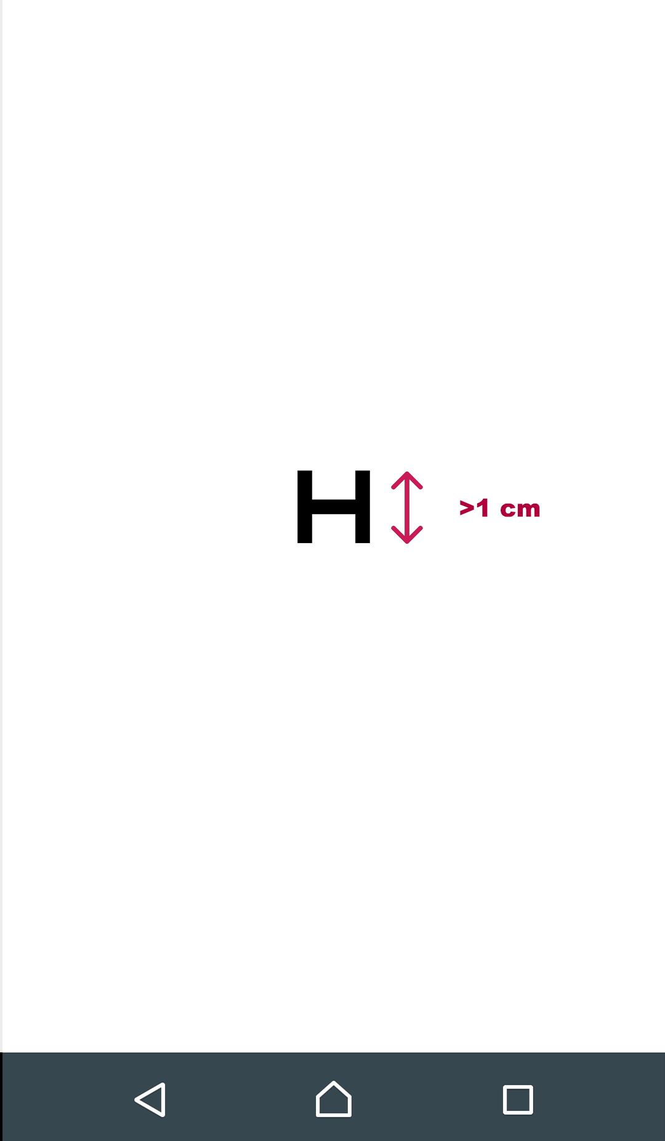
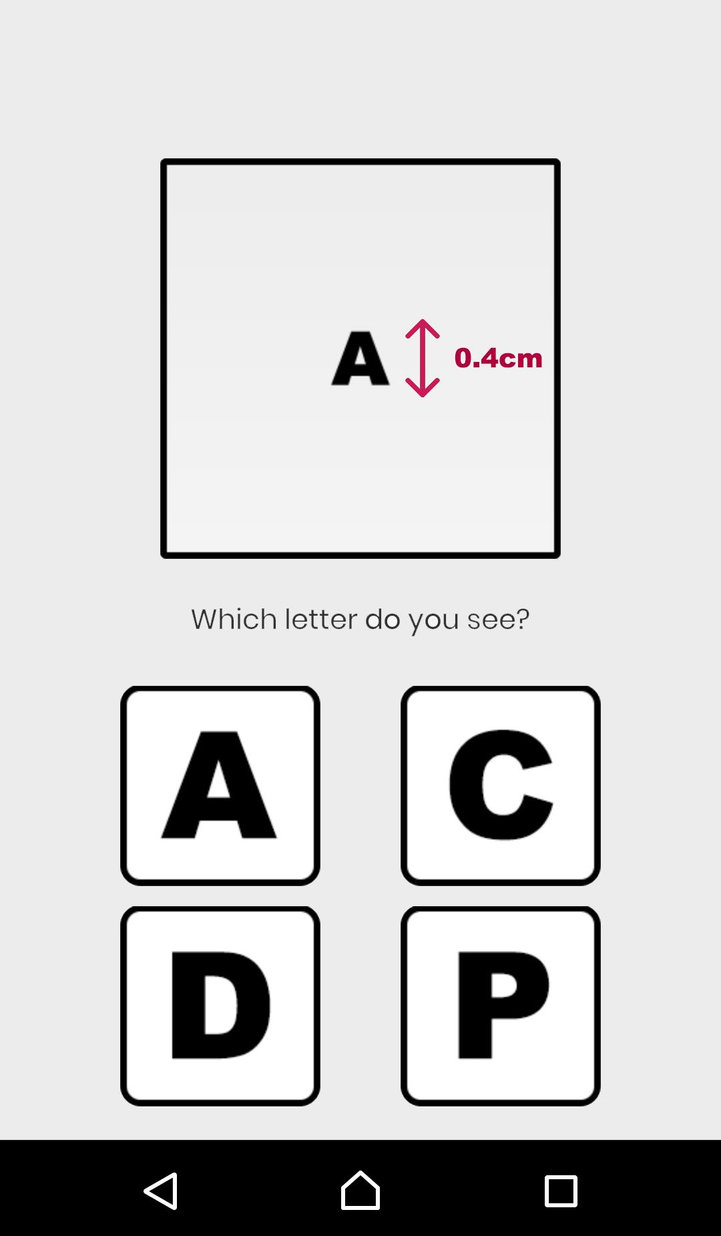
Problem 2 : Incorrect Results (Example)
EyeTest (Health4Mob)
OcuFy

Slide 10
What did we do?
Ocufy is a Mobile Eye Testing Interface which you can use to find your eye acuity in under just 5 minutes.
It is free to use and will provide the most accurate results than any other eye testing mobile application ever built!

Slide 11
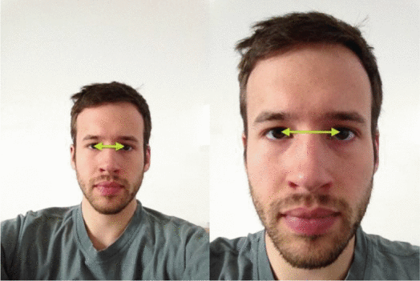
How are we unique?
We have used Android Face Detection libraries to find the recognize eyes from face and then find the distance between them
With the help of this, we have devised a method to identify the distance of the phone from the face with respect to the eye distance measured.

Slide 12
How are we unique? (2)
This phone-to-face distance is then used to make sure that the user is holding the phone at a certain distance after only which the test will start
The test is devised in accordance to the distance to the phone so as to provide the most accurate results.
Also the alphabet in the test are not usual characters but are special characters called “Optotypes” which are scaled according to Snellen factor!

Slide 13
WORKING OF THE APPLICATION
(TECHNICAL CORE)

Slide 14
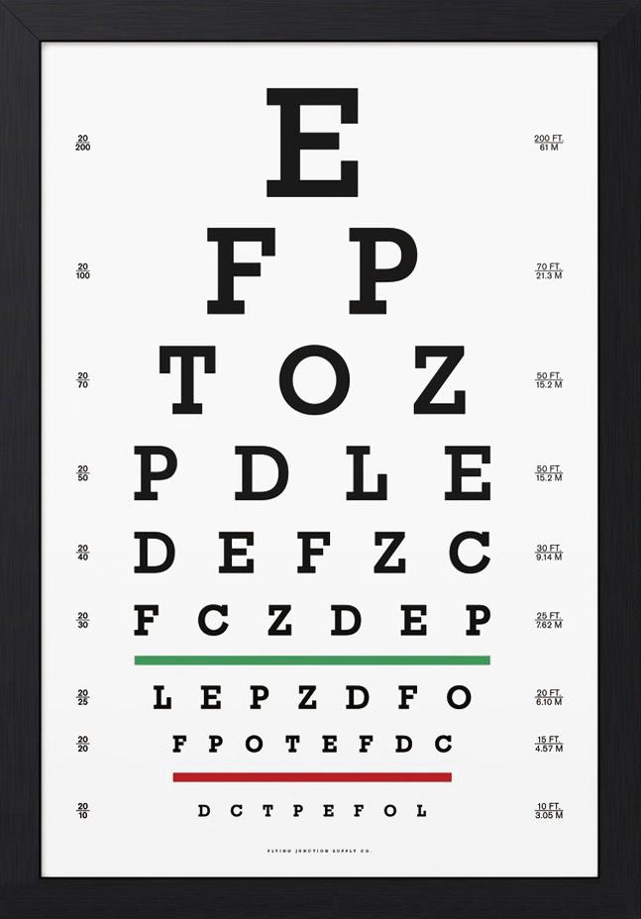
How does Traditional Eye test work?
A Snellen chart is an eye chart that can be used to measure visual acuity
Only the ten letters C, D, E, F, L, N, O, P, T, Z are used in the common Snellen chart.
A person taking the test covers one eye from 6 meters or 20 feet away, and reads aloud the letters of each row, beginning at the top.
The smallest row that can be read accurately indicates the visual acuity in that specific eye
Source: https://en.wikipedia.org/wiki/Snellen_chart

Slide 15
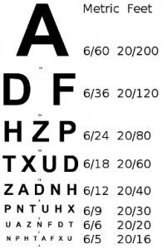

Distance at which user can see it from
Distance at which a normal person can see it from

Slide 16
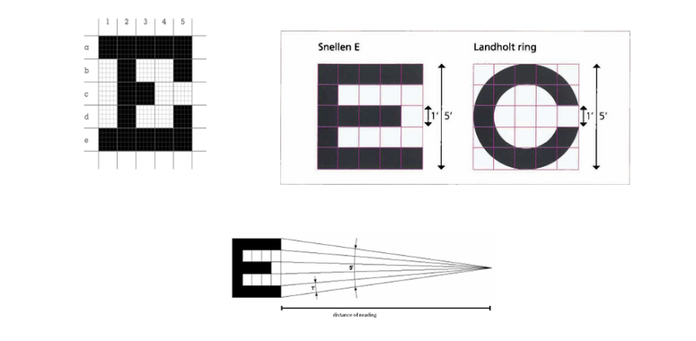
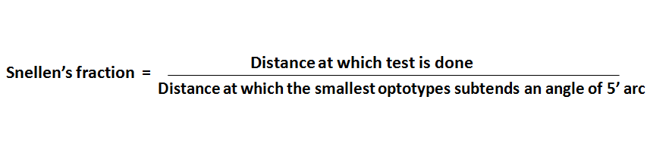
What is special about the alphabets?
Snellen developed charts using symbols based in a 5×5 unit grid so that the size of the critical detail (each gap width) subtends 1/5th of the overall height
The thickness of the lines equals the thickness of the white spaces between line
The height and width of the optotype (letter) is five times the thickness of the line.
where 1 minute of arc is 1/60 of a 1 degree
Source : http://optometryzone.com/2016/11/10/visual-acuity-chart/

Slide 17
Can this test be made mobile?
There have been multiple attempts to make an online eye check-up test.
But most of these turned out to be not accurate and definitely "not a replacement for a comprehensive eye health examination.”^{[CNN]}
The users easily see all the lines of the Snellen Chart while using the phone
Source : https://www.cnn.com/2017/03/15/health/online-eye-exam-telemedicine-explainer/index.html

Slide 18
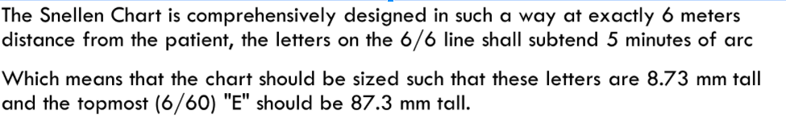
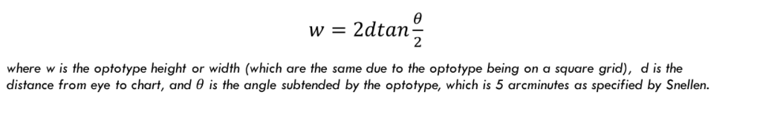
HCI to the Rescue!

Slide 19
How is this information used?
After doing all these calculations we came up with the golden number that tells us the size of the largest optotype on the basis of the distance between the face and the screen
Height & Width of the largest Optotype = × Phone-to-Screen distance
68.76

Slide 20
That's how the test is optimized!

Slide 21
DEMO

Slide 22
www.ocufy.xyz

Slide 23
Future Scope
Using the face detection module as a service so that the test can be stopped every time a user takes the phone near the face
Design an algorithm to provide unique eye test for each individual on basis of user’s phone distance, age, gender etc.
Provide relevant doctor suggestions in nearby locality(using apis) if the user requires to immediately check up with an opthamologist
Increase the functionality of the application by providing tests to check colour blindness, astigmatism, contrast/sensitivity, cataract detection, duochrome acuity etc.

Slide 24
ANY QUESTIONS?

Slide 25
THANKYOU

