Slide 1
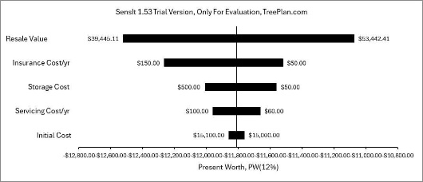
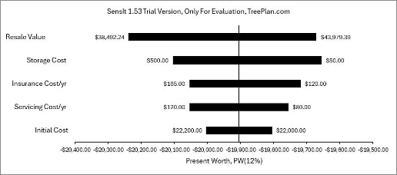
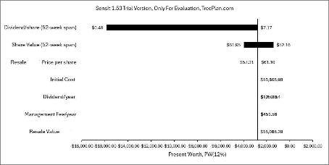
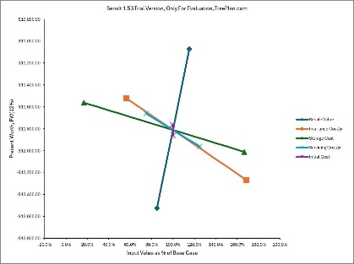
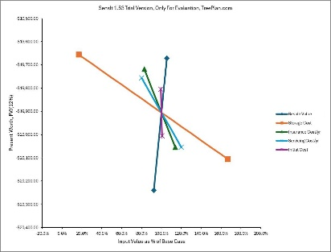
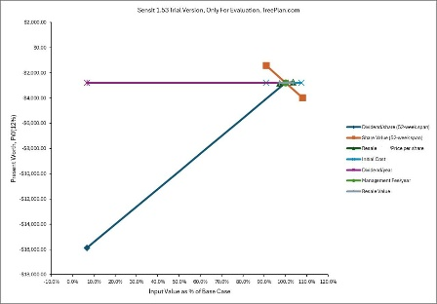
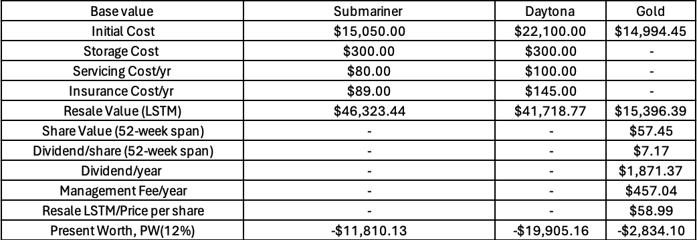
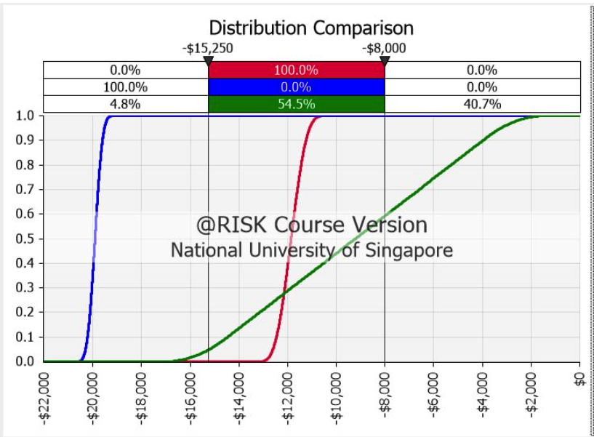
IE2111 ISE Principles & Practice II (2024) Project Timeless Investments: A comparative analysis of Watches and Gold ETFs Aloysius Marcello Widagdo Benedict Chua Muaz Omar Rahul Mitra Soham Goswami Zhang Xianyang
Problem Description
Tornado & Spider Diagram
What-If analysis
Our project aims to deliver a comprehensive analysis of investing in Rolex watches versus investing in Gold-ETFs - specifically iShares Gold Strategy ETF (IAUF). Our goal is to analyse the historical data of these Rolex watches and IAUF. We will be using a Time-Series model to predict the future values of IAUF and Rolex watches, considering how different factors affect the prices of Rolex watches and IAUF. As a result, we will be providing investors with decent analysis and suggestions on which of the two financial investments is the more appropriate investment.
Submariner
Daytona
Gold ETF
Financial:
1. IAUF dividend growth by 0.1% per year
2. Black Swan event – Pandemic
3. Rolex models discontinued
Non-Financial:
1. Geopolitical Tensions
2. Environmental Factors
3. Liquidity Risk
Base Value Data & PW
Probabilistic Risk Analysis
Key Assumptions
Monthly MARR is 12%.
Study period is 20 years.
All cash flows are after-tax cash flows.
Personal income tax not taken into consideration.
Conclusion
Alternatives
To summarise, an investor would opt for IAUF should he have a higher risk tolerance, looking for higher potential returns. An investor can opt for the Rolex Submariner if he/she has a milder risk tolerance. Finally, the Rolex Daytona will be the preferred choice should he/she have a lower risk tolerance and favour a relatively stable return on investment.
Invest in gold ETFs
Invest in Rolex Watches

