Slide 1

CodeIt
Java-Microproject
Online code compiler
(web based platform)
Team members:
1.Soham Pirale(2032)
2.Anjali Landage(20)

Slide 2
Overview of the project
Project Goal: To create a web-based Python compiler that allows users to write, execute,
and view output of Python code in real-time from any device.Key Achievements
Tech Stack: Backend developed using Spring Boot with REST APIs, and data is stored in
MongoDB for persistence.
Challenges and Solutions
Execution Engine: Integrated with Judge0 API (or your own logic – tell me what you
used) to safely compile and execute Python code in a sandboxed environment.

Slide 3



Relevance to Real World Problems
No heavy IDE or Setup effort is required
One step closer to cloud based IDE -
Coding on the Go
Education & Learning
our platform enables coding and execution from any device, anywhere.
Students can test and learn without any technical hurdles or system requirements.

Slide 4
Objectives of the project
✅
Enable Online Python Code Execution:
✅
Provide a Beginner-Friendly Environment:
✅
Implement User Authentication
✅
Integrate a Secure Code Execution Engine:

Slide 5

Problem Statement
Beginners, students, and developers often face barriers when trying to run Python code—such as the need to install local environments, configure IDE’s, or manage dependencies. These challenges slow down learning, quick prototyping, and accessible coding, especially on limited or shared devices.
There is a need for a lightweight, browser-based Python compiler that enables secure, real-time code execution with zero setup—accessible anytime, anywhere.
Target Users
Domain
EdTech (Educational Technology)
👨‍🎓 Students & Beginners
👨‍🏫 Educators & Trainers
Online Coding Tools / Cloud IDEs
👨‍💻 Developers & Programmers
Developer Productivity Tools

Slide 6
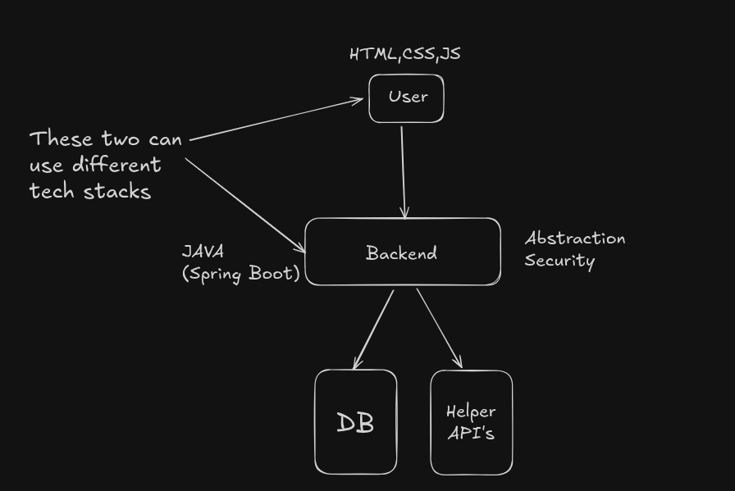
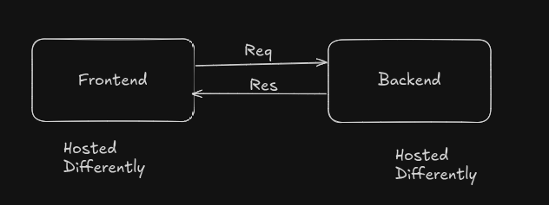
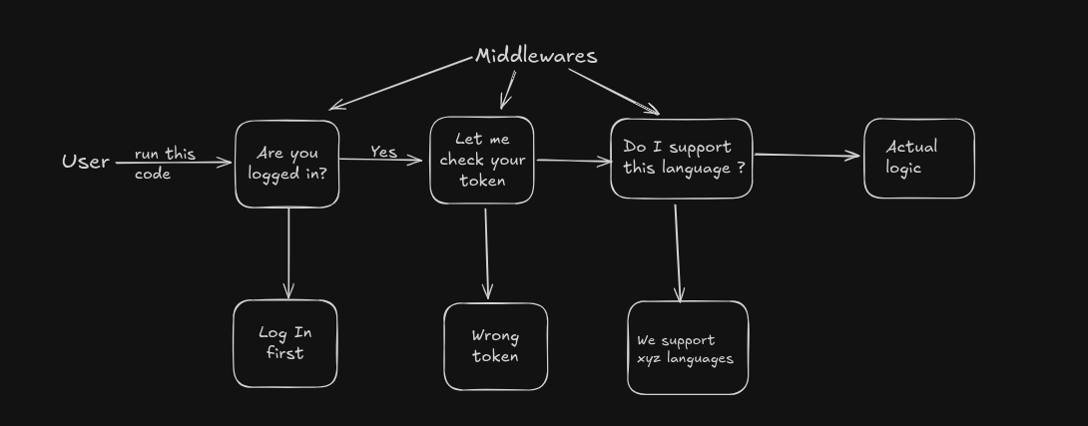
Architechture
2.
1.
3.

Slide 7



Tech Stacks
Database
1.MongoDB
2.In memory
Backend
1.Java (Spring Boot)
Dependancies
1.MongoDB Driver
2.Json web token
Frontend
1.Hosting Platform -Vercel
2.Tech Stack-HTML,CSS,JS

Slide 8
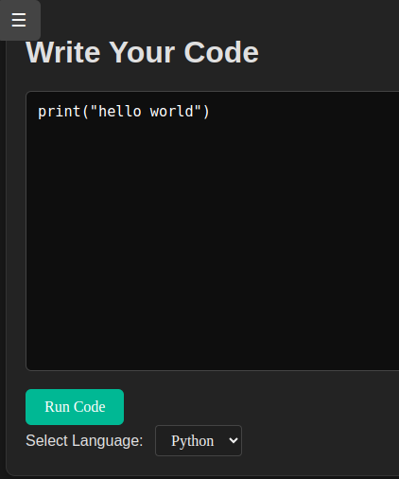
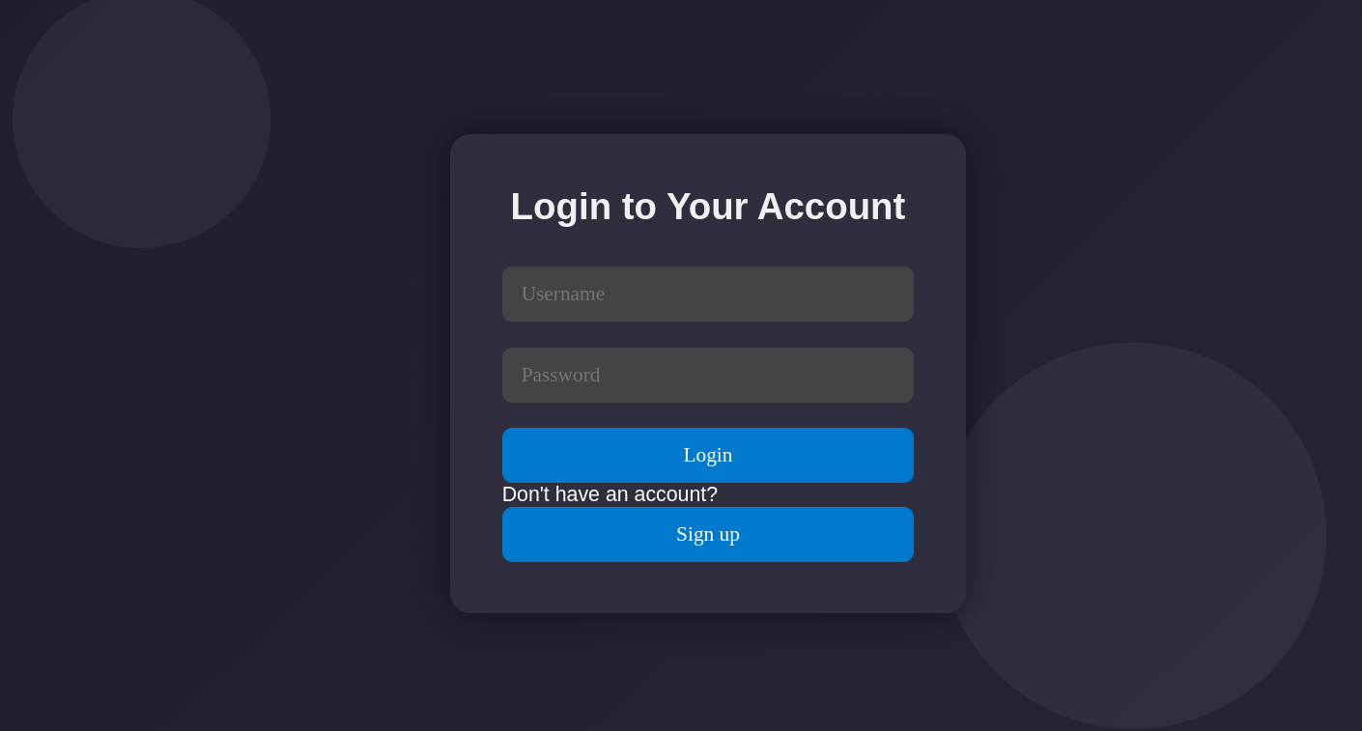
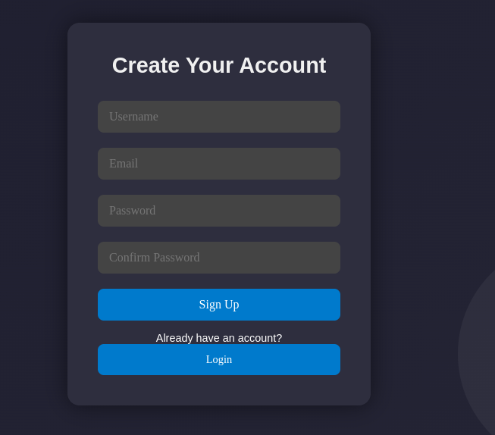
Implementation
onlineCompilor
login
signup

Slide 9
Challenges & Learnings
🔧
Code Execution Environment Integration
💾
Temporary Code History Storage
🔐
Handling Authentication
🌐
Frontend and Backend Communication

Slide 10

Conclusion and Future Scope
Summary of completed features
Online Python Code Editor
Judge0 API Integration
User Authentication
Temporary Code History
Frontend Hosted on Vercel
Real-time Output Display
Future Scope
Syntax Highlighting & Code Editor Upgrade
Collaborative Coding (Pair Mode)
Code Sharing & Snippet Links

Slide 11
Thank you

