Slide 1
SonarQube
Presented by: Bansari Deshmukh & Astha Gangwar

Slide 2
Agenda Day-1
• Importance of Static Code Analysis
• Introduction to Static Code Analysis
• What is SonarQube?
• Why SonarQube?
• Basic Understanding and its features
• SonarQube Architecture
• Sonarqube Dashboard

Slide 3

IMPORTANCE OF STATIC CODE ANALYSIS
Comparison with real life example
Copyright © 2021 Cybage Software Pvt. Ltd. All Rights Reserved. Cybage Confidential.
www.cybage.com

Slide 4
Class Tests
Software Application
Student
Mathematics
Bugs
Physics
Vulnerabilities
Code Smells
Duplications
Data Structure
Digital Logic
Semester Exams
QA Testing
Static Code Analysis (Sonarqube)
Final Exams
Production

Slide 5
Introduction to Static Code Analysis
Examining code without executing the program
Checks for coding standards in program
Checks Code as per industry standards
Detects bugs at an early phase of software development

Slide 6

Pain areas and Solution
Non respect of coding standards
Having duplicated lines of code
Having complex component
Having no or low code coverage by unit tests
Leaving potential bugs , performance issues
Not following architecture and design
Code with no Conventions
Solution:

Slide 7
What is SonarQube?
Static Code Analysis tool
Open source platform to manage & analyze code quality, developed by SonarSource
It provides health of an application and issues newly introduced.
Code quality management platform
Written in Java

Slide 8
Why SonarQube?
It covers the 7 axes of code quality
Supports 25+languages (50+ plugins)
Combine metrics altogether with historical data
It provides efficient dashboard
Quality Gates
Configurable quality profiles
Permissions (Global level /Project level)

Slide 9
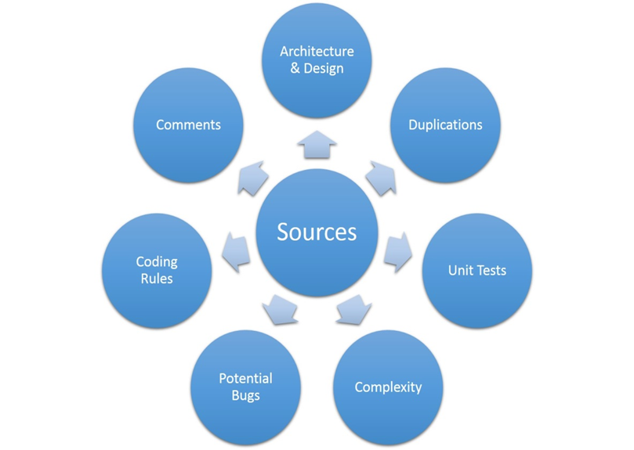
7 Axes of Code Of Quality
o
Copyright © 2019 Cybage Software Pvt. Ltd. All Rights Reserved. Cybage Confidential.
www.cybage.com

Slide 10
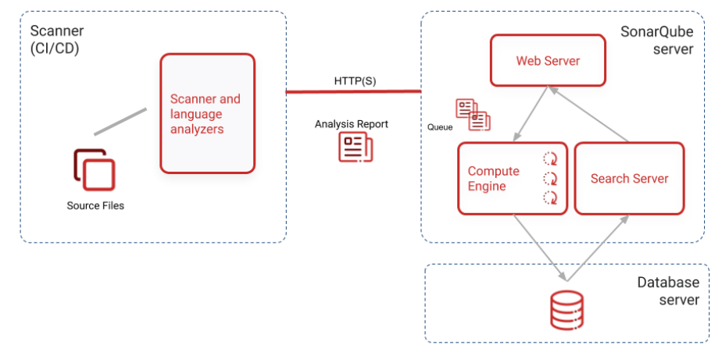
SonarQube Architecture

Slide 11
SonarQube Architecture
The SonarQube server running the following processes:
A web server that serves the SonarQube user interface.
A search server based on Elasticsearch.
Compute engine in charge of processing code analysis reports and saving them in the SonarQube database.
The database to store the following:
Metrics and issues for code quality and security generated during code scans.
The SonarQube instance configuration.
One or more scanners running on your build or continuous integration servers to analyze projects.

Slide 12
Benefits of SonarQube
Increase developer skills:
Receives regular feedbacks on quality issues .
Increase Productivity:
It detect and reduces duplication and redundancy of code.
Detects and Alerts:
It detects bugs in the code automatically and alerts developers

Slide 13
Benefits
Sustainability
By reducing complexities, duplications and potential bugs
Neat and clean code
Increased unit tests.
Centralize Quality:
One place to provide a shared vision of code

Slide 14
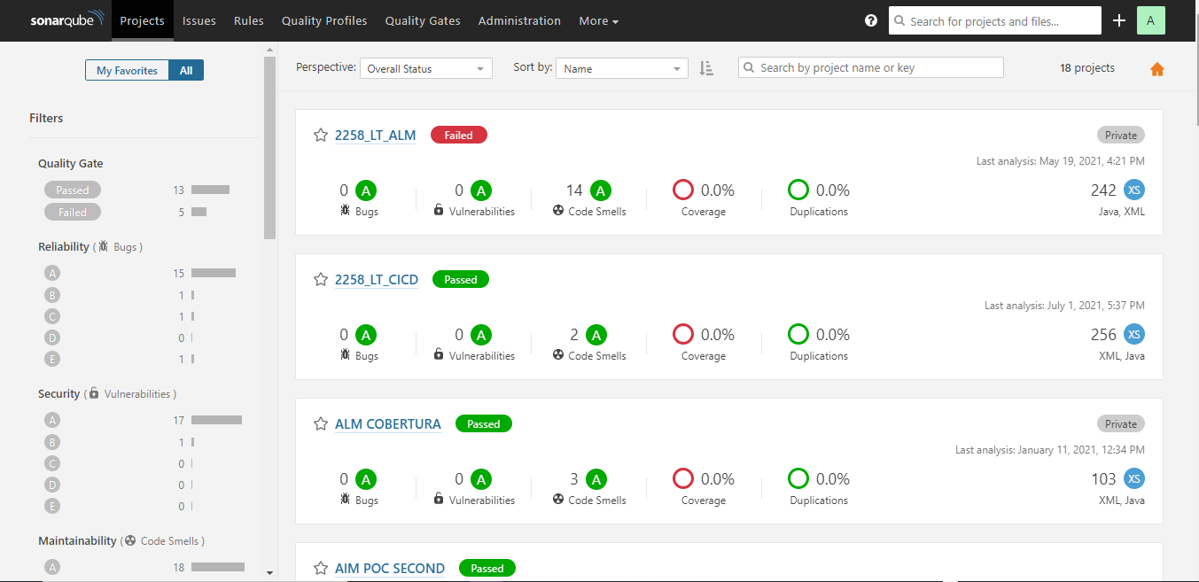
Sonarqube Dashboard

Slide 15


Thank You!
12/13/2023
www.cybage.com
Copyright © 2023 Cybage Software Pvt. Ltd. All Rights Reserved. Cybage Confidential.

