Slide 1
SonarQube
Presented by: Bansari Deshmukh & Astha Gangwar

Slide 2
Agenda Day-2
• Supported Languages
• Code Coverage
• Quality Profile/Quality Gate
• Sonarlint
• Integration with other tools
• Security in Sonarqube
• Comparison with other tools
• Pre-requisite of Sonarqube

Slide 3
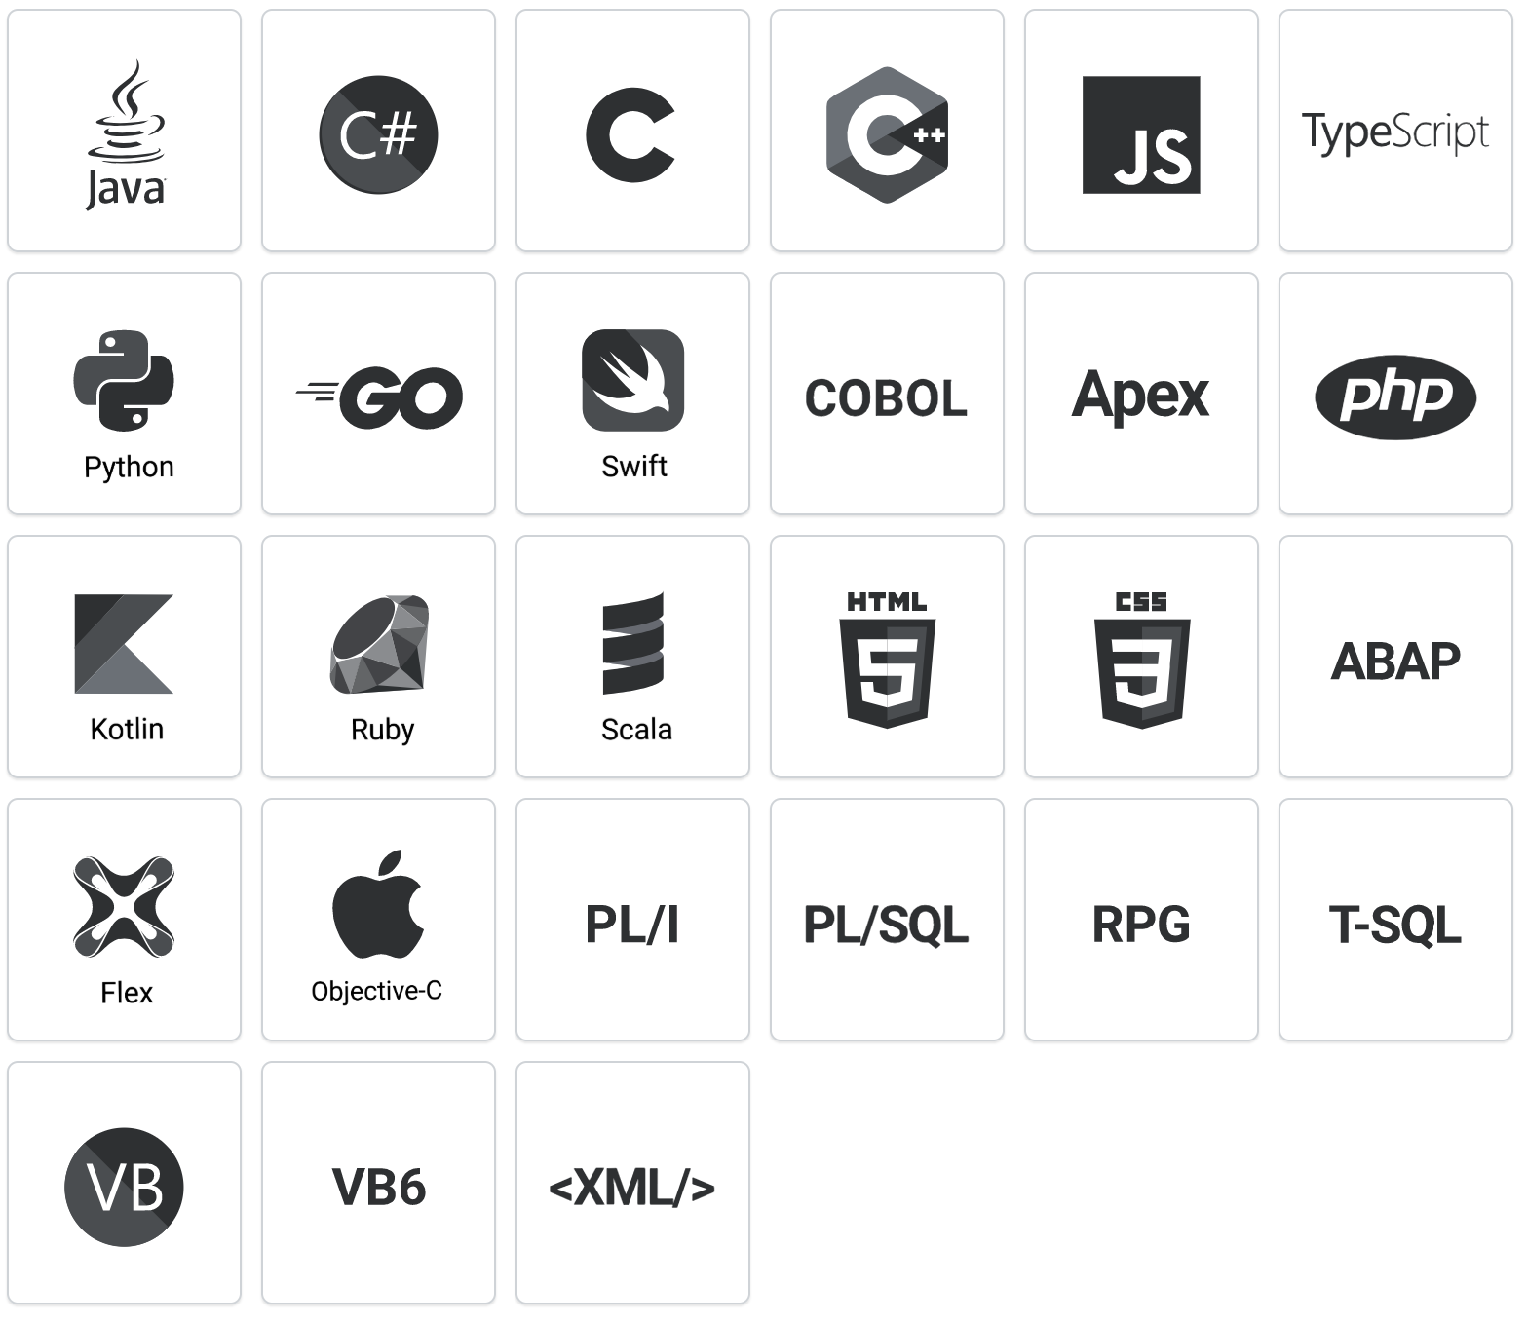
Supported Languages

Slide 4
Code coverage/Report
Lines of code covered by unit tests
Showcase Unit tests execution and code coverage reports
Some supported code coverage tools
JaCoCo
Cobertura
Clover
jasmine/karma

Slide 5
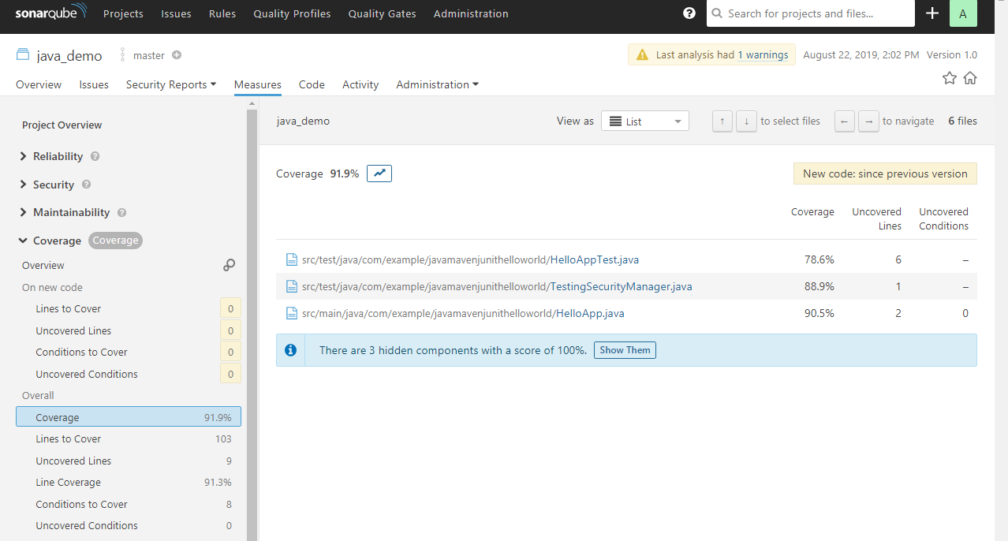
Code Coverage

Slide 6
Quality Profiles
Collection of rules to apply during analysis
Same or different profile for multiple project
You can implement quality profile according to languages eg. Java, PHP, JS ,Html etc.
Rule configuration- Activation/Deactivation/Modification

Slide 7
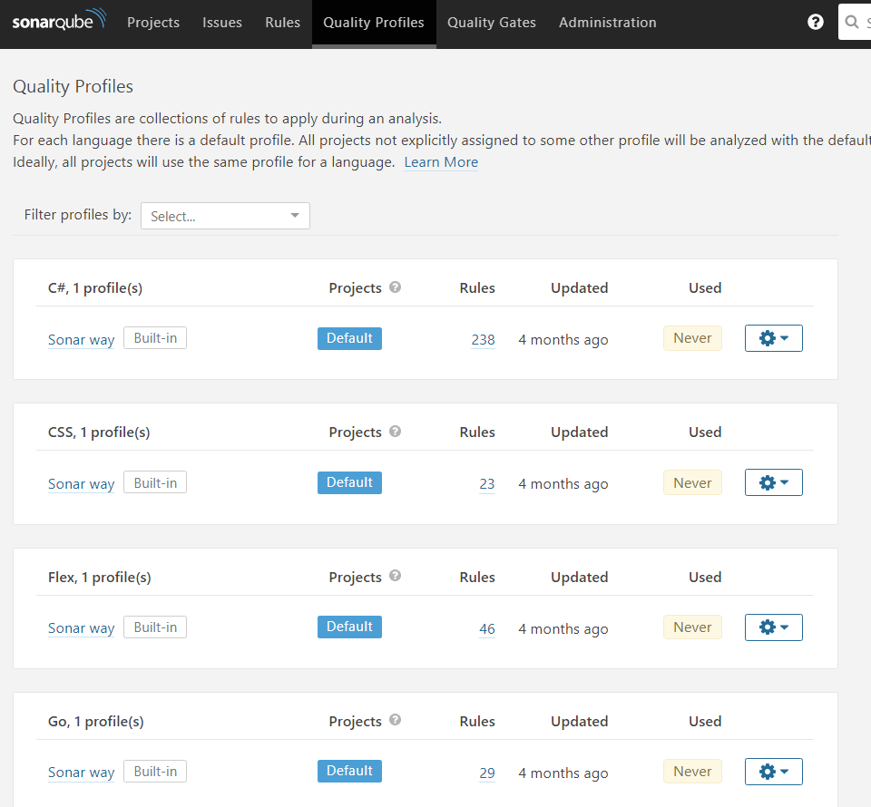
Quality Profile

Slide 8
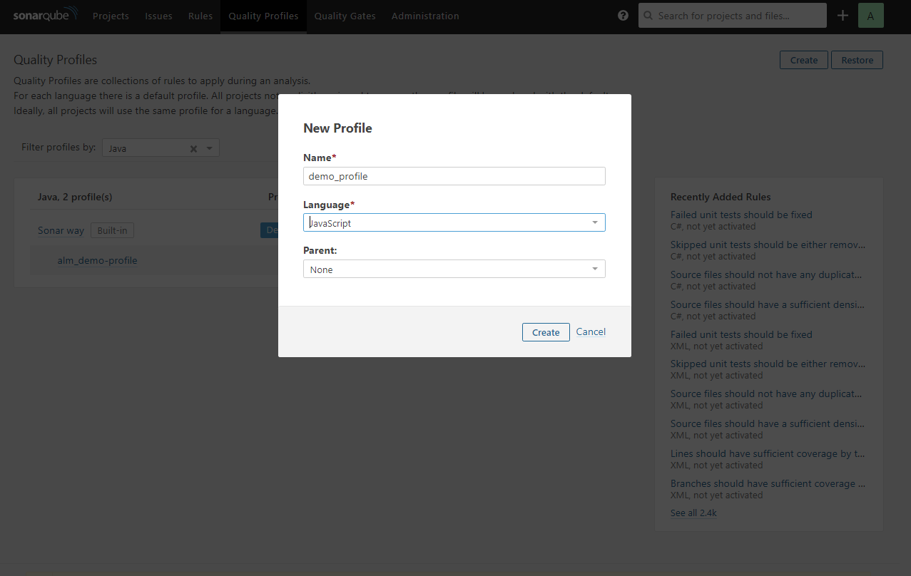
Creating New Profile

Slide 9
Quality Gates
Set of Boolean conditions
It helps you know immediately whether your projects are production-ready
Multiple conditions
E.g. code coverage < 80 %
duplications < 50

Slide 10
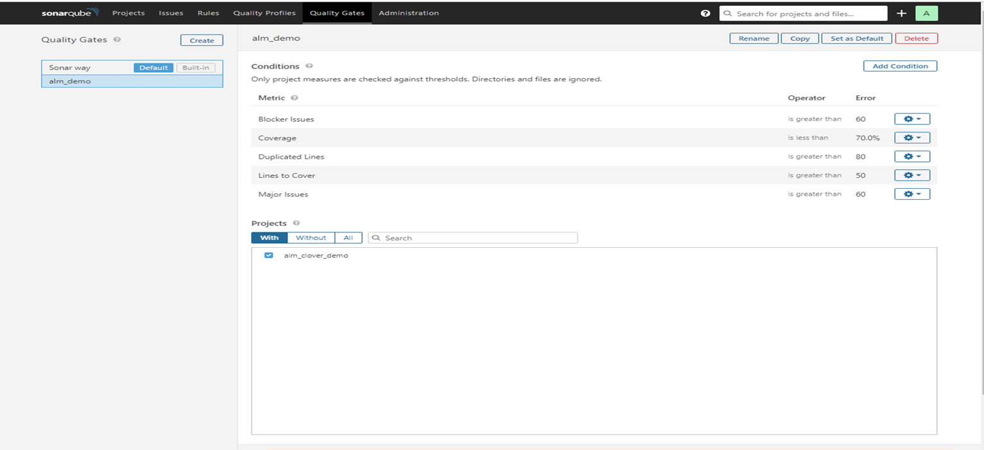
Quality Gate

Slide 11

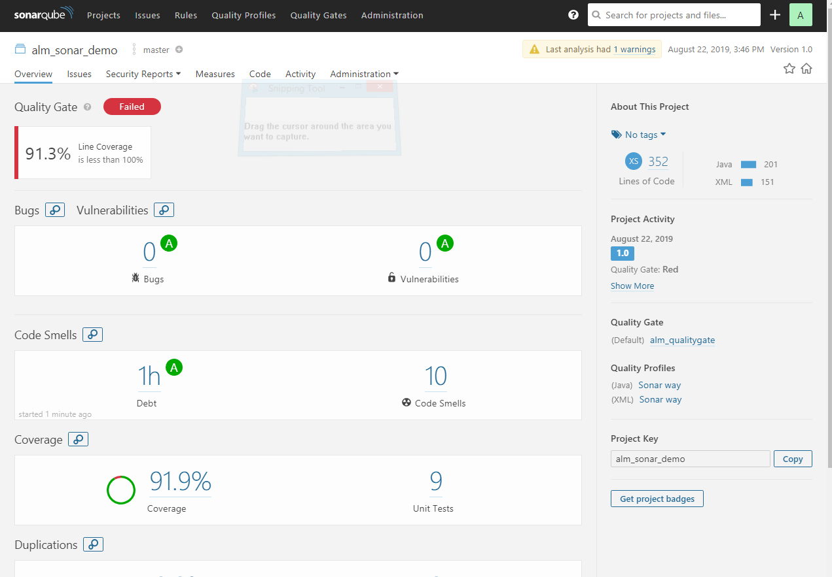
Quality Gate

Slide 12
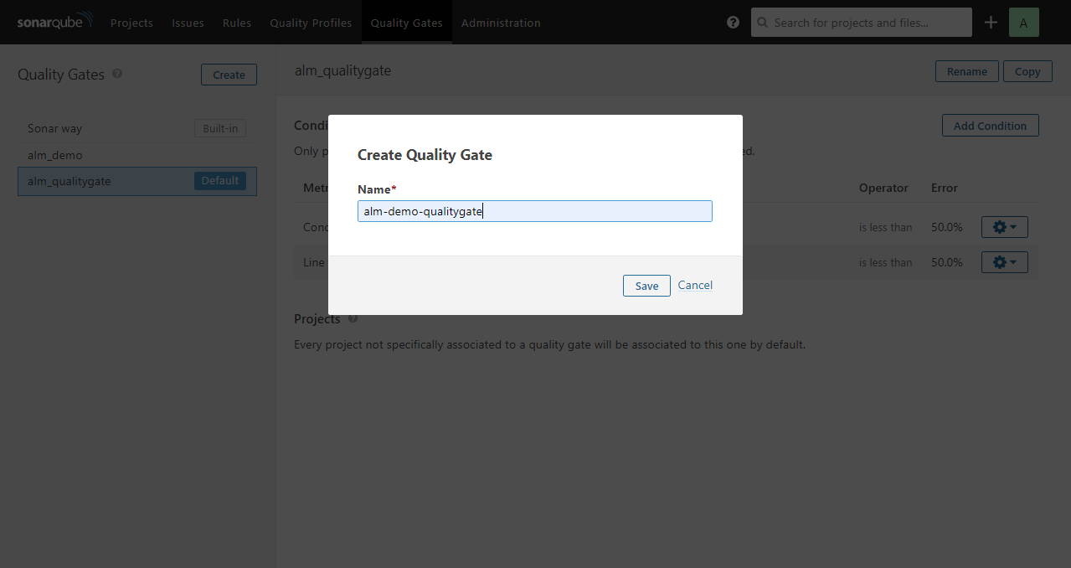
Quality Gate

Slide 13
Class Tests
Physics>40
DS>40
Vulnerabilities<20
Bugs<20
Software Application
Student
Mathematics
Bugs
Physics
Vulnerabilities
Code Smells
Duplications
Data Structure
Digital Logic
Semester Exams
QA Testing
Static Code Analysis (Sonarqube)
Final Exams
Production

Slide 14
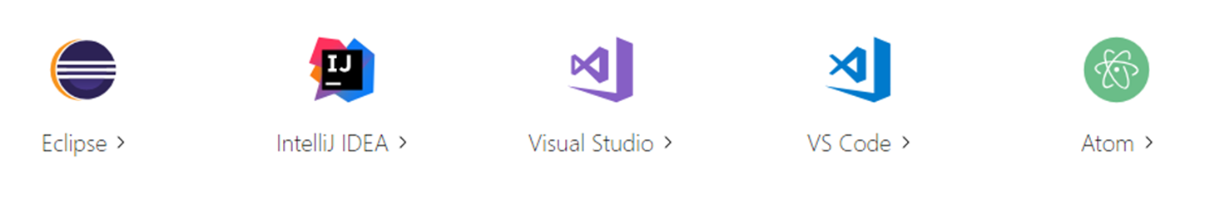
SonarLint
Fix issues before they exist.
SonarLint is an IDE extension that helps you detect and fix quality issues as you write code.

Slide 15
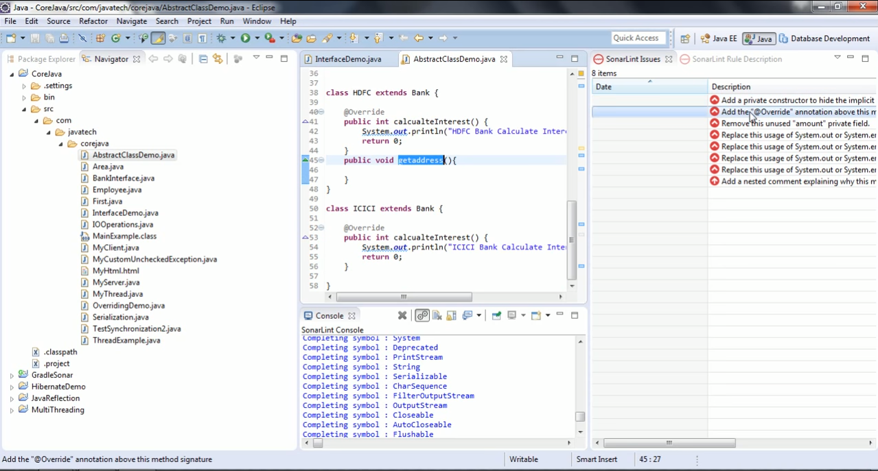
SonarLint

Slide 16
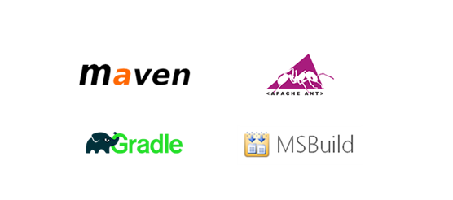

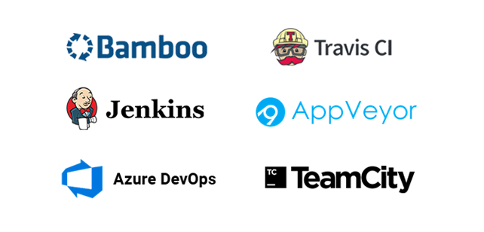
Integration with other tools
1.IDE
2.Build Tools
3.Continuous Integration

Slide 17
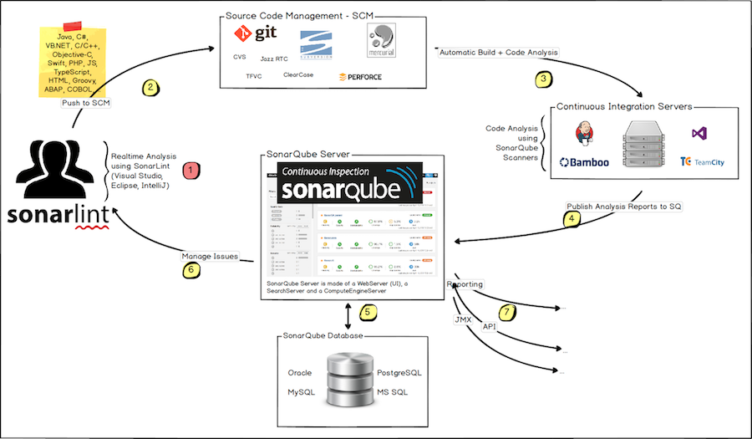
Integration With Other ALM Tools

Slide 18
Security in SonarQube
User
Group
Global Permissions
Project Permissions

Slide 19
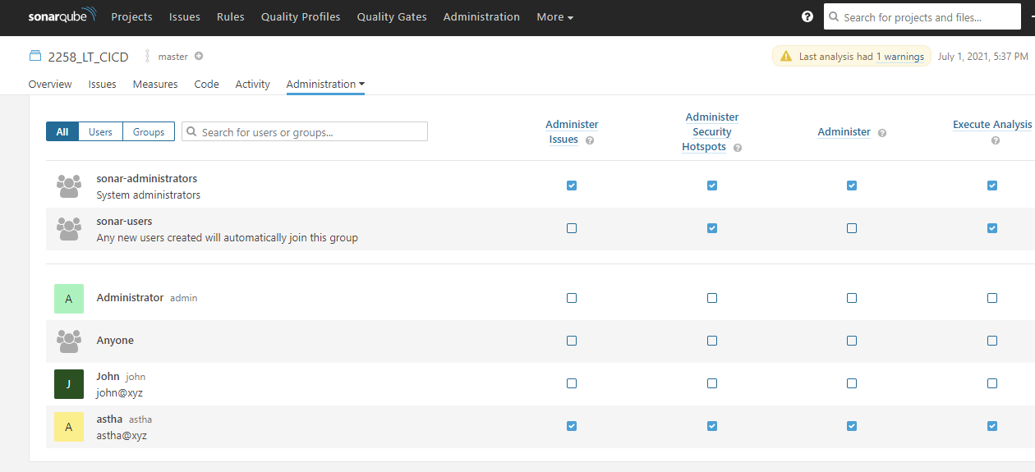
Global Permission

Slide 20
Comparison with other tools
There are several tools for static code analysis:
Checkstyle – Focuses on ‘Conventions’
PMD – Find out issues related to Bad Practices
FindBugs – Potential bugs
Hp-Fortify – security vulnerabilities

Slide 21
Pre-requisite for SonarQube
The SonarQube server requires at least 2GB of RAM to run efficiently and 1GB of free RAM for the OS.
Running SonarQube is to have Java (Oracle JRE 11 or OpenJDK 11) installed on your machine.
For More detailed info, (like compatible version of DB ,web browser, etc) go to
https://docs.sonarqube.org/latest/requirements/requirements/
o
Copyright © 2019 Cybage Software Pvt. Ltd. All Rights Reserved. Cybage Confidential.
www.cybage.com

Slide 22
Test Your Knowledge Quotient for Sonarqube
Q1: What Sonarqube Database stores?
a) reports b) configuration c)source code d)reports and configuration both
Q2: Default Sonarqube database is?
a)H2 b)Oracle c)PostgreSQL d) MS SQL Server
Q3: Sonarqube Scanner and Sonarqube Server are same tool.
a) True b)False
Q4: Default port of Sonarqube server is ______?
a)9000 b)9001 c)8080 d)8000
Q5: In which language Sonarqube is written?
a)Python b)Java c)C++ d)PHP
Q6: Default Quality Profile is:
a) Sonarqube way b)Sonar way c) Scanner way

Slide 23


Thank You!
12/14/2023
www.cybage.com
Copyright ©2023 Cybage Software Pvt. Ltd. All Rights Reserved. Cybage Confidential.

