Slide 1
BrainScan AI
Brain tumor MRI classification with an explainable web app
Applied Machine Learning project, Semester 7
Team: Soham Sabhaya, Mayur Chauhan, [Member 3 name], [Member 4 name]
Guide / course instructor: [name to add] Date: [presentation date]
Educational and research use only. Not a medical device and not a diagnosis.
Notes:
Welcome. BrainScan AI classifies a single brain MRI slice into glioma, meningioma, pituitary tumor or no tumor, explains the result with a heatmap, and is wrapped in a web application. Say at the start that this is a course prototype and not a medical device. Introduce each team member by name and say which part they did. Fill in the bracketed placeholders (member names, guide, date) before presenting.

Slide 2
Problem and motivation
• Task: classify one 2-D brain MRI slice into four classes: glioma, meningioma, pituitary tumor, no tumor.
• Supervised multi-class image classification on a public dataset.
• Two questions: how much does ImageNet transfer learning help over a small CNN trained from scratch, and how do we present a model result responsibly?
• Deliverables: trained models, an evaluation we can defend, and a web application with explanations and safety states.
Four target classes
Glioma
Meningioma
Pituitary tumor
No tumor (notumor)
Input: 224 x 224 RGB image
Output: 4 softmax scores
BrainScan AI | Educational prototype, not a medical device
2
Notes:
Brain MRI reading is specialised work, and tumor type matters for what happens next. The project asks a narrow, well-defined question: given one 2-D slice, which of four classes is it? We chose it because public data exists and because it lets us study both the ML side and a safe user interface. Stress that the aim is learning and comparison of two models, not building a diagnostic tool.

Slide 3
Objectives and scope
Objectives
Out of scope
• Train and compare a custom CNN and a ResNet50 transfer model.
• Evaluate on an untouched test set and report per-class behaviour.
• Audit the data for problems before trusting the scores.
• Explain predictions (Grad-CAM) and show uncertainty.
• Wrap the models in a tested web application with history and PDF reports.
• Clinical use, screening or triage.
• Real patient data or hospital integration.
• External validation on other scanners (not done).
• Any claim of diagnostic performance.
BrainScan AI | Educational prototype, not a medical device
3
Notes:
Read the objectives, then the scope boundary. The out-of-scope list matters: we explicitly do not claim clinical use. The success criteria are about honesty of the evaluation, not only about the accuracy number.

Slide 4
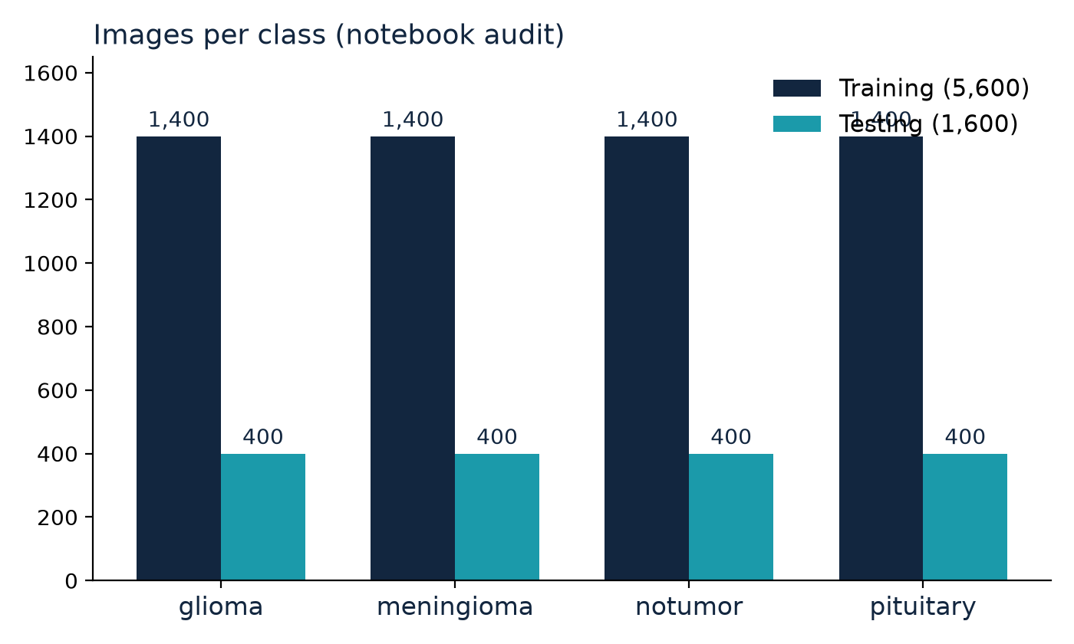
Dataset: Kaggle Brain Tumor MRI
• Training: 5,600 images (1,400 per class)
• Testing: 1,600 images (400 per class)
• Validation: 1,120 images carved from Training (80/20 split, 4,480 for fitting)
• 224 x 224 RGB input
• 0 unreadable files
Source: Nickparvar (2021), Kaggle, built on Cheng et al. (2015), figshare. Counts from the notebook audit.
BrainScan AI | Educational prototype, not a medical device
4
Notes:
The dataset is the public Kaggle Brain Tumor MRI Dataset by Nickparvar, built on the figshare collection by Cheng et al. In our notebook copy the classes are exactly balanced: 1,400 training and 400 test images per class, 5,600 and 1,600 in total. Images were resized to 224 by 224. The dataset is not in the repository. We have no information on patient demographics or scanners.

Slide 5
Data audit: what the notebook found
0
138
0
identical images shared between Training and Testing
duplicate hashes inside Training (171 extra copies)
unreadable files in Training or Testing
• Consequence: validation accuracy (95.80% for ResNet50 at epoch 15) is optimistic. The test figure is the honest one.
• Unknown: patient-level overlap between Training and Testing; near-duplicate slices (exact hashing cannot see them).
• Planned, not done: de-duplicate, re-split, retrain (pipeline written in ml/, never executed).
BrainScan AI | Educational prototype, not a medical device
5
Notes:
The notebook hashed every file. Between Training and Testing it found zero identical images, so the test score is not inflated by exact copies. But inside the Training folder there are 138 hashes with 171 extra copies. Because the validation set is cut randomly from Training, duplicates can sit on both sides of the split, so validation accuracy is optimistic. We do not know whether slices of the same patient appear in both Training and Testing, and exact hashing cannot catch near-duplicates. This is why we trust the test number rather than the validation number.

Slide 6
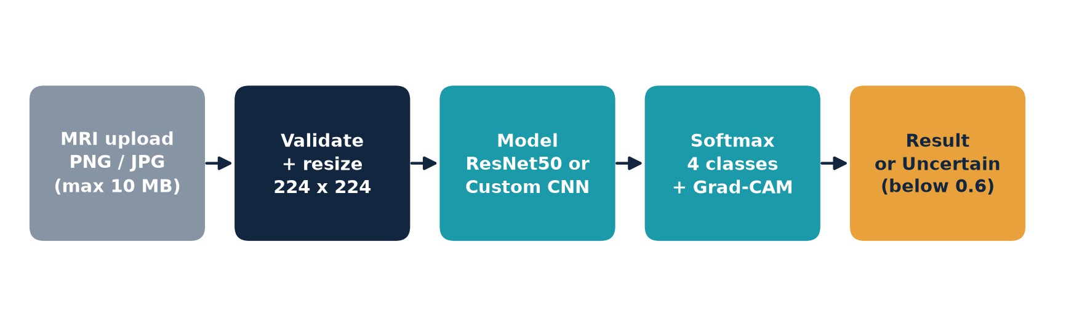
From upload to result: the inference pipeline
• Validation: extension, size, and a real PNG or JPEG decode (a renamed text file is rejected).
• Models embed their own scaling, so raw 0-255 pixels go in (no double normalisation).
• Confidence is a softmax score, not a probability of being right.
BrainScan AI | Educational prototype, not a medical device
6
Notes:
This diagram shows what happens when a user uploads an image. The backend only validates and resizes to 224 by 224; the scaling is inside each saved model (Rescaling 1/255 in the custom CNN, ResNet50 preprocess_input in a Lambda layer), so the backend deliberately does not normalise again, and a test checks this. The model returns four softmax scores; if the top score is below 0.6 the interface shows Uncertain result instead of a confident class. 0.6 is a pragmatic threshold, not a calibrated one.

Slide 7
Two models compared
 | Custom CNN (baseline) | ResNet50 transfer
Structure | 3 conv blocks (32/64/128), BatchNorm, pooling, Dense 128, Dropout 0.4 | ImageNet ResNet50, frozen; pooling, Dense 128, BatchNorm, Dropout 0.4
Total parameters | 111,172 | 23,851,012
Trainable parameters | 110,724 | 263,044
Optimizer | Adam, lr 1e-3 | Adam, lr 1e-4
Training data | 4,480 images (80% of Training) | 4,480 images (80% of Training)
Augmentation | Random horizontal flip only | Random horizontal flip only
Single run, single seed for each model. No hyper-parameter search.
BrainScan AI | Educational prototype, not a medical device
7
Notes:
The custom CNN is the baseline: three convolution blocks trained from scratch, about 111 thousand parameters. ResNet50 uses ImageNet weights with a frozen backbone, so only the new head of 263,044 parameters is trained; no fine-tuning was done. Both used Adam, up to 15 epochs, early stopping and learning-rate reduction. Be upfront that the custom CNN training log in the notebook is truncated during epoch 8 and was unstable early on (validation accuracy between 0.25 and 0.83), so we cite no final training figure for it.

Slide 8
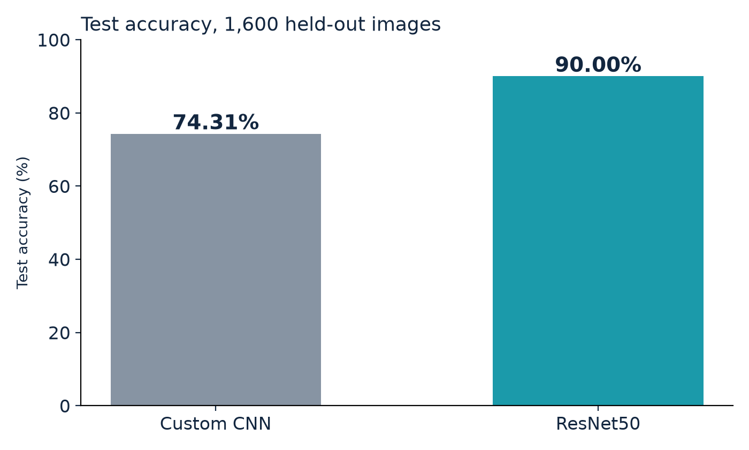
Results: test accuracy
90.00%
ResNet50 (1,440 / 1,600 correct)
74.31%
Custom CNN (1,189 / 1,600 correct)
Test set: 1,600 images, 400 per class. Single run; no confidence interval.
BrainScan AI | Educational prototype, not a medical device
8
Notes:
On the untouched 1,600-image test set, ResNet50 reaches 90.00% and the custom CNN 74.31%, a gap of about 15.7 percentage points. ResNet50 got 1,440 of 1,600 right. This is one run on one test set, so there is no confidence interval; a rough binomial estimate is plus or minus 1.5 points, which is our own back-of-the-envelope figure and not a notebook result. The numbers come from model_comparison_results.csv and the notebook outputs.

Slide 9
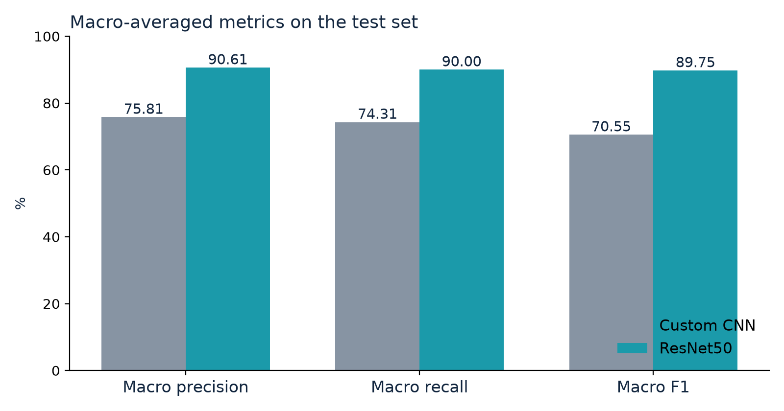
Results: macro precision, recall and F1
Metric (test) | Custom CNN | ResNet50
Accuracy | 74.31% | 90.00%
Macro precision | 75.81% | 90.61%
Macro recall | 74.31% | 90.00%
Macro F1 | 70.55% | 89.75%
ResNet50 is better on every metric, but the margin is from one run.
Values from model_comparison_results.csv and notebook cell 28.
BrainScan AI | Educational prototype, not a medical device
9
Notes:
Macro metrics average the four classes equally. ResNet50 is ahead on all three. For the custom CNN, macro F1 of 70.55% is well below its accuracy of 74.31%, which tells us some classes are predicted badly; the next slide shows which. Macro recall equals accuracy only because the test classes are exactly balanced.

Slide 10
Per-class behaviour: where the models fail
ResNet50 confusion matrix (test)
Custom CNN confusion matrix (test)
true \ pred | glioma | mening. | notumor | pituit.
glioma | 285 | 87 | 24 | 4
mening. | 14 | 363 | 11 | 12
notumor | 0 | 1 | 399 | 0
pituit. | 1 | 6 | 0 | 393
true \ pred | glioma | mening. | notumor | pituit.
glioma | 303 | 20 | 64 | 13
mening. | 129 | 99 | 125 | 47
notumor | 0 | 0 | 400 | 0
pituit. | 7 | 5 | 1 | 387
• ResNet50: glioma recall 0.71 (87 of 400 predicted meningioma); meningioma precision 0.79; notumor recall 1.00.
• Custom CNN: meningioma recall 0.25 (129 predicted glioma, 125 predicted notumor); notumor precision 0.68.
• A single accuracy number hides these differences, which is why we show the matrices.
BrainScan AI | Educational prototype, not a medical device
10
Notes:
Rows are the true class, columns the predicted class, 400 images per row. For ResNet50 the weak spot is glioma: recall is 0.71 and 87 of 400 gliomas were called meningioma, so meningioma precision is only 0.79. For the custom CNN, meningioma recall is just 0.25; it labels most meningiomas as glioma or notumor. Both models detect notumor very reliably (recall 1.00). Confusion matrices were read from figures saved in the notebook and cross-checked: every row sums to 400 and the diagonals sum to 1,440 and 1,189. Per-class values are in ml/results/model_insights.json.

Slide 11
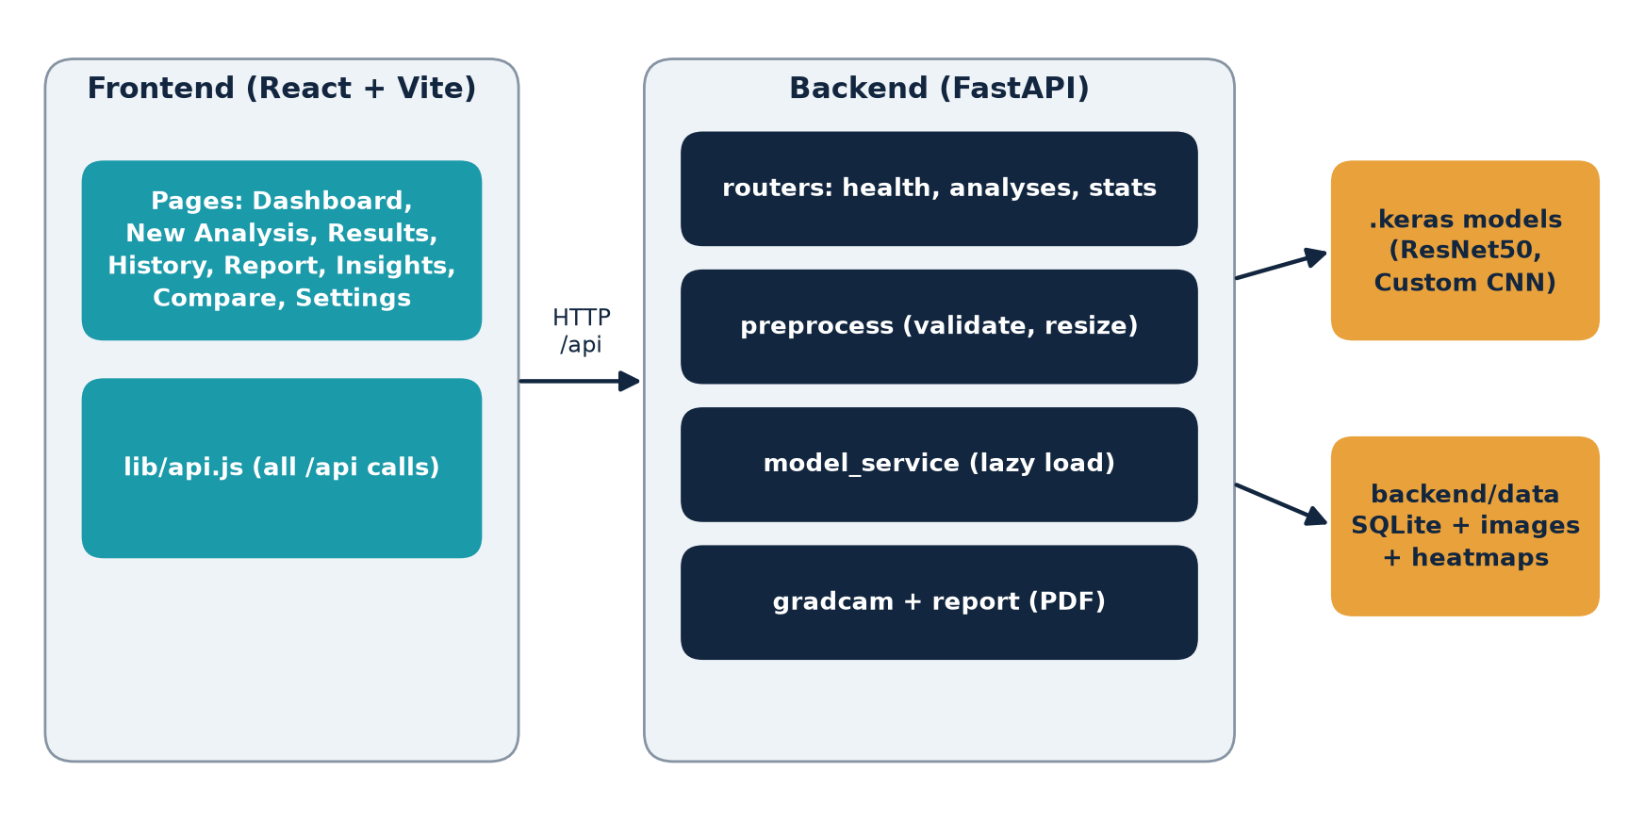
System architecture
• React + Vite frontend, 8 pages
• FastAPI backend under /api
• Models loaded lazily; /api/health works without TensorFlow
• SQLite and files stay on the host machine
• Optional API key, rate limit, upload size and pixel limits
• Demo mode with a visible badge
BrainScan AI | Educational prototype, not a medical device
11
Notes:
The React and Vite frontend only talks to the backend through relative /api URLs, all in one file, lib/api.js. The FastAPI backend validates the upload, runs the Keras model, builds a Grad-CAM overlay, stores the result in SQLite plus files on the same machine, and can generate a PDF report. Models load lazily on the first analysis, so the API starts even without TensorFlow. Nothing is sent to a third party. The frontend also has a clearly badged demo mode with mock data for when the backend is off.

Slide 12
The web application
Screenshot to insert
Dashboard
Screenshot to insert
New Analysis (upload and options)
Screenshot to insert
History table
• Pages: Dashboard, New Analysis, Results, History, Report, Insights, Compare, Settings.
• Model choice: ResNet50, Custom CNN, or both side by side.
• History with search and filter; one-click delete with confirmation; PDF report per scan.
• Preferences stay in the browser; no accounts.
BrainScan AI | Educational prototype, not a medical device
12
Notes:
Walk through the main screens while showing the live app or the screenshots. Dashboard: summary and recent analyses. New Analysis: drag and drop, choose ResNet50, custom CNN or both, optional heatmap. Results: class, confidence, four probabilities, heatmap and disclaimer. History: search, filter, delete with confirmation. Insights: the real test results. Insert real screenshots in the boxes before presenting; none were captured by the person who prepared this deck.

Slide 13
Explainability and safety by design
Screenshot to insert
Results page with Grad-CAM heatmap
Screenshot to insert
Uncertain result state (top score below 0.6)
• Grad-CAM: an aid, not proof; coarse 7 x 7 for ResNet50
• Uncertain result when top score < 0.6
• All four probabilities and the runner-up shown
• Disclaimer on results and in the PDF: "AI-generated prediction for educational and research use only. It is not a medical diagnosis and must not replace review by a qualified clinician."
• Privacy: uploads stay on the host machine; optional retention setting and delete-all with confirmation.
BrainScan AI | Educational prototype, not a medical device
13
Notes:
Grad-CAM weights the last convolutional feature maps by the gradient of the predicted class and overlays the result. For ResNet50 it is a coarse 7 by 7 grid. It shows what influenced the score; it does not prove the model looked at the tumor, and it has not been validated against expert annotation. The uncertain state, the four probabilities, the exact disclaimer and the avoidance of reassuring wording for no tumor are there to reduce automation bias. These reduce, but do not remove, the risk. Insert real screenshots of the result page and the uncertain state.

Slide 14
Testing and engineering practice
What exists
Known gaps
• pytest suite with a fake model service (no TensorFlow needed)
• Upload validation: 400, 413, 415, 503 paths
• History, delete, PDF report, stats, CORS
• Confidence flag, entropy, model=both, retention, insights
• CI workflow, PR template, commit convention
• Docs set: architecture, methodology, ethics, testing, deployment
• No test runs the real .keras models through the API
• No frontend unit or end-to-end tests yet
• API key and rate limiter lack dedicated tests
• Docker setup written but not run by us
• No accessibility audit or load test
BrainScan AI | Educational prototype, not a medical device
14
Notes:
Backend tests use pytest and FastAPI TestClient with a fake model service, so they run without TensorFlow. They cover upload validation, error codes, history, reports, the v1.1 safety fields, retention and the insights endpoint. Be honest about gaps: no test loads the real models through the API, the frontend has no tests yet (the test libraries are listed as dev dependencies but no script exists), the API key and rate limiter have no dedicated tests, and Docker has not been run. CI is defined in .github/workflows/ci.yml; its backend job needs backend/requirements-dev.txt, which still has to be added.

Slide 15
Team and roles
Member | Role | Main contribution
Soham Sabhaya | ML pipeline | Notebook, trained models, metrics, ml/ folder
Mayur Chauhan | Web application | FastAPI backend and React frontend
[Member 3 name] | [Role, e.g. QA and testing] | [Add real contribution]
[Member 4 name] | [Role, e.g. documentation and demo] | [Add real contribution]
• Workflow: feature branches from upstream dev, pull requests, a second reviewer, CI must pass.
• Roles for members 3 and 4 are proposals in docs/TEAM.md and must be confirmed by the team.
BrainScan AI | Educational prototype, not a medical device
15
Notes:
Introduce each person and what they actually did. Soham Sabhaya owns the ML pipeline and Mayur Chauhan the web application, as recorded in docs/TEAM.md. The other two rows are placeholders: replace them with the real names and the real contributions. Do not claim work that is not visible in the git history (git shortlog -sn shows who committed what).

Slide 16
Limitations (honest view)
• 138 duplicate hashes (171 copies) inside Training: validation accuracy is optimistic; rely on the test result.
• Patient-level independence unknown; near-duplicates not checked.
• Single public source, no external validation; scanner and site variation not represented.
• Single run, frozen backbone, no confidence intervals; custom CNN training log is incomplete.
• Softmax confidence is uncalibrated; the 0.6 threshold is pragmatic.
• Balanced test set differs from real prevalence; non-brain images still get one of four labels.
• Not a medical device: no clinical validation, no regulatory clearance, not for diagnosis.
BrainScan AI | Educational prototype, not a medical device
16
Notes:
Say these plainly; they are the most credible part of the talk. Duplicates inside Training make validation optimistic, so we rely on the test set. We cannot rule out patient overlap or near-duplicates. The data is one public source, so we do not know how it performs on other scanners. Softmax scores are not calibrated. The test set is balanced, unlike real prevalence, so real-world precision would differ. One run, no confidence intervals. And above all: this is not a medical device and must not be used on patients.

Slide 17
Future work (planned, not done)
Machine learning
Application
• De-duplicate Training and re-split before validation
• Fine-tune top ResNet50 blocks; compare with frozen baseline
• Several seeds; report mean and spread; bootstrap intervals
• Temperature scaling and calibration
• External validation if a suitable dataset exists
• Frontend tests and lint in CI
• Verify Docker setup; configurable API base URL
• Out-of-distribution rejection for non-MRI images
• Accessibility audit
• Public demo with synthetic or public images only
BrainScan AI | Educational prototype, not a medical device
17
Notes:
Everything on this slide is a plan. A fine-tuning pipeline exists in the ml folder but has never been executed, so no result is claimed for it. The first priority is a clean, duplicate-aware split, because that fixes how we measure everything else.

Slide 18
Conclusion and questions
• Transfer learning helped: ResNet50 90.00% vs custom CNN 74.31% on 1,600 test images.
• Per-class results show weak spots: glioma recall 0.71 (ResNet50), meningioma recall 0.25 (custom CNN).
• Data duplicates and the missing external validation limit what the numbers mean.
• The web app adds explanation, an uncertain state and privacy-minded storage.
• Educational prototype only; not a medical device.
References
Nickparvar, M. Brain Tumor MRI Dataset, Kaggle, 2021.
Cheng, J. et al. Brain tumor dataset, figshare, 2015.
He, K. et al. Deep Residual Learning for Image Recognition, CVPR 2016.
Selvaraju, R. R. et al. Grad-CAM, ICCV 2017.
Thank you. Questions?
BrainScan AI | Educational prototype, not a medical device
18
Notes:
Summarise: transfer learning clearly helped (90.00% vs 74.31% on 1,600 test images), but the weak glioma and meningioma results, the duplicates and the lack of external validation mean the system is a learning prototype only. Then open for questions. Likely questions are prepared in docs/VIVA_QA.md. References: Nickparvar 2021 (Kaggle dataset); Cheng et al. 2015 (figshare); He et al., CVPR 2016 (ResNet); Selvaraju et al., ICCV 2017 (Grad-CAM).

