Slide 1
Improving CNNs with the help of Data Augmentation and Boosting

Slide 2
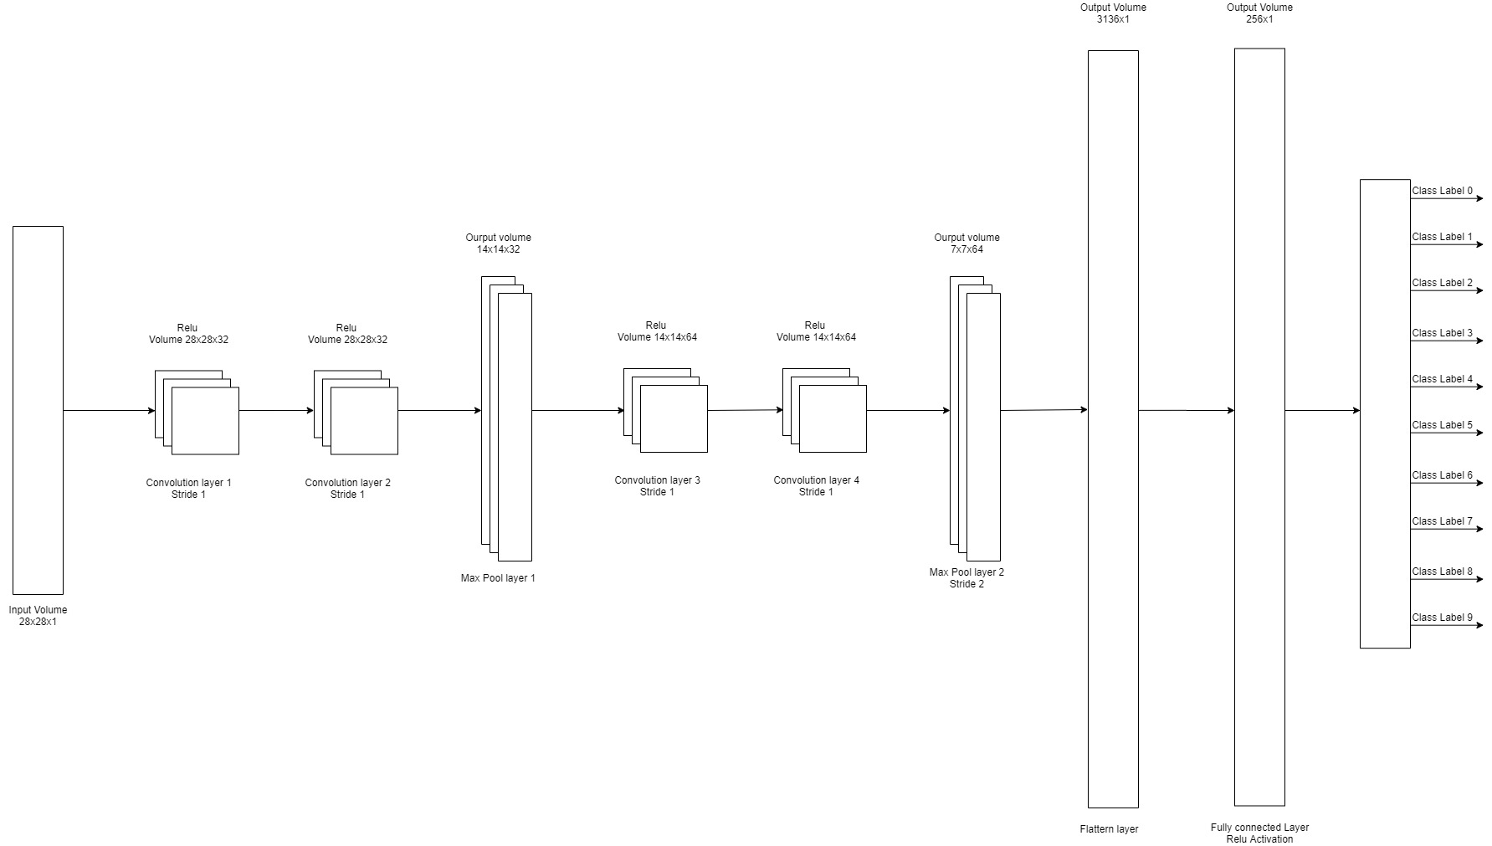
What are CNNs?
A Convolutional Neural Network (ConvNet/CNN) is a Deep Learning algorithm which can take in an input image, assign importance (learnable weights and biases) to various aspects/objects in the image and be able to differentiate one from the other.[1]

Slide 3
What is Augmentation?
Deep networks need large amount of training data to achieve good performance. To build a powerful image classifier using very little training data, image augmentation is usually required to boost the performance of deep networks.
Image augmentation artificially creates training images through different ways of processing or combination of multiple processing, such as random rotation, shifts, shear and flips, etc.
An augmented image generator can be easily created using ImageDataGenerator API in Keras. ImageDataGenerator generates batches of image data with real-time data augmentation.[2]

Slide 4
CNN + Image Augmentation: Improvement
There are many ways to address complications associated with limited data in machine learning. Image augmentation is one useful technique in building convolutional neural networks that can increase the size of the training set without acquiring new images.
To duplicate images with some kind of variation so the model can learn from more examples. Ideally, we can augment the image in a way that preserves the features key to making predictions, but rearranges the pixels enough that it adds some noise.

Slide 5
What is Boosting?
Boosting algorithms are one of the most widely used algorithm in Machine Learning. Boosting grants power to machine learning models to improve their accuracy of prediction.
The term ‘Boosting’ refers to a family of algorithms which converts weak learner to strong learners. Boosting algorithms often outperform simpler models.
Boosting is one of the techniques that uses the concept of ensemble learning. A boosting algorithm combines multiple simple models (also known as weak learners or base estimators) to generate the final output.[3]

Slide 6
4 Boosting Algorithms in Machine Learning
Gradient Boosting Machine (GBM)
Extreme Gradient Boosting Machine (XGBM)
LightGBM
CatBoost

Slide 7
My Work
Dataset: MNIST Dataset, Handwritten digits.
Built a CNN model (Sequential).
Architecture of CNN model (Next Slide).
Intermediate layer to extract features for XGBoosting.
Variations in Datagenrator.

Slide 8
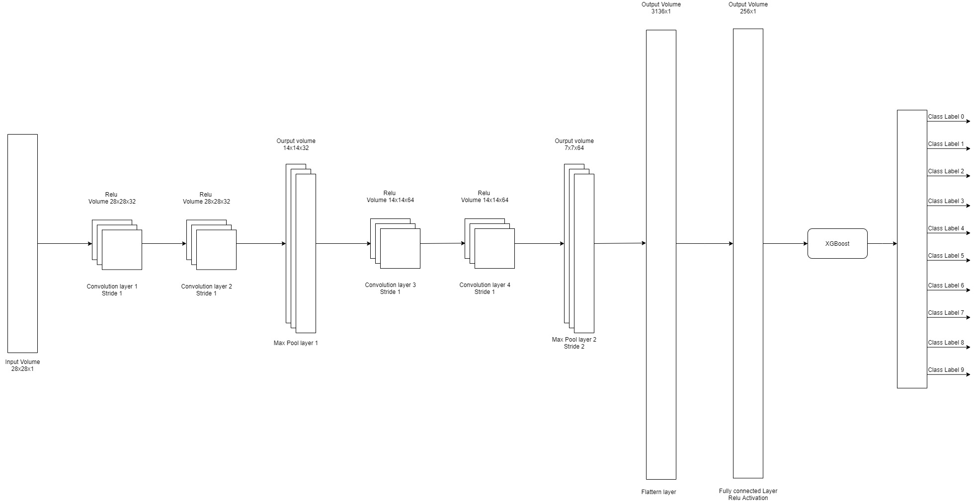

Slide 9
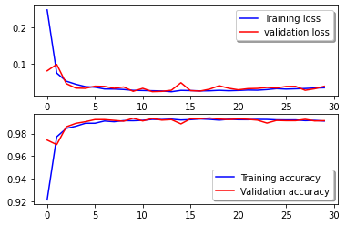
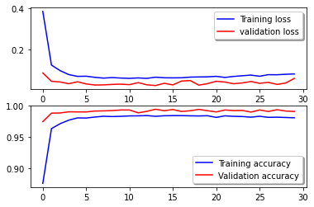
Loss and Accuracy comparison
CNN
Data Augmentation + CNN

Slide 10
Accuracies of experiments
CNN Model: 99.14%
Data Augmentation + CNN Model: 99.28%
Data Augmentation + CNN Model + XGB: 99.4%

Slide 11
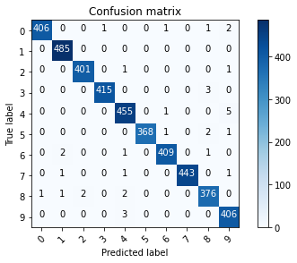


Confusion Matrix
CNN
Data Augmentation + CNN
Data Augmentation + CNN + XGB

Slide 12
Future Scope
Instead of XGBoost, we can feed the features to another classifier like Bayes Gaussian Classifier.
Working on Colored Images, provides us with different variations in Data Augmentation.
Working on Different boosting algorithm.

Slide 13
References list
[1] M.V. Valueva, N.N. Nagornov, P.A. Lyakhov, G.V. Valuev, N.I. Chervyakov, Application of the residue number system to reduce hardware costs of the convolutional neural network implementation, Mathematics and Computers in Simulation, Volume 177, 2020
[2] Shorten, C., Khoshgoftaar, T.M. A survey on Image Data Augmentation for Deep Learning. J Big Data 6, 60 (2019).
[3] Zhou Zhi-Hua. Ensemble Methods: Foundations and Algorithms. (2012)

Slide 14
Thank You!

