Slide 1
HR ATTRITION
ANALYSIS
Understanding & Reducing Employee Turnover Through Data
Excel
SQL
Python
Power BI
Soham Sutar | Data Analyst | March 2025

Slide 2
Introduction
What is HR Analytics & Employee Attrition?
HR Analytics
📊 Dataset Overview
HR Analytics (People Analytics) is the use of data-driven methods to improve HR decision-making. It transforms raw employee data into actionable insights.
Source:
IBM HR Analytics (Kaggle)
Records:
1,470 Employees
Features:
35 Columns
Target:
Attrition (Yes/No)
Employee Attrition
Employee attrition is the gradual reduction of workforce due to resignations, retirements, or other departures. High attrition increases costs and disrupts operations.
Key Features Analyzed
Age, Department, Job Role, Monthly Income
Years at Company, Job Satisfaction, Work-Life Balance
OverTime, Business Travel, Education Field
HR Attrition Analysis | Soham Sutar | March 2025
2 / 10

Slide 3
Problem Statement
Key Business Questions We Aim to Answer
❓ Why are employees leaving?
🏢 Department-wise attrition?
💰 Salary & income impact?
Identify the primary drivers of attrition — job role, satisfaction, personal factors.
Which departments have the highest turnover and what patterns emerge?
Does lower monthly income correlate with higher attrition rates?
⏰ Overtime impact?
📅 Age & tenure effect?
😊 Satisfaction drivers?
Are employees working overtime significantly more likely to leave?
Do younger or shorter-tenured employees leave more frequently?
How do job satisfaction, work-life balance, and environment scores affect retention?
HR Attrition Analysis | Soham Sutar | March 2025
3 / 10

Slide 4
Data Cleaning Using Excel
Preparing the Dataset for Analysis
01
Remove Duplicates
Used Excel's Remove Duplicates feature to ensure each employee record is unique.
02
Handle Missing Values
Identified & filled blanks using median imputation for numeric columns; flagged others.
03
Format Columns
Standardized date formats, corrected data types (text vs numeric) across all fields.
04
New Columns Created
AgeGroup (bins), IncomeLevel (Low/Mid/High), Attrition_Flag (0/1 binary).
HR Attrition Analysis | Soham Sutar | March 2025
4 / 10

Slide 5
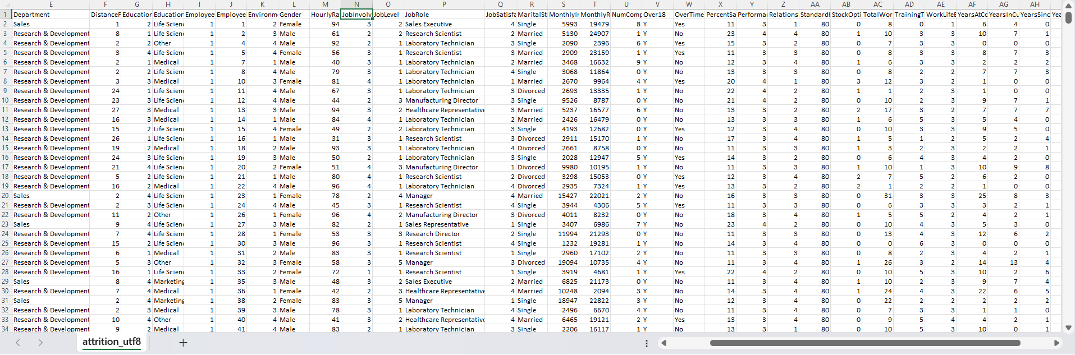

Slide 6
Data Analysis Using SQL
Querying the Database for Key Metrics
SQL Queries • HR_Attrition.sql
Queries Covered
-- Total Employees & Attrition Count SELECT COUNT(*) AS Total_Employees, SUM(Attrition_Flag) AS Total_Attrition, ROUND(SUM(Attrition_Flag)*100.0/COUNT(*),2) AS Attrition_Rate FROM hr_data; -- Department-wise Attrition SELECT Department, COUNT(*) AS Emp_Count, SUM(Attrition_Flag) AS Attrition FROM hr_data GROUP BY Department ORDER BY Attrition DESC;
Total employees & attrition rate
Department-wise attrition breakdown
Overtime vs. non-overtime comparison
Avg salary by job role & attrition
HR Attrition Analysis | Soham Sutar | March 2025
5 / 10

Slide 7
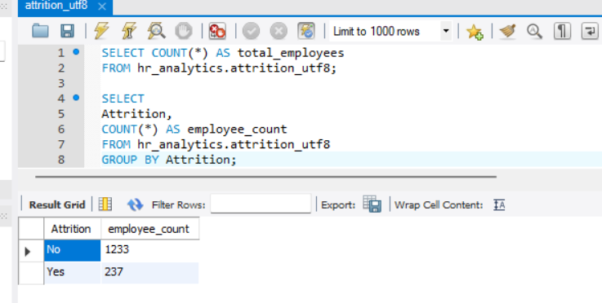
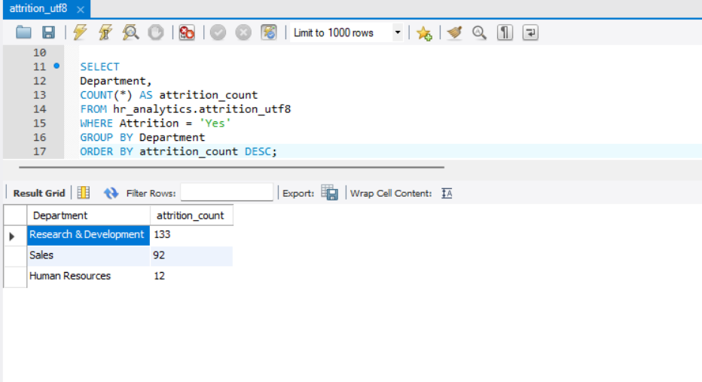
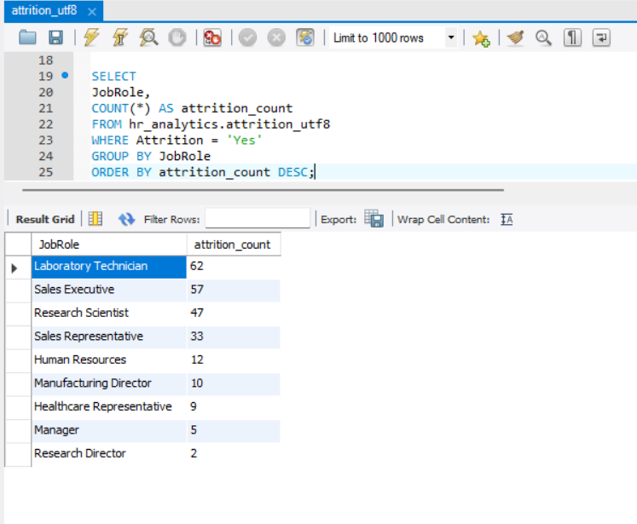
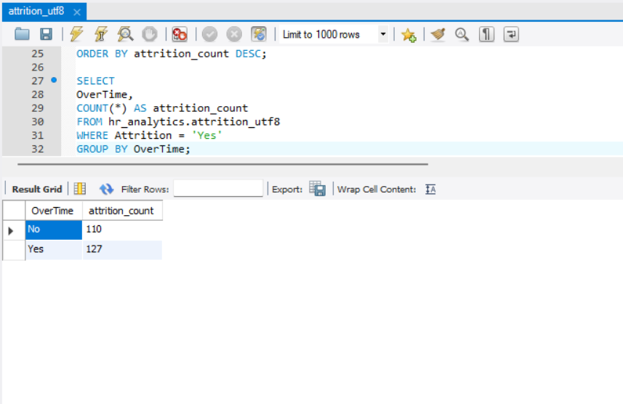

Slide 8
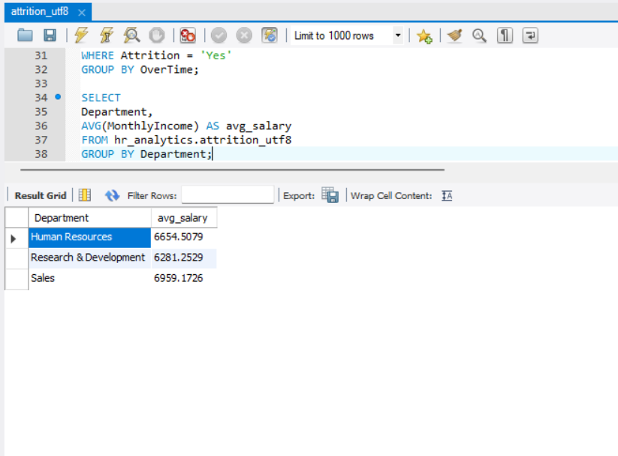
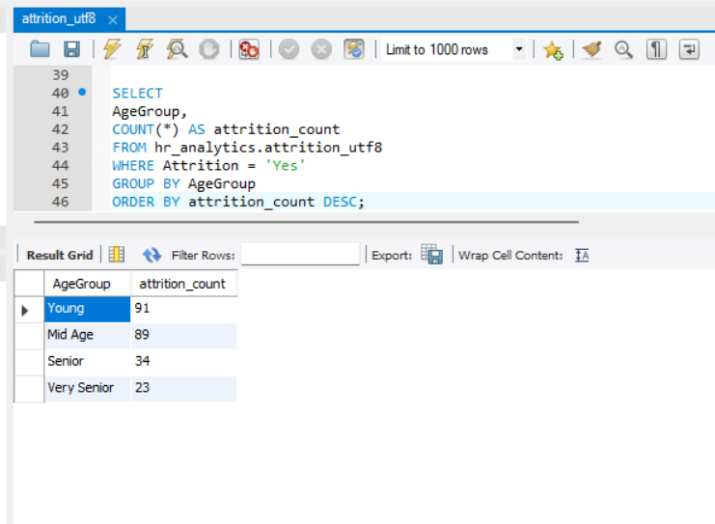

Slide 9
Exploratory Data Analysis — Python
Pandas & Matplotlib for Data Visualization
Libraries Used
Pandas — data wrangling & aggregation
Matplotlib — charts & visualizations
Seaborn — statistical plots & heatmaps
📊 overtime vs attrition
📊 Dept-wise Attrition
EDA Steps
📊 Salary Distribution
📊 job role attrition
Data shape, dtypes, describe()
Attrition rate calculation
Univariate & bivariate analysis
Correlation heatmap
HR Attrition Analysis | Soham Sutar | March 2025
6 / 10

Slide 10
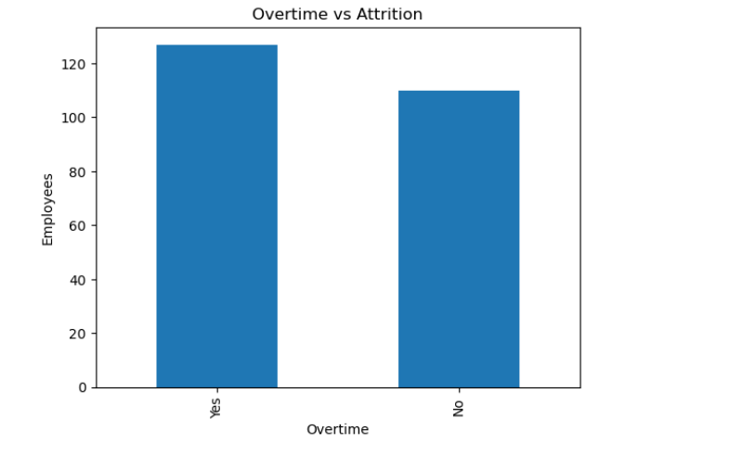
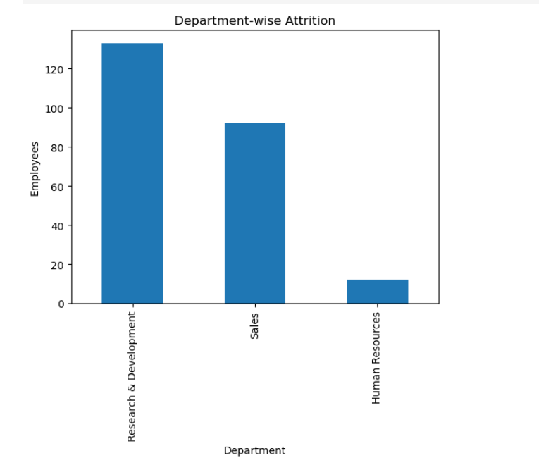
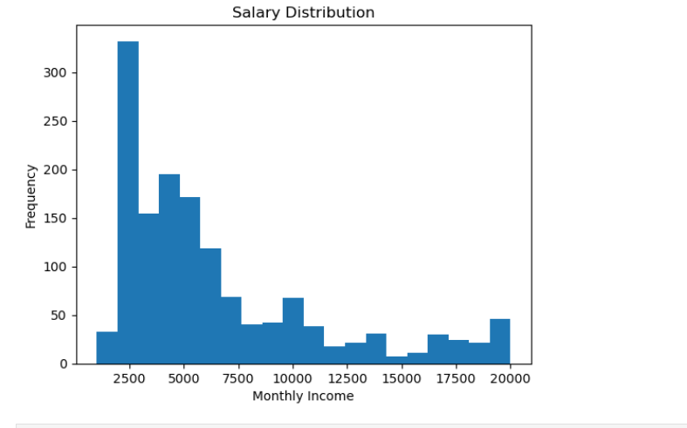
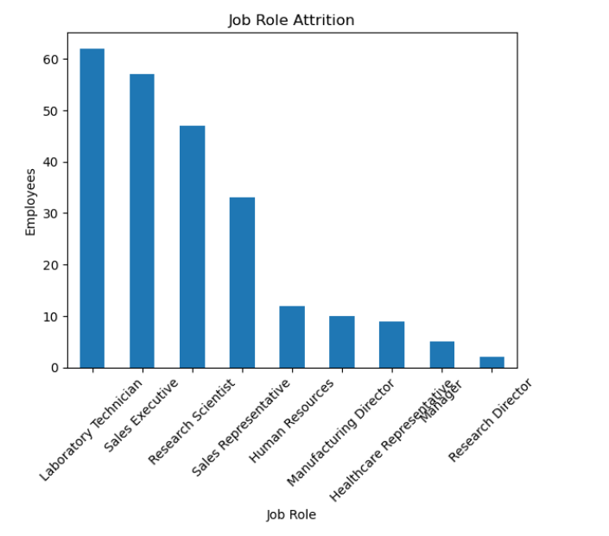

Slide 11
Power BI Interactive Dashboard
Visual Analytics & Business Intelligence
📌
KPI Cards
Total Employees, Attrition Count, Attrition Rate %, Avg Age
📊
Charts & Visuals
Bar: Dept Attrition | Pie: Gender split | Line: Tenure trend
🔍
Slicers & Filters
Filter by Department, Gender, Job Role, Age Group, OT Status
🗺️
Drill-through
Click on a department to drill into individual employee details
HR Attrition Analysis | Soham Sutar | March 2025
7 / 10

Slide 12
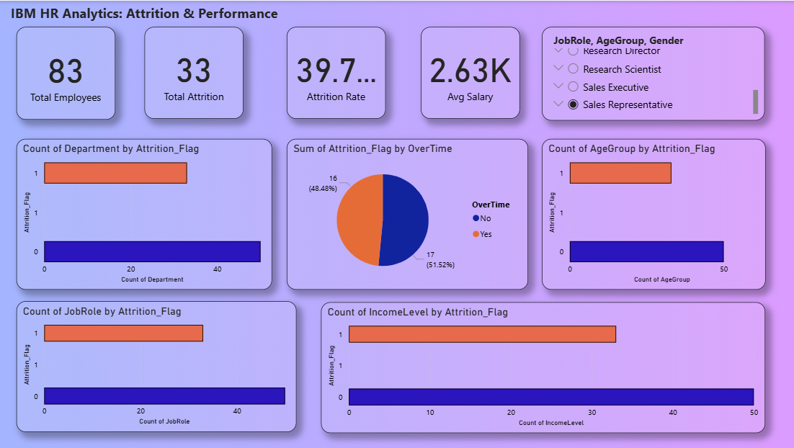

Slide 13
Key Insights
What the Data Reveals About Employee Attrition
16.1%
Sales
2.5×
26–35
Overall Attrition Rate
Highest Attrition Dept.
OT Employees Quit More
Age Group Most At Risk
🏢 Sales Dept. Attrition
⏰ Overtime Impact
Sales Representatives show the highest attrition (~40%). High targets and travel demands contribute to burnout.
Employees working overtime are 2.5× more likely to leave, indicating workload imbalance is a critical issue.
📅 Age & Experience
💰 Salary Factor
Employees aged 26–35 with <3 years tenure leave most often. Early career disengagement is a key challenge.
Employees earning below ₹5,000/month show 3× higher attrition. Compensation directly impacts retention.
HR Attrition Analysis | Soham Sutar | March 2025
8 / 10

Slide 14
Business Recommendations
Strategies to Reduce Attrition & Improve Retention
💰
Revise Compensation Packages
⏰
Regulate Overtime Policies
🎯
Strengthen Onboarding & Mentoring
Benchmark salaries against industry standards. Introduce performance-linked bonuses and transparent pay bands to reduce income-driven attrition.
Cap overtime hours and introduce comp-off policies. Automate workload distribution to prevent burnout in high-demand teams.
Develop a 90-day structured onboarding programme with mentor assignment. Target employees in the 0–2 year tenure high-risk window.
🏢
Department-Level Retention Plans
📋
Employee Engagement Surveys
🤖
Predictive Attrition Modelling
Create targeted retention initiatives for Sales. Address job role clarity, travel expectations, and career progression paths.
Run quarterly pulse surveys to track satisfaction. Use results to inform HR policy adjustments and management training.
Deploy ML models (Logistic Regression / Random Forest) to flag at-risk employees for proactive HR interventions.
HR Attrition Analysis | Soham Sutar | March 2025
9 / 10

Slide 15
PROJECT CONCLUSION · HR ATTRITION ANALYSIS
Project Summary
✅
Cleaned and processed 1,470 employee records using Excel.
✅
Executed SQL queries to extract attrition KPIs and department metrics.
✅
Conducted EDA with Python (Pandas, Matplotlib) to uncover attrition patterns.
Built an interactive Power BI dashboard for stakeholder reporting.
✅
✅
Identified key factors: overtime, salary, age, and department as primary drivers.
Github Link : https://github.com/sohamsutar07
HR Analytics empowers organisations to make proactive, data-driven decisions that reduce attrition, boost employee satisfaction, and drive business growth.
— Soham Sutar | Data Analyst | March 2025

