Slide 1

APSIT AI ASSISTANT: A RETRIEVAL-AUGMENTED CONVERSATIONAL SYSTEM FOR INSTITUTIONAL KNOWLEDGE
Theme- SDG 4 – Quality Education
SDG 9: Industry, Innovation and Infrastructure
Category- Software
Group No -10
Group Members-Anup Singh,Soham Waradkar,Sanket Kokare,Yogesh Vartak
Guide-Prof.Sumeet Shingi

Slide 2
Presentation Outline:
Introduction & SDG mapped
Literature Survey
Limitations in Existing Systems
Problem Statement
Proposed Solution
Experimental Setup
Implementation
Conclusion
Research & References

Slide 3
Introduction:
The main purpose of this chatbot is to provide instant, automated responses to students, visitors, and staff by answering their common queries related to admissions, courses, fees, schedules, and other college information.
In many cases, users have to search through multiple web pages to find information, which can be time-consuming. This chatbot simplifies the process by providing quick and accurate responses in real time through an interactive interface.
This project uses modern programming and database technologies to understand user queries and return relevant answers efficiently

Slide 4
Literature Survey:
Author(s) & Year | Techniques/Methods | Key points
[1] R. Parkar, Y. Payare, K. Mithari, J. Nambiar, J. Gupta (2021) | • AI-based chatbot system • Natural Language Processing (NLP) • Machine Learning • Web-based GUI interface • Speech recognition integration | Developed interactive college enquiry chatbot Handles student queries using NLP techniques Web-based system for easy accessibility Enhances user interaction in educational institutions Reduces manual enquiry workload
[2] N. Bhardwaj, S. K. H, A. D, R. M (2024) | • AI-powered smart chatbot • Knowledge-based systems • NLP (Semantics & Syntax analysis) • Vector-based representation • Machine Learning models | • Designed for smart educational communities • Focuses on improved user interaction • Uses semantic understanding for better responses • Supports institutional information systems • Enhances communication efficiency
[3]S. Meshram, N. Naik, M. VR, T. More, S. Kharche (2021) | • Rasa Framework • Rasa NLU & Rasa Core • NLP techniques • Recurrent Neural Networks (RNN) • Web-based application | College enquiry chatbot using Rasa Intent classification & entity extraction Dialogue management using Rasa Core Provides automated query handling Easy deployment as web application

Slide 5
Literature Survey:
Author(s) & Year | Techniques/Methods | Key points
[4]A. Huddar, C. Bysani, C. Suchak, U. D. Kolekar, K. Upadhyaya (2020) | • RASA open-source framework • Machine Learning algorithms • LSTM & RNN models • Database integration | Developed “Dexter” FAQ chatbot Focused on college FAQ automation Uses deep learning for intent detection Improves response accuracy Reduces dependency on manual enquiry systems
[5] J. S, J. S, S. M, G. R. Hemalakshmi (2023) | • NLP-based chatbot • Artificial Intelligence • Database-driven response system • Query processing models | College enquiry chatbot for student support Automates admission & course-related queries Improves productivity & response time Designed for educational institutions Enhances student interaction experience

Slide 6
Limitations of Existing Systems
Mostly rule-based or intent-based — struggle with unseen questions.
Limited multilingual support
Static knowledge base (manual updates required)
Weak integration with modern AI models (LLMs / RAG-based systems)
Inaccurate intent classification in edge cases
Limited context awareness

Slide 7
Problem Statement
College websites contain large amounts of important information, but students and visitors often struggle to find specific details quickly. They have to navigate through multiple pages or rely on manual support, which can be time-consuming and inefficient. Additionally, providing instant responses to every query through human support is not always possible due to limited availability.

Slide 8
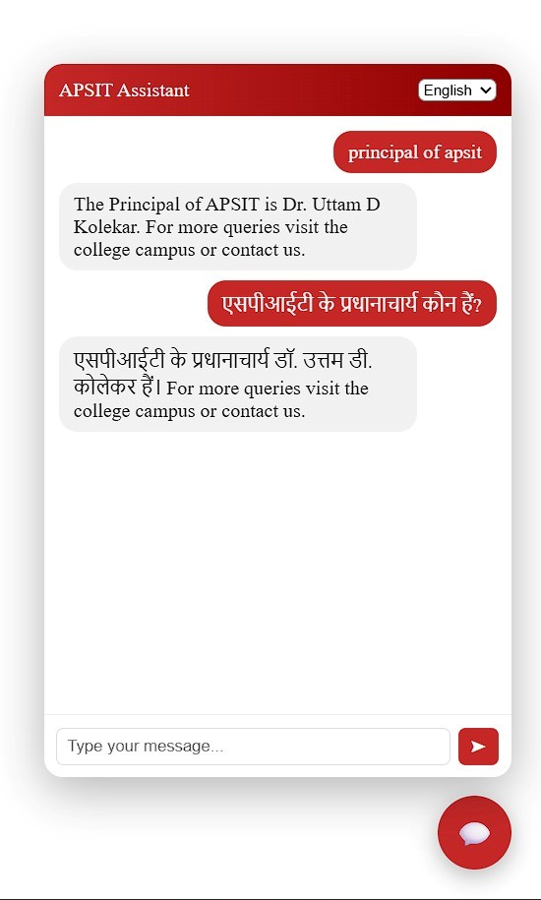
Proposed Solution
Problems:
Delayed responses to student and parent queries.
Manual handling of repetitive academic and administrative questions.
Difficulty in accessing updated circulars, timetables, and admission information.
Proposed Idea:AI-Powered Chatbot for College Website Assitance
An AI-powered chatbot integrated into the college website.
Provides real-time responses using live institutional data sources.
Supports multilingual interaction for wider accessibility.
Innovation & Uniqueness:
Uses semantic search instead of keyword-based search.
Leverages advanced Large Language Models (LLMs) with contextual understanding for more accurate and dynamic query interpretation.
Delivers intelligent, real-time 24×7 automated support with adaptive learning and seamless information retrieval.

Slide 9
Experimental Setup
Frontend:
React.js: Builds interactive chatbot interface.
TypeScript: Ensures type safety and maintainable code.
Axios/Fetch API: Handles API communication with backend.
Next.js: Provides smooth multi-device interaction.
Backend:
Python: Core backend programming language.
FastAPI: High-performance API framework for handling requests.
Google GenAI (Gemini):Embedding generation,Context-aware response generation (LLM)
Qdrant Cloud: Vector database for semantic similarity search.
RAG Pipeline: Retrieval-Augmented Generation for accurate responses.
Web Crawler & Document Extractor: Automated ingestion of website and PDFs.
Database & Storage:
Qdrant Vector Database: Stores vector embeddings.
Cloud Deployment (Railway / Cloud Platform): Scalable hosting environment.

Slide 10
Implementation

Slide 11
Conclusion
The proposed AI-powered College Enquiry Assistant enhances student interaction by leveraging Retrieval-Augmented Generation (RAG) architecture for accurate and context-aware responses. It eliminates reliance on rigid rule-based systems by integrating semantic search with Large Language Models.
The system efficiently processes institutional data through automated crawling, embedding generation using Gemini, and vector storage in Qdrant, enabling intelligent real-time information retrieval.
Overall, the project delivers a scalable, dynamic, and intelligent solution that provides 24×7 automated support, improves user experience, and reduces manual workload in educational institutions

Slide 12
Research and References
R. Parkar, Y. Payare, K. Mithari, J. Nambiar and J. Gupta, "AI And Web-Based Interactive College Enquiry Chatbot," 2021 13th International Conference on Electronics, Computers and Artificial Intelligence (ECAI), Pitesti, Romania, 2021, pp. 1-5, doi: 10.1109/ECAI52376.2021.9515065. keywords: {Training;Tongue;Terminology;Social networking (online);Tutorials;Speech recognition;Chatbots;Artificial Intelligence;Machine Learning;Chatbot;Natural Language;GUI},
N. Bhardwaj, S. K. H, A. D and R. M, "AI Chatbot for Smart Communities: Enhancing User Interaction in Educational Institutions," 2024 IEEE 6th PhD Colloquium on Emerging Domain Innovation and Technology for Society (PhD EDITS), Bangalore, India, 2024, pp. 1-2, doi: 10.1109/PhDEDITS64207.2024.10838692. keywords: {Technological innovation;Smart cities;Semantics;Knowledge based systems;Education;Machine learning;Syntactics;Chatbots;Vectors;Time factors;Artificial Intelligence;Machine Learning;Chatbot;Natural Language Processing;User Interaction;Educational Institutions},
S. Meshram, N. Naik, M. VR, T. More and S. Kharche, "College Enquiry Chatbot using Rasa Framework," 2021 Asian Conference on Innovation in Technology (ASIANCON), PUNE, India, 2021, pp. 1-8, doi: 10.1109/ASIANCON51346.2021.9544650. keywords: {Technological innovation;Recurrent neural networks;Speech recognition;Maintenance engineering;Chatbots;Probabilistic logic;Internet of Things;Chatbot;AI;Rasa;Rasa NLU;Rasa Core;NLP;Web Application;Enquiry Chatbot},
A. Huddar, C. Bysani, C. Suchak, U. D. Kolekar and K. Upadhyaya, "Dexter the College FAQ Chatbot," 2020 International Conference on Convergence to Digital World - Quo Vadis (ICCDW), Mumbai, India, 2020, pp. 1-5, doi: 10.1109/ICCDW45521.2020.9318648. keywords: {Chatbot;Databases;Artificial intelligence;Machine learning;Knowledge based systems;Information technology;Open source software;RASA;machine learning;LSTM;RNN},
J. S, J. S, S. M and G. R. Hemalakshmi, "College Enquiry Chatbot," 2023 2nd International Conference on Vision Towards Emerging Trends in Communication and Networking Technologies (ViTECoN), Vellore, India, 2023, pp. 1-4, doi: 10.1109/ViTECoN58111.2023.10156978. keywords: {Training;Productivity;Industries;Databases;Chatbots;Market research;Manufacturing;chatbot;NLP;enquiry;query;artificial intelligence;college;chatterbot;student},

