Slide 1

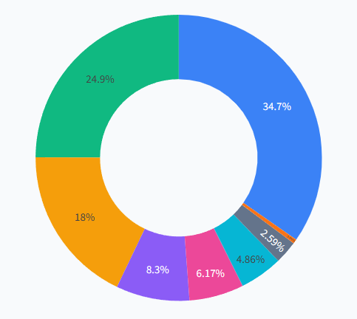
DAV LAB
Overview
System
Methodology
Results
Conclusion
30 OCT,
2026
E-Commerce
Analytics
DAV Mini Project
Sales and customer behaviour analytics on 1 million+ online retail transactions (2009–2011): revenue, categories, locations, delivery, reviews and purchasing trends.
Dashboard
Soham Admane | Vaishnav Balpande | Lokesh Parate

Slide 2
DAV LAB
Overview
System
Methodology
Results
Conclusion
30 OCT,
2026
Project
The Dataset
The Domain
UCI Online Retail II: 1,067,371 invoice lines from a UK online gift retailer (Dec 2009 – Dec 2011) with product, price, date, customer and country.
E-commerce stores generate huge transaction logs every day. Turning them into insight drives pricing, stock, delivery and marketing decisions.
Introduction
This mini-project applies the Data Analysis & Visualization (DAV) lab syllabus to a large, real-world retail dataset instead of small textbook examples.
It answers one central question: what drives revenue and customer satisfaction in an online store, and what should the business do about it?
The work is split into a data pipeline, an analysis notebook and an interactive dashboard, so every result can be reproduced and explored by non-technical users.
Our Approach
The Outcome
We clean and enrich the data with Pandas and NumPy, then analyse it with DAV Practicals 1–8: grouping, plotting, time series and regression.
A Streamlit dashboard with 5 filters, 6 KPI cards and 7 analytics tabs, plus RFM customer segments and ARIMA revenue forecasts.

Slide 3
DAV LAB
Overview
System
Methodology
Results
Conclusion
30 OCT,
2026
Key Questions We Answer
Problem
Which months, days and hours generate the most revenue?
Which product categories and items sell best?
Which countries buy the most outside the UK?
How does delivery time affect customer ratings?
Which customers are loyal, and which are at risk of leaving?
Can we forecast the next two weeks of sales?
Statement
The Challenge
  Revenue
  Locations
  Categories
  Delivery & Reviews
Online retailers record millions of invoice lines, but raw transactions alone do not show which products, regions, periods or customers actually drive revenue.
Without analysis, late deliveries, poor reviews, seasonal swings and at-risk customers go unnoticed until sales have already dropped.
Analyze revenue, product categories, customer locations, delivery times, reviews and purchasing trends using Python, Pandas, Plotly and Streamlit.

Slide 4
DAV LAB
Overview
System
Methodology
Results
Conclusion
30 OCT,
2026
Our Goal In This Project
Measurable Targets
Analyze
Build a reproducible analytics pipeline and an interactive dashboard that turns 1M+ raw retail transactions into clear, filterable insight a manager can act on without writing code.
Clean 1M+ rows reproducibly
Report 6 headline KPIs
Build 7 interactive analysis tabs
Create 5 RFM customer segments
Forecast revenue 7–30 days ahead
Evaluate regression with MSE & R²
Clean the data and measure revenue, category mix, country footprint, delivery performance and review ratings for 2009–2011.
Project
Segment & Predict
Group customers into RFM segments, forecast daily revenue with ARIMA, and test a linear regression model using MSE and R².
Objectives

Slide 5
DAV LAB
Overview
System
Methodology
Results
Conclusion
30 OCT,
2026
Existing
How It Works Today
System
Retail data usually lives in Excel sheets and static monthly reports. Analysts filter rows by hand, and every new question means rebuilding pivot tables and charts from scratch.
Data exported manually from the order system
Excel pivot tables with basic bar and pie charts
Static PDF / PowerPoint reports shared monthly
Decisions based on last month’s numbers
Drawbacks
No interactive filters by year, country, category or segment
No customer segmentation: loyal and at-risk buyers look
the same
No forecasting, so Q4 demand peaks are planned by
guesswork
Excel slows down or crashes on 1M+ rows
Delivery and review data are never linked to sales

Slide 6
DAV LAB
Overview
System
Methodology
Results
Conclusion
30 OCT,
2026
Proposed
Data Pipeline
data_preprocessing.py removes invalid rows, flags cancellations and adds date, category, delivery, review and RFM features, then saves a cleaned CSV and a 100k sample.
System
Interactive Dashboard
app.py shows 6 KPI cards and 5 global filters (year, date, country, category, segment) that drive 7 tabs built with Plotly Express and Graph Objects.
We propose a Python analytics pipeline plus a Streamlit web dashboard that lets anyone explore 1M+ transactions through filters and interactive Plotly charts.
Analytics & ML
Every technique maps to a DAV practical (1–8): Pandas cleaning, Matplotlib / Seaborn plots, Plotly interactivity, ARIMA time series and regression.
RFM customer segmentation, 7-day SMA / EMA smoothing, ARIMA(1,1,1) forecasts with confidence bands, a correlation heatmap and linear regression.

Slide 7
DAV LAB
Overview
System
Methodology
Results
Conclusion
30 OCT,
2026
System Architecture
01
02
03
04
05
Raw Data
Cleaning
Features
Segmentation
Storage
online_retail_II.xlsx converted to CSV: 1.07M rows, 8 columns
Trim text, drop invalid items and zero prices, flag ‘C’ invoices
Date parts, np.select categories, simulated delivery & ratings
Recency, Frequency, Monetary scores → 5 customer segments
Cleaned CSV (1.06M rows) + 100k-row sample for a fast dashboard
Streamlit Dashboard (app.py)
5 global filters → 6 KPI cards → 7 Plotly tabs: Revenue · Categories · Locations · Delivery · Reviews · Trends · Forecasting & ML

Slide 8
DAV LAB
Overview
System
Methodology
Results
Conclusion
30 OCT,
2026
Technologies
Language & Data
Visualization
Used
Python 3 as the core language; Pandas for loading, cleaning and group-by; NumPy for np.select rules and random seeds.
Plotly Express & Graph Objects for interactive charts and the world map; Matplotlib and Seaborn for notebook plots.
Hardware
Intel i5 / Ryzen 5 or equivalent processor
8 GB RAM (16 GB for the full 1M-row mode)
About 1 GB free disk space for data files
Analytics & ML
Interface & Tools
Statsmodels for ARIMA and seasonal decomposition; Scikit-learn for train/test split, Linear Regression, MSE and R².
Streamlit for the web dashboard, Jupyter Notebook for analysis, VS Code for coding, Git and GitHub for version control.
Software
Windows, Linux or macOS
Python 3.10+ with the libraries listed
Chrome or Edge browser to view the dashboard

Slide 9
DAV LAB
Overview
System
Methodology
Results
Conclusion
30 OCT,
2026
Dashboard Features
data_preprocessing.py
1.06M
Cached loading (@st.cache_data) in fast 100k-sample or full 1M-row mode
5 global filters: year, date range, country, category, RFM segment
6 KPI cards: revenue, orders, customers, AOV, on-time rate, avg review
5 animated charts with ▶ Play: revenue build-up, category race, world map, weekday hours, ARIMA
Cleaning, features, RFM → CSV
app.py
rows cleaned and enriched once by the pipeline; the dashboard loads a cached 100k-row sample, so every filter updates instantly.
Streamlit dashboard, 7 tabs
Analytics notebook
Step-by-step DAV practicals
7 Analytics Tabs
Revenue: monthly trend, order-value histogram, top 10 products
Categories: share bar, donut chart, units vs revenue
Locations: world choropleth map, top export markets
Delivery: status donut, transit histogram, country box plots
Reviews: star breakdown, review classes, delay vs rating
Trends: 24-hour velocity, weekday sales, RFM segments
Forecasting & ML: SMA / EMA, ARIMA forecast, heatmap, regression
Implementation

Slide 10
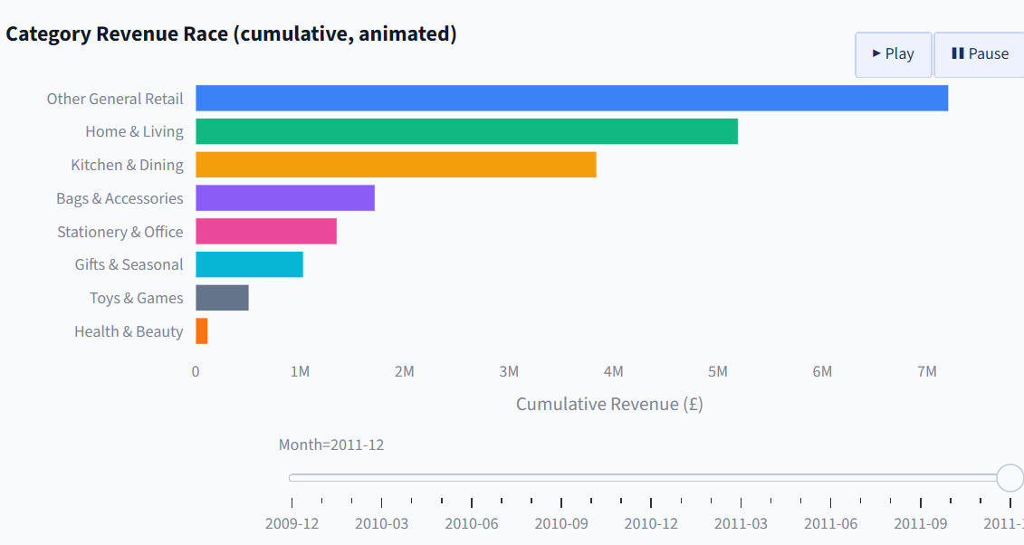
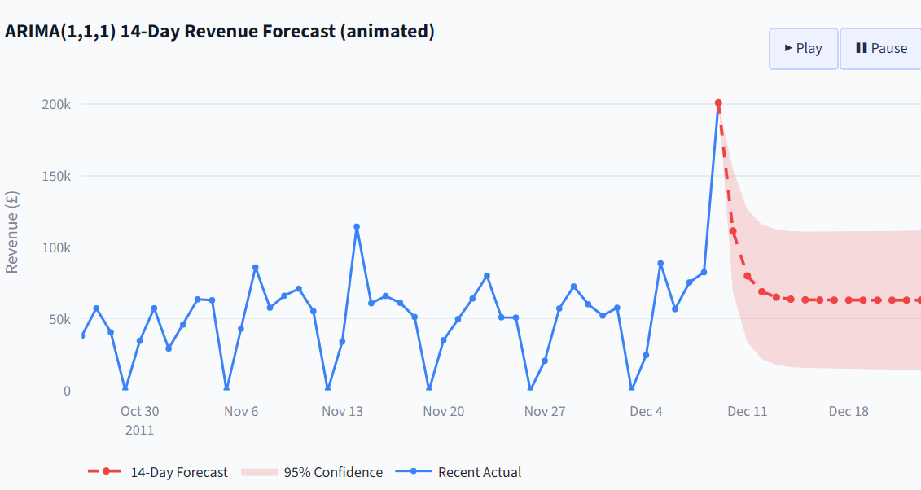
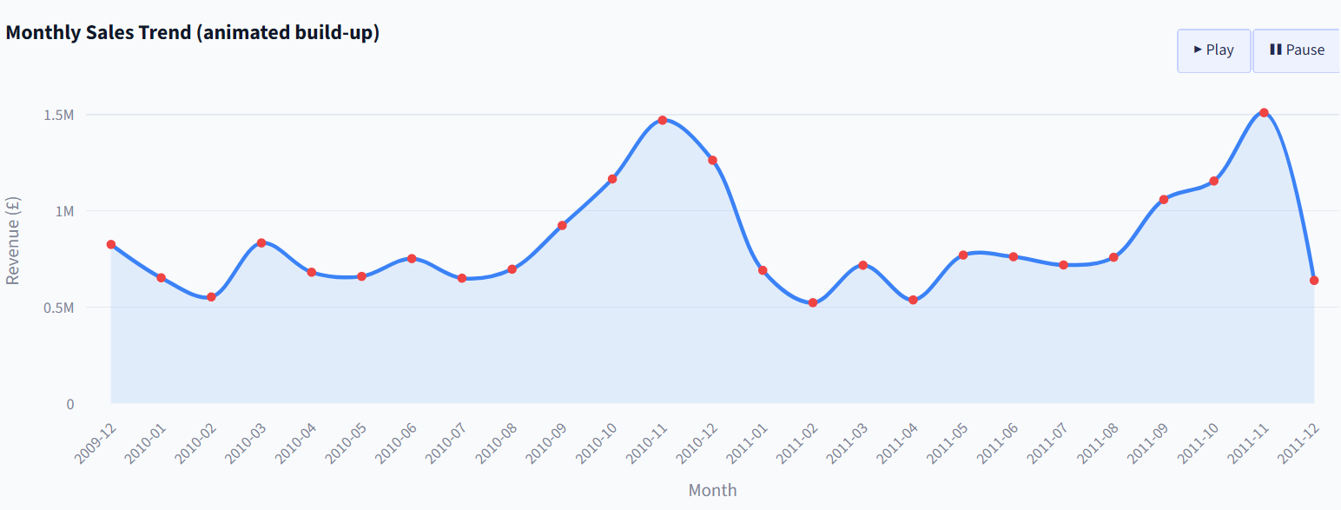
DAV LAB
Overview
System
Methodology
Results
Conclusion
30 OCT,
2026
Dashboard Screenshots
Monthly Sales Trend
Category Revenue Race
ARIMA Revenue Forecast
Animated build-up of monthly revenue for 2009–2011. Clear peaks every November show strong seasonal demand.
Animated race of cumulative revenue by category, month by month. Home & Living leads the named categories.
ARIMA(1,1,1) 14-day forecast that draws itself step by step, with a 95% confidence band (DAV Practical 6).

Slide 11
DAV LAB
Overview
System
Methodology
Results
Conclusion
30 OCT,
2026
Discussion
Key Metrics
£20.97M
Seasonality: revenue peaks every November (£1.47M in 2010, £1.51M in 2011), so stock and staff should be planned before Q4.
Geography: the UK brings 85.2% of revenue; EIRE, the Netherlands and Germany are the strongest export markets.
Categories: Home & Living (24.8%) and Kitchen & Dining (18.3%) lead the named product categories.
Delivery: 71.7% of orders arrive on time, and ratings fall sharply when deliveries are late.
Timing: buying peaks at 12:00 and on Thursdays; Saturday has almost no sales.
Customers: 1,174 Champions vs 2,045 hibernating buyers, a clear target for win-back campaigns.
Forecasting: ARIMA(1,1,1) gives a short-term revenue outlook with a 95% confidence band.
Orders: 40,077
Customers: 5,878
Countries: 43
Avg order value: £523
On-time delivery: 71.7%
Average rating: 4.27 / 5
Cancelled lines: 1.8%
net revenue from 40,077 orders by 5,878 customers in 43 countries. The UK drives 85% of sales.
Results & Discussion
Delivery and review values are simulated in the pipeline; Dec-2011 is a partial month (data ends 9 Dec).

Slide 12
DAV LAB
Overview
System
Methodology
Results
Conclusion
30 OCT,
2026
Who Benefits
Advantages &
Store managers: revenue, orders and KPIs in one place
Marketing teams: target Champions, win back hibernating buyers
Logistics teams: monitor on-time rate and delays by country
Inventory planners: prepare stock ahead of November peaks
Students: a worked example of the full DAV syllabus
Applications
Advantages
  Retail BI
  Logistics
  Marketing
  Forecasting
Insight from 1M+ rows in seconds (cached sample)
5 live filters update every KPI and chart
Open-source stack with zero licence cost
Reproducible pipeline (fixed random seed 42)
Runs on an ordinary laptop in any browser
Easy to extend with new tabs and models
Usable by any online store for Q4 stock planning, targeted RFM campaigns, delivery SLA monitoring and short-term sales forecasting.

Slide 13
DAV LAB
Overview
System
Methodology
Results
Conclusion
30 OCT,
2026
Conclusion &
Conclusion
We cleaned 1.06M transactions and built a 7-tab dashboard showing where revenue comes from, how delivery affects ratings and which customers need attention.
Future Scope
Learning Outcomes
Key Takeaways
Hands-on practice in data cleaning, feature engineering, interactive visualisation, time-series forecasting and building a web app.
Q4 seasonality is the biggest revenue driver
On-time delivery is closely tied to high ratings
Customer recency separates loyal from at-risk buyers
Next Steps
Future Scope
Prophet / LSTM forecasting models
Automated weekly email reports for managers
Real-time data refresh on a schedule
Connect to a live database or API, add churn prediction and product recommendations, use real delivery and review data, and deploy on Streamlit Cloud.

Slide 14
DAV LAB
Overview
System
Methodology
Results
Conclusion
30 OCT,
2026
Thank
You
Questions and discussion are welcome. E-Commerce Sales & Customer Behavior Analytics, DAV Lab Mini-Project.
Q & A
Soham Admane | Vaishnav Balpande | Lokesh Parate

