Slide 1


INSTITUTE OF ENGINEERING
MECHATRONICS DEPARTMENT(BE)
MINOR PROJECT PRESENTAION
Design, Fabrication and Performance Analysis of an Air Cushion Vehicle
Submitted By:
Sohan Kumar | UID – 25BEM80005
Ansh Maurya | UID – 24BEM10034
Guided By:
Mr. Vinay Shah

Slide 2
CONTENTS
1. Introduction
2. Objective of Project
3. Components Used
4. Block Diagram and Working Principle
5. Design and Fabrication Process
6. Results and Conclusion

Slide 3
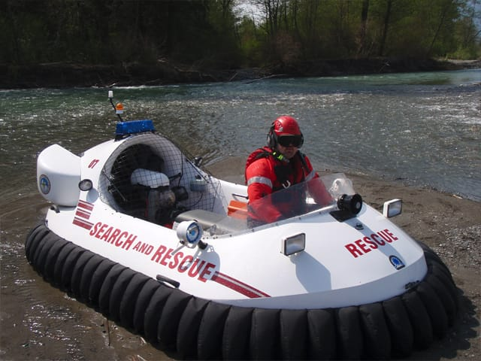
INTRODUCTION
A hovercraft is an air cushion vehicle that moves on a layer of air below its body.
The air layer reduces friction and allows smooth movement over land and water surfaces.
The system uses one motor for lift generation and another motor for forward thrust.
Direction control is achieved using a servo operated rudder mechanism.
This project demonstrates the practical use of hovercraft technology.

Slide 4
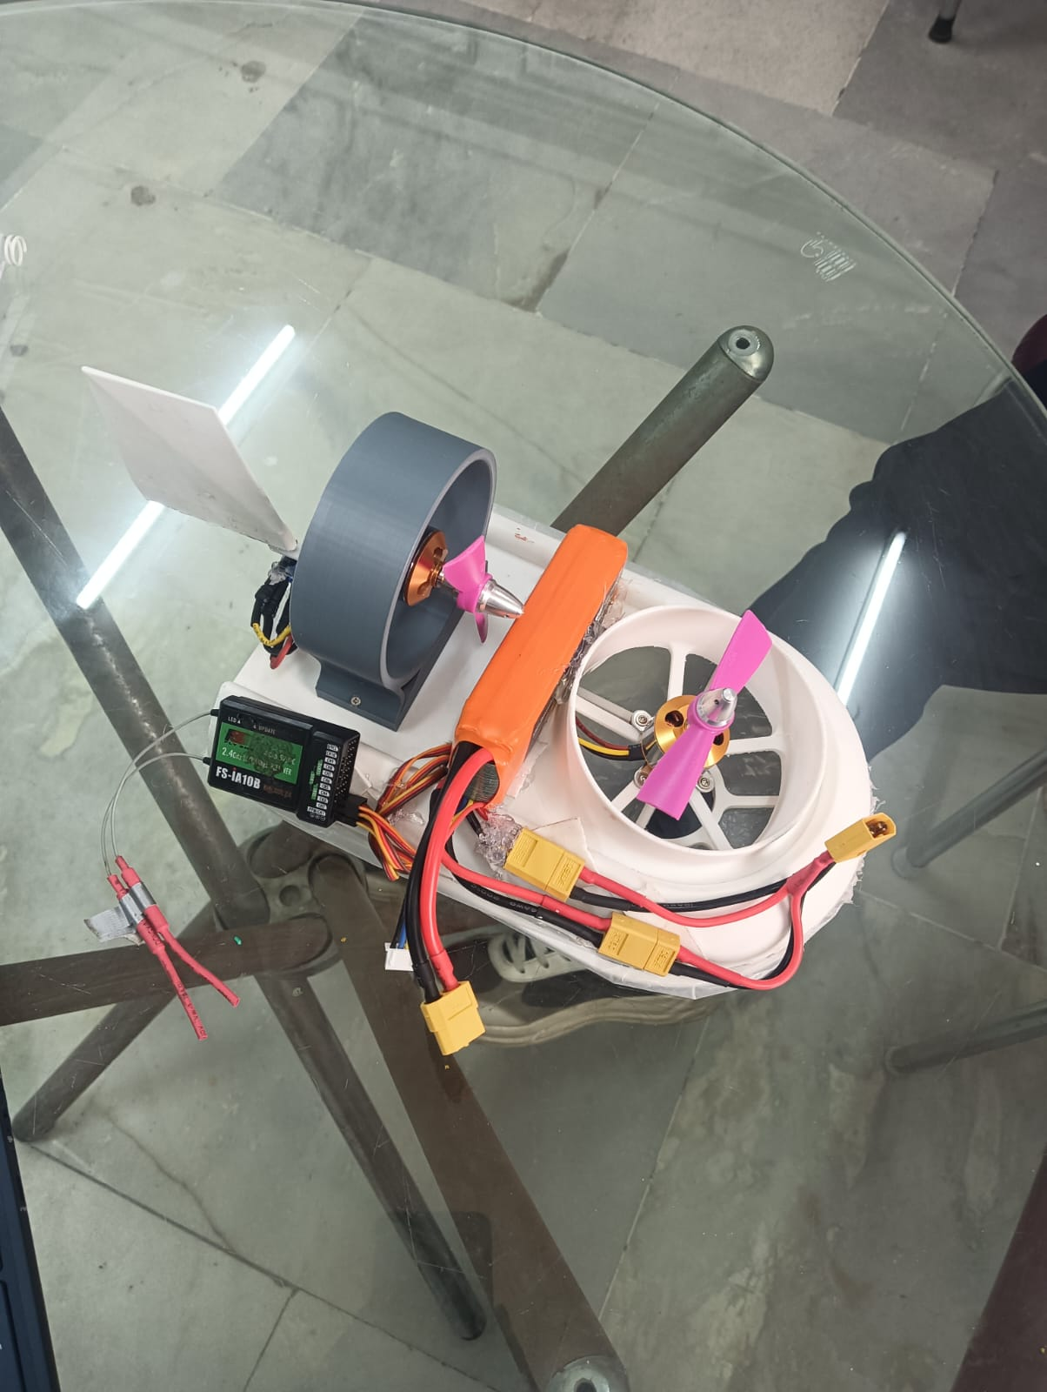
Objective of Project
The project was developed to understand the practical working of an RC controlled hovercraft system. The main objectives of the project are as follows:
• Design a compact and lightweight hovercraft body
• Generate lift using BLDC motor and propeller
• Provide forward motion using thrust motor
• Achieve steering through servo rudder
• Use RC transmitter and receiver for wireless control
• Study the performance of air cushion technology

Slide 5
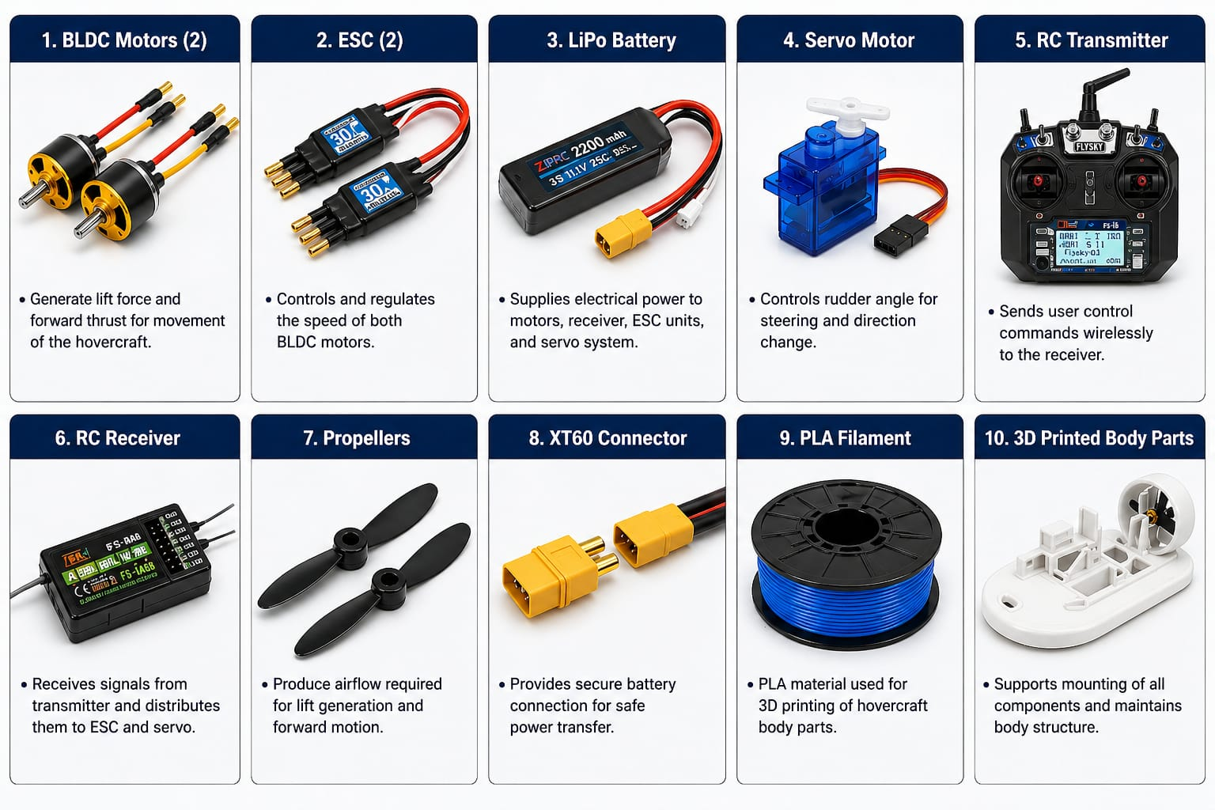
COMPONENTS USED
The hovercraft model was developed using electrical, mechanical, and control components. The main components used are listed below:
Main Components:
• BLDC Motors
• ESC (Electronic Speed Controller)
• LiPo Battery
• Servo Motor
• RC Transmitter & RC Receiver
• Propellers
• XT60 Connector
• 3D Printed Body Parts

Slide 6
BLOCK DIAGRAM AND WORKING
The working of the hovercraft is based on lift generation, forward thrust, and steering control. The system operation is explained below:
Working Steps:
• LiPo battery supplies power to the ESC units and receiver system.
• RC transmitter sends control signals to the receiver wirelessly.
• Receiver distributes signals to both ESC units and servo motor.
• Lift motor rotates the propeller to create an air cushion below the body.
• Thrust motor generates forward force for movement of the hovercraft.
• Servo motor controls the rudder angle for left and right turning.
• Combined operation of lift, thrust, and steering enables smooth movement.

Slide 7
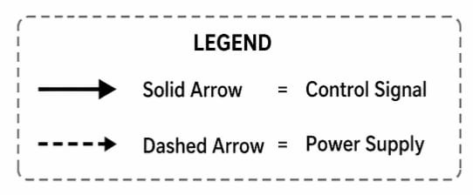
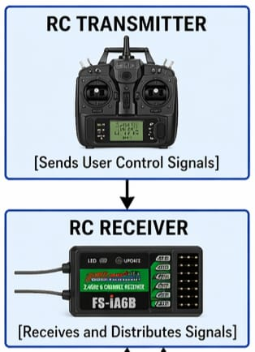
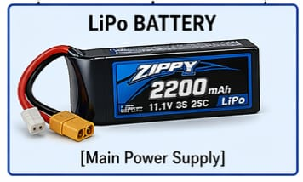
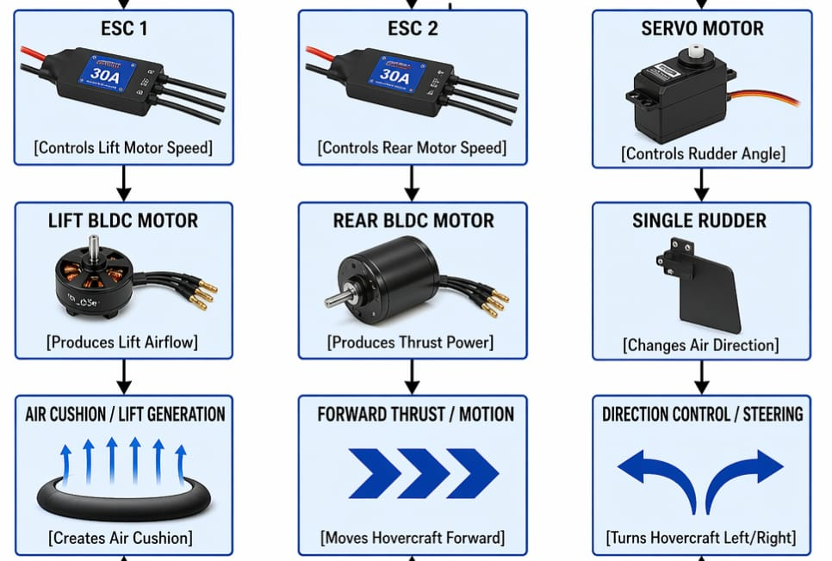
BLOCK DIAGRAM
BEC Output (5V) From ESC 2 to Receiver

Slide 8
Design and Fabrication Process
The hovercraft body and supporting parts were designed and fabricated using suitable software tools and manufacturing methods.
The complete process is summarized below:
• CAD modelling and body design using FreeCAD
• Slicing of final CAD model using Ultimaker Cura
• 3D printing of body parts using PLA material
• Assembly of motors, battery, ESC, and electronics
• Proper wiring and component alignment completed
• Final testing carried out after fabrication
• Smooth movement and system performance achieved

Slide 9
RESULTS AND CONCLUSION
❖ The hovercraft model was tested successfully under controlled conditions.
The important observations are given below:
• Air cushion was generated successfully by lift motor
• Forward movement achieved using thrust motor
• Steering control responded properly through rudder system
• Lightweight body improved movement efficiency
• Wireless control system worked smoothly
• Overall system performance was stable and satisfactory
The project successfully demonstrated the design and working of an RC controlled air cushion vehicle.

Slide 10
THANK YOU
Any Question?

