Slide 1
Team BloodCoded
Presented By:
Sohan Mandal
›
Tech Zephyr 4.0 · IIT Bhubaneswar
PROBLEM STATEMENT
Multi-Agent Network Fault Diagnosis & Interoperability
NetCoop AI
report.json
{
"suspected_root_cause": "congestion",
"confidence": 0.94,
"confidence_category": "high",
"alternative_causes": [ ... ],
"recommended_actions": [ ... ]
}
Alerts tell you something broke. NetCoop AI tells you why, with evidence, or admits it doesn't know.
Five specialist agents read campus telemetry from different angles, argue over the evidence in a typed protocol, and agree on one diagnostic report.
One report: root cause, evidence, alternatives and actions. Below 0.3 confidence it returns insufficient evidence instead of guessing.
netcoop-ai.vercel.app · github.com/sohan1611/NetCoop-AI
Notes:
Campus network faults rarely announce themselves. A single congested uplink shows up as latency, loss and retransmissions on dozens of devices, and the alerting tool lights up every one of them. NetCoop AI is a team of specialist agents that reads that telemetry, argues over what it means, and produces one evidence-based report: the root cause, how sure it is, what else it could be, and what to do. When the data can't support a diagnosis, it says so.

Slide 2
Team BloodCoded
›
Problem & Solution
THE PROBLEM
One fault, many symptoms, messy data
A congested uplink shows up as latency, loss and retransmissions across many devices, in telemetry with renamed fields, mixed units and old schemas. Alert tools flag every symptom; nobody names the cause.
TRADITIONAL
alerts on every symptom
Alert flood
Manual guess
Wrong fix
Symptoms go up.
The root cause stays hidden.
dozens of red tiles, one hidden cause
NETCOOP AI
turns symptoms into a diagnosis
agents argue over the evidence
Telemetry
Normalize
3 agents analyse
Correlate
Report
Root cause + confidence
any format or schema
aliases, units, quality score
performance · infra · connectivity
score hypotheses, query if unsure
evidence, alternatives, actions
congestion · 0.94 high
Don't silence the alerts. Explain them.
Notes:
Every alert in a congestion incident is technically true: latency is high, loss is up, retransmissions climb. But they're all one fault seen from different places, and the data arrives inconsistently: different field names, percent versus fraction, legacy schemas. Traditional tools stop at the symptoms. NetCoop AI normalises the data first, sends it to three specialist agents, lets a correlator weigh their competing hypotheses and ask follow-up questions, and reports one root cause with a confidence score.

Slide 3
Team BloodCoded
›
Technical Architecture
ARCHITECTURE
Five agents, one bus, one report
WHY IT'S MULTI-AGENT
Different angles. Metrics, devices and topology are read by separate specialists.
Performance
latency · loss · RSSI · util
TASK
FINDING
Normalizer
aliases · units · legacy v0 · quality score
Correlator
scores hypotheses · resolves conflicts
Reporter
JSON + Markdown
A typed protocol. TASK, FINDING, QUERY, RESPONSE, ERROR. Bad messages become ERRORs, not crashes.
Telemetry JSON
Infrastructure
status · CPU · errors · drops
Connectivity
topology graph · DNS/DHCP
Real disagreement. The Correlator weighs competing hypotheses and asks agents for more data.
QUERY / RESPONSE when unsure · max 2 rounds
Fails gracefully. A dead agent is skipped and listed as a limitation; the run still reports.
MESSAGE BUS validates every envelope · logs every message · 10 s timeout + 1 retry · checkpoints
Notes:
Telemetry enters the Normalizer, which maps aliases, converts units, upgrades legacy schemas and scores data quality. The orchestrator sends a TASK to each of three analysts: Performance, Infrastructure and Connectivity, which builds a networkx graph to find a common upstream device. Each returns a FINDING. The Correlator scores the competing hypotheses; if confidence is low or the top two are too close, it sends QUERY messages for more data, up to two rounds. The Reporter writes JSON and Markdown. Every message goes through a bus that validates the envelope and logs it.

Slide 4
Team BloodCoded
›
Evidence & Confidence
CONFIDENCE METHOD
Every number in the report can be traced
confidence =
bus message · correlator → performance
{
"type": "QUERY",
"sender": "correlator",
"recipient": "performance",
"correlation_id": "INC-0001",
"payload": {
"action": "widen_window",
"params": { "minutes": 15 },
"reason": "Top hypotheses are too close."
}
}
match × (0.5 + 0.5·coverage) × data_quality × agreement
match graded 0–1 fit of each signature metric, weighted
coverage share of the signature's metrics actually present
data_quality score from the Normalizer (missing, stale, quarantined)
agreement how far the agents' findings back the same cause
< 0.3
insufficient evidence
0.3–0.5
low
0.5–0.75
medium
≥ 0.75
high
Every envelope is a pydantic v2 model, documented field by field in PROTOCOL.md.
If confidence < 0.5 or the top two causes are within 0.15, the Correlator queries agents before it answers.
When the data can't support a diagnosis, it says so.
Notes:
Confidence is a formula, not a vibe. Match is how well the observed metrics fit a fault signature; coverage penalises missing metrics; data quality comes from the Normalizer; agreement reflects whether the agents point the same way. Below 0.3 the report status is insufficient evidence. When it is unsure, the Correlator sends QUERY messages like this one, asking Performance to widen its window to 15 minutes, before it commits.

Slide 5
Team BloodCoded
›
Interoperability & Robustness
BUILT FOR MESSY REALITY
Messy input in, honest report out
⇄
Any input format
⚠
Bad data quarantined
↻
Agent failure survives
Field aliases, unit conversion, legacy v0 schemas, CamelCase, "99.9%" strings and the organizer's generator format.
Impossible values, stale or future samples and duplicates are itemized and never analysed.
10 s timeout, one retry, then skip and record a limitation. Runs checkpoint and resume.
✓
Fixes are verified
⛨
Safe to host
▶
Three ways in
Simulated remediation patches a copy, re-diagnoses, and reports verified true or false.
Per-session isolation, rate limits, 5 MB upload cap, input-size caps, strict security headers.
CLI, a FastAPI console with a live message bus, and an MCP server for other agents.
Runs fully offline with --no-llm. Gemini is optional: it can map unknown fields and write a narrative, but never changes the cause or the confidence.
Notes:
Real telemetry is inconsistent, so interoperability is half the problem. The Normalizer accepts renamed fields, mixed units, old schema versions and the organizer's own generator format, and every fix is recorded as a data-quality note. Impossible values are quarantined, never silently used. If an agent crashes or times out, the run degrades instead of failing. Remediation is simulated: it patches a copy, re-diagnoses, and tells you whether the fix actually cleared the fault.

Slide 6
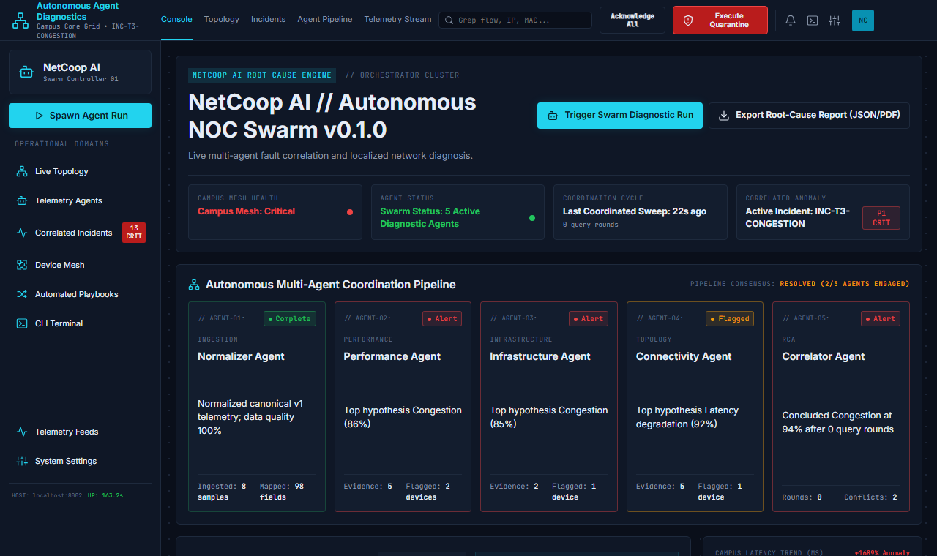
Team BloodCoded
›
Results
RESULTS
Tested like it will be attacked
524
16/16
automated tests passing
labelled scenarios diagnosed correctly
117
0
QA matrix checks executed and passing
crashes on hostile and malformed inputs
20,000 devices diagnosed as healthy in about 2 seconds.
Live console, congestion scenario. Performance and Infrastructure both point to congestion, Connectivity flags latency; the Correlator settles on congestion at 94%.
Notes:
The system is backed by 524 pytest tests and an evaluation harness over 16 labelled scenarios, including the organizer's format, all passing. A 117-check QA matrix and two adversarial scripts throw malformed, hostile and oversized input at the pipeline; nothing crashes. On the right is the live console during the congestion run: three agents report, two agree on congestion, Connectivity sees a latency pattern, and the Correlator resolves the conflict at 94% confidence.

Slide 7
Team BloodCoded
›
Impact
WHY IT MATTERS
From alert floods to answers
ours
NetCoop AI
Threshold alerting
“Why did it break, and how sure are we?”
Dashboards
“What crossed a line?”
“What's red?”
sees metrics
changes nothing on its own
sees one metric at a time
changes the alert count
sees metrics · devices · topology
changes the diagnosis, then verifies the fix
Explainable. Every message is logged; every report lists its evidence, alternatives and limits.
Honest. Below 0.3 confidence it reports insufficient evidence instead of guessing a cause.
Portable. Thresholds, signatures and scenarios are data. CLI, API and MCP make it easy to plug in.
An alert isn't a diagnosis. It's evidence.
NetCoop AI turns that evidence into a root cause you can check.
Notes:
Monitoring tools show what is red. Alerting tools tell you which line was crossed. NetCoop AI asks the question an engineer actually has: why did it break, and how sure are we? It is explainable, honest about uncertainty, and portable. Limits: synthetic data only, rule-based signatures tuned for the scenario topology, and remediation is simulated. Close with: an alert isn't a diagnosis, it's evidence. NetCoop AI turns that evidence into a root cause you can check. Thank you.

