Slide 1
GenderStego: A Novel Framework for Gait-Based Gender Recognition and Video Steganography
Presented by: Sohan Vallapureddy
CS 298: Department of Computer Science
San José State University
Project Advisors:
Dr. Nada Attar Dr. Noha Elfiky
Associate Professor, Computer Science Professor of AI and Business & Data Analytics
San Jose State University Saint Mary's College of California
Dr. Safwat Hamad Dr. Ahmed Elhadad
Professor of AI | Data Science | Business Analytics Associate Professor, Computer Science
Saint Mary's College of California Faculty of Computer and Information
South Valley University-Qena, Saudi Arabia

Slide 2
Table of Contents
Introduction & Motivation
Literature Survey
Dataset
System Architecture
Stage 1: Gait Gender Classifier
Stage 2: Privacy Module
Stage 3: Steganography
Results & Evaluation
Discussion & Limitations
Conclusion
Future Work

Slide 3
Introduction & Motivation
The Privacy Problem
Surveillance cameras are everywhere. Traditional video analytics expose:
  Identity (face, gait signature)
  Demographics (gender, age)
  Behaviour and location history
Storing raw footage creates a permanent, searchable record of people without consent
No widely deployed approach balances strong privacy with rich video analytics

Slide 4
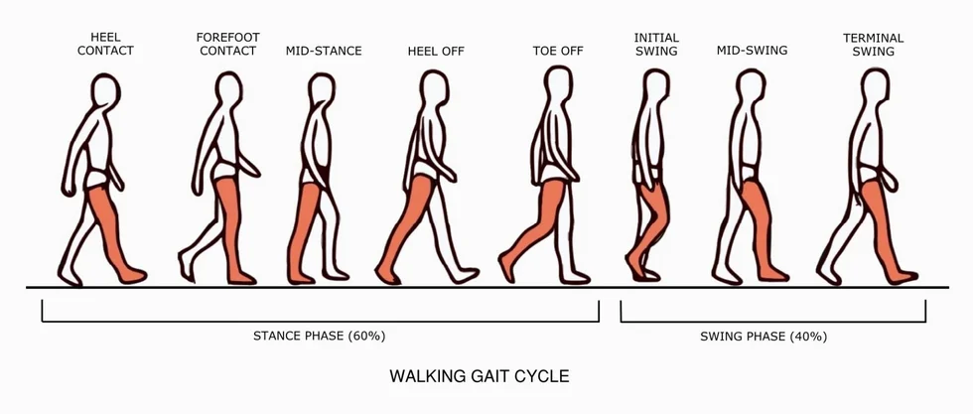
Introduction & Motivation
What is gait?
● A person's unique walking pattern: measurable at distance, without contact or cooperation
● Key cues: stride length, step frequency, hip and shoulder motion
● Works with low resolution, occlusion, or at night: unlike face recognition
Picture taken from: https://www.coachhackfeet.com/blog/2026277_gait-cycle

Slide 5
Why Privacy Matters in Video Analytics
Widespread Surveillance: Increasing camera use raises concerns about how people’s movements are recorded.
Risks of Exposure: Footage enables unauthorized identification, profiling, and misuse of personal data.
Legal and Ethical Concerns: Regulations (e.g., GDPR) and ethics demand stronger privacy protections.
Challenges with Existing Methods: Raw video reveals sensitive details like identity, behavior, and demographics.
Our Goal: Enable meaningful video analysis while safeguarding privacy & blocking information leaks.
We need privacy‑by‑design analytics, not raw‑video pipelines.

Slide 6
Why Combine Gait Analysis, Gender Classification & Steganography?
Gait: unobtrusive biometric, but gait signatures and attributes leak identity
Gender: useful demographic label, but amplifies privacy risk if stored naively
Steganography: hide original video inside skeletal video while preserving utility
GenderStego: use gait‑based gender to control access, and encrypt + hide the full video while exposing only skeletons
  Outcome: A robust system that balances privacy, utility, and security for modern surveillance and analysis.

Slide 7
Project Overview & Contributions
Classify gender from gait using only skeleton pose (no face, clothing, or appearance)
Replace persons with colour‑coded skeletons in an inpainted, person‑free scene
Embed the original video inside the skeletal video with DCT steganography + AES‑256
Project outcomes:
Accurate gait-based gender recognition
Privacy-preserving video processing pipeline
Secure embedding of original video within skeletal videos using steganography

Slide 8
Literature Survey
1. Gait-based pose estimation & gender classification
Paper Title | Model/Technique | Description
GenReGait: Robust Gender Recognition Utilizing Gait Features | Keypoint estimation, Deep Learning | Uses joint keypoint data and deep learning for robust gender recognition from gait.
Learning Visual Prompt for Gait Recognition (CVPR 2024) | Dynamic Transformer, Attention Mechanism | Introduces part-based prompts and attention to improve gait recognition accuracy across views.
Occluded Gait Recognition with Mixture of Experts (ECCV 2024) | Mixture of Temporal & Action Experts | Handles occluded gait data using expert classifiers for more accurate gait gender predictions.
Free Lunch for Gait Recognition (ECCV 2024) | Relation Descriptor | Models relationships between gait features to improve recognition robustness.
Robust and Lightweight System for Gait-Based Gender Classification | Spatial-Temporal Graph Convolutional Network (ST-GCN) | Uses ST-GCN for efficient and noise-robust gender classification from pose data.

Slide 9
2. Privacy Module
Paper Title | Model/Technique | Description
Privacy-Preserving Video Processing with HSV Gaussian Modeling | HSV Gaussian Background Modeling | Uses HSV-based background modeling for robust human masking and inpainting to protect identity.
Appearance Abstraction and Desensitization Techniques for Video Privacy | Object Detection (YOLO, Mask R-CNN) | Masks or blurs identifiable human features to prevent unauthorized identification.
Context-Aware Adaptive Privacy Operators (e.g., X-Stream) | Dynamic Privacy Operator Selection | Dynamically applies different privacy techniques based on video content and risk level.
Encrypted Video Encoding and Analysis | Compressed Encrypted Bitstreams (H.264/AVC, HEVC) | Ensures secure storage and transmission by encrypting video data while enabling selective analytics.
Differential Privacy in Video Analytics | Noise Injection, Differential Privacy | Ensures analytics do not expose individual presence or sensitive information via noise addition.

Slide 10
3. Secure steganographic embedding
Paper Title | Model/Technique | Description
StegaNeRV: Video Steganography using Implicit Neural Representation (CVPR 2024) | Implicit Neural Representation + U-Net | High-capacity video steganography with high-fidelity reconstruction using neural networks.
Stego-STFAN: Neural Network for Video Steganography | Spatial-Temporal Filter Adaptive Network + Attention | Leverages spatiotemporal redundancy and attention to embed secret data imperceptibly.
Adaptive Highly Secure Video Steganography for Medical Images | Deep CNN + AES Encryption | Combines CNN encoding with encryption for secure, imperceptible steganography in sensitive medical videos.
Octree Decomposition for Spatiotemporal Redundancy Exploitation | Octree-based hierarchical embedding | Uses octree decomposition to embed large payloads while preserving carrier quality and robustness.
Hybrid Steganography with Cryptography | AES Encryption + Frame Shuffling + Edge Detection | Enhances security and imperceptibility by combining encryption and advanced embedding techniques.

Slide 11
Positioning GenderStego in the Literature
Builds on ST‑GCN and recent gait models by using skeleton sequences for gender classification under real‑world surveillance noise
Goes beyond prior privacy filters (blurring, masking) by replacing appearance with gender‑coded skeletons that are still analytically useful
Combines DCT‑based video steganography with AES‑256‑CTR + HMAC to link analytics and cryptographic protection in one pipeline

Slide 12
Dataset
Dataset Overview
Two datasets were used across this project:
DenseGait is the primary dataset used for model training and evaluation.
OU-ISIR was used in early experimentation to validate the pipeline approach.
OU-ISIR dataset was used during early pipeline development to validate that the
ST-GCN architecture and training loop functioned correctly before switching
to DenseGait for full-scale training.
Extensive results are on DenseGait.

Slide 13
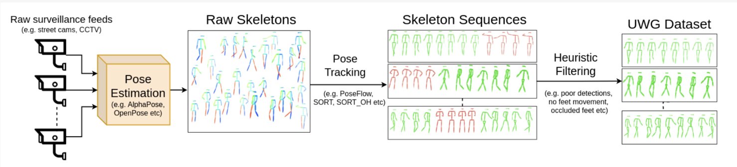
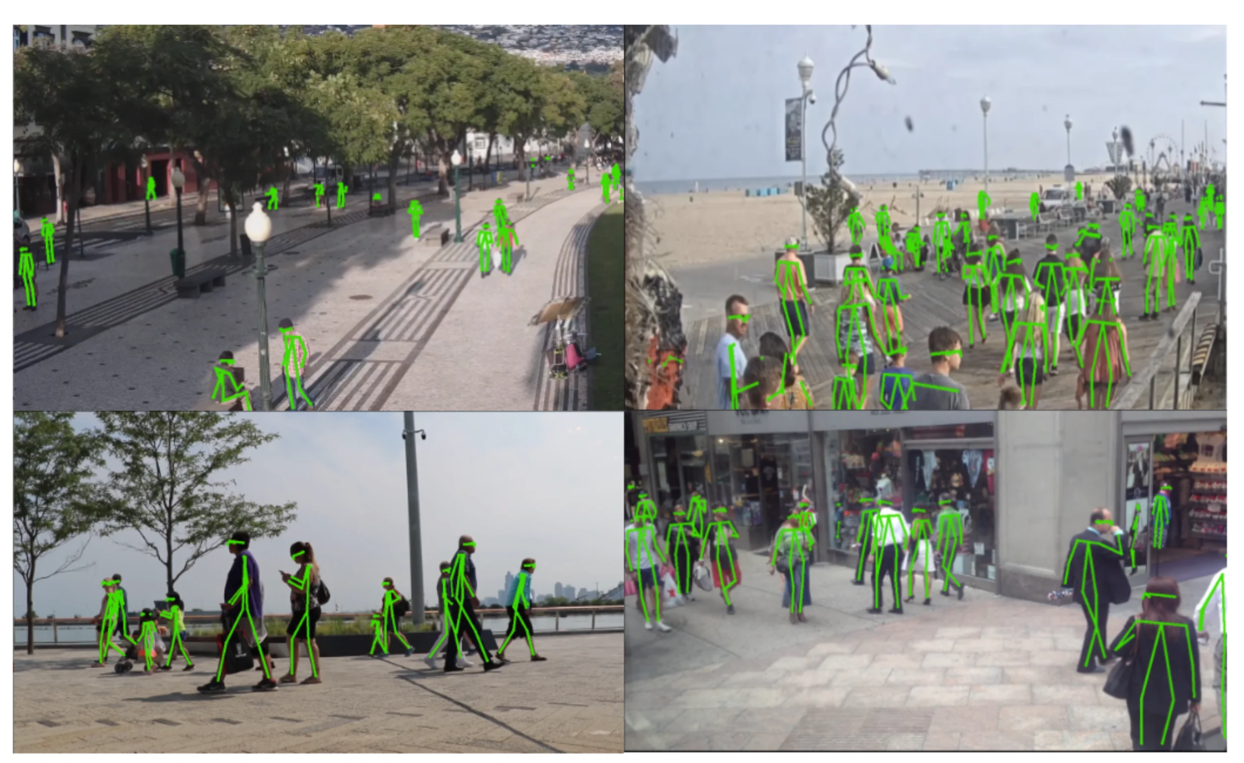
Dataset
DenseGait Dataset
DenseGait (Cosma & Radoi, Sensors 2022)[2] is the largest dataset for gait analysis pretraining.
Tracklets are harvested automatically from real-world video streams and annotated using an automatic attribute detection pipeline.
Gait covariates include occlusion, variable lighting, and multiple camera angles: conditions that mirror real surveillance deployment.
License: CC BY-NC-ND 4.0 (open credentialized access).
Pictures taken from: DenseGait: A Dense Skeleton‑based Gait Database for Pre‑training”, Sensors, 2022

Slide 14
Dataset
Why DenseGait for GenderStego:
• Real-world data: model generalizes beyond controlled lab conditions
• Large scale (217K): sufficient for deep learning without manual annotation
• Binary gender label available as one of 42 attributes: directly usable for classification
Model Input Format:
Tensor shape: [Batch, 3, T, 18, 1]
Coordinates: x, y, confidence (3 channels)
T (frames): sequence length, padded/truncated to T=64
Joints: 18 skeleton joints (ST-GCN graph nodes)
Label: Male = 0, Female = 1 (binary classification)
Limitations: binary gender labels; automatic attributes may contain label noise; fairness across demographics not evaluated

Slide 15
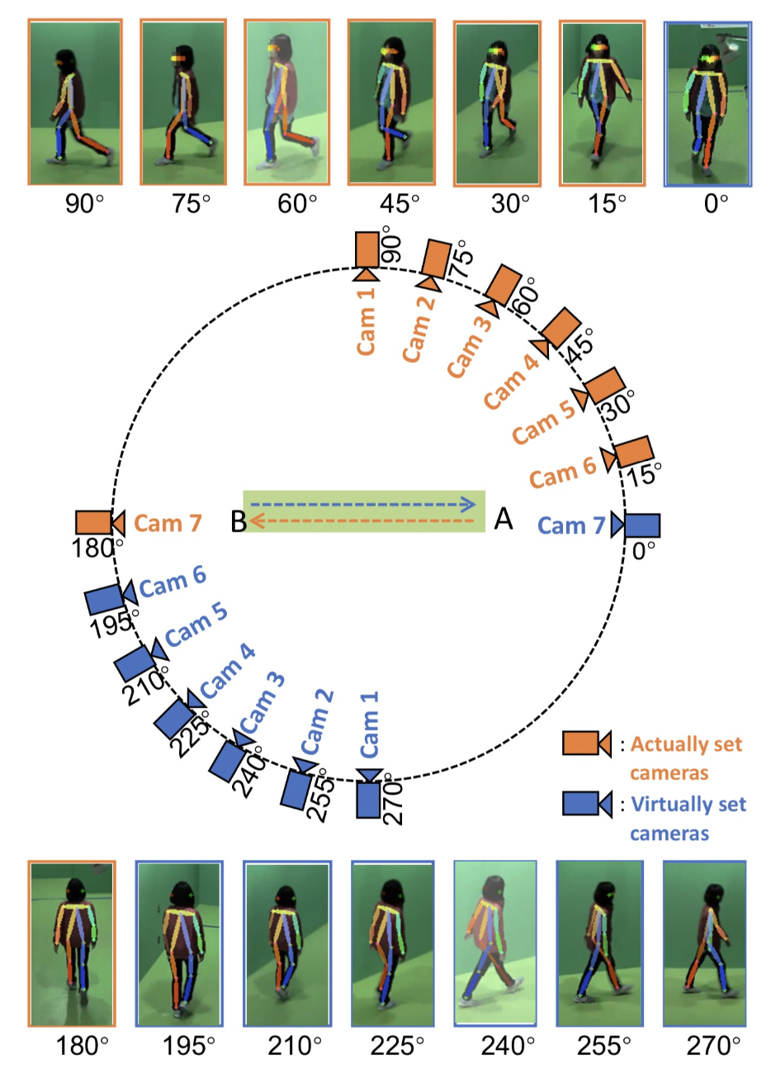
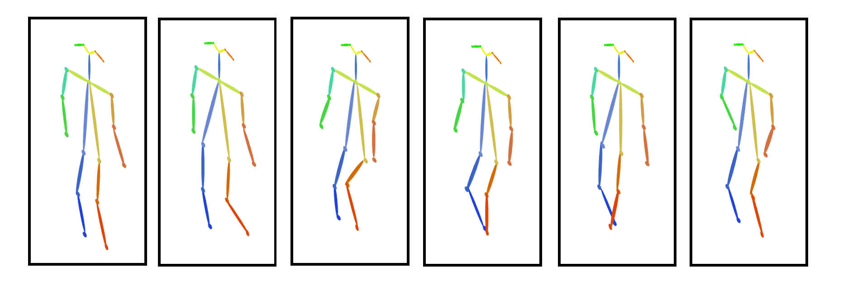
Dataset
The OU-ISIR Gait Database
Multi-view Large Population Dataset with Pose Sequence
This data set was built upon OU-MVLP[3]. It contains 10,307 subjects of round-trip walking sequences captured by seven network cameras at intervals of 15° (this sums to 14 views by considering the round trip on the same walking course) with an image size of 1,280 x 980 pixels and a frame-rate of 25 fps. The video capturing setup is shown here.
The pose sequences are then extracted from RGB images using two state-of-the-art pose estimation algorithms, i.e., OpenPose [Cao+ CVPR2017] and AlphaPose [Fang+ ICCV2017]. The estimated pose results include 18 joints.
The number of frames in a sequence is from 18 to 35, and most of the sequences contain approximately 25 frames.
Note: OU‑ISIR used only for early pipeline validation; final training and evaluation on DenseGait
Pictures taken from: Performance Evaluation of Model‑Based Gait on Multi‑View Very Large Population Database With Pose Sequences

Slide 16
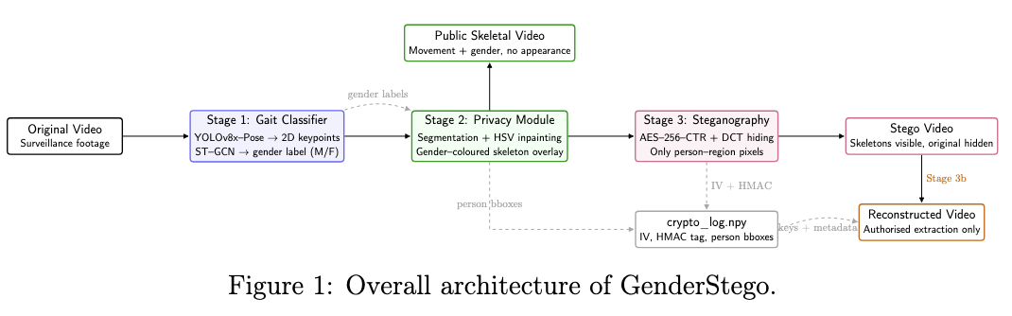
System Architecture
Notes:
Simplify Diagram and add stepwise flow
Add more visuals for each module
Add success and failure cases
Add qualitative and quantitative data output for each stage
This gives scope for future work, how to improve.
Draw different architectures for each stage
Add name for each stage. Group each module (box border)

Slide 17
Methodology
GenderStego enables privacy-preserving video analytics using gait-based AI and secure steganography
It integrates:
Gait-based pose estimation & gender classification
Privacy-preserving video processing
Secure steganographic embedding
Video reconstruction & evaluation metrics

Slide 18
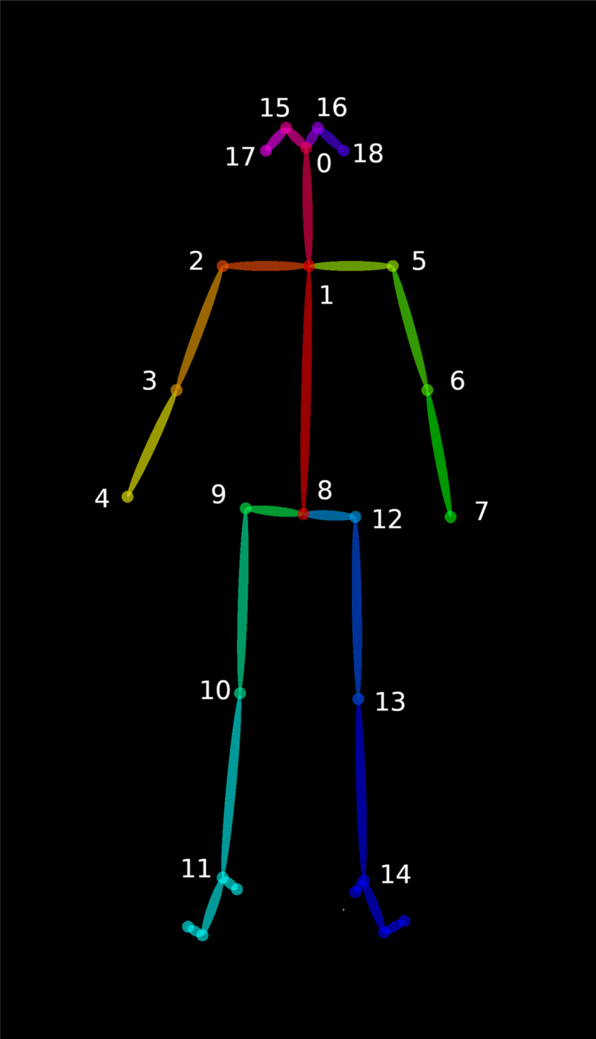
Methodology
1. Gait-based pose estimation & gender classification
Leverages YOLOv8x-Pose for 2D skeletal joint extraction from each video frame.
Extracted pose sequences represent 18 body joints' positions over time. These are the foundation for gender recognition.
Uses Spatial-Temporal Graph Convolutional Network (ST-GCN)
  Models human skeleton as a spatio-temporal graph.
  Nodes: body joints, Edges: spatial (intra-frame) and temporal (inter-frame) connections.
Trained on DenseGait dataset for robust, accurate gender classification.
https://www.researchgate.net/figure/Eighteen-joints-of-a-human-body-extracted-from-each-frame-are-input-to-LSTM-to-classify_fig4_359744285

Slide 19
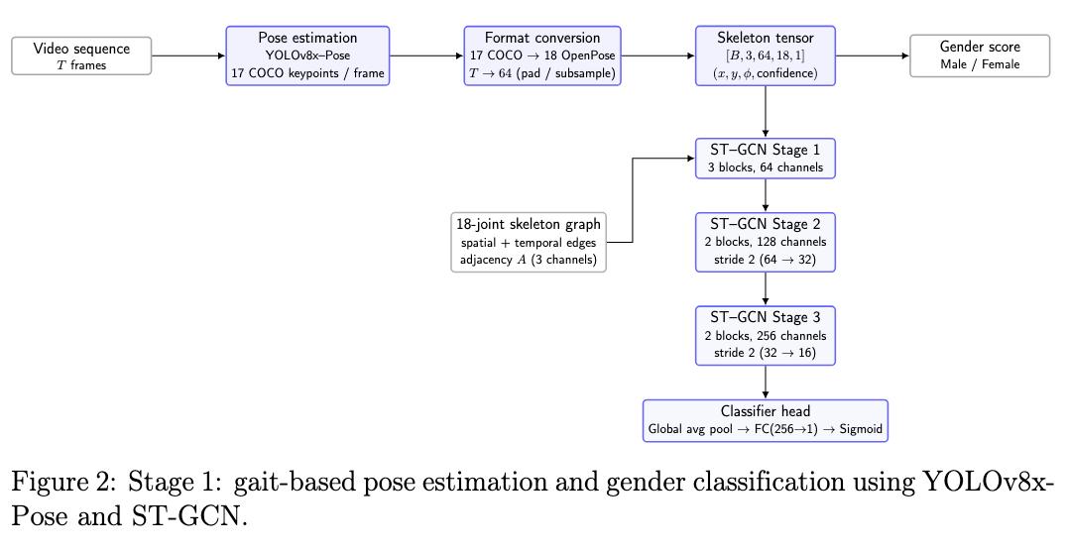
Gait Gender Classifier Architecture
Notes:
Simplify Diagram and add stepwise flow
Add more visuals for each module
Add success and failure cases
Add qualitative and quantitative data output for each stage
This gives scope for future work, how to improve.
Draw different architectures for each stage
Add name for each stage. Group each module (box border)

Slide 20
Methodology
1. Gait-based pose estimation & gender classification
Pose estimation: Use YOLOv8x‑Pose to extract 2D keypoints for each person in every frame
Sequence building: Convert 17 COCO joints to 18 OpenPose joints and build pose sequences of length T=64
ST-GCN model: Feed sequences ‎[B, 3, T, 18, 1] into an ST‑GCN with three stages
  64→128→256 channels
Classification: Apply global average pooling and a sigmoid layer to output a binary gender score (Male / Female)

Slide 21
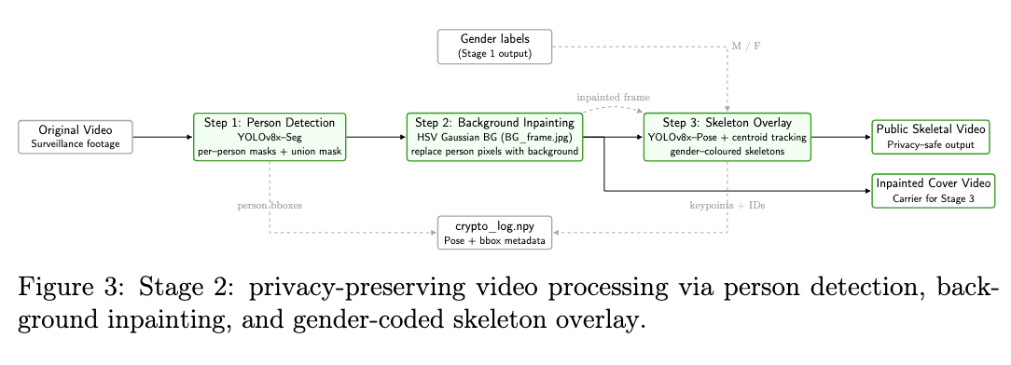
Privacy Module Architecture
Notes:
Simplify Diagram and add stepwise flow
Add more visuals for each module
Add success and failure cases
Add qualitative and quantitative data output for each stage
This gives scope for future work, how to improve.
Draw different architectures for each stage
Add name for each stage. Group each module (box border)

Slide 22
Methodology
2. Privacy-preserving video processing
Generates a clean background with HSV Gaussian modeling to minimize shadow and lighting issues
Blacks out everything except human figures in the video (private/blackout video)
Inpaints human regions with the background to create a person-free scene
Overlays color-coded 2D skeletons (blue: male, red: female) onto the inpainted background
Only pose information (not appearance) is visible. This protects identity while preserving analytic value

Slide 23
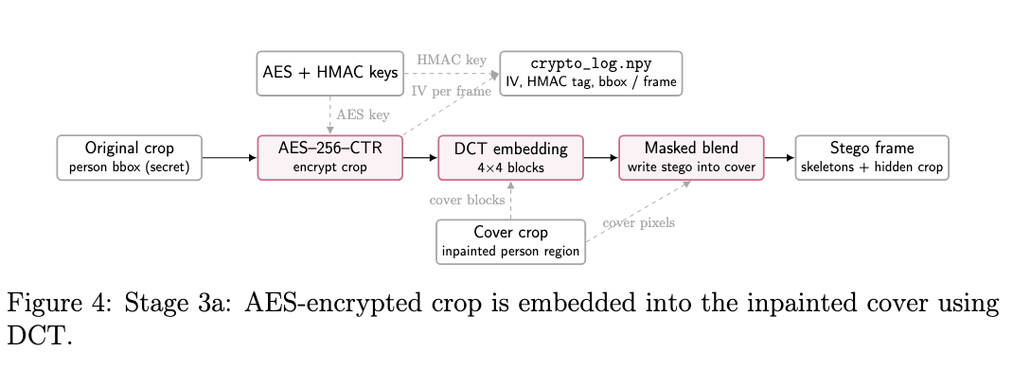
Encryption
Notes:
Simplify Diagram and add stepwise flow
Add more visuals for each module
Add success and failure cases
Add qualitative and quantitative data output for each stage
This gives scope for future work, how to improve.
Draw different architectures for each stage
Add name for each stage. Group each module (box border)

Slide 24
Methodology
3. Secure steganographic embedding
Discrete Cosine Transform (DCT) steganography embeds the original video inside the skeletal (pose) video
Frames hidden in frequency domain using quantization and pixel adjustments for imperceptibility
Embedded data is secured:
  AES-256 encryption for confidentiality
  HMAC for integrity/authentication
Output is a “stego video” that visually shows only pose skeletons but contains the encrypted original

Slide 25
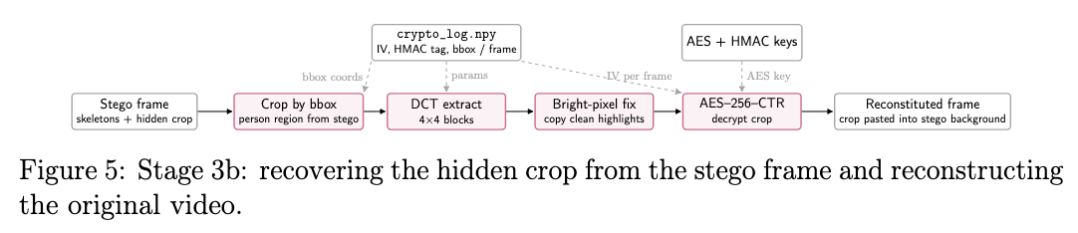
Reconstruction
Notes:
Simplify Diagram and add stepwise flow
Add more visuals for each module
Add success and failure cases
Add qualitative and quantitative data output for each stage
This gives scope for future work, how to improve.
Draw different architectures for each stage
Add name for each stage. Group each module (box border)

Slide 26
Methodology
4. Video reconstruction & evaluation metrics
Original video is reconstructed through an inverse process
Evaluation metrics include:
  Mean Squared Error (MSE)
  Peak Signal-to-Noise Ratio (PSNR)
  Image similarity scores

Slide 27
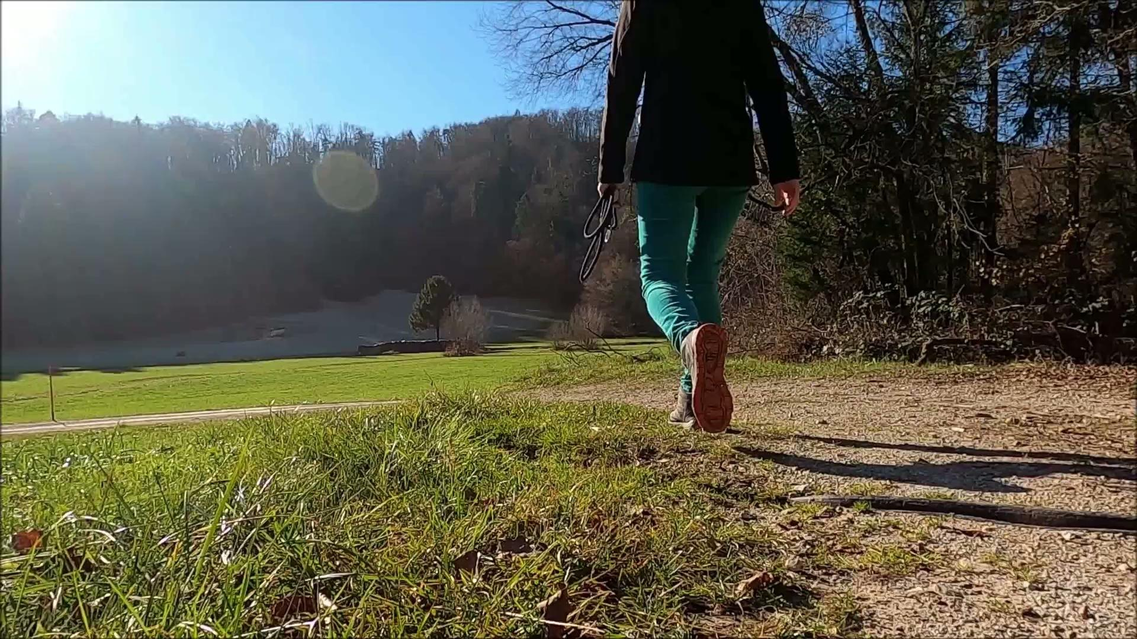
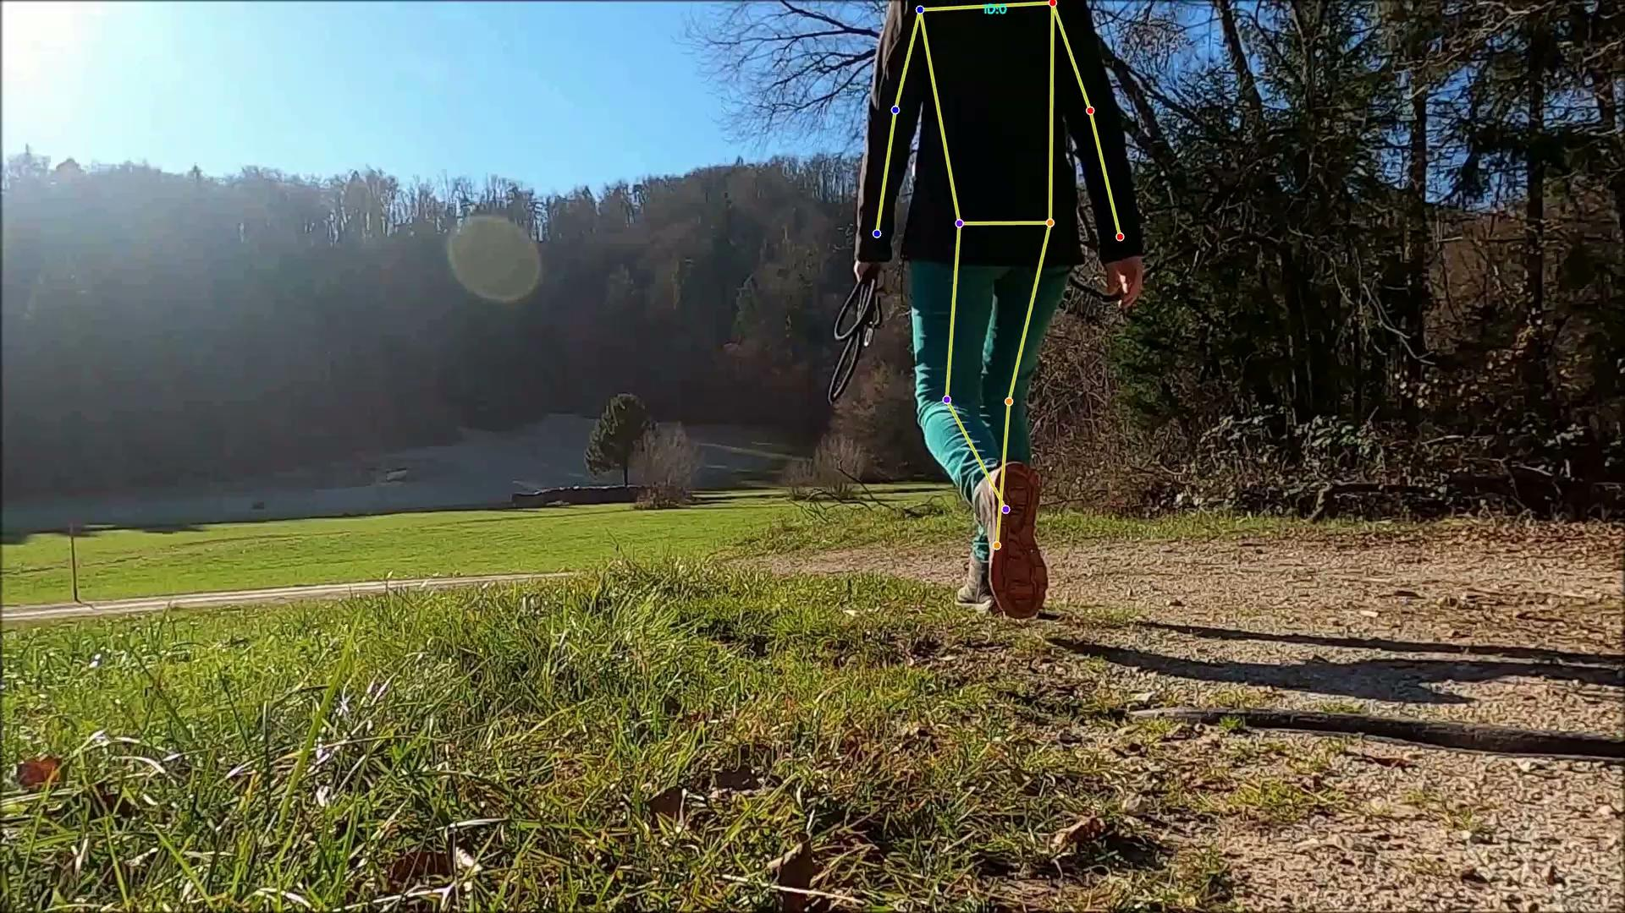
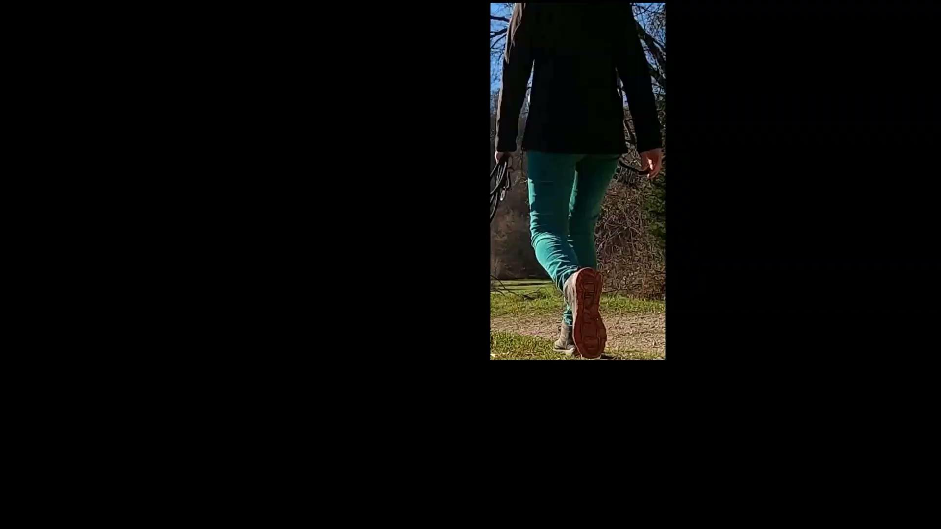
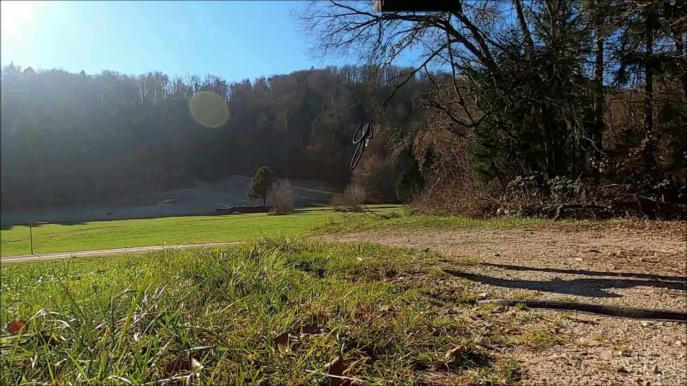
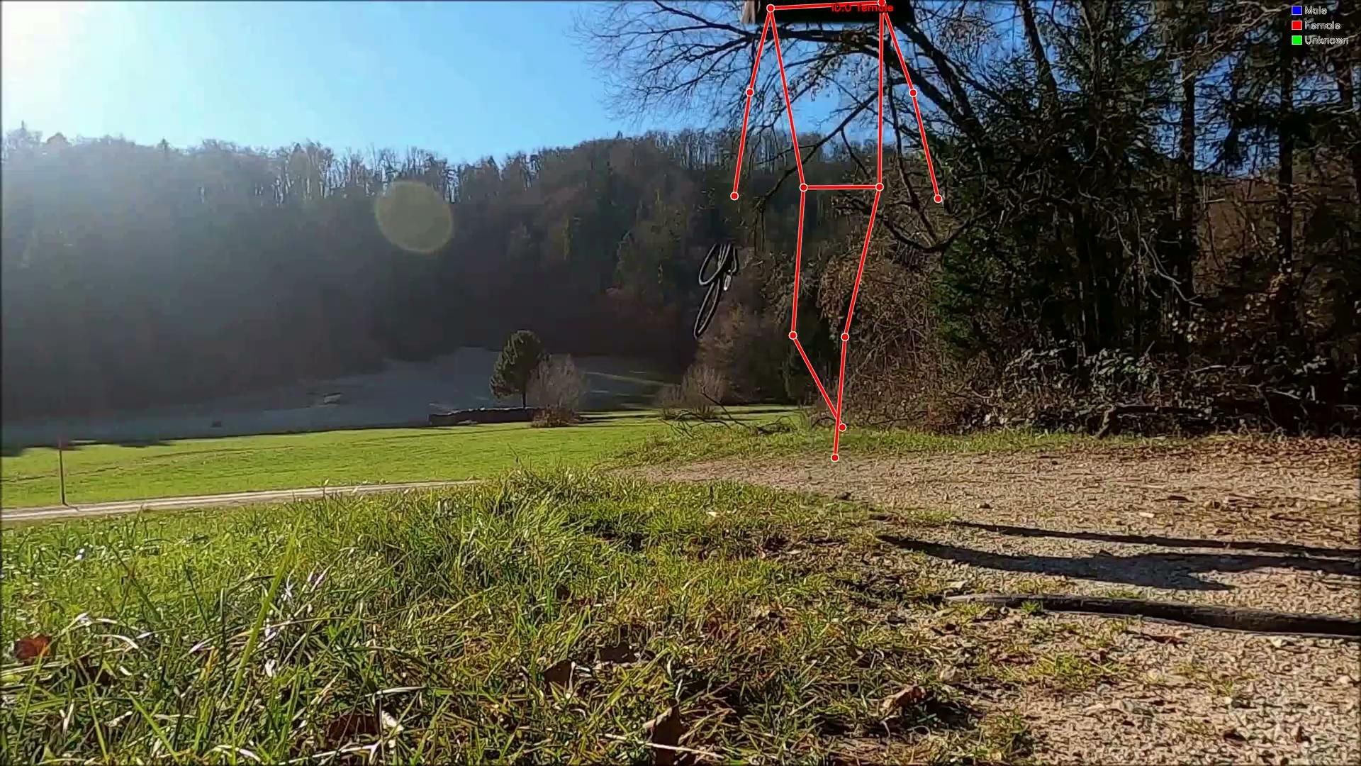
Results
Original Video
Pose Estimation
Isolate Persons
Stego Video
Reconstructed Video
Skeletal Video
vid1
1
2
3
4
5
6

Slide 28
vid1 – Scenario, Expectation, Outcome
Premise
We have still camera, good lighting, only one person walking their dog
Expectation
Pipeline detects person identifies as female, hides her, omits dog
Observed Outcome
Success, outcome is same as expectation

Slide 29
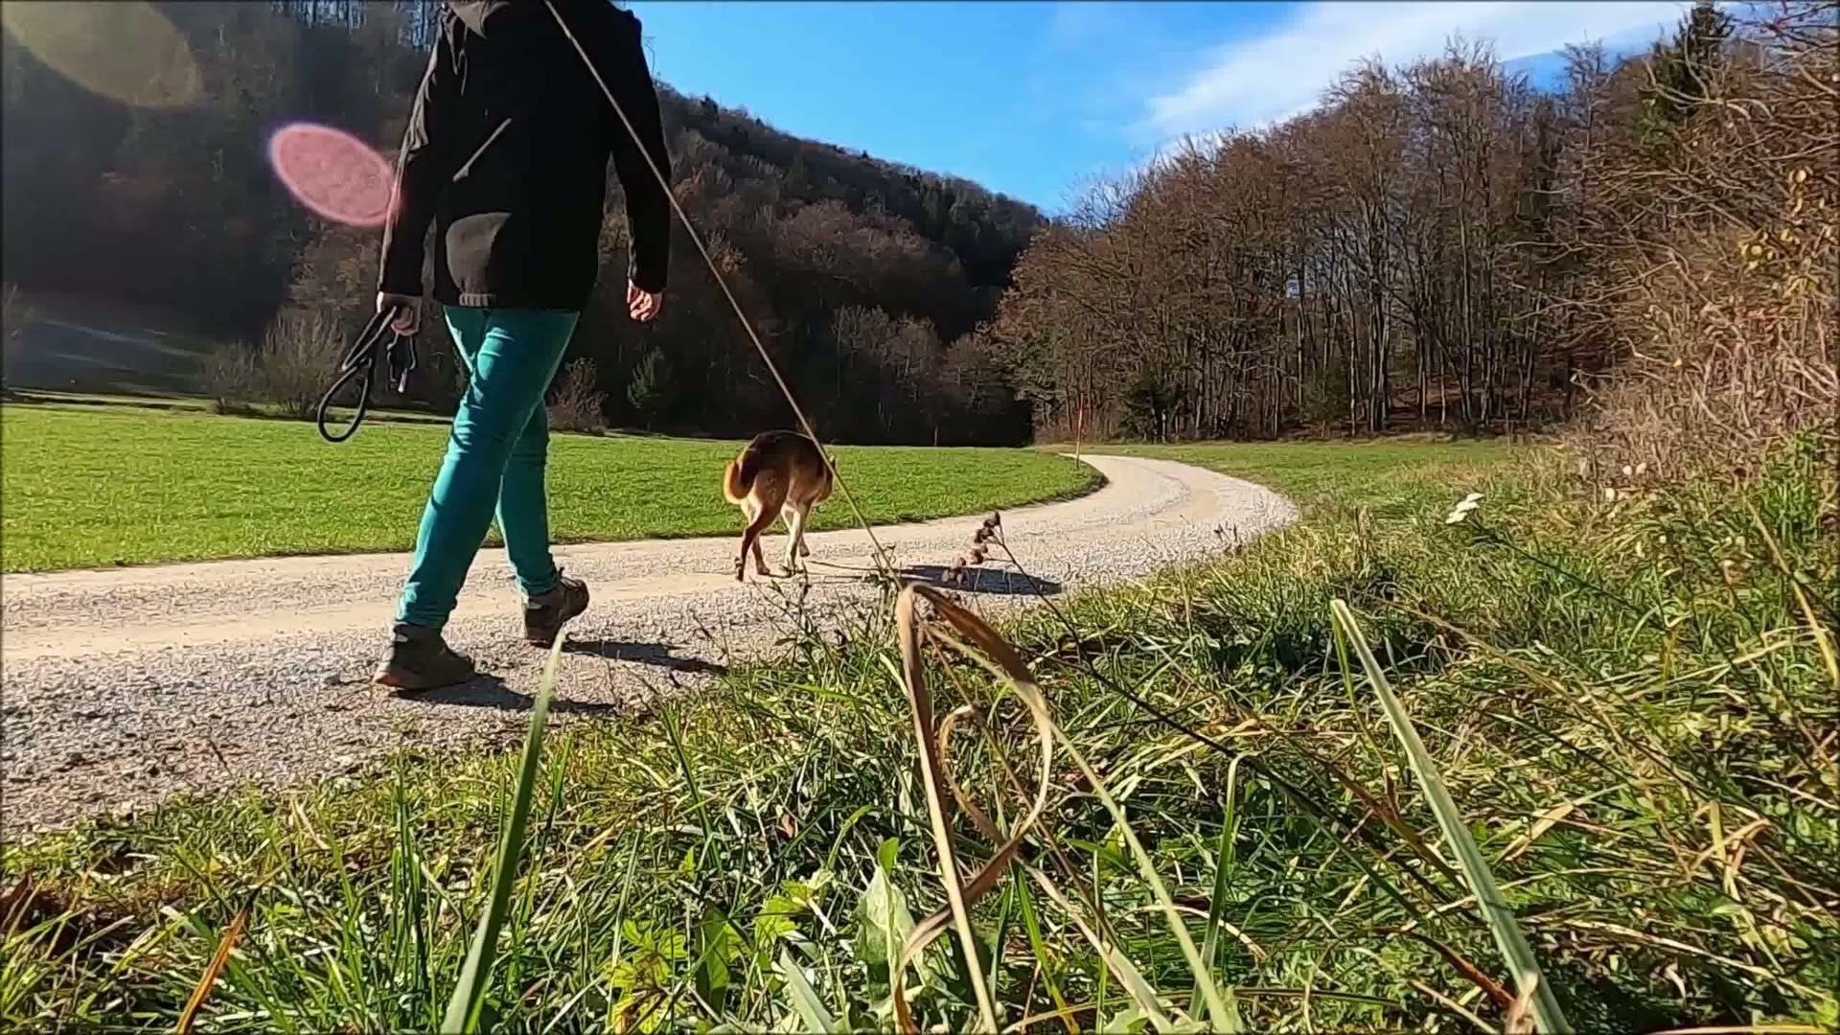
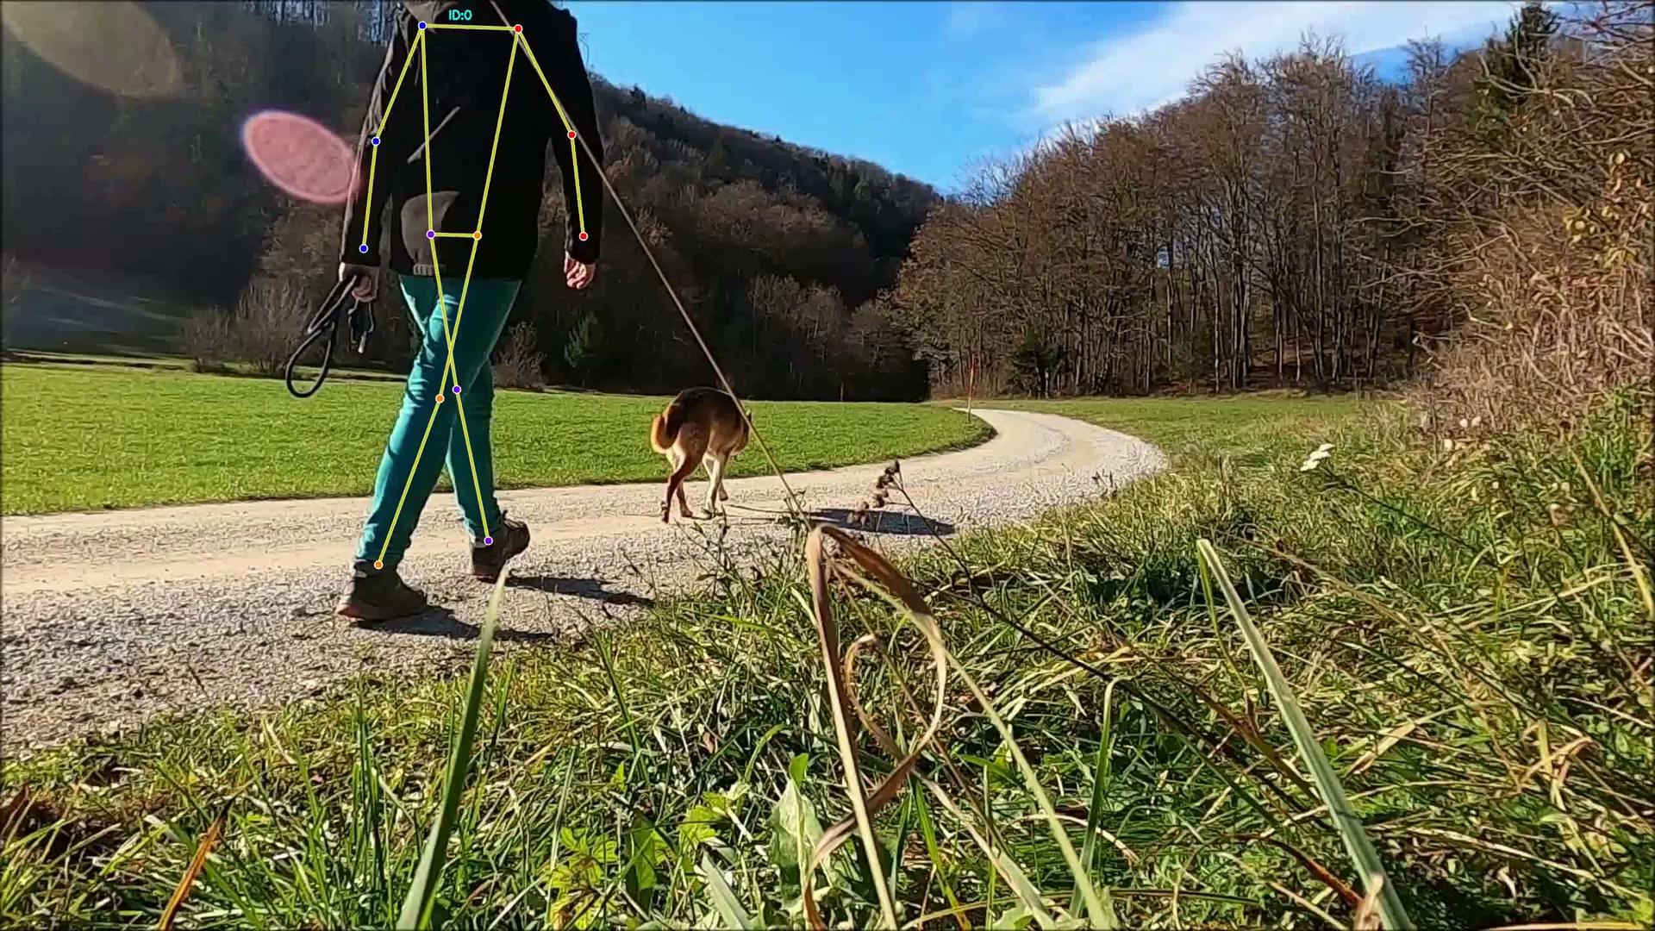

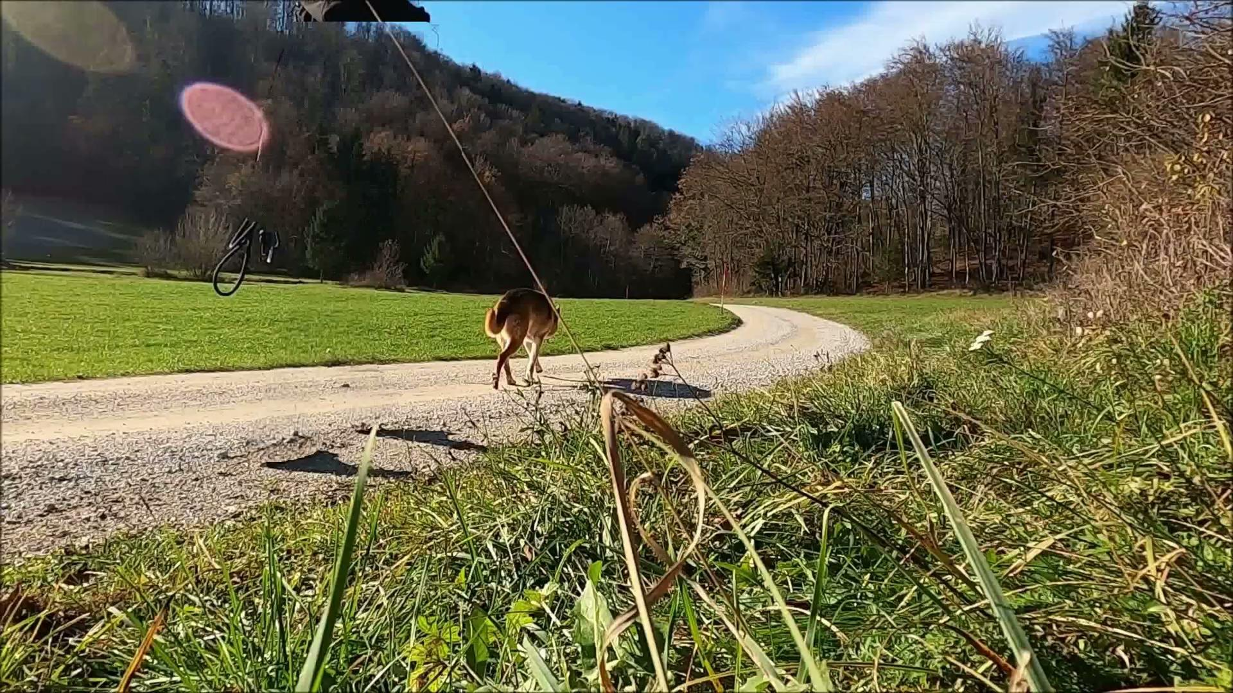
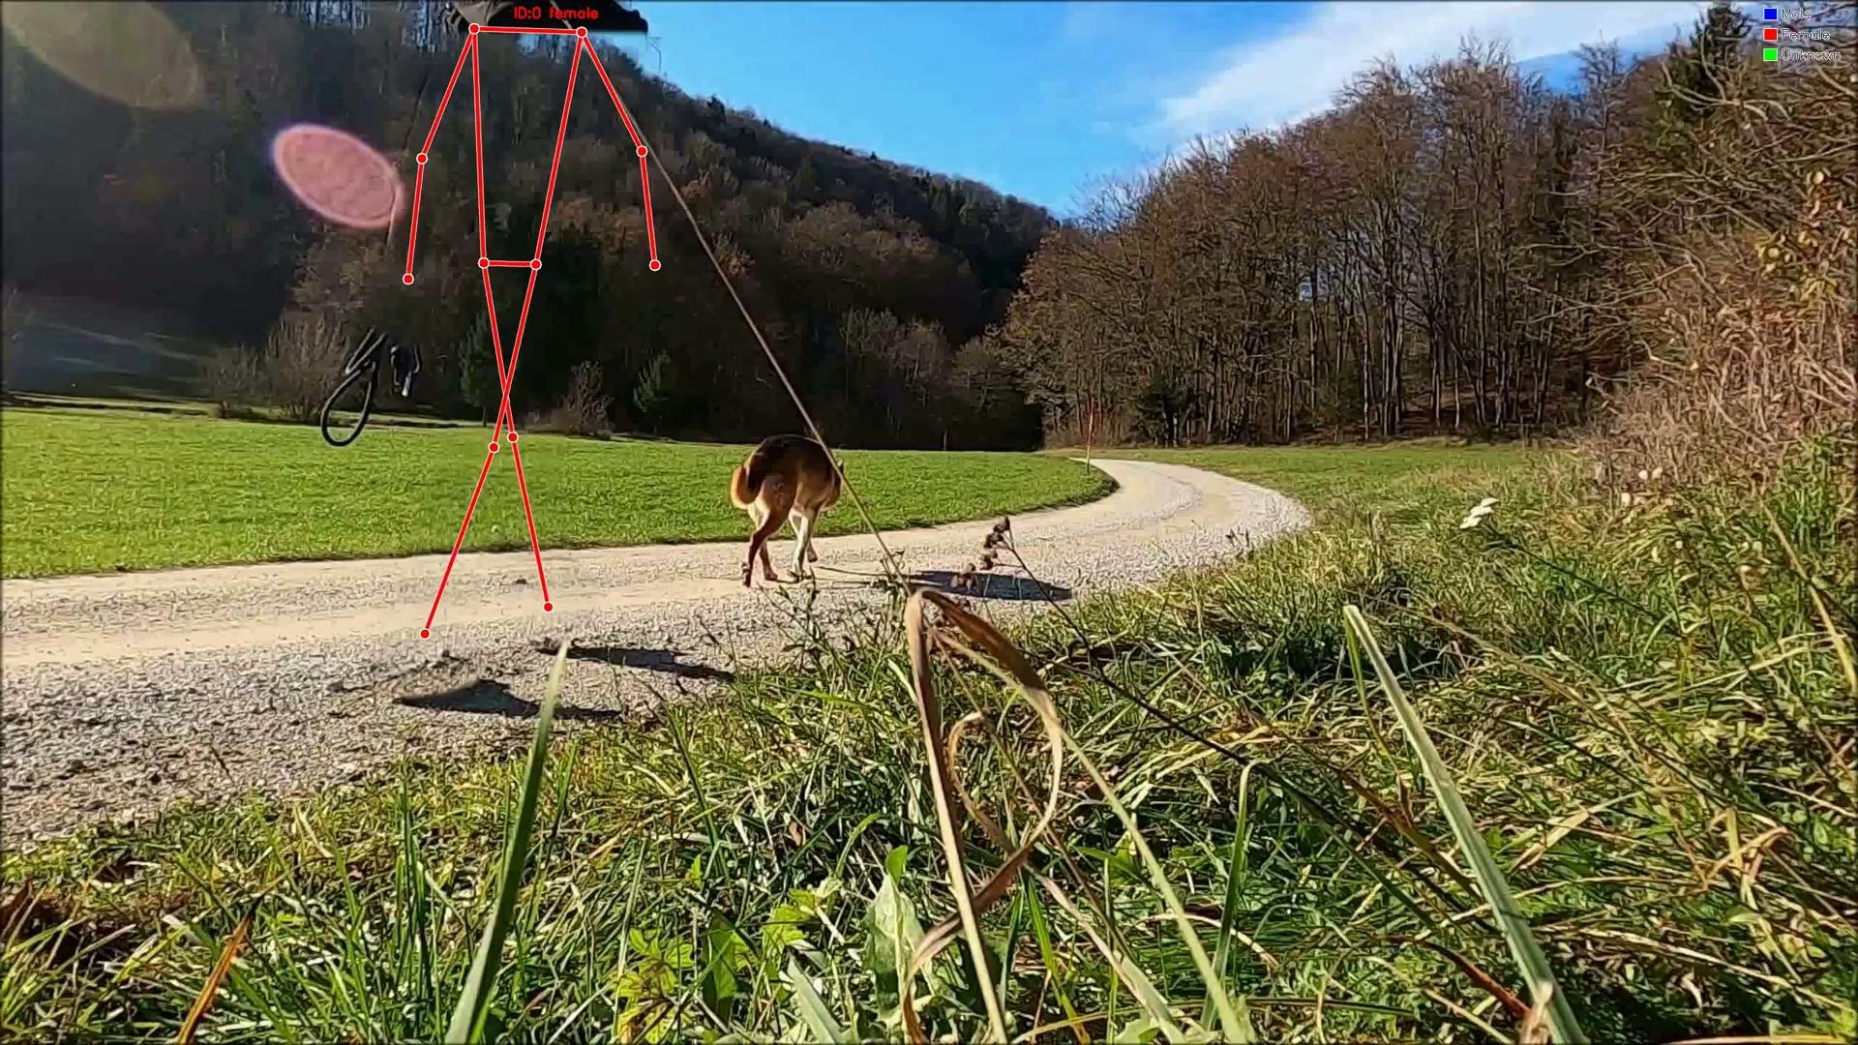
Results
Original Video
Pose Estimation
Isolate Persons
Stego Video
Reconstructed Video
Skeletal Video
vid2
1
2
3
4
5
6

Slide 30
vid2 – Scenario, Expectation, Outcome
Premise
We have still camera, good lighting, only one person walking their dog, different camera angle
Expectation
Pipeline detects person identifies as female, hides her, omits dog
Observed Outcome
Success, outcome is same as expectation

Slide 31






Results
Original Video
Pose Estimation
Isolate Persons
Stego Video
Reconstructed Video
Skeletal Video
vid3
1
2
3
4
5
6

Slide 32
vid3 – Scenario, Expectation, Outcome
Premise
A man walking, still camera, good lighting, black clothing
Expectation
Hides the person, classifies as male
Observed Outcome
Success, outcome is same as expectation

Slide 33





Results
Original Video
Pose Estimation
Isolate Persons
Stego Video
Reconstructed Video
Skeletal Video
vid4
1
2
3
4
5
6

Slide 34
vid4 – Scenario, Expectation, Outcome
Premise
Multiple people in video, people cycling, walking closely, good lighting
Expectation
Hides and classifies people, might struggle with hiding and classifying cyclists
Observed Outcome
Hides people well, correctly classifies people walking, incorrectly classifies cyclists

Slide 35
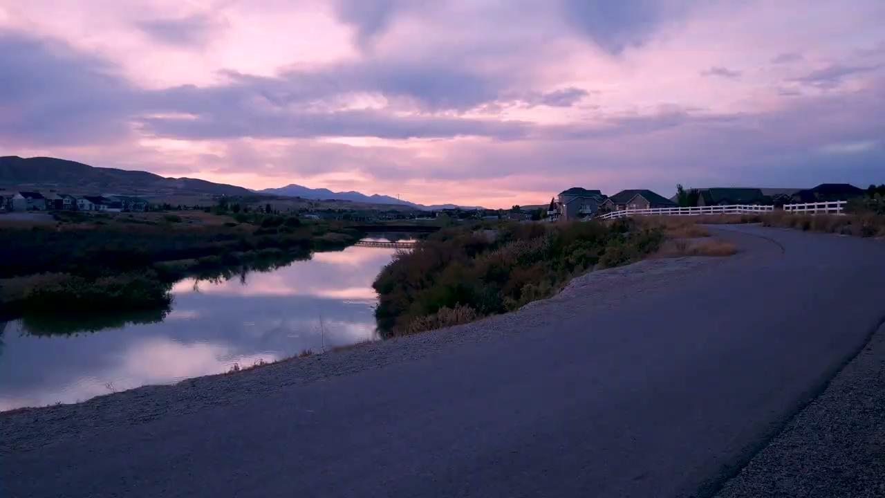
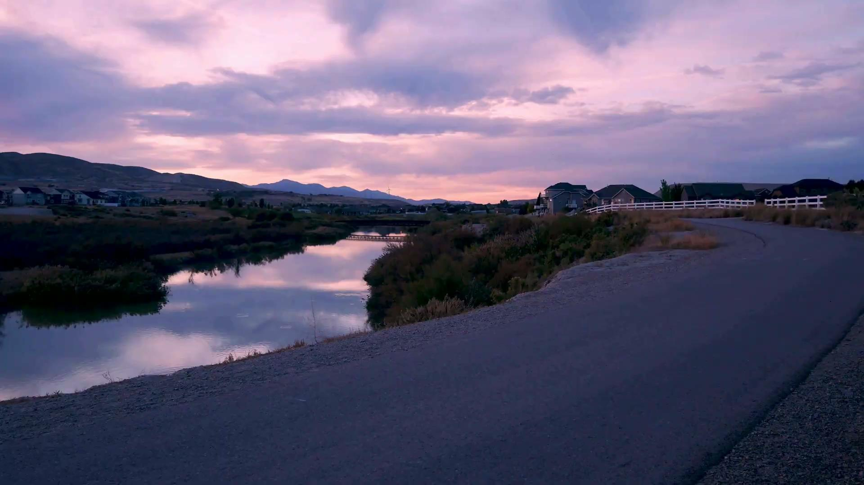

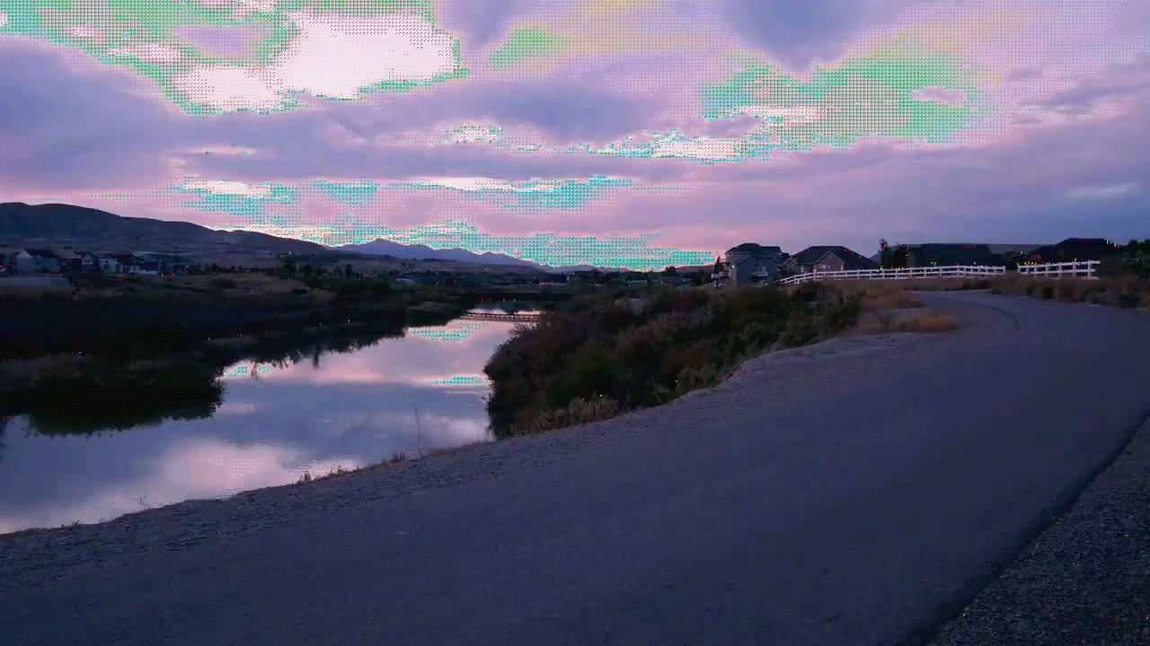

Results
Original Video
Pose Estimation
Isolate Persons
Stego Video
Reconstructed Video
Skeletal Video
vid5
1
2
3
4
5
6

Slide 36
vid5 – Scenario, Expectation, Outcome
Premise
A man walking on a road at sunset, medium lighting
Expectation
Classifies correctly as male and hides the man perfectly
Observed Outcome
Classifies correctly as male, but some pixels are not hidden well

Slide 37
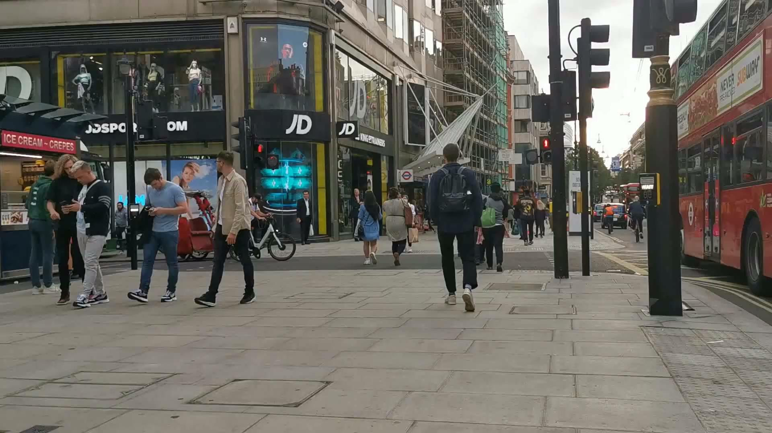
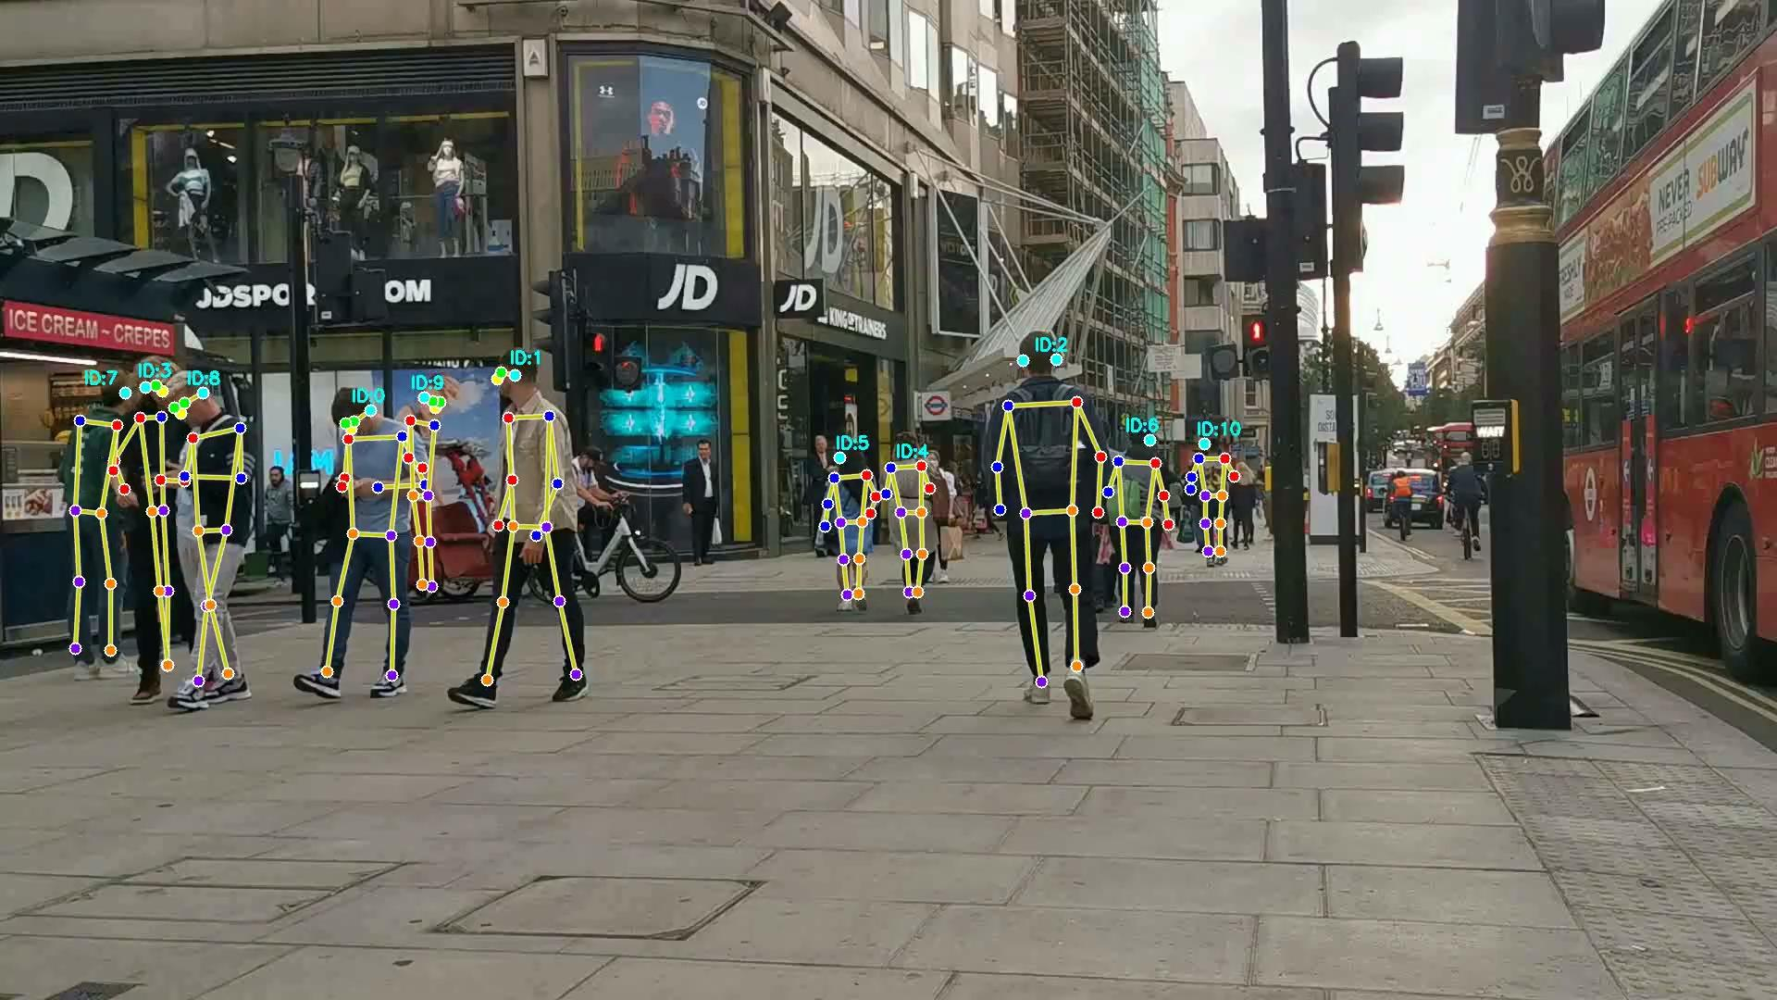
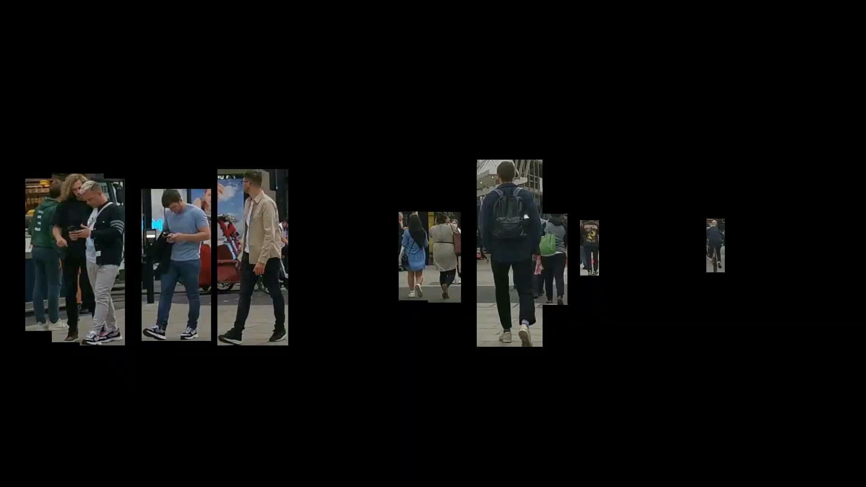
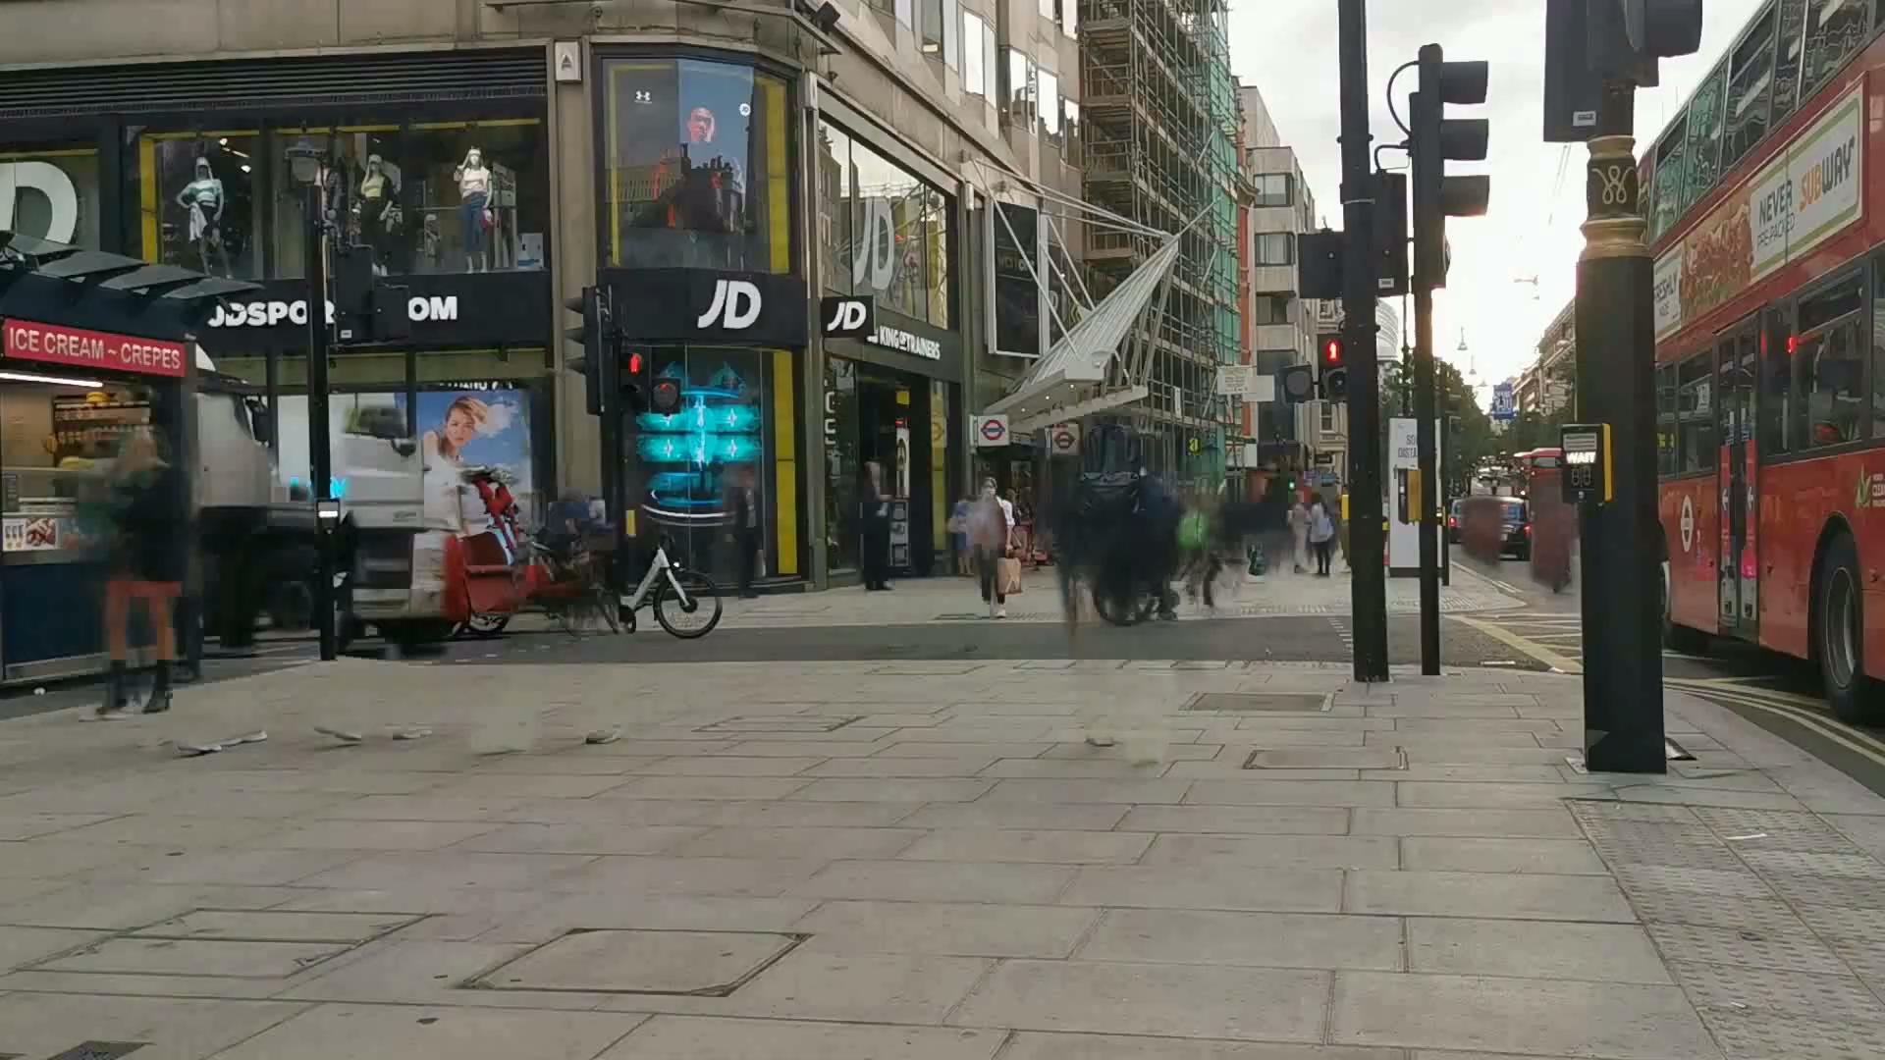
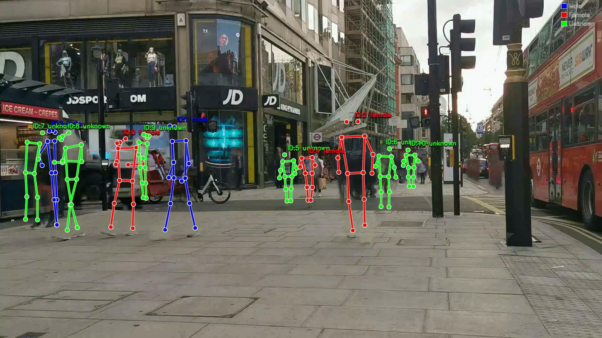
Results
Original Video
Pose Estimation
Isolate Persons
Stego Video
Reconstructed Video
Skeletal Video
vid6
1
2
3
4
5
6

Slide 38
vid6 – Scenario, Expectation, Outcome
Premise
Multiple people walking in a busy street, good lighting
Expectation
The model will struggle to identify people, will classify some people, but cannot classify all of them correctly
Observed Outcome
Model struggles to classify all of the people in the video and some fluctuations is observed in hiding people

Slide 39
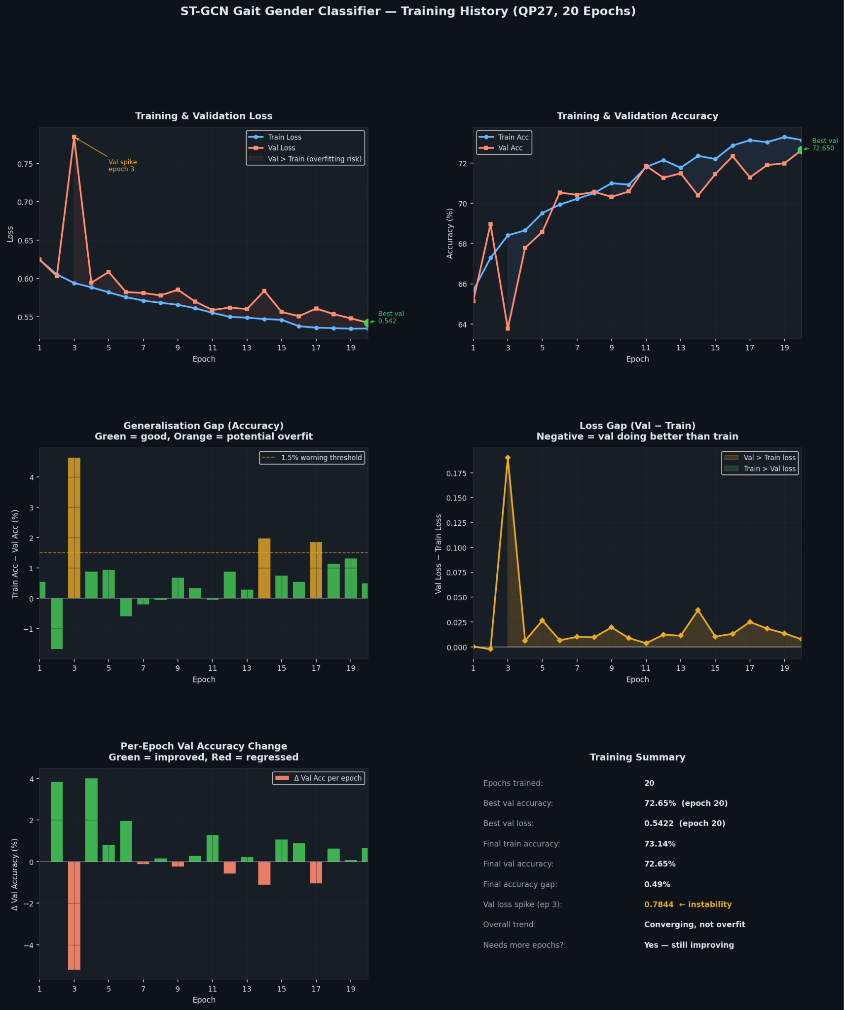
Evaluation and Metrics
Gait Gender Classifier

Slide 40
Evaluation and Metrics
Gait Gender Classifier

Slide 41
Evaluation and Metrics
Gait Gender Classifier

Slide 42
Evaluation and Metrics
Comparison with Prior Work
72.65% on DenseGait is competitive.
The dataset is significantly harder than lab-controlled benchmarks used by prior work.
Method | Dataset | Conditions | Accuracy
GenReGait (keypoints + DL) | Lab-controlled | Controlled lighting, fixed angles | ~88–92%
Lightweight ST-GCN (MDPI 2022) | OU-ISIR (controlled) | Fixed angles, clean lighting | ~85%
GenderStego (ours) | DenseGait (in-the-wild) | Occlusion, variable lighting, multi-angle, noisy labels | 72.65%
Key insight: Accuracy gaps vs prior work reflect dataset difficulty, not model weakness. DenseGait contains automatic (noisy) labels, occlusion, and multi-angle CCTV footage; conditions where even state-of-the-art models lose 10–15 % versus controlled settings.

Slide 43
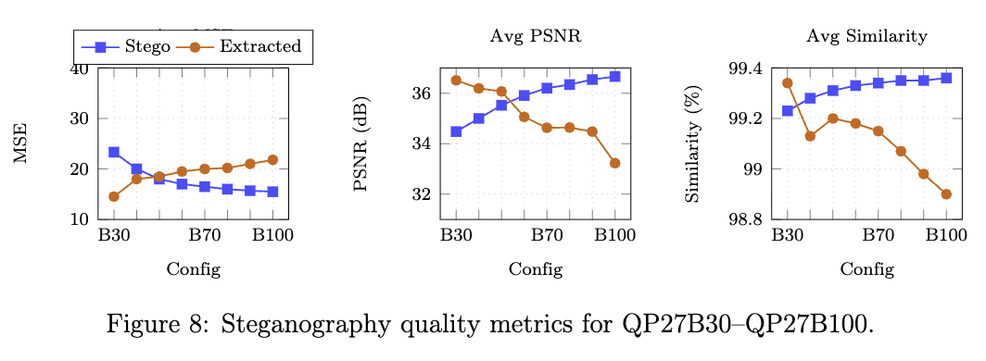
Evaluation and Metrics
Encryption and Reconstruction Metrics

Slide 44
Discussion and Limitations
Non-walking activities
Dynamic lighting
Crowded scenes
Cyclists and runners are misclassified: ST-GCN trained exclusively on walking sequences. Skeletal motion from cycling differs fundamentally from gait.
Fix: Activity-aware classifier or extended training data.
Sunset / rapidly changing illumination causes residual person outlines in inpainted frames. Static HSV Gaussian BG model built from first 40 frames cannot adapt.
Fix: Adaptive Mixture-of-Gaussians background model.
Centroid tracker swaps / loses IDs when people touch or cross paths. Merged segmentation masks lead to partial concealment and mis-classified skeletons.
Fix: ByteTrack or BoT-SORT with appearance cues.

Slide 45
Conclusion
Unified Privacy Framework
  GenderStego is the first framework to combine gait-based gender classification, privacy-preserving video inpainting, and encrypted covert steganography in one pipeline
Effective Gait Classifier
  ST-GCN achieves 72.65% binary gender accuracy on DenseGait with no clear overfitting
  Strong baseline with room to improve via extended training
Identity Protection
  Replacing persons with colour-coded skeletons preserves analytical utility (gender label + pose) while removing all appearance-based identity information.
Imperceptible + Encrypted Embedding
  DCT steganography at QP27B30 achieves stego PSNR > 34 dB — invisible to the human eye.
  AES-256-CTR encryption ensures extracted data is unreadable without the decryption key.
  HMAC-SHA256 detects wholesale tampering of the stego video.
Quantitative Validation
  8 parameter configurations evaluated over 300 frames each with MSE, PSNR, and similarity metrics. Optimal parameters confirmed at QP=27, Beta=30, Alpha=0.05
Limitations: binary gender label, fairness analysis, real‑world tests; these are future work directions

Slide 46
Future Work
Model & training:
  Train 30–60 more epochs with cosine-annealed LR
  Add multi-head self-attention after Stage 3
  Multi-task learning: joint gender + gait cycle segmentation
Fairness audit:
  Evaluate performance by age group, ethnicity, body type
  Apply re-weighted training or adversarial debiasing if disparities found
  Move beyond binary gender labels in consultation with affected communities
Privacy & steganography:
  Replace static HSV BG with adaptive Mixture-of-Gaussians
  Replace centroid tracker with ByteTrack / BoT-SORT
  Adaptive DCT quantisation (higher β in textured regions)
  Neural stego (StegaNeRV / Stego-STFAN) for higher payload
Deployment & governance:
  TensorRT / ONNX Runtime for real-time throughput
  Evaluate on Gait3D, CASIA-E, MOT20 benchmarks
  Complete GDPR Article 35 Data Protection Impact Assessment before any operational use

Slide 47
References
A. Elhadad, S. Hamad, A. Khalifa, and Hussein Abulkasim, “A steganography approach for hiding privacy in video surveillance systems,” Elsevier eBooks, pp. 165–187, Jan. 2020, doi: https://doi.org/10.1016/b978-0-12-819438-6.00017-7.
W. An et al., "Performance Evaluation of Model-Based Gait on Multi-View Very Large Population Database With Pose Sequences," in IEEE Transactions on Biometrics, Behavior, and Identity Science, vol. 2, no. 4, pp. 421-430, Oct. 2020, doi: 10.1109/TBIOM.2020.3008862.
http://www.am.sanken.osaka-u.ac.jp/BiometricDB/GaitLPPose.html
GenReGait: Gender Recognition using Gait Features | Journal of Informatics and Web Engineering - MMU Press, accessed April 4, 2025, https://journals.mmupress.com/index.php/jiwe/article/view/636
Learning Visual Prompt for Gait Recognition - CVPR 2024 Open ..., accessed April 4, 2025, https://openaccess.thecvf.com/content/CVPR2024/html/Ma_Learning_Visual_Prompt_for_Gait_Recognition_CVPR_2024_paper.html
ECCV Poster Occluded Gait Recognition with Mixture of Experts: An ..., accessed April 4, 2025, https://eccv.ecva.net/virtual/2024/poster/389
ECCV Poster Free Lunch for Gait Recognition: A Novel Relation ..., accessed April 4, 2025, https://eccv.ecva.net/virtual/2024/poster/1075
Robust and Lightweight System for Gait-Based Gender Classification toward Viewing Angle Variations - MDPI, accessed April 4, 2025, https://www.mdpi.com/2673-2688/3/2/31

Slide 48
References
CVPR 2024 Open Access Repository, accessed April 4, 2025, https://openaccess.thecvf.com/content/CVPR2024W/INRV/html/Biswal_StegaNeRV_Video_Steganography_using_Implicit_Neural_Representation_CVPRW_2024_paper.html
Stego-STFAN: A Novel Neural Network for Video Steganography - MDPI, accessed April 4, 2025, https://www.mdpi.com/2073-431X/13/7/180
Adaptive highly secure and imperceptible video steganography for medical images via deep convolutional neural network - Inderscience Online, accessed April 4, 2025, https://www.inderscienceonline.com/doi/abs/10.1504/IJICS.2024.142702
Exploiting Spatiotemporal Redundancy Using Octree Decomposition to Enhance the Performance of Video Steganography - MDPI, accessed April 4, 2025, https://www.mdpi.com/2571-5577/8/1/2
Enhancing Video Steganography Techniques Using Hybrid Algorithms, accessed April 4, 2025, https://www.scirp.org/journal/paperinformation?paperid=136435

Slide 49

Thank you!
Happy to answer any Questions

