Slide 1
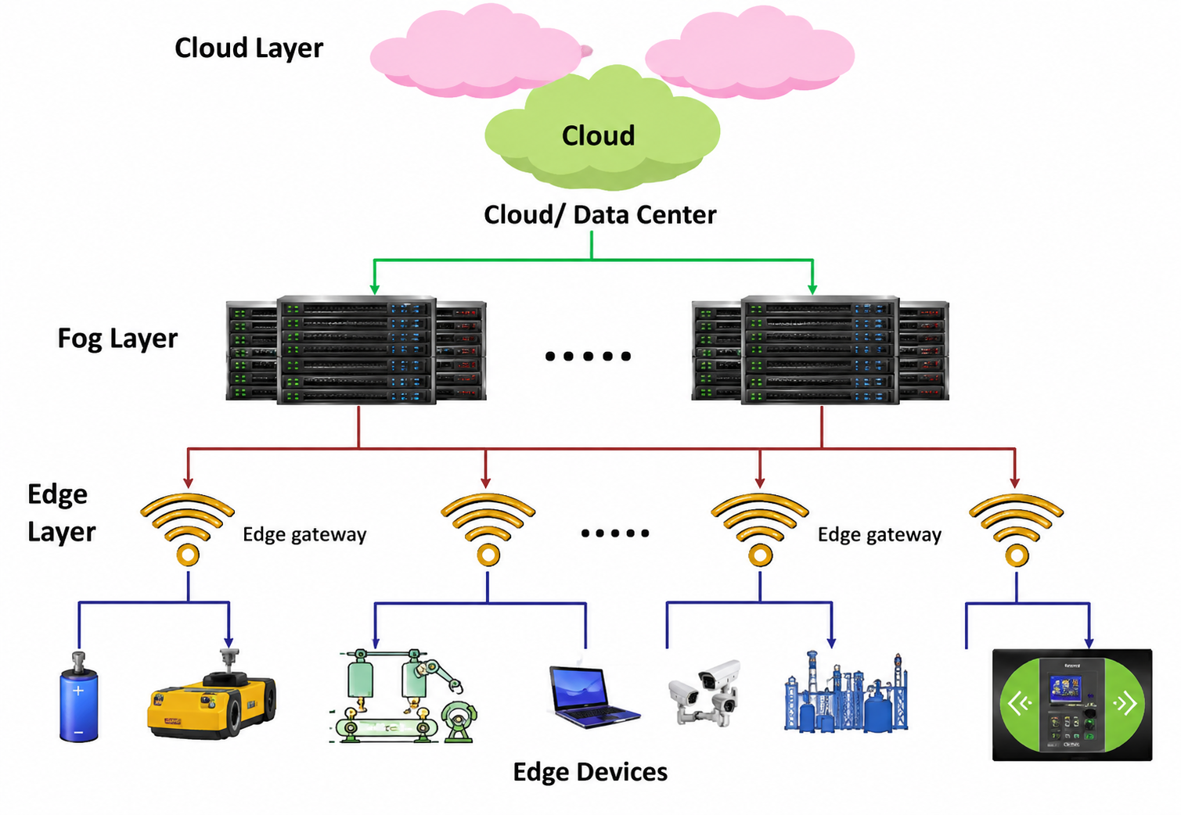
Architecture of Edge Computing
Cloud layer
Long-term storage, dashboards, model training, ERP/MES reporting
Fog layer
Buffers and aggregates data between edge and cloud
Edge layer
Local processing, AI/fault detection, protocol translation
Edge devices
Sensors, cameras, PLCs, robots and IoT modules
Notes:
Explain each layer from bottom to top: devices create data, edge reacts quickly, fog helps aggregate, cloud stores and analyses for the long term.

Slide 2
Cloud vs. Edge Computing
Cloud Computing
Edge Computing
Processing Location
Central cloud servers
Near the device/user
Latency
High (≥ 500 ms)
Low (< 100 ms local)
Bandwidth Use
High — all data to cloud
Low — only summaries sent
Storage Capacity
Very high (unlimited)
Limited (local storage)
Reliability
Requires internet connection
Works offline
Best Use Case
Big data · ML training · ERP
Real-time control · Safety
Notes:
Edge and cloud are complementary, not competing. The hybrid model uses each for what it does best.

Slide 3
Cloud computing vs. Edge computing
Cloud computing
Edge computing
Processing location
Central cloud server
Near the device or user
Latency
Higher
Lower
Bandwidth use
More raw data sent to cloud
Less data leaves the factory
Best use
Big storage and long-term analytics
Real-time local response
Notes:
Say: The difference is not just technology. The main question is where the data is processed. Cloud is far but powerful. Edge is close and fast.

Slide 4
Latency test Setup
Latency Definition
Tested in two environments: Paderborn home Wi-Fi (stable, private) · HSHL central Wi-Fi (shared, congested)
Client device
Edge server
Cloud target
Mobile phone
Ubuntu laptop
Internet server
Generated sensor-like data
Processed the request locally
External online server
Measured latency
Request sent
Time from sending a request until the response is received.
Response received
02
Notes:
Explain that latency means the full round-trip time. The test used a mobile phone as the client, a laptop as the local edge server, and an external internet server for cloud comparison.

Slide 5

Only “HSHL” Wifi USER
03
Notes:
Say that in the edge test, the laptop acts like a small local server. The phone sends data over the same Wi-Fi network, the laptop processes it, and the response comes back without going to a remote cloud server.

Slide 6
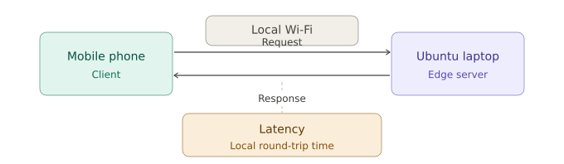
Edge Latency Test
Test Procedure
Server: Ubuntu 22.04 running Python Flask
Client:
Mobile phone → http://192.168.178.78:5000
Terminal log:
Stable local network
Shared network
95 ms
422 ms
POST /process HTTP/1.1" 200
192.168.178.117 → .78:5000
Paderborn home Wi‑Fi
HSHL central Wi‑Fi
Status 200 OK confirms successful edge communication.
03
Notes:
Say that in the edge test, the laptop acts like a small local server. The phone sends data over the same Wi-Fi network, the laptop processes it, and the response comes back without going to a remote cloud server.

Slide 7
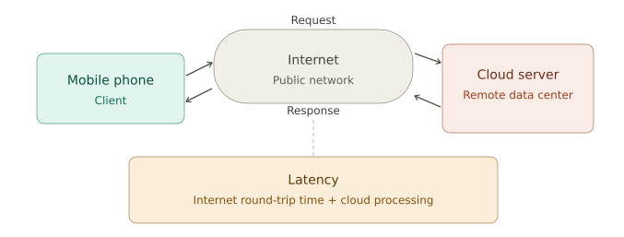
Cloud Latency Test
Test Procedure
Method: HTTP request via public internet
Target:
https://httpbin.org/get
Command:
Measured cloud latency
Worst shared network result
curl -w "Total time: %{time_total} seconds"
https://httpbin.org/get
510 ms
2170 ms
curl -w "%{time_total}s"
https://httpbin.org/get
Paderborn home Wi‑Fi
HSHL central Wi‑Fi
Result: 0.510079 s = 510 ms internet round-trip.
04
Notes:
Explain that the cloud test used a remote HTTP server. The request must go through the public internet, reach the server, and return. This adds round-trip delay.

Slide 8
Measured Results: Edge vs Cloud
Latency in milliseconds (lower is better)
Home Wi‑Fi
95 vs 510 ms
Cloud took about 5.4× longer
HSHL Wi‑Fi
422 vs 2170 ms
Cloud took about 5.1× longer
05

Slide 9
Latency Formulation
C = X / L + D / R
What increases delay?
C = latency
Edge reduces the distance X because processing is local.
X = distance • L = bandwidth • D = data rate • R = computing resources
A shared network lowers available bandwidth L.
Edge path
short X
Cloud routes are longer, so strict millisecond response is harder.
Cloud path
large internet X
08

Slide 10
Edge vs. Cloud: Full Comparison
Criterion | Edge Computing | Cloud Computing
Latency (stable network) | 95 ms | 510 ms
Latency (shared network) | 422 ms | 2,170 ms
Speed advantage | 5.1× – 5.4× faster in every test
Offline operation | ✓ Yes | ✗ No
Suitable for real-time | ✓ Yes | Limited
Network dependency | Local network | Internet required
Storage & analysis scale | Limited | ✓ High
Edge is best for fast local actions. Cloud is best for heavy storage, training, reporting, and long-term analytics.

