Slide 1
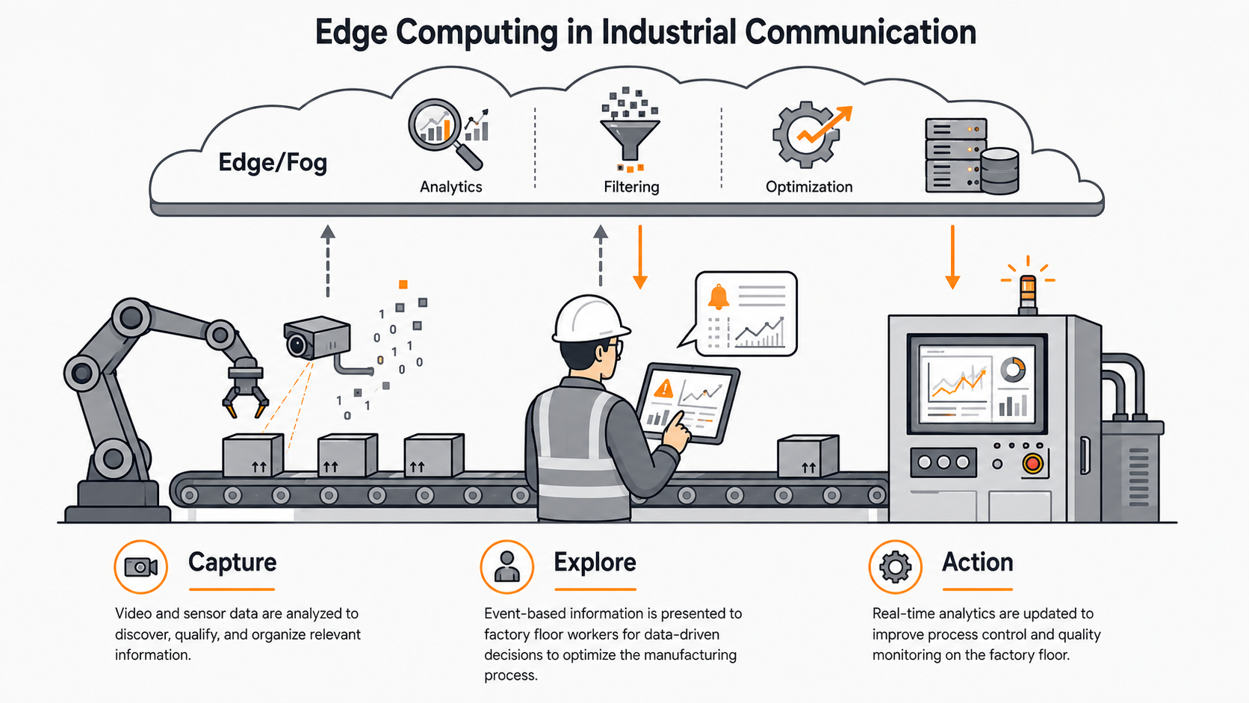
Edge Computing in Industrial Communication
TEAM-A5
Md Mostafizur Rahman
Turja Barua
Deepak Kapil
Moaz Chowdhury
Industrial Communication Standard

Slide 2

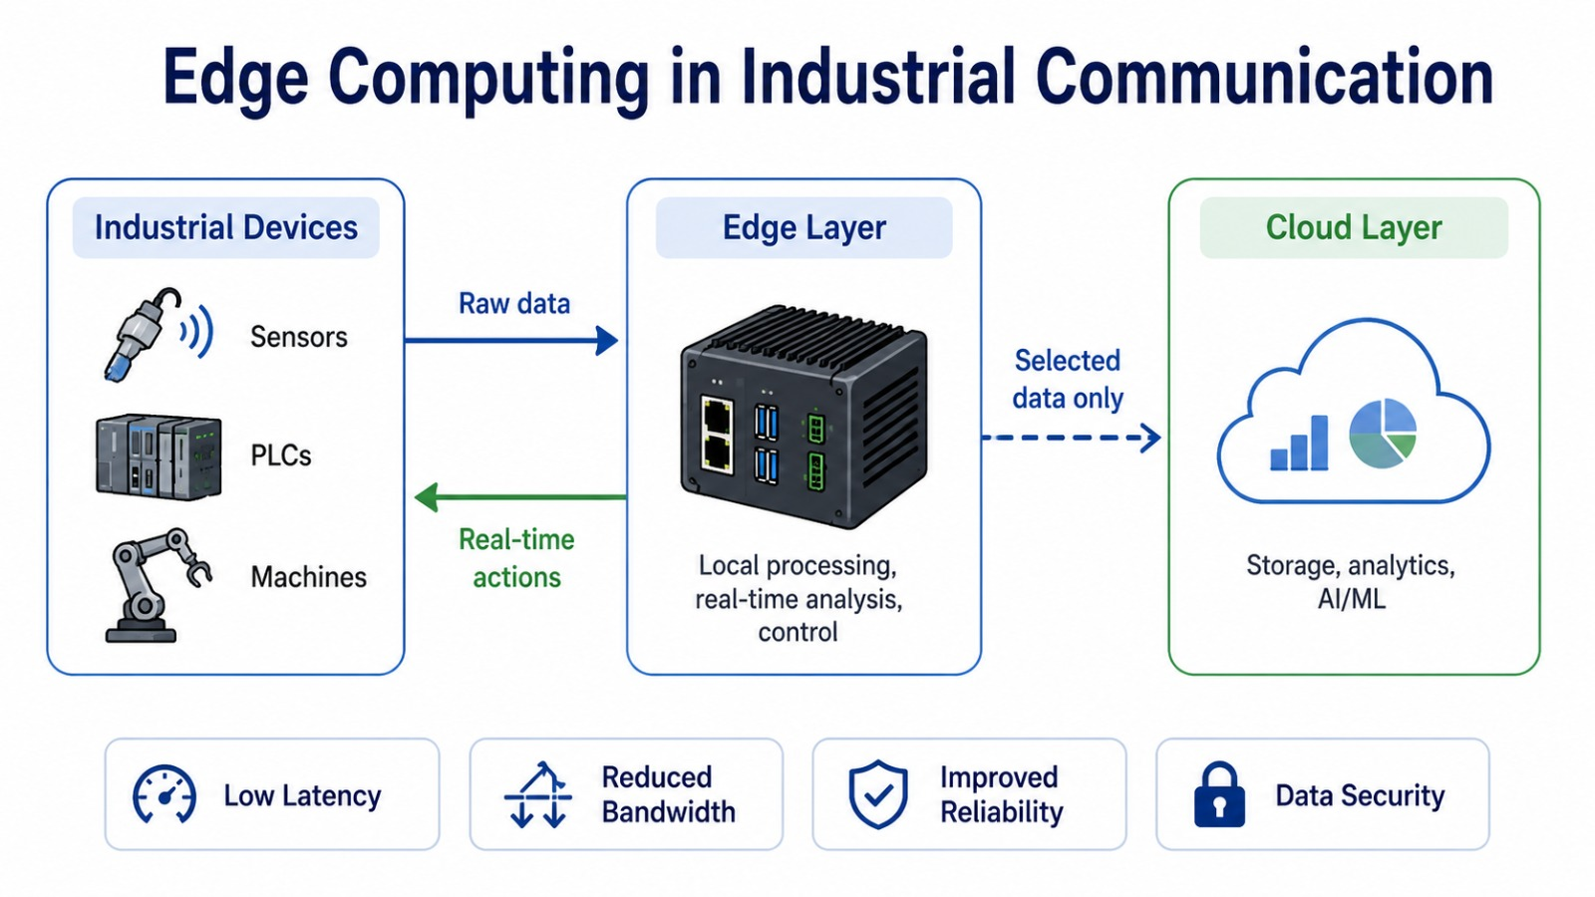
What is Edge Computing?
Closer to the source
1
Processing happens at local gateways or edge servers — not distant cloud data centers.
Three-tier architecture
The Problem
2
Field devices at the bottom, edge nodes in the middle, cloud at the top.
Millisecond decisions
3
Factories can't wait: robotic arms, conveyor belts and safety systems need sub-millisecond responses.
Resilient by design
4
Edge systems operate independently even when the cloud connection is lost.
Notes:
Edge computing moves computation to the network edge — next to factories, hospitals, and vehicles.

Slide 3
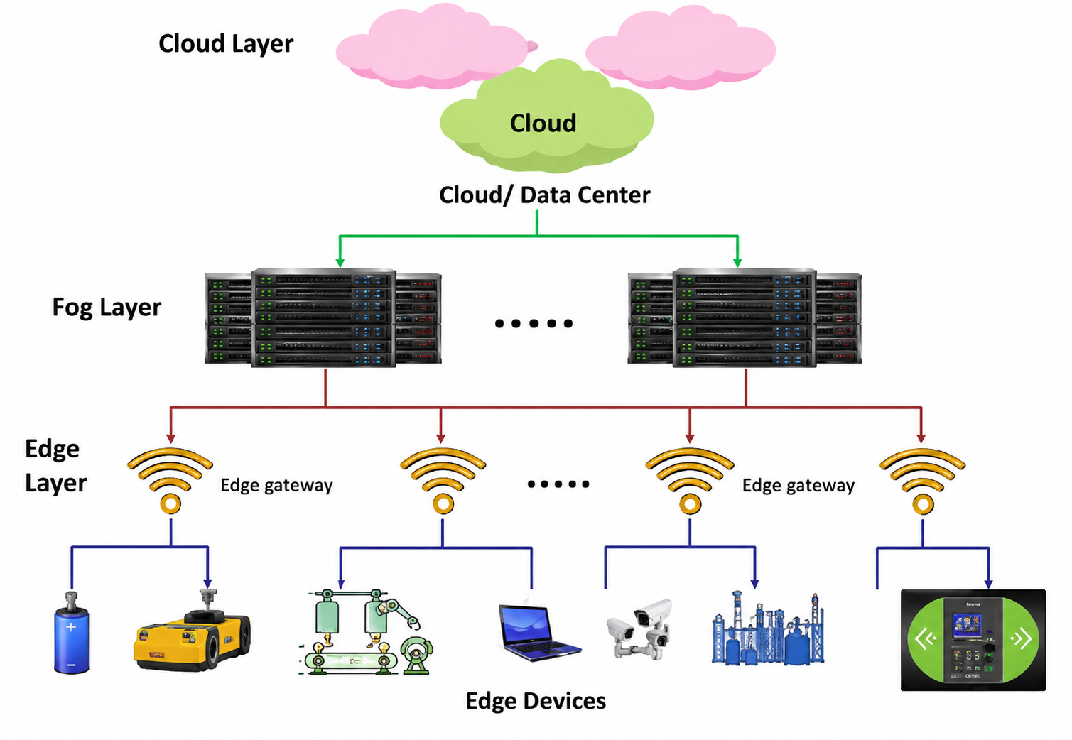
Architecture of Edge Computing
Cloud layer
Long-term storage, dashboards, model training, ERP/MES reporting
Fog layer
Buffers and aggregates data between edge and cloud
Edge layer
Local processing, AI/fault detection, protocol translation
Edge devices
Sensors, cameras, PLCs, robots and IoT modules
Notes:
Explain each layer from bottom to top: devices create data, edge reacts quickly, fog helps aggregate, cloud stores and analyses for the long term.

Slide 4
Cloud vs. Edge Computing
Cloud Computing
Edge Computing
Processing Location
Central cloud servers
Near the device/user
Latency
Higher
Lower
Bandwidth Use
High — all data to cloud
Low — only summaries sent
Storage Capacity
Very high (unlimited)
Limited (local storage)
Reliability
Requires internet connection
Works offline
Best Use Case
Big data · ML training · ERP
Real-time control · Safety
Notes:
Edge and cloud are complementary, not competing. The hybrid model uses each for what it does best.

Slide 5
Latency test Setup
Latency Definition
Tested in two environments: Paderborn home Wi-Fi (stable, private) · HSHL central Wi-Fi (shared, congested)
Client device
Edge server
Cloud target
Mobile phone
Ubuntu laptop
Internet server
Generated sensor-like data
Processed the request locally
External online server
Measured latency
Request sent
Time from sending a request until the response is received.
Response received
02
Notes:
Explain that latency means the full round-trip time. The test used a mobile phone as the client, a laptop as the local edge server, and an external internet server for cloud comparison.

Slide 6

Only “HSHL” Wifi USER
03
Notes:
Say that in the edge test, the laptop acts like a small local server. The phone sends data over the same Wi-Fi network, the laptop processes it, and the response comes back without going to a remote cloud server.

Slide 7
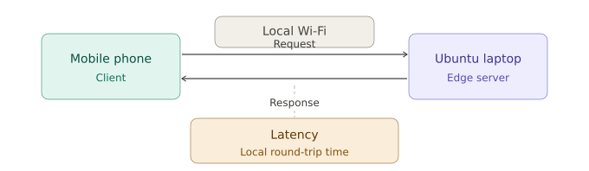
Edge Latency Test
Test Procedure
Server: Ubuntu 22.04 running Python Flask
Client:
Mobile phone → http://192.168.178.78:5000
Terminal log:
Stable local network
Shared network
95 ms
422 ms
POST /process HTTP/1.1" 200
192.168.178.117 → .78:5000
Paderborn home Wi‑Fi
HSHL central Wi‑Fi
Status 200 OK confirms successful edge communication.
03
Notes:
Say that in the edge test, the laptop acts like a small local server. The phone sends data over the same Wi-Fi network, the laptop processes it, and the response comes back without going to a remote cloud server.

Slide 8
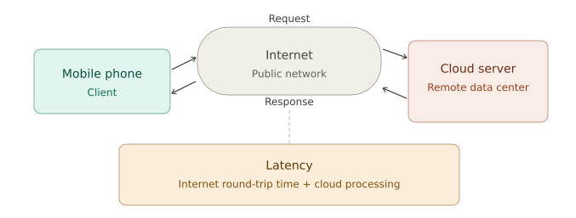
Cloud Latency Test
Test Procedure
Method: HTTP request via public internet
Target:
https://httpbin.org/get
Command:
Measured cloud latency
Worst shared network result
curl -w "Total time: %{time_total} seconds"
https://httpbin.org/get
510 ms
2170 ms
curl -w "%{time_total}s"
https://httpbin.org/get
Paderborn home Wi‑Fi
HSHL central Wi‑Fi
Result: 0.510079 s = 510 ms internet round-trip.
04
Notes:
Explain that the cloud test used a remote HTTP server. The request must go through the public internet, reach the server, and return. This adds round-trip delay.

Slide 9
Measured Results: Edge vs Cloud
Latency in milliseconds (lower is better)
Home Wi‑Fi
95 vs 510 ms
Cloud took about 5.4× longer
HSHL Wi‑Fi
422 vs 2170 ms
Cloud took about 5.1× longer
05

Slide 10
Latency Formulation
C = X / L + D / R
What increases delay?
C = latency
Edge reduces the distance X because processing is local.
X = distance • L = bandwidth • D = data rate • R = computing resources
A shared network lowers available bandwidth L.
Edge path
short X
Cloud routes are longer, so strict millisecond response is harder.
Cloud path
large internet X
08

Slide 11
Edge vs. Cloud: Full Comparison
Criterion | Edge Computing | Cloud Computing
Latency (stable network) | 95 ms | 510 ms
Latency (shared network) | 422 ms | 2,170 ms
Speed advantage | 5.1× – 5.4× faster in every test
Offline operation | ✓ Yes | ✗ No
Suitable for real-time | ✓ Yes | Limited
Network dependency | Local network | Internet required
Storage & analysis scale | Limited | ✓ High
Edge is best for fast local actions. Cloud is best for heavy storage, training, reporting, and long-term analytics.

Slide 12
Industrial Use Cases
🔩
PCB & SMT Assembly
⚙️
CNC Machining
Camera inspection detects misplaced components, missing solder, or bad orientation. The edge system rejects the board instantly — before bad units continue down the line.
Vibration, temperature, and current sensors feed into an edge node that predicts tool wear before breakage, alerting operators to swap tools proactively.
🤖
Automotive Welding
💊
Pharma Filling Lines
Each weld's current, voltage, and timing are compared against quality limits in real time. Defective welds are flagged and the robot halted within milliseconds.
Cameras check fill level, weight, label position, and packaging integrity. Under-filled or contaminated units are removed before final packaging.
Notes:
Cloud-only processing cannot handle any of these scenarios — latency is simply too high for real-time safety decisions.

Slide 13




Key Benefits
Low Latency
Reduced Bandwidth
Processing near the source cuts response times to milliseconds — essential for autonomous vehicles, robotics, and emergency healthcare.
Only key results (alarms, status updates) travel to the cloud. Raw data stays local, saving network capacity.
Improved Privacy
Better Reliability
Sensitive data (e.g. patient records) stays on-premise. Only necessary summaries reach the cloud.
Edge systems continue operating when cloud connectivity is poor or lost — critical for remote factories.
Notes:
These four benefits make edge computing indispensable for industrial real-time systems.

Slide 14





Application Areas
Key Insight
In every domain, the unifying theme is the same: decisions that matter happen in real time, and real time means milliseconds — not the 500 ms+ of a cloud round-trip.
Edge computing bridges the gap between raw sensor data and timely, local intelligence.
Internet of Things
Autonomous Vehicles
Healthcare
Smart homes, factories & agriculture process sensor data locally for instant reactions.
Cameras and LIDAR data processed on-vehicle — cloud round-trips are too slow for safety.
Wearables and patient monitors trigger local emergency alerts within milliseconds.
Industrial Automation
Smart Cities
Fault detection, quality control, and real-time machine monitoring on the factory floor.
Traffic sensors and cameras analysed locally to reduce congestion and improve safety.
Notes:
Edge computing is now deployed across virtually every sector where timely local decisions matter.

Slide 15




Challenges & Limitations
Security Risks
Limited Resources
Edge devices are distributed across many sites, making centralised protection difficult. A compromised device can impact the whole system.
Edge hardware has less compute, memory, and storage than cloud servers. Applications must be carefully optimised.
Management Complexity
Data Consistency
Coordinating software updates, monitoring, and fault detection across hundreds of edge nodes is a significant operational challenge.
Processing data at multiple sites makes it harder to maintain a single consistent view between edge and cloud systems.
Notes:
These challenges are real but solvable — dedicated private networks, hardware security modules, and centralised device management platforms address most of them.

Slide 16
Conclusion
Edge computing is a key technology for modern distributed systems — not a replacement for the cloud, but a complement.
The edge handles latency-sensitive local tasks (fault detection, safety response, quality control).
The cloud handles large-scale storage, model training, and long-term analytics.
Experimental results confirm edge processing is 5.1–5.4× faster across all network conditions tested.
Thank you · Questions welcome
Notes:
Wrap up: edge + cloud is complementary. Key stat: 5.1–5.4× speed advantage confirmed in real measurements.

