Slide 1
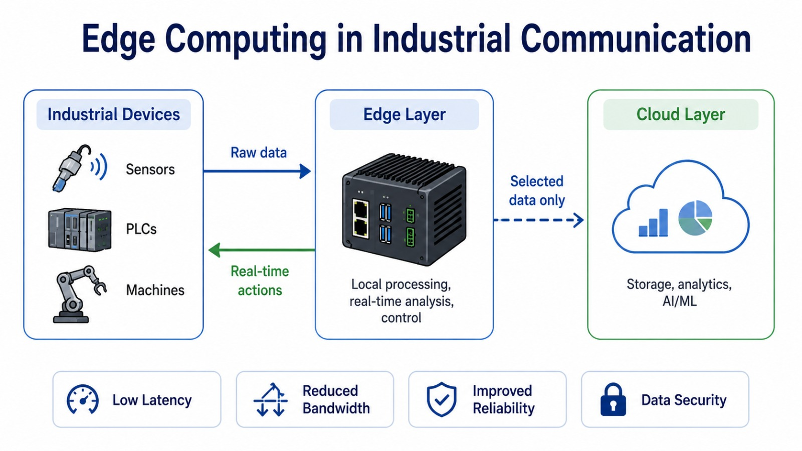
Edge Computing in
Industrial Communication
From sensors and machines to fast local decisions
Low latency • Less bandwidth • Local reliability
Turja Barua • Md Mostafizur Rahman • Deepak Kapil • Moaz Bin Alamgir Chowdhury
Electronic Engineering · Hochschule Hamm‑Lippstadt
Notes:
Start by saying: This presentation explains why edge computing is important in industrial communication. The simple idea is that data should be processed near the machines, not always in a far cloud.

Slide 2
MOTIVATION
Why cloud-only processing is a problem
Industrial systems are time-critical: robots, conveyor belts, sensors and PLCs often need responses in milliseconds.
• Sending every signal to a distant cloud adds network delay. • A late response can mean defects, machine damage or safety risk. • If the internet/cloud connection fails, production still needs to continue.
Factory
machines
Internet
path
Remote
cloud
510 ms measured cloud latency on home Wi‑Fi
2170 ms measured cloud latency on shared HSHL Wi‑Fi
Industry cannot wait for a distant server.
Edge Computing in Industrial Communication
Notes:
Explain with a simple example: If a machine overheats, the system must react immediately. If the data must travel to the cloud and back first, the answer can arrive too late.

Slide 3
CORE CONCEPT
Basic idea: process near the data source
Edge computing places a local gateway/server near sensors, PLCs, robots or cameras.
• Raw data is processed locally. • Only alarms, summaries or important results go to SCADA, ERP or cloud. • The factory can continue operating even if cloud connectivity is unstable.
Industrial devices → edge layer → selected data to cloud
Data stays close. Decisions are faster.
Local processing near machines
Real‑time quick alerts and actions
Hybrid edge + cloud together
Edge Computing in Industrial Communication
Notes:
Say: Edge computing does not remove the cloud. It uses edge for quick local work and cloud for storage, reports, and long-term analysis.

Slide 4
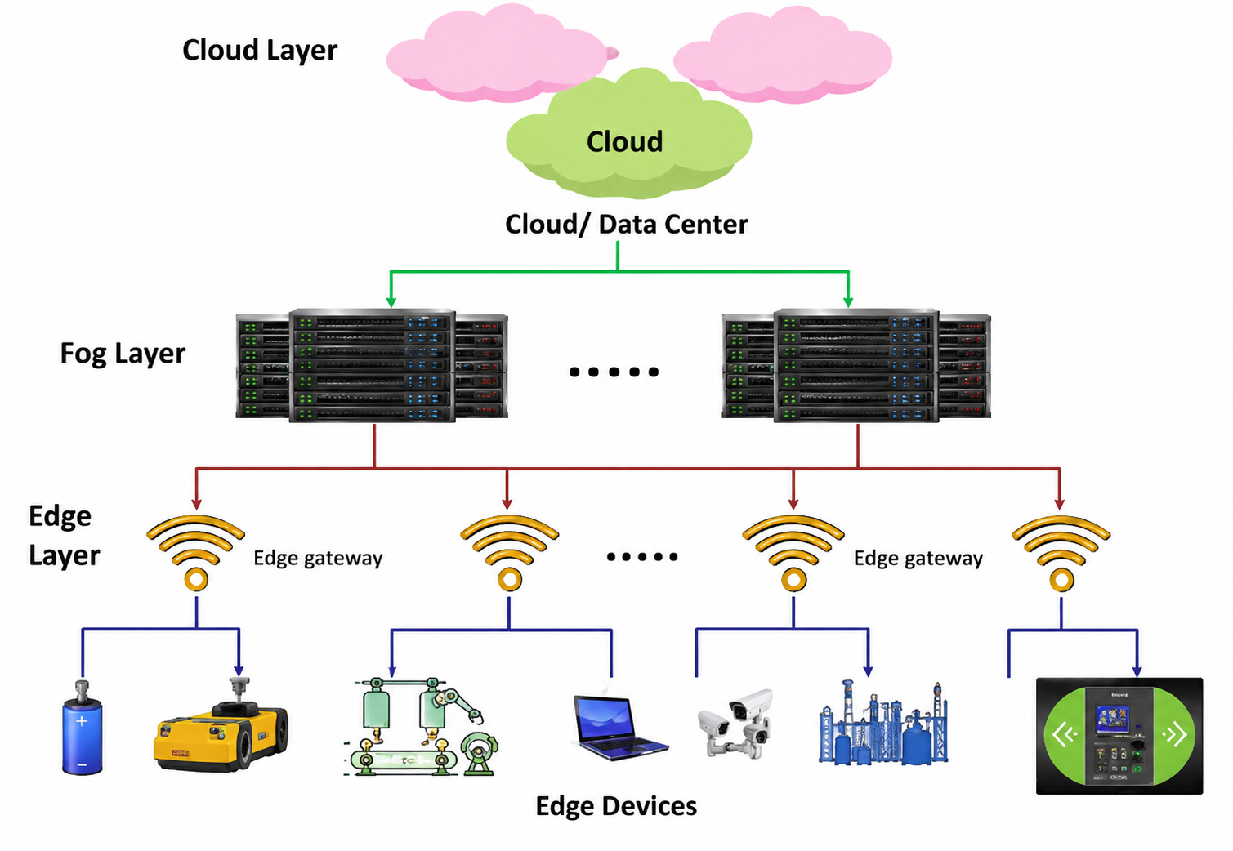
SYSTEM STRUCTURE
Industrial edge architecture
Cloud layer
Long-term storage, dashboards, model training, ERP/MES reporting
Fog layer
Buffers and aggregates data between edge and cloud
Edge layer
Local processing, AI/fault detection, protocol translation
Edge devices
Sensors, cameras, PLCs, robots and IoT modules
Edge devices, edge gateways, fog layer and cloud layer
Fast tasks stay low. Heavy analysis moves up.
Edge Computing in Industrial Communication
Notes:
Explain each layer from bottom to top: devices create data, edge reacts quickly, fog helps aggregate, cloud stores and analyses for the long term.

Slide 5
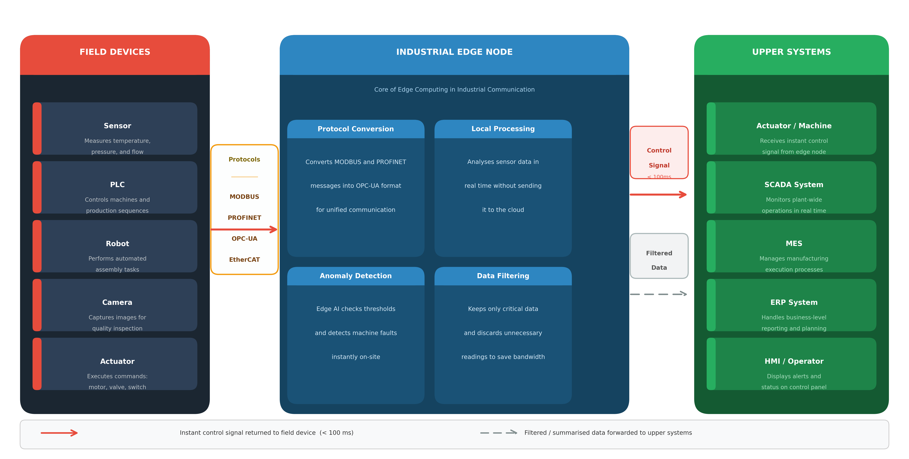
INDUSTRIAL COMMUNICATION
The edge node acts like a local translator and brain
Example: if an abnormal vibration is detected, the edge gateway can trigger an alarm or stop command locally.
• Protocol conversion • Local analytics and filtering • Secure traffic between factory floor and upper network
Field devices connect through an industrial edge node to upper systems
Sensor
MODBUS
Robot
OPC‑UA
Edge gateway
translate + filter + analyse
SCADA / ERP / Cloud
important data only
Edge Computing in Industrial Communication
Notes:
Use a human example: different machines speak different languages. The edge node works like a translator and also decides which messages are important.

Slide 6
COMPARISON
Cloud computing vs. edge computing
Cloud computing
Edge computing
Processing location
Central cloud server
Near the device or user
Latency
Higher
Lower
Bandwidth use
More raw data sent to cloud
Less data leaves the factory
Best use
Big storage and long-term analytics
Real-time local response
They are partners: edge handles urgent tasks, cloud handles heavy tasks.
Edge Computing in Industrial Communication
Notes:
Say: The difference is not just technology. The main question is where the data is processed. Cloud is far but powerful. Edge is close and fast.

Slide 7
WHY IT MATTERS
Main benefits of edge computing
01
Low latency Faster response because data is processed nearby.
02
Reduced bandwidth Only useful results are sent to cloud or upper systems.
03
Better privacy Sensitive data can remain local inside the factory.
04
Higher reliability Local operation can continue if cloud connection is weak.
Best fit: real-time industrial monitoring, fault detection and quality control.
Edge Computing in Industrial Communication
Notes:
Keep this slide simple: list the four benefits. Explain that edge computing is especially useful when time, bandwidth and reliability matter.

Slide 8
APPLICATION AREAS
Where edge computing is used
Smart factories
Autonomous vehicles
Healthcare
machine monitoring, robots, PLCs
local sensor and camera decisions
wearables and emergency alerts
Smart cities
IoT systems
traffic cameras and public safety
smart homes, agriculture and devices
Real industry examples: PCB inspection • CNC tool wear • robotic welding • pharmaceutical packaging
Edge Computing in Industrial Communication
Notes:
Say: In all these areas, the common need is quick local decision-making. For example, in PCB assembly an edge system can reject a bad board immediately.

Slide 9
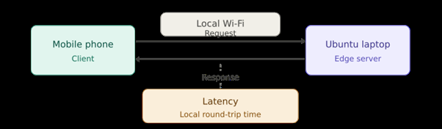
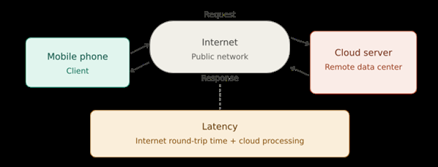
PRACTICAL TEST
Latency experiment: edge vs. cloud
Edge test: mobile phone → home Wi‑Fi → Ubuntu laptop server
Cloud test: mobile phone → internet → remote cloud server
Edge setup
Cloud setup
• Mobile phone acted as client • Ubuntu 22.04 laptop ran a Python Flask server • Both were on the same local Wi‑Fi
• HTTP request sent through the internet • Remote server measured with curl • Total request-response time recorded
Edge Computing in Industrial Communication
Notes:
Explain: The test is simple but useful. It compares a local edge server with a remote cloud request. Latency means request time plus response time.

Slide 10
EXPERIMENT OUTPUT
Measured latency results
95 ms edge latency on stable home Wi‑Fi
510 ms cloud latency on stable home Wi‑Fi
5.1–5.4× edge was faster in the tests
Result: edge computing reduced response time in both network environments.
Edge Computing in Industrial Communication
Notes:
Say: The most important number is not only 95 ms. The key is comparison. In the same location, edge was about five times faster than cloud.

Slide 11
DISCUSSION
What the results mean for industry
Latency relation
Network quality matters
Shared Wi‑Fi increased latency strongly, even for edge computing.
C = X / L + D / R
Cloud distance matters more
Cloud traffic must travel through the public internet and back.
• X = distance • L = network bandwidth • D = data rate • R = computing resources
Best practice
Use a dedicated local industrial network for edge tasks.
Use edge for immediate control; use cloud for long-term analysis.
Edge Computing in Industrial Communication
Notes:
Explain formula simply: latency goes up when distance is larger, bandwidth is limited, data is large, or computing resources are slow. Edge reduces distance.

Slide 12
IMPLEMENTATION
Mapping the prototype to an industrial system
Mobile phone
Sensor / PLC / robot / machine / IIoT device
Wi‑Fi network
Industrial Ethernet / PROFINET / OPC UA / MQTT / 5G
Ubuntu laptop
Edge gateway / industrial PC / local server
Flask app
Local edge analytics or preprocessing software
Latency value
Communication response time in milliseconds
The experiment is small, but the industrial idea is the same.
In a factory, the edge gateway can filter raw machine data and send only warnings, summaries or useful results to upper systems.
Edge Computing in Industrial Communication
Notes:
Say: Our prototype used everyday devices, but the role mapping is clear. Phone becomes sensor/PLC, laptop becomes edge gateway, Wi-Fi becomes industrial network.

Slide 13
CONCLUSION
Challenges and final takeaway
Security
Many distributed devices are harder to protect.
Limited resources
Edge devices have less power than cloud servers.
Management complexity
Updates and monitoring across many nodes are difficult.
Data consistency
Multiple edge sites must stay synchronized.
Final takeaway
Edge computing is not a replacement for cloud computing.
It is the fast local layer that makes industrial communication more responsive, reliable and practical.
Recommended architecture: edge for real-time actions + cloud for storage and analytics.
Edge Computing in Industrial Communication
Notes:
End with the main message: Edge computing is important because factories need fast decisions. The best solution is hybrid: edge for urgent tasks, cloud for heavy analysis.

