Slide 1
Hibernate, JPA, & REST

Slide 2
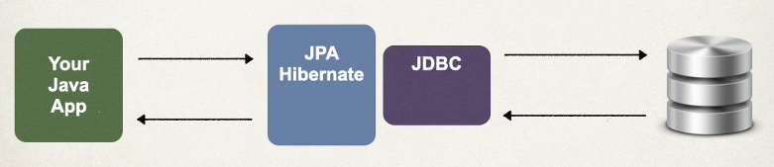
What is hibernate?
A framework for saving /persisting java objects in a database
Object-Relational Mapping (ORM): Bridges the gap between the object-oriented world of Java and the relational world of SQL databases. It allows developers to store and retrieve Java objects directly as database tables and rows without writing complex, boilerplate SQL queries.
  Productivity Boost: Eliminates massive amounts of tedious JDBC code, connection management, and manual result-set mapping.
  Database Independence: By abstracting SQL dialects, Hibernate allows your application to switch underlying databases with minimal configuration changes.
  Built-in Caching: Features a first-level cache (associated with the Session) and an optional second-level cache (shared across sessions) to significantly reduce database round-trips and improve performance.
  Automatic Transaction Management: Handles database transactions and connection pooling efficiently, ensuring data integrity.

Slide 3
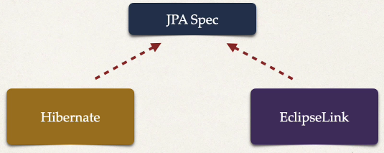
What is JPA?
Jakarta Persistence API (JPA) – previously known as Java Persistence API
  Standard API for Object Relational Mapping
  Is a specification
  Includes interfaces
  Requires implementations to use
  Hibernate is one way we can implement JPA

Slide 4
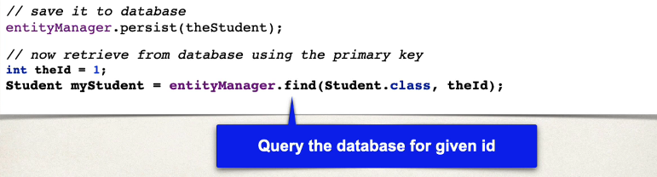
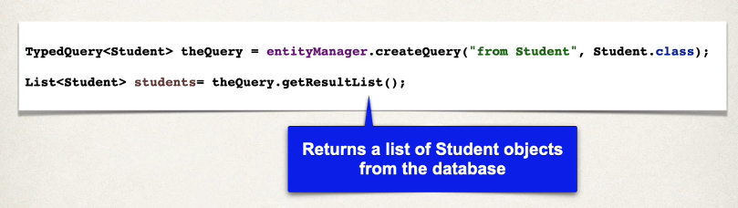
Hibernate/JPA – concrete benefit
No JDBC required! It happens under the hood!

Slide 5
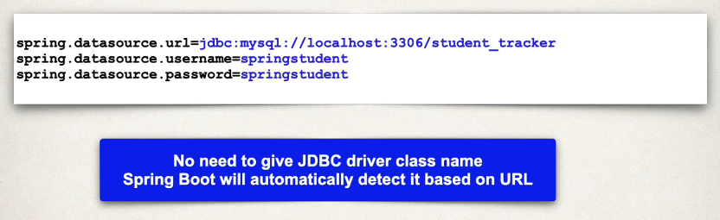

Setup Overview
In Spring Boot, Hibernate is the default implementation of JPA
With Spring Initializr:
  Postgres Driver: org.postgresql:postgresql
  Spring Data JPA: spring-boot-starter-data-jpa
Spring Boot will automatically configure our data source for us based on the above
  Also, our connection details in ‘application.properties’
OR for postgres:

Slide 6
EntityManager vs JpaRepository
EntityManager is the low-level JPA API for directly managing entities and interacting with the persistence context.
JpaRepository is a Spring Data abstraction that gives you a ready-made repository with CRUD, pagination, sorting, and query methods—without writing most of the boilerplate yourself.
We will cover BOTH, starting with EntityManager
Java Persistence Query Language (JPQL) – used for querying entities and their fields, rather than database tables and columns, part of JPA standard and can be used by any JPA provider, i.e. Hibernate, EclipseLink, etc.
Hibernate Query Language (HQL) – Operates similar as above, but is Hibernate specific and thus may come with features unique to Hibernate
We will cover BOTH, starting with JPQL…. And… BOTH are accessible from EntityManager OR JpaRepository
 | EntityManager | JpaRepository
Comes from | JPA | Spring Data JPA
Abstraction level | Low | High
CRUD boilerplate | You write it | Mostly provided
Custom JPQL | Directly | @Query, specifications, etc.
Persistence-context control | Excellent | Limited/direct access not its purpose
Pagination/sorting | Manual | Built in
Derived queries | No | Yes
JPA portability | Yes | Tied to Spring Data
Best for | Complex/custom persistence logic | Typical application CRUD

Slide 7
Typical stack
Spring Data JPA
↓
JpaRepository
↓
EntityManager
↓
Hibernate
↓
Session
↓
Database
More abstracted
Less absracted

Slide 8
JQPL
In SQL you may write:
In JPQL you may write:
HQL is very similar conceptually!
Because we are querying against our entity!
@Entity
public class Student {
private int id;
private String firstName;
private String lastName;
private String email;
}
SELECT *
FROM students
ORDER BY id;
SELECT student
FROM Student student
ORDER BY student.id

Slide 9
Stereotype annotations
@Component
  @Component is the main stereotype annotation. It is a class-level annotation. @Component is used across the application to mark the beans as Spring's managed components.
@Service
  It is a specialization of @Component. The business logic of an application exists in the service layer, and the @Service annotation is used to indicate that a class belongs to the service layer.
@Repository
  It is a specialization of @Component and is very similar to the DAO pattern. DAO classes provide CRUD operations for database tables.
@RestController
  It is a specialization of @Component. The @RestController annotation (which inherits @Controller) indicates that a particular class is a web service controller that returns data. It is mostly used with Spring MVC applications and is used in combination with @RequestMapping annotation. The dispatcher scans the class and detects methods with HTTP annotations:
    @GetMapping, @PostMapping, @PutMapping, & @DeleteMapping

Slide 10
Jackson
Java Library for converting between Java objects and JSON
Built right into Spring
Java Object ──────→ JSON
serialization
JSON ──────→ Java Object
deserialization
It all happens under the hood for us!
Request is made → we prepare a POJO (plain old java object) → Jackson coverts to JSON → client gets JSON
Request is made → we receive JSON (e.g. record to be created) → Jackson converts to POJO → use POJO in app

Slide 11
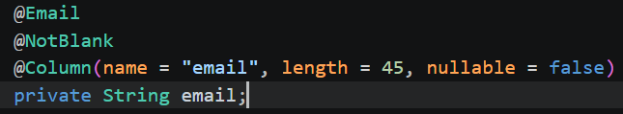
Request Validation & schema enforcement
@NotNull - not null
@NotEmpty - not null or empty such as ""
@NotBlank - not null, empty, or whitespace
@Size
@Min
@Max
@Positive
@PositiveOrZero
@Email
@Pattern
Nullable – enforces schema/db level validation
Often, we use nullable + annotations for maximum protection
@Valid – ensure our endpoints enforce our validations on the application-level

Slide 12
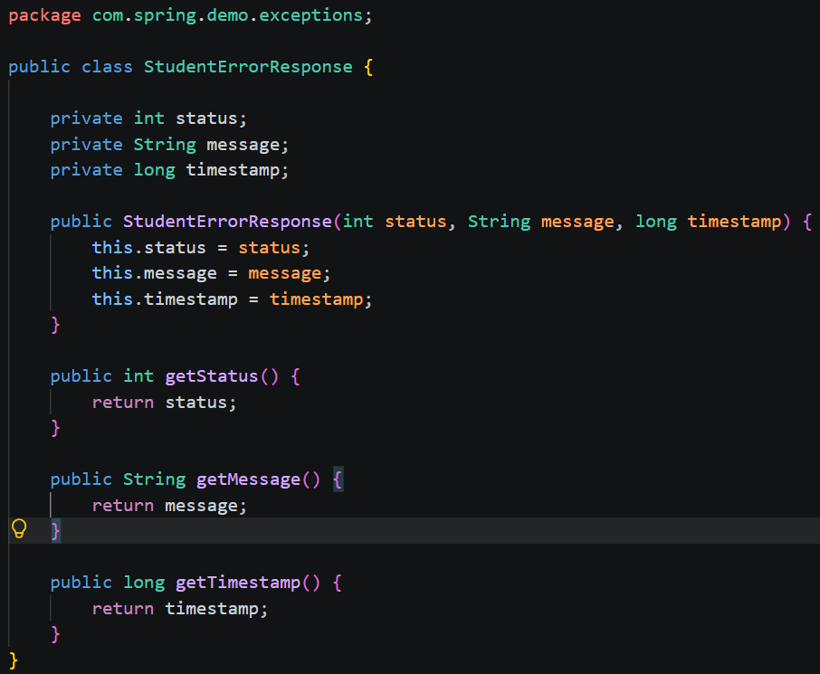
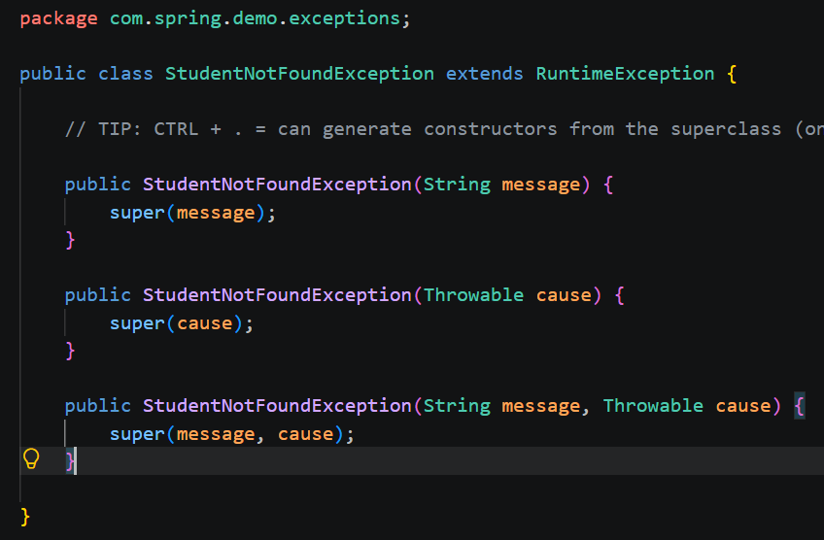
Exception handling
This defines our custom exception, so we have full control to describe the issue:
This defines what our error output should look like
i.e. we define a contract for what returned HTTP errors look like:

Slide 13
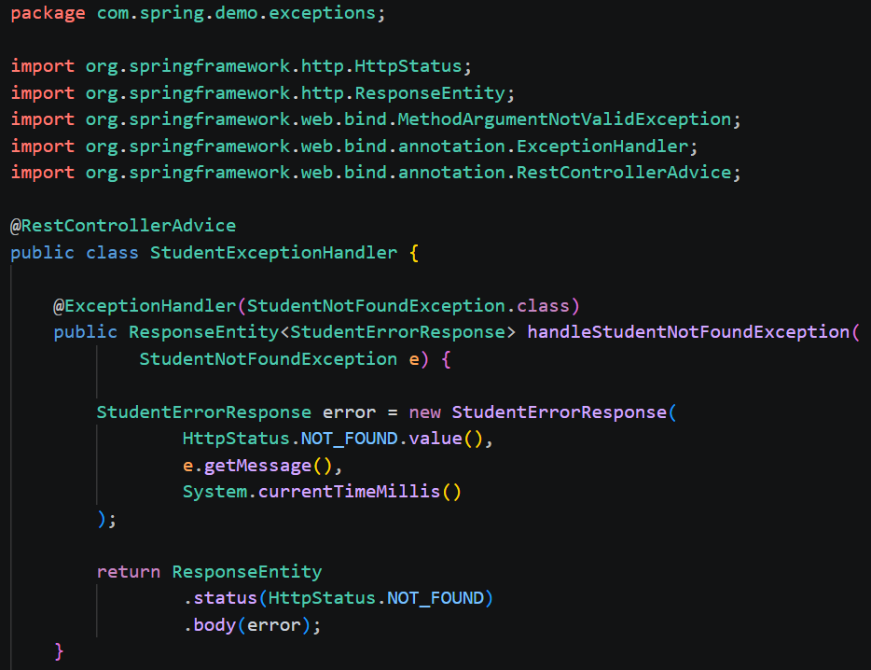
Exception Handling
@RestControllerAdvice – let’s us setup a global handler for exceptions
@ExceptionHanlder – defines a single way to handle a particular exception
For web service applications, we typically want to return a ResponseEntity that includes the relevant error status code and body
We can have more than one @ExceptionHandler methods
This lets us handle/manage many types of exceptions, and their responses, in a single location

Slide 14
STOP
Let’s put theory into practice with a code-along
Please see the completed CRUD app “EntityMangerApp” with code comments in your course materials
We will stick with EntityManager for now, and later create other files in our DAO layer that uses JpaRepository

Slide 15
Mapping JPA relationships
We supply these on @Entity fields to map relationships between entities
@OneToOne
@OneToMany
@ManyToOne
@ManyToMany

Slide 16
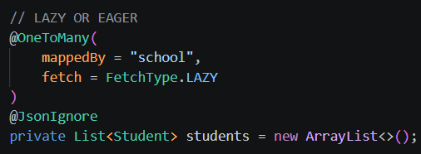

1-n relationship
mappedBy – allows us to use dot notation to reach a student’s school. E.g. someStudent.school
A single school has many students, we don’t necessarily want to load all those into memory when we query a school, so we can fetch it lazily (only when needed/called for)
@JoinColumn + name – defines the database field to use to tie the primary key of the other table
We initialize @OneToMany collections with ArrayList so that it can never be null (best practice pattern)
Domain/School.java
Domain/Student.java

Slide 17
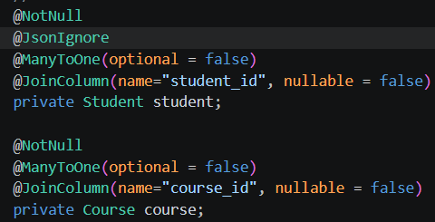
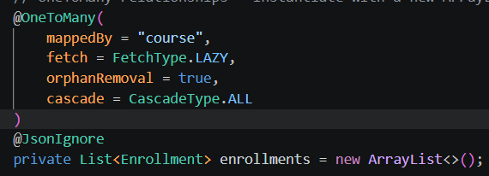
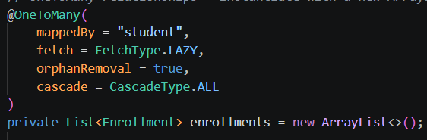
N-M
Many to many relationships may certainly be mapped with @ManyToMany
This doesn’t allow us to create fields on the underlying junction table however
For that reason, it is common to create a domain model for the junction object manually, and then use @ManyToOne and @OneToMany to tie all three tables together!
orphanRemoval – Remove an enrollment from this collection -> delete it from the database.
CascadeType.ALL – if we add or remove an enrollment, then the change is also saved to the db for the parent record
Domain/Course.java
Domain/Enrollment.java
Domain/Student.java

Slide 18
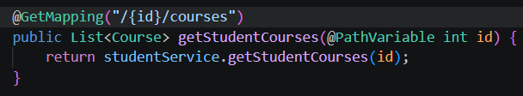
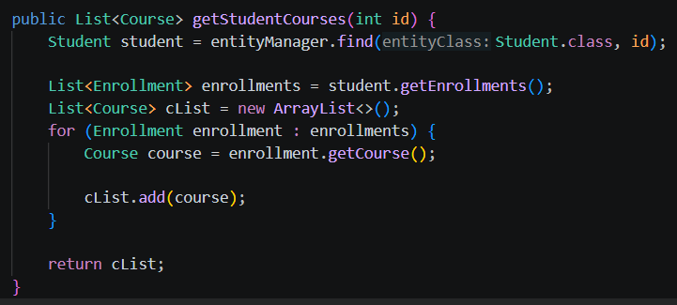
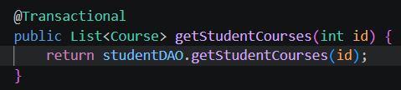
Using entitymanager to traverse relationships
Controller class:
DAO class:
Service class:

Slide 19
JpaRepository
Recap:
  EntityManager is one API to interact with our database, it has a lower level of abstraction and thus, more control
  JpaRepositry is another API to interact with our database, it has a higher level of abstraction and thus, less control
Benefits of JpaRepository:
  We simply create an interface that extends JpaRepository, and then we get CRUD methods out of the box
  E.g. before we had: Service → DAOInterface → Concretion (We had to write boilerplate here for CRUD)
  Now we will have: Service → RepoInterface that extends JpaRepository
  No extra code required for common CRUD tasks!

Slide 20
Jparepository – out-of-the-box methods
Method | Parameters | Return type | What it does
existsById(123) | Integer id | boolean | Checks whether a record exists
count() | none | long | Counts all records
findAll() | none | List<Student> | Gets all students
findById(123) | Integer id | Optional<Student> | Gets one student by ID
save(student) | Object: Student student | Student | Inserts or updates
delete(student) | Object: Student student | void | Deletes a student
deleteById(123) | Integer id | void | Deletes by primary key
deleteAll() | none | void | Deletes all students

Slide 21
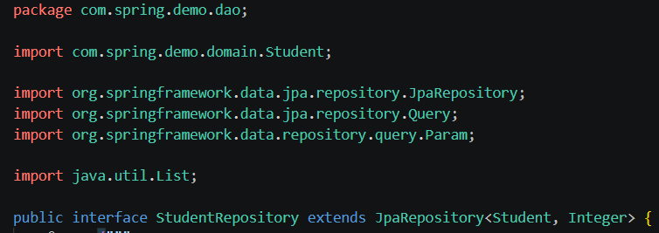
Creating a jparepository
We create an interface that extends JpaRepository
The type provided is: <Entity, EntityIdDataType>
Now our service can simply make calls to this interface!

Slide 22
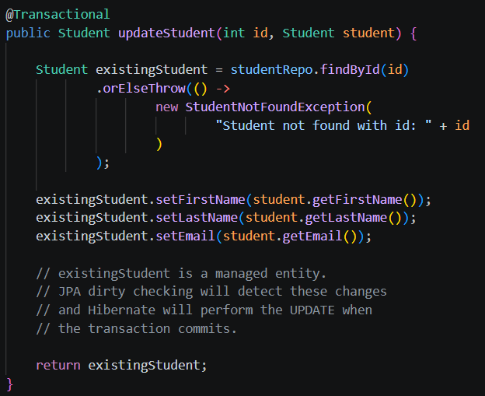
Jparepository – Optional<T>
The following shows our service layer, now calling a JpaRepository
Not that some OOB methods return a type of Optional<T>
That’s because it may or may not find the record
We commonly handle this with: orElseThrow()
We could throw a RuntimeException, or a custom one!

Slide 23
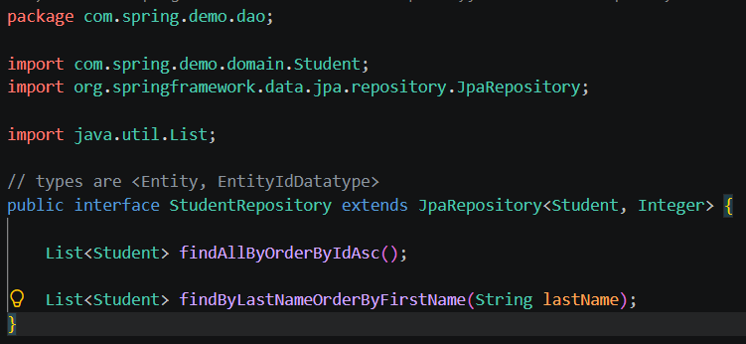
Jparepository – derived query methods
Derived Query Methods - Spring Data JPA parses the method name according to strict naming conventions and automatically generates the underlying JPQL (Java Persistence Query Language) and SQL at runtime.
We simply need to create the method in our Repo interface:

Slide 24

Jparepository – derived query methods
Every derived query method is split into two major parts: the Subject (what the query does) and the Predicate (the criteria/filters)

Slide 25
Jparepository – derived query methods
Introducer modifiers:
  Data Retrieval: find...By, read...By, query...By, get...By
  Counting: count...By (returns a long)
  Existence Checks: exists...By (returns a boolean)
  Result Limiting Modifiers: You can inject First or Top to limit records
User findFirstByOrderByRegistrationDateDesc();
List<User> findTop5ByStatus(String status);

Slide 26
Jparepository – derived query methods
Everything after the keyword By maps directly to the entity's properties and filtering criteria.
  Equality (Default): If you just name a field, Spring assumes an exact match comparison.
  Logical Operators: Combine multiple fields using And or Or.
  Property Expressions: Keywords that change the comparison type (e.g., LessThan, Like, Containing).

Slide 27
Jparepository – derived query methods
Keyword / Condition | Method Example
Equality | findByEmail(String email)
And | findByFirstNameAndLastName(String f, String l)
Or | findByStatusOrRole(String s, String r)
Between | findByAgeBetween(int start, int end)
LessThan / GreaterThan | findByPriceLessThan(double price)
Like / Containing / In | findByTitleContaining(String keyword)
Null Checks | findByDeletedAtIsNull()
IgnoreCase | findByUsernameIgnoreCase(String user)
Sorting | findByStatusOrderByLastNameAsc(String s)

Slide 28
Pitfalls of Derived Query methods
Avoid complex relationship traversal
Avoid long method names:
  Instead of this (in repo):
  We could do this (in repo):
  Then our service can:
List<Student> findByLastNameOrderByFirstNameAsc();
List<Student> findByLastName(
String lastName,
Sort sort
);
studentRepository.findByLastName(
"Smith",
Sort.by("firstName").ascending()
);

Slide 29
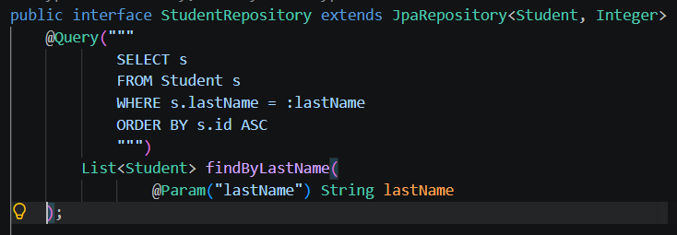
@query
When derived query methods aren’t enough, we can always use @Query to write JPQL
This is great for more complex queries

Slide 30


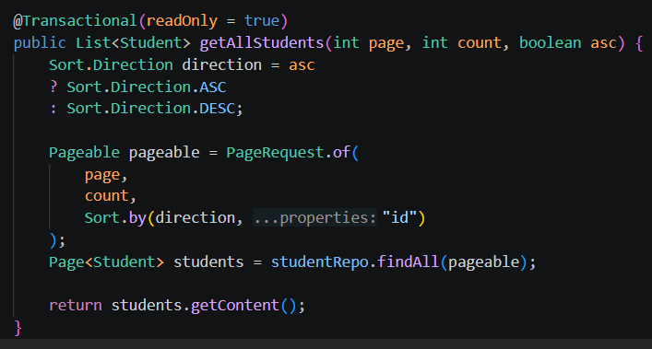
Pagination
Imports:
In our repo interface:
In our service:

Slide 31
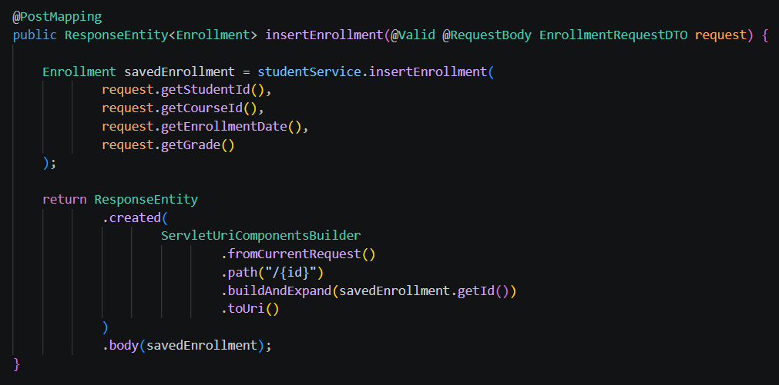
DTO – data transfer objects
DTOs allow us to format the requests and response as they enter/leave our web service
Example: Student Enrollments
  We need to assign a course + a student to an enrollment record
  We shouldn’t send an entire course or student record nested inside an enrollment insert
  Instead, our DTO formats the request, and we can use the provided IDs to retrieve and persist the records dynamically

Slide 32
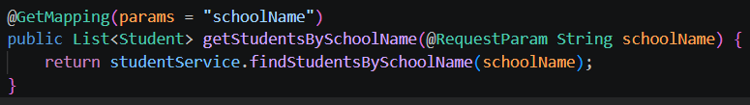
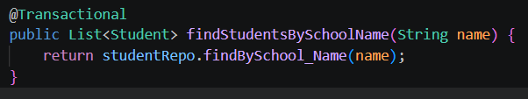

Using jparepository to traverse relationships
controller class:
Underscores allow us to traverse relationships
You can traverse through multiple levels of relationships
Remember, we can always use @Query to create custom solutions when relationship traversal gets too complicated via derived query methods
Service layer class:
dao/repo layer class:

Slide 33
STOP
Let’s put theory into practice with a code-along
Please see the completed CRUD app “JpaRepoApp” with code comments in your course materials

Slide 34
Challenge – let’s check our understanding
Goal:
Scenario: 5 min
Create endpoints for different types of coaches
Example: One endpoint uses a ‘baseBallCoach’ and prints ‘Practice Baseball’
Another endpoint uses a ‘basketballCoach’ and prints ‘Practice Basketball’
Hint: You can inject more than one item, with multiple @Qualifier(s)!

