Slide 1
Spring boot & Spring core features

Slide 2
Spring
Spring is a Java framework used to build applications, especially web applications, APIs, and enterprise applications.
At its core, Spring helps you manage the complexity of a large Java application by providing features such as:
  Dependency Injection (DI): Spring creates and manages objects for you instead of you manually creating them everywhere.
  Inversion of Control (IoC): The framework controls how application components are created and connected.
  Web development: Spring MVC can be used to build REST APIs and web applications.
  Database access: Spring integrates with technologies such as JPA, Hibernate, and JDBC.
  Security: Spring Security provides authentication and authorization.
  Transaction management: Helps manage database transactions.
  Modular architecture: You can use only the Spring modules your application needs.

Slide 3
DI – Dependency Injection
Without DI, we would likely make concretions ourselves, and need to carefully manage them:
UserService service = new UserService();
With DI, we can define annotations, and then have objects initialized only when needed:
@RestController
public class UserController {
private final UserService service;
public UserController(UserService service) {
this.service = service;
}
}
@Service
public class UserService {
}

Slide 4
Spring vs Spring Boot
Both are Java frameworks, but Spring can be very difficult to setup on its own
Spring Boot is a framework built on top of Spring that makes it much easier and faster to create Spring applications.
Spring Boot provides convention over configuration, automatic configuration, embedded servers, and convenient project setup.
Spring | Spring Boot
The underlying ecosystem/framework | Built on top of Spring
More configuration may be required | Provides automatic configuration
You often configure components yourself | Many things are configured automatically
Can require external server setup | Usually includes an embedded server
More flexible/configurable | Optimized for quickly building applications
Foundation | Simplified way to use Spring

Slide 5
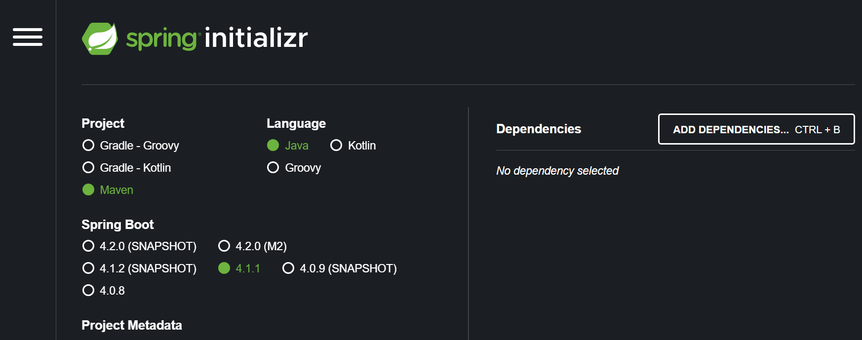
Spring Initializr - Start.pring.io
Spring Initializr is a web-based tool from the Spring ecosystem that helps you quickly create the basic structure of a Spring Boot application.
It generates a ready-to-use project with:
  Project structure and configuration files
  Build tool setup (Maven or Gradle)
  Java version selection
  Spring Boot dependencies (such as Spring Web, Spring Data JPA, Spring Security)
  Basic application entry point

Slide 6
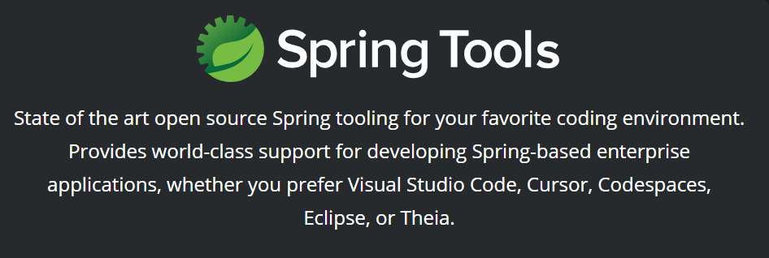
Spring tools suite - spring.io/tools
STS is traditionally an IDE based on Eclipse that makes Spring configuration easier
Spring Tools now support VS Code, Cursor, and more

Slide 7

Spring tools - vs code extension

Slide 8

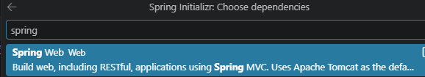
Creating a Spring boot app – vs code
With the extensions installed, you can open the command palette to use Spring Initializr, and create a Maven project
Walk through the options, choosing java version, coordinates, project name, etc.
JAR/WAR – WAR (Web Application Archive) is the traditional(old) way to setup a web app.
  For WAR, we would need to configure a web server ourself and then deploy the WAR to it.
  JAR (Java ARchive) – the modern choice
Choose the Spring Web dependency so we can create a RESTful application

Slide 9
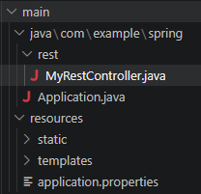
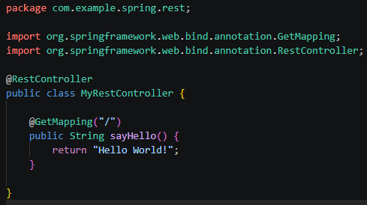
Hello world setup
Let’s create a new package ‘REST’ & our first controller
Run the project with ‘mvn spring-boot:run’
  ‘CTRL + C’ to close the running application
Navigate to http://localhost:8080 to see the output

Slide 10
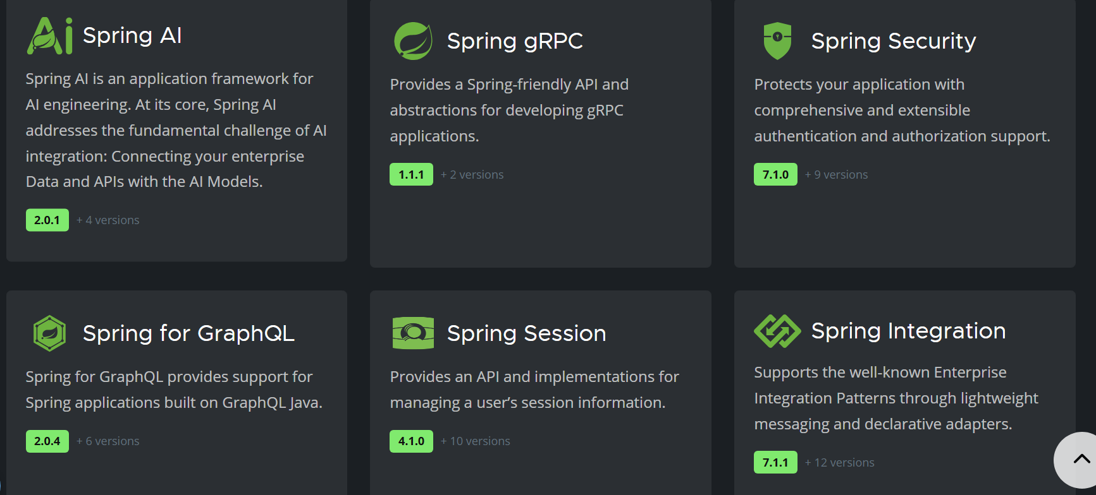
Spring projects
Spring Projects are additional Spring modules built on top of the Spring Framework
We can pick and choose only what we need
Find information & docs at ‘spring.io/projects’

Slide 11
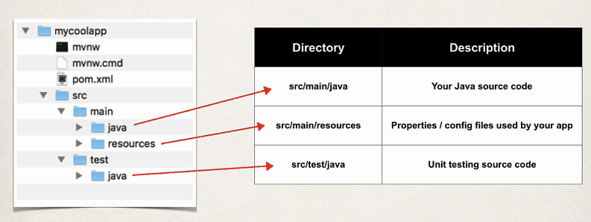
Spring project structure - maven
Uses the standard Maven project structure, with some additions…

Slide 12

Spring project structure - maven
These two files are Maven wrapper files
These allows us to run maven commands against our project even if we don’t have the correct version of Maven installed (or if we don’t have it installed at all!)
For example, we could run:
  mvnw spring-boot:run
Since we likely have Maven installed, we can just run:
  mvn spring-boot:run
One is for windows, the other is for linux/mac systems

Slide 13
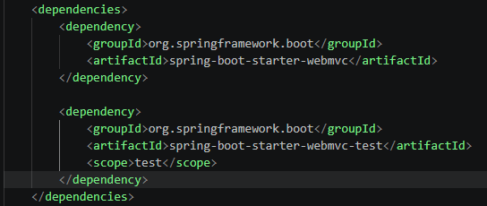
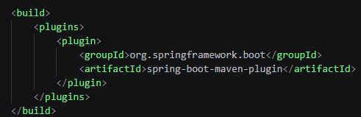
Spring project structure - Pom file
The starter dependencies are bundles of other dependencies
This helps us get started quickly with a lower dependency footprint in the pom file
The provided plugin is what we are using when we run our app or compile it to JAR/WAR

Slide 14
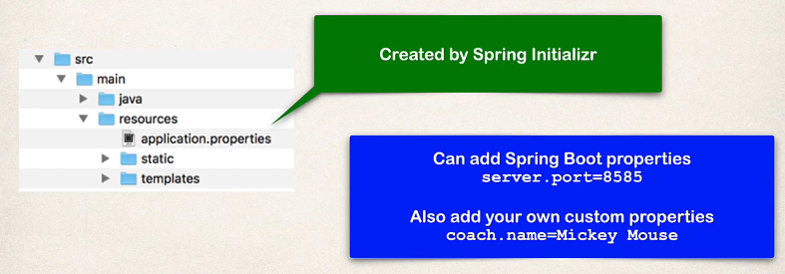
Spring project structure - Application.properties
There are over 1000 properties! You can find the docs for them here:
https://docs.spring.io/spring-boot/appendix/application-properties/index.html

Slide 15
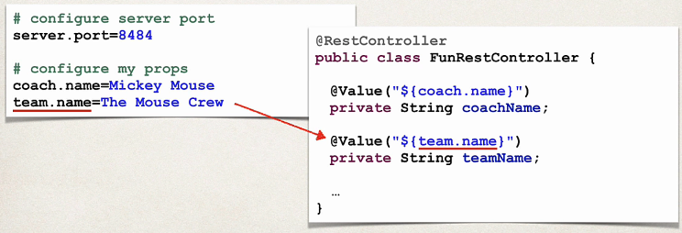
Spring project structure - using custom properties

Slide 16
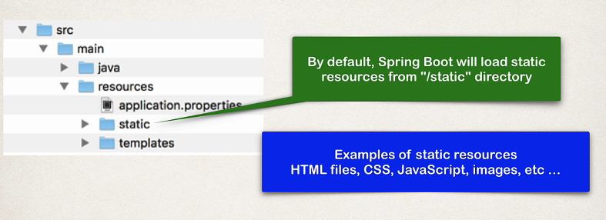
Spring project structure - Static content

Slide 17

Spring project structure - webapp standard location

Slide 18
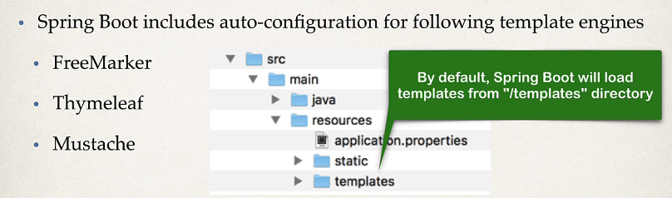
Spring project structure - Template engines
Template engines return views (markup) from server-side, instead of JSON responses

Slide 19
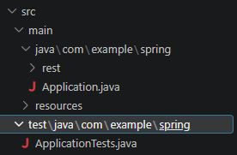
Spring project structure – unit tests

Slide 20
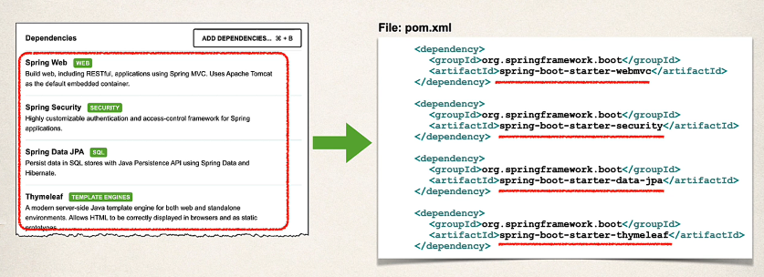
Spring boot starters - review

Slide 21
Spring boot starters – review – common starters
spring-boot-starter-web: Includes everything needed to build a web application, including an embedded Tomcat or Jetty server, Spring MVC, and other web-related dependencies.
spring-boot-starter-data-jpa: Provides support for using Spring Data JPA for database access, including Hibernate as the default JPA implementation.
spring-boot-starter-security: Offers Spring Security configurations for securing applications, including authentication, authorization, and common security features.
spring-boot-starter-test: Includes dependencies and configurations for writing tests in a Spring Boot application, such as JUnit, Mockito, and Spring Test.
There are 70+ starters! You can find them on the docs!
https://docs.spring.io/spring-boot/reference/using/build-systems.html#using.build-systems.starters

Slide 22
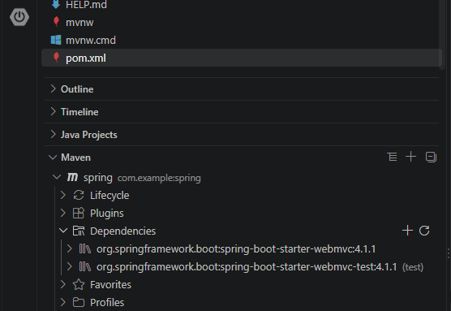
View starter dependencies – vs code
With the ‘Extension pack for Java’ extension, you get access to the ‘Maven for Java’ extension
With this you can view Maven dependencies in the bottom left of the VS Code UI

Slide 23
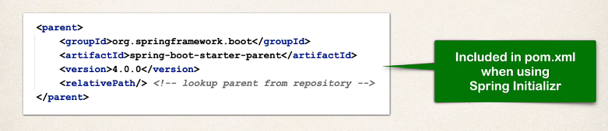
Spring boot starter parent
Spring Boot provides a ‘starter parent’
This is a special starter that provides default configurations
Found in pom.xml

Slide 24
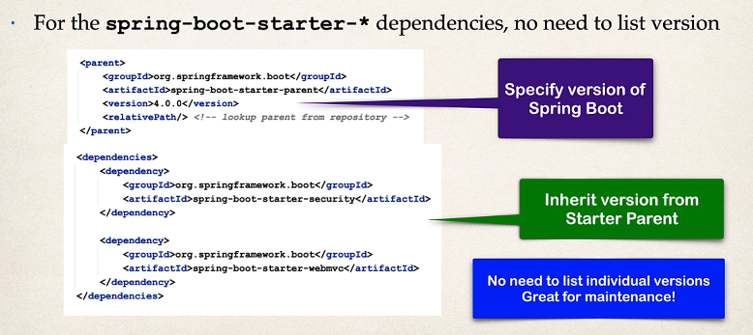
Spring boot starter parent
We simply set the version of the parent, and all dependencies will be automatically versioned to ensure compatibility. The Maven plugin is the same. Configurations for dependencies and plugins will come from the parent!

Slide 25
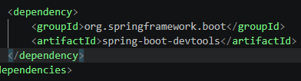
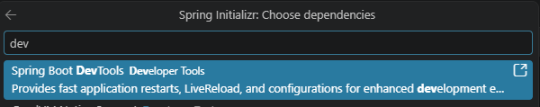
Spring boot dev tools – hot reload
This feature will allow us to make changes to our code, and see the changes apply immediately without having to stop/start our application after each change
We can add it manually to our pom.xml, or we could have added it during project initialization with the Spring Initializr

Slide 26
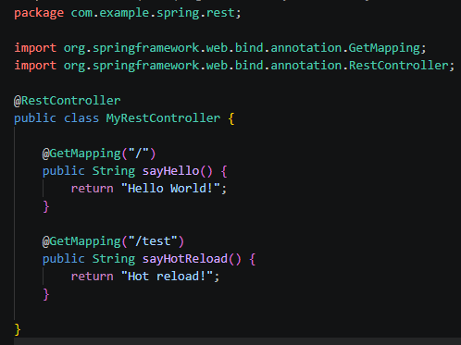
Testing hot reload
We can add another endpoint to test that it works!

Slide 27
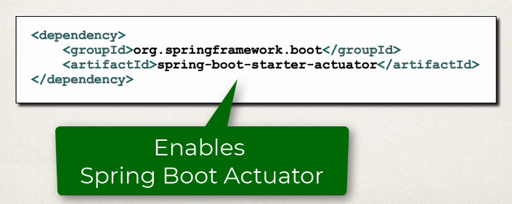
Spring boot actuator
Exposes endpoints to monitor the health of our application, as well as return other metrics/info
We simply need to add the dependency to our POM file
REST endpoints are then automatically added to our application
No need to write additional code!
We can secure these endpoints later with Spring Security!

Slide 28
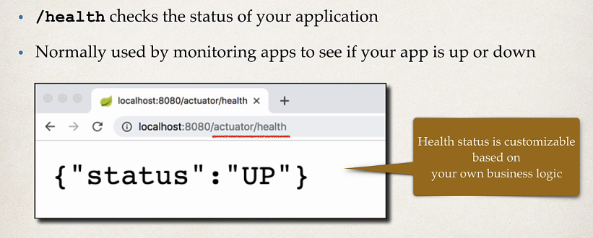
Spring boot actuator - health

Slide 29
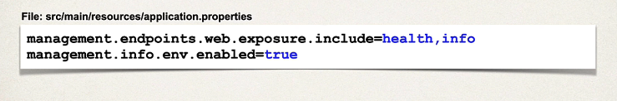
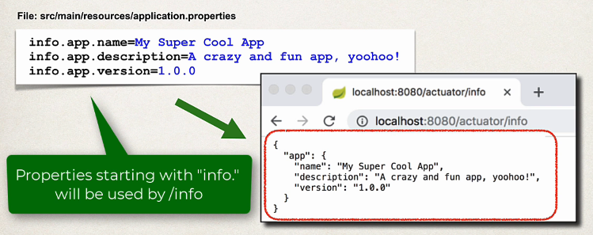
Spring boot actuator – exposing endpoints
By default, only /health is exposed
/info can provide information about our app, but we need to include it first!
We can also expose ALL endpoints with: *

Slide 30
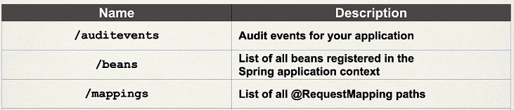
Spring boot actuator – available endpoints
See the docs below for a complete list, there are many!
https://docs.spring.io/spring-boot/reference/actuator/endpoints.html#page-title

Slide 31
STOP
Let’s install actuator here and view some endpoints
Info, health, mappings, beans, etc.

Slide 32
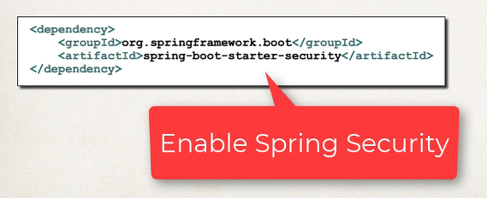
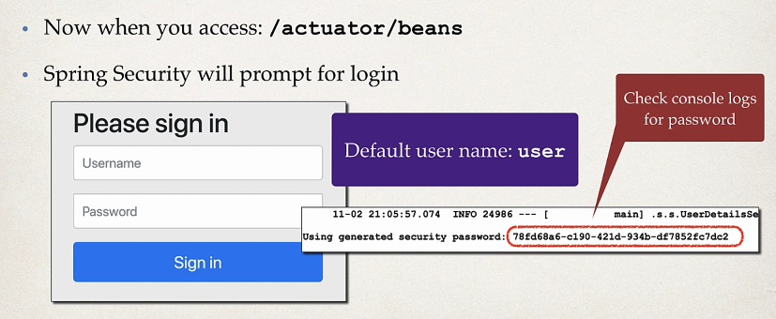
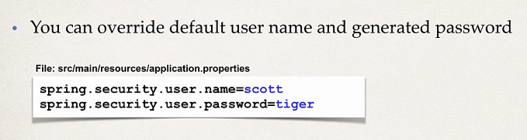
Securing Spring actuator endpoints

Slide 33
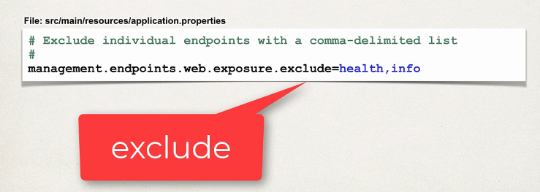
Securing Spring actuator endpoints
We can exclude endpoints so no one can access them!

Slide 34
STOP
Let’s add Spring Security
Set a custom username / password
Exclude the /health endpoint (recommended to re-enable after)
Test our secured endpoints
WE WILL COVER SECURITY MORE IN DEPTH LATER IN THE COURSE!!!
  We can do things like use database roles to secure endpoints, setup encrypted passwords, and more!

Slide 35
Packaging/running via CLI
Windows:
Linux/Bash shell:
Since we have Maven installed (from earlier in our course), we could have used mvn instead of mvnw
We could also start the app with either: ‘mvn spring-boot:run’ OR ‘mvnw spring-boot:run’
  Instead of manually creating the jar and launching it

Slide 36
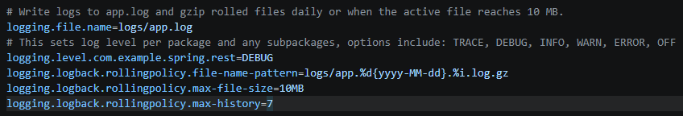
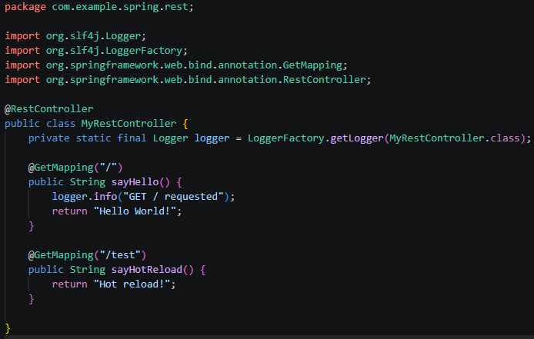
Spring Logging
Spring-boot-starter-webmvc already contains the logging dependencies we need
We can set properties in our ‘application.properties’ file to customize logging for Spring apps

Slide 37
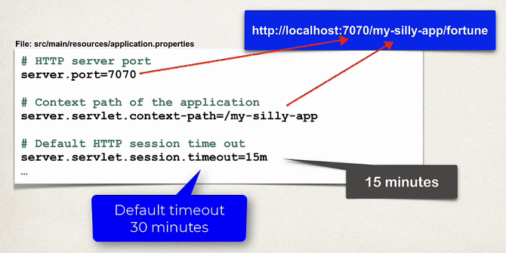
Application.properties - config

Slide 38
Challenge – custom endpoint & logging
Goal:
Scenario: 5 min
Create a new endpoint
Create a new endpoint which returns a string = “My name is: VALUE”
Where “VALUE” is dynamically injected from a custom property in your ‘application.properties’ file
Log an info message to a file when someone makes a GET request on our endpoint

Slide 39
Ioc – inversion of control
The approach of outsourcing the construction and management of objects
The Spring Container has two main responsibilities:
  Create and manage objects (IoC)
  Inject object dependencies (Dependency Injection)
When it comes to configuring the Spring Container:
  XML Configuration file (legacy)
  Java Annotations (Modern)
  Java source code (Modern)

Slide 40
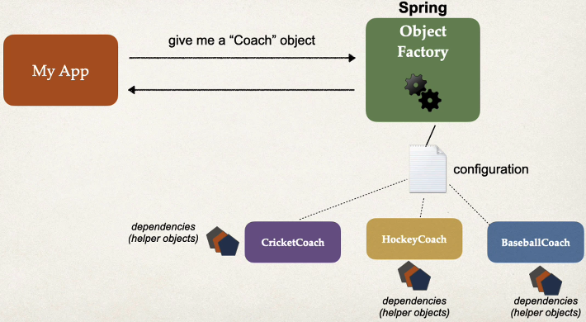
Spring Dependency Injection through dependency Inversion
SOLID
Dependency Inversion – the client delegates to another object the responsibility of providing its dependencies
  Give me a car → Car Factory
  Car Factory may need to assemble the car first (gather its dependencies)
  We get a car without needing to provide its dependencies ourself

Slide 41
Types of dependency injection
Constructor Injection
  Use this when you have required dependencies
  Generally recommended by the spring.io development team as the first choice
  This form of Dependency Injection is accomplished when a class receives its dependencies through its constructor during the instantiation process.
Setter Injection
  Use this when you have optional dependencies
  If dependency is not provided, your app can provide reasonable default logic
  This type of Dependency Injection happens when a class receives its dependencies through setter methods after it has been constructed.
Field Injection (generally less recommended)
  Field Injection happens when the dependencies are injected directly into the fields of a class, bypassing the constructor or setters.
  It reduces the amount of boilerplate code, as no explicit setter or constructor is needed. BUT, it makes your classes harder to test because you can't easily replace the dependencies with mocks. It also breaks encapsulation because you're modifying private fields outside of the class.

Slide 42
What is spring autowiring
@Component
class Engine {
void start() {
System.out.println("Engine started");
}
}
@Component
class Car {
private final Engine engine;
@Autowired
Car(Engine engine) {
this.engine = engine;
}
void drive() {
engine.start();
System.out.println("Car is driving");
}
}
@SpringBootApplication
public class App {
public static void main(String[] args) {
ApplicationContext context =
SpringApplication.run(App.class, args);
Car car = context.getBean(Car.class);
car.drive();
}
}
For dependency injection, Spring can use AutoWiring
This is a convention-based approach
Spring will look for a class that matches (by type: class or interface)
Spring will then inject it automatically, hence ‘AutoWired’
Spring will scan for @component, if any implement the needed class, in gets automatically loaded, this is called component scanning
Classes marked as ’@Component’ means objects instantiated from this class are what we refer to as a Spring Bean
Another note: If we only have a single constructor, @Autowired is technically optional

Slide 43
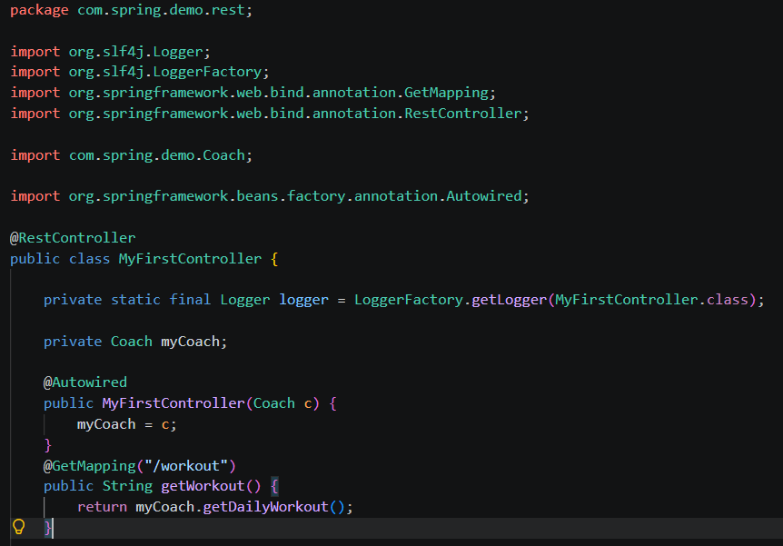
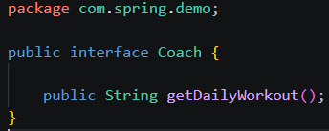
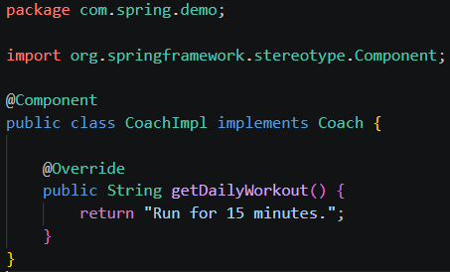
Constructor injection – putting it together
Note: @Component is a catch-all
We have other annotations we will use later that better describe intent
I.e. @Service, @Repository, etc.

Slide 44
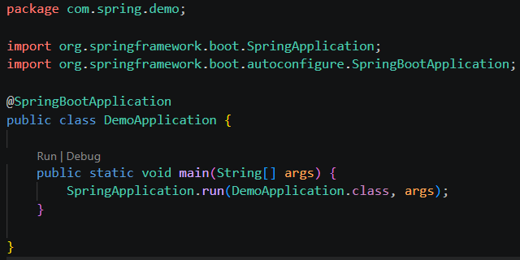
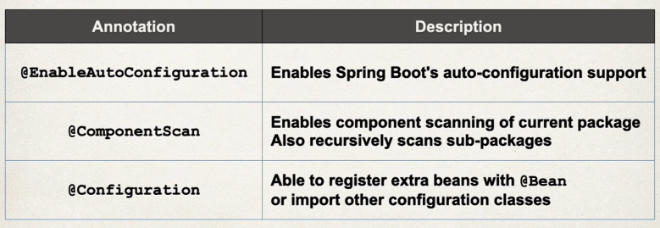
More on Component scanning
@SpringBootApplication is composed of the following annotations
Since @ComponentScan is part of that, and by default it’s only applied to the starter package, i.e. com.spring.demo
That means no packages outside of this root package will get their components scanned, let's see a visual on the next slide…

Slide 45
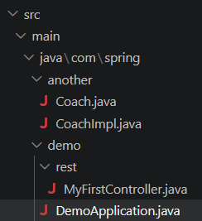
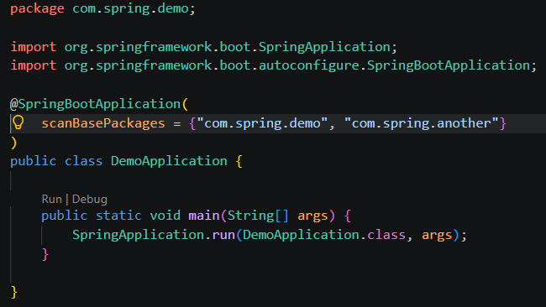
More on component scanning
If our main package is ‘com.spring.demo’ then those components will be scanned by default
The ‘com.example.another’ package will NOT automatically have its components scanned!
We can fix this by setting ‘scanBasePackages’

Slide 46
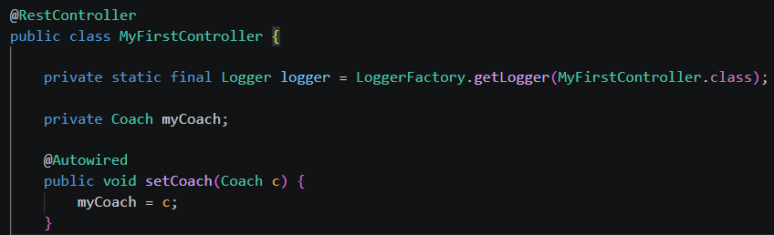
Setter Injection – putting it together
It’s a small change to our previous example
The method name doesn’t matter, but convention uses ‘set’
We can now instantiate a ‘MyFirstController’ WITHOUT a coach, so….
We could do this:
MyFirstController controller = new MyFirstController();
controller.getWorkout(); // myCoach is null / incomplete state for when we may not need a Coach!
This allows us to instantiate objects that don’t require all their dependencies!

Slide 47
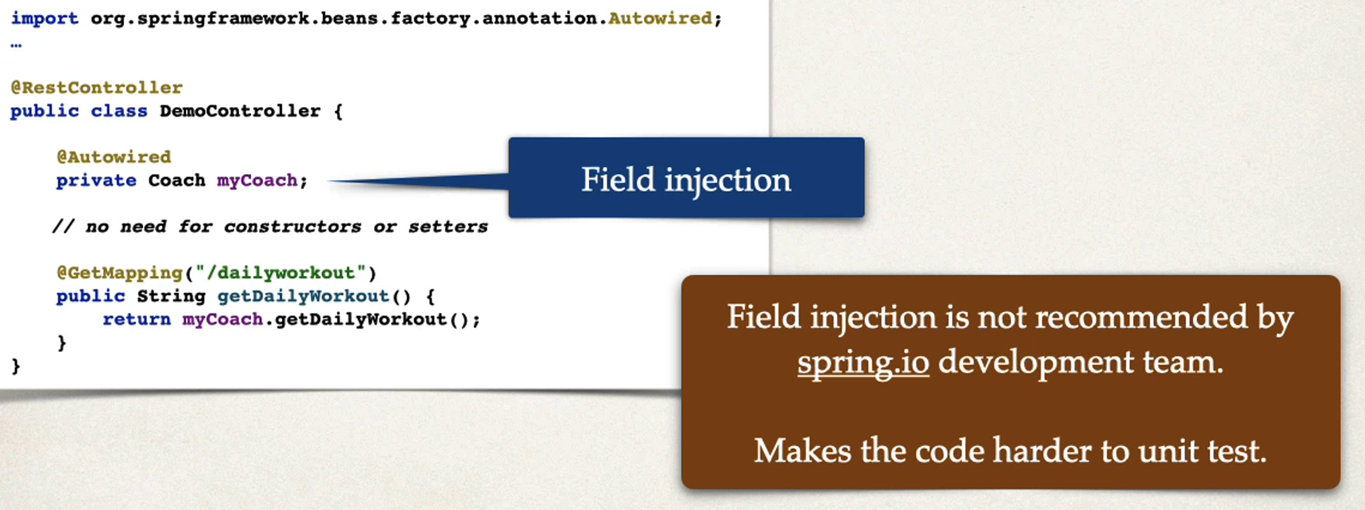
Field injection – not recommended

Slide 48
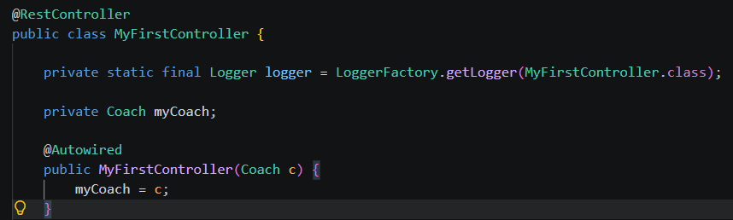
Question….
We only had 1 ‘CoachImpl’
What if we had more than one implementation?
How does Spring determine which one to use?

Slide 49
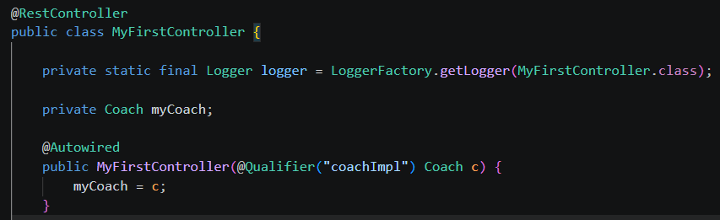
One possible Solution - @qualifier
We just need to supply the bean id to @Qualifier
The bean id is always the name of our class, with the first letter in lowercase
Now we have set the exact class we want to inject!
This works the same for setter injection too!

Slide 50
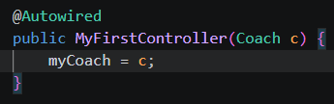
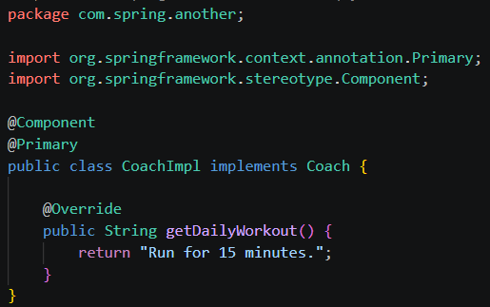
Another solution - @primary
@Primary – leaves it up to the classes to determine which one to use
You can only have a single @Primary made available for injection
You can mix @Primary & @Qualifier
  @Qualifier takes priority!
In general, I recommend just sticking with @Qualifier as it is more specific and takes priority

Slide 51
Challenge – let’s check our understanding
Goal:
Scenario: 5 min
Create endpoints for different types of coaches
Example: One endpoint uses a ‘baseBallCoach’ and prints ‘Practice Baseball’
Another endpoint uses a ‘basketballCoach’ and prints ‘Practice Basketball’
Hint: You can inject more than one item, with multiple @Qualifier(s)!

Slide 52
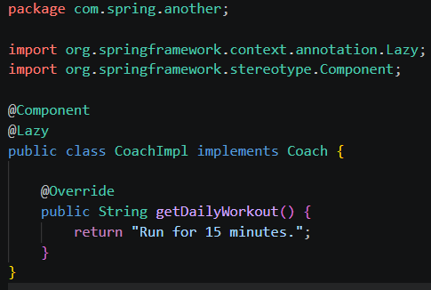
Lazy Instantiation
By default, Spring will load and initialize all beans, even if they aren’t injected anywhere!
We can set the @Lazy annotation so that an object of the class isn’t initialized until it is needed!
Alternatively, we can set the relevant property in our ‘application.properties’ file to enable lazy instantiation for ALL classes
You should really make sure you have enough memory once all objects are loaded before worrying about optimization with lazy instantiation!

Slide 53
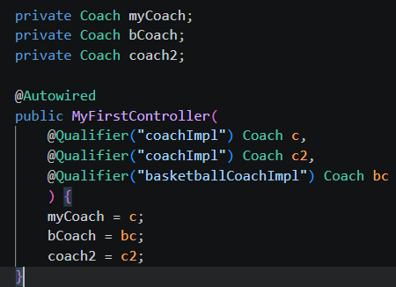
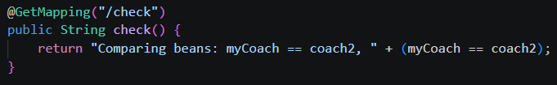
Bean Scope
By default, the Spring Container only creates on instance of a bean – A Singlton
It is cached in memory and all dependency injections will reference the SAME bean
That means ‘myCoach’ & ‘coach2’ will by default, be the SAME bean in memory
The endpoint shown will print ‘true’!

Slide 54

Bean scope

Slide 55


Bean scope - prototype
Set to prototype, we will get a new object instantiation for each injection
The same ‘/check’ endpoint will now print ‘false’!
The are different beans in memory now!

Slide 56

Bean lifecycle

Slide 57

Bean lifecycle methods – why?
You can add custom code during bean initialization
  @PostConstruct
  Set up handles to resources (db, sockets, file etc)
You can add custom code during bean destruction
  @PreDestroy
  Clean up handles to resources (db, sockets, files etc)
Note: Prototype scoped beans will NOT call @PreDestroy methods!

Slide 58
Configuring the spring container - recap
When it comes to configuring the Spring Container:
  XML Configuration file (legacy)
  Java Annotations (Modern)
    @Component, @Service, @Repository, etc.
  Java source code (Modern)
    What we will discuss now!

Slide 59



@Configruation & @Bean
Notice our SwimCoach does NOT use @Component
We instead setup a @Configuration class to get full control
  For example, we can now pass params into ‘new SwimCoach()’
  You could pass an API key, set fields, manually set dependencies, etc.

Slide 60
Another example
You may want to make an existing third-party class available for the Spring Framwork
You may not have access to the source code of the third-party class
However, you want to use the third-party class as a spring bean
Real world example:
  Setup an AWS S3 client as a Spring Bean in your app
  We can’t modify the AWS SDK source code
  We can’t just add @Component
  We CAN configure it as a Spring bean, so we can use it across our app!

Slide 61

Another example – further explained

Slide 62

Another example – further explained

