Slide 1
COMPUTER VISION EXTRAPOLATED TO EXTRACT TABULAR COLUMNS FROM THE INVOICE AND CONVERTING IT INTO A JSON AND CSV FORMAT
Under the guidance of:
Dr.A.Jesudoss,M.E.,Ph.D.,
Dr.S.Revathy,M.E.,Ph.D., (IT Department)
Department of Computer Science And Engineering
Sathyabama Institute Of Science And Technology
Chennai - 600119
Presented by:
Venkata Naga Sai Rakesh Kamisetty (38110635)
Bodapati Sohan Chidvilas (38110688)

Slide 2
Introduction
Computer vision has emerged as a powerful data dependent hierarchical feature in extraction method. It is widely used in solving problems for instance, Computer vision learns important characters from training samples automatically.
It is observed, that the Optical character recognition (OCR) train samples very easily. Several regularization methods have been proposed to avoid the over fitting. In spite of this, the OCR is sensitive to the color distribution within the images which is ignored by the existing approaches.
In this paper, we have discovered the table robustness problem of computer vision by proposing a simple course of action, In OCR we have detected new images which are generated with new channels created by combining the original channels with the stochastic weights. Experiments were carried out over widely.

Slide 3
Abstract
Optical Character Recognition (OCR) is an important feature learning mechanism for visual data. They have been very successful in many applications, primarily within a controlled experimental setup.
We propose a simple PYTESSARACT OCR as it is reliable and compared to any other open-source OCR's available like Easy OCR and Keras OCR, which increases the average accuracy by 80% to detect the accurate data in the invoice.
This research tries to find out a methodology through which any data from the daily-use printed bills and invoices can be extracted. The data from these bills or invoices can be used extensively later on -such for statistical analysis. This research focuses on extraction of any content that the end user wants from the invoice, itinerary, date and similar data from bills and invoices as they encapsulate an ample amount of information about the users purchases, likes or dislikes etc.
OCR technology is a system that provides a full alphanumeric recognition of printed or handwritten characters from images. we take pdf or image(jpg, jpeg, png) as an input and if it is a pdf it will convert it into an image then processing has been used to detect the text and filter out the unnecessary noise from the image. Then intermediate image is passed for further processing using PYTESSARACT OCR engine. After acquiring the text, we will be cleaning and converting it into a desired form in order to convert it into a json or csv.
Our methodology proves to be highly accurate while tested on a variety of input images of bills and invoices. We also use the image processing techniques during training to increase the robustness of the Computer Vision, which achieves an increase in accuracy by 80%. The proposed approach can be used to improve the robustness of Computer Vision.

Slide 4
Problem statement
It is observed that the performance of the Computer vision degrades drastically under the course of action. The results are also compared with existing computer vision fooling approaches to evaluate the accuracy drop. We propose a primary state-of-the-art performance using the solution in terms of the computer robustness under OCR is observed in the experiments.
Computer vision can be fooled very easily by augmenting the test data, which limits its practical uses over unseen data in real applications.
No OCR in this world which can detect only the specific contents with more than 80 percent accuracy which can convert it into JSON or CSV.

Slide 5
Project Justification
The necessity of this protrude is extracting the relevant data instead of unnecessary matter. For instance take medical bills, when we need only the tabular contents then there is no OCR that can detect the tabular columns separately, that to with 80 % accuracy and returning the output as JSON as well as CSV.
Our OCR can also segregate based on the industry. For instance, medical and restaurant bills will be separated accordingly.
The end user can also get the entire invoice contents if they need, by just giving invoice number and the output will be in json as well as CSV.
The main advantage of JSON and CSV is that the end user need not enter contents as they will directly return the particulars.

Slide 6
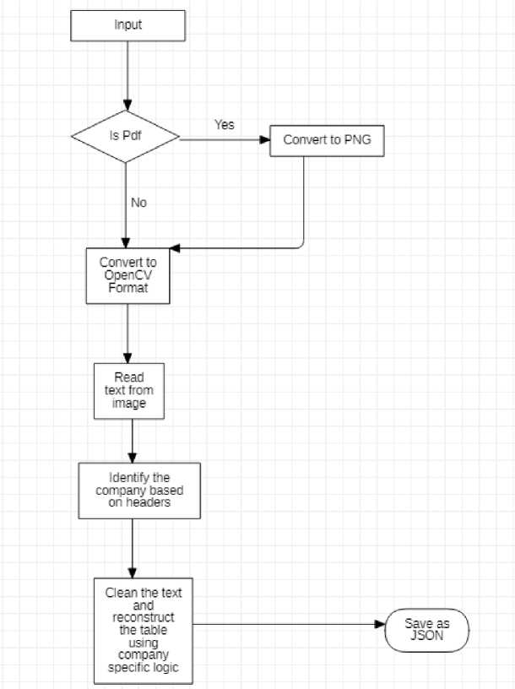
Flow chart

Slide 7
Objectives
To extract the billing information from the given medical bill and convert the text into JSON format as well as CSV.
STEPS TO ACHIEVE OBJECTIVE:
Firstly, we will take the invoice from the end-user which is in pdf format or in any other image format and convert it into a processed image for more accuracy.
In the second step, we will apply image processing techniques and find out the best one which suits.
In the tertiary step, OCR will come in place and extract the text out of the invoice, then bad characters will be removed to make it into a list.
To identify the distributor, we are using the header contents to segregate with one another.
Then we will find out the beginning and end of the table with keywords as well as SI No.
Finally, we will extract the table and convert it into a JSON file.

Slide 8
Prerequisites
Python 3.8.1 and above
Poppler
https://drive.google.com/drive/folders/11Dp4OKoAZmPix1i98JKwp5e29 Ar sE6N?usp=sharing
Tesseract OCR
https://drive.google.com/drive/folders/1IMehnDsWiKK8c6vRgToQTnB OS QfZmSO?usp=sharing
Points to note:
1) After installing the poppler file change the file path in the pngcon.py file to '~\poppler-21.03.0\Library\bin' and include the path in environment variable in any operating system
2) After installing the tesseract OCR file change the file path in the tesseract_OCR.py file to '~\Tesseract-OCR\tesseract.exe' according to the operating system.
3) Change the path where the end user is giving the invoice as an input.

Slide 9
Python Libraries used:
tesseract_OCR: this is used for specifying tesseract path (pip install tesseract).
numpy: default library (pip install numpy).
cv2: (pip install opencv-python).
Pdf2image: Converts pdf format to image if the invoice is in pdf.
Fuzzywuzzy: it makes the image diaphanous.
copy: to remove replicates(deepcopy).
re: It is used for cleaning text.
JSON.

Slide 10
Limitations
If any Handwritten text in invoice this will affect the dialectics of the program.
When an image is Fuzzy.
If OCR detects wrong text then this dialectics will not work.
If headroom is much bigger between the end of the table and keyword that we are searching for in the invoice.
This can not be a generalized solution as we are going with header specific contents.
Finally, if there are any misprinted values in the invoice, then the JSON will be affected.
Only erect pdf will work.

Slide 11
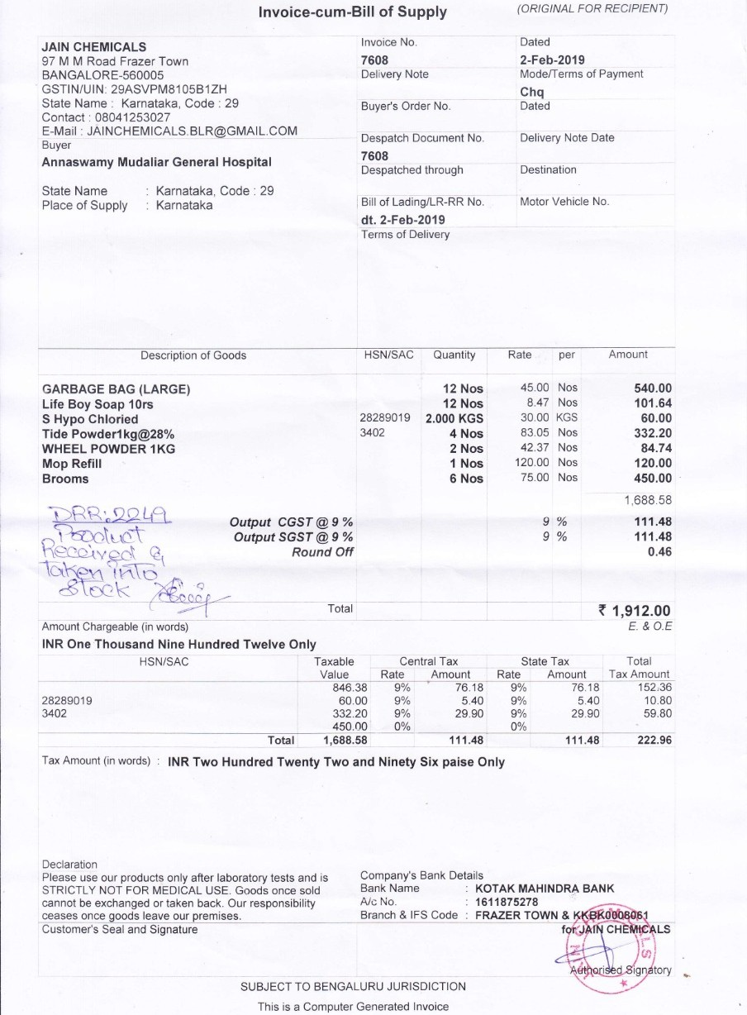
Invoice Example

Slide 12
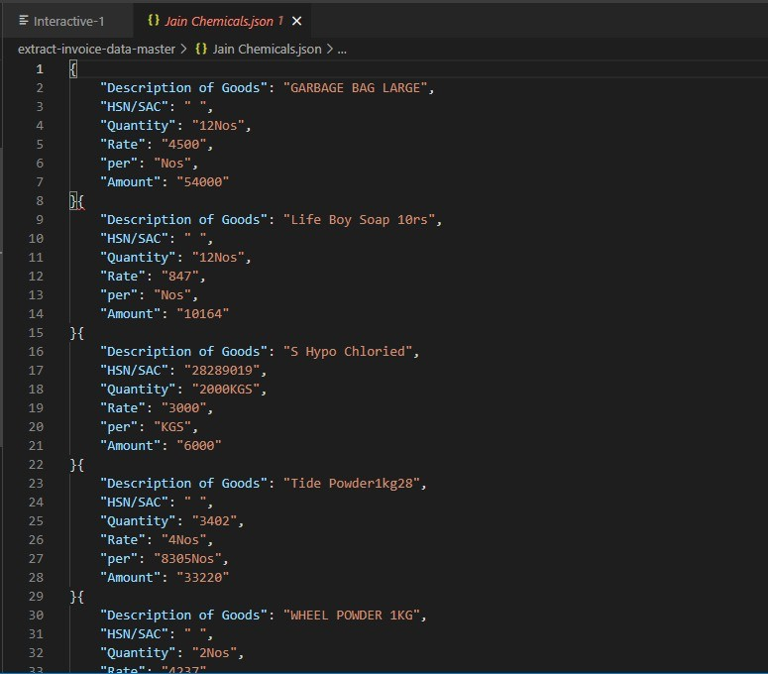
Output

Slide 13
Base Paper
Mixed-Initiative Approach to Extract Data from Pictures of Medical Invoice
Publisher: IEEE
Authors: Seokweon Jung; Kiroong Choe; Seokhyeon Park; Hyung-Kwon Ko; Youngtaek Kim; Jinwook Seo
Link: https://ieeexplore.ieee.org/abstract/document/9438774

Slide 14
THANK YOU

