Slide 1


WELCOME
DNS
Conclution
Topic
SMTP
END
FTP
Presentation
Computer Network
Presented By-Md.Sohan Mia
ID:20111102
Dept: Computer Science &Engineering
BSFMSTU

Slide 2
Topic:
01.DNS
02.FTP
Conclution
DNS
SMTP
END
FTP
TOPIC
03.SMTP

Slide 3
COVERAGE
DNS DEFINITION
DNS SERVER
DNS TOOLS
DNS TYPE
NEED OF DNS
DNS COMPONENTS
FTP
DNS
Conclution
SMTP
TOPIC
END
DNS CONTEXT

Slide 4
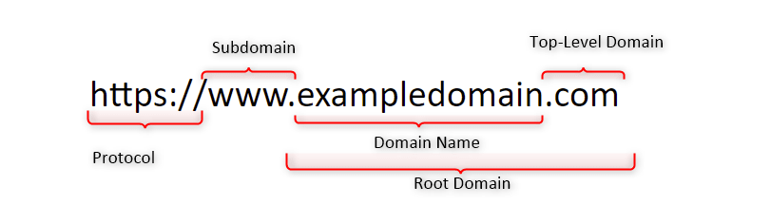
DOMAIN NAME SYSTEM
What is DNS ?
The Domain Name System (DNS) is the phonebook of the Internet. Humans access information online through domain names, like kupasamsu.com or bdnews24.com. Web browsers interact through Internet Protocol (IP)addresses. DNS translates domain names to IP addresses so browsers can load Internet resources.
Each device connected to the Internet has a unique IP address which other machines use to find the device. DNS servers eliminate the need for humans to memorize IP addresses such as 192.168.1.1 (in IPv4), or more complex newer alphanumeric IP addresses such as 2400:cb00:2048:1::c629:d7a2 (in IPv6).
FTP
DNS
Conclution
SMTP
TOPIC
END

Slide 5
DNS CONTINUED
DNS Include A Network Protocol for Memorizing Host Name And Addresses Through A Distaributed Data Base.
All The Top- Level domains, delegates authority for second level domains, and a database of registered name servers for all second-level domains Monitored by The Network Information System(NIC)
FTP
Conclution
SMTP
DNS
END
TOPIC
Host name assignments maintained through zone file on primary DNS server.Secondary DNS server gets zone file fromn primary server.

Slide 6
DNS SERVER
There are different types of DNS SERVER available we can install any of them as per our requirement. It is of three types,
Primary:-Locally stored file exists on the name server data base
FTP
Conclution
SMTP
TOPIC
END
DNS
Secondary:- Get data called z zone transfer from another server that is the zone authority.
For example :-
    BIND,BJBDNS,ANS/CNS,POWER,DNS etc

Slide 7
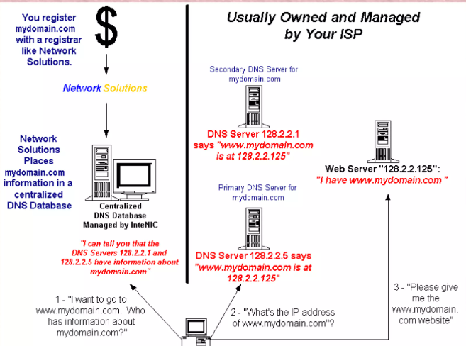
DNS IN ACTION
FTP
Conclution
SMTP
TOPIC
END
DNS

Slide 8
TYPE OF DOMAIN
GENERIC DOMAIN
  .com, .org, .xyz, .arpa, .asia, .club, .info.
FTP
Conclution
SMTP
TOPIC
END
DNS
COUNTRY DOMAIN
  .in, .ca, .uk, .xm, .ir, .au, .ir, .bd, .fr, .gr, mx

Slide 9



File Transfer
Protocol
(FTP)
follow
SMTP
DNS
Conclution
FTP
Topic
END

Slide 10
CONTENTS
CONNECTIONS
COMMUNICATION
COMMAND PROCESSING
FILE TRANSFER
follow
SMTP
DNS
Conclution
FTP
TOPIC
END

Slide 11
FTP CONNECTION
FTP uses the services of TCP.
It needs two TCP connections.
The well-known port 21 is used
for the control connection
and the well-known
port 20 for the data connection.
follow
SMTP
DNS
Conclution
FTP
TOPIC
END

Slide 12
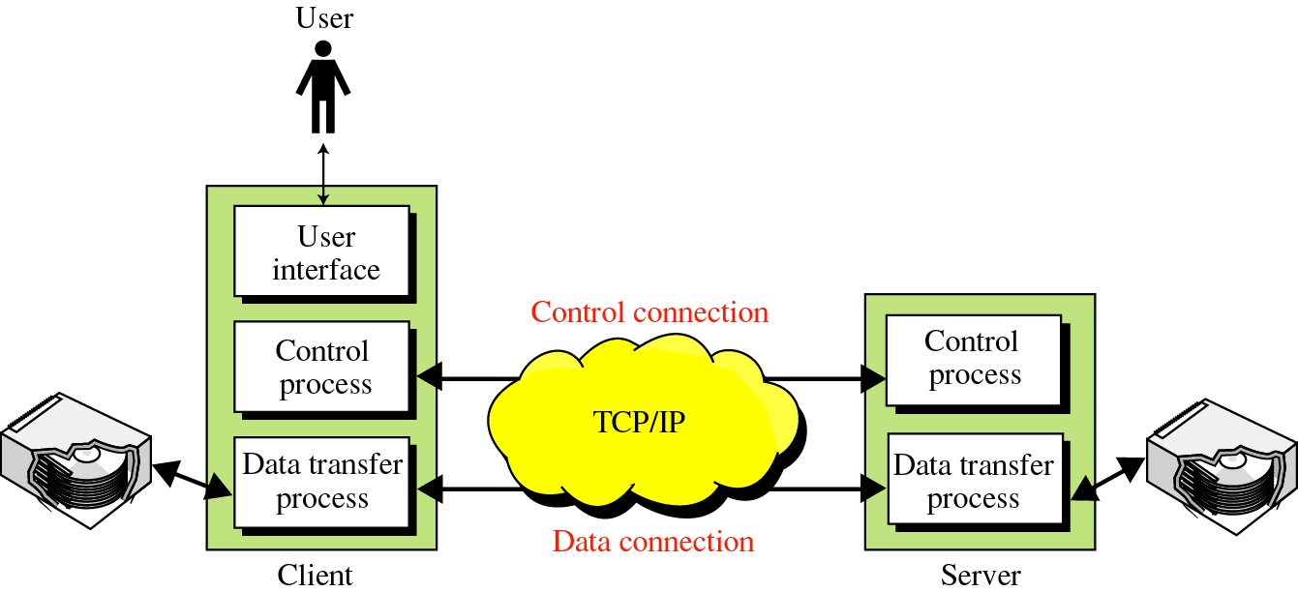
FTP CONNECTION
follow
SMTP
DNS
Conclution
FTP
TOPIC
END

Slide 13
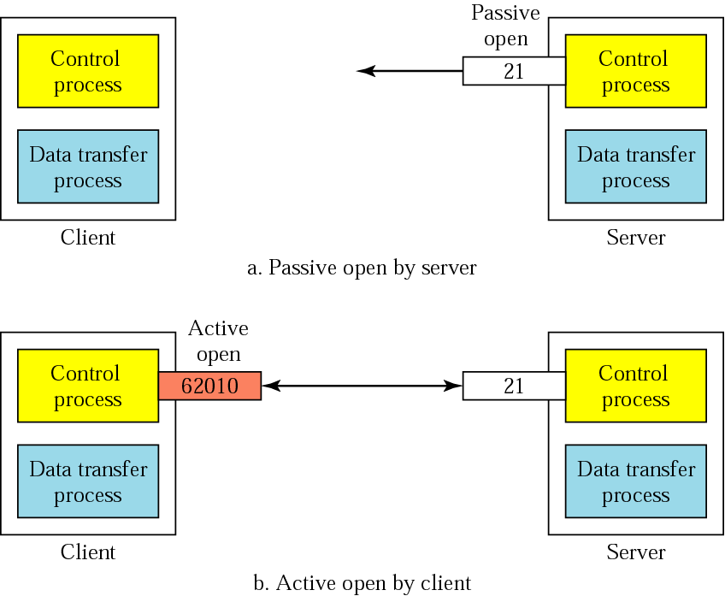
Connections: The control connection
follow
SMTP
DNS
Conclution
FTP
TOPIC
END

Slide 14
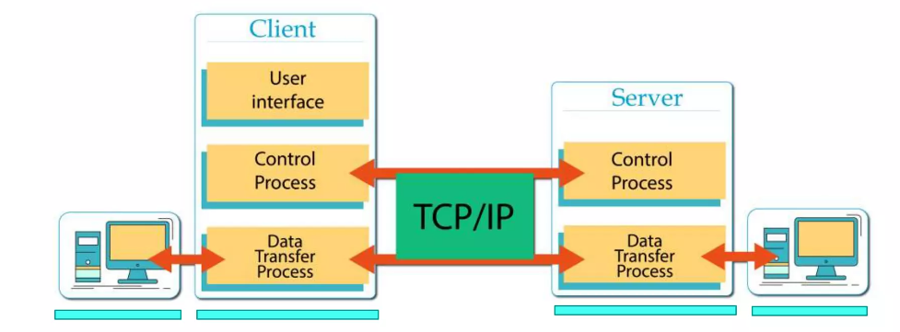
COMMUNICATION
  Mechanism Of FTP.
follow
SMTP
DNS
Conclution
FTP
TOPIC
END

Slide 15
The Data Connection
Uses Server’s well-known port 20
Client issues a passive open on an ephemeral port, say x.
Client uses PORT command to tell the server about the port number x.
Server issues an active open from port 20 to port x.
Server creates a child server/ephemeral port number to serve the client
follow
SMTP
DNS
Conclution
FTP
TOPIC
END

Slide 16
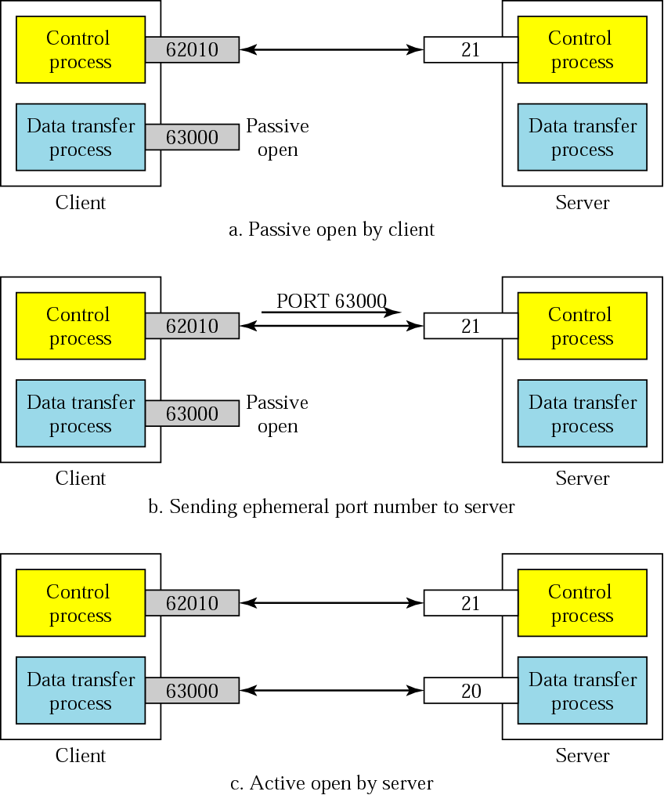
Creating
the data
connection
follow
SMTP
DNS
Conclution
FTP
TOPIC
END

Slide 17
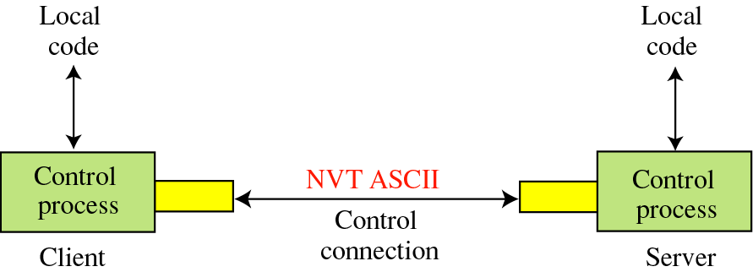
Communication
Using the control connection
follow
SMTP
DNS
Conclution
FTP
TOPIC
END

Slide 18
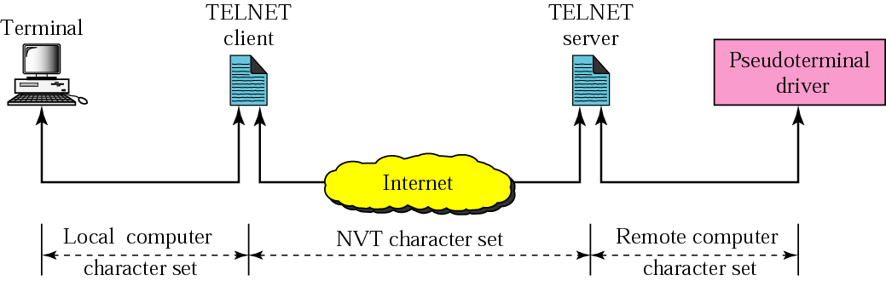
NVT
follow
SMTP
DNS
Conclution
FTP
TOPIC
END
Note: NVT means network virtual terminal

Slide 19
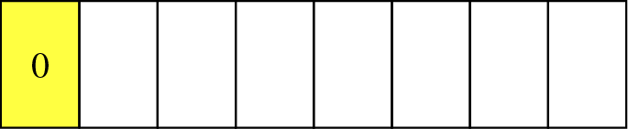
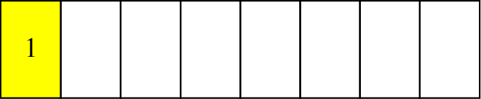
Format of NVT ASCII characters
follow
SMTP
DNS
Conclution
FTP
TOPIC
END
Format of NVT control characters

Slide 20
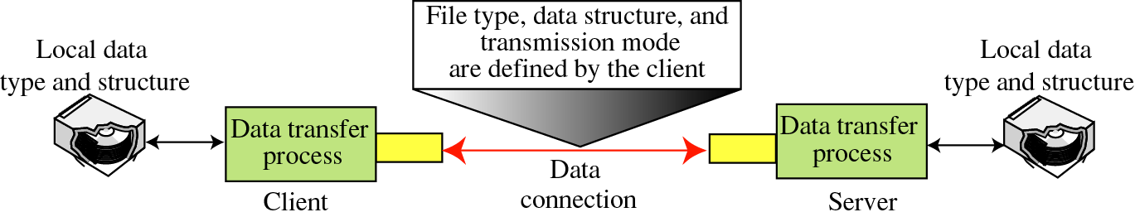
Using the data connection
follow
SMTP
DNS
Conclution
FTP
TOPIC
END
File Type
Data Structure
Transmission Mode
ASCII or EBCDIC
  Nonprint
  TELNET
Image
File Structure
Record Structure
Page Structure
Stream mode
Block mode
Compressed mode

Slide 21
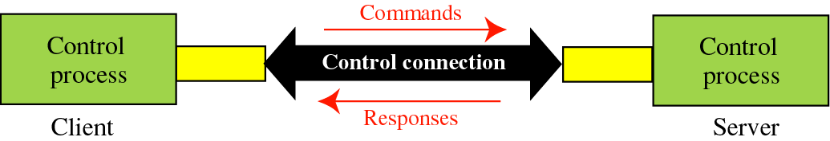
Command processing
Access Commands
File Management
Data Formatting
Port defining
File transfer
Miscellaneous
DNS
follow
SMTP
FTP
TOPIC
Conclution
END

Slide 22
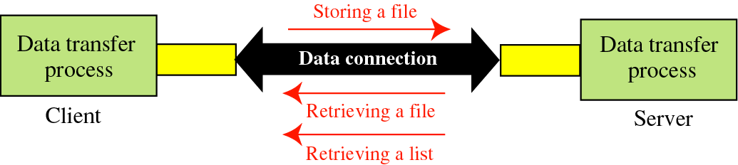
File transfer
DNS
follow
SMTP
FTP
TOPIC
Conclution
END

Slide 23
Simple Male Transfer
Protocol
(SMTP)
DNS
FTP
TOPIC
Conclution
SMTP
END

Slide 24

CONTENT
SMTP DEFINITION
HISTORY OF SMTP
GENERAL FEATURES
SMTP COMMANDS
DNS
FTP
TOPIC
Conclution
SMTP
END
SMTP REPLIES
ARCHITECTURE OF SMTP
THE MAIL OBJECT
RELAYING

Slide 25
What is SMTP?
The Simple Mail Transfer Protocol (SMTP) is the actual protocol used to transfer mail from MTA to MTA
MTA: Mail Transfer Agent ….A program that actually routes ans delivers mail.
MUA: Mail User Agent …. A Program that is used to access mail after delivery.
DNS
FTP
TOPIC
Conclution
SMTP
END

Slide 26
What is SMTP?
The objective of SMTP is to transfer mail reliably and efficiently. SMTP is widely deployed and proven to be very robust. The SMTP model is based on what is called a mail transaction. Sender and receiver MTAs send commands and replies in a structured, lock-step process.
DNS
FTP
TOPIC
Conclution
SMTP
END

Slide 27
History of SMTP.
• The SMTP specification originally started with the Mail Transfer Protocol in 1980
• It evolved into Simple Mail Transfer Protocol (SMTP) in 1981
• Specified in RFC 821
• Most recent RFC is 2821
• First and most important implementation is Sendmail
DNS
FTP
TOPIC
Conclution
SMTP
END

Slide 28
General Features
• Independent of underlying transmission subsystem
• Just needs a reliable ordered data stream channel
• Operates over TCP port 25
• Uses an request-response protocol that is useful to human readers (SMTP commands)
• SMTP sessions are stateful, with both parties carefully maintaining a common view of the current state.
DNS
FTP
TOPIC
Conclution
SMTP
END

Slide 29
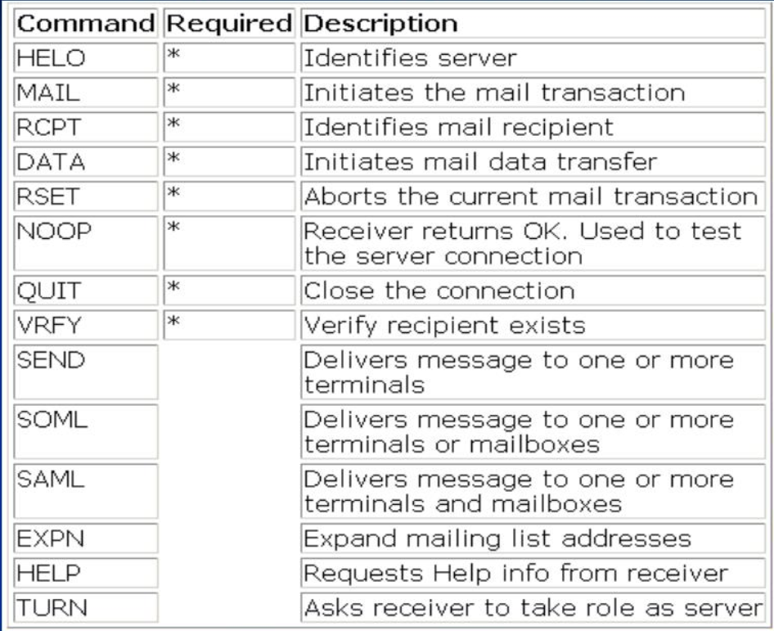
SMTP Commands
DNS
FTP
TOPIC
Conclution
SMTP
END

Slide 30
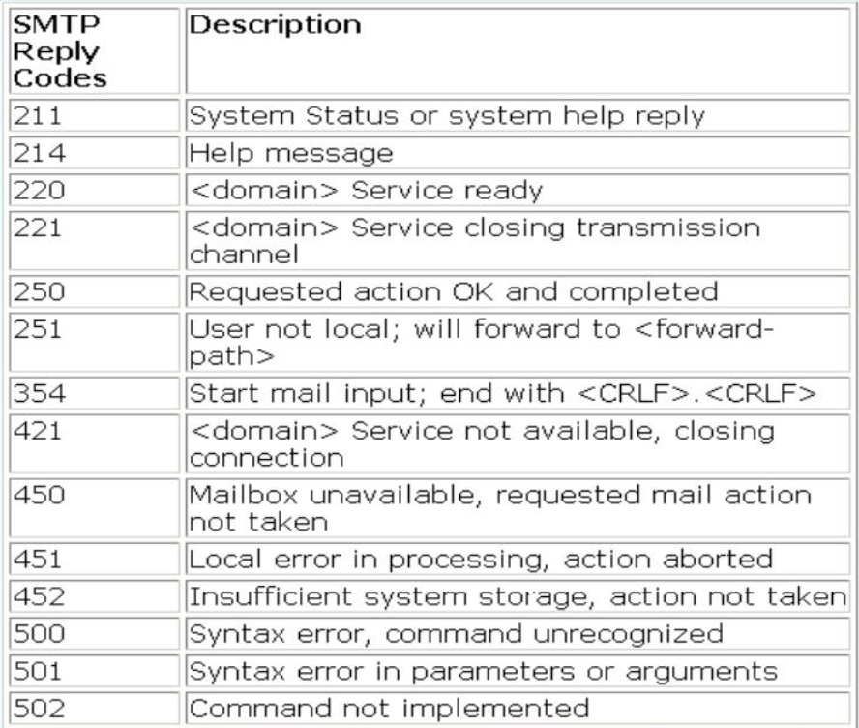
SMTP Replies
DNS
FTP
Conclution
SMTP
TOPIC
END

Slide 31
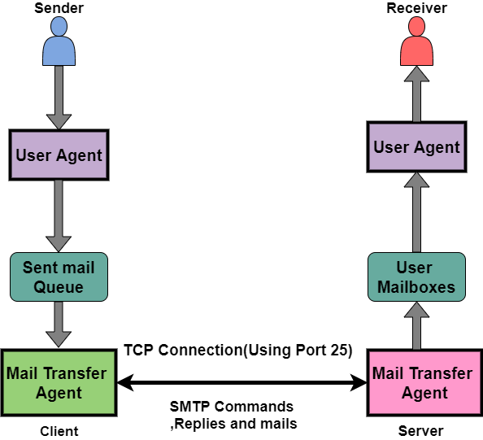
Architecture of SMTP
DNS
FTP
TOPIC
Conclution
SMTP
END

Slide 32
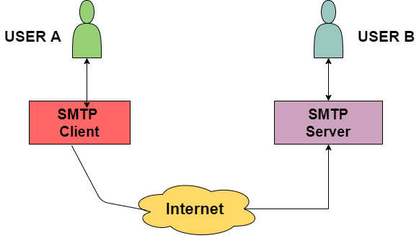
Sending & Receive or download The Email
DNS
FTP
TOPIC
Conclution
SMTP
END
SMTP is used two times while sending an Email:
Between the Sender and Sender's mail server
Between the Sender’s mail server and the Receiver’s mail server
SMTP is receive or download the email,
1There is a need for another protocol between the mail server of receiver and the receiver.
Commonly used protocols are POP3 and IMAP. Thus these two are mail access agents.

Slide 33
SMTP Protocol Method
Store-and-Forward Method
The store and forward method is used within an organization.
End-to-End Method
Mainly the end-to-end method is used to communicate between the different organizations
DNS
FTP
TOPIC
Conclution
SMTP
END

Slide 34
Characteristics of SMTP
SMTP makes use of Port 25.
It makes use of persistent TCP connections and thus can send multiple emails all at once.
It is a stateless protocol.
It is a connection-oriented protocol.
It makes use of TCP at the transport layer.
It is a push control protocol
DNS
FTP
TOPIC
Conclution
SMTP
END

Slide 35
Advantage OF SMTP
SMTP offers reliability in terms of the outgoing email messages.
It is the simplest form of communication between various computers in a network via Email.
In those cases where a particular message was not delivered successfully then, the SMTP server always tries to re-send the same message until the transmission becomes successful.
DNS
FTP
TOPIC
Conclution
SMTP
END
disadvantage OF SMTP
MTP does not provide good security.
It is only limited to 7-bit ASCII characters.
Beyond some specific length, email messages are rejected by SMTP servers.
The usefulness of SMTP is limited by its simplicity.
With the help of SMTP, the transmission of executable files and binary files is not possible until they get converted into text files.

Slide 36
Thank you
for your patience
Ending
SMTP
DNS
Conclution
FTP
TOPIC

