Slide 1
RESEARCH MASTER PLAN & PROTOTYPE VALIDATION
Digital Twin-Based Cyber Attack Detection and Self-Healing for Resource-Constrained IoT Networks
A Reproducible, Closed-Loop Resilience Architecture from Simulation to ESP32/LoRa Hardware
Phase 1: Simulator
● VALIDATED
56 Tests PASS
Physics & Energy Models
Phase 2: Digital Twin
● VALIDATED
68 Tests PASS
0.009 ms Sync Latency
Phase 3: Attack Sim
● VALIDATED
87 Tests PASS
DoS, Drop, Failure Models
Phase 4: Feature Eng
● VALIDATED
94 Tests PASS
95 Multi-Scale Features

Slide 2
MOTIVATION & CONTEXT
Research Problem: The IoT Security & Resilience Trilemma
The Resource-Constrained Dilemma
• Extreme Compute & Energy Constraints: Microcontrollers (e.g. ESP32, 240MHz, 520KB SRAM) and battery-powered nodes cannot sustain heavyweight IDS classifiers, deep neural networks, or complex routing recalculations.
• Fragility to Multi-Vector Attacks: Resource-constrained networks are vulnerable to Denial-of-Service (DoS) buffer exhaustion, gray-hole selective packet dropping, and abrupt node failure outages.
• The Recovery Paradox: Uncoordinated node isolation often causes unintended routing partitions, loop formations, or cascade failures across the topology.
• Hardware Validation Gap: Most literature either remains in abstract software simulation (NS-3/Matlab) or deploys unverified ad-hoc heuristics directly on hardware without safe pre-evaluation.
The Digital Twin Solution Paradigm
• Decoupled Intelligence: Physical nodes stream ultra-lightweight telemetry (TelemetryRecord). Heavy computation (ML detection, feature extraction, graph optimization) is offloaded to the Digital Twin at the edge server.
• Living Virtual Shadow: The Digital Twin maintains continuous, validated state synchronization of every node, active link condition, and historical time-series buffer.
• In-Silico Recovery Simulation (Core Novelty): Before issuing actuation commands to the physical network, the Digital Twin clones the current network state into a virtual sandbox and simulates candidate recovery actions.
• Multi-Objective Optimization: Selects the optimal self-healing policy balancing packet loss, latency stretch, energy consumption, and communication overhead.
• Hardware Portability: Invariant telemetry contract allows seamless transfer from Python simulation to physical ESP32 + LoRa hardware.

Slide 3
SCIENTIFIC OBJECTIVES
Research Questions Guiding the Experimental Framework
RQ1: State Synchronization & Overhead
Can a low-overhead, event-driven telemetry ingestion protocol maintain high-fidelity synchronization between constrained IoT nodes and their Digital Twin shadow without battery degradation?
RQ2: Telemetry-Driven ML Attack Detection
How accurately and with what detection latency can lightweight, interpretable machine learning models identify DoS, selective forwarding, and node failure anomalies using temporal rolling features?
RQ3: Dynamic Behavioral Risk Modeling
How can multi-factor physical indicators (forwarding fidelity, energy drain drift, and channel loss consistency) be synthesized into a dynamic node trust score without arbitrary heuristics?
RQ4: Pre-Execution Recovery Simulation
Does forward-simulating candidate recovery strategies inside the Digital Twin prior to live actuation reduce recovery failures, prevent network partitioning, and minimize Mean Time to Recovery (MTTR)?
RQ5: Scalability & Resilience Quantification
How does the closed-loop self-healing framework scale across network sizes (N = 6 to 100 nodes) in terms of computational overhead, communication overhead, and network availability?
RQ6: Hardware Portability (Sim-to-Real)
Can the identical Digital Twin and self-healing software pipeline ingest telemetry and actuate recovery on physical ESP32 microcontrollers over LoRa without architectural redesign?

Slide 4
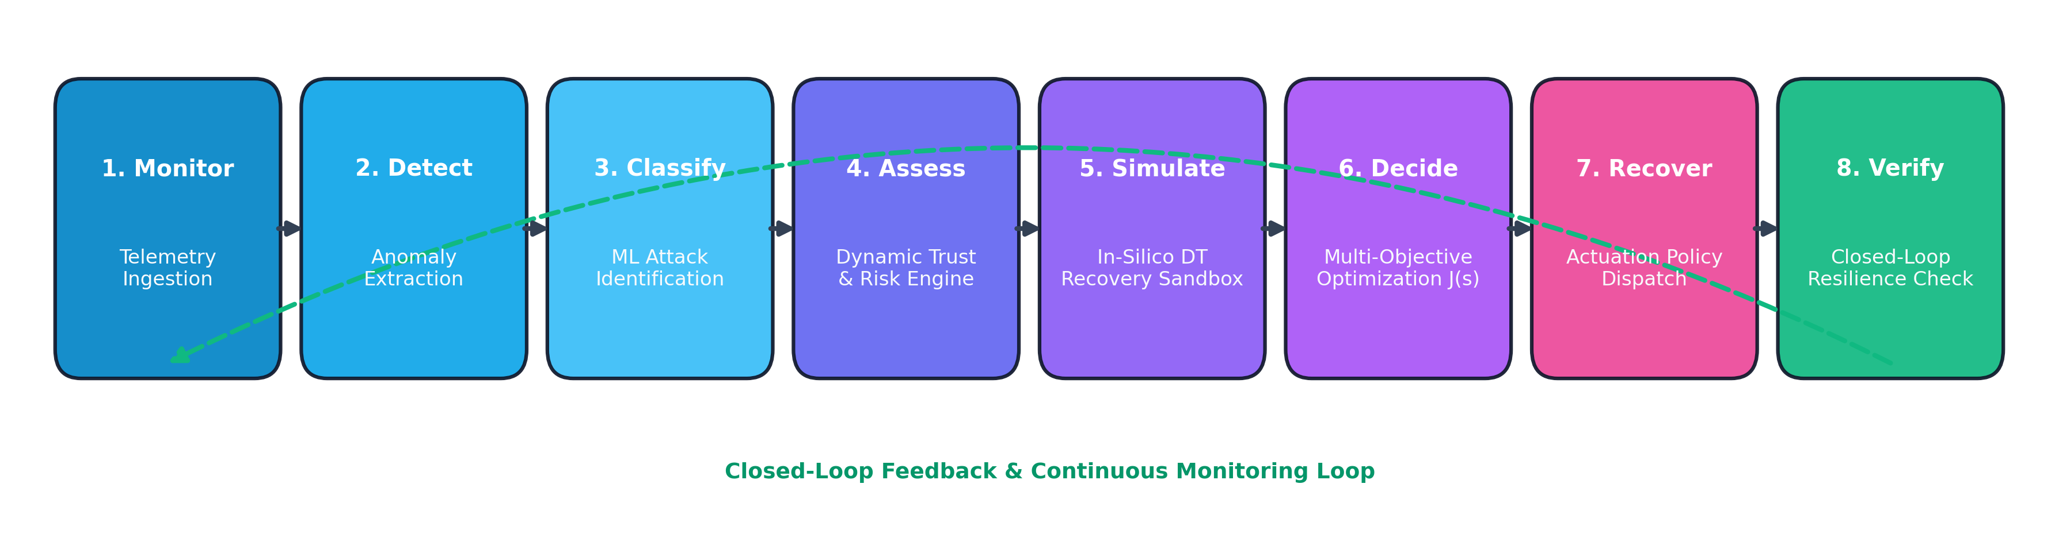
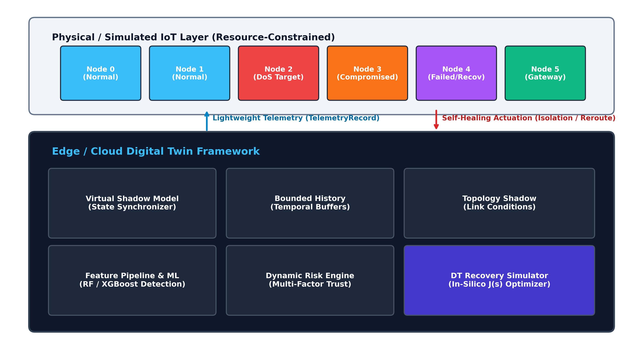
SYSTEM ARCHITECTURE
Global Closed-Loop System Architecture

Slide 5
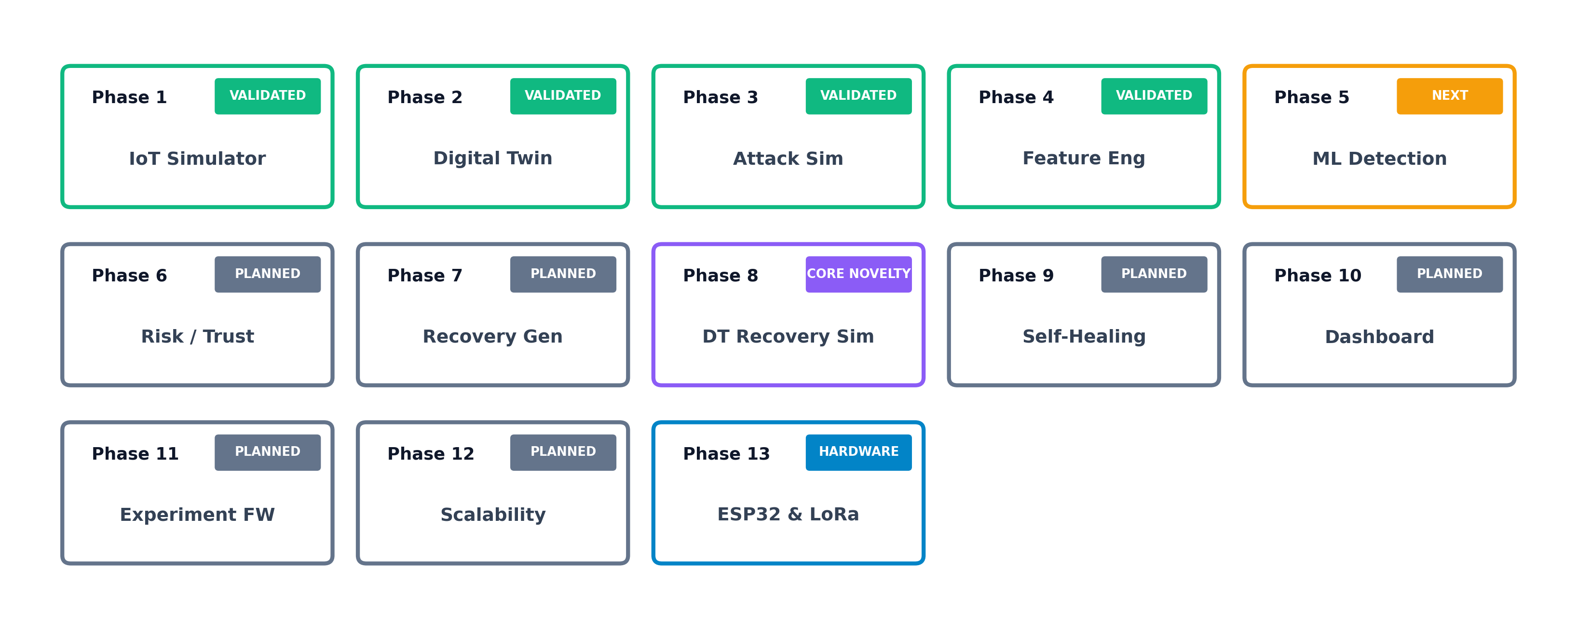
RESEARCH ROADMAP
Complete 13-Phase Incremental Research Progression
Phase Progression & Milestone Governance
• Phases 1–4 (COMPLETED & VALIDATED - 94 Unit Tests Passing):
- Established reproducible network simulator, Digital Twin state synchronizer, 3 threat models, and 95 engineered temporal features.
• Phases 5–9 (CORE INTELLIGENCE & HEALING - Current Stage):
- ML detection (Phase 5), Dynamic trust engine (Phase 6), Candidate generation (Phase 7), In-silico DT simulation (Phase 8), Self-healing (Phase 9).
• Phases 10–13 (VALIDATION, SCALABILITY & HARDWARE):
- Research dashboard (Phase 10), Benchmark ablation framework (Phase 11), Scalability to 100 nodes (Phase 12), Physical ESP32 + LoRa testbed (Phase 13).

Slide 6
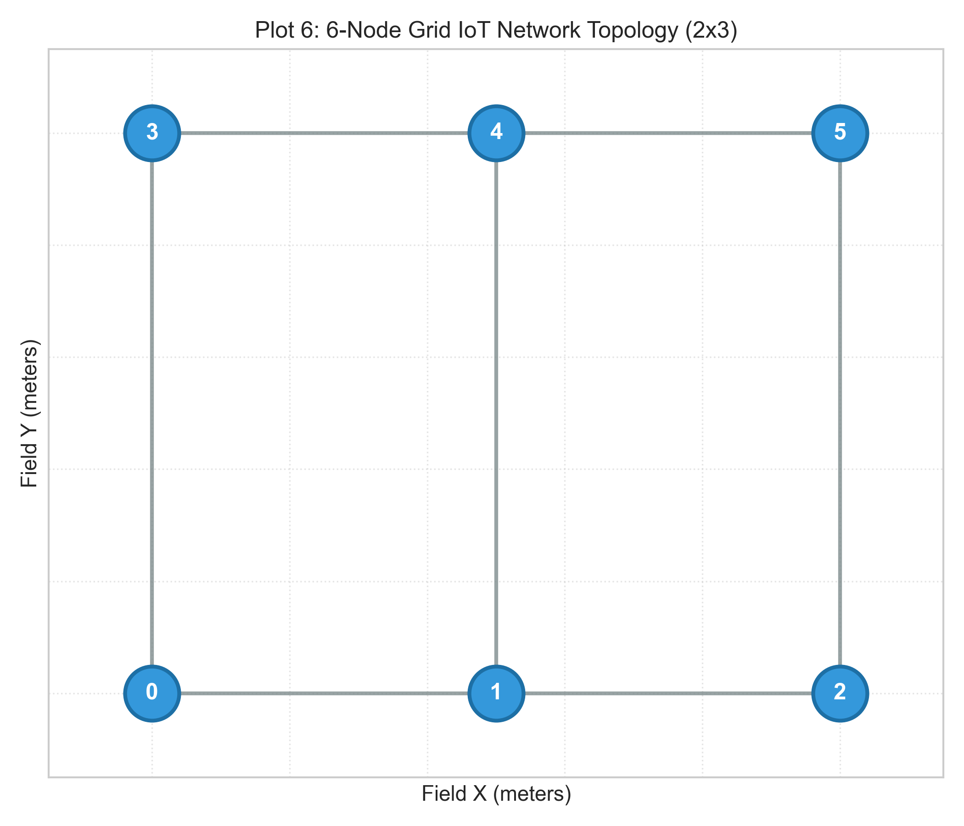
PHASE 1 - COMPLETED & VALIDATED
Phase 1: IoT Network Simulator Implementation
Mathematical & Physics Models (backend/simulation/)
• Wireless Channel Propagation (Log-Distance Path Loss):
RSSI(d) = RSSI_0 - 10 * eta * log10(d / d_0) + X_sigma
eta = 2.8, RSSI_0 = -30 dBm, sigma = 2.0 dB (shadow fading)
• FIFO Buffer Queuing & Drop-Tail Packet Loss:
P_loss = P_buffer_overflow + (1 - P_buffer_overflow) * P_channel_error
Q_max = 50 packets capacity, Sigmoid sensitivity threshold = -100 dBm
• Computational Resource Coupling:
CPU(t) = min(100%, CPU_base + alpha * (lambda_gen + lambda_fwd) + eps_cpu)
RAM(t) = min(100%, RAM_base + (Q_len / Q_max) * 42.5% + beta * N_new)
• Monotonic Battery Depletion Model:
E(t + dt) = E(t) - [P_idle * dt + E_tx * N_tx + E_rx * N_rx]
E_max = 1000 J, P_idle = 15 mW, E_tx = 8 mJ/pkt, E_rx = 4 mJ/pkt

Slide 7
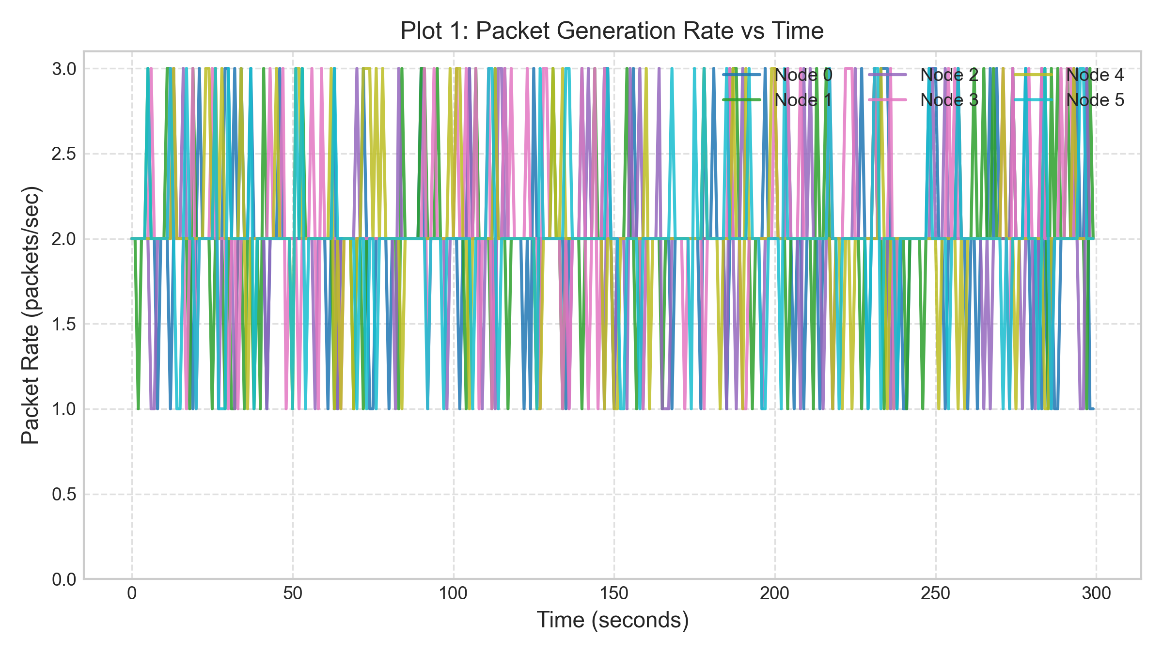
PHASE 1 - COMPLETED & VALIDATED
Phase 1: Baseline Simulation Results & Verification
Baseline Statistics (6 Nodes, 300s, Seed=42)
• Total Records Generated: 1,800 records
• Mean Packet Generation: 2.01 pkts/s (std: 0.45)
• Mean Forwarding Rate: 1.35 pkts/s (std: 1.90)
• Mean Packet Loss Ratio: 0.0246 (2.46% nominal channel loss)
• Mean End-to-End Latency: 28.08 ms (queuing + radio tx)
• Mean RSSI: -81.39 dBm
• Mean CPU Load: 11.05% (std: 3.53%)
• Mean Memory Load: 17.69% (std: 1.59%)
• Mean Remaining Battery: 98.91% (smooth linear discharge)
Validation Status:
✔ 56/56 Unit Tests Passed
✔ Strict Determinism: seed=42 run 1 == run 2 (exact float match)
✔ Scalability: Verified on 6, 10, 20, 50, and 100 nodes across Grid, Random, Mesh, Ring, Star topologies.

Slide 8
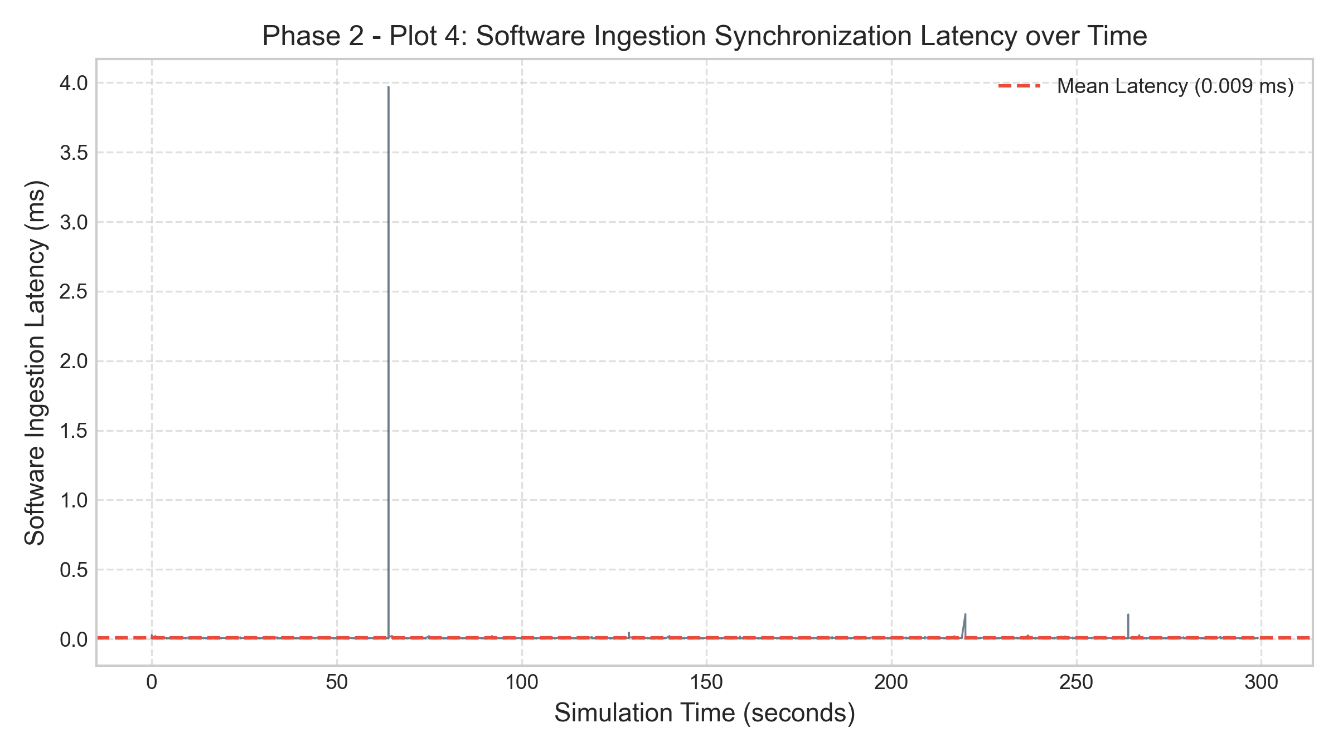
PHASE 2 - COMPLETED & VALIDATED
Phase 2: Digital Twin State Synchronizer & Shadow Model
Digital Twin Architecture (backend/digital_twin/)
• Invariant Telemetry Contract:
Ingests TelemetryRecord directly without schema pollution or hardcoded physical dependencies.
• Virtual Node Shadow Model (TwinNodeState):
Maintains real-time physical, computational, and channel states for every active network node.
• Bounded Temporal History Manager (HistoryManager):
Maintains rolling deques with configurable retention (W = 60s). Automatically prunes expired records to guarantee bounded RAM overhead.
• Topology Shadow Graph (NetworkTopologyModel):
NetworkX-backed dynamic graph tracking directional link states, active adjacency, and connected components.
• Software Synchronization Latency Benchmark:
Mean: 0.0090 ms | Min: 0.0052 ms | Max: 3.9694 ms
Demonstrates sub-millisecond edge software overhead.

Slide 9
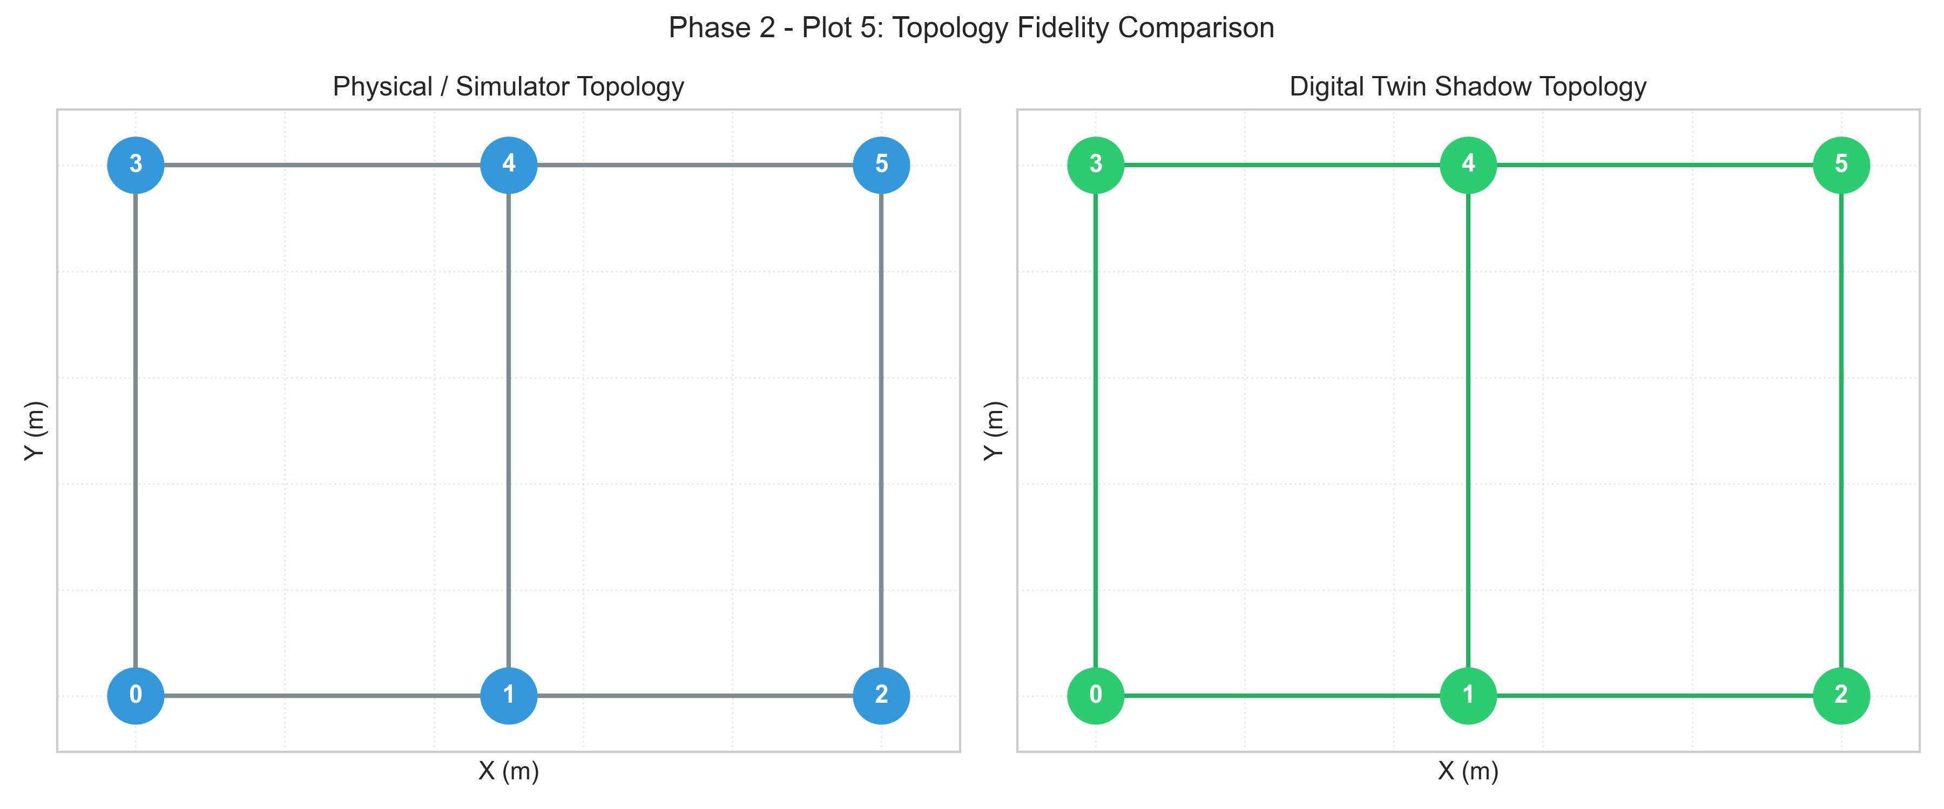
PHASE 2 - COMPLETED & VALIDATED
Phase 2: Digital Twin Fidelity & Health Assessment
Descriptive Network Health
• Deterministic Health Classification:
Strictly metric-driven; avoids arbitrary ML black-box scoring during baseline synchronization.
• Classification Thresholds:
- HEALTHY: Connected ratio >= 0.90, loss < 0.10, and 0 degraded nodes.
- DEGRADED: Connected ratio >= 0.50 and loss < 0.40.
- CRITICAL: Connected ratio < 0.50 or loss >= 0.40.
• State Fidelity Verification:
- 68/68 Tests Passing.
- Exact float-level match between simulator telemetry and Digital Twin query API.
- Disconnected nodes naturally sever incident edges in the virtual shadow graph.

Slide 10
PHASE 3 - COMPLETED & VALIDATED
Phase 3: Controlled Cyberattack Injection Framework
DoS / Packet Flooding
backend/attacks/dos.py
Floods target node buffer with surge traffic (intensity = 20 pkts/s).
Physical Propagation:
• Queue saturation (Q_len -> 50)
• Drop-tail buffer packet loss
• CPU load surges (11% -> 49%)
• Latency surges (28ms -> 91ms)
• Accelerated battery drain
Compromised Node
backend/attacks/compromised_node.py
Simulates internal malicious gray-hole selectively dropping forwarded packets.
Physical Propagation:
• Binomial drop probability p = 0.50
• Downstream throughput suppressed
• Observed packet loss: 2.65% -> 51.32%
• Matches intensity with binomial variance
Node Failure / Outage
backend/attacks/node_failure.py
Simulates transceiver failure, power loss, or processor crash.
Physical Propagation:
• State -> DISCONNECTED
• Ceases transmission & forwarding
• Network availability: 1.0 -> 0.833
• Clean reboot post-attack if energy > 0

Slide 11
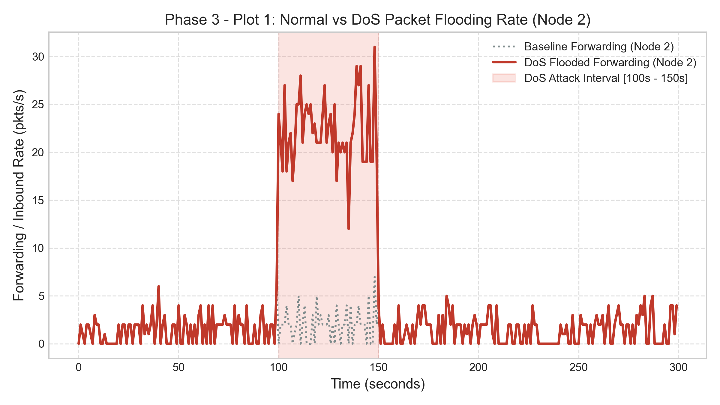
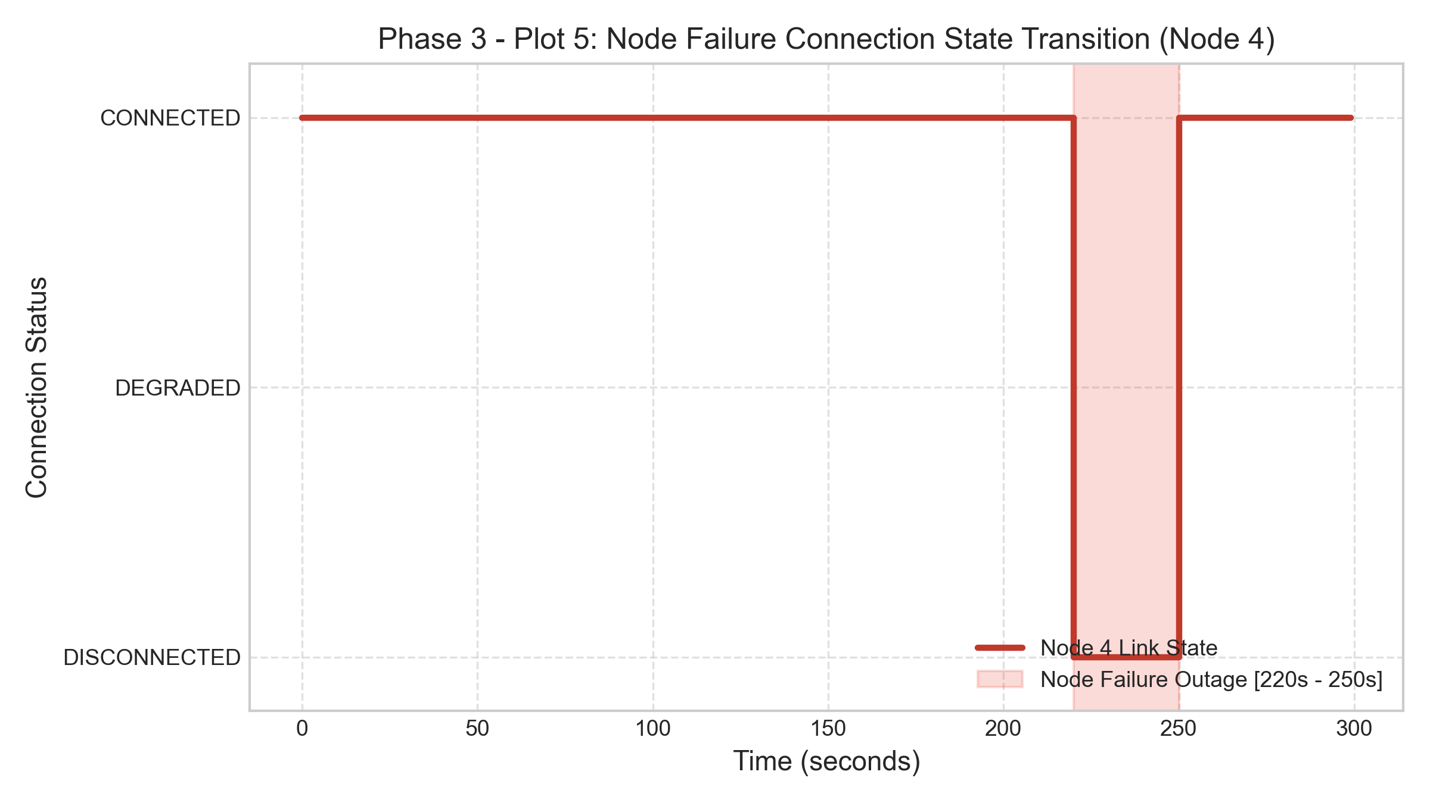
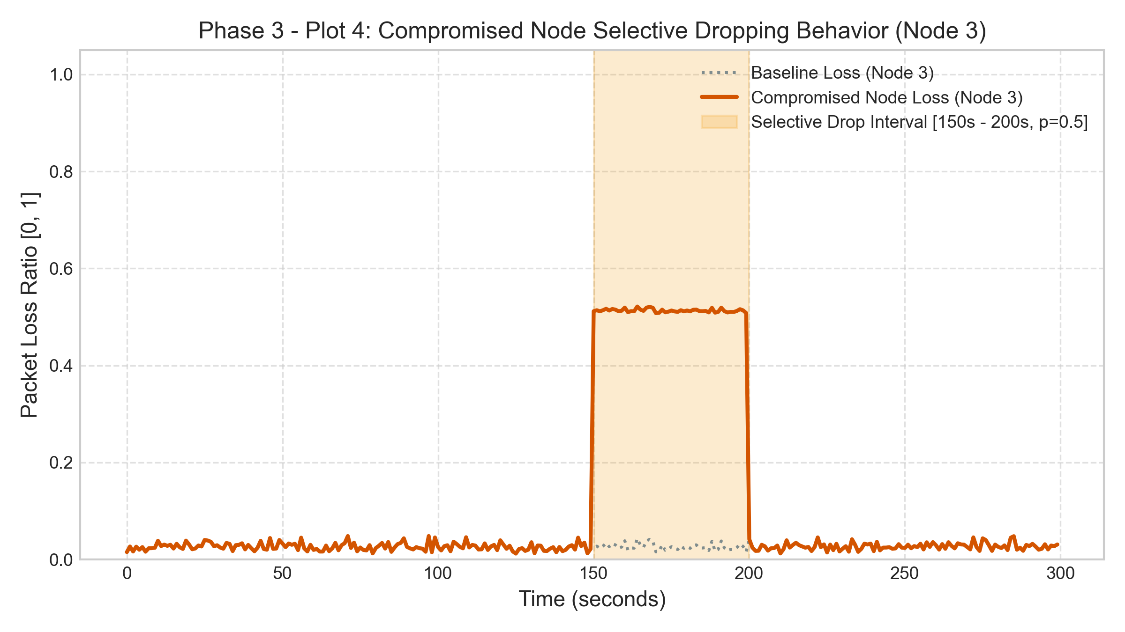
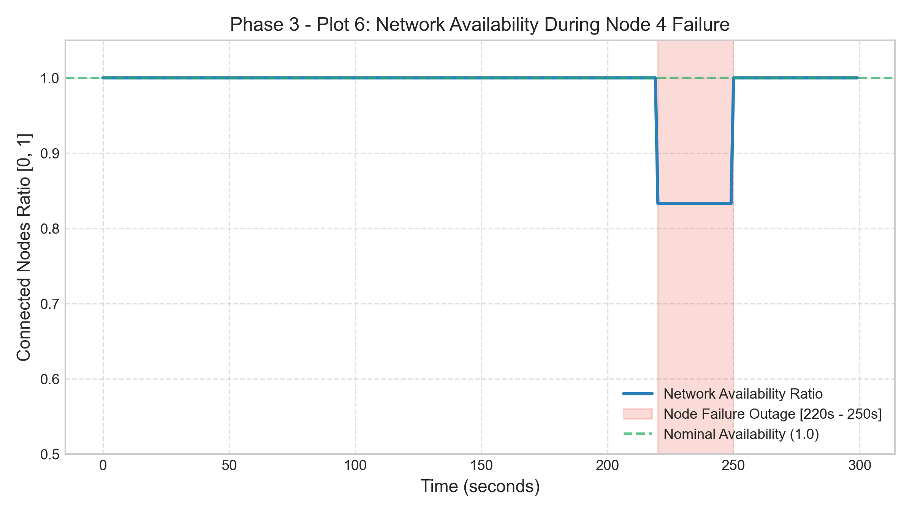
PHASE 3 - COMPLETED & VALIDATED
Phase 3: Observable Attack Effects & Non-Interference

Slide 12
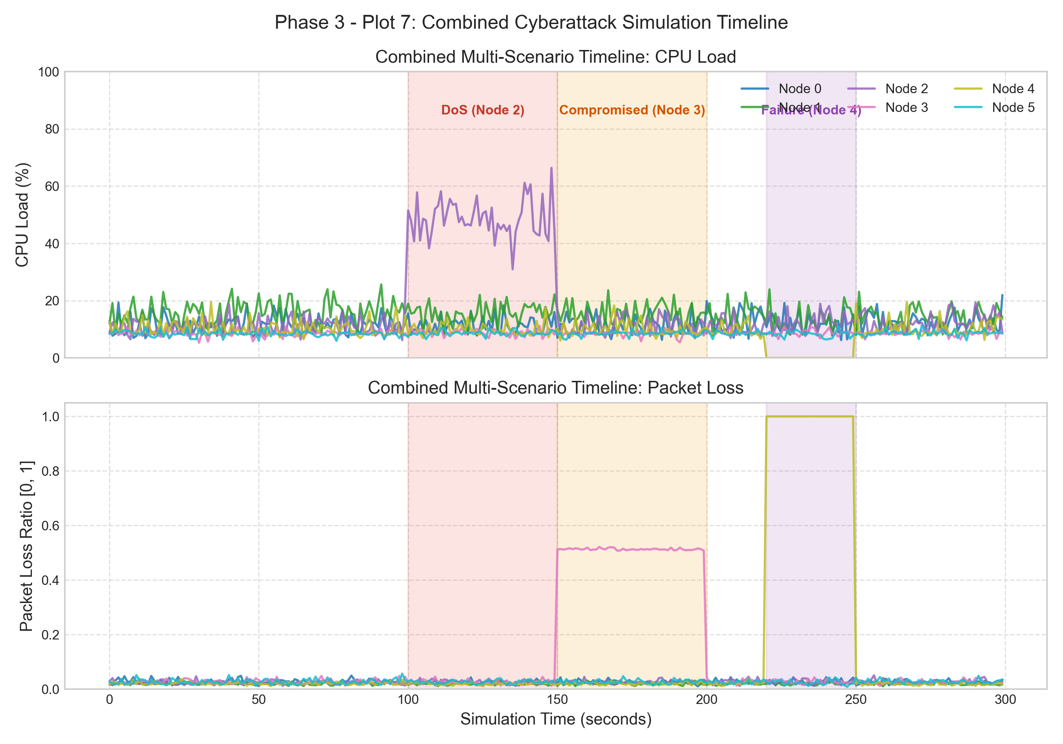
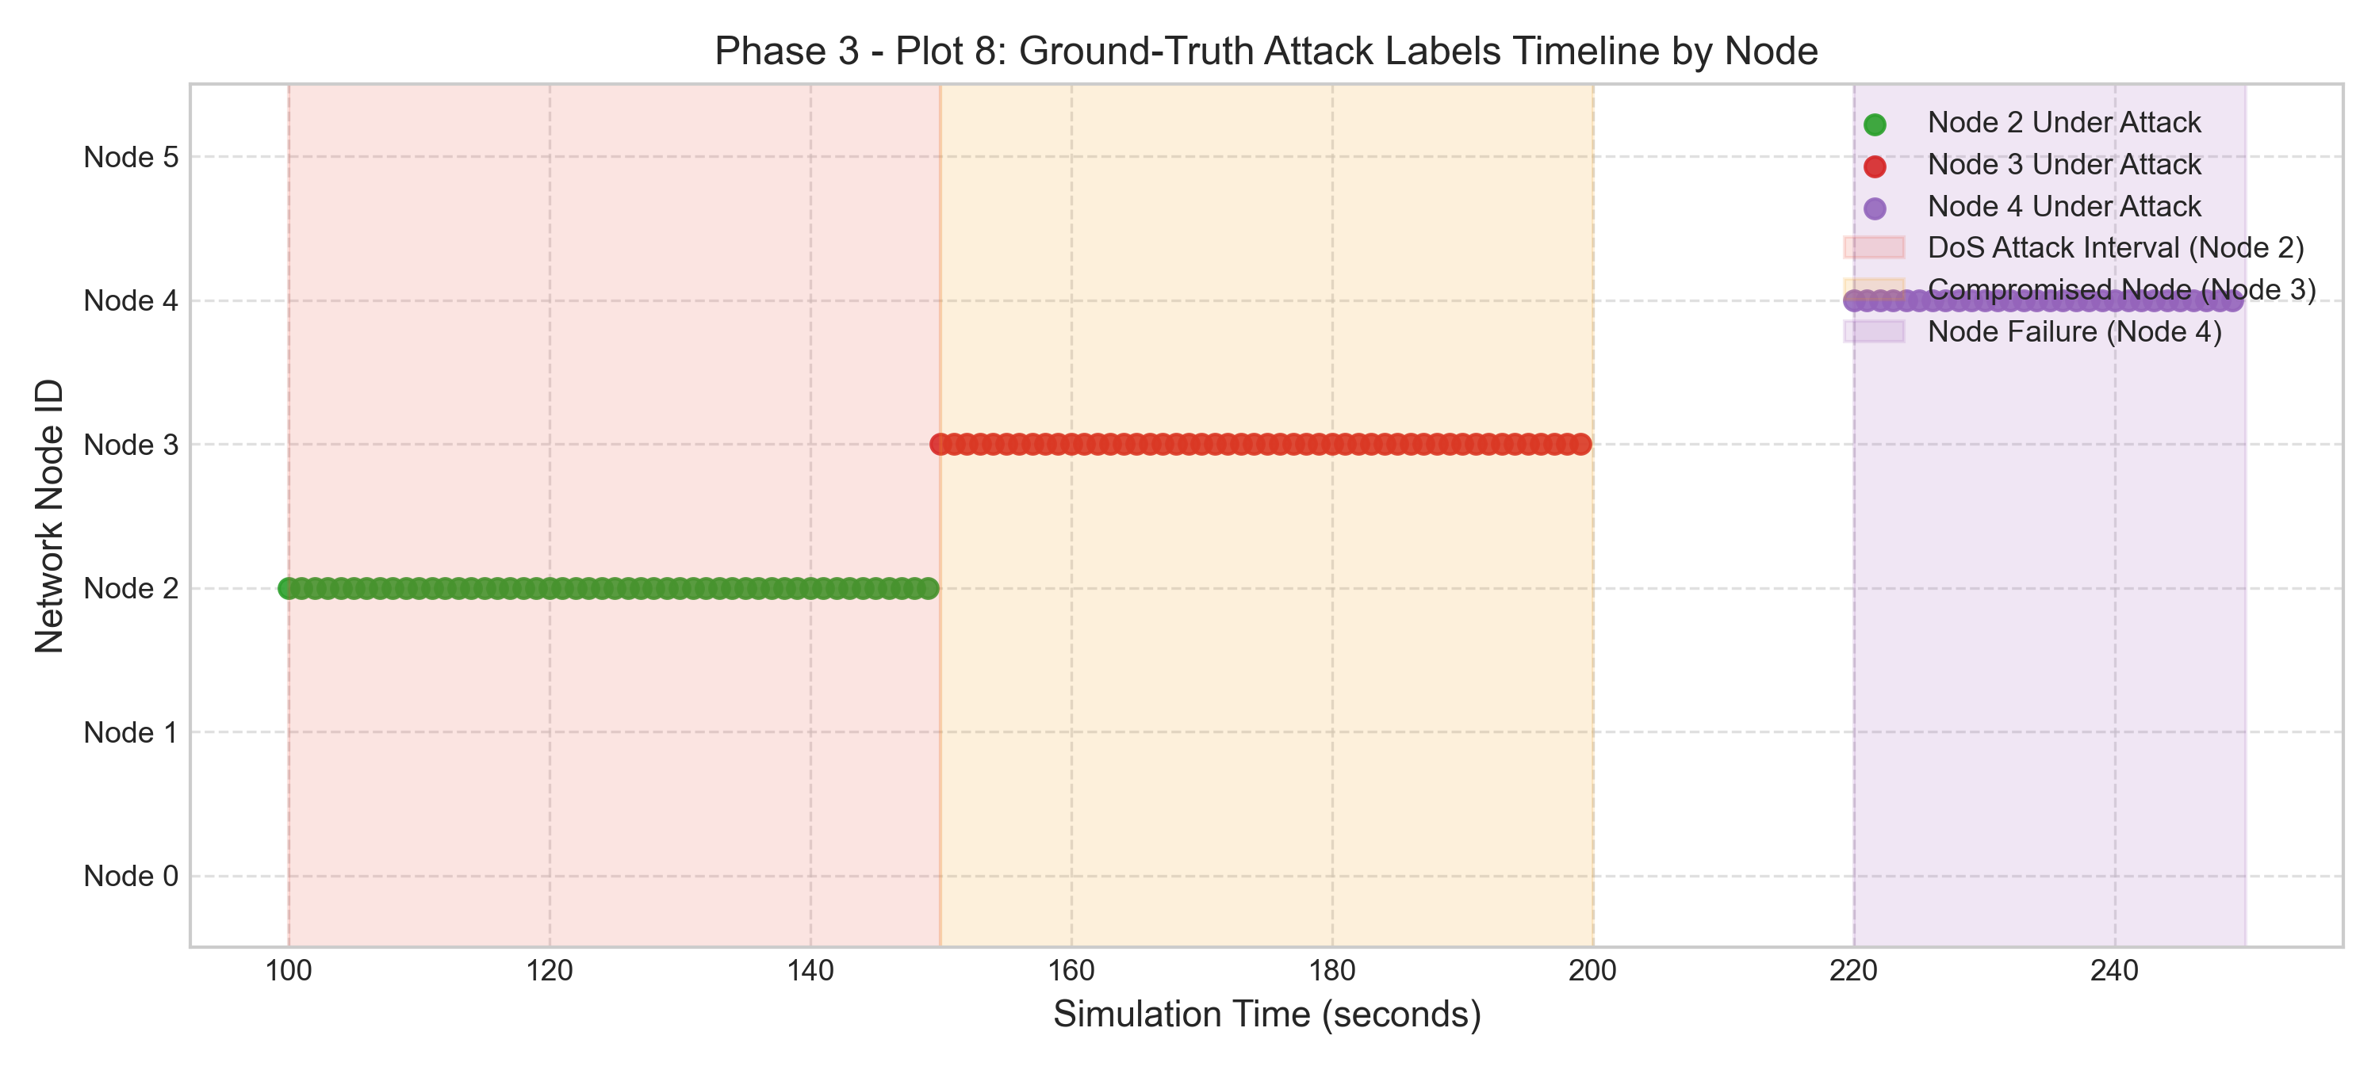
PHASE 3 - COMPLETED & VALIDATED
Phase 3: Multi-Scenario Combined Attack Timeline

Slide 13
PHASE 4 - COMPLETED & VALIDATED
Phase 4: Dataset & Feature Engineering Architecture
Multi-Scale Temporal Windows
Rolling Stats: W = 5s, 15s, 30s
Computed per node for 6 core metrics:
• Rolling Mean (mu_W)
• Rolling Std (sigma_W)
• Rolling Min & Max (min_W, max_W)
Rationale: W=5s isolates sudden bursts (DoS); W=30s isolates slow battery drain & gray-hole drops.
Rate-of-Change Derivatives
Temporal Acceleration
First-order derivatives (dx/dt):
• delta_packet_rate / dt
• delta_forwarding_rate / dt
• delta_cpu / dt
• delta_latency / dt
• energy_drain_rate = -dE/dt
Instantly catches explosive inflection points.
Domain Context Ratios
Physical Interaction Features
Engineered IoT domain features:
• Forwarding Ratio:
N_fwd / (N_gen + N_fwd + 1e-6)
• Congestion Index:
Latency / max(1, |RSSI|)
• Traffic-to-CPU Ratio:
Total Traffic / max(1, CPU)
Spatial Discrepancy
Macro Network Baseline
Deviations from instantaneous network average at timestamp t:
• cpu_network_discrepancy
• loss_network_discrepancy
• latency_network_discrepancy
Isolates anomalous node behavior from general network load.

Slide 14
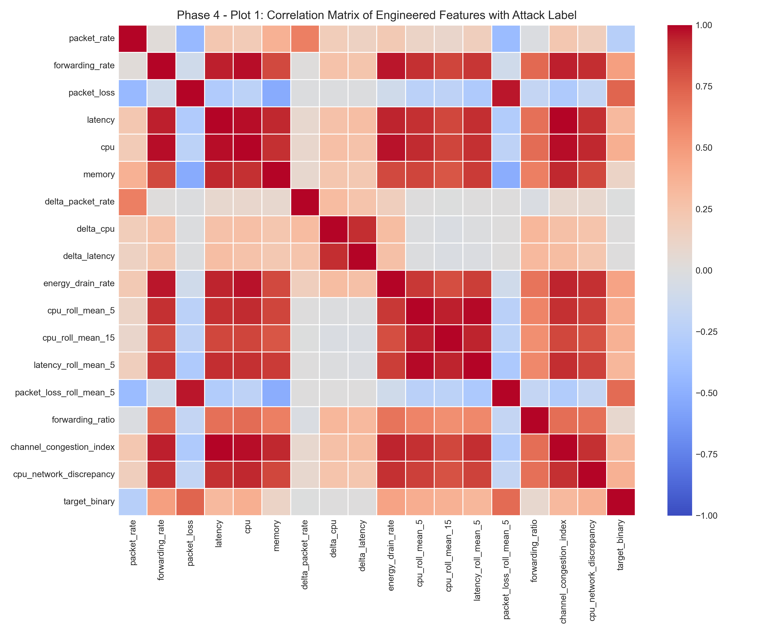
PHASE 4 - COMPLETED & VALIDATED
Phase 4: Data Leakage Safeguards & Partition Integrity
Strict Data Leakage Prevention Protocols
• Strict Causal Backward-Looking Windows:
Rolling features use strictly backward windows ([t - W, t], closed='right').
Proven by test_zero_future_leakage: changing future data at t=40s causes ZERO change to feature vectors at t <= 30s.
• Train-Only Scaler Parameter Fitting:
Z-score parameters (means mu, stds sigma) are fitted STRICTLY on the training split (t <= 209s) and frozen in feature_metadata.json.
• Dataset Partitioning (models/datasets/):
- Training Set: 1,260 records (70%, t <= 209s)
- Validation Set: 270 records (15%, 210s < t <= 254s)
- Chronological Test Set: 270 records (15%, t >= 255s)
- Cross-Seed Test Set: 1,800 records (Seed 43, Attack Seed 2001) for out-of-sample stochastic generalization.

Slide 15
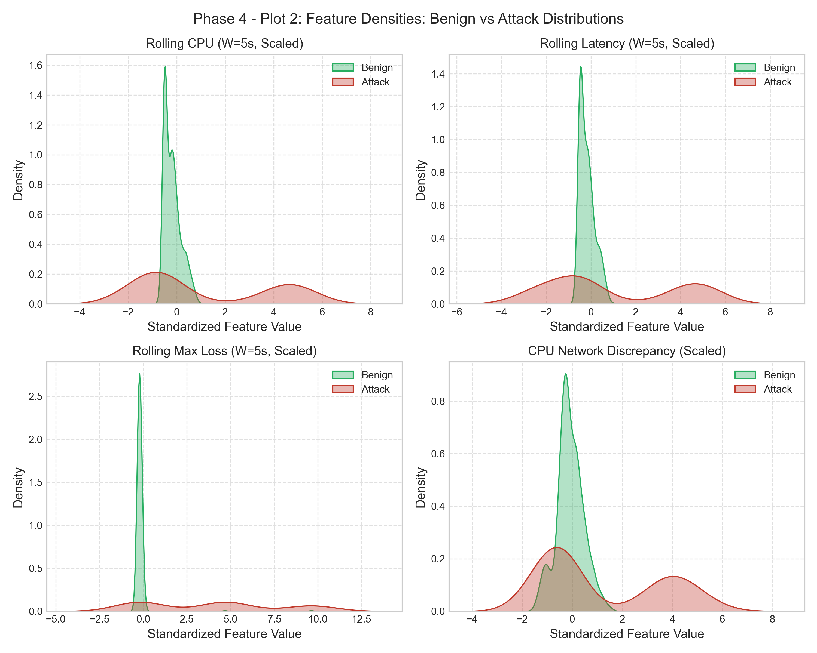
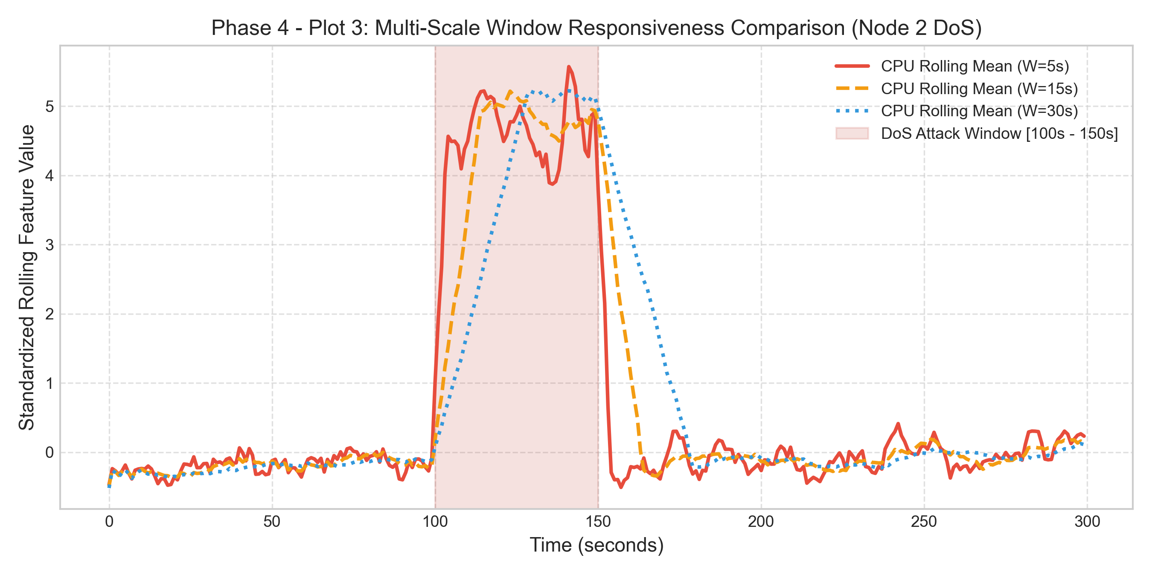
PHASE 4 - COMPLETED & VALIDATED
Phase 4: Feature Responsiveness & Statistical Separability

Slide 16
PHASE 5 - READY TO COMMENCE
Phase 5 (Next Stage): Machine Learning Attack Detection Engine
Model Selection Strategy (backend/detection/)
• Model Hierarchy (Interpretable Baselines First):
1. Regularized Logistic Regression: Linear benchmark, L1/L2 penalty for feature sparsity.
2. Random Forest Classifier: Robust non-linear tree ensemble; captures feature interactions.
3. XGBoost / LightGBM: State-of-the-art gradient boosting for tabular telemetry; handles class imbalance via scale_pos_weight.
• Dual Target Classification Tasks:
- Binary Detection: Benign vs Attack (target_binary).
- Multi-Class Identification: Normal, DoS, Compromised, Node Failure (target_multiclass).
• Zero-Day Anomaly Detection (Secondary):
Isolation Forest / Autoencoder trained strictly on benign baseline to flag unmodeled zero-day anomalies.
Academic Evaluation Metrics
• Rigorous Classification Metrics:
- Precision, Recall, Macro/Weighted F1-Score
- ROC-AUC & Precision-Recall AUC (PR-AUC)
- False Positive Rate (FPR) & False Negative Rate (FNR)
• Real-Time Operational Performance:
- Inference Latency per sample (microseconds)
- Detection Delay (timesteps from attack onset to alarm)
- Model memory footprint (KB, evaluating TinyML edge gateway viability)
• Generalization Validation Gate:
- Evaluation on Chronological Test Split
- Evaluation on Independent Cross-Seed Test Set (Seed 43)
- Export calibrated posterior probabilities P(Attack | x) to feed Phase 6 Trust Engine.

Slide 17
PHASE 6 - PLANNED
Phase 6: Dynamic Risk & Node Trust Assessment Engine
Multi-Factor Behavioral Trust Formulation
Trust Score for Node i at time t:
T_i(t) = w_fwd * T_fwd(i, t) + w_nrg * T_nrg(i, t) +
w_loss * T_loss(i, t) + w_ml * (1 - P_attack(i, t))
Where:
• T_fwd: Forwarding Consistency Trust
Ratio of observed forwarded packets to expected transit packets.
• T_nrg: Energy Depletion Trust
Divergence between theoretical power model and observed drain.
• T_loss: Channel-Consistent Loss Trust
Penalizes loss ratios exceeding physical log-distance expectations.
• P_attack: Calibrated ML posterior attack probability from Phase 5.
Weights constraint: w_fwd + w_nrg + w_loss + w_ml = 1.0
Trust Decay, Penalty & Recovery Dynamics
• Asymmetric Penalty vs Recovery:
- Swift Penalty: Exponential trust decay upon detected malicious activity:
T(t) = T(t-1) * exp(-lambda_penalty * severity)
- Cautious Recovery: Slow logarithmic reinstatement post-attack to prevent on-off strategic attackers.
• Rigorous Sensitivity Analysis Protocol:
Systematically sweep weights (w_fwd, w_nrg, w_loss, w_ml) across a Dirichlet simplex grid to eliminate arbitrary heuristic bias.
• Threshold Integration with Phase 7:
- Nominal: T > 0.75 (Fully Trusted)
- Suspicious: 0.40 <= T <= 0.75 (Candidate for Rate Limiting / Reroute)
- Malicious: T < 0.40 (Triggers In-Silico Recovery Simulation)

Slide 18
PHASE 7 - PLANNED
Phase 7: Candidate Recovery Strategy Taxonomy
STRATEGY 1: Node Isolation
Total Link Quarantine
Completely sever all incident logical edges to target node.
Pros:
• 100% containment of malicious traffic.
Risks:
• Risk of graph partition / unreachable nodes.
STRATEGY 2: Dynamic Rerouting
Topology Bypass
Recompute shortest paths penalizing low-trust nodes without cutting them off.
Pros:
• Preserves global network reachability.
Risks:
• Path stretch (higher latency on detour).
STRATEGY 3: Ingress Rate Limiting
Traffic Throttling
Impose token-bucket rate limiting on suspicious ingress buffers.
Pros:
• Neutralizes DoS buffer overflow.
Risks:
• Legitimate burst traffic dropped if false positive.
STRATEGY 4: Soft Reboot / Rollback
State Reset & Power Boost
Command remote firmware soft-reset or transceiver TX power boost.
Pros:
• Recovers crashed nodes / overcomes jamming.
Risks:
• Transient reboot blackout delay (~5s).

Slide 19
PHASE 8 - CORE RESEARCH NOVELTY
Phase 8: In-Silico Recovery Simulation & Optimization (Core Contribution)
The In-Silico Predictive Sandbox
Why This is the Core Novelty:
Most IoT security papers apply fixed heuristic mitigations (e.g. always isolate). In multi-hop mesh IoT networks, isolating a critical forwarder causes severe collateral partition.
The Digital Twin Pre-Evaluation Workflow:
1. Virtual State Cloned: Current Digital Twin state S(t) is cloned into temporary virtual sandboxes S_sandbox(k).
2. Candidate Strategies Applied: In each sandbox, a distinct candidate strategy s_k from Phase 7 is executed.
3. Lookahead Simulation: The Digital Twin forward-simulates network dynamics for horizon H in [10s, 30s, 60s].
4. Consequences Estimated:
- Projected packet loss delta
- Projected latency path stretch
- Projected battery depletion on reroute hops
- Graph connectivity & partition verification.
Multi-Objective Cost Optimization J(s)
Optimal Strategy Selection Formulation:
s* = argmin_{s_k in S} J(s_k)
Where Cost Function J(s_k) is:
J(s_k) = w_1 * (Delta_Latency / Latency_base) +
w_2 * Delta_Loss +
w_3 * (Delta_Energy / Energy_base) +
w_4 * Signaling_Overhead(s_k)
Subject to Hard Constraints:
• Network must remain connected: Connected_Components(G) == 1
• Projected packet delivery ratio > PDR_min (e.g. 0.90)
• No routing loops: nx.is_directed_acyclic_graph(Routes) == True
Guarantees that the chosen self-healing action is mathematically optimal and provably safe.

Slide 20
PHASE 9 - PLANNED
Phase 9: Autonomous Self-Healing & Closed-Loop Verification
Closed-Loop Actuation Dispatch
• Actuation Policy Dispatcher:
Translates optimal strategy s* into compact downlink actuation frames:
- Reroute commands to 1-hop routing neighbors.
- Ingress rate-limit tokens to suspicious nodes.
- Downlink reboot triggers to failed/compromised nodes.
• Closed-Loop Verification Loop:
Following actuation, the Digital Twin monitors incoming telemetry:
1. Has packet loss dropped back to baseline (P_loss < 0.05)?
2. Has CPU utilization stabilized to nominal (< 15%)?
3. Has network reachability been preserved (100% active nodes connected)?
• Fallback Mechanism:
If verification fails within timeout T_verify, rollback to conservative safe policy.
Resilience & Recovery Metrics
• Mean Time to Detect (MTTD):
MTTD = t_detect - t_attack_start
(Quantifies ML temporal responsiveness)
• Mean Time to Recover (MTTR):
MTTR = t_restored - t_detect
(Quantifies DT simulation + actuation delay)
• Quantitative Resilience Score (R):
Integral of Quality of Service recovery trajectory:
R = [Integral_{t0}^{t0+T} QoS(t) dt] / [QoS_nominal * T]
Where QoS(t) is defined as Packet Delivery Ratio (PDR) or Network Availability.
R = 1.0 indicates instantaneous, loss-free self-healing resilience.

Slide 21
PHASES 10 & 11 - PLANNED
Phases 10 & 11: Dashboard & Comparative Baseline Framework
Phase 10: Research Monitoring Dashboard
• Interactive Visual Telemetry (Streamlit / Plotly):
Academic visualization suite for live paper demonstrations.
• Live Visual Components:
1. Real-Time Network Topology Map: Node status color-coded by connection and trust score.
2. Live Streaming Telemetry: Sliding time-series throughput, loss, latency, and CPU.
3. Physical vs Virtual Shadow Fidelity: Direct side-by-side comparison of physical node and Digital Twin state.
4. Attack Injection Control Panel: Manual trigger for DoS, compromised drop, or node failure.
5. Self-Healing Decision Audit Log: Explaining why candidate strategy s* was selected by J(s).
Phase 11: Comparative Experimental Baselines
Rigorous Evaluation Against 4 Baselines:
• Baseline 1: No Detection / No Recovery
(Raw unmitigated attack degradation)
• Baseline 2: Static Threshold + Fixed Isolation
(Traditional rule-based IDS; naive isolation)
• Baseline 3: ML Detection + Fixed Recovery
(ML detection without DT pre-simulation)
• Proposed Framework: ML Detection + Dynamic Trust + In-Silico DT Recovery Simulation + Autonomous Self-Healing
Ablation Studies:
• Sensitivity to lookahead horizon H (10s vs 30s vs 60s)
• Sensitivity to cost weights w_1, w_2, w_3, w_4
• Resilience under lossy telemetry channels.

Slide 22
PHASES 12 & 13 - PLANNED
Phases 12 & 13: Scalability & Physical Hardware Validation
Phase 12: Scalability & Stress Testing
• Systematic Node Scaling:
N in {6, 10, 20, 50, 100} nodes.
• Variable Traffic & Attack Intensities:
- Nominal traffic: 2 pkts/s -> Extreme stress: 20 pkts/s.
- Multi-attacker scenarios: 1 to 5 compromised nodes.
• System Overhead Profiling:
- Ingestion throughput (records/sec).
- Digital Twin server CPU & RAM consumption.
- Optimization solving time as a function of network size.
- Packet delivery ratio vs network density.
Phase 13: Physical ESP32 + LoRa Testbed
• Hardware Configuration:
4–6 ESP32 microcontrollers (Tensilica Xtensa LX6, 240MHz, 520KB SRAM) equipped with SX1276 LoRa transceivers.
• Gateway Bridge Architecture:
- Physical LoRa gateway receives RF telemetry packets.
- Serial / MQTT bridge converts binary payload into invariant TelemetryRecord JSON stream.
• Seamless Sim-to-Real Transfer:
The Digital Twin, ML detection engine, and recovery optimizer run UNCHANGED on the edge server.
• Physical Actuation Verification:
LoRa downlink command triggers dynamic route table reconfig or deep sleep power state on real ESP32.

Slide 23
RESEARCH GOVERNANCE
Scientific Rigor, Verification Summary & Publication Targets
Automated Test Suite (94 Tests PASS)
• Test Coverage Breakdown:
- tests/test_node.py (5 tests): Energy decay, CPU scaling, bounds.
- tests/test_topology.py (28 tests): Grid, mesh, random, symmetry.
- tests/test_telemetry.py (18 tests): Out-of-bounds rejection.
- tests/test_simulator.py (5 tests): Determinism & progression.
- tests/test_digital_twin.py (10 tests): History eviction, shadow.
- tests/test_attacks.py (17 tests): Boundaries, DoS, drop, non-interference.
- tests/test_phase2_integration.py (2 tests): End-to-end sync.
- tests/test_phase3_integration.py (2 tests): Multi-attack fidelity.
- tests/test_feature_engineering.py (7 tests): Causal non-leakage.
• Scientific Integrity Principles:
- Zero fabricated results; all metrics empirically executed.
- Explicit distinction between software execution time and wireless latency.
Target Flagship Publication Venues
Primary Journal Targets (Q1 / Top Tier):
• IEEE Internet of Things Journal (IEEE IoT-J)
- Focus: Digital Twin telemetry, ML anomaly detection, LoRa evaluation.
• IEEE Transactions on Industrial Informatics (IEEE TII)
- Focus: Autonomous resilience, self-healing closed-loop control.
• Elsevier Computer Networks / JNCA
- Focus: Scalable IoT network simulation and multi-objective optimization.
Target Conference Tracks:
• IEEE INFOCOM / GLOBECOM / ICC
- Focus: Real-time Digital Twin state synchronization and in-silico mitigation.

Slide 24
SUMMARY & IMMEDIATE NEXT STEPS
Solid Foundation Established across Phases 1 to 4
• Complete reproducibility established: 94 unit and integration tests passing.
• Physics-coupled IoT network simulation engine operational.
• Sub-millisecond Digital Twin virtual shadow synchronization verified.
• Multi-vector attack injection (DoS, selective drop, node failure) validated.
• 95 multi-scale temporal and spatial features extracted with zero data leakage.
IMMEDIATE ACTION (PHASE 5):
Ready to implement the Machine Learning Detection Engine:
• Train interpretable baselines (Logistic Regression, Random Forest, XGBoost).
• Benchmark accuracy, F1, ROC-AUC, FPR, FNR, and inference latency.
• Evaluate generalization on chronological and cross-seed test splits.

