Slide 1
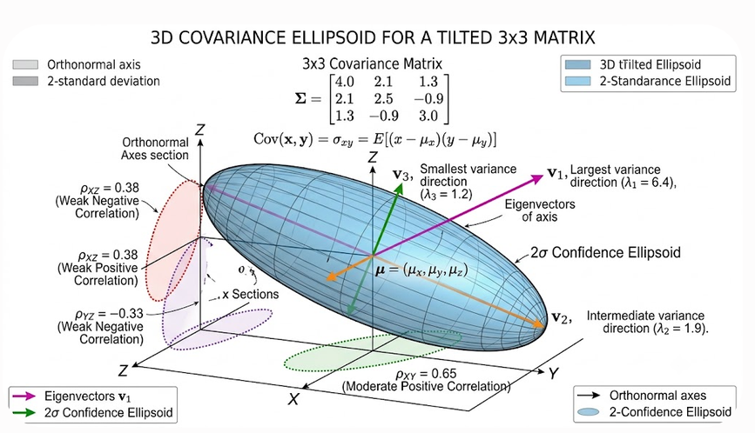
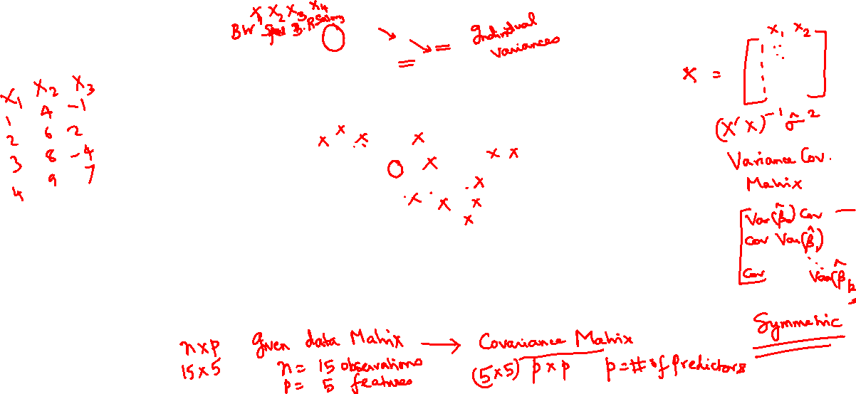
Demonstration of Variance-Covariance Principles

Slide 2
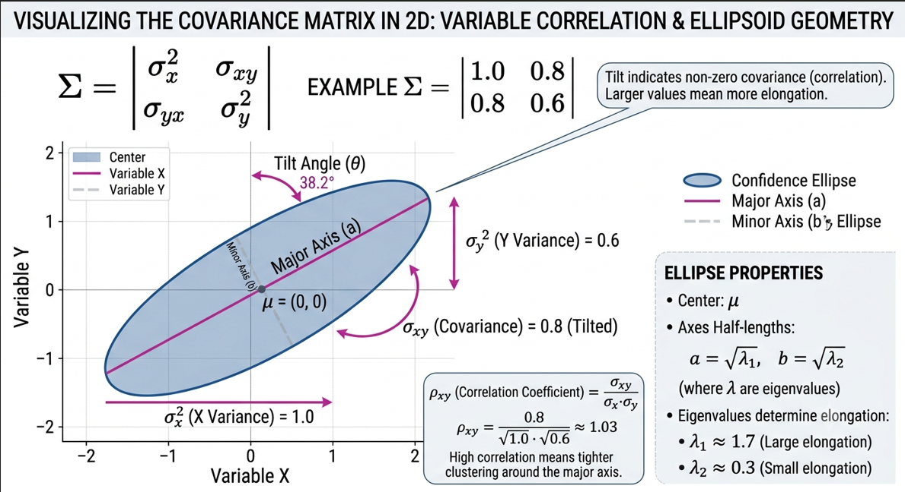
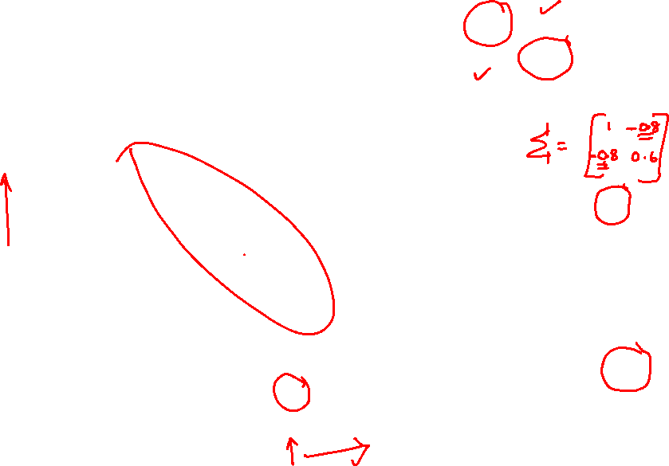
Demonstration of Variance-Covariance Principles

Slide 3
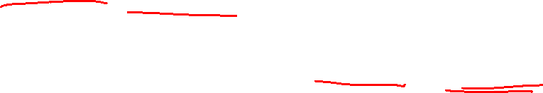
Demonstration of Variance-Covariance Principles
Maiti J, Multivariate Statistical Modeling in Engineering and Management, CRC Press, 2023.
Johnson, R. A., Wishern, D. W., Applied Multivariate Statistical Analysis, sixth ed., Pearson, 2024.

Slide 4
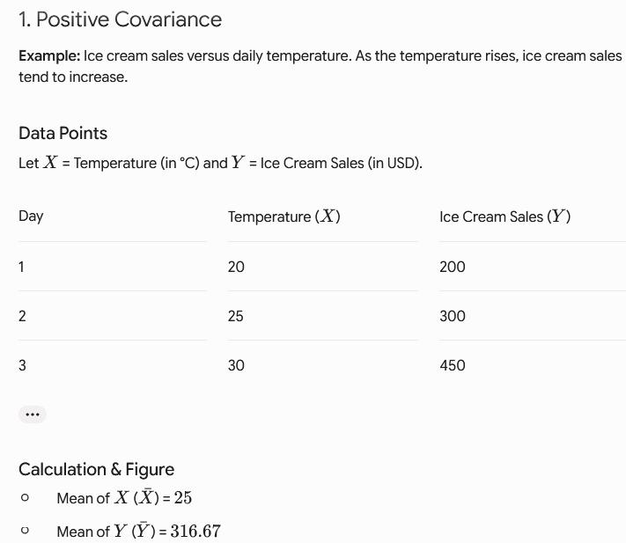
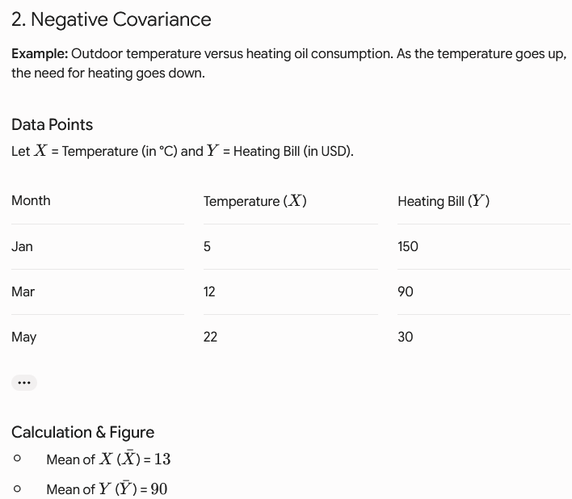
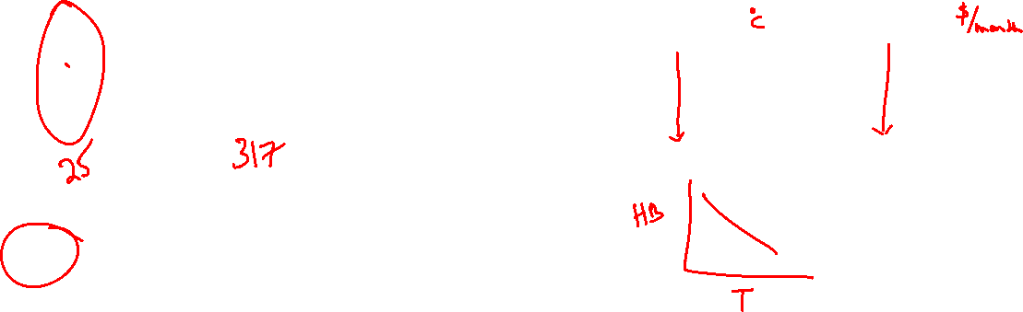

Slide 5
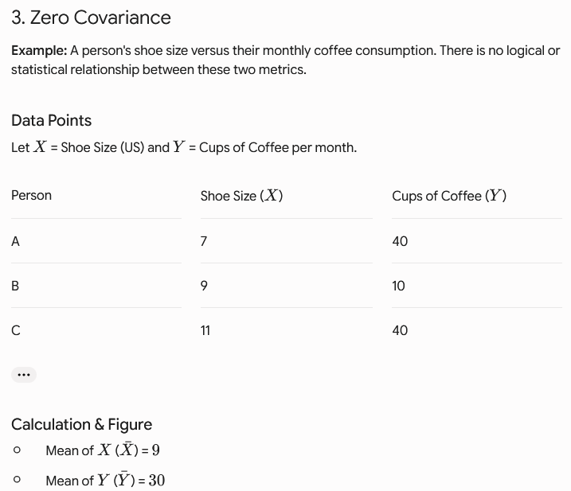
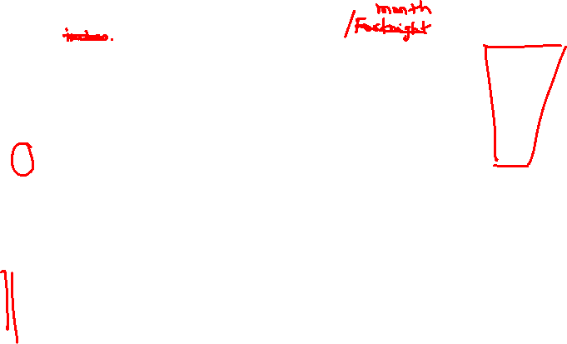

Slide 6
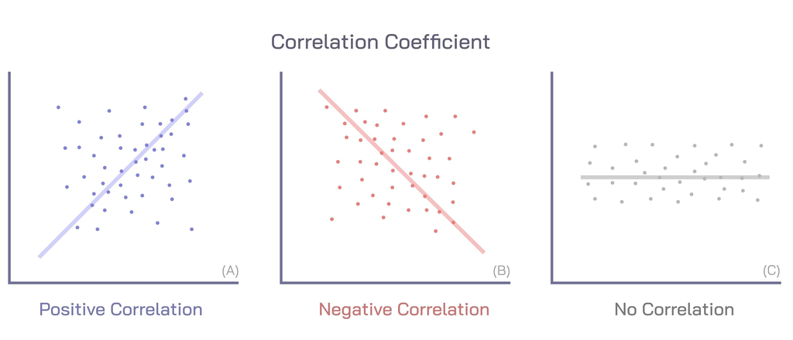
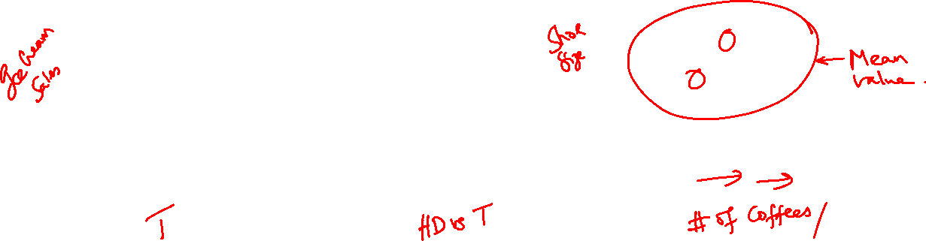
Source: Shuttercock

Slide 7

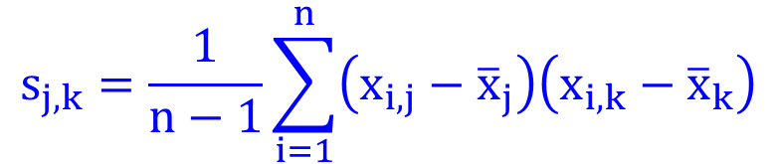
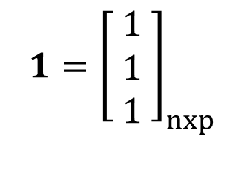

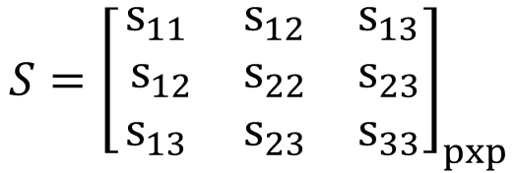
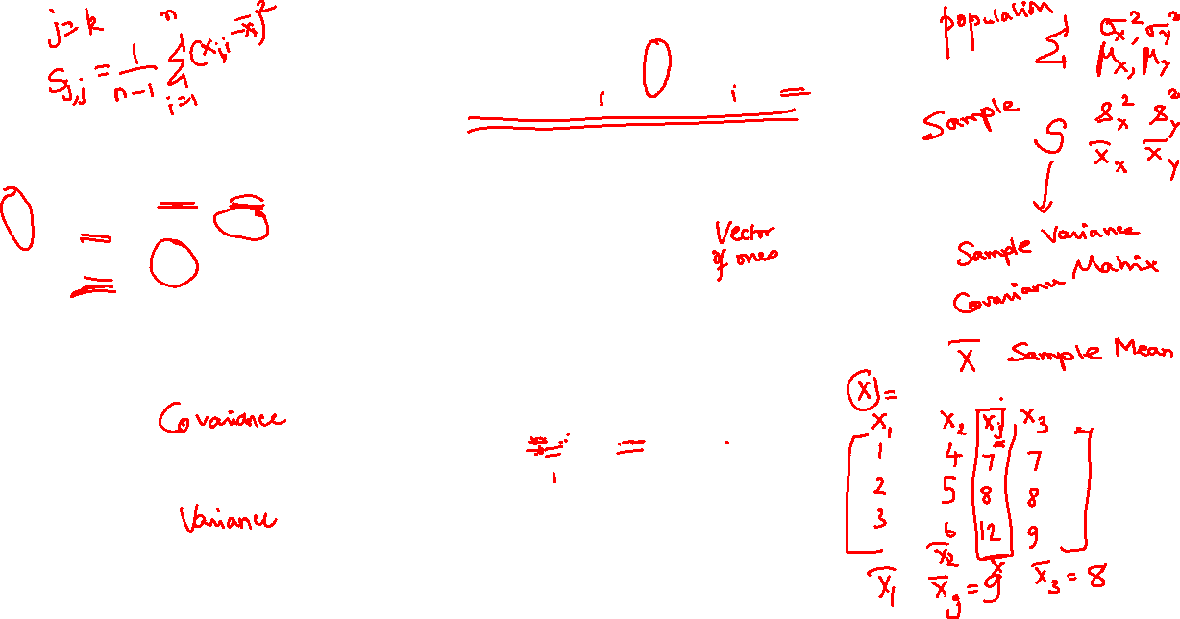

What is an S matrix? Covariance
$$s_{j,k}=\frac{1}{n−1}\sum_{i=1}^{n}{\left(x_{i,j}−{\overline{x}}_{j}\right)\left(x_{i,k}−{\overline{x}}_{k}\right)}$$
$$x_{j}={\left[\begin{matrix}x_{1j} \\ x_{2j} \\ x_{3j}\end{matrix}\right]}_{nxp}$$
$$1={\left[\begin{matrix}1 \\ 1 \\ 1\end{matrix}\right]}_{nxp}$$
$$S={\left[\begin{matrix}s_{11} & s_{12} & s_{13} \\ s_{12} & s_{22} & s_{23} \\ s_{13} & s_{23} & s_{33}\end{matrix}\right]}_{pxp}$$
In matrix form
$$s_{j,k}=\frac{1}{n−1}{\left(x_{j}−1{\overline{x}}_{j}\right)}^{T}\left(x_{k}−1{\overline{x}}_{k}\right)$$
$$s_{j,j}=\frac{1}{n−1}{\left(x_{j}−1{\overline{x}}_{j}\right)}^{T}\left(x_{j}−1{\overline{x}}_{j}\right)$$

Slide 8
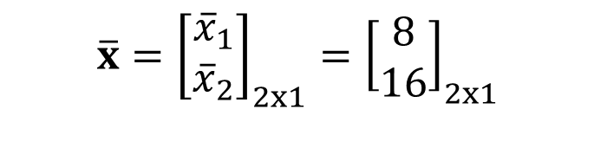
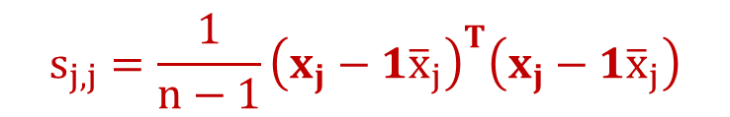

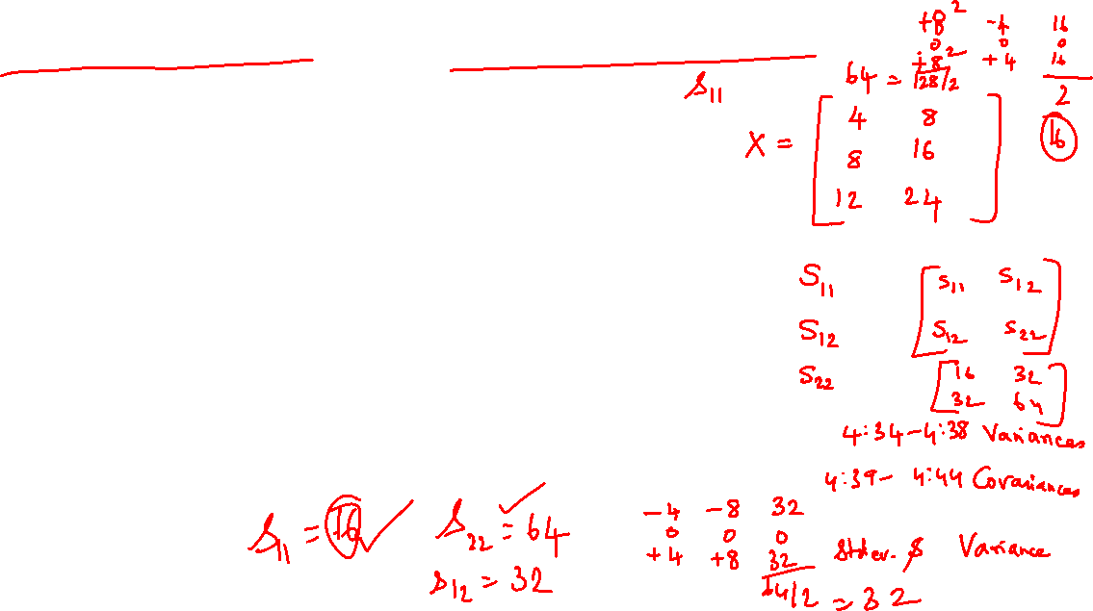


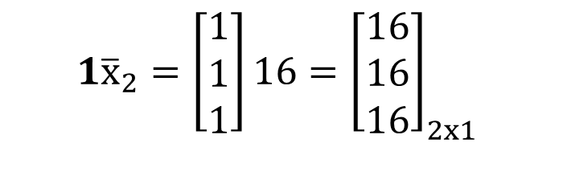
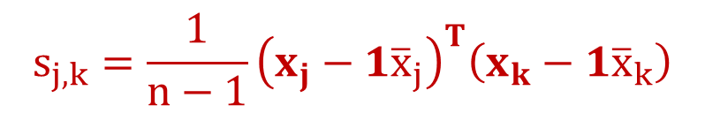
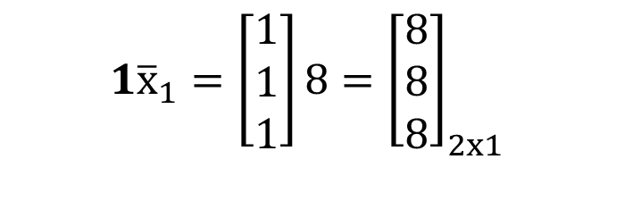
How to get the S Matrix from X Matrix?
$$s_{j,j}=\frac{1}{n−1}{\left(x_{j}−1{\overline{x}}_{j}\right)}^{T}\left(x_{j}−1{\overline{x}}_{j}\right)$$
$$s_{j,k}=\frac{1}{n−1}{\left(x_{j}−1{\overline{x}}_{j}\right)}^{T}\left(x_{k}−1{\overline{x}}_{k}\right)$$
$$x_{j}={\left[\begin{matrix}x_{1j} \\ x_{2j} \\ x_{3j}\end{matrix}\right]}_{nxp}$$
$$\overline{x}={\left[\begin{matrix}{\overline{x}}_{1} \\ {\overline{x}}_{2}\end{matrix}\right]}_{2x1}={\left[\begin{matrix}8 \\ 16\end{matrix}\right]}_{2x1}$$
$$x_{1}={\left[\begin{matrix}4 \\ 8 \\ 12\end{matrix}\right]}_{3x1}$$
$$1{\overline{x}}_{1}=\left[\begin{matrix}1 \\ 1 \\ 1\end{matrix}\right]8={\left[\begin{matrix}8 \\ 8 \\ 8\end{matrix}\right]}_{2x1}$$
$$x_{2}={\left[\begin{matrix}8 \\ 16 \\ 24\end{matrix}\right]}_{3x1}$$
$$1{\overline{x}}_{2}=\left[\begin{matrix}1 \\ 1 \\ 1\end{matrix}\right]16={\left[\begin{matrix}16 \\ 16 \\ 16\end{matrix}\right]}_{2x1}$$

Slide 9

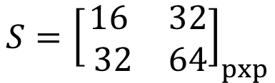
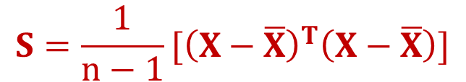
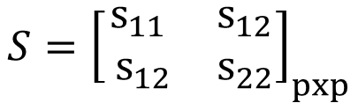

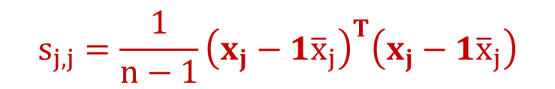
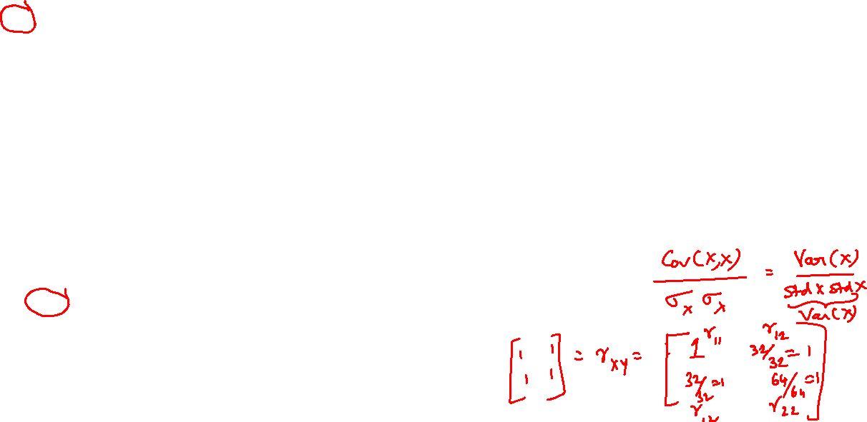
Matlab Code
clc ; clear all
x1=[4 8 12]'; x2 = [8 16 24]';
X=[x1 x2];
% X =
%
% 4 8
% 8 16
% 12 24
COVX=cov(X);
% COVX =
%
% 16 32
% 32 64
val=size(X); % [3x2]
x1bar=mean(X(:,1)); % 8
x2bar=mean(X(:,2)); % 16
onesvector=ones(val(1),1);
% onesvector =
% 1
% 1
% 1
% Verify with actual Matlab code
var11=1/(val(1)-1)*(X(:,1)-onesvector*x1bar)'*(X(:,1)-onesvector*x1bar);
var12=1/(val(1)-1)*(X(:,1)-onesvector*x1bar)'*(X(:,2)-onesvector*x2bar);
var21=1/(val(1)-1)*(X(:,2)-onesvector*x2bar)'*(X(:,1)-onesvector*x1bar);
var22=1/(val(1)-1)*(X(:,2)-onesvector*x2bar)'*(X(:,2)-onesvector*x2bar);
Cov_Matlab = [[var11, var12] ; [var21, var22] ]
% Cov_Matlab =
% 16 32
% 32 64
CorrelationX=corr(X);
% CorrelationX =
% 1.0000 1.0000
% 1.0000 1.0000
Correlation_Matlab = [[var11/sqrt(var11*var11), var12/sqrt(var11*var22)] ; [var21/sqrt(var11*var22), var22/sqrt(var22*var22) ]];
% Correlation_Matlab =
%
%
% 1 1
% 1 1
Sample Pearson Correlation Coefficient Given by
$$S=\frac{1}{n−1}[{\left(X−\overline{X}\right)}^{T}\left(X−\overline{X}\right)]$$
$$s_{j,k}=\frac{1}{n−1}{\left(x_{j}−1{\overline{x}}_{j}\right)}^{T}\left(x_{k}−1{\overline{x}}_{k}\right)$$
$$s_{j,j}=\frac{1}{n−1}{\left(x_{j}−1{\overline{x}}_{j}\right)}^{T}\left(x_{j}−1{\overline{x}}_{j}\right)$$
$$S={\left[\begin{matrix}s_{11} & s_{12} \\ s_{12} & s_{22}\end{matrix}\right]}_{pxp}$$
$$S={\left[\begin{matrix}16 & 32 \\ 32 & 64\end{matrix}\right]}_{pxp}$$

Slide 10
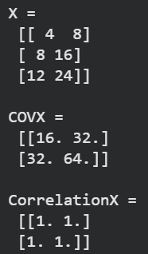
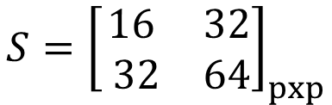
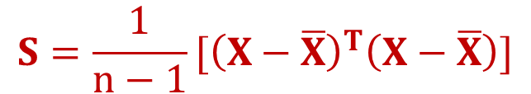
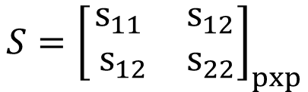


Python Code
# Create column vectors
x1 = np.array([4, 8, 12]).reshape(-1, 1)
x2 = np.array([8, 16, 24]).reshape(-1, 1)
# Concatenate horizontally to form matrix X
X = np.hstack((x1, x2))
# NumPy's cov treats rows as variables by default, so we use rowvar=False to match MATLAB
COVX = np.cov(X, rowvar=False)
val = X.shape # Returns a tuple (3, 2)
x1bar = np.mean(X[:, 0]) # 8.0
x2bar = np.mean(X[:, 1]) # 16.0
onesvector = np.ones((val[0], 1))
x1_col = X[:, 0:1]
x2_col = X[:, 1:2]
var11 = (1 / (val[0] - 1)) * ((x1_col - onesvector * x1bar).T @ (x1_col - onesvector * x1bar)).item()
var12 = (1 / (val[0] - 1)) * ((x1_col - onesvector * x1bar).T @ (x2_col - onesvector * x2bar)).item()
var21 = (1 / (val[0] - 1)) * ((x2_col - onesvector * x2bar).T @ (x1_col - onesvector * x1bar)).item()
var22 = (1 / (val[0] - 1)) * ((x2_col - onesvector * x2bar).T @ (x2_col - onesvector * x2bar)).item()
Cov_Matlab = np.array([[var11, var12], [var21, var22]])
# Calculate correlation matrix
CorrelationX = np.corrcoef(X, rowvar=False)
Correlation_Matlab = np.array([
[var11 / np.sqrt(var11 * var11), var12 / np.sqrt(var11 * var22)],
[var21 / np.sqrt(var11 * var22), var22 / np.sqrt(var22 * var22)]
])
print("X =\n", X)
print("\nCOVX =\n", COVX)
print("\nCorrelationX =\n", CorrelationX)
Sample Pearson Correlation Coefficient Given by
$$S={\left[\begin{matrix}s_{11} & s_{12} \\ s_{12} & s_{22}\end{matrix}\right]}_{pxp}$$
$$S={\left[\begin{matrix}16 & 32 \\ 32 & 64\end{matrix}\right]}_{pxp}$$
$$S=\frac{1}{n−1}[{\left(X−\overline{X}\right)}^{T}\left(X−\overline{X}\right)]$$
$$s_{j,k}=\frac{1}{n−1}{\left(x_{j}−1{\overline{x}}_{j}\right)}^{T}\left(x_{k}−1{\overline{x}}_{k}\right)$$
$$s_{j,j}=\frac{1}{n−1}{\left(x_{j}−1{\overline{x}}_{j}\right)}^{T}\left(x_{j}−1{\overline{x}}_{j}\right)$$

Slide 11
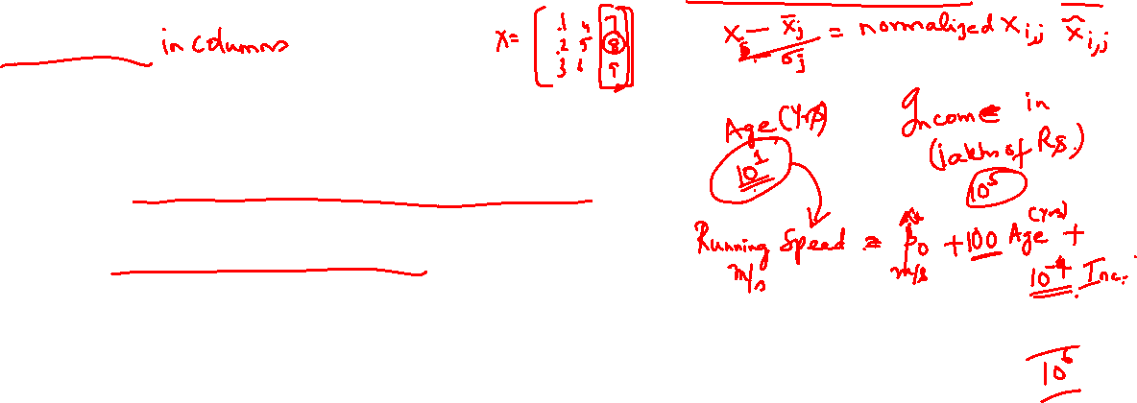
Using a Normalized Data Set
A few precautions are in order whenever we handle a large dataset
The features data vector X is of size n x p (with n rows of observations over p-predictors)
When each of the predictors (X₁, X₂,…,X_{p}) have
a) different measurements and hence units
b) vary widely in their values
Under such circumstances, some of the predictors X_{j}, X_{k}, … may exert more influence not by their real – life significance but by the sheer weight of its magnitude
Necessary to use correlation matrix R rather than S under the above circumstances

Slide 12
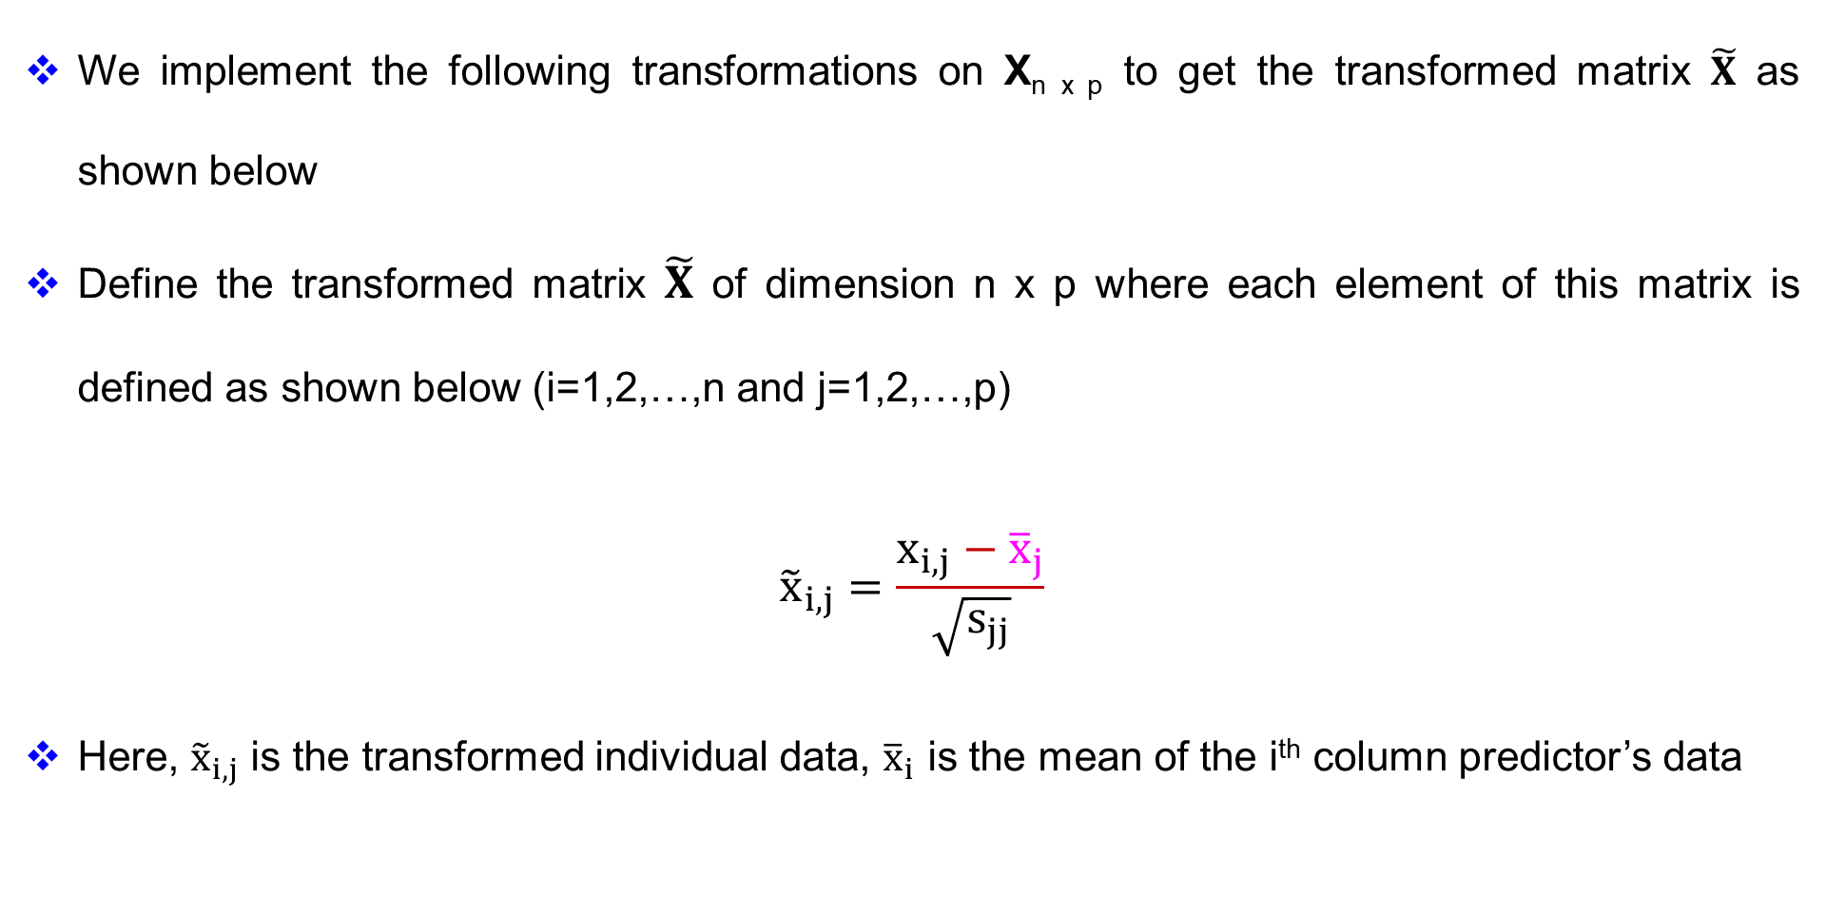
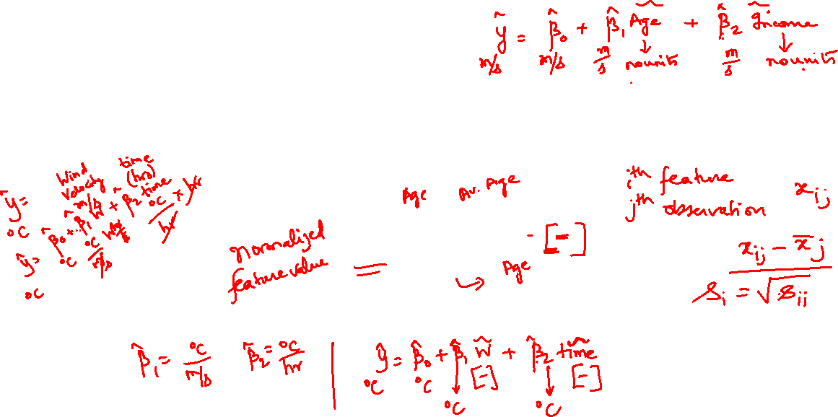
Using a Normalized Data Set
We implement the following transformations on X_{n x p} to get the transformed matrix $\tilde{X}$ as shown below
Define the transformed matrix $\tilde{X}$ of dimension n x p where each element of this matrix is defined as shown below (i=1,2,…,n and j=1,2,…,p)
$${\tilde{x}}_{i,j}=\frac{x_{i,j}−{\overline{x}}_{j}}{\sqrt{s_{jj}}}$$
Here, ${\tilde{x}}_{i,j}$ is the transformed individual data, ${\overline{x}}_{i}$ is the mean of the i^{th} column predictor’s data

Slide 13
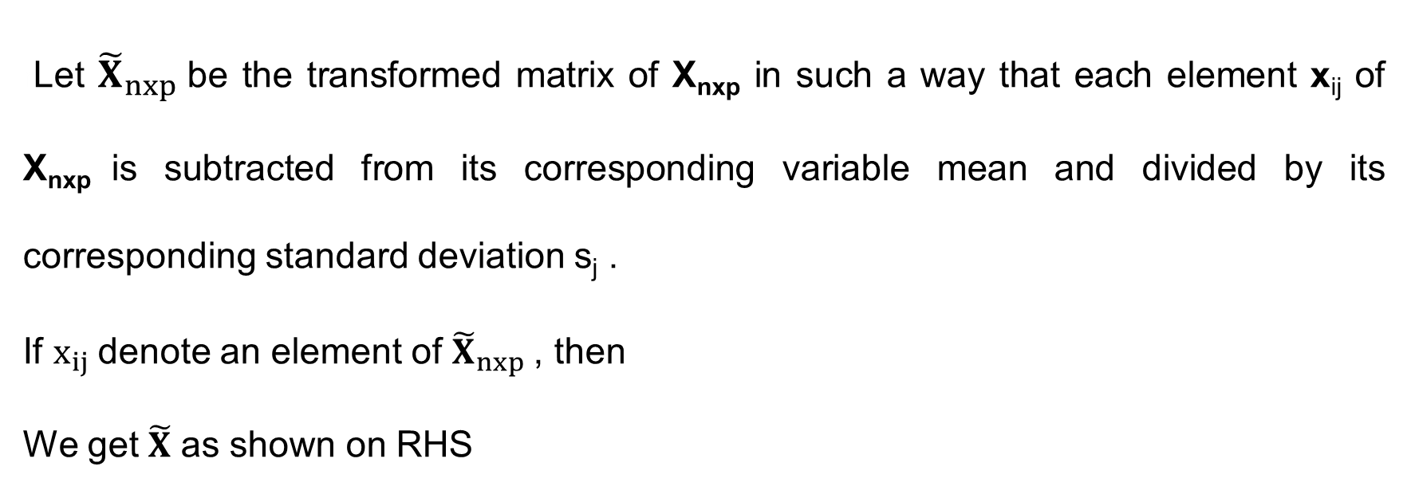

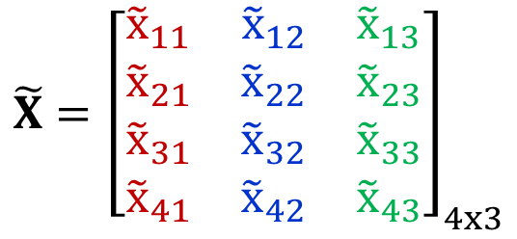
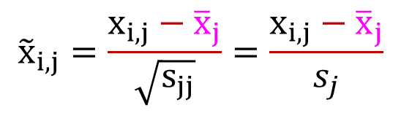
Normalized Matrices
rLet ${\tilde{X}}_{nxp}$be the transformed matrix of X_{nxp} in such a way that each element x_{ij} of X_{nxp} is subtracted from its corresponding variable mean and divided by its corresponding standard deviation s_{j} .
If $x_{ij}$denote an element of ${\tilde{X}}_{nxp}$, then
We get $\tilde{X}$ as shown on RHS
$${\tilde{x}}_{i,j}=\frac{x_{i,j}−{\overline{x}}_{j}}{\sqrt{s_{jj}}}=\frac{x_{i,j}−{\overline{x}}_{j}}{s_{j}}$$
$$\tilde{X}={\left[\begin{matrix}{\tilde{x}}_{11} & {\tilde{x}}_{12} & {\tilde{x}}_{13} \\ {\tilde{x}}_{21} & {\tilde{x}}_{22} & {\tilde{x}}_{23} \\ {\tilde{x}}_{31} & {\tilde{x}}_{32} & {\tilde{x}}_{33} \\ {\tilde{x}}_{41} & {\tilde{x}}_{42} & {\tilde{x}}_{43}\end{matrix}\right]}_{4x3}$$

Slide 14
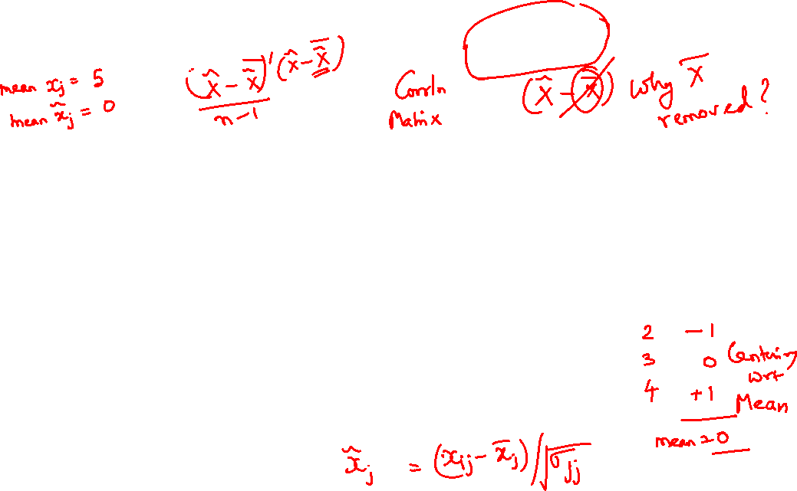
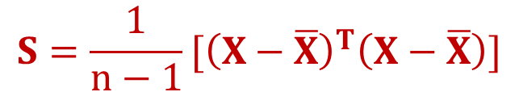

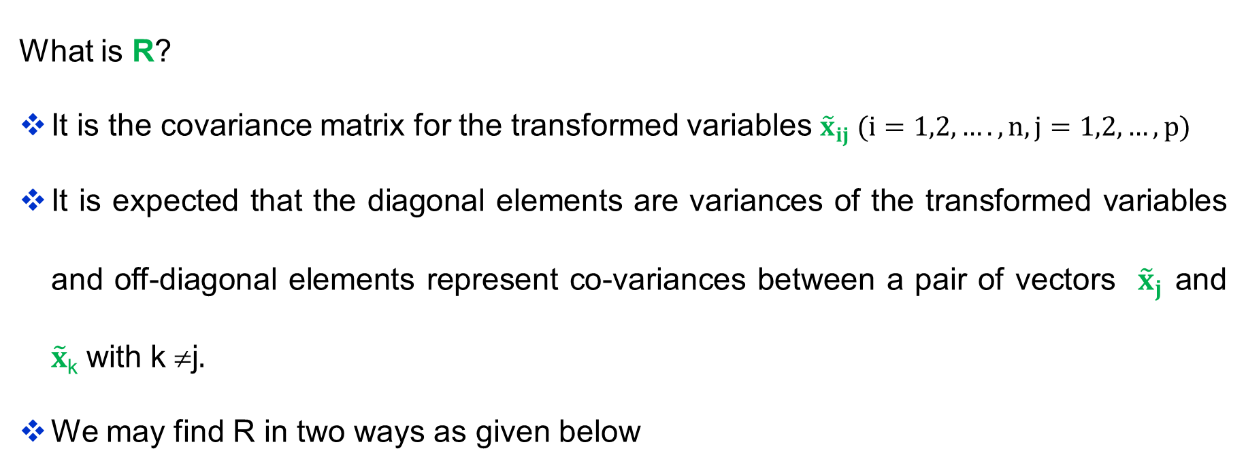

Correlation Matrix (R) For Normalized Values
$$S=\frac{1}{n−1}[{\left(X−\overline{X}\right)}^{T}\left(X−\overline{X}\right)]$$
$$R=\frac{1}{n−1}[{\tilde{X}}^{T}\tilde{X}]$$
What is R?
It is the covariance matrix for the transformed variables ${\tilde{x}}_{ij} (i=1,2,….,n, j=1,2,…,p)$
It is expected that the diagonal elements are variances of the transformed variables and off-diagonal elements represent co-variances between a pair of vectors ${\tilde{x}}_{j}$ and $\tilde{x}$_{k} with k ≠j
We may find R in two ways as given below
$$R=\frac{1}{n−1}[{\tilde{X}}^{T}\tilde{X}]$$

Slide 15
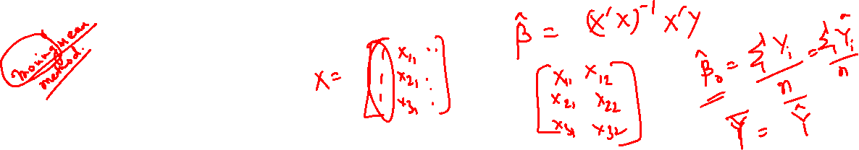
Example Problem With Uneven Data
Lot Area (Square Feet, ft²) – High magnitude (thousands)
Age (Years) – Low magnitude (single/double digits)
Monthly Rent (USD, $) – Medium-high magnitude (thousands)
Distance to Metro (Miles) – Very low magnitude / Continuous decimals
Annual Energy Cost (USD, $) – Very high magnitude (tens of thousands)

Slide 16
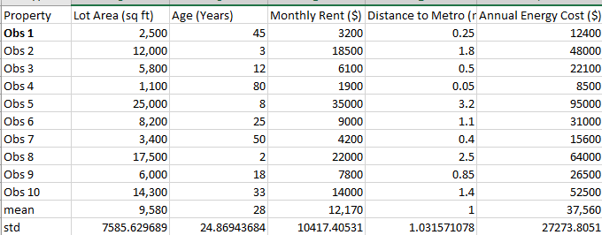
Example Problem With Raw Data

Slide 17
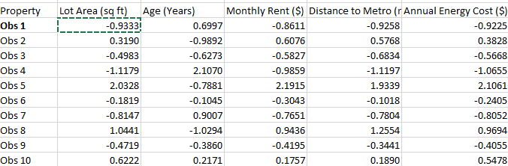
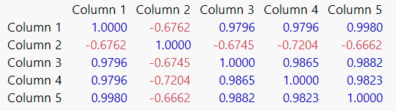
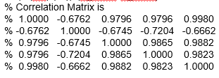
% Code for Raw Data Set Normalizing and Processing
clear all ; clc
X = [
2500 45 3200 0.25 12400
12000 3 18500 1.8 48000
5800 12 6100 0.5 22100
1100 80 1900 0.05 8500
25000 8 35000 3.2 95000
8200 25 9000 1.1 31000
3400 50 4200 0.4 15600
17500 2 22000 2.5 64000
6000 18 7800 0.85 26500
14300 33 14000 1.4 52500
];
val=size(X);
X_norm = normalize(X);
% X_norm =
% -0.9333 0.6997 -0.8611 -0.9258 -0.9225
% 0.3190 -0.9892 0.6076 0.5768 0.3828
% -0.4983 -0.6273 -0.5827 -0.6834 -0.5668
% -1.1179 2.1070 -0.9859 -1.1197 -1.0655
% 2.0328 -0.7881 2.1915 1.9339 2.1061
% -0.1819 -0.1045 -0.3043 -0.1018 -0.2405
% -0.8147 0.9007 -0.7651 -0.7804 -0.8052
% 1.0441 -1.0294 0.9436 1.2554 0.9694
% -0.4719 -0.3860 -0.4195 -0.3441 -0.4055
% 0.6222 0.2171 0.1757 0.1890 0.5478
S=cov(X_norm);
% Variance-Covariance Matrix is
% 1.0000 -0.6762 0.9796 0.9796 0.9980
% -0.6762 1.0000 -0.6745 -0.7204 -0.6662
% 0.9796 -0.6745 1.0000 0.9865 0.9882
% 0.9796 -0.7204 0.9865 1.0000 0.9823
% 0.9980 -0.6662 0.9882 0.9823 1.0000
R=(1/(val(1)-1))*(X_norm'*X_norm);
% Correlation Matrix is
% 1.0000 -0.6762 0.9796 0.9796 0.9980
% -0.6762 1.0000 -0.6745 -0.7204 -0.6662
% 0.9796 -0.6745 1.0000 0.9865 0.9882
% 0.9796 -0.7204 0.9865 1.0000 0.9823
% 0.9980 -0.6662 0.9882 0.9823 1.0000
Covariance of Normalized Data:
Using Built-In Code
Normalized Matrix
Variance Covariance Matrix
Correlation Matrix

Slide 18


Covariance of Normalized Data
% Verify with actual Matlab code
for i=1:val(2)
for j=1:val(2)
var(i,j)=(1/(val(1)-1))*(X_norm(:,i)-onesvector*Mean_Matrix(i))'*(X_norm(:,j)-onesvector*Mean_Matrix(j));
end
end
for i=1:val(2)
for j=1:val(2)
R_Norm(i,j) = var(i,j)/sqrt(var(i,i)*var(j,j));
end
end

Slide 19


import numpy as np
np.set_printoptions(precision=2)
X = np.array([
[2500, 45, 3200, 0.25, 12400],
[12000, 3, 18500, 1.8, 48000],
[5800, 12, 6100, 0.5, 22100],
[1100, 80, 1900, 0.05, 8500],
[25000, 8, 35000, 3.2, 95000],
[8200, 25, 9000, 1.1, 31000],
[3400, 50, 4200, 0.4, 15600],
[17500, 2, 22000, 2.5, 64000],
[6000, 18, 7800, 0.85, 26500],
[14300, 33, 14000, 1.4, 52500]
])
val = X.shape # val[0] is the number of rows (10), val[1] is the number of columns (5)
# Normalize data (Z-score normalization)
# ddof=1 forces sample standard deviation (N-1) instead of population standard deviation
X_norm = (X - np.mean(X, axis=0)) / np.std(X, axis=0, ddof=1)
# Using np.round to display to 4 decimal places similar to MATLAB's default view
print("X_norm =\n", np.round(X_norm, 4))
# Variance-Covariance Matrix
# rowvar=False treats each column as an independent variable
S = np.cov(X_norm, rowvar=False)
print("\nVariance-Covariance Matrix is\n", np.round(S, 4))
# To confirm above results by own code
# (1/(val(1)-1))*(X_norm'*X_norm) in MATLAB becomes:
# Note: val(1) in MATLAB (rows) corresponds to val[0] in Python
R = (1 / (val[0] - 1)) * (X_norm.T @ X_norm)
print("\nCorrelation Matrix is\n", np.round(R, 4))
Covariance of Normalized Data:
Python

Slide 20
Code links
Python and Matlab code Links

