Slide 1
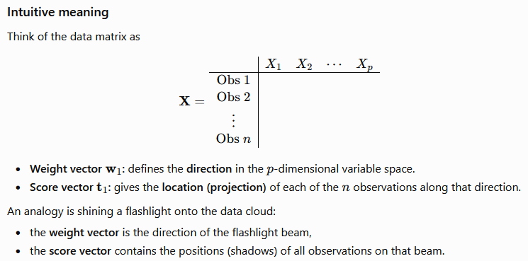
PLS: t₁ = Xw₁

Slide 2


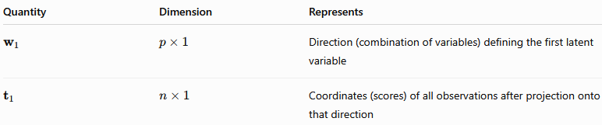

Slide 3
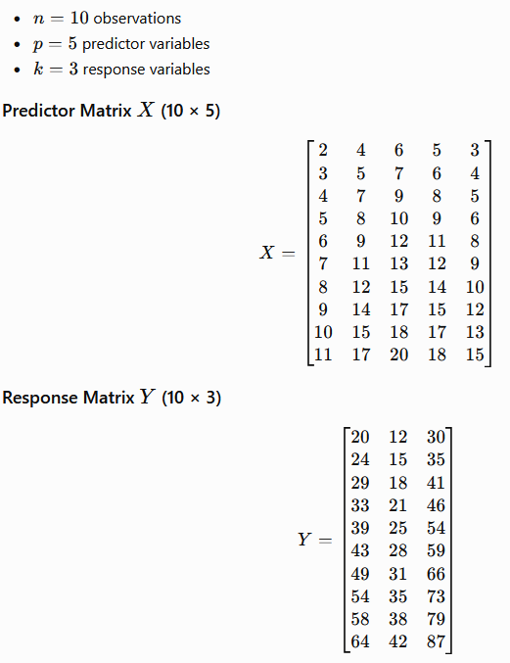
X and Y
Let’s consider the calculations associated with the first PLS factor.
Let X be an n x p matrix whose columns are the p predictors and
Y is an n x k matrix whose columns are the k responses

Slide 4
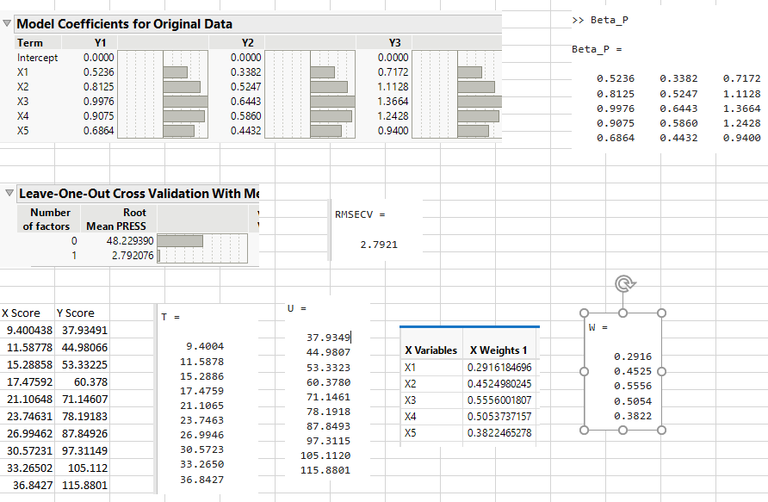
Validation with JMP

Slide 5
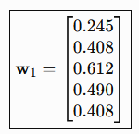
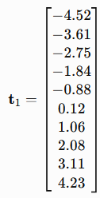
PLS: Theory
The weight vector w₁ (px1) is used to weight each of the observations in X (1xp).
Do it for all the n observations of X to get the Latent Vector t₁ (nx1)
The n weighted linear combinations of the entries in the columns of X are called X scores, denoted by the vector t₁.
The X scores are the entries of the vector t₁ = Xw₁ (nxpxpx1)
Note that the size of the score vector, t₁ , is n x 1

Slide 6
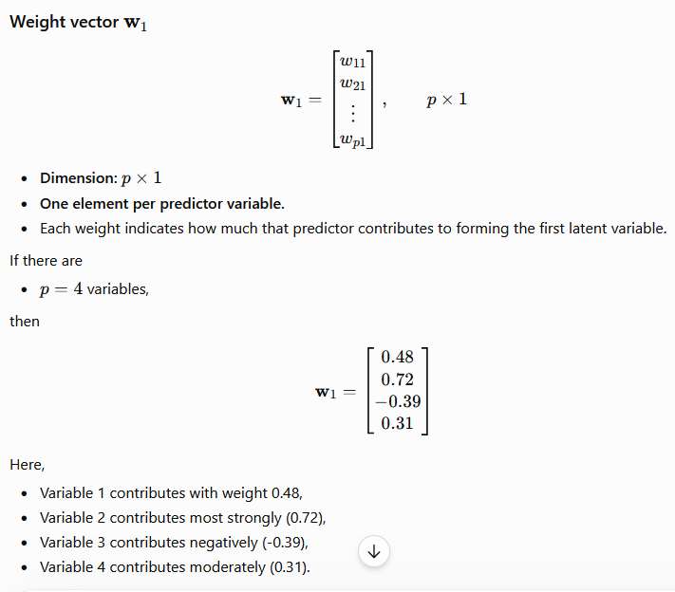
PLS: t₁ = Xw₁

Slide 7
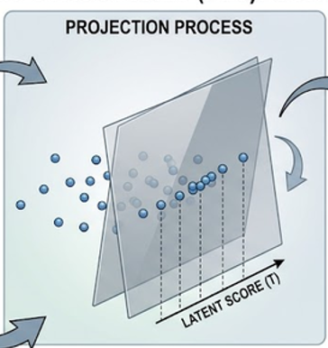
PLS: t₁ = Xw₁
Values in the column of t₁ matrix in PLS are called as X scores
Think of the vector w₁ as defining a linear transformation mapping ALL the p predictors to a one dimensional subspace
With this interpretation, Xw₁ represents the mapping of the data to this one-dimensional subspace

Slide 8
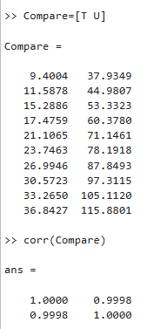
PLS: Theory
Technically, t₁ is a linear combination of the variables in X that has maximum covariance with a linear combination of the variables in Y,
subject to normalizing constraints.
the COVARIANCE between
t₁ (= Xw₁ ) and u₁ (= Yq₁)
is a MAXIMUM.
The vector q₁ is a Y weight vector
The elements of the vector u₁ are the Y scores
For the First factor, we expect the X scores and the Y scores to be strongly correlated

Slide 9
PLS: Theory
To obtain subsequent factors, first, we use all factors available to that point to predict BOTH X and Y
In the NIPALS algorithm, the process of obtaining a new weight vector and defining new X scores is applied to the residuals from the predictive models for X and Y
We say that X and Y are deflated into predictions + residuals and the process itself is called deflation
This ensures that subsequent factors are independent of (orthogonal to) all previously extracted factors

Slide 10
PLS: Theory
Suppose that ‘a’ factors are extracted. Then there are:
‘a’ weight vectors, w₁,w₂….,w_{a}
‘a’ X-score vectors, t₁, t₂,…, t_{a}
‘a’ Y-score vectors, u₁, u₂,…,u_{a}
We can now define three matrices:
W is the p x a matrix whose columns consist of the weight vectors;
T and U are the n x a matrices whose columns consist of the X-score & Y-score vectors, respectively

Slide 11
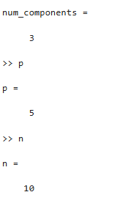
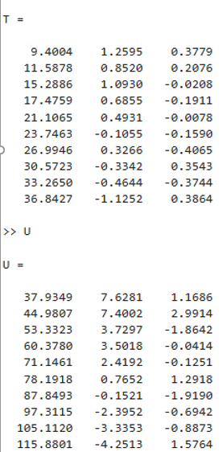
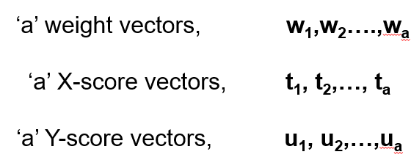
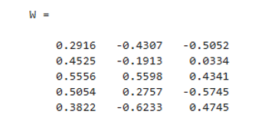

Slide 12
Philosophy of PLS2 Algorithm
Standard multiple regression, may fail if predictors are
highly correlated (multicollinearity) or
outnumber the observations,
PLS2 avoids overfitting by doing dimensionality reduction in 2 ways
1. Latent Variable Extraction: It projects both the X and Y matrices into a new, smaller space of "latent variables".
2. Maximizing Covariance: Instead of just finding components that explain the maximum variance in X (like PCA), it determines linear combinations of X that have the maximum covariance with Y.

Slide 13
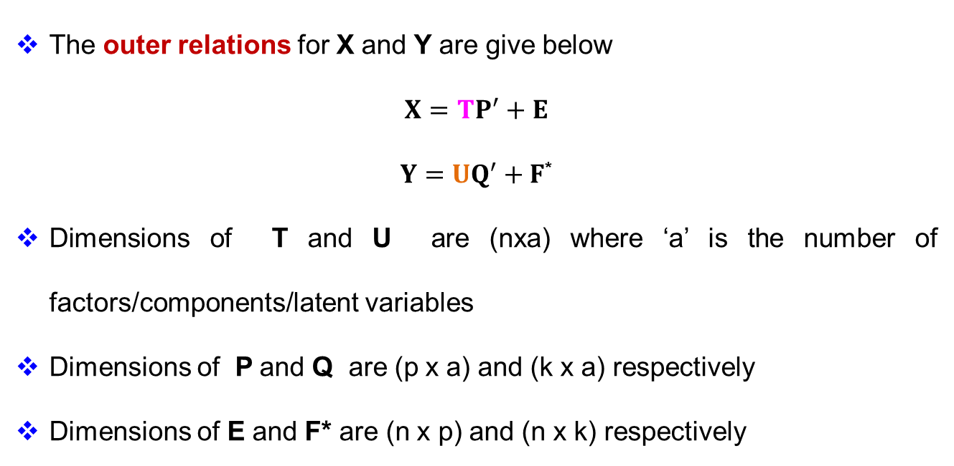
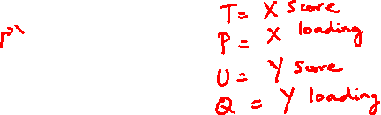
PLS2 Algorithm: Outer Relations
The outer relations for X and Y are give below
$$X=TP^{′}+E$$
$Y=UQ^{′}+F$*
Dimensions of T and U are (nxa) where ‘a’ is the number of factors/components/latent variables
Dimensions of P and Q are (p x a) and (k x a) respectively
Dimensions of E and F* are (n x p) and (n x k) respectively

Slide 14
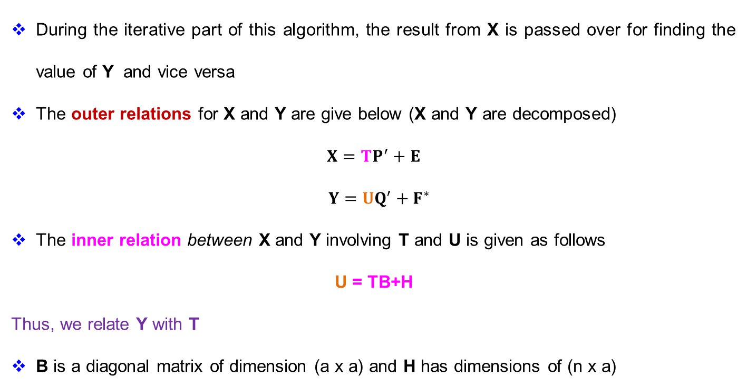
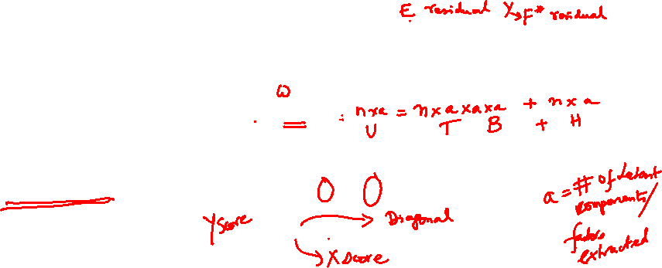
PLS2 Algorithm: Iterations
During the iterative part of this algorithm, the result from X is passed over for finding the value of Y and vice versa
The outer relations for X and Y are give below (X and Y are decomposed)
$$X=TP^{′}+E$$
$$Y=UQ^{′}+F^{∗}$$
The inner relation between X and Y involving T and U is given as follows
U = TB+H
Thus, we relate Y with T
B is a diagonal matrix of dimension (a x a) and H has dimensions of (n x a)

Slide 15
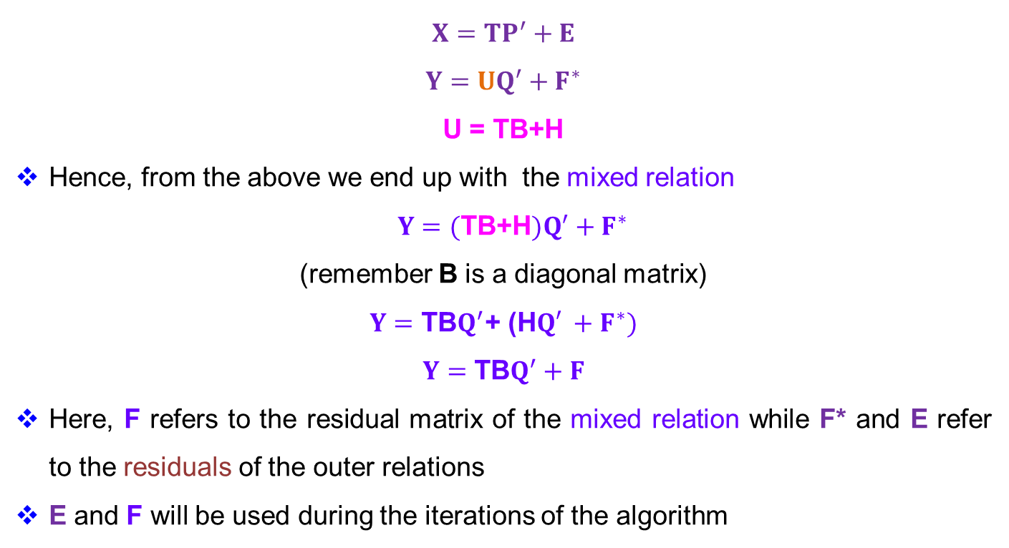

PLS2: Decomposing Y
$$X=TP^{′}+E$$
$$Y=UQ^{′}+F^{∗}$$
U = TB+H
Hence, from the above we end up with the mixed relation
$Y=(\text{TB}\text{+}\text{H})Q^{′}+F^{∗}$
(remember B is a diagonal matrix)
$$Y=\text{TB}Q^{′}\text{+ (}\text{H}Q′ +F^{∗})$$
$$Y=\text{TB}Q^{′}+F$$
Here, F refers to the residual matrix of the mixed relation while F* and E refer to the residuals of the outer relations
E and F will be used during the iterations of the algorithm
Outer Relation
Inner Relation
Mixed Relation

Slide 16
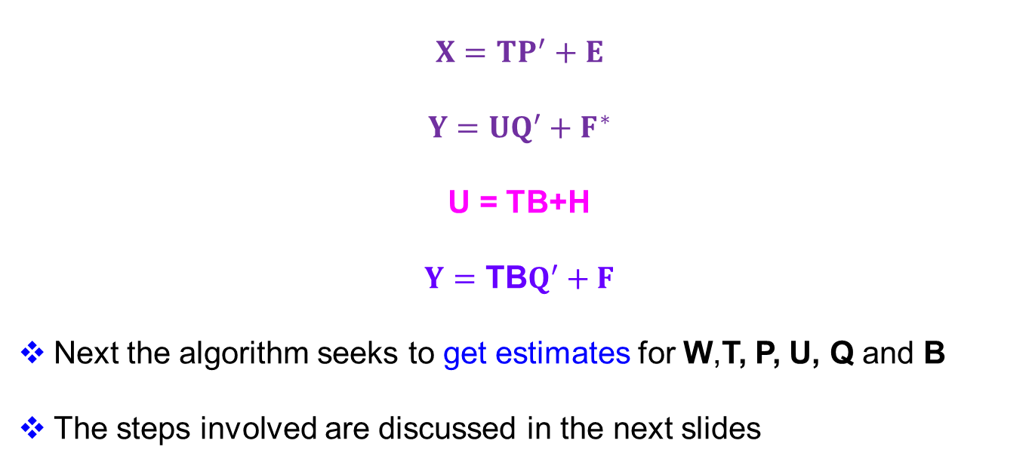
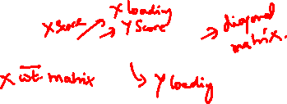
PLS2 Algorithm: Summary of Relations
$$X=TP^{′}+E$$
$$Y=UQ^{′}+F^{∗}$$
U = TB+H
$$Y=\text{TB}Q^{′}+F$$
Next the algorithm seeks to get estimates for W,T, P, U, Q and B
The steps involved are discussed in the next slides
Outer Relation
Inner Relation
Mixed Relation

Slide 17
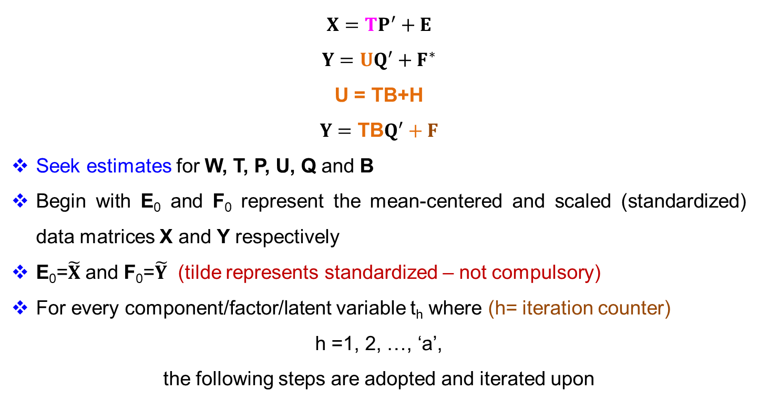
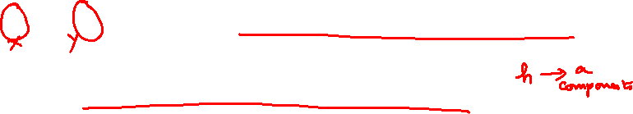
PLS2 Algorithm
$$X=TP^{′}+E$$
$$Y=UQ^{′}+F^{∗}$$
U = TB+H
$$Y=\text{TB}Q^{′}+F$$
Seek estimates for W, T, P, U, Q and B
Begin with E₀ and F₀ represent the mean-centered and scaled (standardized) data matrices X and Y respectively
E₀=$\tilde{X}$ and F₀=$\tilde{Y}$ (tilde represents standardized – not compulsory)
For every component/factor/latent variable t_{h} where (h= iteration counter)
h =1, 2, …, ‘a’,
the following steps are adopted and iterated upon

Slide 18



PLS2 Algorithm: Steps (0-2)
$$X=TP^{′}+E Y=UQ^{′}+F^{∗} Y=\text{TB}Q^{′}+F$$
Notice that u is associated with Y and t is associated with X
Step 0: Choose the first column of the matrix F_{h-1} as a starting value for u_{h}
You may try choosing any column in Y say, the first or one which has highest variance

Slide 19
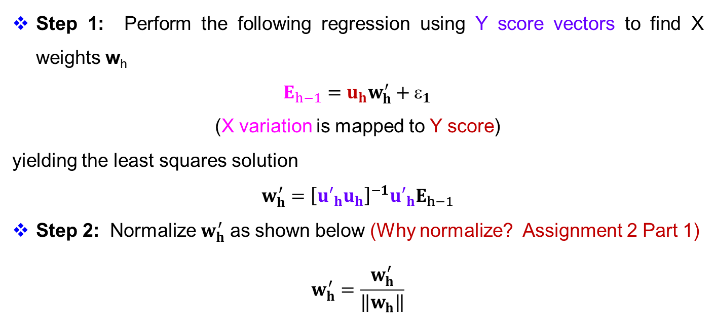
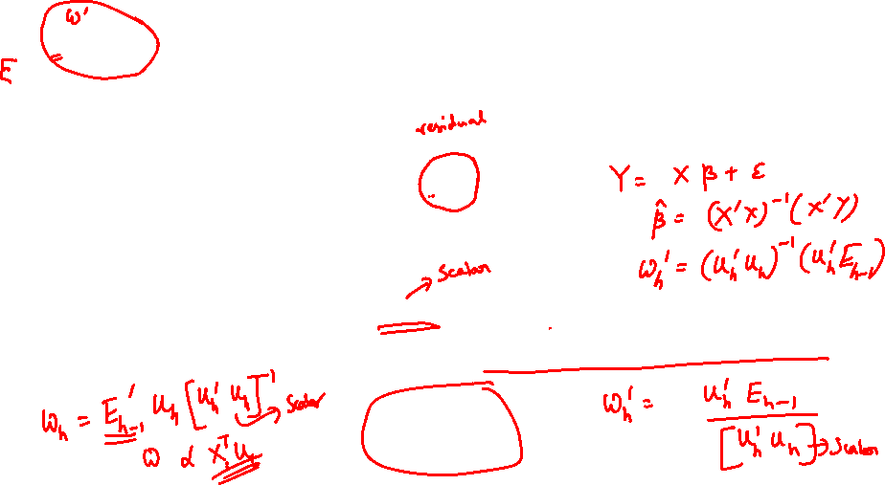
PLS2 Algorithm: Steps (0-2)
$$X=TP^{′}+E Y=UQ^{′}+F^{∗} Y=\text{TB}Q^{′}+F$$
Step 1: Perform the following regression using Y score vectors to find X weights w_{h}
$E_{h−1}=u_{h}w_{h}^{′}+_{1}$
(X variation is mapped to Y score)
yielding the least squares solution
$$w_{h}^{′}={\left[{u′}_{h}u_{h}\right]}^{−1}{u′}_{h}E_{h−1}$$
Step 2: Normalize $w_{h}^{′}$ as shown below (Why normalize? Assignment 2 Part 1)
$$w_{h}^{′}=\frac{w_{h}^{′}}{\left\|w_{h}\right\|}$$

Slide 20
PLS2 Algorithm: Steps (0-2)
$$X=TP^{′}+E Y=UQ^{′}+F^{∗} Y=\text{TB}Q^{′}+F$$
Step 1: Perform the following regression using Y score vectors to find X weights w_{h}
$E_{h−1}=u_{h}w_{h}^{′}+_{1}$
(X variation is mapped to Y score)
yielding the least squares solution
$$w_{h}^{′}={\left[{u′}_{h}u_{h}\right]}^{−1}{u′}_{h}E_{h−1}$$
Step 2: Normalize $w_{h}^{′}$ as shown below (Why normalize? Assignment 2 Part 1)
$$w_{h}^{′}=\frac{w_{h}^{′}}{\left\|w_{h}\right\|}$$

Slide 21
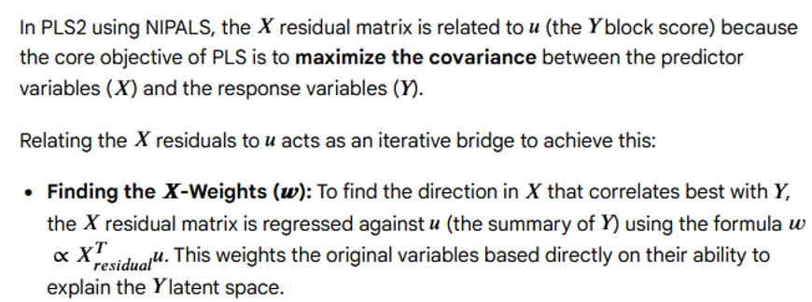



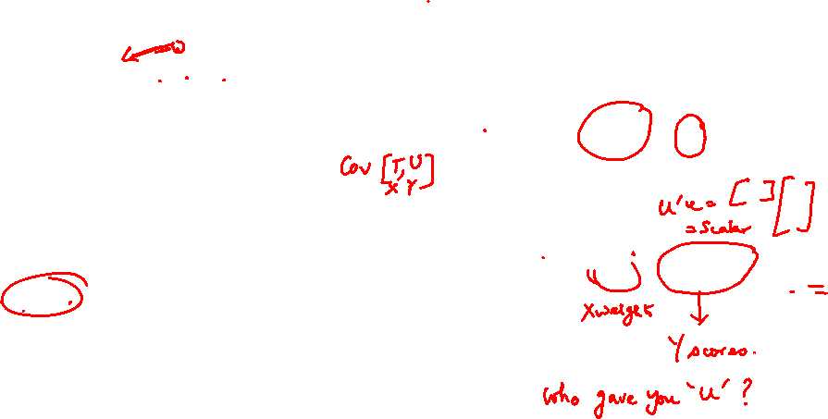

Using U to find W: Justification
$$X=TP^{′}+E Y=UQ^{′}+F^{∗}$$
$$E_{h−1}=u_{h}w_{h}^{′}+_{1}$$
$$w_{h}^{′}={\left[{u′}_{h}u_{h}\right]}^{−1}{u′}_{h}E_{h−1}$$

Slide 22

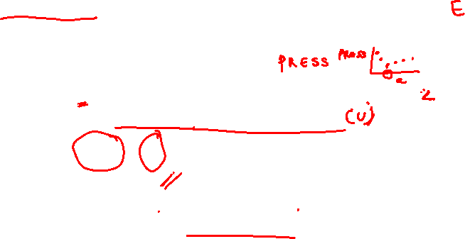
PLS2 Algorithm: Explanation
Imagine X contains hundreds of process variables and Y contains several quality measurements.
After removing the first latent factor, there is still residual unexplained variation in X.
Some of that variation is related to Y, and some is just noise or irrelevant process variation.
By relating the X residuals to u (the Y Score vector: Summary Sheet for Y), PLS focuses only on the part of the remaining X variation that still helps explain Y
This is what gives PLS its predictive power.
The X residual matrix is related to the Y score vector u because PLS extracts new X directions w based on their ability to explain the remaining Y structure, not merely on their ability to explain remaining X variance.
$$E_{h−1}=u_{h}w_{h}^{′}+_{1}$$

Slide 23
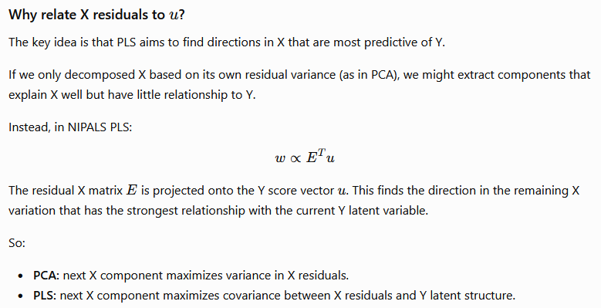

PLS2 Algorithm: Explanation
$$E_{h−1}=u_{h}w_{h}^{′}+_{1}$$

Slide 24
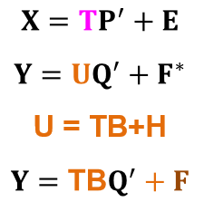


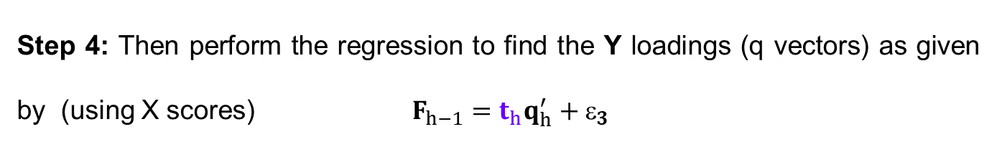









PLS2 Algorithm: Find X Scores & Y Loadings
Step 3: Now perform the regression to find X scores vector t_{h}
$$E_{h−1}=t_{h}w_{h}^{′}+_{2}$$
$${E′}_{h−1}=w_{h}{t′}_{h}+{′}_{2}$$
$$t_{h}^{′}={\left[w_{h}′w_{h}\right]}^{−1}{w′}_{h}{E′}_{h−1}$$
Step 4: Then perform the regression to find the Y loadings (q vectors) as given by (using X scores) $F_{h−1}=t_{h}q_{h}^{′}+_{3}$
$${ E}_{h−1}=u_{h}w_{h}^{′}+_{1}$$
$q_{h}^{′}{=\left[t_{h}′t_{h}\right]}^{−1}t_{h}′F_{h−1}$ and after normalizing
Step 5: $q_{h}^{′}=\frac{q_{h}^{′}}{\left\|q_{h}\right\|}$

Slide 25


PLS2 Algorithm: Find X Scores & Y Loadings
Step 3: Now perform the regression to find X scores vector t_{h}
$$E_{h−1}=t_{h}w_{h}^{′}+_{2}$$
$${E′}_{h−1}=w_{h}{t′}_{h}+{′}_{2}$$
$$t_{h}^{′}={\left[w_{h}′w_{h}\right]}^{−1}{w′}_{h}{E′}_{h−1}$$
Step 4: Then perform the regression to find the Y loadings (q vectors) as given by (using X scores) $F_{h−1}=t_{h}q_{h}^{′}+_{3}$
$${ E}_{h−1}=u_{h}w_{h}^{′}+_{1}$$
$q_{h}^{′}{=\left[t_{h}′t_{h}\right]}^{−1}t_{h}′F_{h−1}$ and after normalizing
Step 5: $q_{h}^{′}=\frac{q_{h}^{′}}{\left\|q_{h}\right\|}$

Slide 26


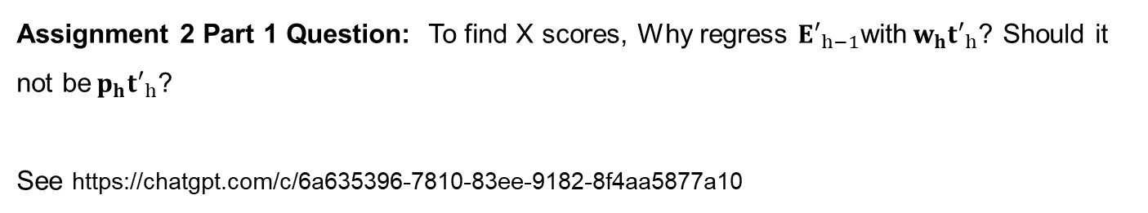

PLS2 Algorithm: Find X Scores &Y Loadings
$$E_{h−1}=t_{h}w_{h}^{′}+_{2}$$
$${E′}_{h−1}={w_{h}t′}_{h}+{′}_{2}$$
$$t_{h}^{′}={\left[w_{h}′w_{h}\right]}^{−1}{w′}_{h}{E′}_{h−1}$$
Assignment 2 Part 1 Question: To find X scores, Why regress ${E′}_{h−1}$with${{ w}_{h}t′}_{h}$? Should it not be${{ p}_{h}t′}_{h}$?
See https://chatgpt.com/c/6a635396-7810-83ee-9182-8f4aa5877a10

Slide 27
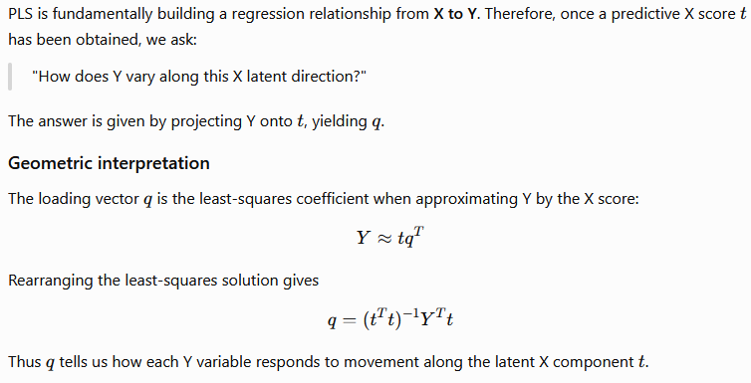












For Y loading vector Why Use X scores in PLS2 Nipals?
$$F_{h−1}=t_{h}q_{h}^{′}+_{3}$$
$$q_{h}^{′}{=\left[t_{h}′t_{h}\right]}^{−1}t_{h}′F_{h−1}$$
$$q_{h}{=\left[t_{h}′t_{h}\right]}^{−1}{F_{h−1}^{′} t}_{h}$$

Slide 28



Tips For Remembering
Y loading vector u helps find the X weights vector w because it tells us which X directions are relevant to Y.
X score vector t helps find the Y loadings vectors q because Y is ultimately modeled and predicted from the X latent scores.
So the algorithm alternates between Y-guided (U) extraction of X components and X-guided (T) reconstruction of Y,
Ensures the latent variables maximize covariance while remaining useful for prediction.

Slide 29




PLS2: Steps 6 and 7
Step 6: Perform the regression to obtain new values of u_{h} (refer step 0)
$$F_{h−1}=u_{h}q_{h}^{′}+_{4}$$
$${F′}_{h−1}=q_{h}{u′}_{h}+{′}_{4}$$
$$u_{h}^{′}={\left[q_{h}′q_{h}\right]}^{−1}q_{h}′{F′}_{h−1}$$
Step 7: Check the convergence of t_{h} using a suitable convergence criteria.
If the new t_{h} is much different than the previous one according to this criterion initiate a new iteration from Step 1 with this new value.
Else go to Step 8

Slide 30


PLS2: Steps 8-10
Step 8: Perform the regression to obtain new values of X loadings $p_{h}$
$$E_{h−1}=t_{h}p_{h}^{′}+_{5}$$
$$p_{h}^{′}={\left[t_{h}′t_{h}\right]}^{−1}{t′}_{h}E_{h−1}$$
Step 9: Fit t_{h} to the newly gained p_{h} as $t_{h}=t_{h}\left\|p_{h}\right\|$
Step 10: Normalize p$′$_{h} as $p_{h}^{′}=\frac{p_{h}^{′}}{\left\|p_{h}\right\|}$
Assignment 2 Part 1 Question: Why is this done? Explain briefly.

Slide 31



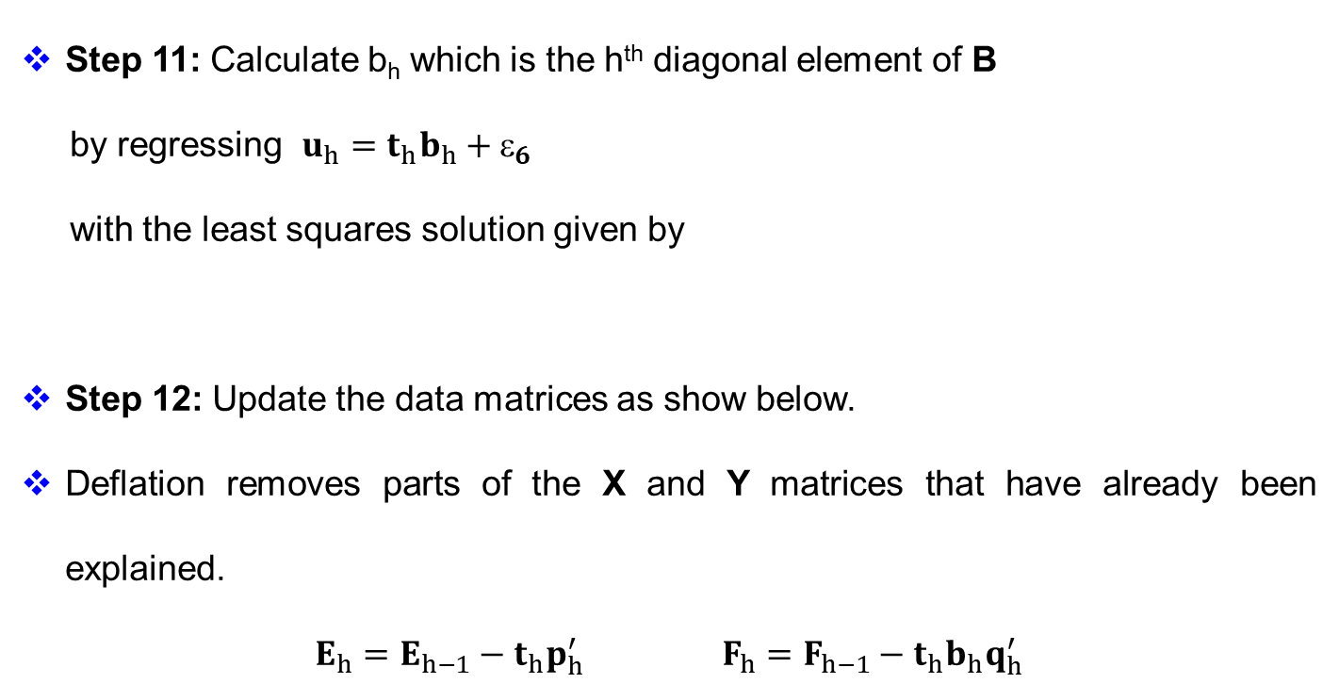



PLS2: Steps 11-12
Step 11: Calculate b_{h} which is the h^{th} diagonal element of B
by regressing $u_{h}=t_{h}b_{h}+_{6}$
with the least squares solution given by
Step 12: Update the data matrices as show below.
Deflation removes parts of the X and Y matrices that have already been explained.
$E_{h}=E_{h−1}−t_{h}p_{h}^{′}$ $F_{h}=F_{h−1}−t_{h}b_{h}q_{h}^{′}$
$$b_{h}={\left[t_{h}′t_{h}\right]}^{−1}{t′}_{h}u_{h}$$

Slide 32
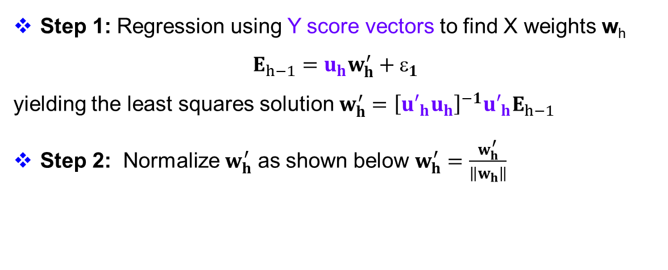
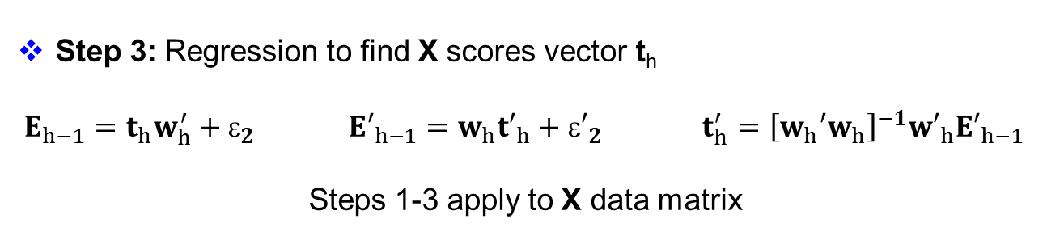
Discussion on the NIPALS algorithm
Step 1: Regression using Y score vectors to find X weights w_{h}
$E_{h−1}=u_{h}w_{h}^{′}+_{1}$
yielding the least squares solution $w_{h}^{′}={\left[{u′}_{h}u_{h}\right]}^{−1}{u′}_{h}E_{h−1}$
Step 2: Normalize $w_{h}^{′}$ as shown below $w_{h}^{′}=\frac{w_{h}^{′}}{\left\|w_{h}\right\|}$
Step 3: Regression to find X scores vector t_{h}
$E_{h−1}=t_{h}w_{h}^{′}+_{2}$ ${E′}_{h−1}=w_{h}{t′}_{h}+{′}_{2}$ $t_{h}^{′}={\left[w_{h}′w_{h}\right]}^{−1}{w′}_{h}{E′}_{h−1}$
Steps 1-3 apply to X data matrix

Slide 33
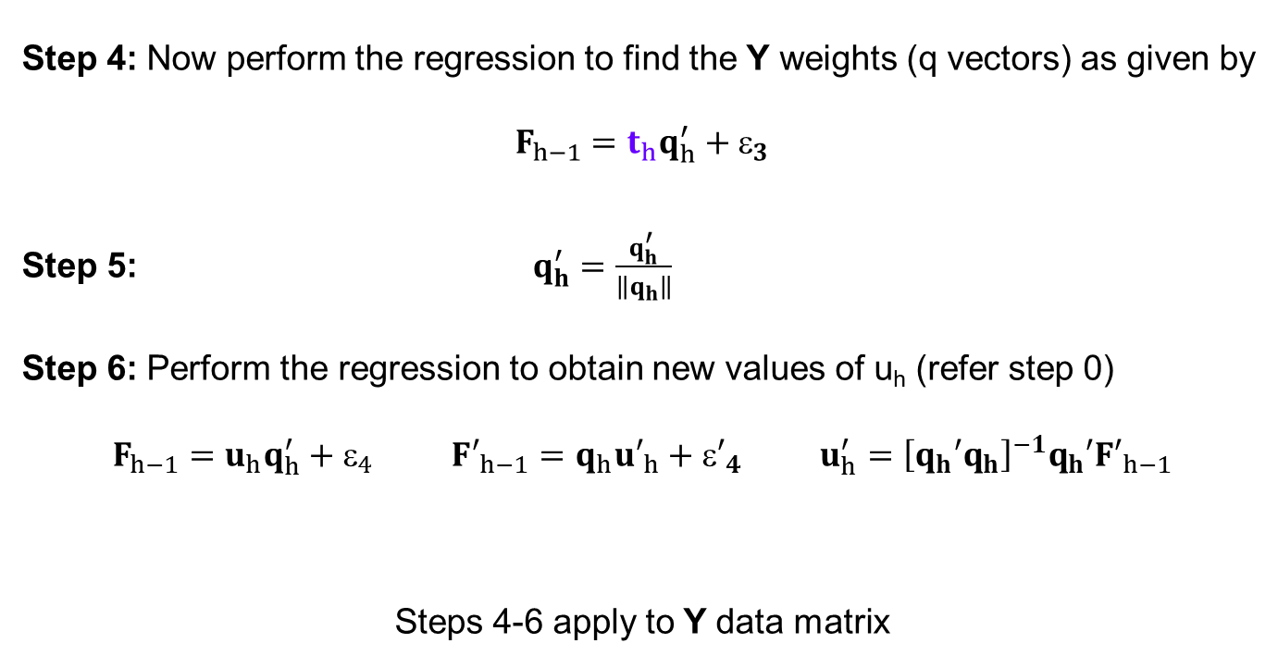
Discussion on the NIPALS algorithm
Step 4: Now perform the regression to find the Y weights (q vectors) as given by
$$F_{h−1}=t_{h}q_{h}^{′}+_{3}$$
Step 5: $q_{h}^{′}=\frac{q_{h}^{′}}{\left\|q_{h}\right\|}$
Step 6: Perform the regression to obtain new values of u_{h} (refer step 0)
$F_{h−1}=u_{h}q_{h}^{′}+_{4}$ ${F′}_{h−1}=q_{h}{u′}_{h}+{′}_{4}$ $u_{h}^{′}={\left[q_{h}′q_{h}\right]}^{−1}q_{h}′{F′}_{h−1}$
Steps 4-6 apply to Y data matrix

Slide 34
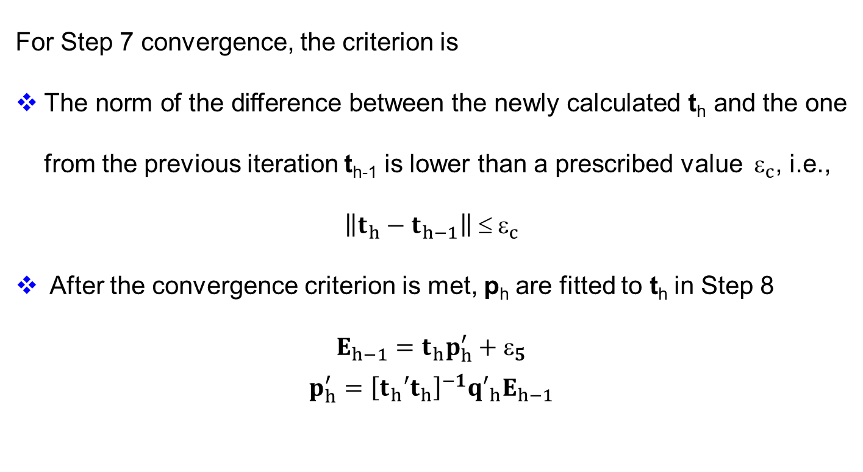
PLS2: Convergence Criterion
For Step 7 convergence, the criterion is
The norm of the difference between the newly calculated t_{h} and the one from the previous iteration t_{h-1} is lower than a prescribed value ${ }_{c}$, i.e.,
$$\left\|t_{h}−t_{h−1}\right\| ≤{ ε}_{c}$$
After the convergence criterion is met, p_{h} are fitted to t_{h} in Step 8
$$E_{h−1}=t_{h}p_{h}^{′}+_{5}$$
$$p_{h}^{′}={\left[t_{h}′t_{h}\right]}^{−1}{q′}_{h}E_{h−1}$$

Slide 35
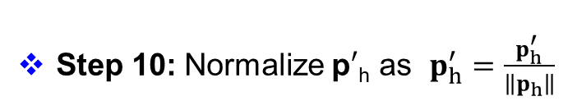
PLS2: Steps 9 and 10
Step 9: Fit t_{h} to the newly gained p_{h} as $t_{h}=t_{h}\left\|p_{h}\right\|$
Step 10: Normalize p$′$_{h} as $p_{h}^{′}=\frac{p_{h}^{′}}{\left\|p_{h}\right\|}$
In Step 10, p_{h} are normalized to length 1 to make them comparable to principal components.
The t_{h} have to be fitted to the new p_{h} in Step 9

Slide 36
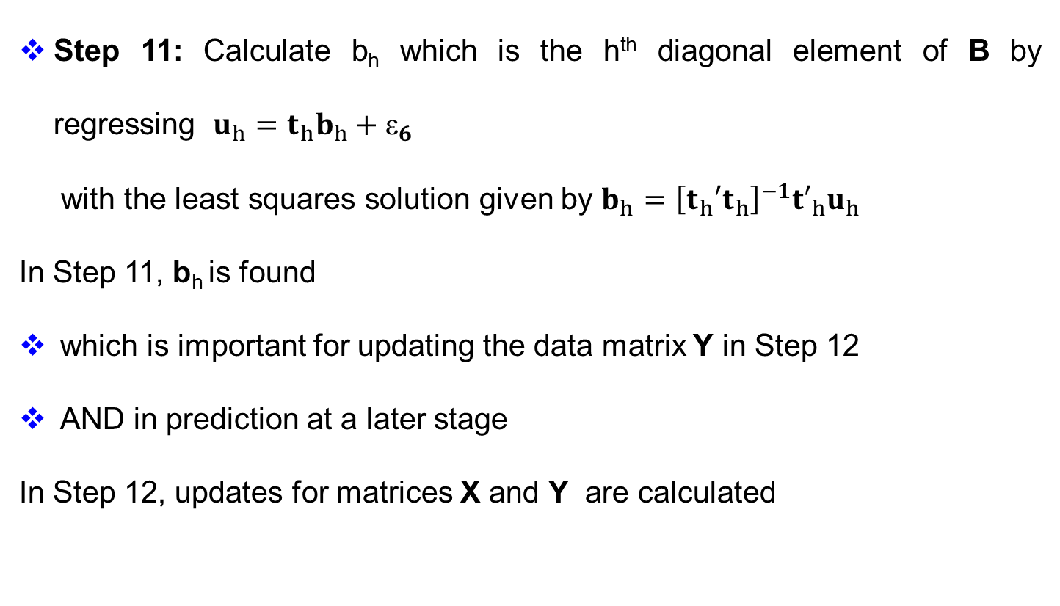
PLS2: Steps 11 and 12
Step 11: Calculate b_{h} which is the h^{th} diagonal element of B by regressing $u_{h}=t_{h}b_{h}+_{6}$
with the least squares solution given by $b_{h}={\left[t_{h}′t_{h}\right]}^{−1}{t′}_{h}u_{h}$
In Step 11, b_{h} is found
which is important for updating the data matrix Y in Step 12
AND in prediction at a later stage
In Step 12, updates for matrices X and Y are calculated

Slide 37
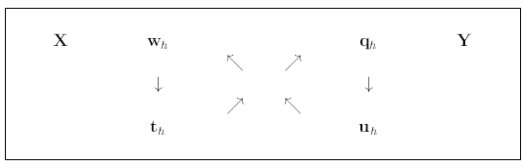
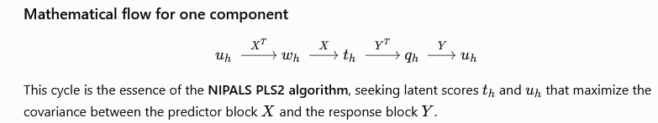
PLS2: Graphical Representation

Slide 38
PLS2: Updating the Data Matrices
The reason for using F and F* is for predicting values, the goal of PLS.
For this, use the mixed relation Y=TBQ′+F instead of the outer relation Y=UQ′+F*
Further, the rank of Y is not reduced by 1 for each component, so it is really possible to deduce the maximal number of components, namely as many as the rank of X.

Slide 39
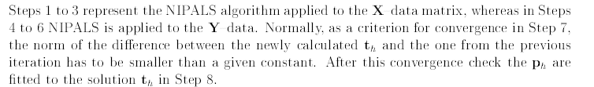
PLS: Theory
PLS regression decomposes both X and Y as a product of a common set of orthogonal factors and a set of specific loadings
The independent variables are decomposed as
X = TP′
with
T ′ T = I, (T ′= T⁻¹)

Slide 40
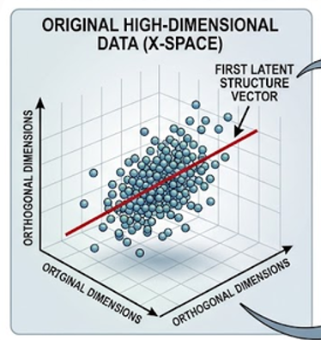
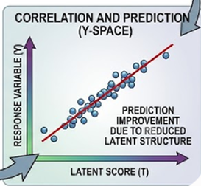
PLS: Outcomes
PLS is a projection method that reduces dimensionality.
We have taken a three-dimensional cloud of points and represented those points using a one-dimensional subspace, namely a line.
We say that we have extracted one factor from the data.
We have used this one factor to define a linear subspace onto which to project both the Xs and the Ys.

Slide 41
