Slide 1
Mid-Term Feedback
Instructions (1 Unclear -10 Very Clear): 9
Questions (1 Unclear -10 Very Clear): 9
Difficulty (1 Very Difficult – 10 Very Easy): 5.5 Moderate
Time (1 Very less - 10 Plenty): 6
MCQ for endsem, no negative marking, home preferred, cheat sheet not allowed, discuss answers, partial marking, self brought calculator

Slide 2
Mid-Term Feedback
Instructions (1 Unclear -10 Very Clear): 9
Questions (1 Unclear -10 Very Clear): 9
Difficulty (1 Very Difficult – 10 Very Easy): 5.5 Moderate
Time (1 Very less - 10 Plenty): 6
MCQ for endsem, no negative marking, home preferred, cheat sheet not allowed, discuss answers, partial marking, self brought calculator

Slide 3
Singling Out on the Singular Matrix
Sir if p >> n, the matrix is not square.
So how can we comment on it being singular?
sir one of the reason it could if rows/columns is become linearly dependent when P is large kind of over-parameterize . then it can become singular

Slide 4
Singling Out on the Singular Matrix
A singular matrix is one for which inverse does not exist
Further singularity applies only to square matrices
By definition, a matrix is singular if det(A)=0.
Calculating the inverse of a matrix requires dividing by its determinant (A⁻¹=​adj(A)/det(A)), division by zero is undefined, making it impossible for an inverse to exist.
Singularity applies only to square matrices
Concepts of determinants & standard matrix inverses are strictly defined only for square matrices (n×n).
Since non-square matrices do not have a determinant, they cannot be classified as singular or non-singular

Slide 5
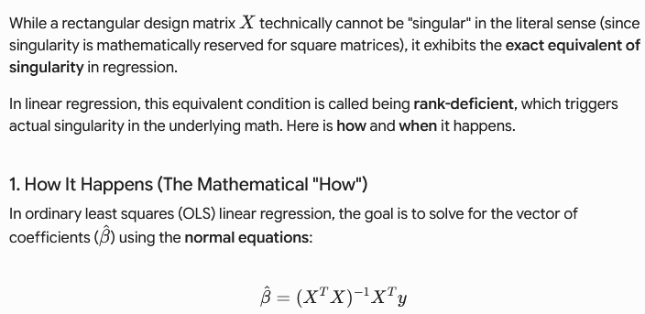
How can a Rectangular Matrix Be(come) Singular?

Slide 6
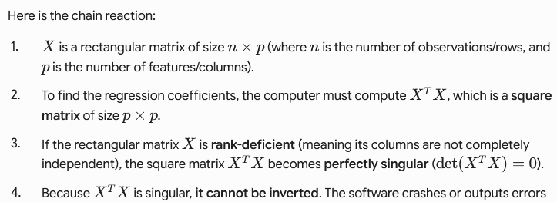
How can a Rectangular Matrix Be(come) Singular?

Slide 7
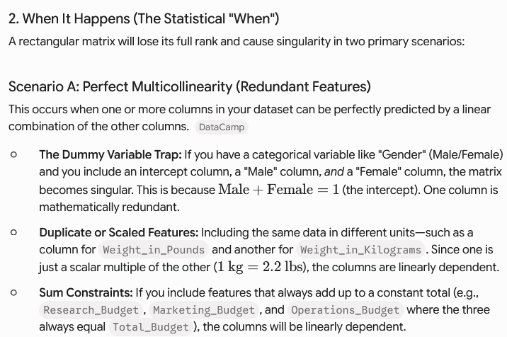
When can a Rectangular Matrix Be(come) Singular?

Slide 8
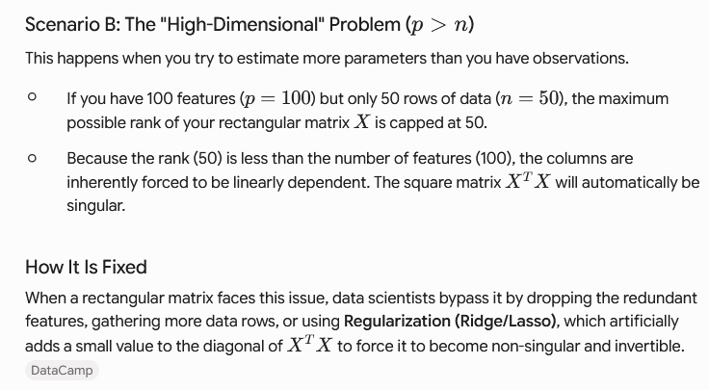
When can a Rectangular Matrix Be(come) Singular?

Slide 9

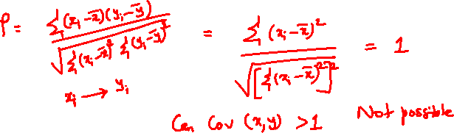
Too Much Correlation
"On the 'Demonstration of Variance-Covariance Principles' slide (Slide No. 2 of VarCovProblems_pyLinks.pptx), the sample problem lists a correlation coefficient value of '1.03'. If the correlation coefficient is equal to or greater than 1 ((>=1)), it should form a straight line rather than an ellipse, right? Could you kindly check this sample problem from the shared slide? Thanks in advance”

Slide 10
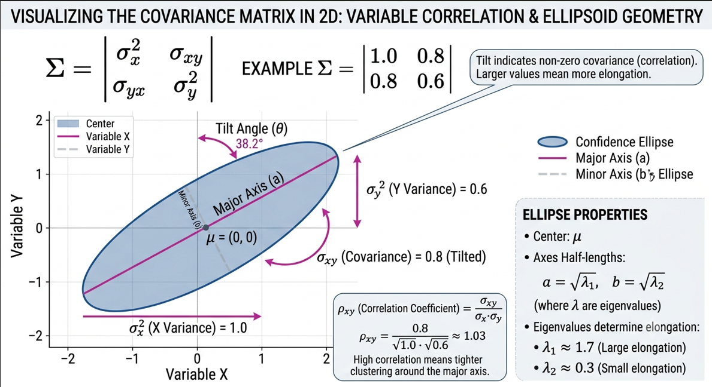
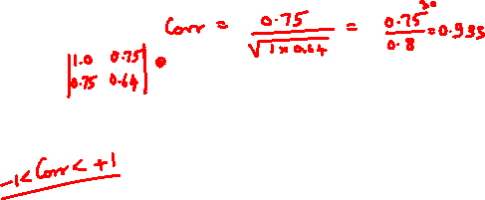
Demonstration of Variance-Covariance Principles

Slide 11
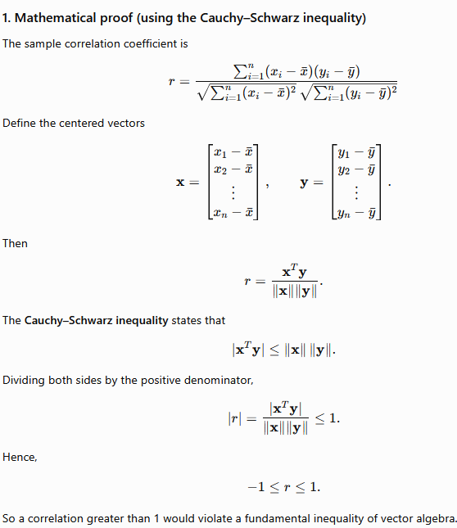
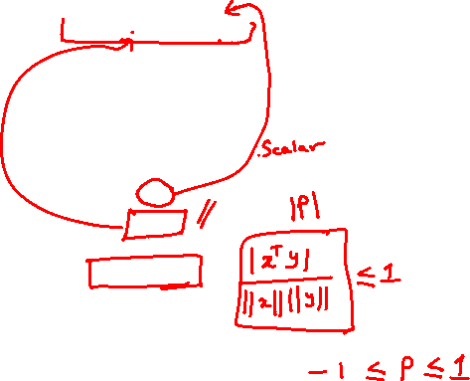

Slide 12
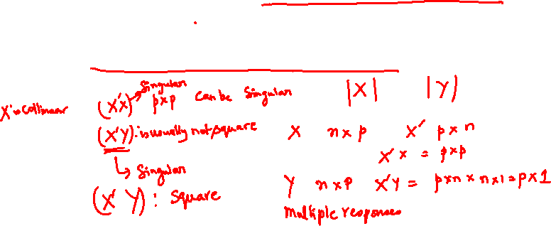
Covariance and Collinearity
Doubt :
Sir, when we say we need to maximize the covariance of X (with Y) in-order to find latent variable(s)
so here are we ignoring the collinearity in PLS as collinearity will be high in this case ?

Slide 13
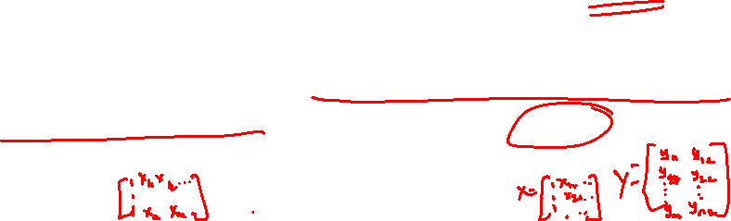
Covariance and Collinearity
Rephrasing the question:
By maximizing covariance between X and Y (scores), Y becomes strongly related to X and hence ‘collinear’ with Y. Does this mean we are ignoring collinearity between X and Y as collinearity will be high in this case?
X and Y are unchanged. There may be strong collinearity within X which makes linear regression infeasible.
Even in linear regression, strong strength of linear relationship (correlation) between X and Y is welcomed so that a good fit is achieved.
You put all X in one matrix but X and Y are separate matrices

Slide 14
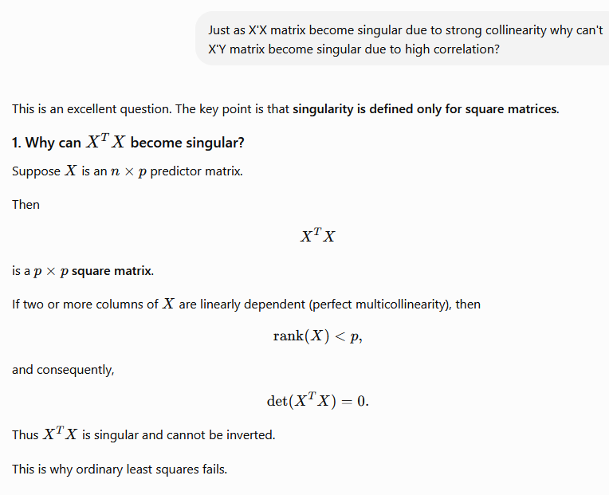


Slide 15
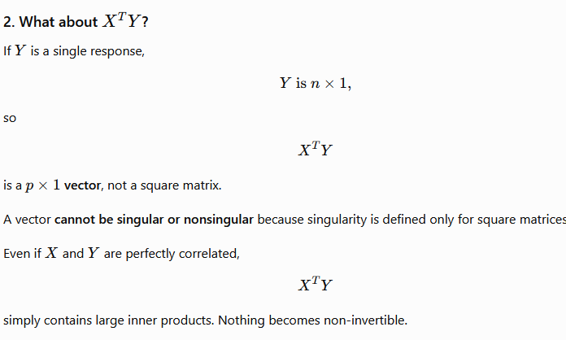
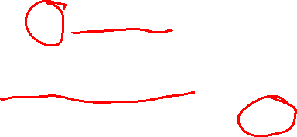
Covariance and Collinearity

Slide 16
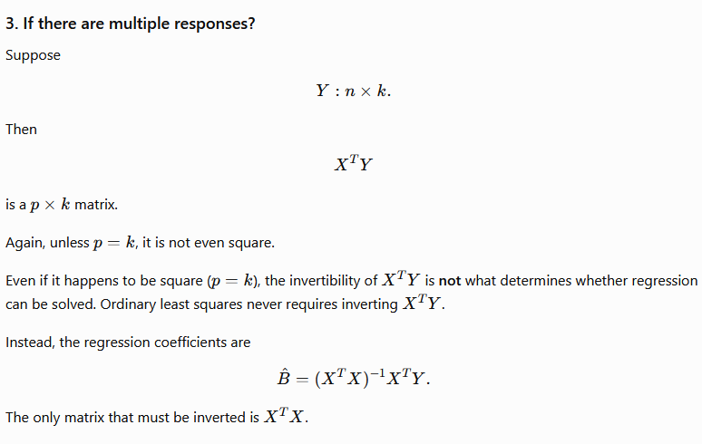
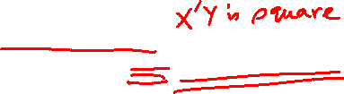
https://chatgpt.com/c/6a5e3f65-a90c-83ee-88d0-f7041512dfa4

Slide 17
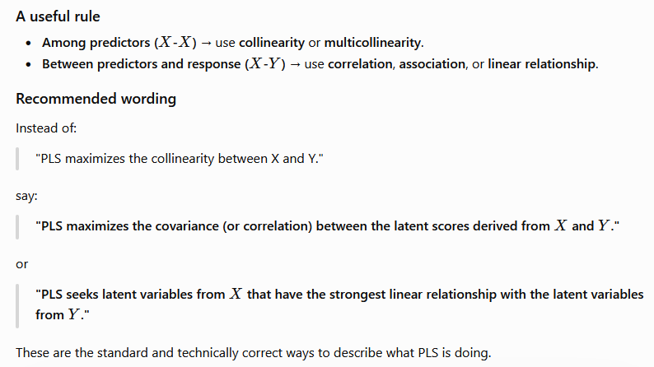

https://chatgpt.com/c/6a5e3f65-a90c-83ee-88d0-f7041512dfa4

Slide 18
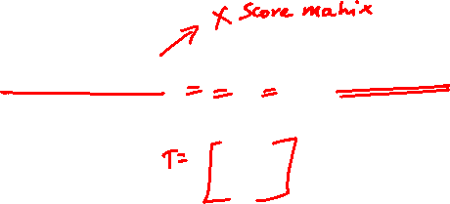
Covariance and Collinearity
X and Y are unchanged. There may be strong collinearity within X which makes linear regression infeasible. In PLS we are talking about (cor)relationship between X and Y.
As told in class we are finding relation between X and Y through T i.e., we express Y in terms of T.
While X may be collinear, the components of T (t₁,t₂,…t_{a}) are orthogonal. Hence the T matrix does not suffer from singularity issues when you related T to Y.

Slide 19
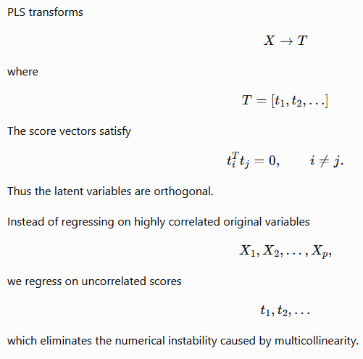

Slide 20
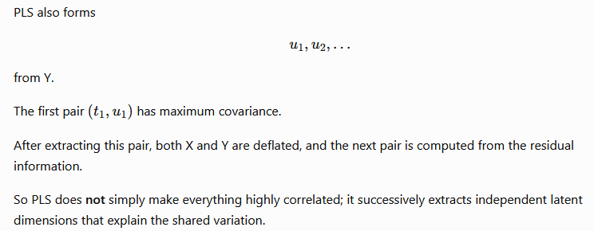

Slide 21
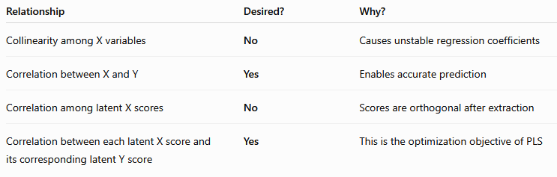
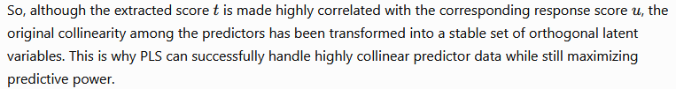


Slide 23
Covariance and Collinearity
Rephrasing the question:
By maximizing covariance between X and Y (scores), Y becomes strongly related to X and hence collinear with Y. Does this mean we are ignoring collinearity between X and Y as collinearity will be high in this case?
Answer:
In PLS we want to find suitable directions for the factors/latent variables/components.
We maximize covariance between the X and Y scores. T=Xw and U=Yq
We find (principal) components in PCA that maximize the variance in X alone.
In PLS we find the components by maximizing the covariance involving X and Y.
In PCA you have no Y just X.
In PLS and PCA you find directions of maximum variance or covariance. IN PLS the direction of the latent variables (factors) identified is based on maximizing covariance between X and Y which gives PLS its predictive power.

Slide 24
a

Slide 25
Covariance and Collinearity
Rephrasing the question:
Then how and where does PLS2 maximize the covariance between X and Y ?
Answer:
Taking a step back we find (principal) components in PCA that maximize the variance in X alone.
In PLS we find the components by maximizing the covariance involving X and Y.
In PCA you have no Y just X.
In PLS and PCA you find directions of maximum variance or covariance. IN PLS the direction of the latent variables (factors) identified is based on maximizing covariance between X and Y which gives PLS its predictive power.

