Slide 1
Kubernetes + ML Deployment

Slide 2
Recap
Cloud
Virtualization
Containers
Docker
Docker Images
Docker Networking
Kubernetes

Slide 3
docker tag ml-app:v1 quay.io/ppnaik/ml-app:v1
docker push quay.io/myorg/ml-app:v1

Slide 4
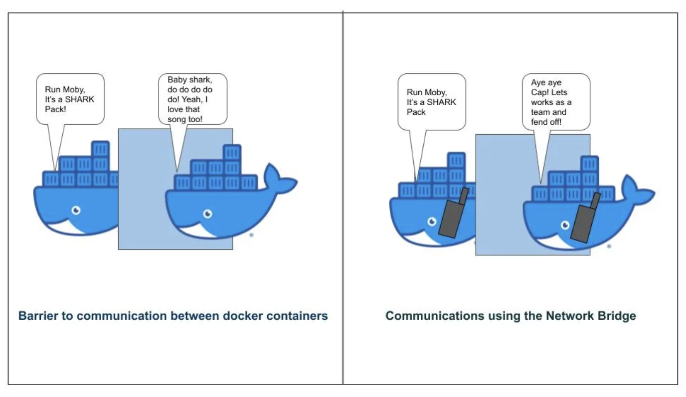

Slide 5
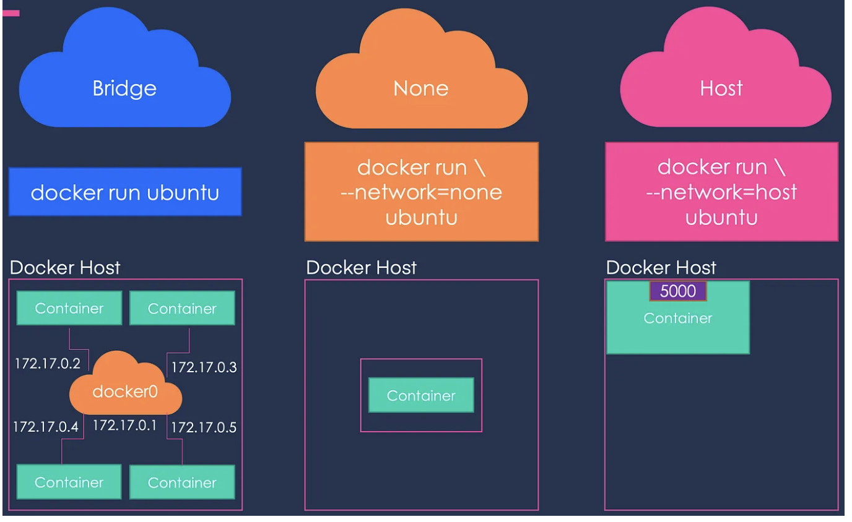
Docker Networking
Three networks created automatically - Bridge, Host, and None
The Bridge network assigns IPs in the range of 172.17.x.x to the containers
Host Mode: Accessible on the same port on the docker host without any explicit port mapping
None network keeps the container in complete isolation
Notes:
https://towardsdatascience.com/docker-networking-919461b7f498

Slide 6
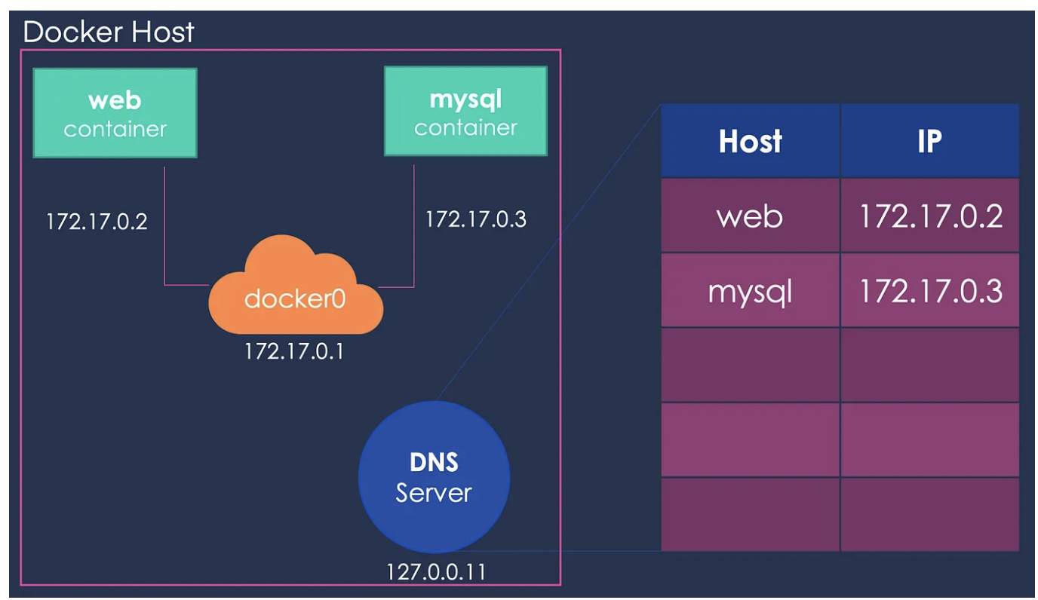
Docker Bridge Network
Default network container connect to bridge

Slide 7
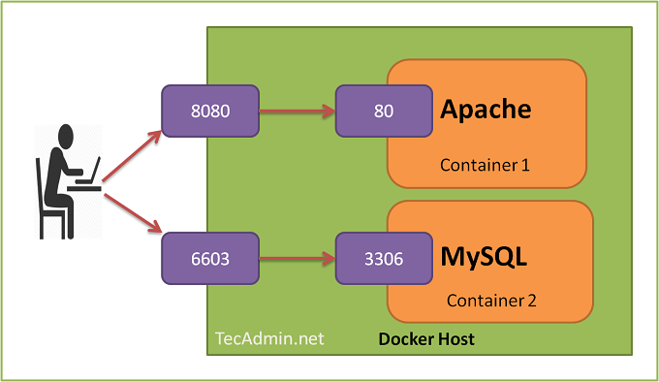
Container port forwarding
Dockerfile EXPOSE 80
https://tecadmin.net/tutorial/wp-content/uploads/2017/09/Docker-port-binding.png

Slide 8
Port forwarding
docker run -d --name mycontainer1 -p 8080:80 mypython-app:v1
See in action: go to browser and enter URL localhost:8080

Slide 9
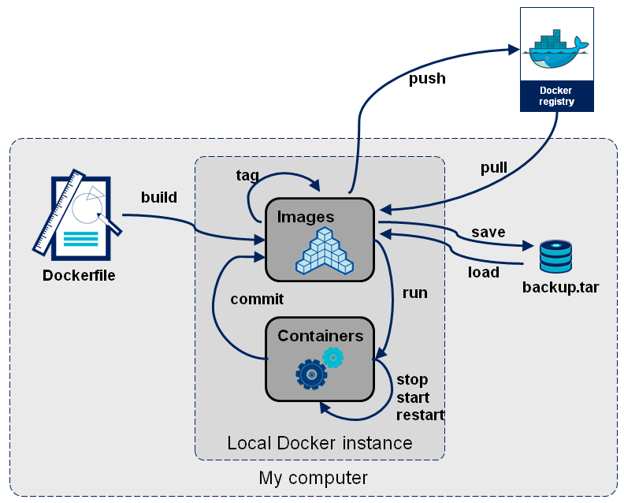
Docker commands summarized
https://blog.octo.com/docker-registry-first-steps/

Slide 10
Container orchestration

Slide 11
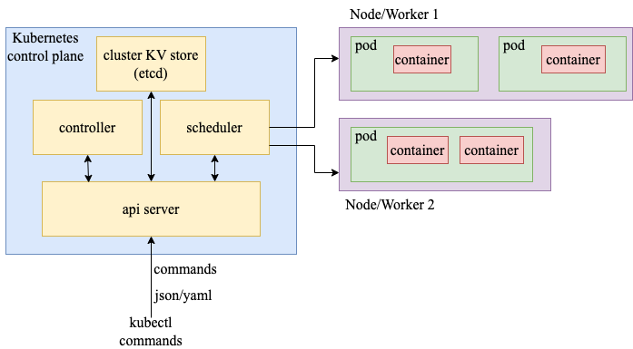
What is kubernetes?
Docker: Single machine container deployment
Kubernetes (k8s): Container Orchestration
Across a cluster of machines
Manage automated deployment, scaling

Slide 12
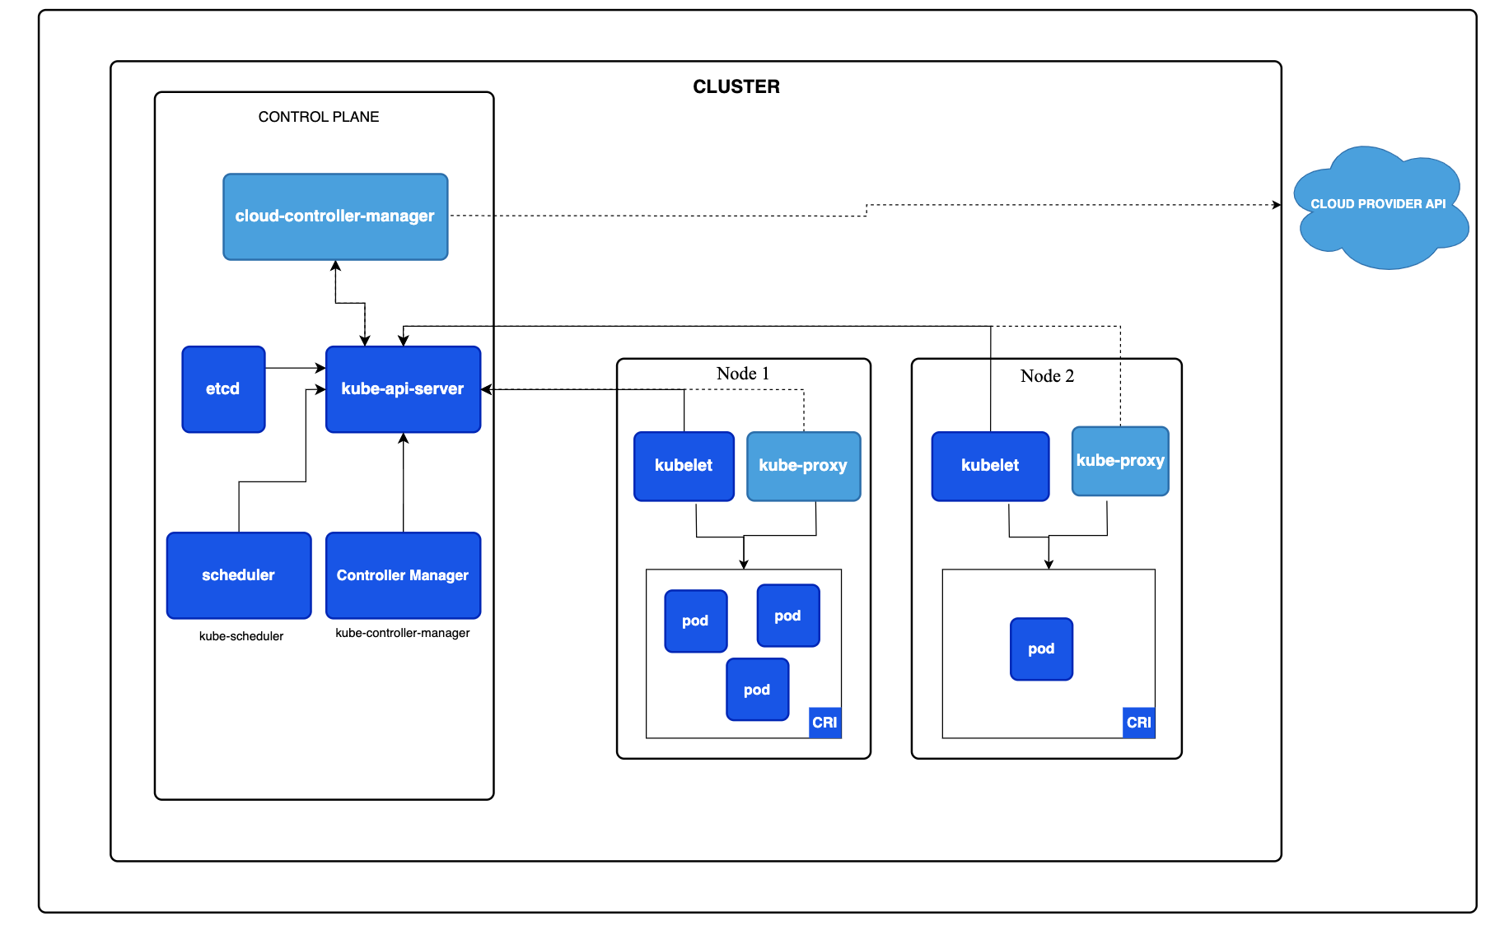
Kubernetes Architecture
REST based front end for k8s frontend

Slide 13
Kubernetes Architecture
highly-available key value store for backing k8s data

Slide 14
Kubernetes Architecture
Schedules pods to nodes Based on filtering and scoring

Slide 15
Kubernetes Architecture
runs on every node to ensure containers are in running state

Slide 16
Kubernetes Architecture
Maintains network rules on a node

Slide 17
Kubernetes Overview: Master and Worker Nodes
Kubernetes clusters consist of workers, each running pods
Control Plane: Manages workers and pods scheduling, fault-tolerance
kube-apiserver: REST based front end for k8s frontend
etcd: highly-available key value store for backing k8s data
Node Components:
kubelet: runs on every node to ensure containers are in running state
kube-proxy: Maintains network rules on a node.
container runtime: software for running containers. e.g. containerd, docker

Slide 18
Namespace
Namespace: Isolated environment for each user

Slide 19
Kubectl get started
Create a namespace
kubectl create namespace <urname>
Go to the namespace:
kubectl config set-context --current --namespace=<namespacename>
To test locally:
Install minikube
Install kubectl
Install docker/podman
minikube start --driver=docker
minikube kubectl create namespace abc
minikube kubectl -- config set-context --current --namespace=abc
alias kubectl="minikube kubectl --"

Slide 20
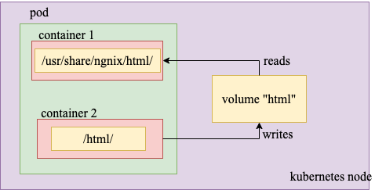
Pods
Application specific logical host.
single unit of deployment
group of containers with shared storage and network resources.
Notes:
Because we’re not supposed to pack multiple processes into a single container, we need a higher-level structure that will allow us to tie and wrap containers together and manage them as a single unit. This is the reasoning behind the pods. Simply put, a Kubernetes pod is a collection of containers.
A given Pod (as defined by a UID) is never "rescheduled" to a different node; instead, that Pod can be replaced by a new, near-identical Pod, with even the same name if desired, but with a different UID.
related thing (a volume, in this example) is also destroyed and created anew. Init containers can run with a different view of the filesystem than app containers in the same Pod. Consequently, they can be given access to Secrets that app containers cannot access.

Slide 21
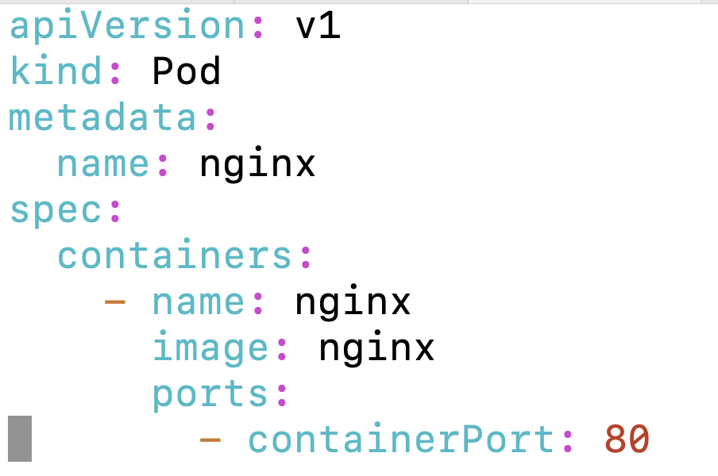
Pod Example add namespace
Create a single nginx pod:
kubectl apply -f ngnix-pod.yaml -n <namespace>
Check the pod:
kubectl describe pod nginx
Kubectl exec -it nginx -- /bin/bash
Notes:
Explain metadata,
How we get image
Various stages in pod creation
Sidecar and volume sharing
Advance + hw: init container start main container only when another pod endpoint is up
(give example of microservice chain)

Slide 22
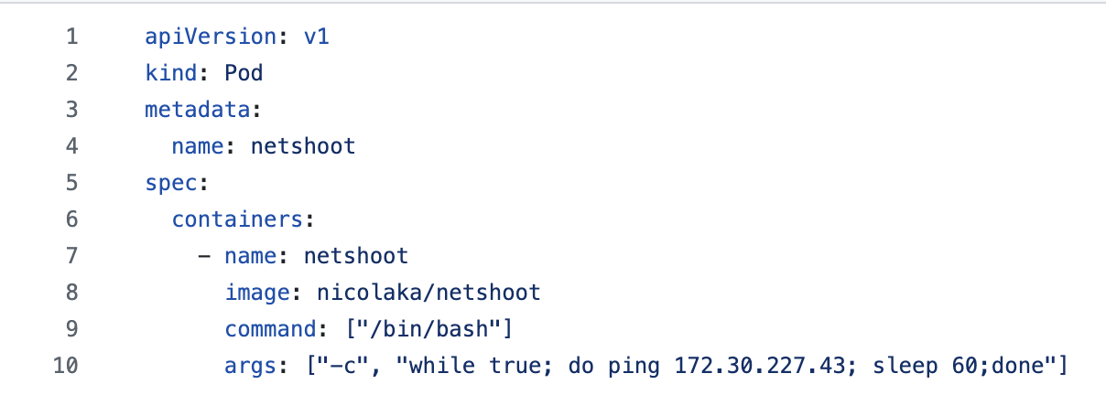
Another Pod Yaml Example

Slide 23
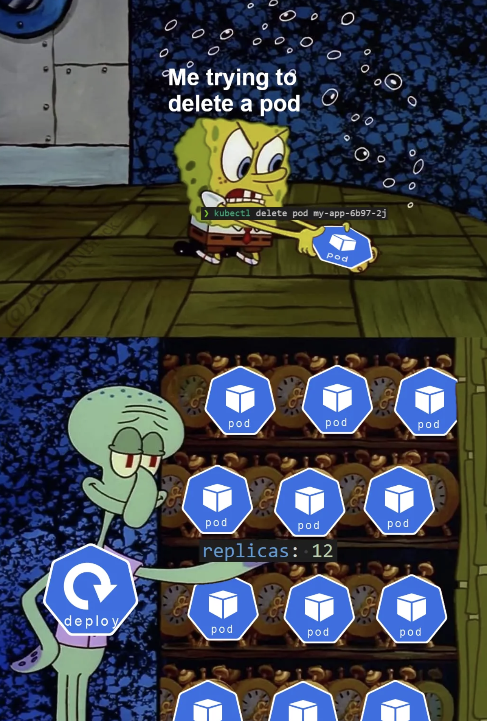
Deployments
Kubernetes Controllers
Features:
Rolling Update
Rollback
Version Control
Notes:
hey are implemented as a loop that monitors for changes in the resource and makes changes if necessary.
https://semaphoreci.com/blog/replicaset-statefulset-daemonset-deployments#:~:text=Hence%2C%20in%20comparison%20to%20ReplicaSets,database%20that%20requires%20persistent%20storage.

Slide 24
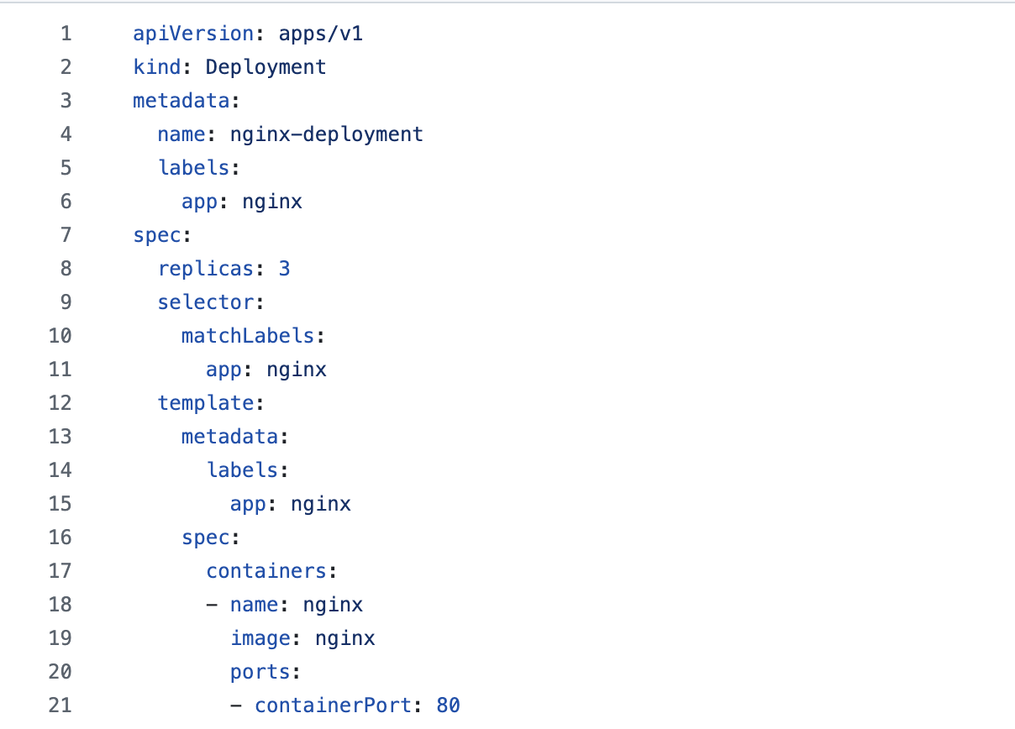

Slide 25

Deployment Example
kubectl apply -f nginx_dep.yaml
Replicas, delete and see them start
Notes:
Advance + hw: init container start main container only when another pod endpoint is up
(give example of microservice chain)
microk8s enable hostpath-storage

Slide 26
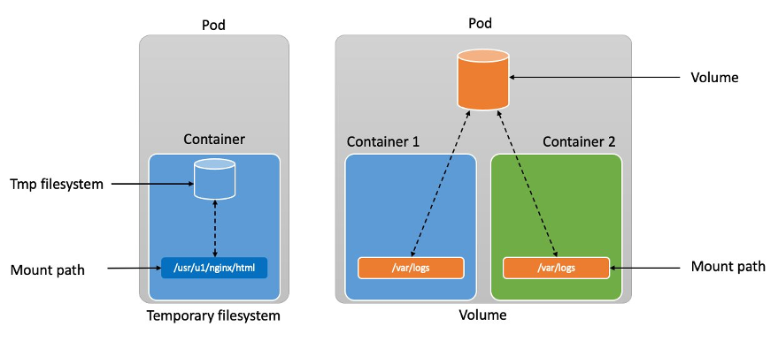
Persistent Volume

Slide 27
Persistent Volume and PersistentVolumeClaim
PersistentVolume (PV):
is a cluster resource
Implemented as plugin (hostpath,local,nfs)
Have a lifecycle independent of a pod
PersistentVolumeClaim (PVC) :
is a storage request from a user.
Request for volume similar to CPU, memory
PVC access modes: ReadWriteOnce, ReadOnlyMany, ReadWriteMany, or ReadWriteOncePod
Notes:
hostPath - HostPath volume (for single node testing only; WILL NOT WORK in a multi-node cluster; consider using local volume instead)
local - local storage devices mounted on nodes. Can be a acccesible to pod even if it moves (restarts)
nfs - Network File System (NFS) storage
ReadWriteOnce
the volume can be mounted as read-write by a single node. ReadWriteOnce access mode still can allow multiple pods to access the volume when the pods are running on the same node. For single pod access, please see ReadWriteOncePod.
ReadOnlyMany
the volume can be mounted as read-only by many nodes.
ReadWriteMany
the volume can be mounted as read-write by many nodes.
ReadWriteOncePod
FEATURE STATE: Kubernetes v1.29 [stable]
the volume can be mounted as read-write by a single Pod. Use ReadWriteOncePod access mode if you want to ensure that only one pod across the whole cluster can read that PVC or write to it.

Slide 28
Statefulset and Daemonset
Statefulset
Deployment and scaling of stateful pods
Stateful pod: requires persistent storage
Daemonset
An instance of the pod runs on each node
System daemons and background processes
https://semaphoreci.com/blog/replicaset-statefulset-daemonset-deployments
Notes:
Ngnix staefulset
apiVersion: apps/v1
kind: DaemonSet
metadata:
name: fluentd
spec:
selector:
matchLabels:
app: fluentd
template:
metadata:
labels:
app: fluentd
spec:
containers:
- name: fluentd
image: fluent/fluentd:v1.7.4-1.0
volumeMounts:
- name: varlog
mountPath: /var/log
terminationGracePeriodSeconds: 30
volumes:
- name: varlog
hostPath:
path: /var/log

Slide 29
Services
Abstraction for an application running multiple replica
Service discovery to find matching endpoint
Multi-port Service
Type:
ClusterIP:
NodePort:
LoadBalancer:
ExternalName:
Service Discovery
Notes:
https://kubernetes.io/docs/concepts/services-networking/service/#services-without-selectors Handle external application as well (when used without selector, needs to have endpoint IP then)
Multi port service

Slide 30
Types of Service
ClusterIP:
Default service type. Accessible within the cluster
NodePort:
Allocates a port on each node to forward request to the service
--service-node-port-range flag (default: 30000-32767)
Load Balancer
Traffic from the external load balancer is directed at the backend Pods.
You can specify a loadBalancerIP or use ephemeral IP
ExternalName
Service to a DNS name
my.database.example.com
Notes:
If you want to specify particular IP address(es) to proxy the port, you can set the --nodeport-addresses flag for kube-proxy or the equivalent nodePortAddresses field of the kube-proxy configuration file to particular IP block(s).
apiVersion: v1
kind: Service
metadata:
name: example-service
spec:
selector:
app: example
ports:
- port: 8765
targetPort: 9376
type: LoadBalancer

Slide 31
Service
kubectl apply -f nginx-service.yaml
kubectl describe service nginx-service
Check connectivity (use the netshoot pod)
curl <serviceIP:port>
Which IP, which port ??

Slide 32
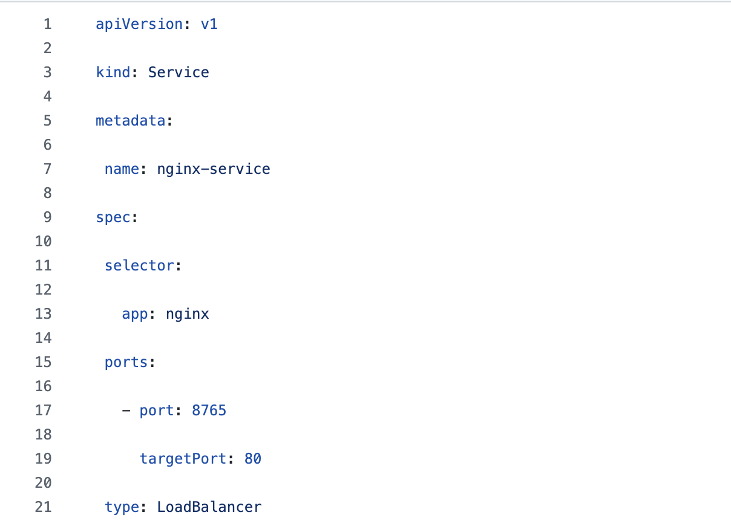

Slide 33
Ml-app example
kubectl apply -f configmap.yaml
kubectl apply -f pv.yaml
kubectl apply -f deployment.yaml
kubectl port-forward -n ml-app svc/ml-app 8002:80
curl -X POST http://localhost:8002/predict \
-H "Content-Type: application/json" \
-d '{"texts": ["This movie was amazing!"]}'

Slide 34
Try it out
https://github.com/pnl-iiitd/acm_fsn/tree/main (k8s and service)
https://medium.com/aspnetrun/deploying-microservices-on-kubernetes-35296d369fdb

Slide 35
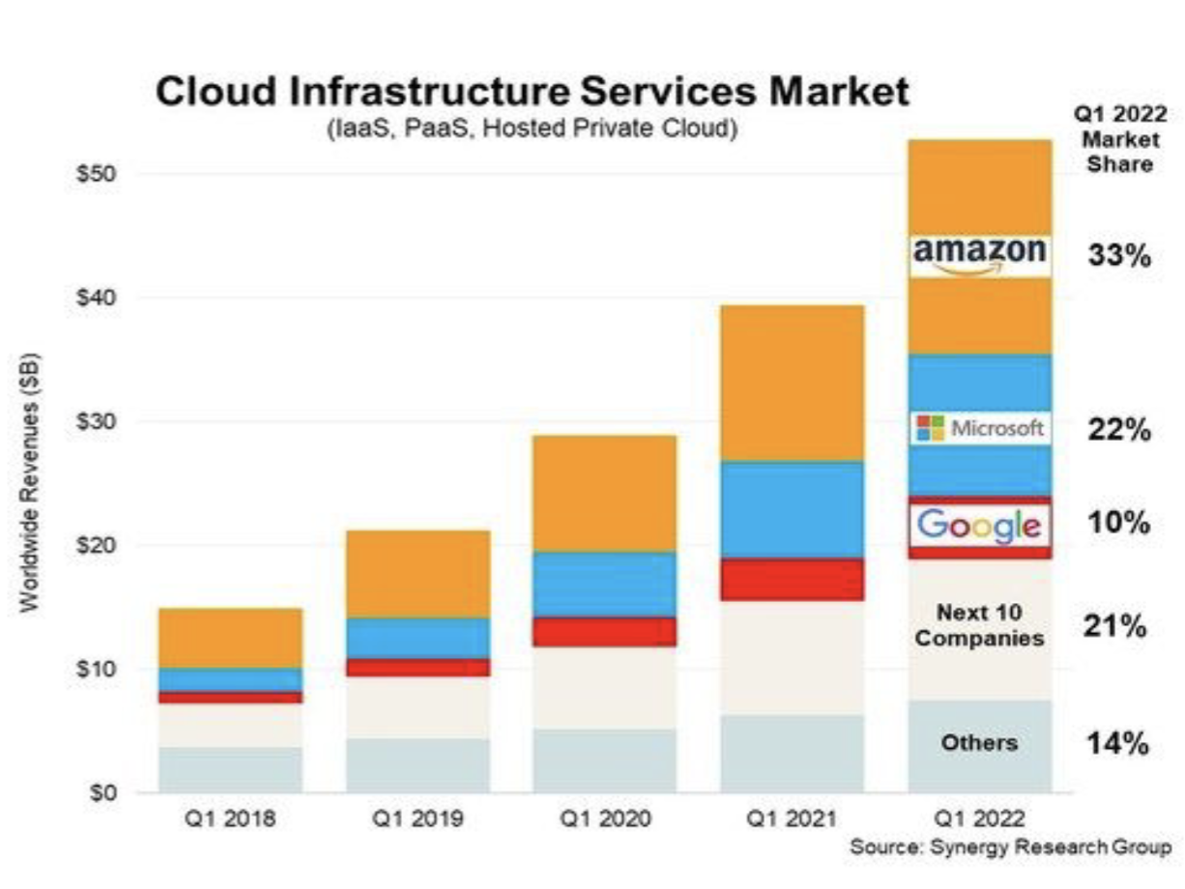
Cloud Market

Slide 36
Hyperscale Cloud Providers
 | AWS EC2 | Azure | GCP
Providers | Amazon | Microsoft | Google
Strengths | Market leader/ Pricing Model | Integration with Microsoft suite | Fastest growing for AI-ML market
Users | Netflix, Airbnb, Coursera | HSBC, Starbucks, HP | Paypal, Unilever, Toyota
Scale | 200 Data centers (22 regions) | More regions (66) | 26 regions, Low latency
Notes:
Aws avings plans for predictable workloads.

Slide 37

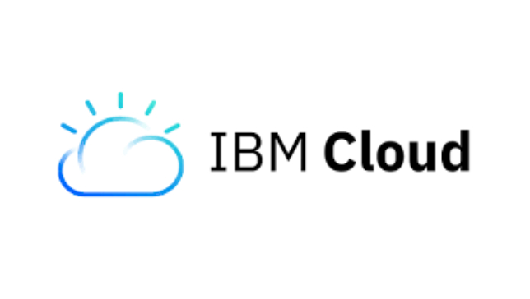

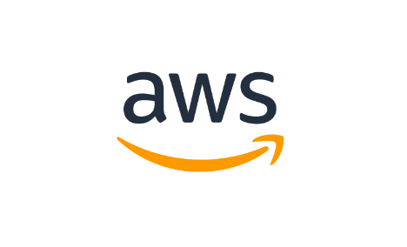
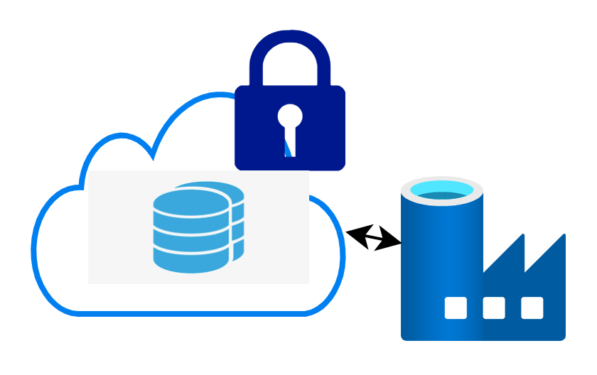
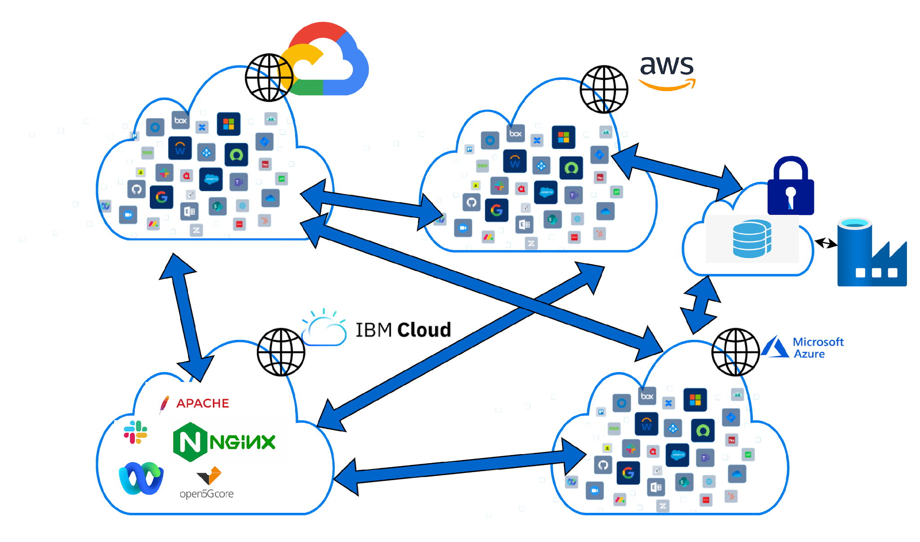
Hybrid Cloud
Public Cloud
Private Cloud/ On Prem
Multi-Cloud

