Slide 1
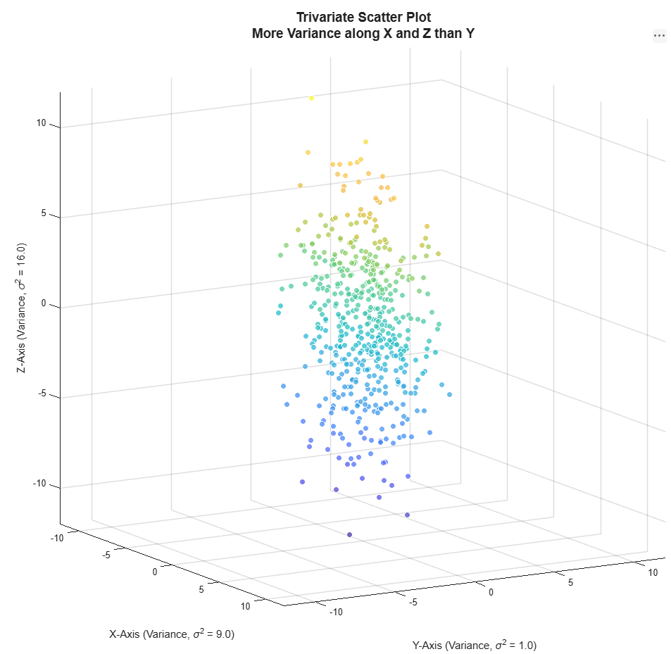
Statistical Distance

Slide 2
Reference Books
Brereton R. J., The Chi Squared and Multinormal Distributions, J. Chemometrics 2015, 29: 9–12
Johnson R A and D W Wichern, Applied Multivariate Statistical Analysis, Prentice Hall, 2002.
Maiti J, Multivariate Statistical Modeling in Engineering and Management, CRC Press, 2023

Slide 3
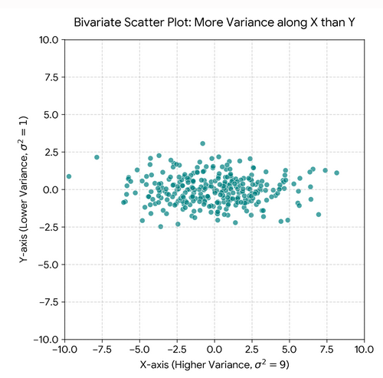
Two-Dimensional Scattered Data Plot
Consider Fig. on RHS, a bivariate scatter plot of variables X and Y
The population (sample) is characterized by the two variables X and Y
The population (sample) shows scattered values along both X and Y dimensions.
Variability along X ( σ_{X}² ) is greater than along Y (say σ_{Y}²),
The two variables are not correlated

Slide 4
Two-Dimensional Scattered Data Plot
Data Generation: The dataset consists of 300 points drawn from a bivariate normal distribution where the dimensions are independent.
X-axis Variance: The standard deviation along the X-axis is set to σ_{x}​=3.0, yielding a variance of σ_{x}²​=9.0
Y-axis Variance: The standard deviation along the Y-axis is set to σ_{y​}=1.0, yielding a variance of σ_{y}²​=1.0
Visual Scale: To accurately represent the true geometric difference in variance without stretching distortion, the plot utilizes an equal aspect ratio with symmetric axis limits ranging from −10 to 10.
The data points stretch horizontally into an elongated oval shape, clearly demonstrating that the spread (dispersion) of data is 3 times wider along the X-axis than along the Y-axis.

Slide 5
Python Code: 2 D Scatter Plot
import numpy as np
import matplotlib.pyplot as plt
# Set random seed for reproducibility
np.random.seed(42)
# Generate data: X has a variance of 9, Y has a variance of 1
x = np.random.normal(loc=0, scale=3.0, size=300)
y = np.random.normal(loc=0, scale=1.0, size=300)
# Create the scatter plot using subplots
fig, ax = plt.subplots(figsize=(8, 6))
ax.scatter(x, y, alpha=0.7, color='teal', edgecolor='w', linewidth=0.5)
# Set titles and labels using LaTeX formatting
ax.set_title('Bivariate Scatter Plot: More Variance along X than Y', fontsize=14, pad=15)
ax.set_xlabel('X-axis (Higher Variance, $\sigma^2 = 9$)', fontsize=12)
ax.set_ylabel('Y-axis (Lower Variance, $\sigma^2 = 1$)', fontsize=12)
# Set equal aspect ratio and matching limits to perfectly visualize the variance difference
ax.set_aspect('equal', adjustable='box')
ax.set_xlim(-10, 10)
ax.set_ylim(-10, 10)
ax.grid(True, linestyle='--', alpha=0.5)
plt.tight_layout()
plt.savefig('scatter_plot_variance.png', dpi=300)

Slide 6
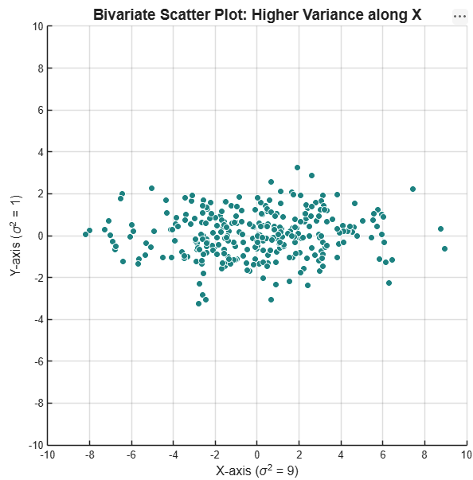
Matlab Code: 2 D Scatter Plot
% 1. Set seed for reproducibility
rng(42);
% 2. Define parameters (X has higher variance than Y)
num_points = 300;
mean_x = 0; mean_y = 0;
std_x = 3.0; std_y = 1.0; % Variance X = 9, Variance Y = 1
% 3. Generate independent normally distributed data
x = mean_x + std_x * randn(num_points, 1);
y = mean_y + std_y * randn(num_points, 1);
% 4. Create the scatter plot
figure('Color', 'w'); % Open a white background figure
scatter(x, y, 35, 'filled', 'MarkerFaceColor', [0 0.5 0.5], 'MarkerEdgeColor', 'w');
% 5. Format labels and titles
title('Bivariate Scatter Plot: Higher Variance along X', 'FontSize', 14);
xlabel('X-axis (\sigma^2 = 9)', 'FontSize', 12);
ylabel('Y-axis (\sigma^2 = 1)', 'FontSize', 12);
% 6. Adjust axes for true geometric representation
grid on;
axis equal; % CRITICAL: Keeps 1 unit on X equal to 1 unit on Y
xlim([-10, 10]);
ylim([-10, 10]);

Slide 7
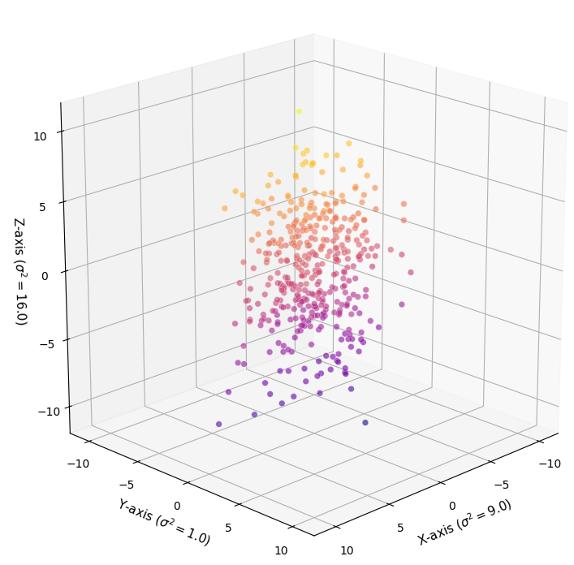
Python Code: 3 D Scatter Plot
import numpy as np
import matplotlib.pyplot as plt
# Set random seed for reproducibility
np.random.seed(101)
# Generate 3D data with specified variances
# X variance: std = 3.0 -> var = 9.0
# Y variance: std = 1.0 -> var = 1.0
# Z variance: std = 4.0 -> var = 16.0
n_samples = 400
x = np.random.normal(loc=0, scale=3.0, size=n_samples)
y = np.random.normal(loc=0, scale=1.0, size=n_samples)
z = np.random.normal(loc=0, scale=4.0, size=n_samples)
# Create 3D subplot
fig, ax = plt.subplots(figsize=(8, 8), subplot_kw={"projection": "3d"})
# Plot the 3D scatter points
sc = ax.scatter(x, y, z, c=z, cmap='plasma', alpha=0.6, edgecolors='w', linewidth=0.3, s=30)
# Set labels using LaTeX formatting
ax.set_xlabel('X-axis ($\sigma^2 = 9.0$)', fontsize=11)
ax.set_ylabel('Y-axis ($\sigma^2 = 1.0$)', fontsize=11)
ax.set_zlabel('Z-axis ($\sigma^2 = 16.0$)', fontsize=11)
ax.set_title('Tri-variate Scatter Plot (Uniform 1:1:1 Spatial Axes)', fontsize=13, pad=20)
# CRITICAL: Force the physical bounding box to be a perfect cube
ax.set_box_aspect([1, 1, 1])
# Enforce uniform coordinate limits across all axes
ax.set_xlim(-12, 12)
ax.set_ylim(-12, 12)
ax.set_zlim(-12, 12)
# Adjust viewing angle for an optimal 3D perspective
ax.view_init(elev=20, azim=45)
plt.tight_layout()
plt.show()

Slide 8
Matlab Code: 3-D Scatter Plot
% 1. Set random seed for reproducibility
rng(101);
% 2. Define statistical parameters (Standard Deviations)
num_points = 500;
std_x = 3.0; % Variance (sigma^2) = 9.0
std_y = 1.0; % Variance (sigma^2) = 1.0
std_z = 4.0; % Variance (sigma^2) = 16.0
% 3. Generate independent normally distributed data
x = std_x * randn(num_points, 1);
y = std_y * randn(num_points, 1);
z = std_z * randn(num_points, 1);
% 4. Create a clean figure with a white background
figure('Color', 'w', 'Position', [100, 100, 750, 650]);
% 5. Generate 3D scatter plot
% Points are color-mapped by their Z-axis values using the 'parula' colormap
scatter3(x, y, z, 35, z, 'filled', 'MarkerEdgeColor', 'w', 'MarkerFaceAlpha', 0.7);
colormap('parula');
cb = colorbar;
ylabel(cb, 'Z-Value Intensity', 'FontSize', 10);
% 6. Add labels containing the explicit variance (\sigma^2) values
title({'Trivariate Scatter Plot', 'More Variance along X and Z than Y'}, 'FontSize', 14, 'FontWeight', 'bold');
xlabel('X-Axis (Variance, \sigma^2 = 9.0)', 'FontSize', 11);
ylabel('Y-Axis (Variance, \sigma^2 = 1.0)', 'FontSize', 11);
zlabel('Z-Axis (Variance, \sigma^2 = 16.0)', 'FontSize', 11);
% 7. CRITICAL: Force uniform spatial distance scale along all 3 axes
grid on;
axis equal; % Ensures 1 unit physically looks the same on X, Y, and Z
% 8. Enforce identical bounding limits to maintain a perfect cubic grid
axis_limit = 12;
xlim([-axis_limit, axis_limit]);
ylim([-axis_limit, axis_limit]);
zlim([-axis_limit, axis_limit]);
% 9. Set the optimal 3D isometric perspective view (Azimuth, Elevation)
view(40, 25);

Slide 9
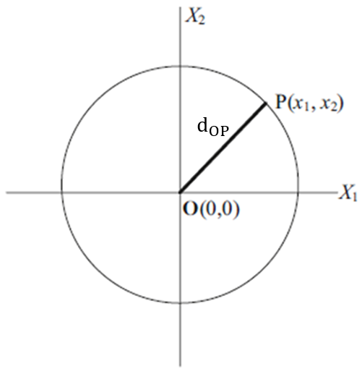
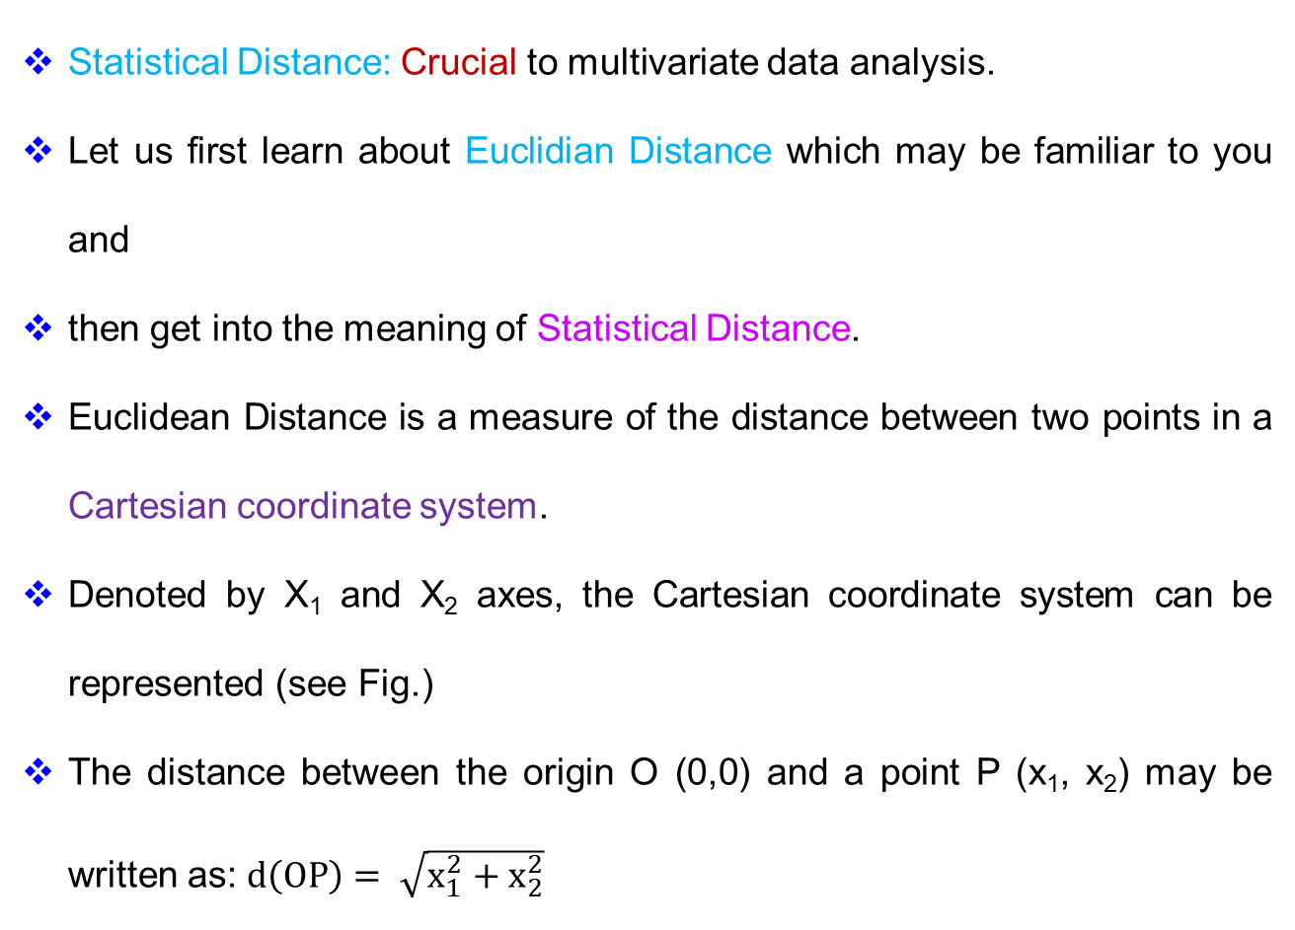
Some Essential Background
Statistical Distance: Crucial to multivariate data analysis.
Let us first learn about Euclidian Distance which may be familiar to you and
then get into the meaning of Statistical Distance.
Euclidean Distance is a measure of the distance between two points in a Cartesian coordinate system.
Denoted by X₁ and X₂ axes, the Cartesian coordinate system can be represented (see Fig.)
The distance between the origin O (0,0) and a point P (x₁, x₂) may be written as: $d\left(OP\right)= \sqrt{x_{1}^{2}+x_{2}^{2}}$

Slide 10
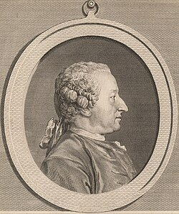
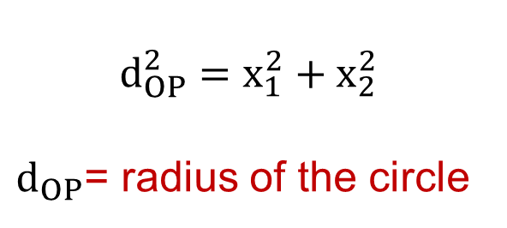
The specific algebraic formula used to calculate this distance was not actually written by Euclid.
Instead, the distance formula itself was first published in 1731 by the French mathematician Alexis Clairaut.
It builds upon the Pythagorean theorem and the Cartesian coordinate system introduced by René Descartes in 1637
Alexis Clairaut
$$d_{OP}^{2}=x_{1}^{2}+x_{2}^{2}$$
$d_{OP}$= radius of the circle

Slide 11
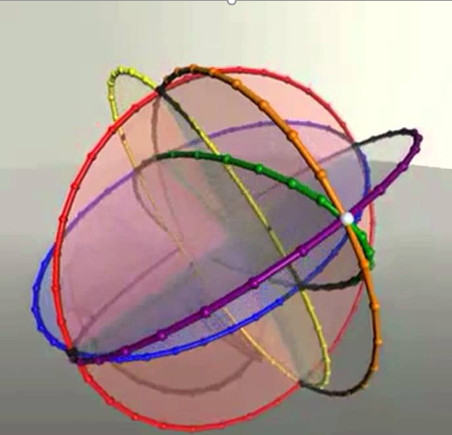
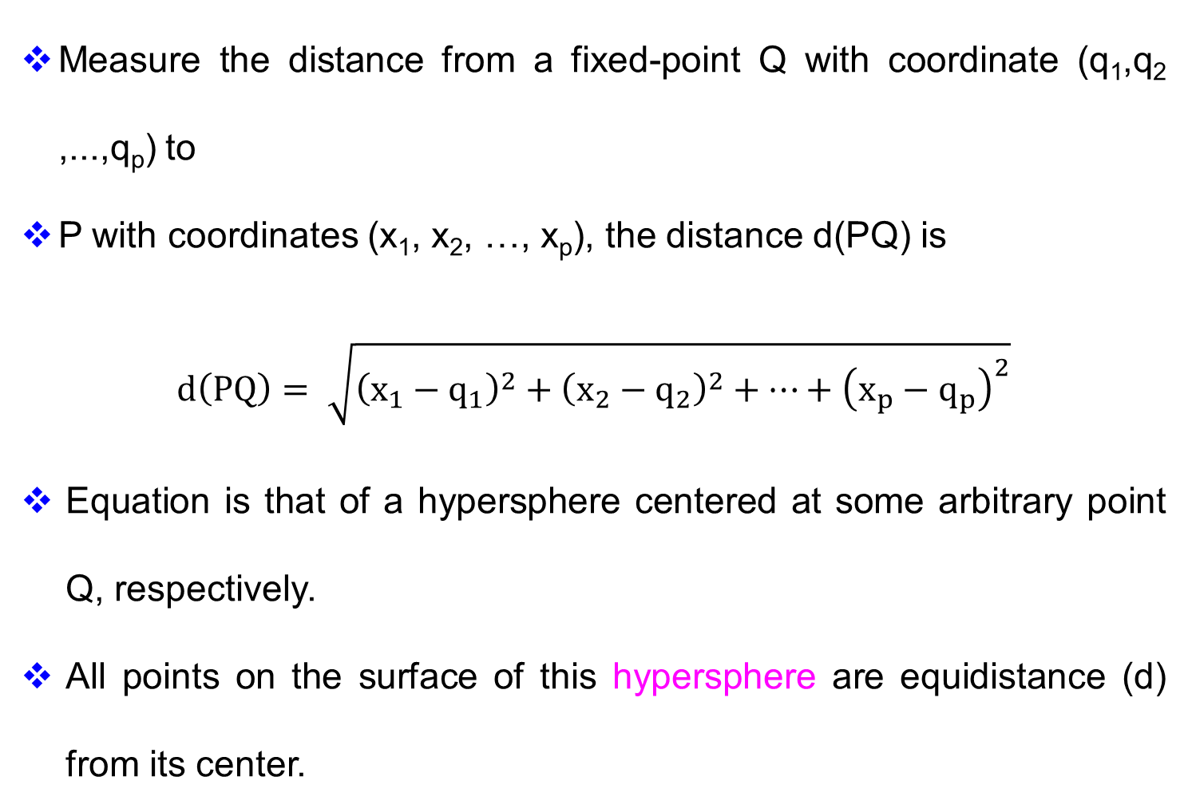
Euclidean Distance: General Form
Measure the distance from a fixed-point Q with coordinate (q₁,q₂ ,...,q_{p}) to
P with coordinates (x₁, x₂, …, x_{p}), the distance d(PQ) is
$$d\left(PQ\right)= \sqrt{{\left(x_{1}−q_{1}\right)}^{2}+{\left(x_{2}−q_{2}\right)}^{2}+…+{\left(x_{p}−q_{p}\right)}^{2}}$$
Equation is that of a hypersphere centered at some arbitrary point Q, respectively.
All points on the surface of this hypersphere are equidistance (d) from its center.
hypersphere
https://www.youtube.com/watch?v=XFW769hqa1U

Slide 12
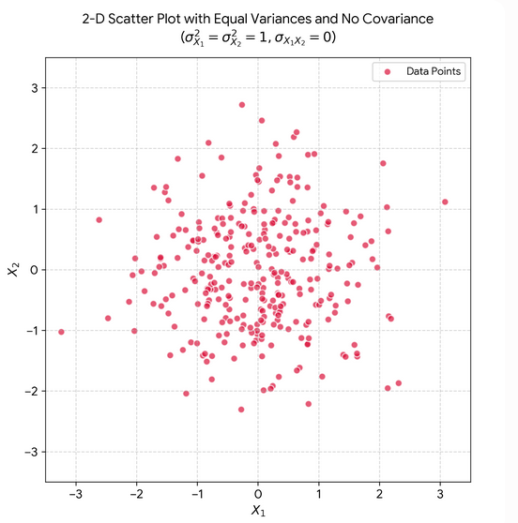
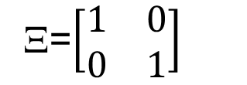
A. Uncorrelated X₁ and X₂ With Equal Variances
Let us now consider four applications A, B, C, and D, each characterized with two variables X₁ and X₂.
The scatter plots for each of the four applications are shown in this and other slides
Every point on the scatter is a bivariate observation
The data for process A exhibit a circular pattern that is indicative of equal spread (variance) for the two variables X₁ and X₂.
In such a case, there is no correlation between the two variables X₁ and X₂.
Ξ=$\left[\begin{matrix}1 & 0 \\ 0 & 1\end{matrix}\right]$
Notes:
Let us now consider four processes A, B, C, and D, each characterized with two variables X1 and X2. Let one observed n data points for each of the four processes and the scatter plots of the n points are shown in Figure 5.2. What can one interpret about the four processes based on the scatter plots? Every point on the scatter is a bivariate observation and is measured in the two- dimensional statistical system (X1, X2). The data for process A (Figure 5.2, top left) exhibit a circular pattern that is indicative of equal spread (variance) for the two variables X1 and X2. There is no correlation between

Slide 13
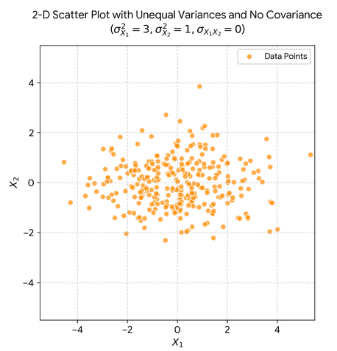
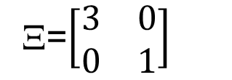
B. Uncorrelated X₁ and X₂ with Different Variances
The data for process A exhibit an elliptic pattern that is indicative of different spread (variance) for the two variables X₁ and X₂.
However, there is no correlation between the two variables X₁ and X₂.
Ξ=$\left[\begin{matrix}3 & 0 \\ 0 & 1\end{matrix}\right]$
Notes:
Let us now consider four processes A, B, C, and D, each characterized with two variables X1 and X2. Let one observed n data points for each of the four processes and the scatter plots of the n points are shown in Figure 5.2. What can one interpret about the four processes based on the scatter plots? Every point on the scatter is a bivariate observation and is measured in the two- dimensional statistical system (X1, X2). The data for process A (Figure 5.2, top left) exhibit a circular pattern that is indicative of equal spread (variance) for the two variables X1 and X2. There is no correlation between

Slide 14
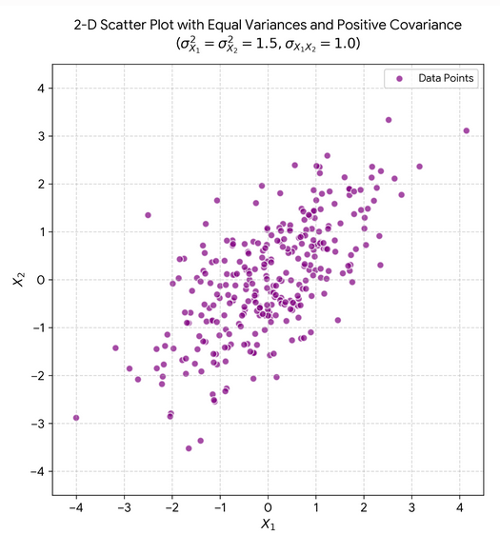
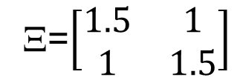
C. Positively Correlated X₁ and X₂ with Same Variances
The data for process C exhibit an elliptic pattern with equal variance for the two variables X₁ and X₂.
However, there is a positive correlation between the two variables X₁ and X₂.
Ξ=$\left[\begin{matrix}1.5 & 1 \\ 1 & 1.5\end{matrix}\right]$
Notes:
Let us now consider four processes A, B, C, and D, each characterized with two variables X1 and X2. Let one observed n data points for each of the four processes and the scatter plots of the n points are shown in Figure 5.2. What can one interpret about the four processes based on the scatter plots? Every point on the scatter is a bivariate observation and is measured in the two- dimensional statistical system (X1, X2). The data for process A (Figure 5.2, top left) exhibit a circular pattern that is indicative of equal spread (variance) for the two variables X1 and X2. There is no correlation between

Slide 15
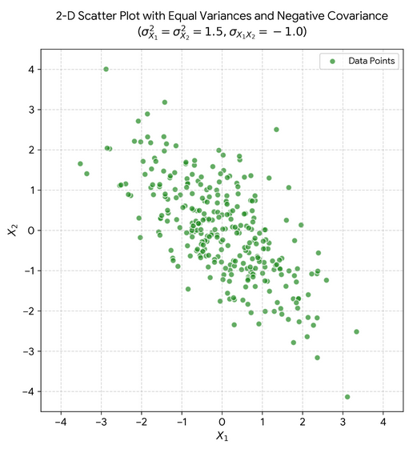
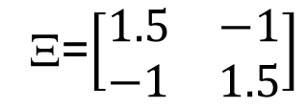
C. Negatively Correlated X₁ and X₂ with Same Variances
The data for process C exhibit an elliptic pattern with equal variances for the two variables X₁ and X₂.
However, there is a negative correlation between the two variables X₁ and X₂.
Ξ=$\left[\begin{matrix}1.5 & −1 \\ −1 & 1.5\end{matrix}\right]$
Notes:
Let us now consider four processes A, B, C, and D, each characterized with two variables X1 and X2. Let one observed n data points for each of the four processes and the scatter plots of the n points are shown in Figure 5.2. What can one interpret about the four processes based on the scatter plots? Every point on the scatter is a bivariate observation and is measured in the two- dimensional statistical system (X1, X2). The data for process A (Figure 5.2, top left) exhibit a circular pattern that is indicative of equal spread (variance) for the two variables X1 and X2. There is no correlation between

Slide 16
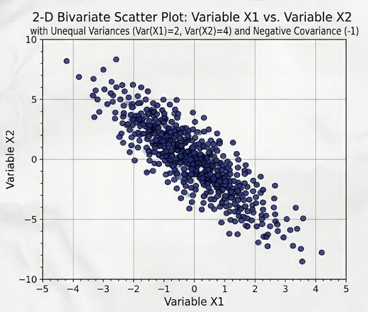
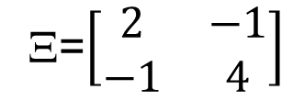
D. Negatively Correlated X₁ and X₂ with Different Variances
The data for process C exhibit an elliptic pattern that is indicative of unequal variances for the two variables X₁ and X₂.
Moreover, there is a negative correlation between the two variables X₁ and X₂.
Ξ=$\left[\begin{matrix}2 & −1 \\ −1 & 4\end{matrix}\right]$
Notes:
Let us now consider four processes A, B, C, and D, each characterized with two variables X1 and X2. Let one observed n data points for each of the four processes and the scatter plots of the n points are shown in Figure 5.2. What can one interpret about the four processes based on the scatter plots? Every point on the scatter is a bivariate observation and is measured in the two- dimensional statistical system (X1, X2). The data for process A (Figure 5.2, top left) exhibit a circular pattern that is indicative of equal spread (variance) for the two variables X1 and X2. There is no correlation between

Slide 17
D. Preamble for Statistical Distance
For computing statistical distance the following conditions may be stated:
Every application is characterized by two (bivariate) or more variables >2 (multivariate) system
The variables, each taken as an individual group, may or may not have equal variance.
The variables, may be either independent or correlated
Variance- covariance relationships given by the Σ matrix define the pattern in the data.
The pattern may be captured through appropriate distance measure.

Slide 18
Some Essential Background
Now let us consider Application B.
The pattern that defines the data is an ellipse.
Here the major and minor axes of the ellipse are parallel to the XY−coordinate system.
The center C is at the origin (0,0),
C
Notes:
Let us now consider four processes A, B, C, and D, each characterized with two variables X1 and X2. Let one observed n data points for each of the four processes and the scatter plots of the n points are shown in Figure 5.2. What can one interpret about the four processes based on the scatter plots? Every point on the scatter is a bivariate observation and is measured in the two- dimensional statistical system (X1, X2). The data for process A (Figure 5.2, top left) exhibit a circular pattern that is indicative of equal spread (variance) for the two variables X1 and X2. There is no correlation between

Slide 19
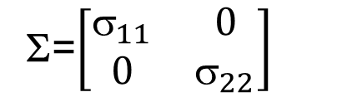

Uncorrelated Variables
No correlation between X₁ and X₂
X₁ and X₂ are independent
From Process C, it is seen that σ₁₁ is 3 times more than σ₂₂.
To obtain the statistical distance of P(X₁,X₂) from C(0,0), we first require the coordinates to be on equal footing (standardizing).
Standardizing is possible by the following transformation
Ξ=$\left[\begin{matrix}3 & 0 \\ 0 & 1\end{matrix}\right]$
Σ=$\left[\begin{matrix}_{11} & 0 \\ 0 & σ_{22}\end{matrix}\right]$
P
C
Notes:
Let us now consider four processes A, B, C, and D, each characterized with two variables X1 and X2. Let one observed n data points for each of the four processes and the scatter plots of the n points are shown in Figure 5.2. What can one interpret about the four processes based on the scatter plots? Every point on the scatter is a bivariate observation and is measured in the two- dimensional statistical system (X1, X2). The data for process A (Figure 5.2, top left) exhibit a circular pattern that is indicative of equal spread (variance) for the two variables X1 and X2. There is no correlation between

Slide 20
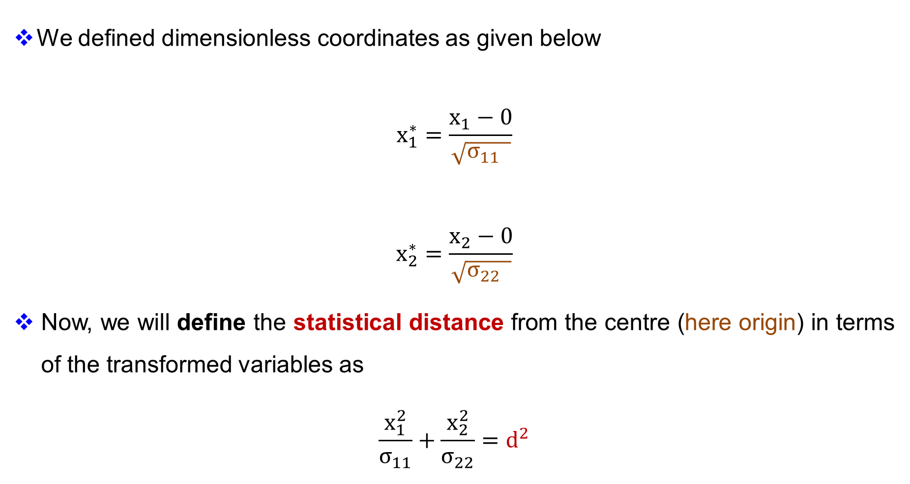
Equal Footing
We defined dimensionless coordinates as given below
$$x_{1}^{∗}=\frac{x_{1}−0}{\sqrt{σ_{11} }}$$
$$x_{2}^{∗}=\frac{x_{2}−0}{\sqrt{σ_{22} }}$$
Now, we will define the statistical distance from the centre (here origin) in terms of the transformed variables as
$$\frac{x_{1}^{2}}{σ_{11}}+\frac{x_{2}^{2}}{σ_{22}}=d^{2}$$
Note the square root on the variance to give the standard deviation
Notes:
Let us now consider four processes A, B, C, and D, each characterized with two variables X1 and X2. Let one observed n data points for each of the four processes and the scatter plots of the n points are shown in Figure 5.2. What can one interpret about the four processes based on the scatter plots? Every point on the scatter is a bivariate observation and is measured in the two- dimensional statistical system (X1, X2). The data for process A (Figure 5.2, top left) exhibit a circular pattern that is indicative of equal spread (variance) for the two variables X1 and X2. There is no correlation between

Slide 21


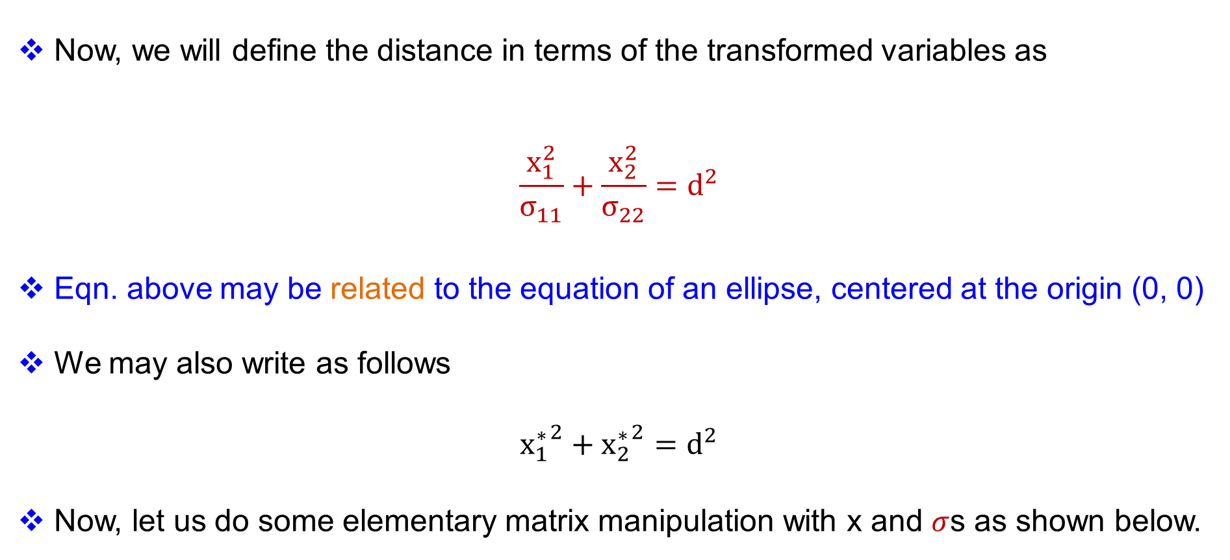
Equal Footing
Now, we will define the distance in terms of the transformed variables as
$$\frac{x_{1}^{2}}{σ_{11}}+\frac{x_{2}^{2}}{σ_{22}}=d^{2}$$
Eqn. above may be related to the equation of an ellipse, centered at the origin (0, 0)
We may also write as follows
$${x_{1}^{∗}}^{2}+{x_{2}^{∗}}^{2}=d^{2}$$
Now, let us do some elementary matrix manipulation with x and $σ$s as shown below.
Notes:
Let us now consider four processes A, B, C, and D, each characterized with two variables X1 and X2. Let one observed n data points for each of the four processes and the scatter plots of the n points are shown in Figure 5.2. What can one interpret about the four processes based on the scatter plots? Every point on the scatter is a bivariate observation and is measured in the two- dimensional statistical system (X1, X2). The data for process A (Figure 5.2, top left) exhibit a circular pattern that is indicative of equal spread (variance) for the two variables X1 and X2. There is no correlation between

Slide 22





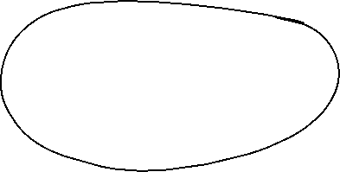
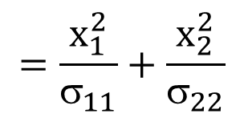

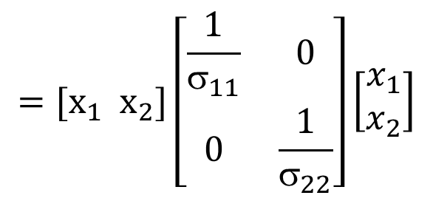


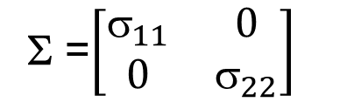

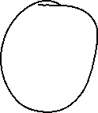
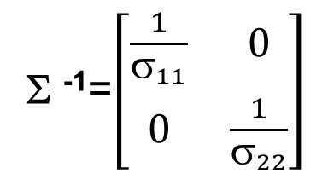
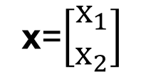

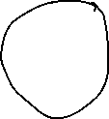



Σ =$\left[\begin{matrix}_{11} & 0 \\ 0 & σ_{22}\end{matrix}\right]$
Σ ⁻¹=$\left[\begin{matrix}\frac{1}{σ_{11}} & 0 \\ 0 & \frac{1}{σ_{22}}\end{matrix}\right]$
x=$\left[\begin{matrix}x_{1} \\ x_{2}\end{matrix}\right]$
$$x′=[x_{1} x_{2}]$$
$$=[x_{1} x_{2}]\left[\begin{matrix}\frac{1}{σ_{11}} & 0 \\ 0 & \frac{1}{σ_{22}}\end{matrix}\right]\left[\begin{matrix}x_{1} \\ x_{2}\end{matrix}\right]$$
P
C
$$=\frac{x_{1}^{2}}{σ_{11}}+\frac{x_{2}^{2}}{σ_{22}}$$

Slide 23












Slide 24
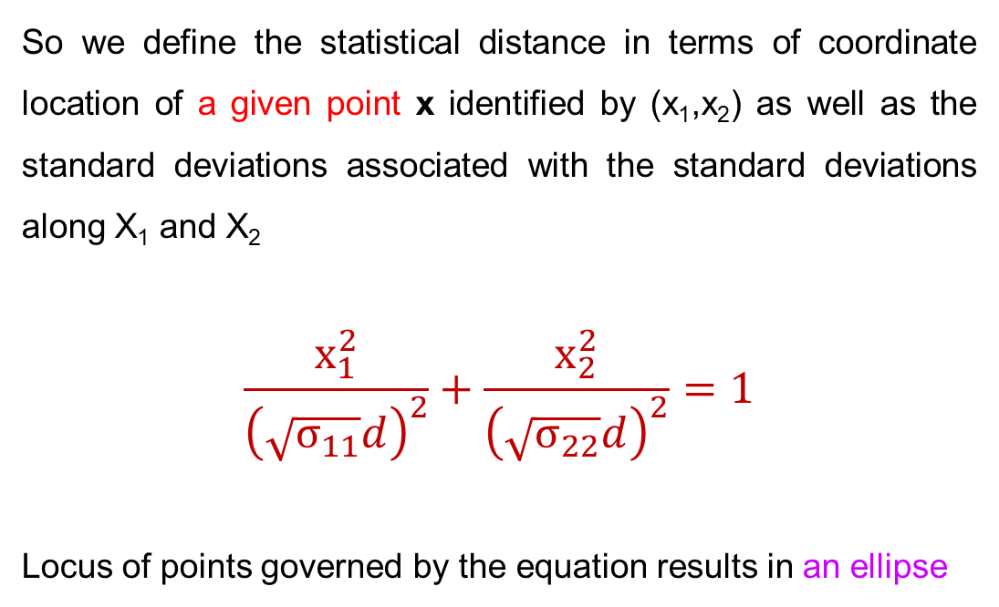
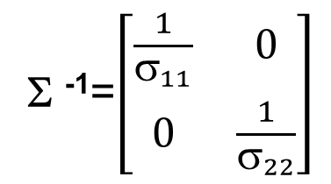
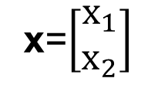

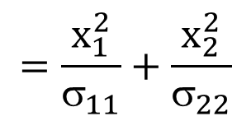


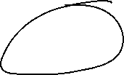
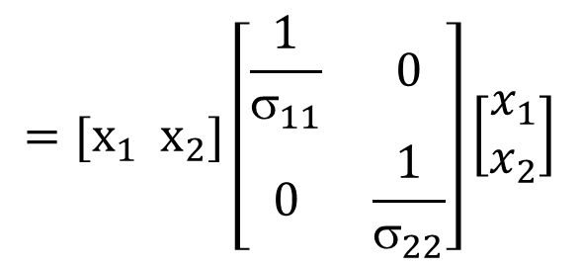
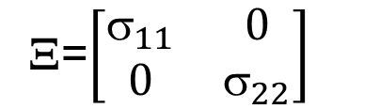
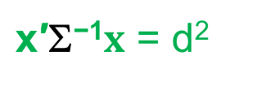

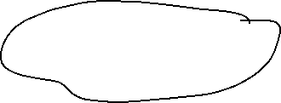
Definition of Statistical Distance
$$\frac{x_{1}^{2}}{σ_{11}}+\frac{x_{2}^{2}}{σ_{22}}=d^{2}$$
$${x_{1}^{∗}}^{2}+{x_{2}^{∗}}^{2}=d^{2}$$
Ξ=$\left[\begin{matrix}_{11} & 0 \\ 0 & σ_{22}\end{matrix}\right]$
$\text{x}\text{′Σ−1}x$ = d²
Σ ⁻¹=$\left[\begin{matrix}\frac{1}{σ_{11}} & 0 \\ 0 & \frac{1}{σ_{22}}\end{matrix}\right]$
x=$\left[\begin{matrix}x_{1} \\ x_{2}\end{matrix}\right]$
$$x′=[x_{1} x_{2}]$$
So we define the statistical distance in terms of coordinate location of a given point x identified by (x₁,x₂) as well as the standard deviations associated with the standard deviations along X₁ and X₂
$$\frac{x_{1}^{2}}{{\left(\sqrt{σ_{11}}d\right)}^{2}}+\frac{x_{2}^{2}}{{\left(\sqrt{σ_{22}}d\right)}^{2}}=1$$
Locus of points governed by the equation results in an ellipse
$$=[x_{1} x_{2}]\left[\begin{matrix}\frac{1}{σ_{11}} & 0 \\ 0 & \frac{1}{σ_{22}}\end{matrix}\right]\left[\begin{matrix}x_{1} \\ x_{2}\end{matrix}\right]$$
$$=\frac{x_{1}^{2}}{σ_{11}}+\frac{x_{2}^{2}}{σ_{22}}$$
Notes:
Let us now consider four processes A, B, C, and D, each characterized with two variables X1 and X2. Let one observed n data points for each of the four processes and the scatter plots of the n points are shown in Figure 5.2. What can one interpret about the four processes based on the scatter plots? Every point on the scatter is a bivariate observation and is measured in the two- dimensional statistical system (X1, X2). The data for process A (Figure 5.2, top left) exhibit a circular pattern that is indicative of equal spread (variance) for the two variables X1 and X2. There is no correlation between

Slide 25

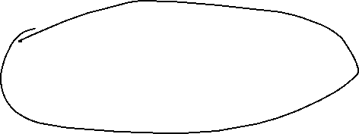




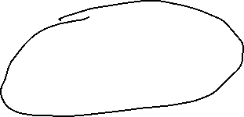



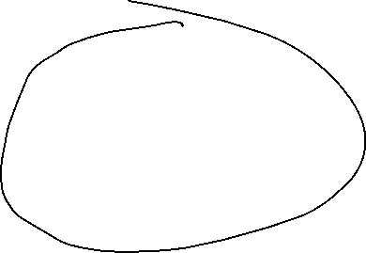

Slide 26
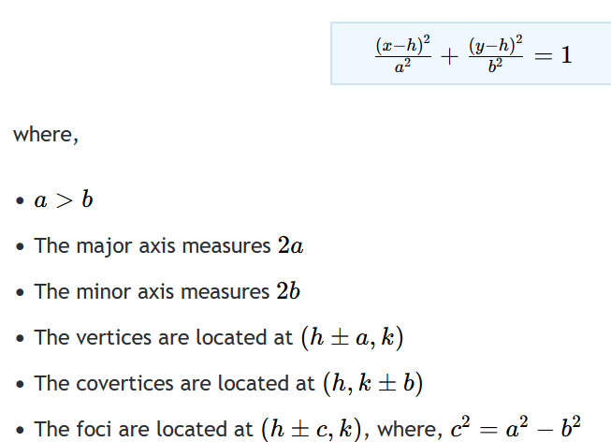
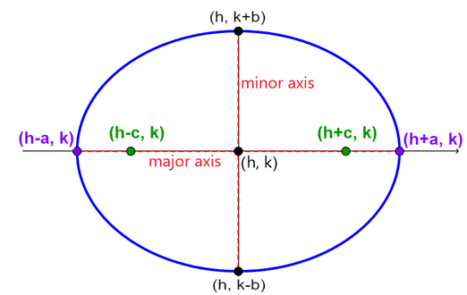

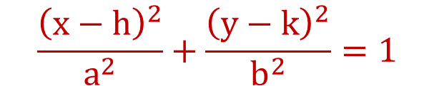
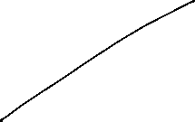

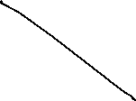




General Equation of an Ellipse
$$\frac{{\left(x−h\right)}^{2}}{a^{2}}+\frac{{\left(y−k\right)}^{2}}{b^{2}}=1$$
https://en.neurochispas.com/precalculus/equation-of-an-ellipse-with-center-outside-the-origin/#2-standard-form-of-ellipses-with-center-outside-the-origin
Notes:
Let us now consider four processes A, B, C, and D, each characterized with two variables X1 and X2. Let one observed n data points for each of the four processes and the scatter plots of the n points are shown in Figure 5.2. What can one interpret about the four processes based on the scatter plots? Every point on the scatter is a bivariate observation and is measured in the two- dimensional statistical system (X1, X2). The data for process A (Figure 5.2, top left) exhibit a circular pattern that is indicative of equal spread (variance) for the two variables X1 and X2. There is no correlation between

Slide 27

Significance of Focii
The foci (plural of focus) of an ellipse are two special reference points located along its major axis. Their fundamental mathematical significance is that the sum of the distances from these two points to any single point on the edge of the ellipse is always a constant
https://byjus.com/maths/foci-of-an-ellipse/.

Slide 28






Some Essential Background
What will happen to the above equations if the center of the ellipse is NOT at the origin (0, 0)?
Let the center be at μ = [µ₁ µ₂] : We center around the mean of x₁ and x₂
Then, the transformed variables are
$$\frac{{\left(x_{1}−μ_{1}\right)}^{2}}{σ_{11}}+\frac{{\left(x_{2}−μ_{2}\right)}^{2}}{σ_{22}}=d^{2}$$
In matrix notation we have
$(x−μ)′$⁻¹$\left(x−μ\right)=d^{2}$
$$ = $\left[\begin{matrix}_{11} & 0 \\ 0 & σ_{22}\end{matrix}\right]$
$$ = $\left[\begin{matrix}2 & 0 \\ 0 & 4\end{matrix}\right]$
Notes:
Let us now consider four processes A, B, C, and D, each characterized with two variables X1 and X2. Let one observed n data points for each of the four processes and the scatter plots of the n points are shown in Figure 5.2. What can one interpret about the four processes based on the scatter plots? Every point on the scatter is a bivariate observation and is measured in the two- dimensional statistical system (X1, X2). The data for process A (Figure 5.2, top left) exhibit a circular pattern that is indicative of equal spread (variance) for the two variables X1 and X2. There is no correlation between

Slide 29














$$\frac{{\left(x_{1}−μ_{1}\right)}^{2}}{σ_{11}}+\frac{{\left(x_{2}−μ_{2}\right)}^{2}}{σ_{22}}=d^{2}$$

Slide 30



Centering Scatter Plot at any (μ₁,μ₂); No Correlation
Notes:
Let us now consider four processes A, B, C, and D, each characterized with two variables X1 and X2. Let one observed n data points for each of the four processes and the scatter plots of the n points are shown in Figure 5.2. What can one interpret about the four processes based on the scatter plots? Every point on the scatter is a bivariate observation and is measured in the two- dimensional statistical system (X1, X2). The data for process A (Figure 5.2, top left) exhibit a circular pattern that is indicative of equal spread (variance) for the two variables X1 and X2. There is no correlation between

Slide 31



Slide 32
Matlab Code: Centering of Scatter Plot at any (μ₁,μ₂)
% 3. Draw standard deviation contours (Ellipses)
theta = linspace(0, 2*pi, 100);
for n_std = 1:3
% Scale the standard deviations by the number of deviations
r1 = n_std * sqrt(sigma11);
r2 = n_std * sqrt(sigma22);
% Parametric equations for the ellipse centered at (-2, 4)
ellipse_x = mu(1) + r1 * cos(theta);
ellipse_y = mu(2) + r2 * sin(theta);
if n_std == 1
plot(ellipse_x, ellipse_y, 'k--', 'LineWidth', 1.5, 'DisplayName', '1, 2, 3 Std Dev Contours');
else
plot(ellipse_x, ellipse_y, 'k--', 'LineWidth', 1.5, 'HandleVisibility', 'off');
end
end
% Formatting the plot
grid on;
ax = gca;
ax.GridAlpha = 0.3;
axis equal; % Ensures the 1:1 aspect ratio so the geometric shapes look correct
% Add reference lines for the center
xline(mu(1), ':', 'Color', [0.5, 0.5, 0.5], 'LineWidth', 1, 'HandleVisibility', 'off');
yline(mu(2), ':', 'Color', [0.5, 0.5, 0.5], 'LineWidth', 1, 'HandleVisibility', 'off');
% Labels and Title
xlabel('x_1');
ylabel('x_2');
title({'Scatterplot of Bivariate Normal Distribution', ...
'Centered at (-2, 4) with \sigma_{11}=2, \sigma_{22}=4, \sigma_{12}=0'});
legend('Data points', 'Center (-2, 4)', 'Location', 'best');
hold off;
% Set random seed for reproducibility
rng(42);
% Parameters
mu = [-2, 4]; % Center / Mean
sigma11 = 2; % Variance of X1
sigma22 = 4; % Variance of X2
covariance = 0; % Covariance between X1 and X2
% Construct the covariance matrix
Sigma = [sigma11, covariance; covariance, sigma22];
% Generate 1000 data points
num_points = 1000;
data = mvnrnd(mu, Sigma, num_points);
x1 = data(:, 1);
x2 = data(:, 2);
% Create the plot
figure;
hold on;
% 1. Plot the simulated data points
scatter(x1, x2, 25, [0.6, 0, 0], 'filled', 'MarkerFaceAlpha', 0.5);
% 2. Plot the center point
plot(mu(1), mu(2), 'ko', 'MarkerSize', 10, 'MarkerFaceColor', 'k');
Notes:
Let us now consider four processes A, B, C, and D, each characterized with two variables X1 and X2. Let one observed n data points for each of the four processes and the scatter plots of the n points are shown in Figure 5.2. What can one interpret about the four processes based on the scatter plots? Every point on the scatter is a bivariate observation and is measured in the two- dimensional statistical system (X1, X2). The data for process A (Figure 5.2, top left) exhibit a circular pattern that is indicative of equal spread (variance) for the two variables X1 and X2. There is no correlation between

Slide 33
Python Code: Centering of Scatter Plot at any (μ₁,μ₂)
import numpy as np
from matplotlib import pyplot as plt
from matplotlib.patches import Ellipse
# Set random seed for statistical reproducibility
np.random.seed(42)
# Define distribution parameters
mean = [-2, 4] # Center (mu_1, mu_2)
sigma_11 = 2 # Variance along x_1 axis
sigma_22 = 4 # Variance along x_2 axis
covariance = 0 # Covariance (sigma_12)
# Define the full covariance matrix
cov_matrix = [[sigma_11, covariance],
[covariance, sigma_22]]
# Generate 1,000 random data points from the distribution
x1, x2 = np.random.multivariate_normal(mean, cov_matrix, 1000).T
# 1. Plot the random data points
plt.scatter(x1, x2, alpha=0.5, color='darkred', edgecolors='none', label='Data points')
# 2. Plot the center point
plt.plot(mean[0], mean[1], 'ko', markersize=8, label='Center (-2, 4)')
# 3. Overlay the theoretical standard deviation contours (Ellipses)
ax = plt.gca()
for n_std in [1, 2, 3]:
# Width and height correspond to full diameter (2 * radius)
# Since covariance is zero, radii scale directly with sqrt(variance)
width = 2 * n_std * np.sqrt(sigma_11)
height = 2 * n_std * np.sqrt(sigma_22)
ellipse = Ellipse(xy=mean, width=width, height=height,
edgecolor='black', linestyle='--', fill=False, alpha=0.7,
label=f'{n_std} Std Dev Contour' if n_std == 1 else "")
ax.add_patch(ellipse)
# Format axes and labels
plt.xlabel('$x_1$')
plt.ylabel('$x_2$')
plt.title('Scatterplot of Bivariate Normal Distribution\nCentered at (-2, 4) with $\\sigma_{11}=2, \\sigma_{22}=4, \\sigma_{12}=0$')
# Add crosshairs for the center point
plt.axhline(4, color='gray', linestyle=':', alpha=0.5)
plt.axvline(-2, color='gray', linestyle=':', alpha=0.5)
plt.grid(True, alpha=0.3)
plt.legend(loc='best')
# Crucial: Ensure 1:1 aspect ratio so the ellipse is not visually distorted
plt.axis('equal')
# Save the plot
plt.savefig('scatterplot_ellipse.png', bbox_inches='tight', dpi=300)
# plt.show() # Uncomment this line if running in a local GUI environment
Notes:
Let us now consider four processes A, B, C, and D, each characterized with two variables X1 and X2. Let one observed n data points for each of the four processes and the scatter plots of the n points are shown in Figure 5.2. What can one interpret about the four processes based on the scatter plots? Every point on the scatter is a bivariate observation and is measured in the two- dimensional statistical system (X1, X2). The data for process A (Figure 5.2, top left) exhibit a circular pattern that is indicative of equal spread (variance) for the two variables X1 and X2. There is no correlation between

Slide 34



General Ellipse with non-zero centre and with Correlation
$$ = $\left[\begin{matrix}2 & 2.5 \\ 2.5 & 4\end{matrix}\right]$
Notes:
Let us now consider four processes A, B, C, and D, each characterized with two variables X1 and X2. Let one observed n data points for each of the four processes and the scatter plots of the n points are shown in Figure 5.2. What can one interpret about the four processes based on the scatter plots? Every point on the scatter is a bivariate observation and is measured in the two- dimensional statistical system (X1, X2). The data for process A (Figure 5.2, top left) exhibit a circular pattern that is indicative of equal spread (variance) for the two variables X1 and X2. There is no correlation between

Slide 35
Matlab Code
% 3. Draw tilted standard deviation contours (Ellipses)
theta = linspace(0, 2*pi, 100);
base_ellipse = [cos(theta); sin(theta)]; % Unit circle template
for n_std = 1:3
% Scale the unit circle along its principal components using eigenvalues
scaled_ellipse = V * (n_std * sqrt(D) * base_ellipse);
% Shift the rotated ellipse to the center (-2, 4)
ellipse_x = mu(1) + scaled_ellipse(1, :);
ellipse_y = mu(2) + scaled_ellipse(2, :);
if n_std == 1
plot(ellipse_x, ellipse_y, 'k--', 'LineWidth', 1.5, 'DisplayName', '1, 2, 3 Std Dev Contours');
else
plot(ellipse_x, ellipse_y, 'k--', 'LineWidth', 1.5, 'HandleVisibility', 'off');
end
end
% Formatting the plot
grid on;
ax = gca; ax.GridAlpha = 0.3;
axis equal; % Essential to see the true physical angle and geometry
% Add reference lines for the center
xline(mu(1), ':', 'Color', [0.5, 0.5, 0.5], 'LineWidth', 1, 'HandleVisibility', 'off');
yline(mu(2), ':', 'Color', [0.5, 0.5, 0.5], 'LineWidth', 1, 'HandleVisibility', 'off');
% Labels and Title
xlabel('x_1'); ylabel('x_2');
title({'Scatterplot of Bivariate Normal Distribution', ...
'Centered at (-2, 4) with \sigma_{11}=2, \sigma_{22}=4, \sigma_{12}=2.5'});
legend('Data points', 'Center (-2, 4)', 'Location', 'best');
hold off;
% Set random seed for reproducibility
rng(42);
% Parameters
mu = [-2, 4]; % Center / Mean
sigma11 = 2; % Variance of X1
sigma22 = 4; % Variance of X2
covariance = 2.5; % Covariance between X1 and X2
% Construct the covariance matrix
Sigma = [sigma11, covariance; covariance, sigma22];
% Generate 1000 data points from the bivariate normal distribution
num_points = 1000;
data = mvnrnd(mu, Sigma, num_points);
x1 = data(:, 1);
x2 = data(:, 2);
% Calculate Eigenvalues and Eigenvectors for the Ellipse Rotation
% The eigenvectors (V) determine the diagonal tilt angle.
% The square root of the eigenvalues (D) determine the lengths of the axes.
[V, D] = eig(Sigma);
% Create the plot
figure;
hold on;
% 1. Plot the simulated data points
scatter(x1, x2, 25, [0.8, 0.4, 0], 'filled', 'MarkerFaceAlpha', 0.4);
% 2. Plot the center point
plot(mu(1), mu(2), 'ko', 'MarkerSize', 10, 'MarkerFaceColor', 'k');
Notes:
Let us now consider four processes A, B, C, and D, each characterized with two variables X1 and X2. Let one observed n data points for each of the four processes and the scatter plots of the n points are shown in Figure 5.2. What can one interpret about the four processes based on the scatter plots? Every point on the scatter is a bivariate observation and is measured in the two- dimensional statistical system (X1, X2). The data for process A (Figure 5.2, top left) exhibit a circular pattern that is indicative of equal spread (variance) for the two variables X1 and X2. There is no correlation between

Slide 36
Python Code
import numpy as np
import matplotlib.pyplot as plt
from matplotlib.patches import Ellipse
# Set random seed for reproducibility
np.random.seed(42)
# Define distribution parameters
mean = [-2, 4] # Center (mu_1, mu_2)
sigma_11 = 2 # Variance along x_1 axis
sigma_22 = 4 # Variance along x_2 axis
covariance = 2.5 # Covariance (sigma_12)
# Define the full covariance matrix
cov_matrix = [[sigma_11, covariance],
[covariance, sigma_22]]
# Generate 1,000 random data points from the distribution
x1, x2 = np.random.multivariate_normal(mean, cov_matrix, 1000).T
# Initialize the plot
plt.figure(figsize=(6, 6))
# 1. Plot the random data points
plt.scatter(x1, x2, alpha=0.5, color='darkorange', edgecolors='none', label='Data points')
# 2. Plot the center point
plt.plot(mean[0], mean[1], 'ko', markersize=8, label='Center (-2, 4)')
# 3. Calculate and overlay the tilted standard deviation contours (Ellipses)
# Get eigenvalues and eigenvectors to find the tilt angle and scaling factors
vals, vecs = np.linalg.eigh(cov_matrix)
# Sort eigenvalues and eigenvectors in descending order to align with the major axis
order = vals.argsort()[::-1]
vals, vecs = vals[order], vecs[:, order]
# Compute the rotation angle in degrees
angle = np.degrees(np.arctan2(vecs[1, 0], vecs[0, 0]))
ax = plt.gca()
for n_std in [1, 2, 3]:
# Width and height correspond to full diameters along the principal axes
# (2 * number of standard deviations * sqrt(eigenvalue))
width = 2 * n_std * np.sqrt(vals[0])
height = 2 * n_std * np.sqrt(vals[1])
ellipse = Ellipse(xy=mean, width=width, height=height, angle=angle,
edgecolor='black', linestyle='--', fill=False, alpha=0.7,
label=f'{n_std} Std Dev Contour' if n_std == 1 else "")
ax.add_patch(ellipse)
# Format axes and labels
plt.xlabel('$x_1$')
plt.ylabel('$x_2$')
plt.title('Scatterplot of Bivariate Normal Distribution\nCentered at (-2, 4) with $\\sigma_{11}=2, \\sigma_{22}=4, \\sigma_{12}=2.5$')
# Add crosshairs for the center point
plt.axhline(4, color='gray', linestyle=':', alpha=0.5)
plt.axvline(-2, color='gray', linestyle=':', alpha=0.5)
plt.grid(True, alpha=0.3)
plt.legend(loc='best')
# Crucial: Ensure 1:1 aspect ratio so the diagonal tilt and shape are visually accurate
plt.axis('equal')
# Save and display the plot
plt.savefig('scatterplot_covariance_2.5.png', bbox_inches='tight', dpi=300)
# plt.show() # Uncomment this line if running in a local GUI environment
Notes:
Let us now consider four processes A, B, C, and D, each characterized with two variables X1 and X2. Let one observed n data points for each of the four processes and the scatter plots of the n points are shown in Figure 5.2. What can one interpret about the four processes based on the scatter plots? Every point on the scatter is a bivariate observation and is measured in the two- dimensional statistical system (X1, X2). The data for process A (Figure 5.2, top left) exhibit a circular pattern that is indicative of equal spread (variance) for the two variables X1 and X2. There is no correlation between

Slide 37









$(x−μ)′\text{∑}$⁻¹$\left(x−μ\right)=d^{2}$
Here d², is known as squared statistical distance
Statistical distance d² incorporates the variance-covariance relationship of a given process and hence is very different from the Euclidean distance.
It may be extended to any p number of variables (p>1)
If there are n data points, we can calculate d_{i}², i=12,,..n using Equation below
${\left(x_{i}−μ\right)}^{T}{\text{∑}}^{−1}$ $\left(x_{i}−μ\right)=d_{i}^{2}$
${\begin{matrix}{[x}_{i,1}−μ_{1} & x_{i,2}−μ\end{matrix}}_{2}]$ ${\left[\begin{matrix}_{11} & σ_{12} \\ _{12} & σ_{22}\end{matrix}\right]}^{−1}\left[\begin{matrix}x_{i,1}−μ_{1} \\ x_{i,2}−μ_{2}\end{matrix}\right] =d_{i}^{2}$
Notes:
Let us now consider four processes A, B, C, and D, each characterized with two variables X1 and X2. Let one observed n data points for each of the four processes and the scatter plots of the n points are shown in Figure 5.2. What can one interpret about the four processes based on the scatter plots? Every point on the scatter is a bivariate observation and is measured in the two- dimensional statistical system (X1, X2). The data for process A (Figure 5.2, top left) exhibit a circular pattern that is indicative of equal spread (variance) for the two variables X1 and X2. There is no correlation between

Slide 38







Mahalanobis Distance
But the population mean vector μ and covariance matrix Σ are seldom known.
Then, i/o ${\left(x_{i}−μ\right)}^{T}{\text{∑}}^{−1}$ $\left(x_{i}−μ\right)=d_{i}^{2}$
we get
Hence, we use their sample estimates $\overline{x}$ and S.
The distance d_{i}² is known as squared Mahalanobis distance (MD) which was developed by Prasanta Chandra Mahalanobis in the 1930s.
${\left(x_{i}−\overline{x}\right)}^{′}{\text{S}}^{−1}$ $\left(x_{i}−\overline{x}\right)=d_{i}^{2}$
Mahalanobis has been considered the father of statistics in India
https://en.wikipedia.org/wiki/Prasanta_Chandra_Mahalanobis
Notes:
Let us now consider four processes A, B, C, and D, each characterized with two variables X1 and X2. Let one observed n data points for each of the four processes and the scatter plots of the n points are shown in Figure 5.2. What can one interpret about the four processes based on the scatter plots? Every point on the scatter is a bivariate observation and is measured in the two- dimensional statistical system (X1, X2). The data for process A (Figure 5.2, top left) exhibit a circular pattern that is indicative of equal spread (variance) for the two variables X1 and X2. There is no correlation between

Slide 39















Slide 40





















Slide 41
















Slide 42


Applications of Mahalanobis Distance
Mahalanobis distance plays a very important role in multivariate statistics and has several multivariate data applications such as
(i) detection of multivariate outliers,
(ii) quality control,
(iii) choice of calibration samples for a large set of measurements,
(iv) clustering based pattern recognition,
(v) Detection of faults
Notes:
Let us now consider four processes A, B, C, and D, each characterized with two variables X1 and X2. Let one observed n data points for each of the four processes and the scatter plots of the n points are shown in Figure 5.2. What can one interpret about the four processes based on the scatter plots? Every point on the scatter is a bivariate observation and is measured in the two- dimensional statistical system (X1, X2). The data for process A (Figure 5.2, top left) exhibit a circular pattern that is indicative of equal spread (variance) for the two variables X1 and X2. There is no correlation between

Slide 43
Applications of Mahalanobis Distance
The selection of calibration samples from a large set of measurements and
for investigating the representativity between two data sets.
In pattern recognition, the MD is applied in clustering techniques such as the k-Nearest Neighbour method,
In discrimination techniques such as linear, quadratic and regularized discriminant analysis DA,
Notes:
Let us now consider four processes A, B, C, and D, each characterized with two variables X1 and X2. Let one observed n data points for each of the four processes and the scatter plots of the n points are shown in Figure 5.2. What can one interpret about the four processes based on the scatter plots? Every point on the scatter is a bivariate observation and is measured in the two- dimensional statistical system (X1, X2). The data for process A (Figure 5.2, top left) exhibit a circular pattern that is indicative of equal spread (variance) for the two variables X1 and X2. There is no correlation between

Slide 44


Need for Statistical Distance
Consider the observation x = [x₁, x₂]^{T}, denoted as P(x₁, x₂).
In all the three applications shown below I, II, and III, the Euclidean distance d(OP) is same,
We ask whether the observation P(x₁, x₂) represents the same relevance for all the three applications?

Slide 45





Need for Statistical Distance
For the first and second case on RHS, the observations P(x₁, x₂), both equi-distant from the origin are just on the boundary and you need to check if they are outliers are not
Had the pink circle applied, P would be an outlier
However, in the third case, the point P though equidistant from the origin is within the crowd and is NOT an outlier
Hence, the location of the point within or out of the crowd depends not only on the Euclidean distance, but also on the shape of the curve (ellipse or circle) and the inclination all of which are decided by the variance-covariance matrix $\text{}$ or S.
P
P
C
C
I
II
P
C
III

Slide 46





Application I Analysis
$$\frac{x_{1}^{2}}{σ_{11}}+\frac{x_{2}^{2}}{σ_{22}}=d^{2}$$
${x_{1}^{∗}}^{2}+{x_{2}^{∗}}^{2}=d^{2}$
For the special case, where both variances $σ_{11}$ and $σ_{22}$ are unity and the correlation does not exist we have
$$\frac{x_{1}^{2}}{{\left(\sqrt{1}\right)}^{2}}+\frac{x_{2}^{2}}{{\left(\sqrt{1}\right)}^{2}}=d^{2}$$
Locus of points governed by the equation results in CIRCLE centred at the origin and statistical distance reduces to Euclidean Distance

Slide 47


Application I Analysis
For the special case, where both variances $σ_{11}$ and $σ_{22}$ are unity and the correlation does not exist we have
$$\frac{x_{1}^{2}}{{\left(\sqrt{1}\right)}^{2}}+\frac{x_{2}^{2}}{{\left(\sqrt{1}\right)}^{2}}=d^{2}$$
Locus of points governed by the equation results in CIRCLE centred at the origin
When you calculate statistical distance with unity variances and zero correlation, the covariance matrix simplifies to the identity matrix. Because of this, the formula reduces directly to standard Euclidean distance.

Slide 48
Application I Analysis
Geometrically, this means the set of points at a constant statistical distance from the mean forms a circle (in 2D space) or a hypersphere (in higher dimensions) where
the Euclidean distance is the radius

Slide 49






Application II Analysis: No Correlation, Different Variances
$(x−μ)′$⁻¹$\left(x−μ\right)=d^{2}$
$${\begin{matrix}{[x}_{i,1}−μ_{1} & x_{i,2}−μ\end{matrix}}_{2}]\left[\begin{matrix}{1/σ}_{11} & 0 \\ 0 & {1/σ}_{22}\end{matrix}\right]\left[\begin{matrix}x_{i,1}−μ_{1} \\ x_{i,2}−μ_{2}\end{matrix}\right] =d_{i}^{2}$$
$$\frac{{\left(x_{i,1}−μ_{1}\right)}^{2}}{{\left(\sqrt{σ_{11}}d_{i}\right)}^{2}}+\frac{{\left(x_{i,2}−μ_{2}\right)}^{2}}{{\left(\sqrt{σ_{22}}d_{i}\right)}^{2}}=1$$
Locus of points governed by the equation results in Ellipse centred at (μ₁,μ₂)

Slide 50
Application II Analysis: No Correlation, Different Variances
$(x−μ)′$⁻¹$\left(x−μ\right)=d^{2}$
$${\begin{matrix}{[x}_{i,1}−μ_{1} & x_{i,2}−μ\end{matrix}}_{2}]\left[\begin{matrix}{1/σ}_{11} & 0 \\ 0 & {1/σ}_{22}\end{matrix}\right]\left[\begin{matrix}x_{i,1}−μ_{1} \\ x_{i,2}−μ_{2}\end{matrix}\right] =d_{i}^{2}$$
$$\frac{{\left(x_{i,1}−μ_{1}\right)}^{2}}{{\left(\sqrt{σ_{11}}d_{i}\right)}^{2}}+\frac{{\left(x_{i,2}−μ_{2}\right)}^{2}}{{\left(\sqrt{σ_{22}}d_{i}\right)}^{2}}=1$$
Locus of points governed by the equation results in Ellipse centred at (μ₁,μ₂)

Slide 51













General Case: Centered at μ₁ and μ₂ with Correlation
$(x−μ)′$⁻¹$\left(x−μ\right)=d^{2}$
$${\begin{matrix}{[x}_{i,1}−μ_{1} & x_{i,2}−μ\end{matrix}}_{2}]\left[\frac{1}{_{11}_{22}−_{12}^{2}}\right]\left[\begin{matrix}_{22} & {−}_{12} \\ {−}_{12} & _{11}\end{matrix}\right]\left[\begin{matrix}x_{i,1}−μ_{1} \\ x_{i,2}−μ_{2}\end{matrix}\right] =d_{i}^{2}$$
$${\begin{matrix}{[x}_{i,1}−μ_{1} & x_{i,2}−μ\end{matrix}}_{2}]\left[\frac{1}{_{11}_{22}−_{12}^{2}}\right]\left[\begin{matrix}\frac{_{22}}{_{11}_{22}−_{12}^{2}} & \frac{{−}_{12}}{_{11}_{22}−_{12}^{2}} \\ \frac{{−}_{12}}{_{11}_{22}−_{12}^{2}} & \frac{_{11}}{_{11}_{22}−_{12}^{2}}\end{matrix}\right]\left[\begin{matrix}x_{i,1}−μ_{1} \\ x_{i,2}−μ_{2}\end{matrix}\right]=d_{i}^{2}$$

Slide 52








General Case: Centered at μ₁ and μ₂ with Correlation
$(x−μ)′$⁻¹$\left(x−μ\right)=d^{2}$
$${\begin{matrix}{[x}_{i,1}−μ_{1} & x_{i,2}−μ\end{matrix}}_{2}]\left[\frac{1}{_{11}_{22}−_{12}^{2}}\right]\left[\begin{matrix}\frac{_{22}}{_{11}_{22}−_{12}^{2}} & \frac{{−}_{12}}{_{11}_{22}−_{12}^{2}} \\ \frac{{−}_{12}}{_{11}_{22}−_{12}^{2}} & \frac{_{11}}{_{11}_{22}−_{12}^{2}}\end{matrix}\right]\left[\begin{matrix}x_{i,1}−μ_{1} \\ x_{i,2}−μ_{2}\end{matrix}\right]=d_{i}^{2}$$

Slide 53










General Case: A More Compact Version
$${\begin{matrix}{[x}_{i,1}−μ_{1} & x_{i,2}−μ\end{matrix}}_{2}]\left[\frac{1}{_{11}_{22}−_{12}^{2}}\right]\left[\begin{matrix}\frac{_{22}}{_{11}_{22}−_{12}^{2}} & \frac{{−}_{12}}{_{11}_{22}−_{12}^{2}} \\ \frac{{−}_{12}}{_{11}_{22}−_{12}^{2}} & \frac{_{11}}{_{11}_{22}−_{12}^{2}}\end{matrix}\right]\left[\begin{matrix}x_{i,1}−μ_{1} \\ x_{i,2}−μ_{2}\end{matrix}\right]=d_{i}^{2}$$
$(x−μ)′\text{Ξ}$⁻¹$\left(x−μ\right)=d^{2}$
$(x−μ)′$⁻¹$\left(x−μ\right)=d^{2}$
$$\left[\frac{1}{1−ρ_{12}^{2}}\right] \left[\frac{{\left(x_{i,1}−μ_{1}\right)}^{2}}{{\left(\sqrt{σ_{11}}\right)}^{2}}−2ρ_{12}\frac{\left(x_{i,1}−μ_{1}\right)}{\sqrt{σ_{11}}}\frac{\left(x_{i,2}−μ_{2}\right)}{\sqrt{σ_{22}}}+\frac{{\left(x_{i,2}−μ_{2}\right)}^{2}}{{\left(\sqrt{σ_{22}}\right)}^{2}}\right]=d_{i}^{2}$$
Here $_{12}=\frac{σ_{12}}{\sqrt{σ_{11σ_{22}}}}$ = Correlation Coefficient between X₁ and X₂

Slide 54





Chi-Square Distribution and Mahalanobis Distance
What will be the shape of the following equation?
Here X is p-variable vector
For p- dimension, the shape will be an ellipsoid centered at μ=[μ₁,μ₂,…,μ_{p}]^{T}.
So for the most general case, we have
which is an ellipsoid of p- axes
$(x−μ)′$⁻¹$\left(x−μ\right)=d^{2}$
$(x−μ)′$⁻¹$\left(x−μ\right)=d^{2}$
Notes:
Let us now consider four processes A, B, C, and D, each characterized with two variables X1 and X2. Let one observed n data points for each of the four processes and the scatter plots of the n points are shown in Figure 5.2. What can one interpret about the four processes based on the scatter plots? Every point on the scatter is a bivariate observation and is measured in the two- dimensional statistical system (X1, X2). The data for process A (Figure 5.2, top left) exhibit a circular pattern that is indicative of equal spread (variance) for the two variables X1 and X2. There is no correlation between

Slide 55


So How to Find d_{i}²?
$(x−μ)′$⁻¹$\left(x−μ\right)=d^{2}$
The parameter d² is known as squared statistical distance of x from μ.
follows chi- square ( χ_{p}² ) distribution with p degrees of freedom
$(x−μ)′$⁻¹$\left(x−μ\right)=d^{2}$
Notes:
Let us now consider four processes A, B, C, and D, each characterized with two variables X1 and X2. Let one observed n data points for each of the four processes and the scatter plots of the n points are shown in Figure 5.2. What can one interpret about the four processes based on the scatter plots? Every point on the scatter is a bivariate observation and is measured in the two- dimensional statistical system (X1, X2). The data for process A (Figure 5.2, top left) exhibit a circular pattern that is indicative of equal spread (variance) for the two variables X1 and X2. There is no correlation between

Slide 56












Slide 57




















Slide 58














Slide 59




Chi-Square Distribution and Mahalanobis Distance
The equation given below
Subscribes to the chi-square distribution with p-degrees of freedom.
In other words, the Mahalanobis distance squared is the same as the chi-square variable value which may be associated with a probability or a fraction
$(x−μ)′$⁻¹$\left(x−μ\right)=d^{2}$
$(x−μ)′$⁻¹$\left(x−μ\right) ≤ χ_{p}^{2}(α)$
$$d^{2}  _{p}^{2}()$$
$(x−\overline{x})′\text{S}$⁻¹$\left(x−\overline{x}\right) ≤ χ_{p}^{2}(α)$
Notes:
Let us now consider four processes A, B, C, and D, each characterized with two variables X1 and X2. Let one observed n data points for each of the four processes and the scatter plots of the n points are shown in Figure 5.2. What can one interpret about the four processes based on the scatter plots? Every point on the scatter is a bivariate observation and is measured in the two- dimensional statistical system (X1, X2). The data for process A (Figure 5.2, top left) exhibit a circular pattern that is indicative of equal spread (variance) for the two variables X1 and X2. There is no correlation between

Slide 60



Chi-Square Distribution and Mahalanobis Distance
$(x−μ)′$⁻¹$\left(x−μ\right) ≤ χ_{p}^{2}(α)$
The Percentile Definition: With respect to a chi-square distribution with p-degrees of freedom, the standard 100(1-α)^{th} percentile means that a total area of 1−α lies to the left (below) the $_{p}^{2}()$ value.
The value of d² at 100(1 – α)^{th} percentile value represents all multivariate- observations of X such that 100(1 – α)% lie below the $_{p}^{2}\left(\text{α}\right)$ value and each of these observations will have squared distances less than or equal to this value i.e., $d^{2} _{p}^{2}()$
$(x−μ)′$⁻¹$\left(x−μ\right) ≤ χ_{p}^{2}(α)$ with a probability of 1-α
Notes:
Let us now consider four processes A, B, C, and D, each characterized with two variables X1 and X2. Let one observed n data points for each of the four processes and the scatter plots of the n points are shown in Figure 5.2. What can one interpret about the four processes based on the scatter plots? Every point on the scatter is a bivariate observation and is measured in the two- dimensional statistical system (X1, X2). The data for process A (Figure 5.2, top left) exhibit a circular pattern that is indicative of equal spread (variance) for the two variables X1 and X2. There is no correlation between

Slide 61


Chi-Square Distribution and Mahalanobis Distance
Now we will see what d² is.
d² is known as squared statistical distance of x from μ.
The relation
$(x−μ)′$⁻¹$\left(x−μ\right) ≤ χ_{p}^{2}(α)$
follows chi- square χ² distribution with p degrees of freedom
The pdf for χ² distribution is shown in Figure
Figure shows the pdf of χ² for 1, 2, 3, 5, and 7 degrees of freedom.
Notes:
Let us now consider four processes A, B, C, and D, each characterized with two variables X1 and X2. Let one observed n data points for each of the four processes and the scatter plots of the n points are shown in Figure 5.2. What can one interpret about the four processes based on the scatter plots? Every point on the scatter is a bivariate observation and is measured in the two- dimensional statistical system (X1, X2). The data for process A (Figure 5.2, top left) exhibit a circular pattern that is indicative of equal spread (variance) for the two variables X1 and X2. There is no correlation between

Slide 62


Chi-Square Distribution and Mahalanobis Distance

Slide 63


χ² Distribution & Mahalanobis Distance

Slide 64

χ² Distribution & Mahalanobis Distance: Matlab

Slide 65
χ² Distribution & Mahalanobis Distance: Matlab Code
% MATLAB Script: Visualize a 3D Hyper-ellipse using Mahalanobis Distance
clear; clc; close all;
%% 1. Define Parameters and Generate Synthetic 3D Data
rng(42); % Set seed for reproducibility
% Define a mean vector and a positive-definite covariance matrix
mu = [0; 0; 0];
Sigma = [3, 1, 0.5;
1, 2, 0.8;
0.5, 0.8, 1];
% Generate 500 random samples from a Multivariate Normal Distribution
N = 500;
data = mvnrnd(mu, Sigma, N);
%% 2. Compute Chi-Squared Critical Value
p = 3; % Number of dimensions (degrees of freedom)
alpha = 0.05; % Significance level
% Critical value: 95% of data falls below this threshold
c2 = chi2inv(1 - alpha, p);
%% 3. Calculate Mahalanobis Distance to Identify Outliers
% Calculate squared Mahalanobis distance for each point manually or via mafal:
% d2 = mahalanobis(data, mu, Sigma)
invSigma = inv(Sigma);
d2 = zeros(N, 1);
for i = 1:N
diff = data(i, :)' - mu;
d2(i) = diff' * invSigma * diff;
end
% Separate data into inliers and outliers based on threshold
inliers = data(d2 <= c2, :);
outliers = data(d2 > c2, :);
%% 4. Generate the 3D Hyper-ellipse Geometry
% Get eigenvalues (lengths) and eigenvectors (directions) of Covariance Matrix
[V, D] = eig(Sigma);
% Generate a standard unit sphere mesh grid
[U, V_grid] = meshgrid(linspace(0, 2*pi, 100), linspace(0, pi, 100));
X_unit = cos(U) .* sin(V_grid);
Y_unit = sin(U) .* sin(V_grid);
Z_unit = cos(V_grid);
% Scale the sphere along the principal axes using eigenvalues and chi2 threshold
% Radii along principal axes are sqrt(lambda * c^2)
radii = sqrt(diag(D) * c2);
X_scaled = X_unit * radii(1);
Y_scaled = Y_unit * radii(2);
Z_scaled = Z_unit * radii(3);
% Rotate and translate the scaled ellipsoid using eigenvectors and the mean
ellipsoid_points = [X_scaled(:), Y_scaled(:), Z_scaled(:)] * V';
X_ellip = reshape(ellipsoid_points(:, 1), size(X_scaled)) + mu(1);
Y_ellip = reshape(ellipsoid_points(:, 2), size(Y_scaled)) + mu(2);
Z_ellip = reshape(ellipsoid_points(:, 3), size(Z_scaled)) + mu(3);
%% 5. Plotting the Results
figure('Position', [100, 100, 900, 700]);
hold on;
% Plot the inlier data points (Blue)
scatter3(inliers(:,1), inliers(:,2), inliers(:,3), 20, 'b', 'filled', ...
'MarkerFaceAlpha', 0.4, 'DisplayName', 'Inliers (\leq 95%)');
% Plot the outlier data points (Red)
scatter3(outliers(:,1), outliers(:,2), outliers(:,3), 30, 'r', 'filled', ...
'DisplayName', 'Outliers (Top 5%)');
% Render the hyper-ellipse surface mesh (Transparent Cyan)
surf(X_ellip, Y_ellip, Z_ellip, 'FaceColor', 'cyan', 'FaceAlpha', 0.15, ...
'EdgeColor', [0.5 0.5 0.5], 'EdgeAlpha', 0.3, 'LineWidth', 0.5, ...
'DisplayName', sprintf('Hyper-ellipse (\\chi^2_{0.05, 3} = %.2f)', c2));
% Aesthetic configurations
title('3D Hyper-ellipse Boundary (\alpha = 0.05)', 'FontSize', 14);
xlabel('X_1', 'FontSize', 12);
ylabel('X_2', 'FontSize', 12);
zlabel('X_3', 'FontSize', 12);
grid on;
view(45, 20); % Set a clean isometric orientation angle
legend('Location', 'best', 'FontSize', 11);
axis equal; % Crucial for protecting true geometric aspect ratios
hold off;

Slide 66
χ² Distribution & Mahalanobis Distance: Python Code
import numpy as np
import matplotlib.pyplot as plt
from scipy.stats import chi2
import matplotlib.patches as mpatches
np.random.seed(42) # Set seed for reproducibility
# Define a mean vector and a positive-definite covariance matrix
mu = np.array([0, 0, 0])
Sigma = np.array([[3.0, 1.0, 0.5],
[1.0, 2.0, 0.8],
[0.5, 0.8, 1.0]])
# Generate 500 random samples from a Multivariate Normal Distribution
N = 500
data = np.random.multivariate_normal(mu, Sigma, N)
# Compute Chi-Squared Critical Value
p = 3 # Number of dimensions (degrees of freedom)
alpha = 0.05 # Significance level
# Critical value: 95% of data falls below this threshold
c2 = chi2.ppf(1 - alpha, p)
# Calculate Mahalanobis Distance to Identify Outliers
invSigma = np.linalg.inv(Sigma)
# Calculate squared Mahalanobis distance (Vectorized approach)
diff = data - mu
d2 = np.sum(np.dot(diff, invSigma) * diff, axis=1)
# Separate data into inliers and outliers based on threshold
inlier_mask = d2 <= c2
inliers = data[inlier_mask]
outliers = data[~inlier_mask]
# Generate the 3D Hyper-ellipse Geometry
# Get eigenvalues (lengths) and eigenvectors (directions) of Covariance Matrix
eigenvalues, eigenvectors = np.linalg.eigh(Sigma)
# Generate a standard unit sphere mesh grid
U = np.linspace(0, 2 * np.pi, 100)
V_grid = np.linspace(0, np.pi, 100)
U, V_grid = np.meshgrid(U, V_grid)
X_unit = np.cos(U) * np.sin(V_grid)
Y_unit = np.sin(U) * np.sin(V_grid)
Z_unit = np.cos(V_grid)
# Scale the sphere along the principal axes using eigenvalues and chi2 threshold
radii = np.sqrt(eigenvalues * c2)
X_scaled = X_unit * radii[0]
Y_scaled = Y_unit * radii[1]
Z_scaled = Z_unit * radii[2]
# Rotate and translate the scaled ellipsoid using eigenvectors and the mean
scaled_points = np.column_stack([X_scaled.ravel(), Y_scaled.ravel(), Z_scaled.ravel()])
ellipsoid_points = np.dot(scaled_points, eigenvectors.T)
X_ellip = ellipsoid_points[:, 0].reshape(X_scaled.shape) + mu[0]
Y_ellip = ellipsoid_points[:, 1].reshape(Y_scaled.shape) + mu[1]
Z_ellip = ellipsoid_points[:, 2].reshape(Z_scaled.shape) + mu[2] # Fixed index from [3] to [2]
# Plotting the Results
fig = plt.figure(figsize=(10, 8))
ax = fig.add_subplot(111, projection='3d')
# Plot the inlier data points (Blue)
ax.scatter(inliers[:, 0], inliers[:, 1], inliers[:, 2],
c='b', s=20, alpha=0.4, label='Inliers (≤ 95%)')
# Plot the outlier data points (Red)
ax.scatter(outliers[:, 0], outliers[:, 1], outliers[:, 2],
c='r', s=30, label='Outliers (Top 5%)')
# Render the hyper-ellipse surface mesh (Transparent Cyan)
ax.plot_surface(X_ellip, Y_ellip, Z_ellip, color='cyan', alpha=0.15,
edgecolor='gray', linewidth=0.5)
# Added 'rf' (raw string) to fix the escape sequence error
surf_proxy = mpatches.Patch(color='cyan', alpha=0.3,
label=rf'Hyper-ellipse ($\chi^2_{{0.05, 3}} = {c2:.2f}$)')
# Aesthetic configurations
ax.set_title(r'3D Hyper-ellipse Boundary ($\alpha = 0.05$)', fontsize=14)
ax.set_xlabel('$X_1$', fontsize=12)
ax.set_ylabel('$X_2$', fontsize=12)
ax.set_zlabel('$X_3$', fontsize=12)
# Set a clean isometric orientation angle (elev, azim)
ax.view_init(elev=20, azim=45)
# Assemble legend
handles, labels = ax.get_legend_handles_labels()
handles.append(surf_proxy)
ax.legend(handles=handles, loc='best', fontsize=11)
# Aspect ratio lock for true geometric geometry
max_range = np.array([X_ellip.max()-X_ellip.min(),
Y_ellip.max()-Y_ellip.min(),
Z_ellip.max()-Z_ellip.min()]).max() / 2.0
mid_x = (X_ellip.max()+X_ellip.min()) * 0.5
mid_y = (Y_ellip.max()+Y_ellip.min()) * 0.5
mid_z = (Z_ellip.max()+Z_ellip.min()) * 0.5
ax.set_xlim(mid_x - max_range, mid_x + max_range)
ax.set_ylim(mid_y - max_range, mid_y + max_range)
ax.set_zlim(mid_z - max_range, mid_z + max_range)
ax.set_box_aspect([1, 1, 1])
plt.show()

Slide 67
Multivariate Normal Distribution
For the normal (Gaussian) distribution, we may determine whether an observation is likely to belong to a predefined population, depending upon the number of standard deviations it is away from the mean.
If the probability is 5%, then we only expect to find an observation that far from the mean with a probability of 1in 20
Likewise, for a multinormal distribution, the distance from the mean or center of the measurements (represented by the means μ₁ and μ₂) may be used to determine the likelihood of membership of a predefined population.
Notes:
Let us now consider four processes A, B, C, and D, each characterized with two variables X1 and X2. Let one observed n data points for each of the four processes and the scatter plots of the n points are shown in Figure 5.2. What can one interpret about the four processes based on the scatter plots? Every point on the scatter is a bivariate observation and is measured in the two- dimensional statistical system (X1, X2). The data for process A (Figure 5.2, top left) exhibit a circular pattern that is indicative of equal spread (variance) for the two variables X1 and X2. There is no correlation between

Slide 68
Multivariate Normal Distribution
Finding distance in more than one dimension does not have a forward (+) or backward (-) sign,
The statement means that when you calculate the separation between points in spaces with two or more dimensions (like (2D) or (3D) coordinate planes), the result is an absolute, directionless scalar. Unlike 1D movement (where (+) and (-) represent "forward" and "backward"), multi-dimensional distance has no predefined positive or negative sign
So, we use squared distances
Will the squared distance from the mean of a dataset tell us how likely an observation is part of the crowd i.e., a predefined population, analogous to the single variable case?
The rest of the points without membership to the population are classified as outliers
Notes:
Let us now consider four processes A, B, C, and D, each characterized with two variables X1 and X2. Let one observed n data points for each of the four processes and the scatter plots of the n points are shown in Figure 5.2. What can one interpret about the four processes based on the scatter plots? Every point on the scatter is a bivariate observation and is measured in the two- dimensional statistical system (X1, X2). The data for process A (Figure 5.2, top left) exhibit a circular pattern that is indicative of equal spread (variance) for the two variables X1 and X2. There is no correlation between

Slide 69

Chi-Square Distribution
The square of each individual standardized normal variable must fall into an underlying chi square distribution.
So, must $Z_{1}^{2}+Z_{2}^{2}+…+Z_{p}^{2}=_{p}^{2}.$
Note that there is no multiplier constant before these standard normal variables Zs.
Notes:
Let us now consider four processes A, B, C, and D, each characterized with two variables X1 and X2. Let one observed n data points for each of the four processes and the scatter plots of the n points are shown in Figure 5.2. What can one interpret about the four processes based on the scatter plots? Every point on the scatter is a bivariate observation and is measured in the two- dimensional statistical system (X1, X2). The data for process A (Figure 5.2, top left) exhibit a circular pattern that is indicative of equal spread (variance) for the two variables X1 and X2. There is no correlation between

Slide 70
Mahalanobis Distance
So, how can we use chi square distribution to determine whether an observation belongs to a predefined population by looking at the distance from the centre (0,0) or (μ₁, μ₂)?
When only one variable is measured, it is of course simple
A new measurement of distance comes into play, the Mahalanobis distance.
Notes:
Let us now consider four processes A, B, C, and D, each characterized with two variables X1 and X2. Let one observed n data points for each of the four processes and the scatter plots of the n points are shown in Figure 5.2. What can one interpret about the four processes based on the scatter plots? Every point on the scatter is a bivariate observation and is measured in the two- dimensional statistical system (X1, X2). The data for process A (Figure 5.2, top left) exhibit a circular pattern that is indicative of equal spread (variance) for the two variables X1 and X2. There is no correlation between

Slide 71

Mahalanobis Distance
Normal standardization (Z-score normalization) places correlated variables on the same scale by transforming them to have a mean of 0 and a standard deviation of 1
This removes the influence of different units (e.g., kg, temperature) and magnitudes (0-1000 kg versues -5 to +100ºC, allowing the variables to contribute equally to analysis based on their relative deviation from the mean, not their raw units.
$(x−μ)′$⁻¹$\left(x−μ\right) ≤ χ_{p}^{2}(α)$
Notes:
Let us now consider four processes A, B, C, and D, each characterized with two variables X1 and X2. Let one observed n data points for each of the four processes and the scatter plots of the n points are shown in Figure 5.2. What can one interpret about the four processes based on the scatter plots? Every point on the scatter is a bivariate observation and is measured in the two- dimensional statistical system (X1, X2). The data for process A (Figure 5.2, top left) exhibit a circular pattern that is indicative of equal spread (variance) for the two variables X1 and X2. There is no correlation between

Slide 72

Mahalanobis Distance
Even with 2 variables with correlation, the above expression leads to the equation of an ellipse whose principal axes are orthogonal
Figure below is of the Mahalanobis distance of 2 (or a squared distance of 4) units from the centre of a bivariate normal distribution.
Notes:
Let us now consider four processes A, B, C, and D, each characterized with two variables X1 and X2. Let one observed n data points for each of the four processes and the scatter plots of the n points are shown in Figure 5.2. What can one interpret about the four processes based on the scatter plots? Every point on the scatter is a bivariate observation and is measured in the two- dimensional statistical system (X1, X2). The data for process A (Figure 5.2, top left) exhibit a circular pattern that is indicative of equal spread (variance) for the two variables X1 and X2. There is no correlation between

Slide 73
Mahalanobis Distance
Figure in previous slide is of the Mahalanobis distance of 2 (or a squared distance of 4) units from the centre of a bivariate normal distribution.
If an underlying distribution is multinormal, we expect the Mahalanobis distances to be characterized by a chi square distribution.
The number of degrees of freedom of the chi-square distribution equals the number of variables.
So, for two variables, it has 2 degrees of freedom
Notes:
Let us now consider four processes A, B, C, and D, each characterized with two variables X1 and X2. Let one observed n data points for each of the four processes and the scatter plots of the n points are shown in Figure 5.2. What can one interpret about the four processes based on the scatter plots? Every point on the scatter is a bivariate observation and is measured in the two- dimensional statistical system (X1, X2). The data for process A (Figure 5.2, top left) exhibit a circular pattern that is indicative of equal spread (variance) for the two variables X1 and X2. There is no correlation between

Slide 74
Mahalanobis Distance
Using Excel, we predict the # of observations that is outside a defined number of Mahalanobis distances from the centre.
The percentage predicted to be further than 2 Mahalanobis distance units from the centre is given by CHISQ.DIST.RT(4,2), where 4 is the square of 2 (the number of units, remember this is squared) and 2 is the number of degrees of freedom.
Notes:
Let us now consider four processes A, B, C, and D, each characterized with two variables X1 and X2. Let one observed n data points for each of the four processes and the scatter plots of the n points are shown in Figure 5.2. What can one interpret about the four processes based on the scatter plots? Every point on the scatter is a bivariate observation and is measured in the two- dimensional statistical system (X1, X2). The data for process A (Figure 5.2, top left) exhibit a circular pattern that is indicative of equal spread (variance) for the two variables X1 and X2. There is no correlation between

Slide 75
Mahalanobis Distance
Chi-Square distribution is only adhered to only if the underlying distribution is multinormal
So, one could calculate the squared Mahalonobis distances of samples that are not multinormal, and they would NOT adhere to a chi square distribution
Let us consider the upper 100(1 – α)^{th} percentile of the d² distribution.
Notes:
Let us now consider four processes A, B, C, and D, each characterized with two variables X1 and X2. Let one observed n data points for each of the four processes and the scatter plots of the n points are shown in Figure 5.2. What can one interpret about the four processes based on the scatter plots? Every point on the scatter is a bivariate observation and is measured in the two- dimensional statistical system (X1, X2). The data for process A (Figure 5.2, top left) exhibit a circular pattern that is indicative of equal spread (variance) for the two variables X1 and X2. There is no correlation between

Slide 76

Mahalanobis Distance
The value of d² at the upper 100(1 – α)^{th} percentile value represents all multivariate- observations of X such that
When α = 0.05, we get a d² value at 95th percentile point (see Figure in next slide) which is χ₂² (0.05)
Once the value of d² is determined, use Equation to construct the ellipsoid.
When p = 2, the ellipsoid becomes an ellipse.
Notes:
Let us now consider four processes A, B, C, and D, each characterized with two variables X1 and X2. Let one observed n data points for each of the four processes and the scatter plots of the n points are shown in Figure 5.2. What can one interpret about the four processes based on the scatter plots? Every point on the scatter is a bivariate observation and is measured in the two- dimensional statistical system (X1, X2). The data for process A (Figure 5.2, top left) exhibit a circular pattern that is indicative of equal spread (variance) for the two variables X1 and X2. There is no correlation between

Slide 78
Code links
2D and 3D Scatterplot code (both Python and Matlab)
Centering scatterplot (both Python and Matlab)
Mahalanobis Distance (both Python and Matlab)
Notes:
Let us now consider four processes A, B, C, and D, each characterized with two variables X1 and X2. Let one observed n data points for each of the four processes and the scatter plots of the n points are shown in Figure 5.2. What can one interpret about the four processes based on the scatter plots? Every point on the scatter is a bivariate observation and is measured in the two- dimensional statistical system (X1, X2). The data for process A (Figure 5.2, top left) exhibit a circular pattern that is indicative of equal spread (variance) for the two variables X1 and X2. There is no correlation between

