Slide 1
Amrita School of Engineering, Bengaluru · Department of ECE · B.Tech VII Semester
Testing a 4-bit Carry-Save Adder
Fault list reduction, test pattern generation and fault simulation with Cadence Modus and Atalanta
23ECE336 VLSI Testing and Testability · Simulation Assignment · AY 2026–2027 (Odd Semester)
Register No.: ____________
Name: ____________
Notes:
This presentation explains my VLSI testing simulation assignment. I designed a 4-bit carry-save adder in gate-level Verilog and demonstrated three testing algorithms on it: fault list reduction and fault simulation using Cadence Modus, and test pattern generation using the open-source Atalanta ATPG tool. All results shown come from the lab run on 31 October 2026.

Slide 2
★
Three testing algorithms, one design
1
2
3
Fault list reduction
Test pattern generation
Fault simulation
Cadence Modus
Atalanta 2.0
Cadence Modus
160 → 104
20
6
faults after collapsing (35% fewer)
patterns, 100% fault coverage
patterns detect all 160 faults
Design under test: 4-bit carry-save adder (csa_4bit), gate-level Verilog, 12 inputs, 8 outputs, 20 gates
Notes:
The assignment asks for three testing algorithms on a design of our own. Algorithm 1, fault list reduction, uses Cadence Modus to collapse equivalent faults: 160 faults become 104. Algorithm 2, test pattern generation, uses Atalanta: it produced 20 patterns with 100% fault coverage. Algorithm 3, fault simulation, uses Modus again: 6 patterns detect all 160 faults, and limiting the pattern count shows how coverage grows with the number of patterns. The design under test is a 4-bit carry-save adder.

Slide 3
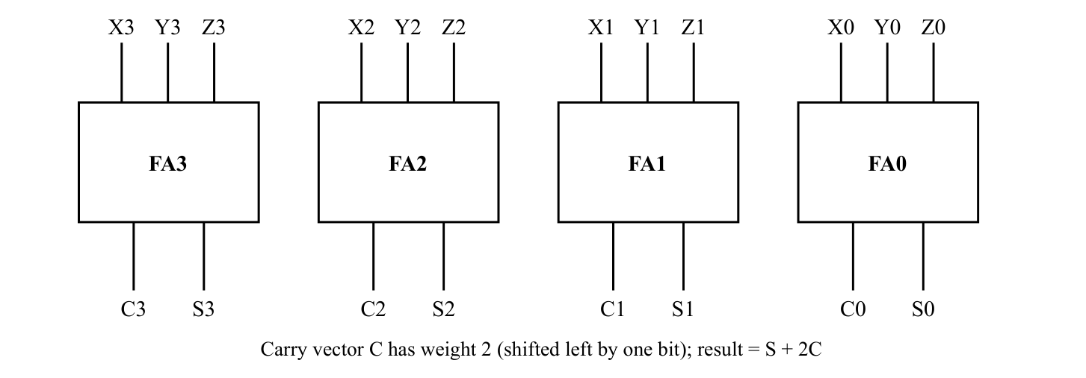
D
The design: a 4-bit carry-save adder
12
8
primary inputs (X, Y, Z)
primary outputs (S, C)
20
3
logic gates
logic levels
0
X + Y + Z = S + 2C
Four independent full adders, one per bit; the carry vector C is shifted left by one bit.
flip-flops: combinational
Notes:
A carry-save adder, or 3:2 compressor, adds three numbers X, Y and Z without propagating carries. Each bit position has its own full adder, so the four full adders work independently and in parallel. Full adder i produces a sum bit Si and a carry bit Ci. The carry vector has weight two, so the final result is S plus C shifted left by one bit. A carry-propagate adder would be needed afterwards to get a single sum. The circuit has 12 primary inputs, 8 primary outputs, 20 gates, 3 logic levels and no flip-flops, so it is purely combinational.

Slide 4
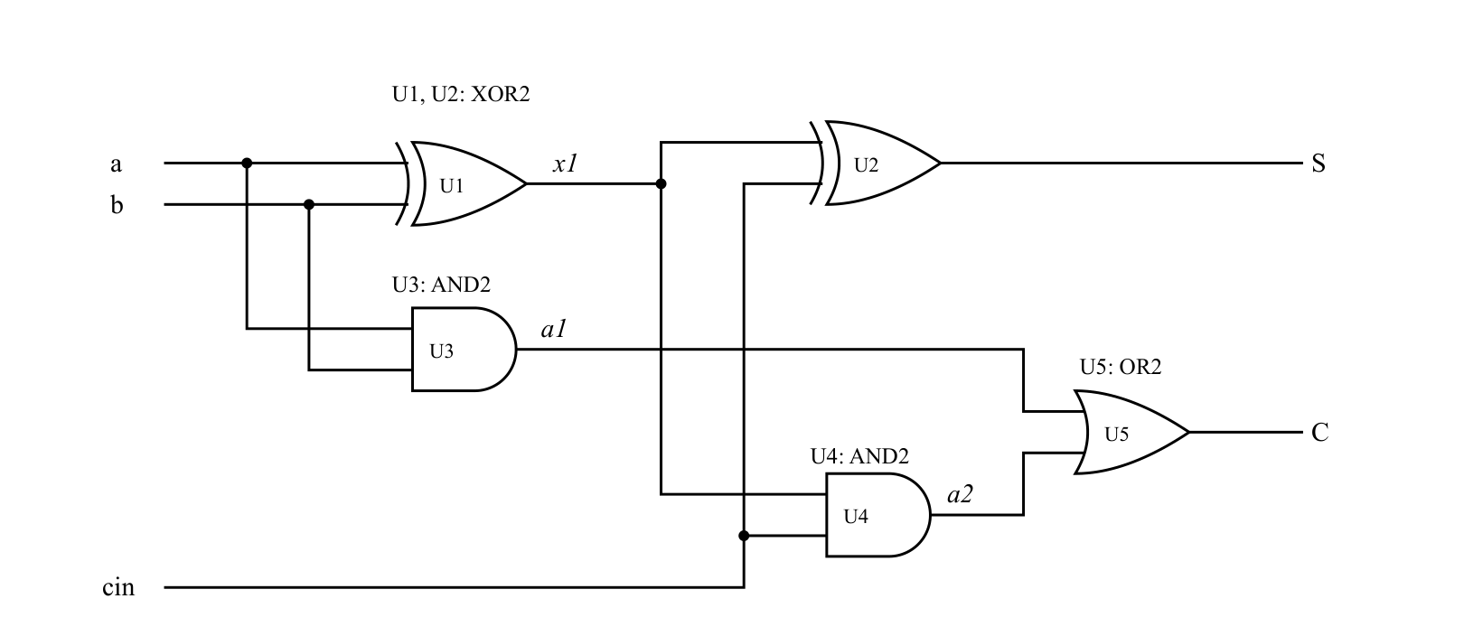
D
Each bit is a five-gate full adder
Gate | Type | Output
U1 | XOR2 | x1 = a ⊕ b
U2 | XOR2 | S = x1 ⊕ cin
U3 | AND2 | a1 = a·b
U4 | AND2 | a2 = x1·cin
U5 | OR2 | C = a1 + a2
Repeated for bits 0–3 as U0_1…U3_5: 20 gates in total.
S = a ⊕ b ⊕ cin C = a·b + (a ⊕ b)·cin
Notes:
Inside each full adder there are five gates. U1 computes x1 = a XOR b. U2 computes the sum S = x1 XOR cin. U3 computes a1 = a AND b, U4 computes a2 = x1 AND cin, and U5 ORs them to get the carry C. So S = a xor b xor cin and C = ab + (a xor b) cin, which is the majority function. The same five gates are repeated for bits 0 to 3, giving 20 gates in total. The longest path is XOR, AND, OR, which is three logic levels.

Slide 5
D
Verilog structure decides which faults Modus sees
Full-adder module as cell
Single flattened module
One-gate cells (final)
80
40
160
faults on the full-adder pins only
faults on chip inputs and outputs only
faults on every gate pin, 104 collapsed
Reported 100% with 3 patterns, but internal gate faults were never modelled
The whole circuit became one cell; no internal faults at all
Same fault model as Atalanta: both report 104 collapsed faults
Modus places stuck-at faults on the pins of leaf cells (cell-boundary fault model) and on the primary inputs and outputs.
Notes:
Modus uses a cell-boundary fault model: it puts stuck-at faults only on the pins of leaf cells (modules that contain just gate primitives) and on the chip's inputs and outputs. My first version wrapped each full adder in a module, so Modus saw only 80 faults on the full-adder pins and reported a misleading 100% with only 3 patterns: the internal gate faults were invisible. Flattening everything into one module made it worse: only the 40 input and output faults were left. The final version wraps every gate in its own one-gate cell (XOR2, AND2, OR2). Now every gate pin carries faults: 160 in total, 104 after collapsing, which exactly matches Atalanta's gate-level count.

Slide 6
D
Verilog: 20 gates built from one-gate cells
module XOR2 (input A, input B, output O);
xor g (O, A, B);
endmodule
module AND2 (input A, input B, output O);
and g (O, A, B);
endmodule
module OR2 (input A, input B, output O);
or g (O, A, B);
endmodule
module csa_4bit (input [3:0] X, Y, Z,
output [3:0] S, C);
wire fa0_x1, fa0_a1, fa0_a2; // ... bits 1-3
// Bit 0 (bits 1-3 identical)
XOR2 U0_1 (.A(X[0]), .B(Y[0]), .O(fa0_x1));
XOR2 U0_2 (.A(fa0_x1), .B(Z[0]), .O(S[0]));
AND2 U0_3 (.A(X[0]), .B(Y[0]), .O(fa0_a1));
AND2 U0_4 (.A(fa0_x1), .B(Z[0]), .O(fa0_a2));
OR2 U0_5 (.A(fa0_a1), .B(fa0_a2), .O(C[0]));
endmodule
Three one-gate cells: XOR2, AND2, OR2
Top module csa_4bit: 5 cell instances per bit, 20 in total
Gate-level and structural: Modus build_model reads it directly
Checked in iverilog: S + 2C = X + Y + Z for all 4,096 inputs
Same netlist in design.bench for Atalanta
Notes:
This is the structure of design.v. Three tiny modules, XOR2, AND2 and OR2, each contain one gate primitive. The top module csa_4bit has 4-bit inputs X, Y, Z and 4-bit outputs S and C. For each bit it instantiates two XOR2, two AND2 and one OR2, named U<bit>_1 to U<bit>_5, connected exactly as in the full-adder diagram. Only bit 0 is shown here; bits 1 to 3 are identical with the index changed. The same circuit was written as design.bench for Atalanta, with one line per gate.

Slide 7
1
Algorithm 1: fault list reduction collapses equivalent faults
1
build_model -designsource design.v
Why collapse faults?
read the gate-level Verilog
2
build_testmode -testmode FULLSCAN
Equivalent faults are detected by exactly the same tests, so only one fault from each class has to be targeted.
create the test mode
3
verify_test_structures -testmode FULLSCAN
design-rule check
4
build_faultmodel
Example: AND gate
create and collapse the fault list
5
create_logic_tests -experiment FULL
Input A stuck-at-0 ≡ output stuck-at-0
Input B stuck-at-0 ≡ output stuck-at-0
3 faults → 1 fault to target
generate test patterns
6
report_faults -faultstatus "untested aborted redundant"
list hard faults
7
create_logic_tests -experiment reduced_faults -maxpatterns 7
limit pattern count
8
create_logic_tests -experiment 70percent -maxcoverage 70.0
limit coverage
Notes:
Fault list reduction removes faults that are equivalent, meaning any test that detects one also detects the other. For example, on an AND gate, any input stuck-at-0 forces the output to 0, exactly like the output stuck-at-0, so only one of them needs to be targeted. Keeping one fault per equivalence class reduces the work for ATPG and the test time, without losing coverage. The Modus flow: build_model reads the Verilog, build_testmode creates the FULLSCAN test mode, verify_test_structures checks design rules, build_faultmodel creates and collapses the fault list, create_logic_tests generates patterns, and report_faults lists hard faults. Two extra experiments limit the pattern count to 7 and the coverage to 70%.

Slide 8
1
Collapsing cut faults by 35% with no loss of coverage
160
→
104
Quantity | Before | After
No. of faults | 160 | 104 (collapsed)
Tested static faults | 160 | 104
Untested static faults | 0 | 0
Fault coverage | 100% | 100%
Test sequences | 6 | 6
Hard faults | 0 | 0
faults before reduction
faults after collapsing
35%
100%
fewer faults to target
coverage before and after
Primary-input faults: 24 · Primary-output faults: 16 · Gate-pin faults: 120
Notes:
build_faultmodel created 160 static stuck-at faults: two per pin, on 12 inputs, 8 outputs and the 20 gate cells. After collapsing equivalent faults, 104 remain, a 35% reduction. The 24 input and 16 output faults cannot be collapsed further. ATPG on the FULL experiment tested all 160 faults, 100% coverage, with 6 test sequences. The table compares the results before and after reduction: coverage and test count stay the same, only the number of faults the tool must target goes down.

Slide 9
1
No hard faults, and why the limits did not bite
0
report_faults -faultstatus "untested aborted redundant"
TFM-112: no faults met the selection criteria. No untested, aborted or redundant faults.
hard faults
6
reduced_faults · -maxpatterns 7
The complete test set needs only 6 patterns, so the limit of 7 was never reached.
patterns, 100%
100%
70percent · -maxcoverage 70.0
Modus checks the coverage limit after each batch of patterns; all 6 were in the first batch. Coverage crosses 70% at pattern 4 (88.75%).
not 70%
Notes:
report_faults with status untested, aborted and redundant returned nothing: message TFM-112, no faults met the selection criteria. So the CSA has no hard-to-test or redundant faults. The reduced_faults experiment allowed up to 7 patterns, but the complete test set only needs 6, so it produced the same 6 patterns and 100% coverage. The 70percent experiment asked Modus to stop at 70% coverage, but it also finished at 100% with 6 patterns. Modus generates and fault-simulates patterns in batches and checks the coverage limit only after each batch. For this small circuit all six patterns fit in the first batch, so the limit was checked only once coverage was already 100%. The per-pattern coverage shown later confirms coverage would have crossed 70% at pattern 4.

Slide 10
2
Algorithm 2: test pattern generation with Atalanta
design.bench (bit 0 shown; bits 1–3 identical)
104
100%
INPUT(X0) ... INPUT(Z3) # 12 inputs
OUTPUT(C0) ... OUTPUT(S3) # 8 outputs
fa0_x1 = XOR(X0, Y0)
S0 = XOR(fa0_x1, Z0)
fa0_a1 = AND(X0, Y0)
fa0_a2 = AND(fa0_x1, Z0)
C0 = OR(fa0_a1, fa0_a2)
collapsed faults
fault coverage
20
0 / 0
test patterns
redundant / aborted
Command used
atalanta -t design.test design.bench
RPT + DTPG + TC mode, REVERSE + SHUFFLE compaction, 0.000 s CPU time
Notes:
Atalanta is an open-source ATPG tool from Virginia Tech. It reads the circuit in ISCAS .bench format, where each line defines one gate. It first applies random patterns, then uses deterministic test generation for the faults that remain, and finally compacts the test set. The command atalanta -t design.test design.bench writes the test patterns and fault-free responses to design.test. Result: 104 collapsed faults, all detected, 100% fault coverage, no redundant or aborted faults, 20 test patterns. Note that 104 matches the Modus collapsed fault count, confirming both tools use the same gate-level fault model.

Slide 11
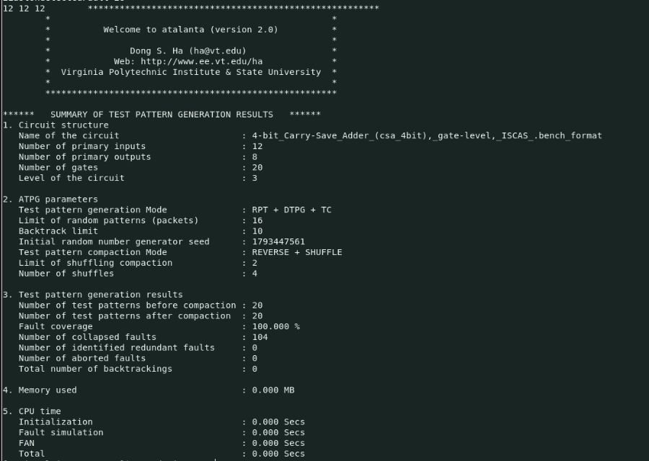
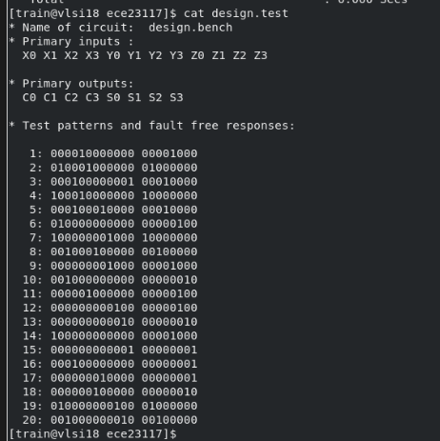
2
Atalanta output from the lab run
design.test: 20 patterns, inputs X0..Z3 and outputs C0..S3
Notes:
Left: the summary Atalanta printed. The circuit has 12 inputs, 8 outputs, 20 gates and 3 levels. Before and after compaction there are 20 patterns, coverage is 100%, there are 104 collapsed faults, and no redundant or aborted faults. Atalanta printed the first comment line of the .bench file as the circuit name. Right: the contents of design.test, listing the 20 test patterns. Each line gives the 12 input bits in the order X0 to X3, Y0 to Y3, Z0 to Z3, followed by the 8 expected outputs C0 to C3 and S0 to S3.

Slide 12
2
Why 20 patterns when 5 would do
Each pattern tests one full adder; the other three see 000
Each adder gets 5 combinations: a b cin = 001, 010, 100, 101, 110
5 × 4 adders = 20 patterns
The adders share no signals, so all four can be tested at once
Unused inputs were filled with 0 before compaction, so the patterns could not be merged
Merged 5-pattern set: same test applied to every bit
# | a b cin | X0..X3 | Y0..Y3 | Z0..Z3 | C0..C3 | S0..S3
1 | 0 0 1 | 0000 | 0000 | 1111 | 0000 | 1111
2 | 0 1 0 | 0000 | 1111 | 0000 | 0000 | 1111
3 | 1 0 0 | 1111 | 0000 | 0000 | 0000 | 1111
4 | 1 1 0 | 1111 | 1111 | 0000 | 1111 | 0000
5 | 1 0 1 | 1111 | 0000 | 1111 | 1111 | 0000
Theoretical minimum: 5 patterns, a 75% reduction from 20 with the same 100% coverage.
Notes:
Looking at the 20 Atalanta patterns, each one exercises only one full adder; the inputs of the other three adders are zero. Every full adder receives the same five input combinations: 001, 010, 100, 101 and 110. Five combinations times four adders gives 20 patterns. But the four full adders share no signals, so the same five combinations can be applied to all four bits at the same time. The table shows such a merged 5-pattern set with its expected outputs. Atalanta did not merge them because it filled the unspecified inputs with 0 before compaction, so the patterns could no longer be combined. I also checked by fault simulation of one full adder that 5 vectors is the minimum.

Slide 13
3
Algorithm 3: fault simulation flow in Modus
Build
Generate
Export & report
Experiments
build_model
build_testmode
verify_test_structures
build_faultmodel
create_logic_tests
-experiment FULL
write_vectors -language verilog
write_vectors -language stil
report_fault_statistics
C70: -maxcoverage 70.0
HS: -maxpatterns 1
GP: -maxpatterns 3
MP: -maxpatterns 5
0 scan chains, no rule violations: the CSA has no flip-flops, so patterns go straight to the 12 inputs and responses are read from the 8 outputs.
Notes:
Fault simulation applies the generated patterns to the circuit with each fault injected, and checks whether the outputs differ from the fault-free outputs. A fault is detected when at least one pattern produces a different output. The flow has four stages. First, build the model, test mode and fault model. Second, generate the FULL test set. Third, export the vectors in Verilog and STIL format and report fault statistics. Fourth, run experiments: C70 with a 70% coverage limit, and HS, GP and MP with 1, 3 and 5 patterns. verify_test_structures found 0 scan chains and no violations, because the CSA has no flip-flops; patterns are applied directly to the 12 inputs and observed on the 8 outputs.

Slide 14
3
Six Modus test patterns, every response verified
# | X0..X3 | Y0..Y3 | Z0..Z3 | C0..C3 | S0..S3 | FA0..FA3 (a b cin)
1 | 1100 | 1100 | 0000 | 1100 | 0000 | 110, 110, 000, 000
2 | 1010 | 1111 | 1101 | 1111 | 1000 | 111, 011, 110, 011
3 | 0001 | 1001 | 0110 | 0001 | 1110 | 010, 001, 001, 110
4 | 1010 | 0100 | 0001 | 0000 | 1111 | 100, 010, 100, 001
5 | 1100 | 0011 | 1000 | 1000 | 0111 | 101, 100, 010, 010
6 | 0111 | 0000 | 1110 | 0110 | 1001 | 001, 101, 101, 100
Vector file codes
203 Z inputs at high-Z
104 test-mode init
151 n start pattern n
900/901 stimulus / measure
200 12 input values
202 8 expected outputs
400 end of pattern
Each full adder receives 001, 010, 100, 101 and 110 across the six patterns, which detects all of its faults.
Notes:
write_vectors produced the Verilog vector file. Code 200 gives the 12 input values and code 202 the 8 expected outputs. The table decodes each pattern: the inputs X, Y and Z, the expected carry and sum outputs, and the input combination each full adder receives. I checked every expected output by hand against the full-adder equations. Across the six patterns, every full adder receives all five combinations that detect its faults: 001, 010, 100, 101 and 110. That is why six patterns give 100% coverage. The file also contains a final repeat of pattern 6, which only holds the inputs after the last test.

Slide 15
3
Coverage passes 70% at pattern 4, 100% at pattern 6
+44.38
points at pattern 4, the largest single gain
C70 / 70percent ended at 100%: the limit is checked only after the whole batch of 6 patterns.
Notes:
This chart is the coverage estimate from write_vectors for the FULL experiment: the cumulative fault coverage after each pattern. Pattern 1 alone detects only 2.5%, because FULL orders its patterns after compaction. Pattern 4 brings the biggest jump, from 44.38% to 88.75%, so a 70% target would be met at pattern 4. Patterns 5 and 6 pick up the last 18 faults to reach 100%. This also explains the C70 and 70percent experiments: Modus checks the coverage limit only after simulating the whole batch of 6 patterns, so they ended at 100% instead of stopping near 70%.

Slide 16
3
More patterns, more coverage: HS, GP and MP
Exp. | Untested | Time (s) | Memory (MB) | Efficiency
HS | 96 | 3.36 | 6.264 | 11.90
GP | 26 | 2.34 | 6.268 | 35.79
MP | 6 | 3.20 | 6.272 | 30.08
FULL | 0 | 2.36 | 6.239 | 42.37
Efficiency = coverage (%) ÷ elapsed time (s)
Untested faults: 96 → 26 → 6 → 0. Each added pattern costs test time but detects more faults: the cost–coverage trade-off.
Notes:
These experiments limit the number of patterns to show the trade-off between test cost and fault coverage. HS with one pattern reaches 40% coverage, 64 of 160 faults, leaving 96 untested; one pattern cannot exercise both the sum and carry paths of all four adders. GP with three patterns reaches 83.75%, with 26 untested. MP with five patterns reaches 96.25%, leaving 6 untested, and FULL needs six patterns for 100%. The table also lists the run time and memory from each run's TDA-001 summary, and efficiency, defined as coverage divided by elapsed time. Memory stays about 6.3 MB for all runs because the circuit is small; run times vary between 2.3 and 3.4 seconds, mostly tool start-up.

Slide 17
★
Atalanta and Modus agree on faults, differ on test length
Quantity | Atalanta | Cadence Modus
Collapsed faults | 104 | 104 (from 160)
Fault coverage | 100% | 100%
Redundant / aborted | 0 / 0 | 0 / 0
Test patterns | 20 | 6
Theoretical minimum | 5 | 5
104 = 104
collapsed faults: same fault model in both tools
6 vs 20
test patterns: Modus compacts across the independent adders
Minimum possible: 5 patterns (one gate-level full adder needs 5 vectors).
Notes:
Both tools found exactly 104 collapsed stuck-at faults and reached 100% coverage, with no redundant or aborted faults. That agreement confirms the gate-level fault model in Modus matches Atalanta's. The difference is test length: Modus produced 6 patterns, close to the theoretical minimum of 5, while Atalanta produced 20 because its compaction could not merge tests for the independent full adders.

Slide 18
Conclusion
35%
Fault list reduction cut 160 faults to 104 with no loss of coverage; no hard faults were found.
100%
Atalanta and Modus both detected all 104 collapsed stuck-at faults.
6
Modus needed 6 patterns, close to the minimum of 5; Atalanta needed 20.
40→100%
Coverage rises with the number of patterns: 40%, 83.75%, 96.25%, 100% for 1, 3, 5, 6 patterns.
Key lesson: how the Verilog is structured decides which faults the ATPG tool can see.
Notes:
To conclude: fault list reduction removed 35% of the faults without reducing coverage, and there were no hard faults. Both ATPG tools detected all 104 collapsed faults. Modus produced a compact 6-pattern test set, close to the 5-pattern minimum, while Atalanta's 20 patterns show how much compaction matters for test length. The pattern-limit experiments show the trade-off between test cost and coverage. The main lesson was that the way the Verilog is structured determines which faults Modus models: with full-adder cells it reported a misleading 100%, and only the one-gate-cell version gave the true gate-level fault coverage. Thank you.

