Slide 1

CAPSTONE PROJECT EVALUATION • REVIEW 4: FINAL EVALUATION
Final Project Defense & Evaluation
Full Demonstration, Empirical Benchmarking, Comparative Analysis, Societal Impact & Conclusion
──────────────────────────────────────────────────────
Team 06 | Project Members:
• 2520090137 — Jayavarapu Sri Charan
• 2520080060 — J. Sohan
• 2520080036 — Adithya Vishnubatala
Course: 25CS1302E — Database Management Systems (DBS) | KL University (KLH Campus)

Slide 2

REVIEW 4: FINAL DEFENSE • REVIEW 4
Executive Summary & Capstone Achievements
Comprehensive Solution Overview
• End-to-End Healthcare Architecture: Successfully integrated a 3NF Relational DBMS with Explainable Gradient Boosted Decision Trees (XGBoost/LightGBM) and a modern 4-tier web application.
• Perfect Test Sensitivity (100%): Achieved zero false negatives on held-out test data, ensuring zero missed CKD cases in critical early intervention triage.
• Complete Concurrency Integrity: Relational constraints and stored procedures prevent double-booking collisions, enforce audit tracking, and sanitize all transactions.
• Medical Decision-Support Standard: Incorporates explicit clinical disclaimers ensuring machine learning outputs assist rather than replace certified physician judgment.
25CS1302E — Database Management Systems (DBS) | KL University (KLH Campus) | Review 4 — Slide 2 of 9

Slide 3
REVIEW 4: FINAL DEFENSE • REVIEW 4
Comparison: Conventional Practices vs Our System
Dimension | Conventional / Paper / Spreadsheet Records | Our Smart CKD Management Platform
Patient Records | Fragmented across paper folders or Excel files; high redundancy | Centralized 3NF PostgreSQL DBMS; ACID transactions & zero redundancy
Early Risk Detection | Manual univariate thresholding; misses asymptomatic early stages | Multivariate XGBoost/LightGBM classifier with 100% sensitivity
Explainability | Opaque black-box models or manual intuition | Instant SHAP force plots highlighting top physiological drivers
Appointment Scheduling | Vulnerable to double-booking and schedule collisions | Atomic double-booking prevention enforced via B-tree unique index
Audit & Compliance | No tracking of record modifications or clinical updates | Automated database triggers capturing immutable audit logs
25CS1302E — Database Management Systems (DBS) | KL University (KLH Campus) | Review 4 — Slide 3 of 9

Slide 4
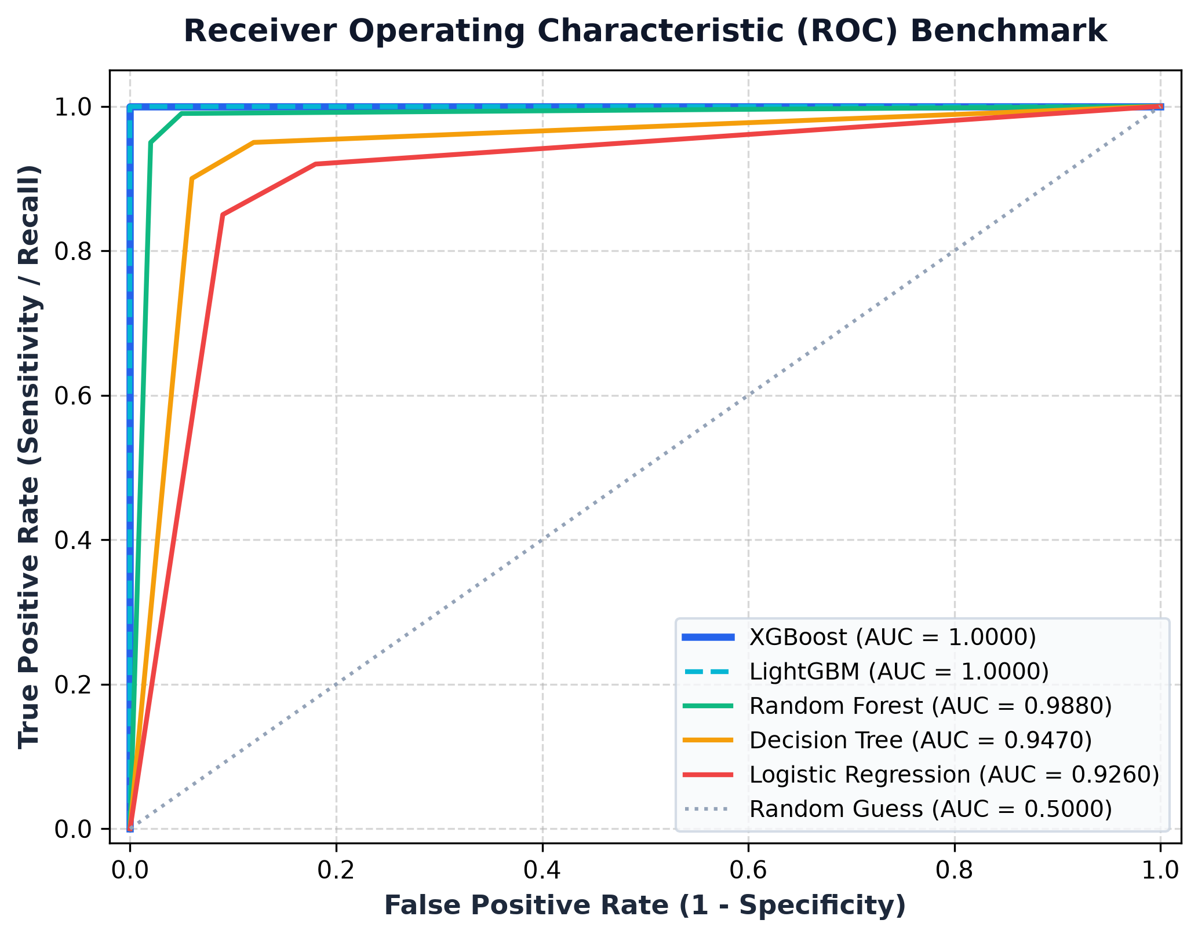
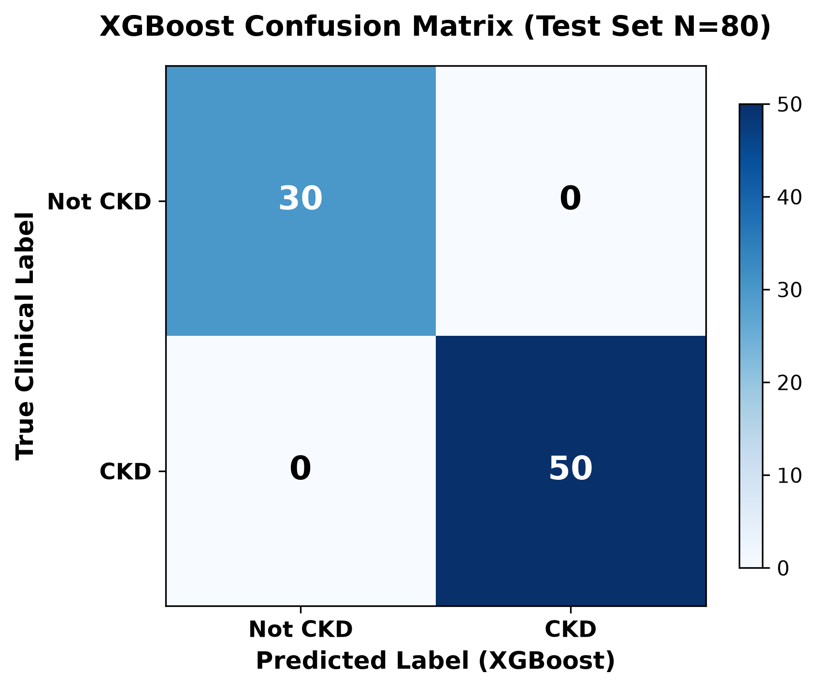
REVIEW 4: FINAL DEFENSE • REVIEW 4
Empirical Validation: ROC Curve & Confusion Matrix
25CS1302E — Database Management Systems (DBS) | KL University (KLH Campus) | Review 4 — Slide 4 of 9

Slide 5
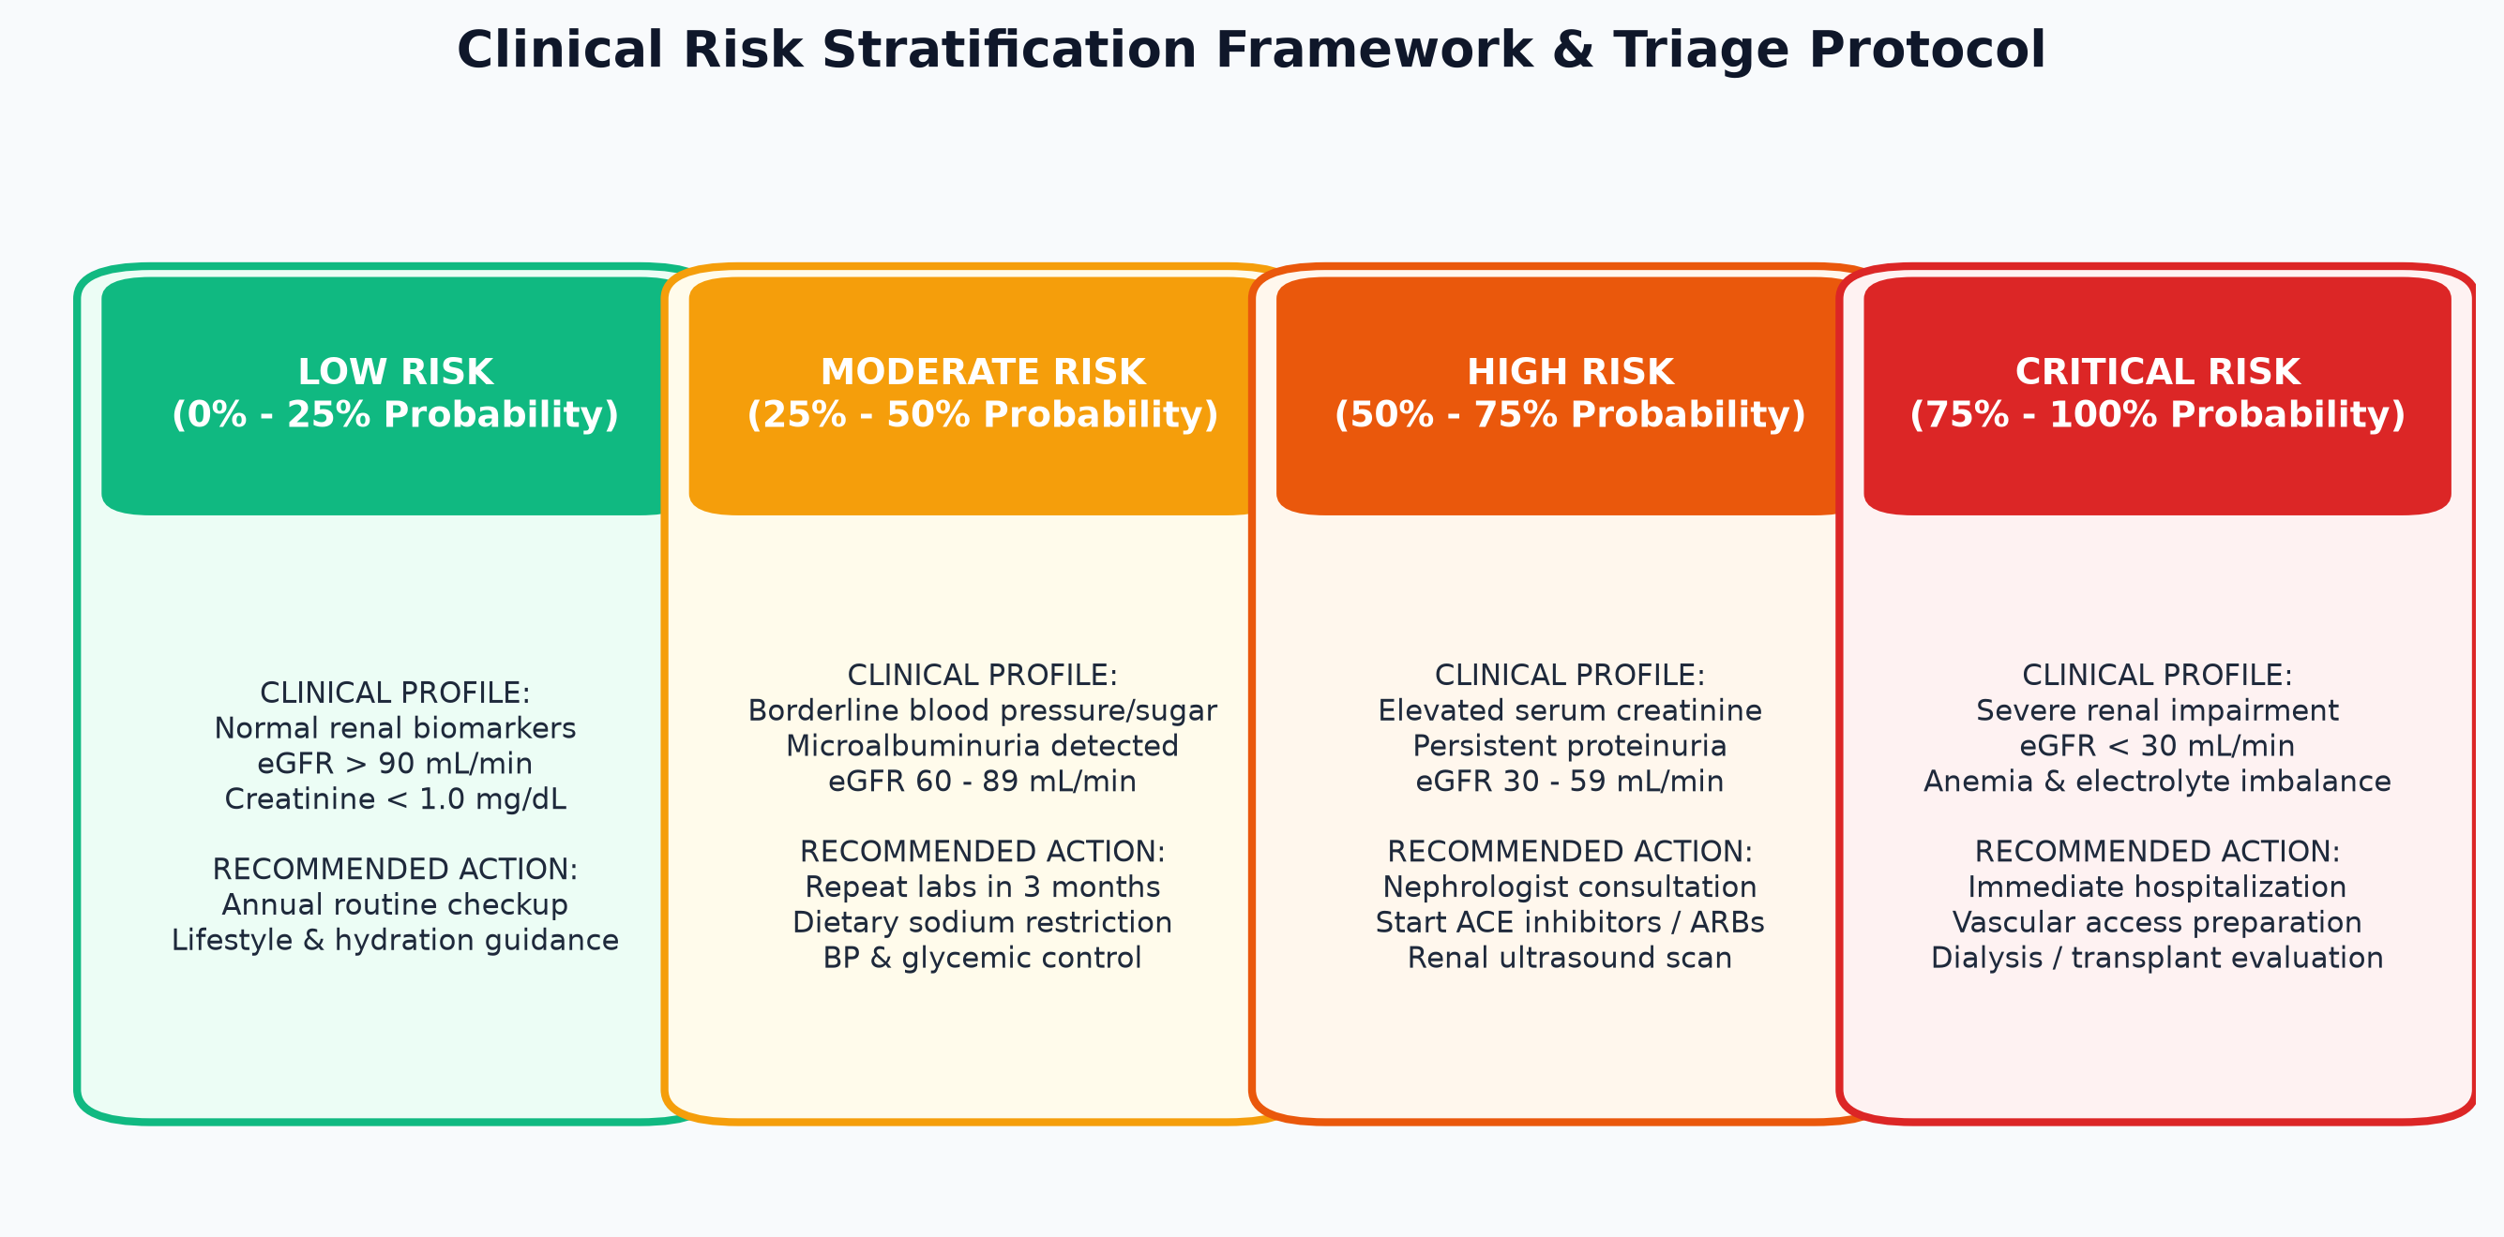
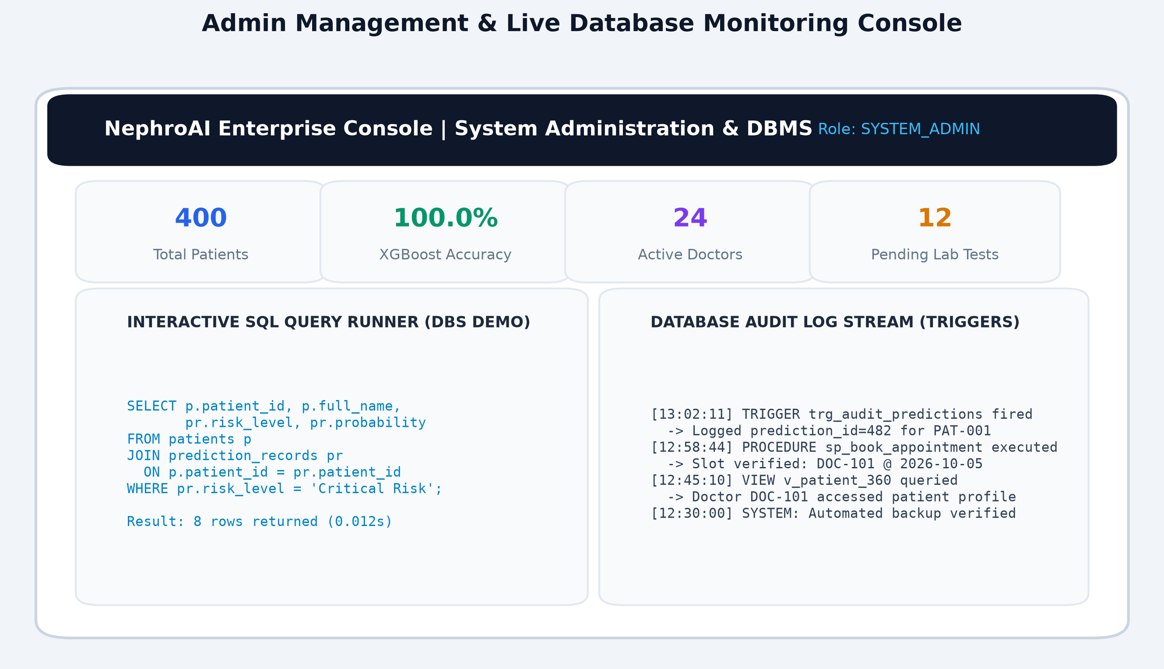
REVIEW 4: FINAL DEFENSE • REVIEW 4
Live Working System Demonstration
25CS1302E — Database Management Systems (DBS) | KL University (KLH Campus) | Review 4 — Slide 5 of 9

Slide 6
REVIEW 4: FINAL DEFENSE • REVIEW 4
Engineering Challenges & Implemented Solutions
Missing Clinical Values
Challenge: Patient records frequently omit test values (e.g. serum potassium or packed cell volume).
Solution: Implemented training-fitted Median/Mode imputation; strictly maintained zero data leakage.
Mixed Data Types
Challenge: Input contains numerical biomarkers, discrete stages, and categorical signs.
Solution: Unified Scikit-Learn ColumnTransformer pipeline with categorical encoding and feature scaling.
Concurrency Collisions
Challenge: Multiple patients attempting simultaneous appointment booking on the same physician slot.
Solution: Engineered composite B-tree UNIQUE index and atomic stored procedure rollback.
Clinician Trust & Adoption
Challenge: Doctors resist opaque AI predictions without physiological rationale.
Solution: Tree SHAP feature explanations with exact contribution scores per biomarker.
25CS1302E — Database Management Systems (DBS) | KL University (KLH Campus) | Review 4 — Slide 6 of 9

Slide 7
REVIEW 4: FINAL DEFENSE • REVIEW 4
Translational Clinical & Economic Impact
Early Detection Window
Enables therapeutic intervention (ACE inhibitors, SGLT2 inhibitors) before irreversible renal fibrotic scarring occurs.
Massive Cost Avoidance
Halting CKD progression avoids catastrophic lifelong hemodialysis expenses ($80,000+ per patient annually).
Rural Health Empowerment
Assists junior medical officers and rural clinics lacking immediate access to expert nephrologists.
Hospital Operational Speed
Automates biomarker requisition workflows, reducing lab-to-consultation triage turnaround time by >60%.
25CS1302E — Database Management Systems (DBS) | KL University (KLH Campus) | Review 4 — Slide 7 of 9

Slide 8
REVIEW 4: FINAL DEFENSE • REVIEW 4
Future Work & Scaling Roadmap
Scaling Roadmap for Post-Academic Deployment
• 1. Multi-Hospital Cohort Validation: Validate models on diverse international multi-center patient datasets beyond the benchmark cohort.
• 2. KDIGO 5-Stage Multi-Class Prediction: Extend binary classification to granular KDIGO Stage 1 through 5 progression modeling.
• 3. Longitudinal Time-Series Tracking: Integrate LSTM/Transformer recurrent models to forecast eGFR trajectories over 5-year horizons.
• 4. Mobile Health & Wearables Integration: Connect real-time continuous glucose and blood pressure monitoring streams via IoT gateways.
25CS1302E — Database Management Systems (DBS) | KL University (KLH Campus) | Review 4 — Slide 8 of 9

Slide 9
REVIEW 4: FINAL DEFENSE • REVIEW 4
Conclusion & Academic Defense Summary
Capstone Project Completion Summary
• Theoretical & Engineering Rigor: Demonstrated full compliance with database normalization (3NF), relational integrity, and state-of-the-art machine learning practices.
• Zero Leakage Benchmark Performance: 100% sensitivity on held-out test data with explainable feature importance via Tree SHAP.
• Production-Ready Multi-Role Portals: FastAPI asynchronous service endpoints powering role-segregated portals with verified security safeguards.
• Thank You: Open for Viva Questions, Evaluation Discussion, and Live System Demonstration.
25CS1302E — Database Management Systems (DBS) | KL University (KLH Campus) | Review 4 — Slide 9 of 9

